Slide 1
MLA RIMMF Training Feb. 9, 2017
Kathy Glennan
University of Maryland

Slide 2
Tools/Guidance on RIMMF website
http://www.marcofquality.com/wiki/rimmf3
Download latest version
Tutorials
FAQ
User guide
Most commonly needed functions
And don’t forget our wiki: http://mla2017preconf.pbworks.com

Slide 3
Entity Records in RIMMF
Separate records for Works, Expressions, Manifestations, Items, Persons, Families, Corporate Bodies (WEMI, PFC)
Can create from scratch or can import existing MARC records – or a combination of the two
In RIMMF, you or the program will link these together
Requires thinking “in RDA” (not “in MARC”)
No need to do Item records – unless you want to
For the most part, subject linkage is not available yet
Only for WEMI or PFC – a biography, a book about another work, etc.
RIMMF captures unlinked subject info if you import a MARC bib record

Slide 4
It’s Not MARC!
Try to apply RDA as written
Don’t take short cuts, like having a manifestation cover both the hardback and paperback versions
No provider neutral records
Selectively apply LC-PCC Policy Statements and MLA Best Practices – use your judgment
If importing MARC records into RIMMF, carefully review what has been placed in which entity record
You may need to move some data to a different WEMI level

Slide 5
The Mantra – Have Fun!
Don’t agonize over making a perfect RDA record
This is a chance for you to explore a non-MARC way of capturing RDA data
If you run into problems during the preconference, ask me or a coach for help
Document your questions, but also make a decision and move on
If you get an odd display result, try restarting RIMMF

Slide 6
Getting Started
Make sure you set up a unique record prefix
One will be assigned to you at the preconference
Create a new data folder
In the same folder where you downloaded RIMMF
Make or import the Manifestation record first
Then bring in or create a work record, followed by an expression record
If you follow the “right” steps, these will all be linked together
Otherwise, you can link them manually
Check your work by looking at the “R-Tree”
Make additional changes as needed

Slide 7

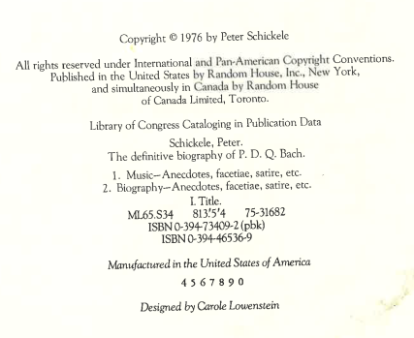
Example 1: Book

Slide 8

Example 2: Score

Slide 9

Example 3:CD

