Slide 1
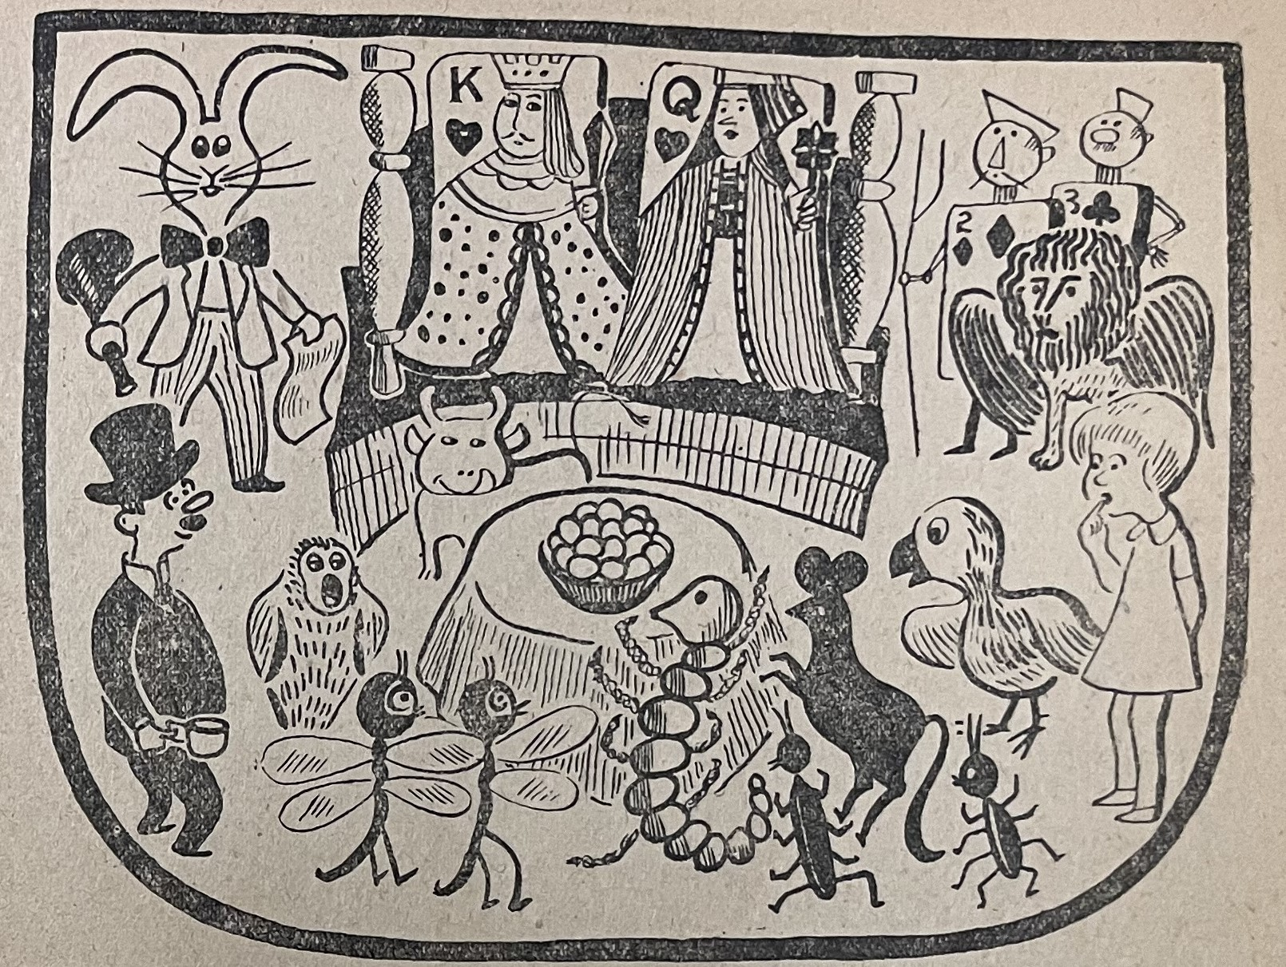

Encountering Alice in Occupied Japan:
Magazines with pictures or conversations
4/26/2023
Kana Jenkins
East Asian Studies Librarian &
Curator of the Gordon W. Prange Collection
University of Maryland Libraries

Slide 2
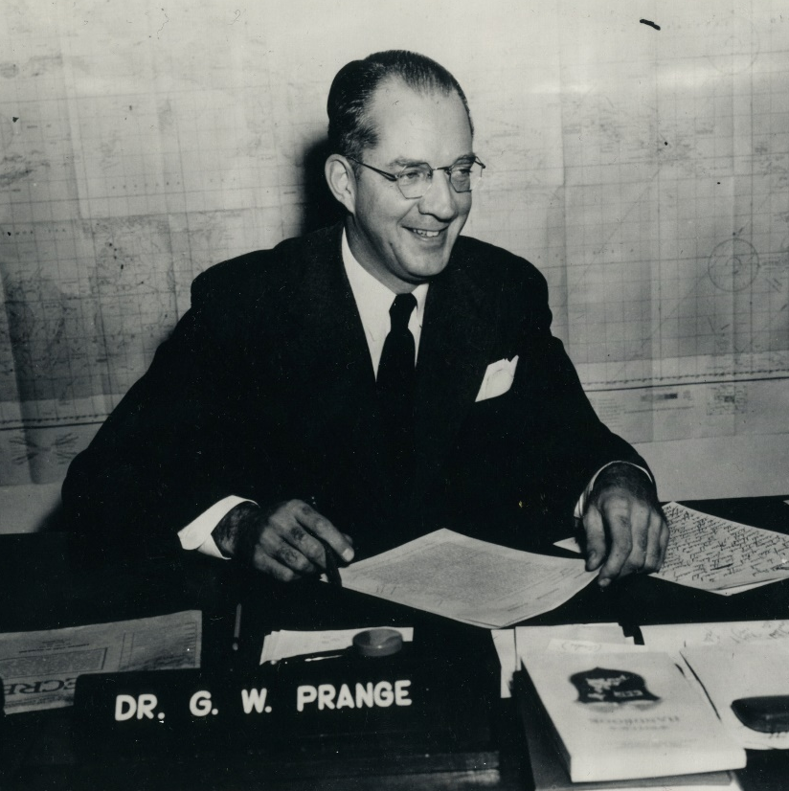
Gordon W. Prange Collection
An archive of Japanese publications issued in Japan between 1945-1949, the first 4 years of Occupation of Japan.
These materials were collected for censorship purpose by SCAP (Supreme Commander of Allied Powers).
The collection also holds items created by the SCAP members and others while living in Japan during the Occupation.

Slide 3
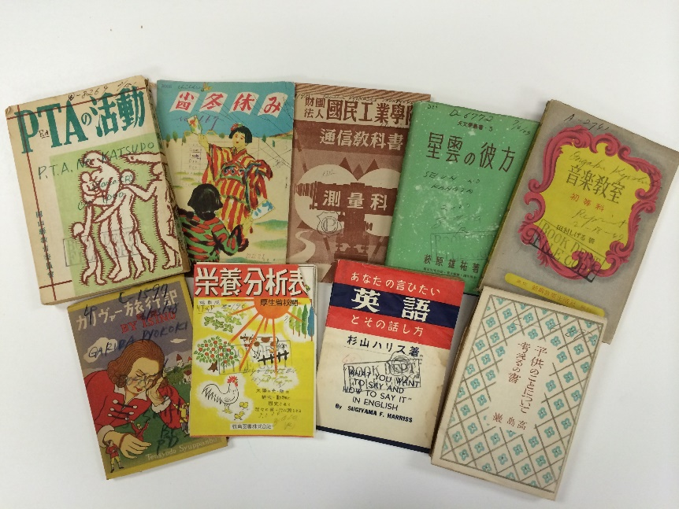
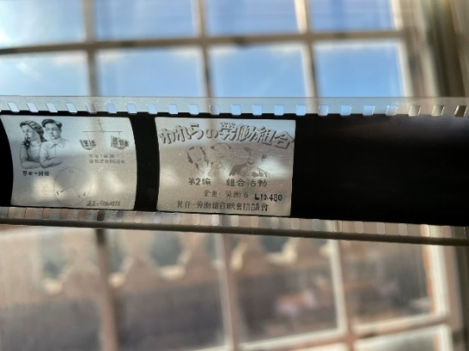
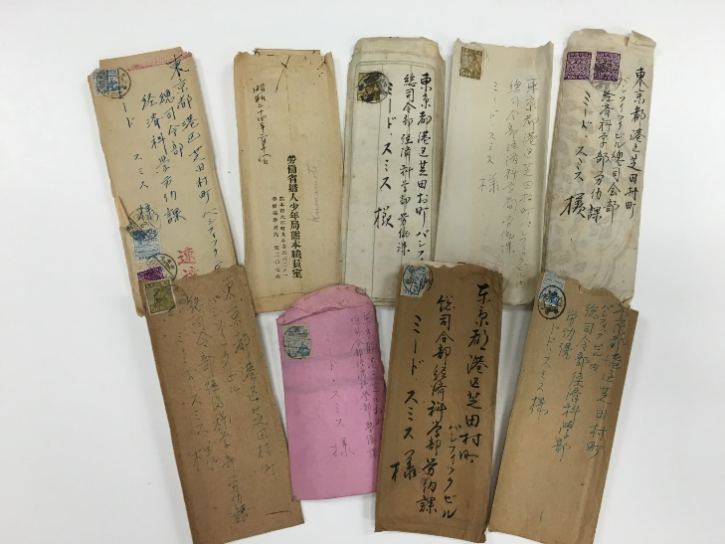
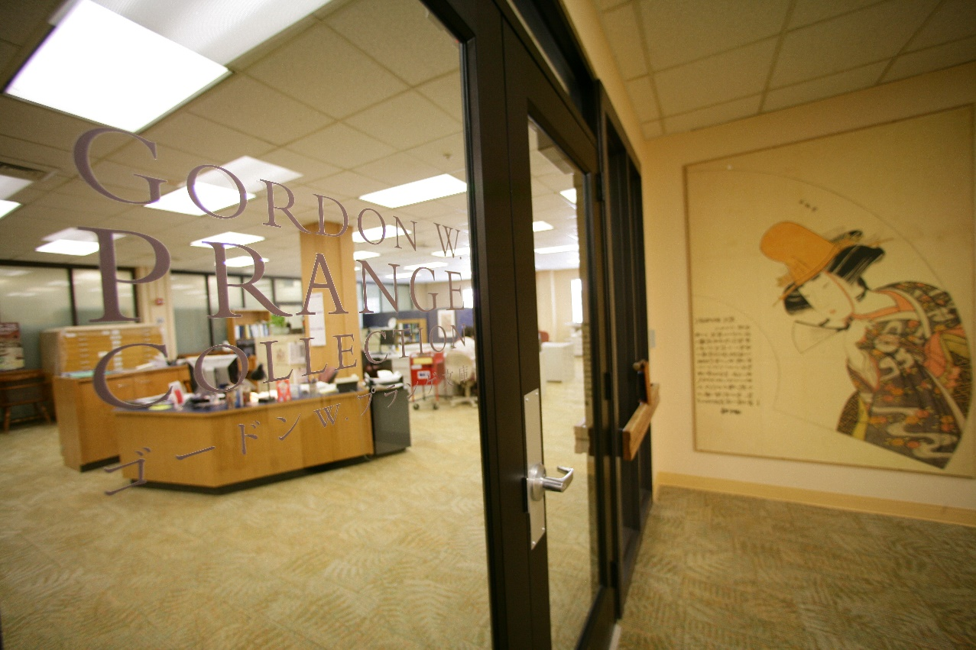
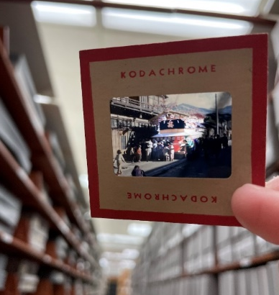
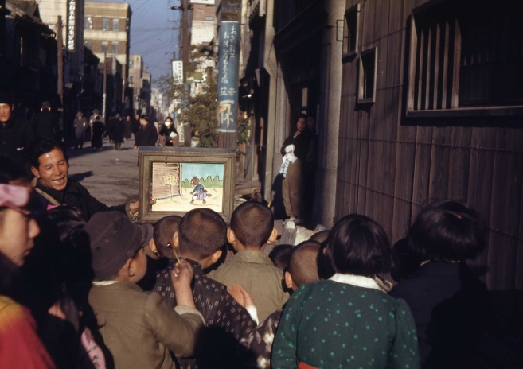
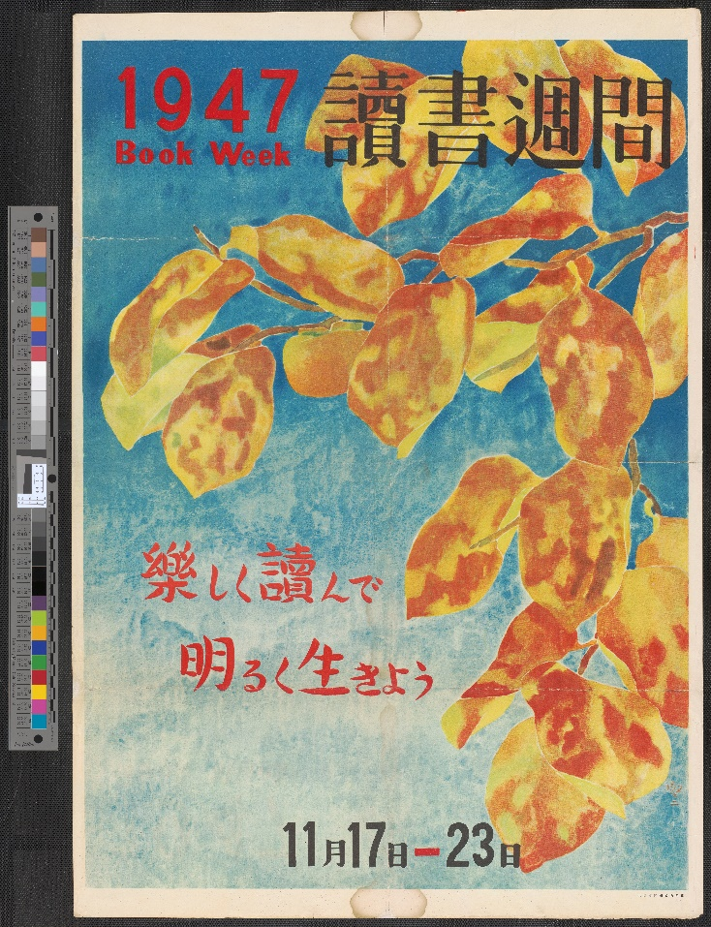
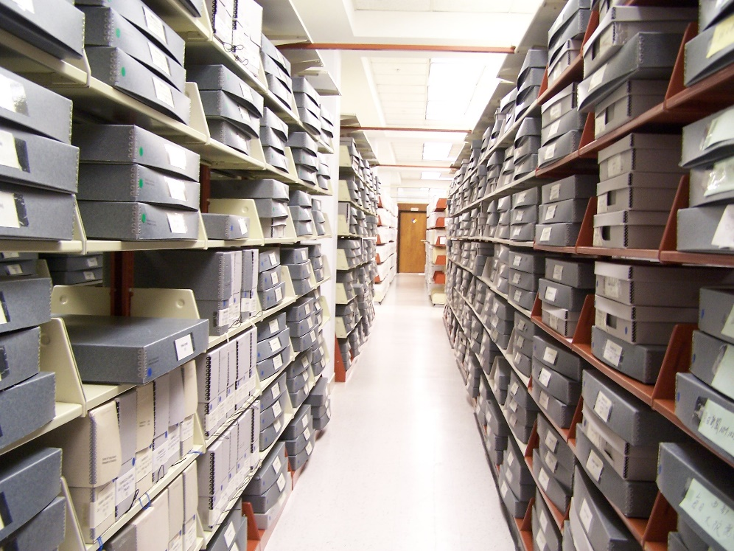
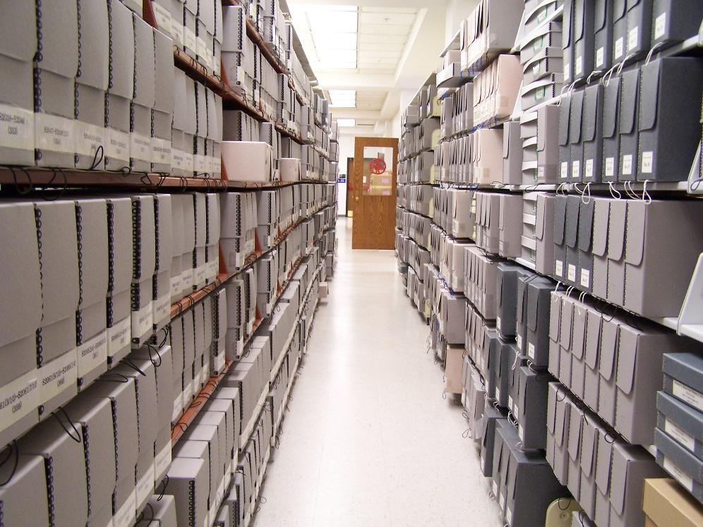
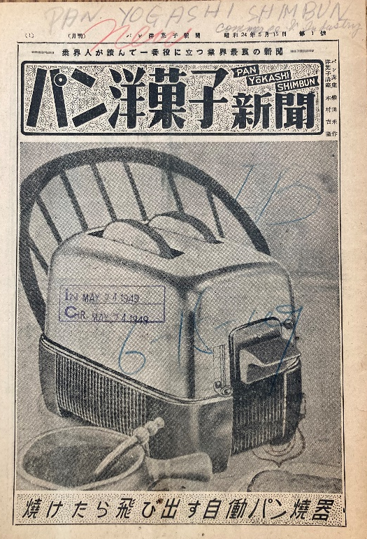
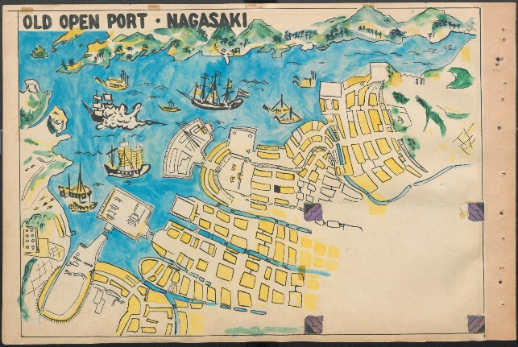

Slide 4
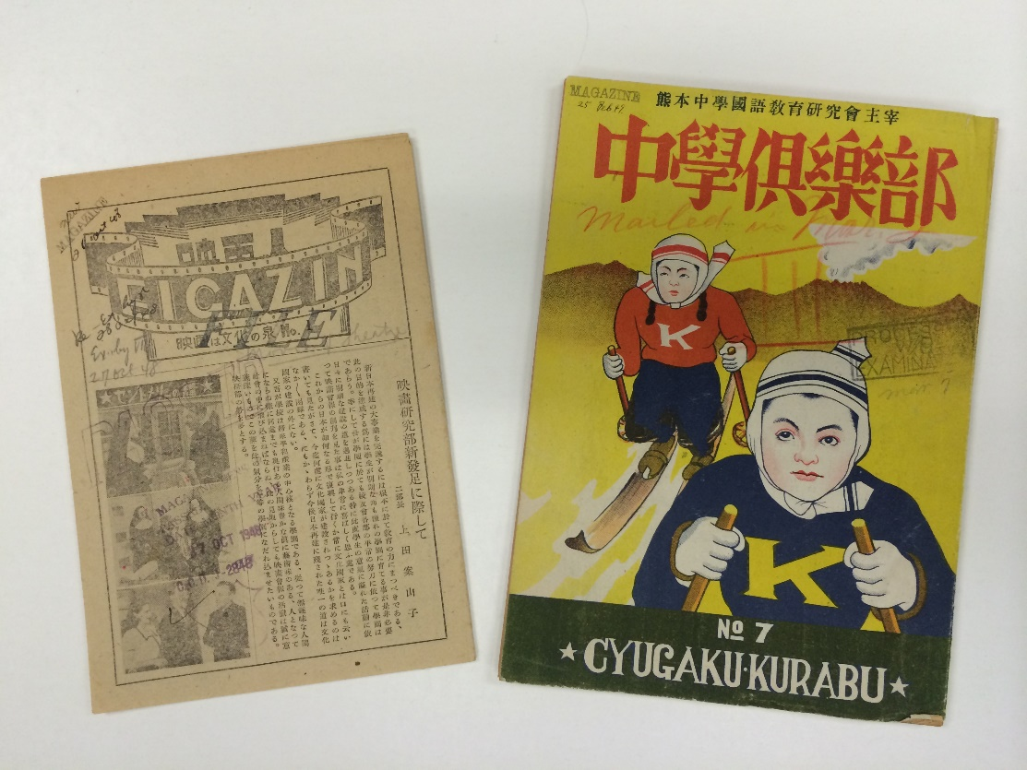
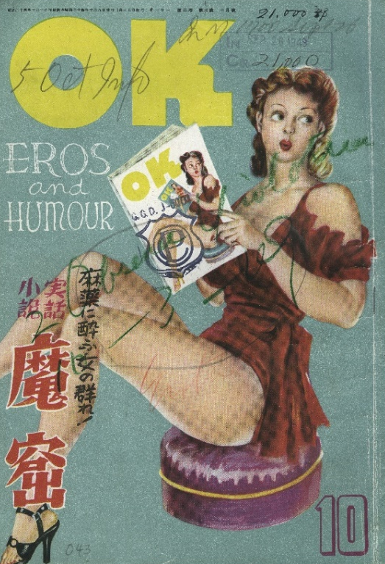
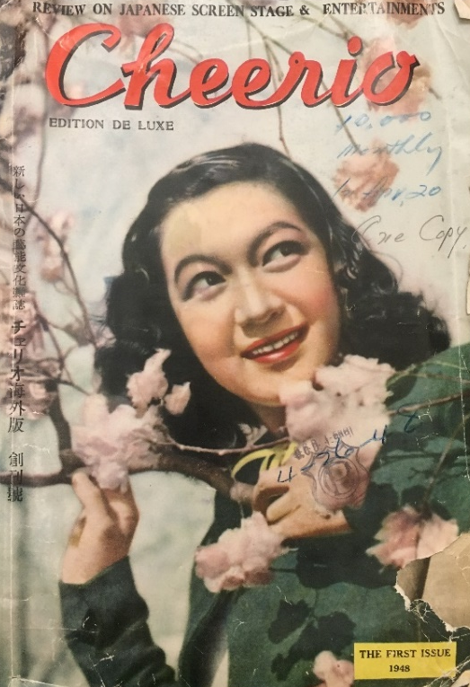
Magazine collection
14,000 titles of magazines
Subject areas – everything!
Microfilmed and are accessible in various U.S. institutions
Title-level search is available via a subscription-based databases (NOT administrated by the Prange Collection)

Slide 5
For future scholarship
Illustrators
Partial translation/(rough) summary
Readership of magazines
Influences (or not) from the original illustrations

Slide 6
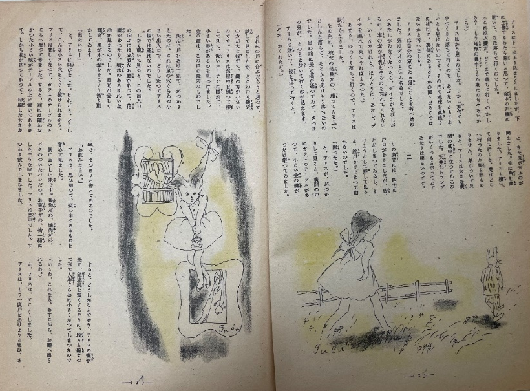
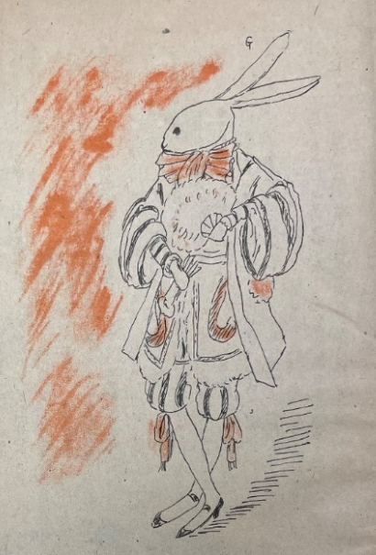
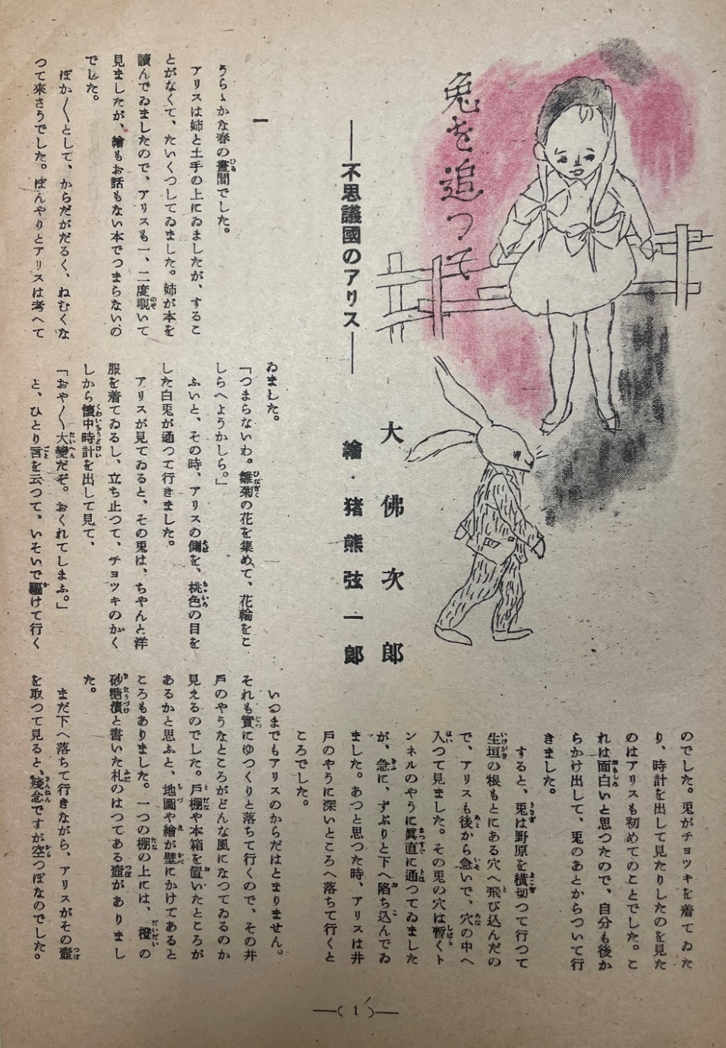
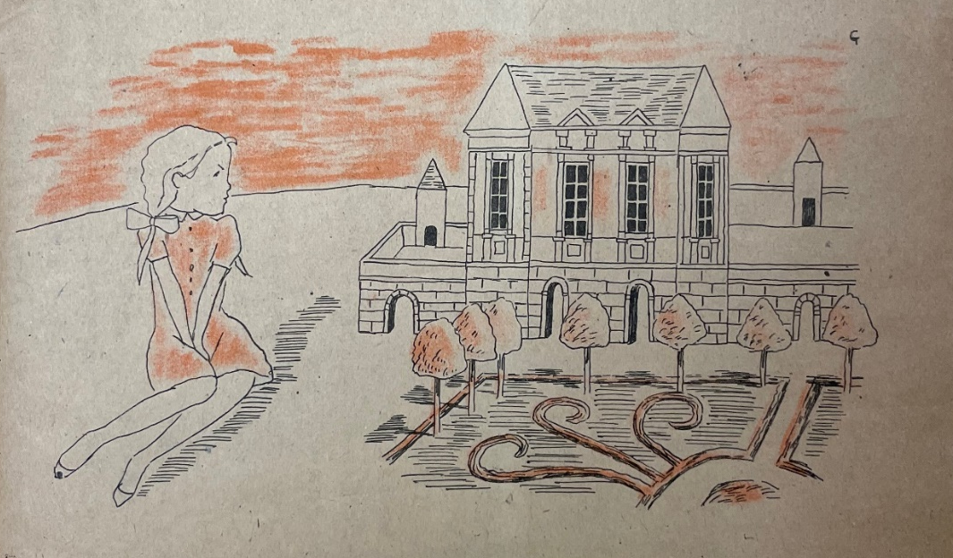
Well-known author/illustrator’s work
Osaragi, Jirō. (1946). Usagi o otte: Fushigikoku no Arisu [Chasing a rabbit: Alice's Adventures in Wonderland] (Gen’ichirō Inokuma, Illus.). Shonen Yomiuri, 1 (1), 1-4.

Slide 7
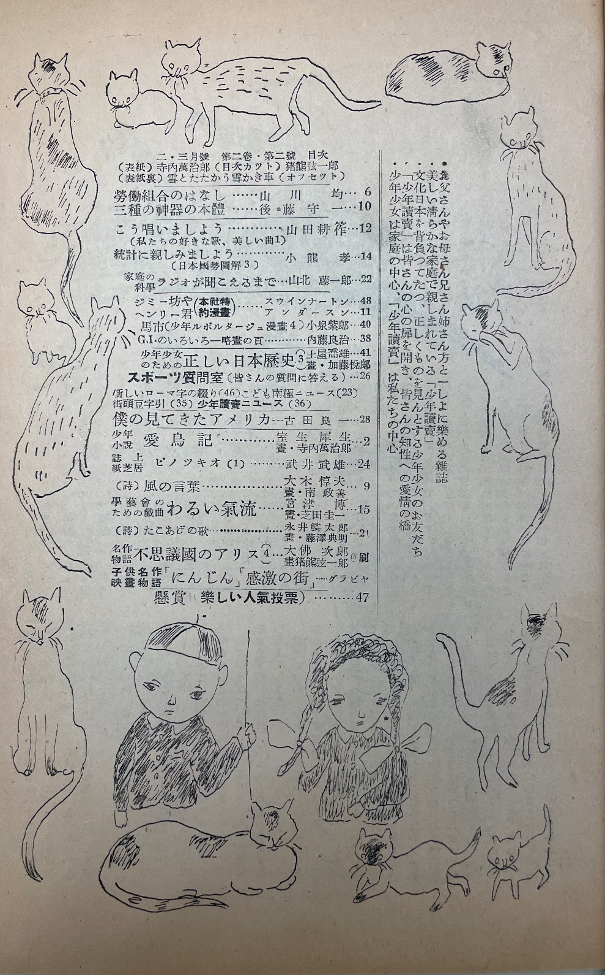
Inokuma, G. (1947). Shonen Yomiuri, 2 (2).

Slide 8
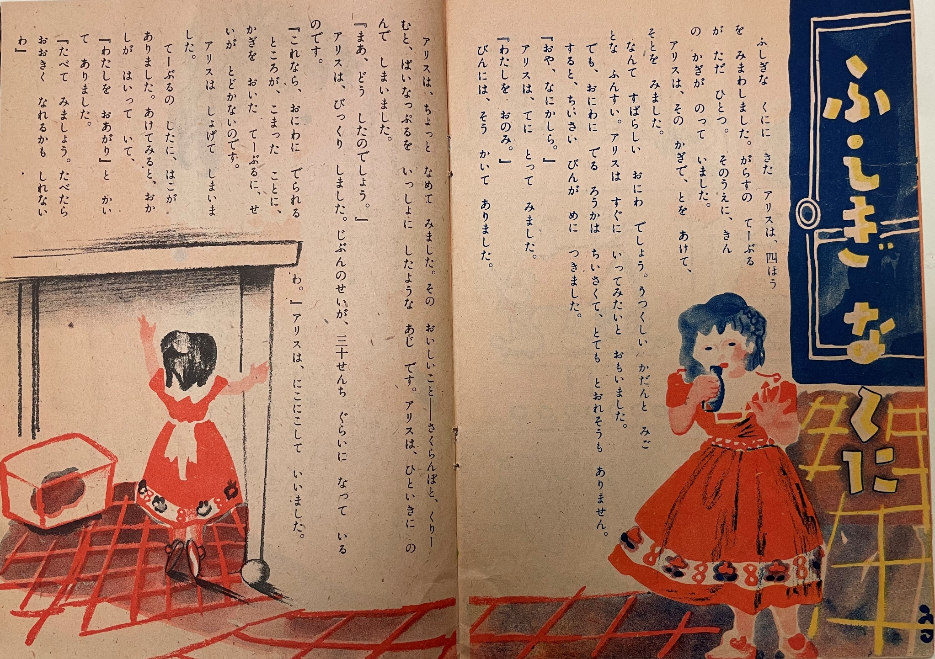
Well-known author/illustrator’s work
Haruo, Mizuto. (1949). Fushigina kuni [Wonderland] (Fumiko Hori, Illus.).Kodomo no hata, 4, 6.

Slide 9
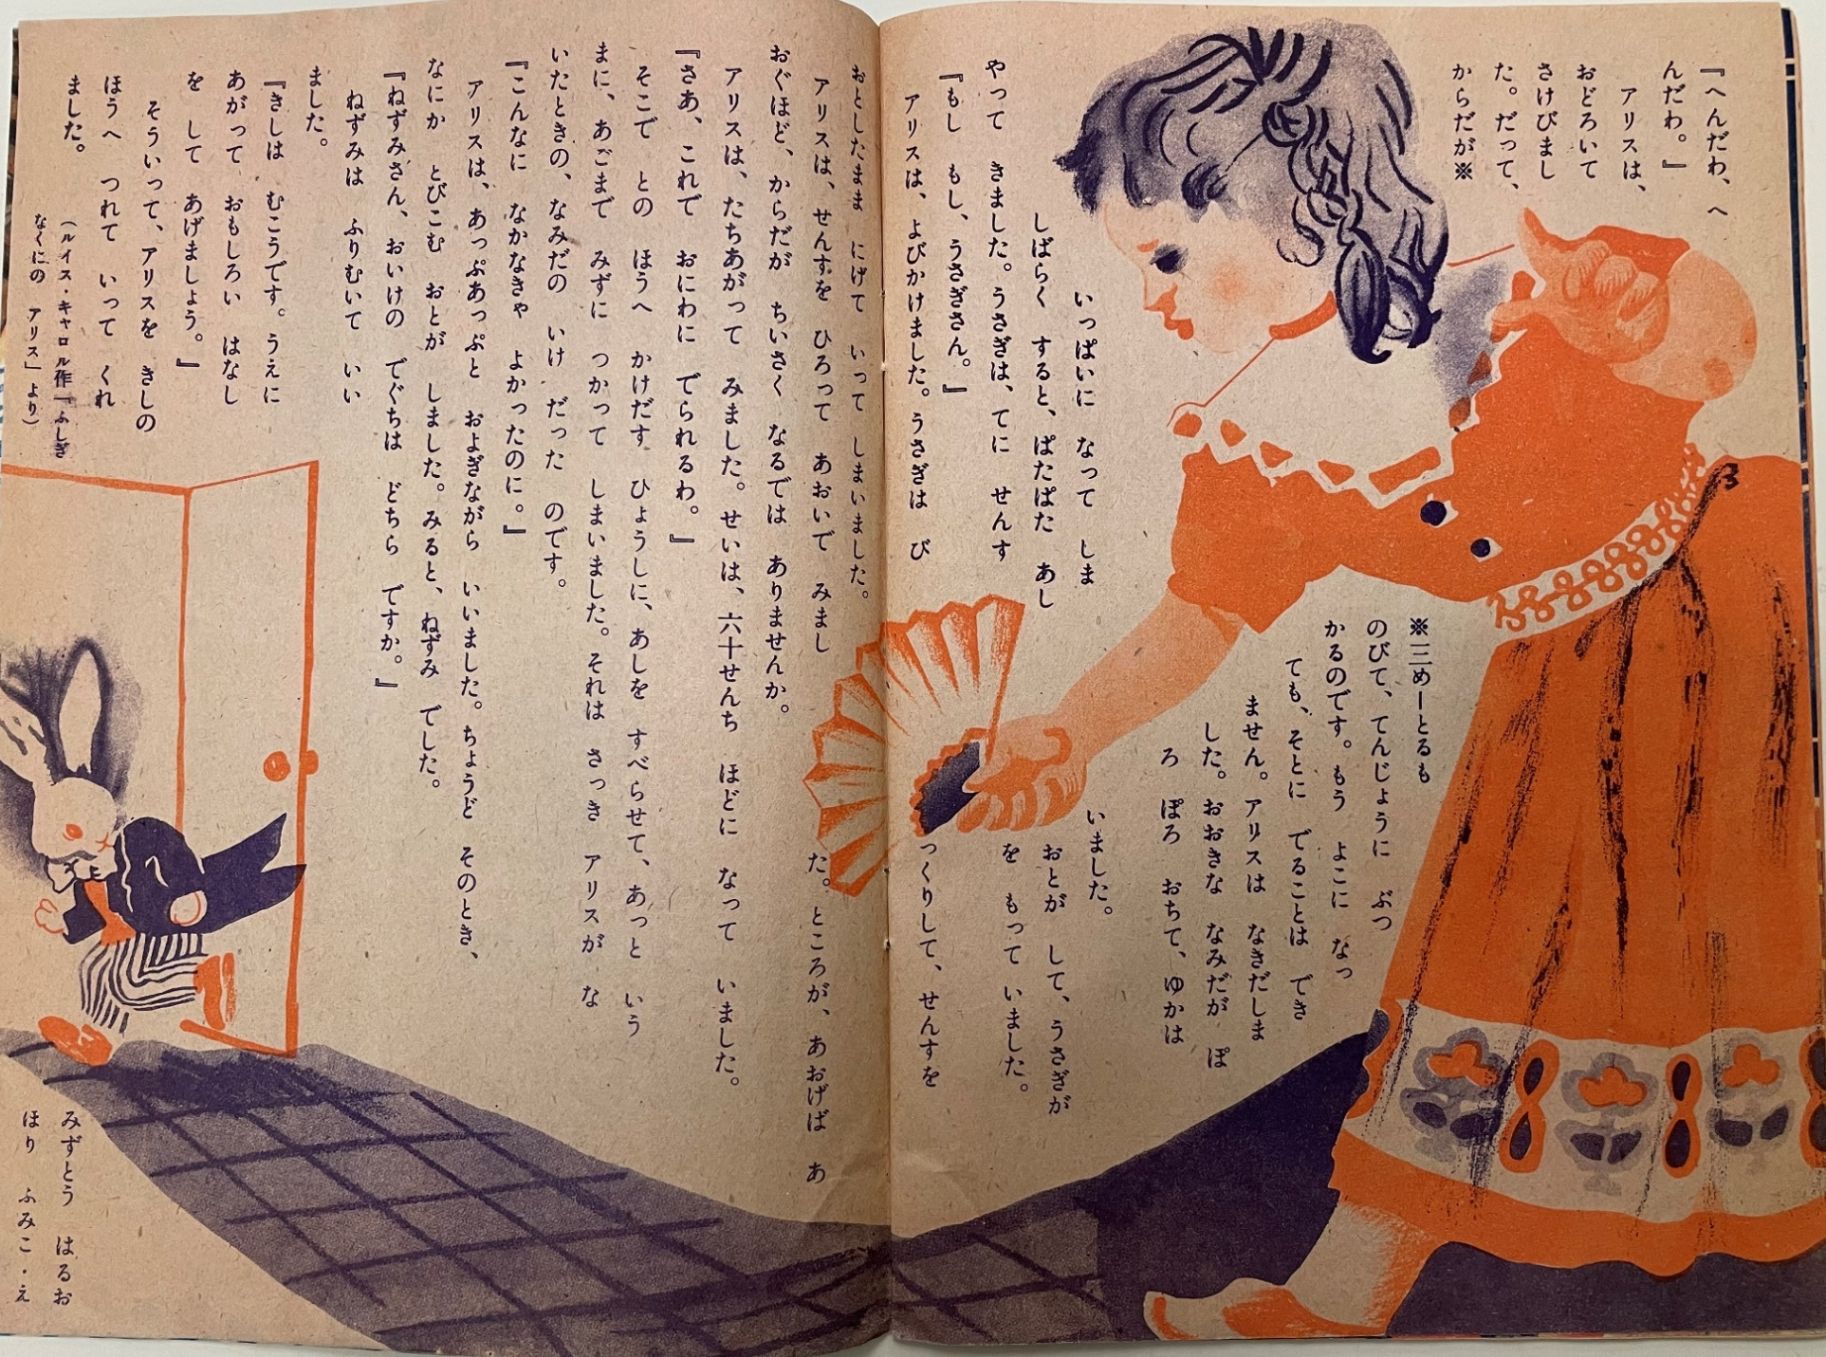

Slide 10
For future scholarship
Illustrators
Partial translation/(rough) summary
Readership of magazines
Influences (or not) from the original illustrations

Slide 11
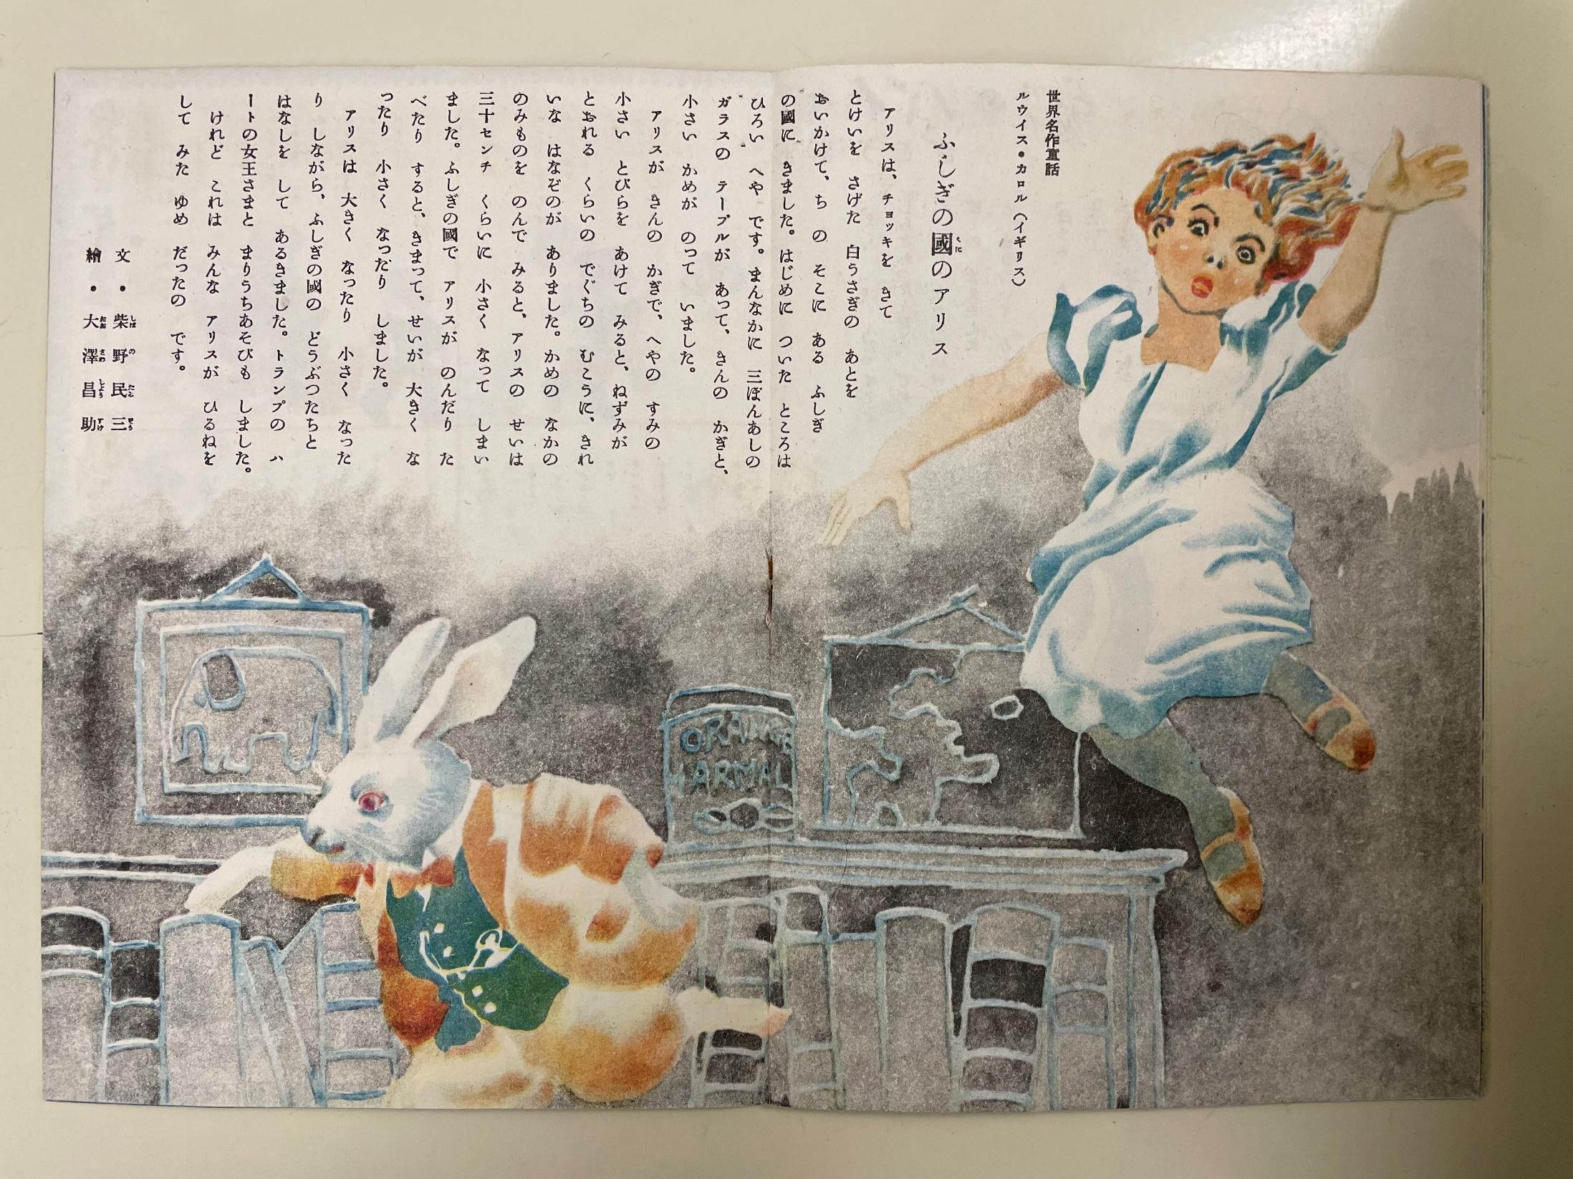
Partial translation/(rough) summary
Tamizo, Shibano. (1947). Fushigi no kuni no Arisu [Alice's Adventures in Wonderland] (Shosuke Osawa, Illus.).Kodomo no mado, 2(5), 10-11.

Slide 12
“As Alice grew big and small, she walked and talked with animals of the wonderland. She also played ball with the Queen of Hearts.
But they were all in Alice’s dream while she was napping.”
Tamizo, Shibano. (1947). Fushigi no kuni no Arisu [Alice's Adventures in Wonderland] (Shosuke Osawa, Illus.).Kodomo no mado, 2(5), 10-11.

Slide 13
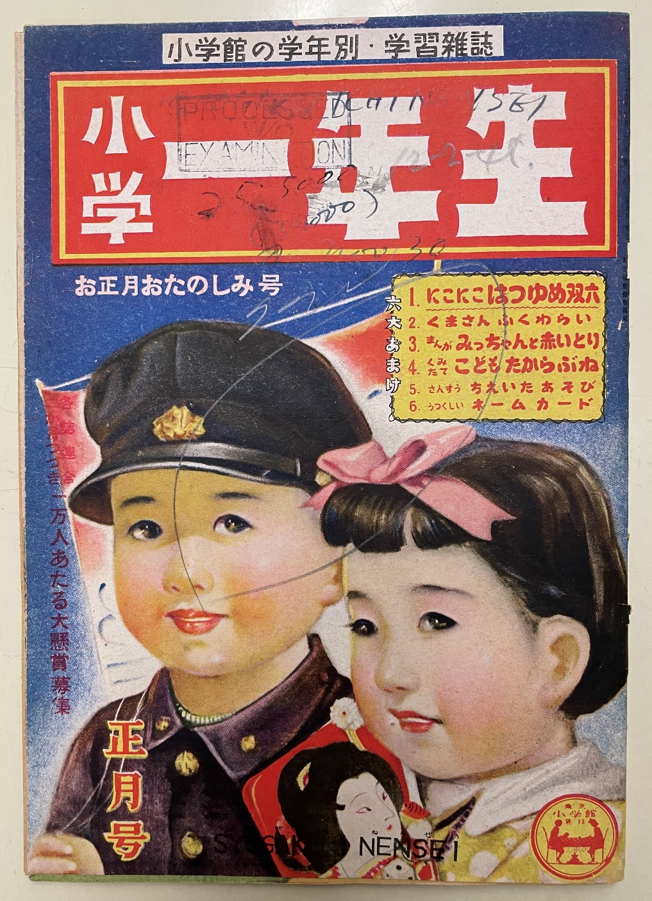
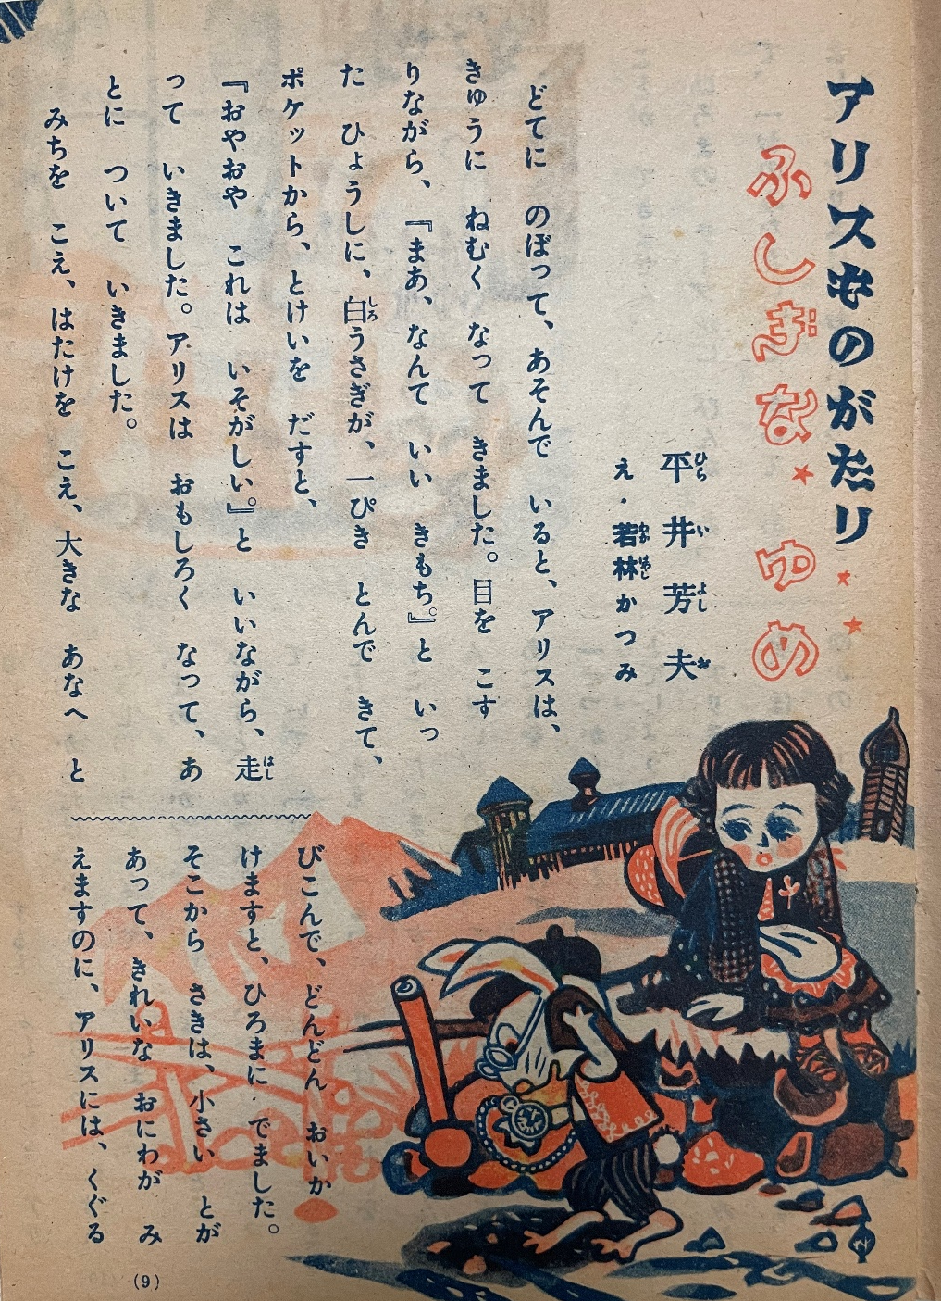
Partial translation/(rough) summary
Hirai, Yoshio. (1949). Arisu monogatari: Fushigina yume[Alice’s Story: Mysterious dream] (Katsumi Wakabayashi, Illus.) Shogaku ichinensei,4(10), 9-11.

Slide 14
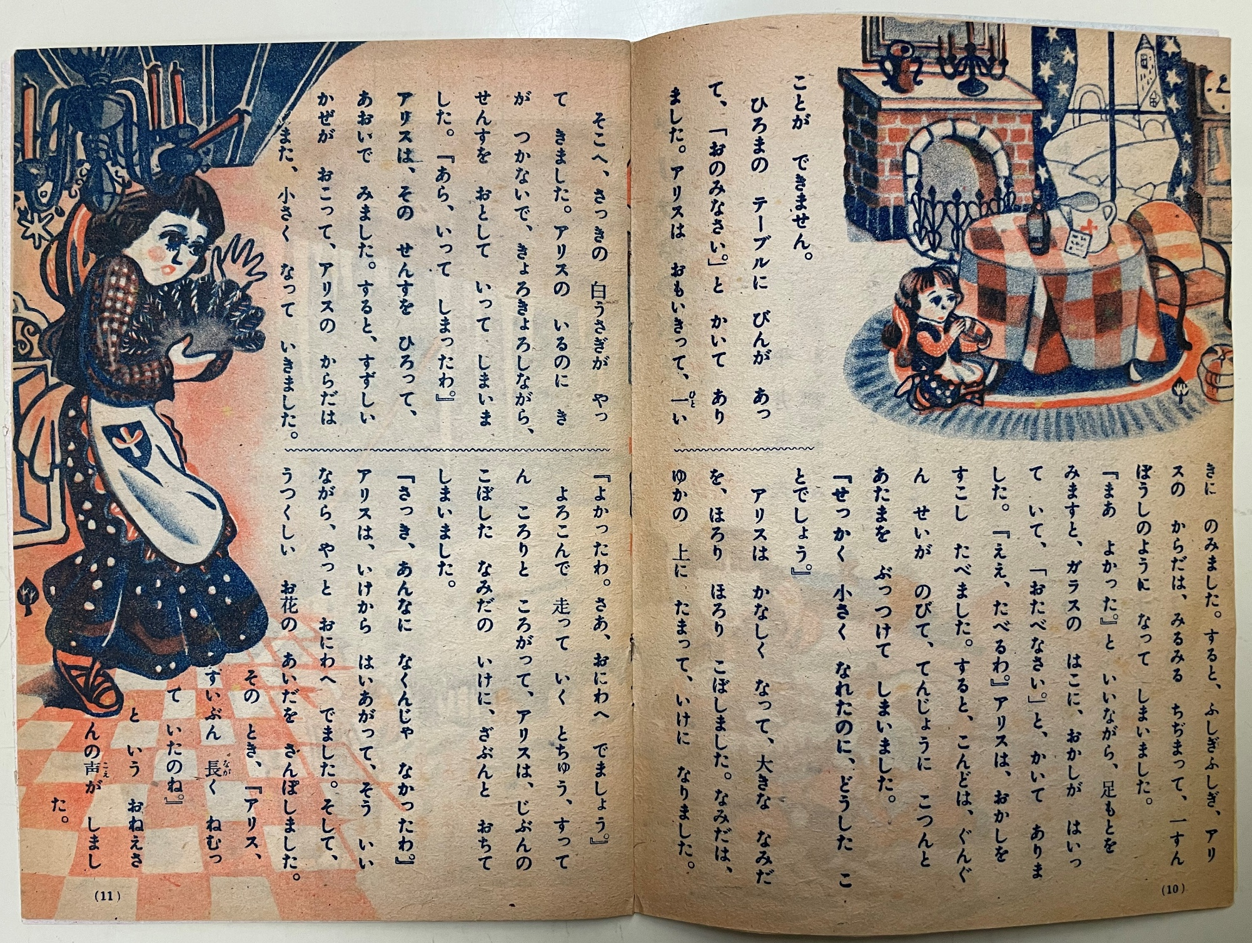

Slide 15
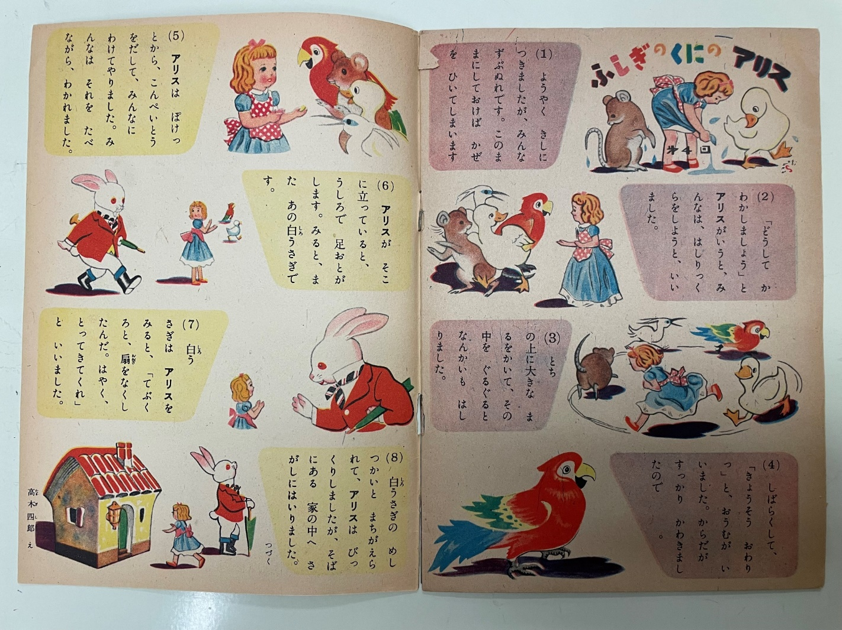
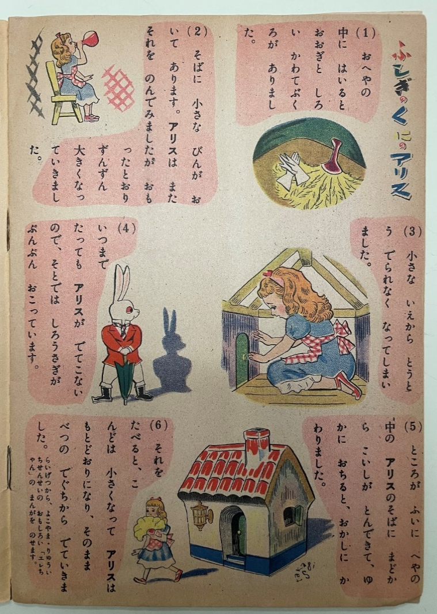
Partial translation vs. (rough) summary
Takagi, Shiro. (1949). Fushigi no kuni no Arisu [Alice's Adventures in Wonderland], Hikari no kuni, 10 (9).
Takagi, Shiro. (1949). Fushigi no kuni no Arisu [Alice's Adventures in Wonderland], Hikari no kuni, 10 (10), 17.

Slide 16
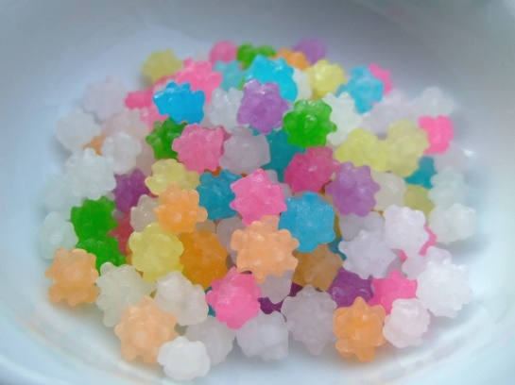
“Alice pulled out konpeito (*Japanese sugar candy*) from her pocket…”

Slide 17
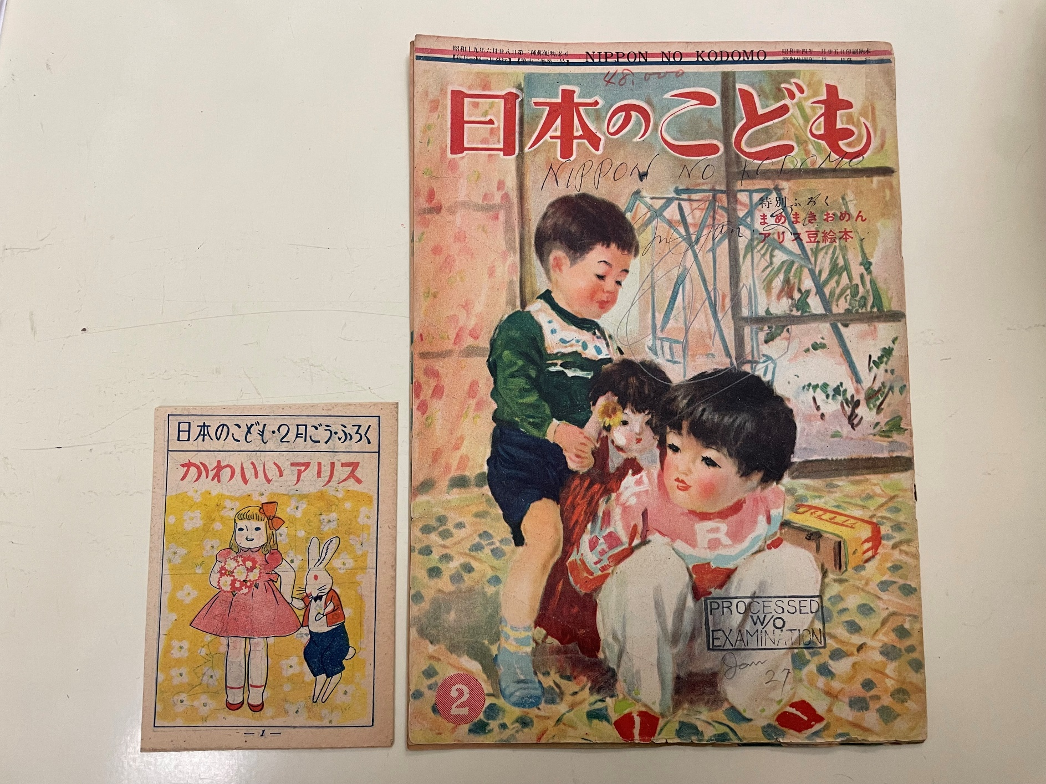
Partial translation vs. (rough) summary
(1949). Kawaii Arisu [Cute Alice]. Nihon no kodomo, 13, 2.

Slide 18
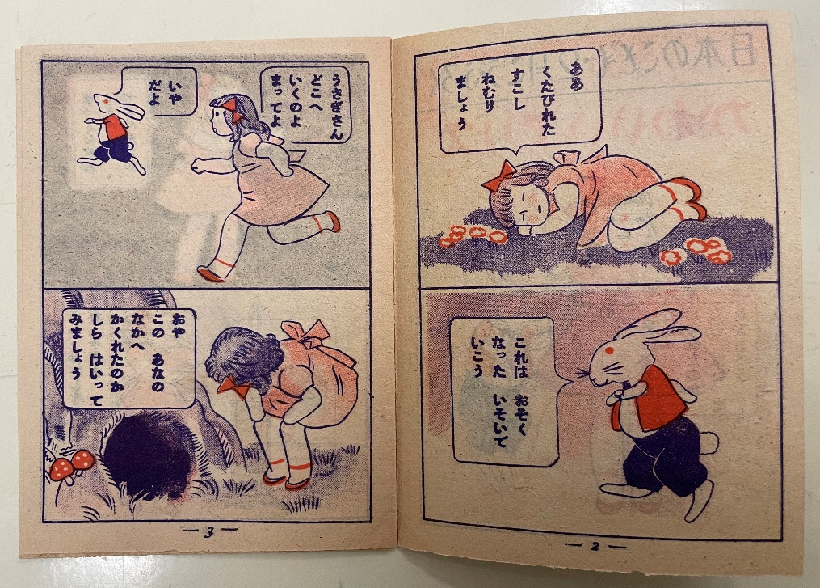
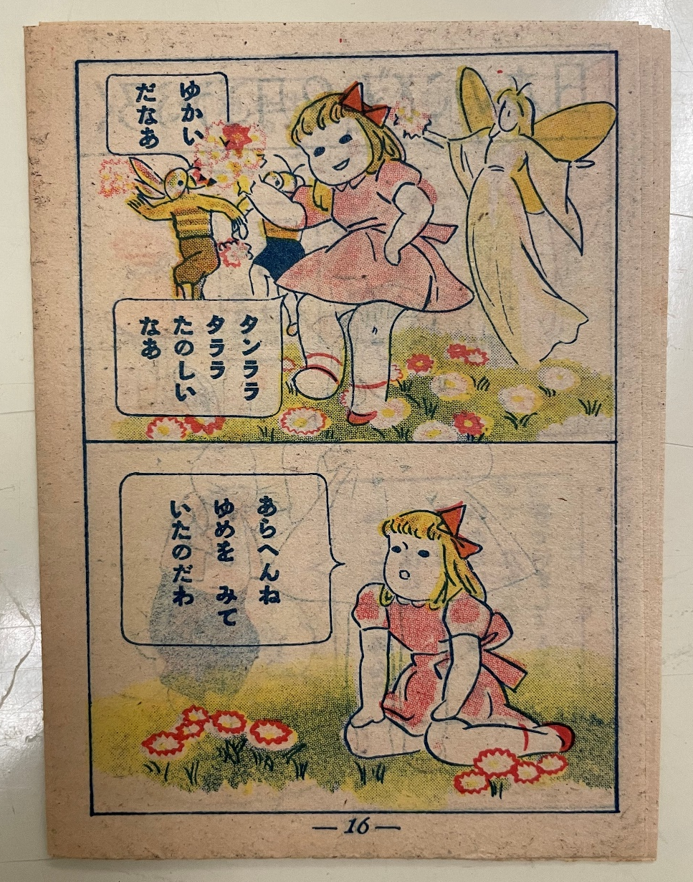

Slide 19
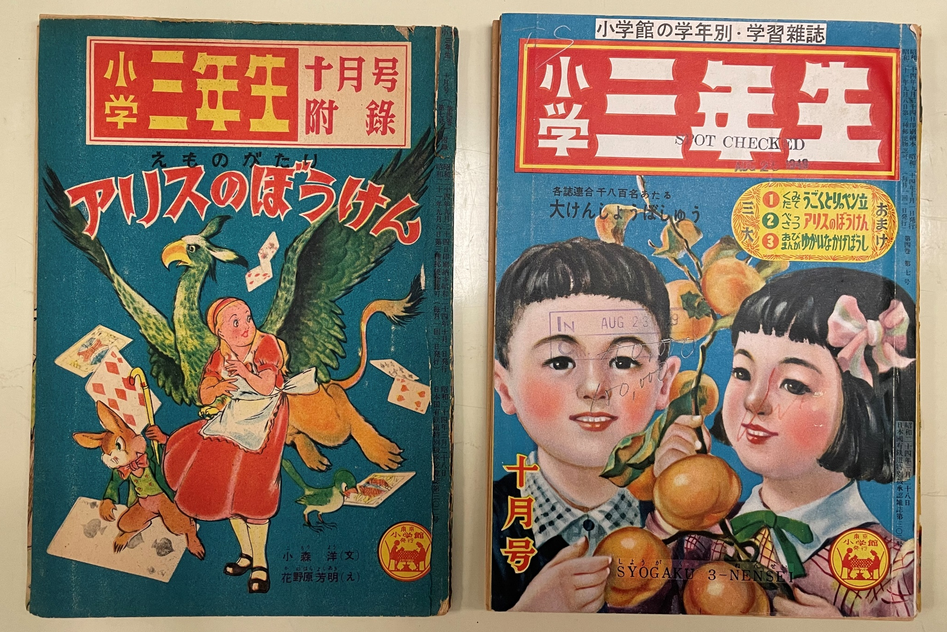
Partial translation/(rough) summary
Komori, Y. (1949). Emonogatari: Arisu no boken [Picture Story: Alice’s Adventure] (Yoshiaki Kanohara, Illus.) Shogaku sannensei, 4, 7.

Slide 20
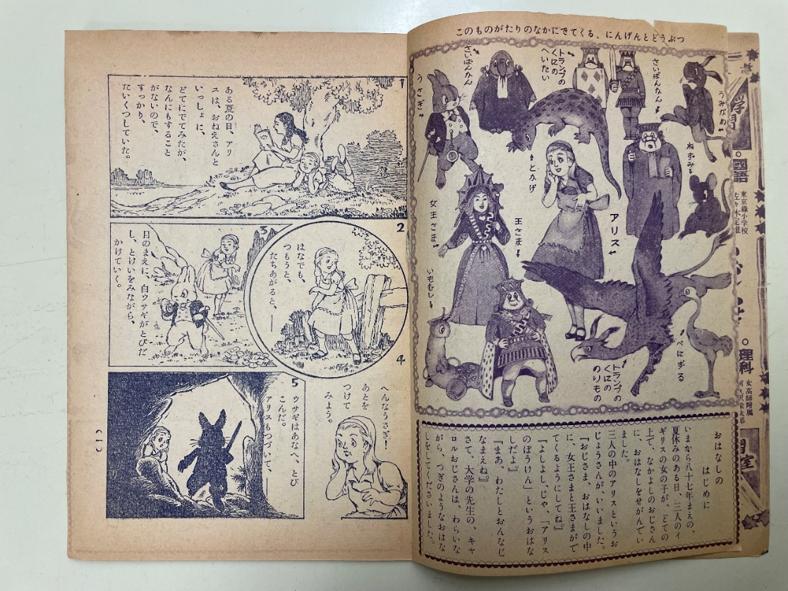
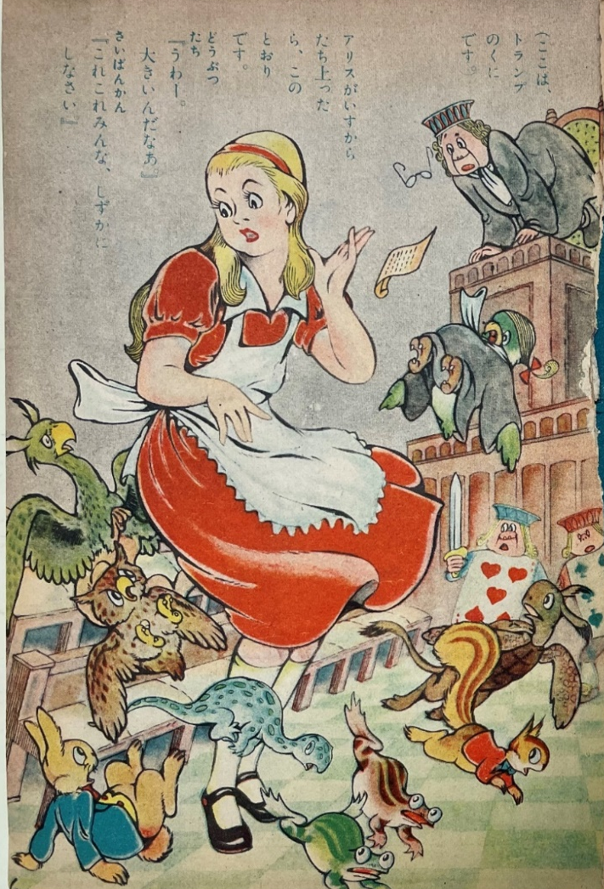

Slide 21
For future scholarship
Illustrators
Partial translation/(rough) summary
Readership of magazines
Influences (or not) from the original illustrations

Slide 22
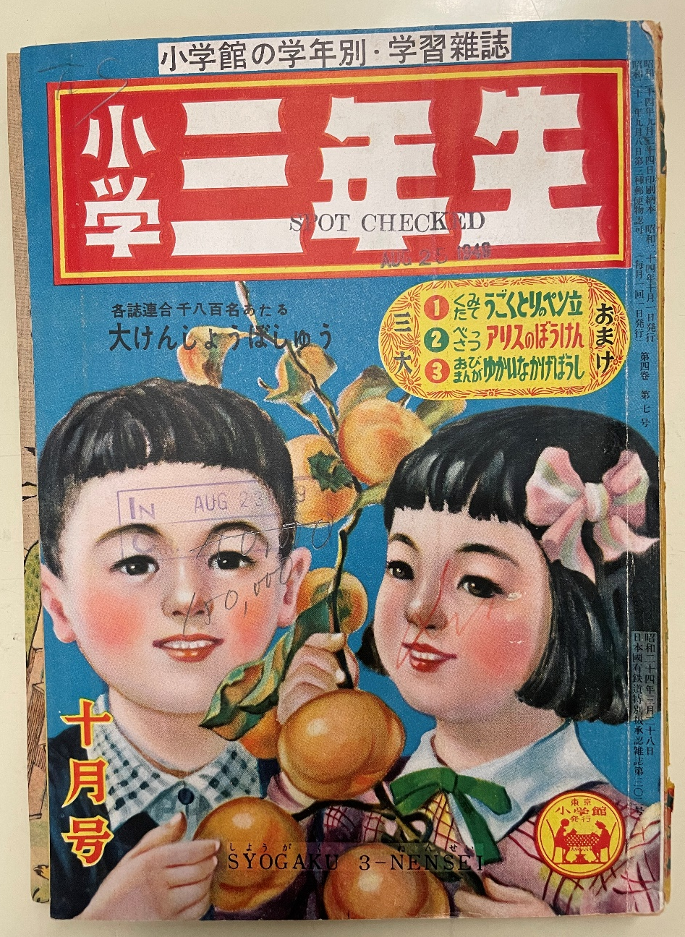

Readership of magazine - Circulation

Slide 23
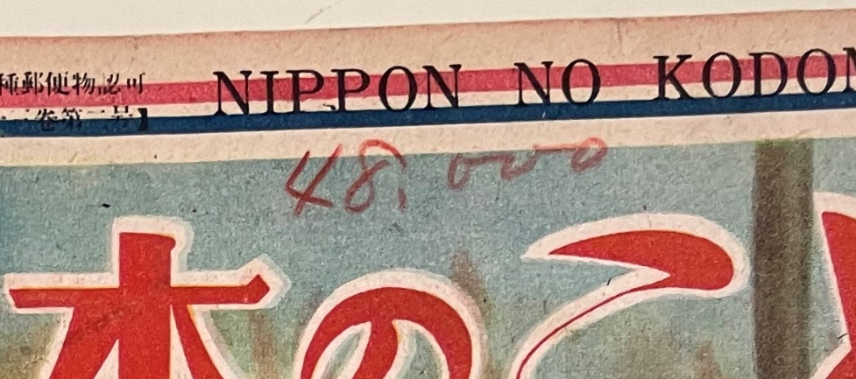

Readership of magazine - Circulation

Slide 24
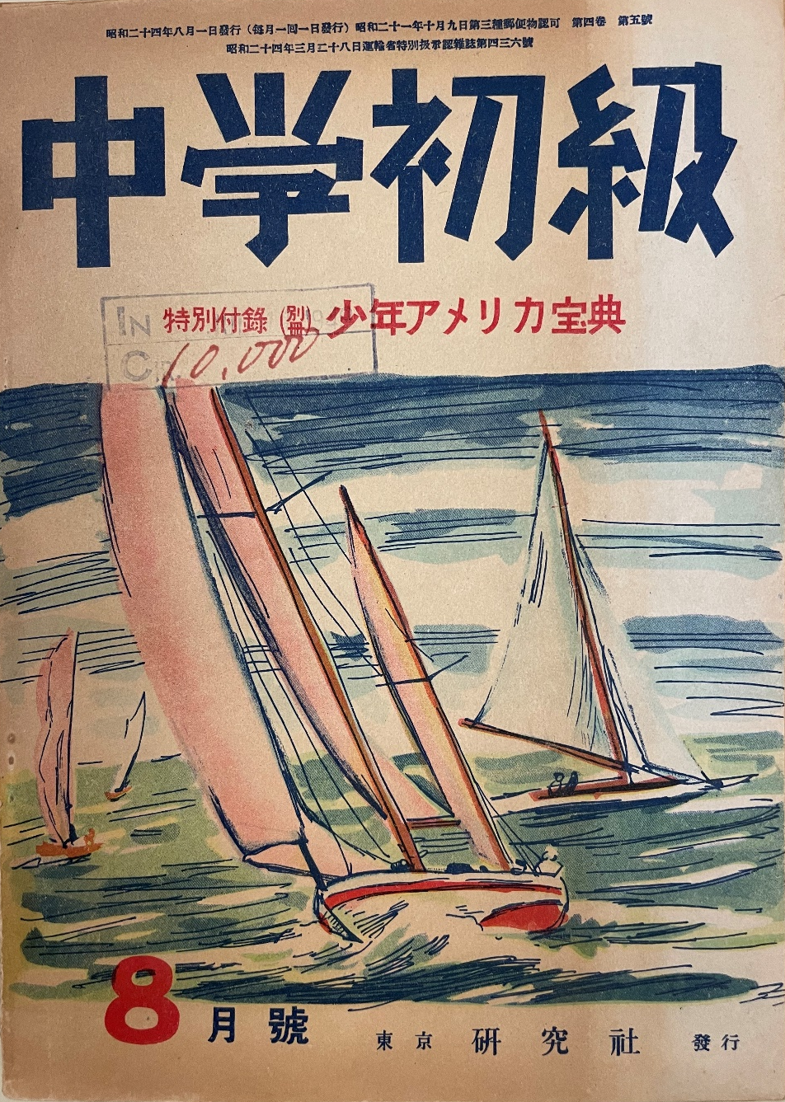

Readership of magazine – Circulation
(1949). Chugaku Shokyu. 4(4).

Slide 25
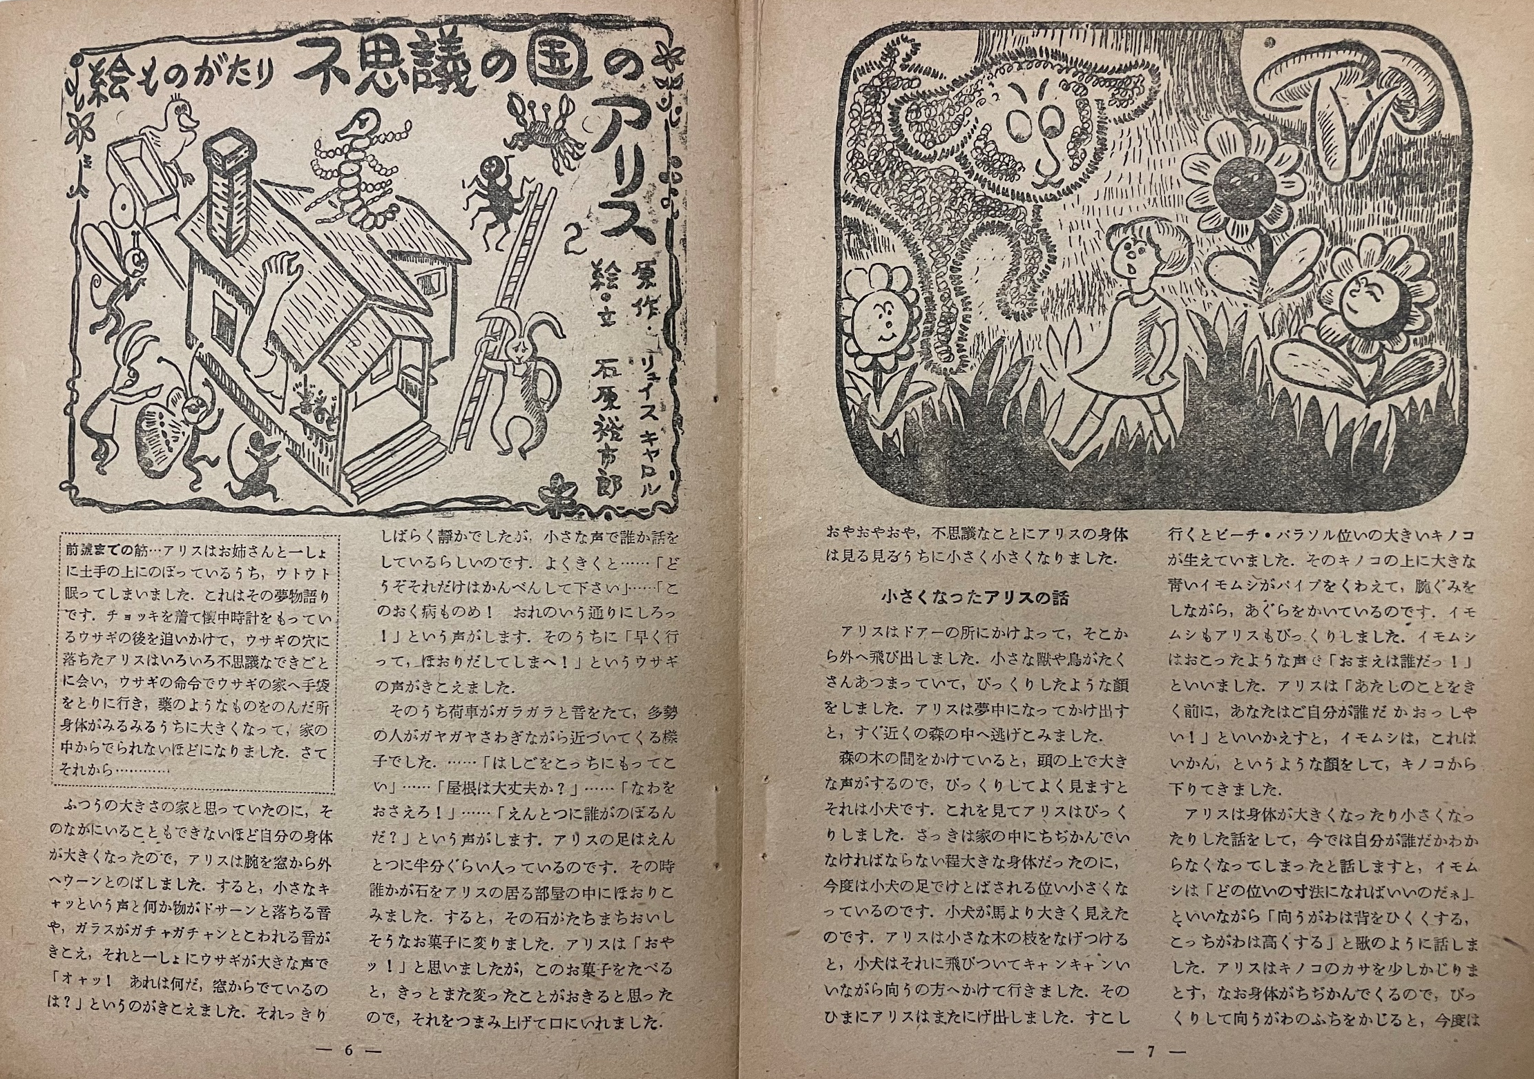
Carroll, L. (Y. Ishihara, Trans.). Emonogatari: Fushigi no kuni no Arisu [Alice’s Adventures in Wonderland]. Chugaku Shokyu. 4(4). 6-9.

Slide 26
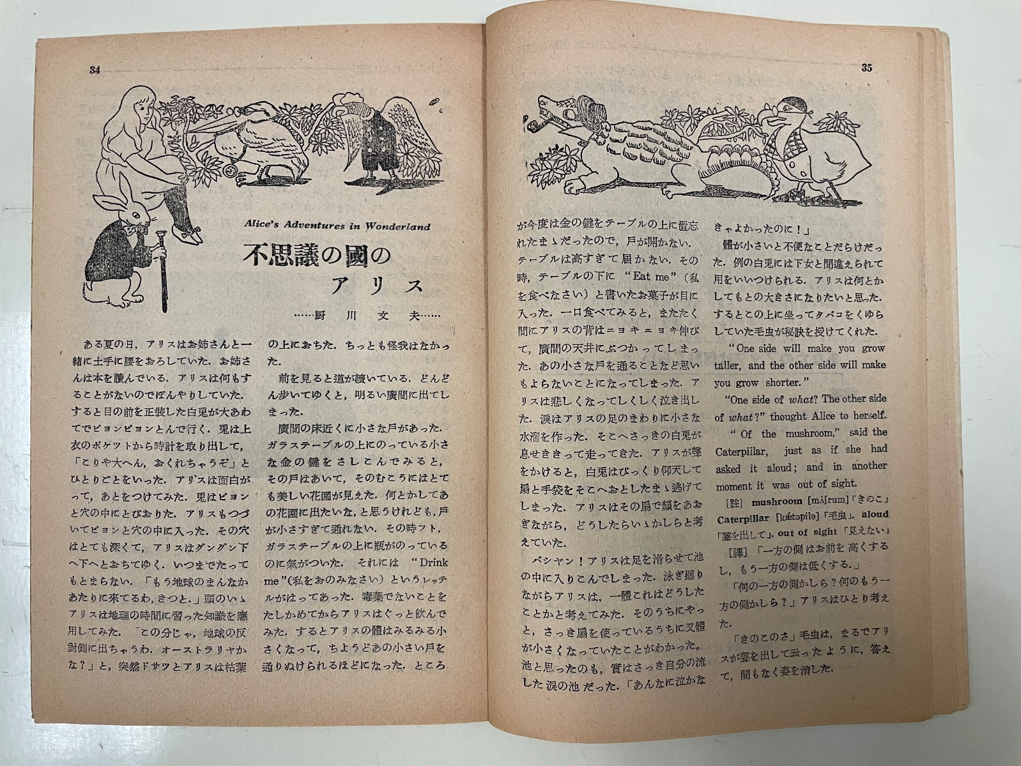
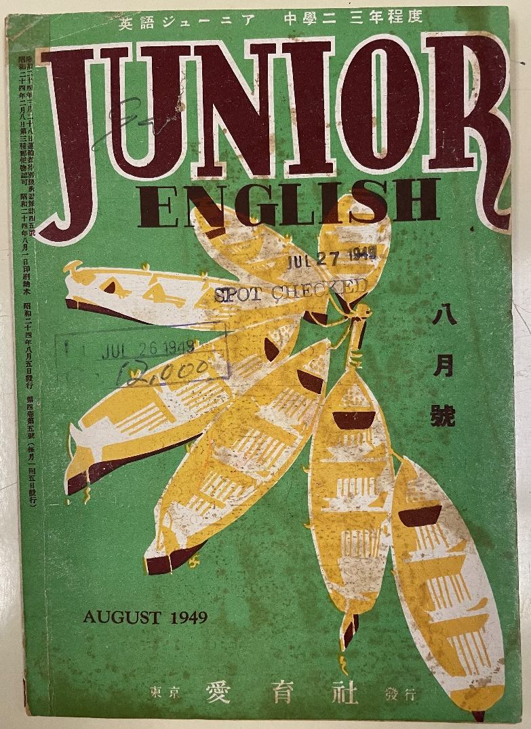
Readership of magazine – Target audience
Kuriyagawa, F. (1949). Fushigi no kuni no Arisu [Alice’s Adventures in Wonderland]. Junior English, 4(5), 34-36.

Slide 27
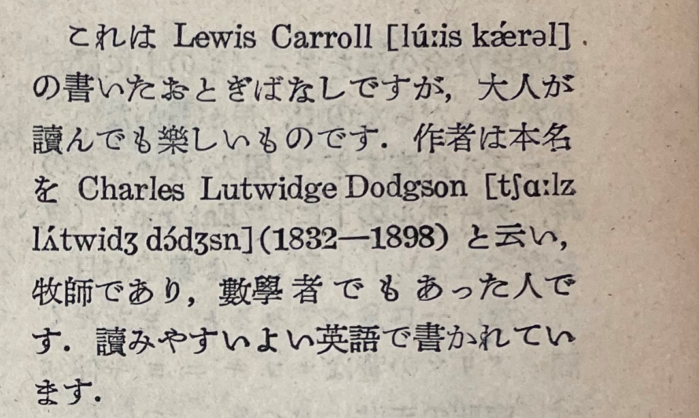

Slide 28
For future scholarship
Illustrators
Partial translation/(rough) summary
Readership of magazines
Influences (or not) from the original illustrations

Slide 29


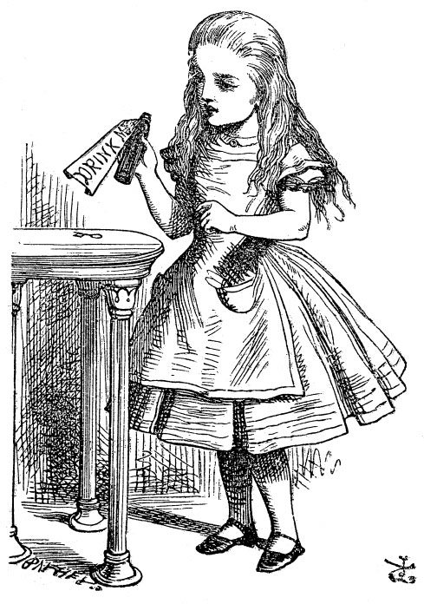
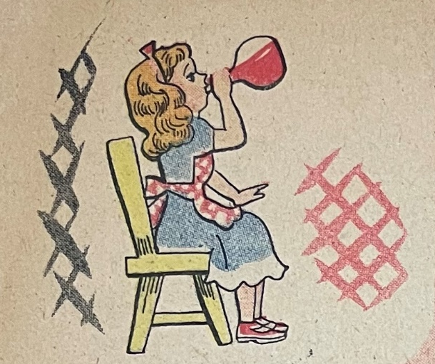
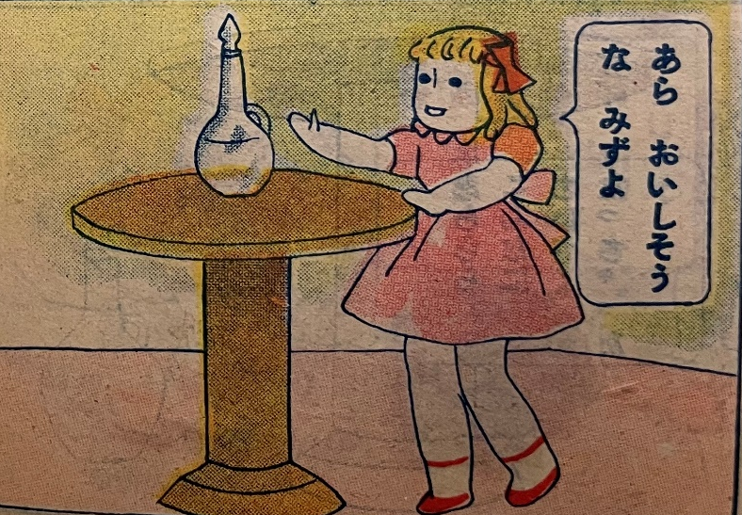
Influences (or not) from the original illustrations – Drink Me Bottle
Shogaku ichinensei
Kodomo no hata
Original illustration by John Tenniel
Hikari no kuni
Nihon no kodomo

Slide 30
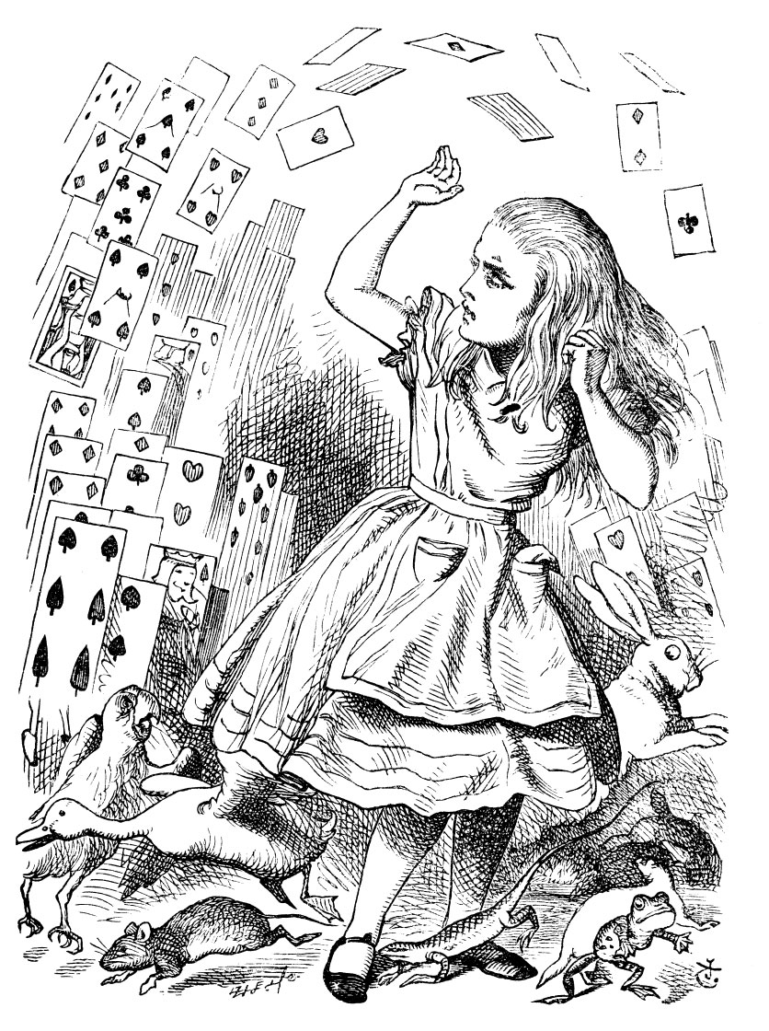
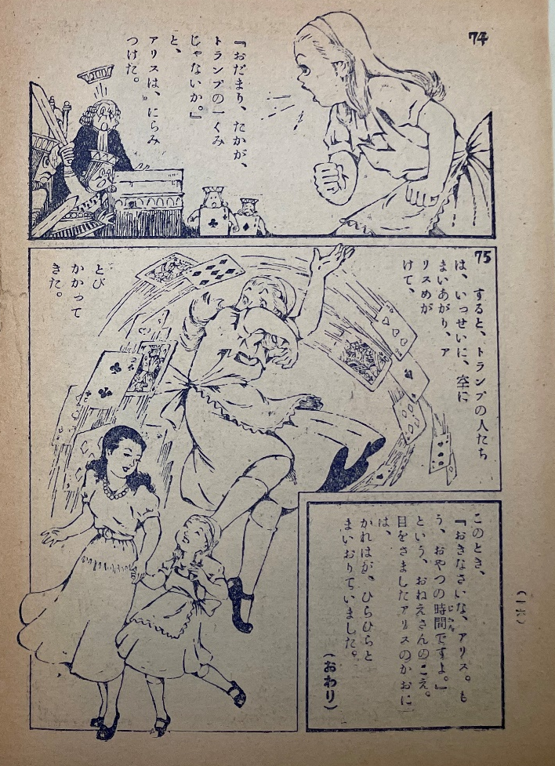
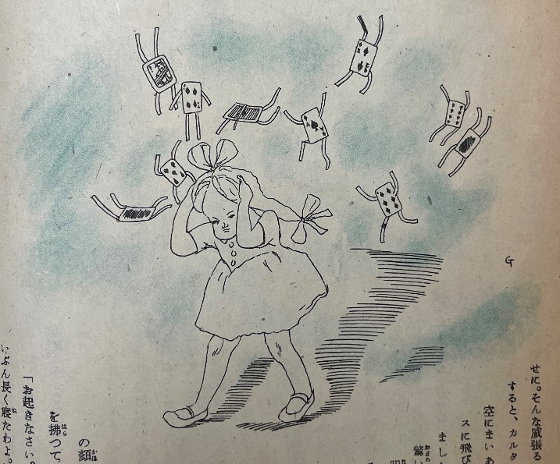
Influences (or not) from the original illustrations – Flying cards
Original illustration by John Tenniel
Shogaku Sannensei
Shonen yomiuri

Slide 31
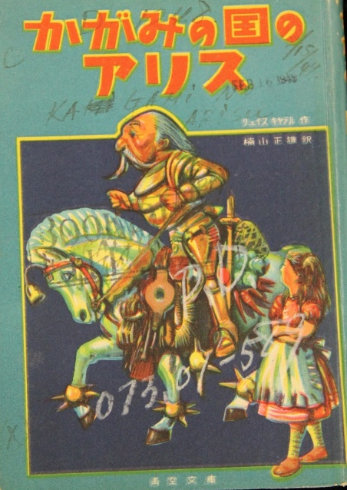




Conclusion AND Translation books in the Prange Collection
Carroll, L. (M. Kusuyama, Trans.). (1948). Fushigi no kuni no Arisu [Alice’s Adventures in Wonderland]. Tokyo: Komine Shoten.
Carroll, L. (M. Kusuyama, Trans.). (1948). Kagami no kuni no Arisu [Through the Looking-Glass, and What Alice Found There」. Tokyo: Komine Shoten.
Kikuchi, S. (1948). Fushigi na kuni no Arisu [Alice’s Adventures in Wonderland]. Tokyo: Kokumin Tosho Kankokai.
Jido Bunka Shinkokai, ed. (1947). Arisu monogatari [Alice’s Adventures in Wonderland]. Tokyo: Keibunkan.
Kitada, T. (1948). Fushigi no kuni [Wonderland]. Tokyo: Furendobooksha.

