Slide 1
Teach Smarter with Free Library
Resources
2022 Annual PTK Symposium:
Communicate, Collaborate, Inspire
University of Maryland, College Park
Feb. 24-25, 2022 (virtual)
Notes:
Hello colleagues! I am happy to have the opportunity to meet you virtually and share free library resources to support your teaching or research. Remember: Teach smarter, not harder! [CLICK]

Slide 2
Who am I?
Nedelina Tchangalova
Public Health Librarian
Notes:
My name is Nedelina Tchangalova and [CLICK] I am a mid-career librarian for the School of Public Health. I am a white woman with brown hair, wearing glasses and a blue blouse. My pronouns are she/her. [CLICK]

Slide 3
Agenda
01
Your Librarian
Get to know your librarian could be a life saver for you and your students.
Library Services
02
Learn how the Libraries can support your teaching.
Library Collections
03
Take advantage of “free” resources to you and your students.
Teaching tips and tricks
04
Engage your students and make them active players in the learning process.
Notes:
Before I move along, I would like to share a few points that I will talk about here as outlined on this slide:
- Your Librarian
Library Services
Library Collections and
Teaching tips and tricks [CLICK]

Slide 4
Meet Your Librarian
01
How to get in touch with me?
Email
In-person
Virtually
nedelina@umd.edu
I can visit your office
We can talk via Zoom
How can I help you and your students?
Library Instruction
Virtual or in-person
Teaching Support
Public Health Research Guide
Citation Management
Zotero
Notes:
Meet your Librarian! Be aware that your Librarian is better than your Google Search engine!
[CLICK] How can you get in touch with me? [CLICK] Write me an email. [CLICK] Or schedule an in-person meeting via Google Calendar. [CLICK] Or we can meet virtually via Zoom. [CLICK]
[CLICK] I can help you and your students through library instruction. Will your students be required to do a literature review? Do you want your students to be effective researchers and produce better papers for your class? If you answered YES to these questions, please don’t delay! Contact me and we can start planning together for a library session for your students!
[CLICK] To support your teaching, I can design a website with resources for one-stop shopping for information. I can visit your classroom via Zoom or in person, and engage your students with interactive tools.
[CLICK] Introduce your students to Zotero. This citation management program allows creating references lists in seconds with a click of the mouse. [CLICK]

Slide 5
02
Library Services
1
Course Reserves
This is a platform for sharing course materials. When the entire class needs access to books, e-books, articles, or media, Course reserves delivers.
https://www.lib.umd.edu/access/reserves-faculty
2
Video Streaming
Placing relevant videos on Streaming reserves provides streaming access to films through your ELMS course portal.
https://www.lib.umd.edu/access/reserves-faculty#streaming
3
ELMS Library Modules
Subject librarians create online research guides that are customizable for your class. You can export entire guides or sections of them into your Canvas course space.
https://go.umd.edu/lib_modules
Notes:
UMD Libraries offer a variety of services to support you to excel in teaching.
[CLICK] For example, place required readings such as book chapters and articles through the Course Reserves system.
[CLICK] Engage students in a conversation after watching a film. Submit a request for Video streaming through your ELMS course portal.
[CLICK] The research process can be a daunting task for novice researchers. Consider embedding library resources directly into your ELMS course space. [CLICK]

Slide 6
Most of these resources are available electronically!
03
Library Collections
Books
Videos
Articles
Check the library catalog for UMD holdings. If not available, request them through Interlibrary Loan for free.
Contact your librarian if a video of interest is not available in UMD Libraries’ collections.
Search library databases to find peer reviewed publications to support your teaching.
Notes:
The Libraries spend millions of dollars every year for books and subscriptions, so take advantage of these resources to support your teaching. You don’t even need to set a foot in the library – [CLICK] most of the library collections are available electronically for free to you! [CLICK]

Slide 7
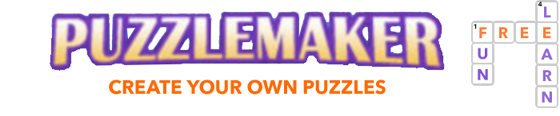
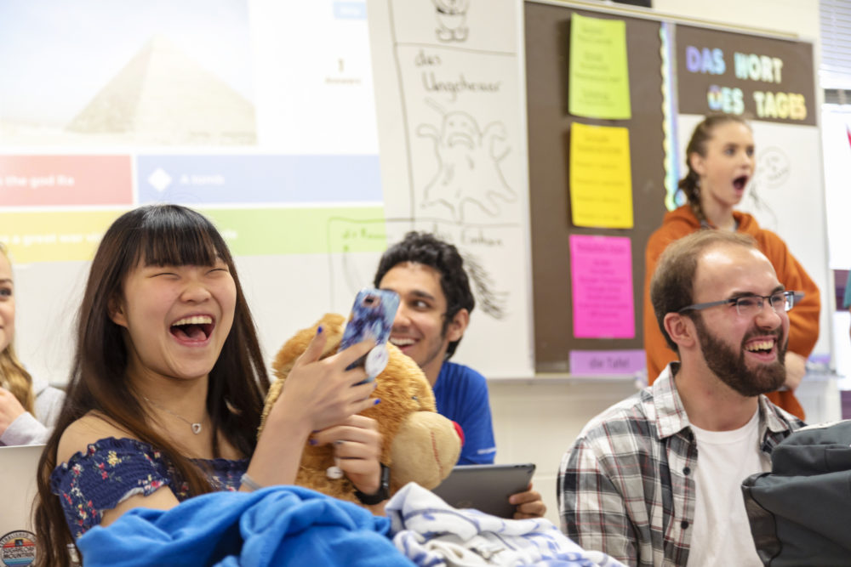


04
Teaching Tips & Tricks
Funny Quizzes
What does MeSH stand for?
Me Sleeping Here
Medical Subject Headings
Medical Emergency Status Hotline
Notes:
Finally, bring excitement in your classroom! From students looking at their phones upon entering your classroom, [CLICK] transform them into active players in the learning process. Get some inspiration with these tools – [CLICK] Kahoot!, [CLICK] Mentimeter, and [CLICK] Puzzlemaker. [CLICK] Bring some humor in your quizzes to alleviate stress and anxiety! [CLICK]

Slide 8
Resources
Public Health Research Guide
https://lib.guides.umd.edu/PublicHealth
Zotero
https://www.zotero.org/
Kahoot!
https://kahoot.com/
Mentimeter
https://www.mentimeter.com/
Crossword Puzzle Maker
https://puzzlemaker.discoveryeducation.com/criss-cross
Notes:
For your convenience, I am including here at a glance links [CLICK] to the Public Health Research Guide, as well as the links to the tools I mentioned earlier including [CLICK] Zotero, [CLICK] Kahoot!, [CLICK] Mentimeter, and [CLICK] the Crossword Puzzle Maker. [CLICK]

Slide 9
www.lib.umd.edu
SEARCH
Databases
ONLINE
Open Educational Resources
Books
Videos
Articles
Newspapers
Theses and Dissertations
and more….
Notes:
Remember, your one-stop shopping for information is [CLICK] the Libraries’ website at L I B dot U M D dot E D U where you can access databases, and [CLICK] download books, videos, articles, newspapers, and more. [CLICK]

Slide 10
Thank you for listening!
Get us in touch soon!
Nedelina Tchangalova
nedelina@umd.edu
Notes:
Thank you for listening! I can be reached at nedelina@umd.edu. Bye and I hope to talk to you soon! [STOP RECORDING]

