Slide 1


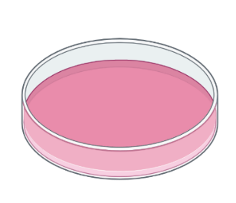

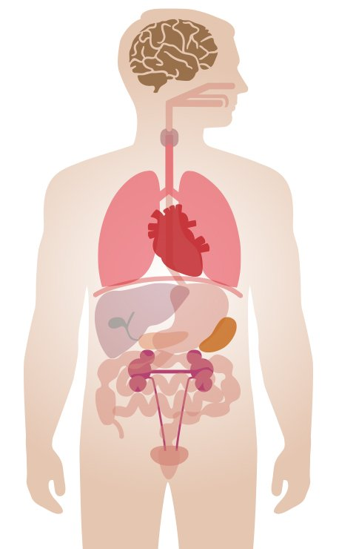


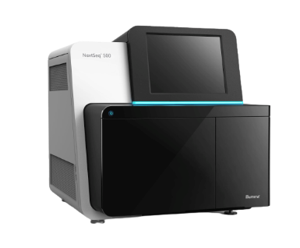

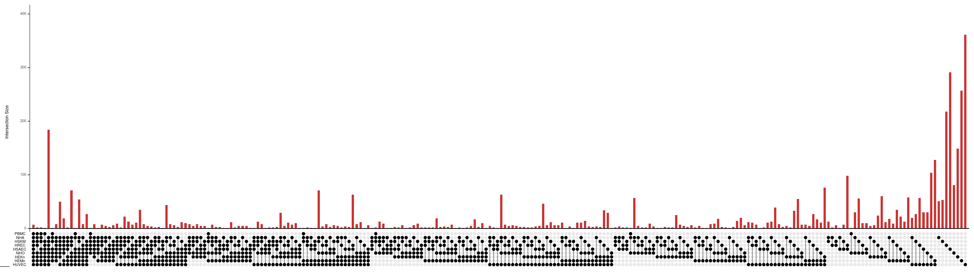
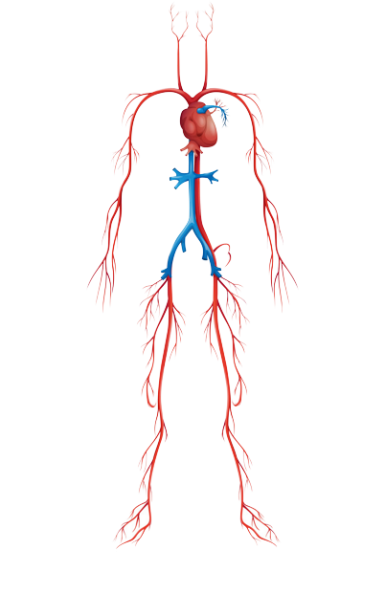
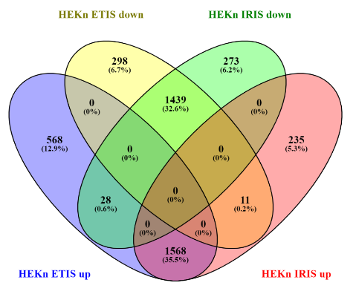
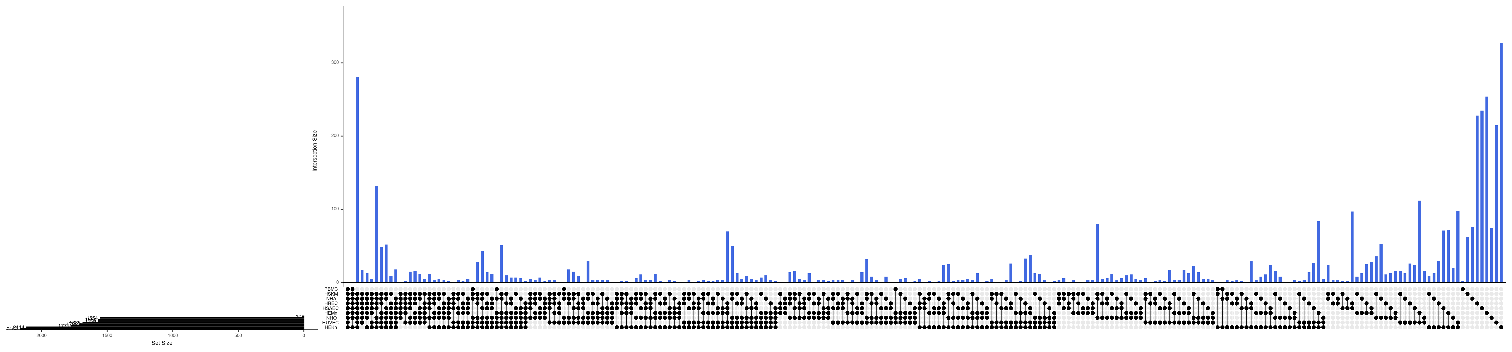

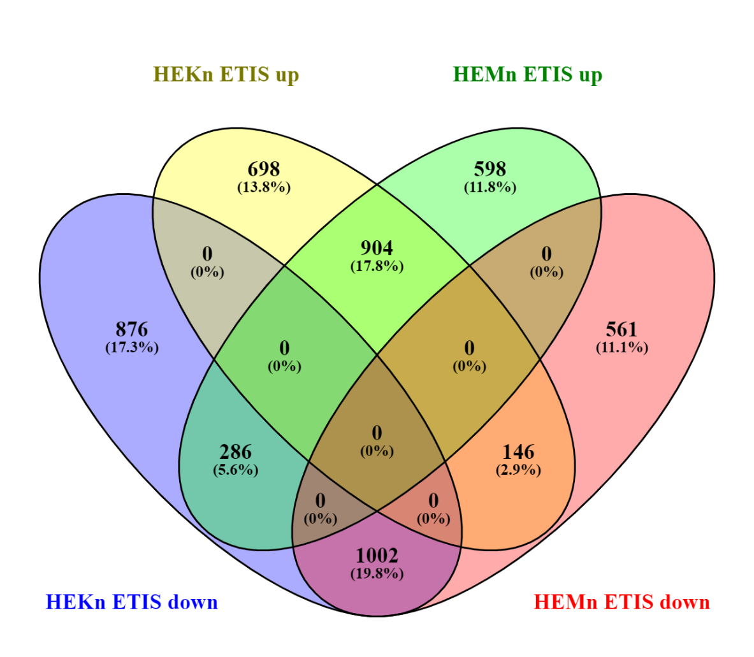

Mapping the heterogeneity of the human senescent proteome
Ana S.G. Cunningham^{1,4}, Dimitrios Tsitsipatis², Carlos Anerillas², Reema Banarjee¹, Krystyna Mazan-Mamczarz², Andy Qi³, Ziyi Yi³, Ying Hao³, Allison B. Herman², Andrew Singleton³, Myriam Gorospe², Nathan Basisty¹
¹Translational Gerontology Branch, ²Laboratory of Genetics and Genomics, ³Center for Alzheimer and Related Dementias, National Institute on Aging, National Institutes of Health, Baltimore, MD; ⁴Department of Biology, University of Maryland, College Park, MD
Background
Results
Results
Cellular senescence is a unique response to sublethal stress characterized by at least two elements: persistent cell cycle arrest and a senescence-associated secretory phenotype (SASP).
Recent evidence suggests a close link between senescence and aging, as selective elimination of senescent cells in mice improves longevity and overall health. Therefore, there is increased interest in identifying markers to develop drugs (senolytics) that selectively eliminate senescent cells without harming healthy, proliferating cells.
However, senescent phenotypes vary across cell types and inducers, creating a need for tissue-specific markers of senescence.
This “senescence catalog” has three aims:
Identify protein and RNA markers of senescence
Compare across models to find overlapping markers
Validate markers with scRNA-seq and IHC in culture and in mice
p16
HREC
HSAEC
HEKn
HEMn
HUVEC
A
Top 10 ↑ |  | Top 10 ↓ | Top 10 ↓ | Final
FUCA1 (14) GDF15 (10) CPQ (9) CTSB (8) ARSB (7) | FDXR (11) VTN (10) ICAM1 (9) ABAT (7) ASAH1 (7) | DNMT1 (13) MCM3 (13) SMC2 (13) MCM5 (12) NCAPH (11) | MCM4 (13) NCAPD2 (13) TMPO (13) MCM6 (11) POLD1 (11) | FUCA1 (↑) SMC2 (↓) DNMT1 (↓) MCM3-7 (↓) NCAPD2 (↓)
p21
B
HREC
HSAEC
HEKn
HEMn
HUVEC
FUCA1
HREC
HSAEC
HEKn
HEMn
HUVEC
HUVEC
GDF15
HREC
HSAEC
HEKn
HEMn
HUVEC
SMC2
HREC
HSAEC
HEKn
HEMn
HUVEC
Methods
A
B
Inducers:
ETIS: etoposide
IRIS: ionizing radiation
CTRL
IRIS
ETIS
Astrocytes (NHA)
IRIS
Figure 2. Proteomic analysis of 3 classical senescence markers. Relative protein abundance of p16, p21, and GDF15 in 5 of 9 cell types. Treated with either etoposide (ETIS) or IR (IRIS) and compared to a proliferating (P) control group.
Figure 4. A. Unbiased identification of novel protein markers of senescence. For all 18 senescence models, proteomic data ranked in order of decreasing magnitude of regulation so that proteins that increased or decreased the most ranked at the top and proteins with least change at the bottom, respectively. Top 50 proteins for each model compared, and proteins repeated across most groups (n ≤ 18) listed on the right. B. Proteomic analysis of 2 novel senescence markers. Relative protein abundance for FUCA1 and SMC2 in 5 of 9 cell types.
Lung (HSAEC)
Proteomic mass spec
Transcriptomic RNA-seq
Skeletal muscle (HSKM)
Osteoblasts (NHO)
A
400
Umbilical vein (HUVEC)
Kidney (HREC)
300
Blood (PBMC)
Keratinocytes (HEKn)
HEKn
HUVEC
NHO
HEMn
HSAEC
HREC
NHA
HSKM
PBMC
200
Melanocytes (HEMn)
100
Discussion
C
The proteomes of senescent cells are highly complex and heterogeneous. We show that some proteins are shared across senescence models, while others are unique. Identifying both shared and unique senescence-associated proteins is critical for developing informative senolytic targets. Our unbiased proteomic analysis across a large number of cell types and inducers reveals a robust set of proteins, including:
DNMT1: DNA (cytosine-5)-methyltransferase 1
SMC2: Structural maintenance of chromosomes protein 2
MCM: DNA replication licensing factors 2-7
NCAPD2: Condensin complex subunit 1
FUCA1: Tissue alpha-L-fucosidase
These proteins may provide promising therapeutic targets for models of senescence that differentially express distinct phenotypes across the body. The presence of previously established senescence markers corroborates the results of the unbiased marker identification. Future directions include replicating pilot data and validating proteomic and transcriptomic markers.
Top 50 proteins, all models
Top 10 increased
100
Overlap across models
200
300
Top 10 decreased
B
Figure 1. A. Diverse models of senescence. 9 types of human primary cells rendered senescence with either etoposide (ETIS) or ionizing radiation (IRIS), harvested after 7-10 days. B. Schematic of the experimental design. Senescent cells (IRIS or ETIS) compared to a healthy, proliferating group (CTRL). RNA sequencing data collected at transcriptomic level, and mass spectrometry data collected at proteomic level. Analysis of relative protein abundance for each of 26 classical markers of senescence for each group in all cell types. C. Workflow of unbiased identification of novel markers. Mass spec data analyzed by ranking proteins in order of decreasing magnitude of regulation. Top 50 proteins increased and top 50 decreased for each senescence model were pooled, and top 10 most common proteins extracted from each list.
Figure 3. Proteomic overlap across models. A. Broad comparison across cell types. UpSet plot of differential protein abundance for all cell types treated with etoposide (ETIS). Most proteins are unique (single dots, green rectangle) rather than shared across multiple groups (dots connected by lines), demonstrating heterogeneity across models. Made using RStudio. B. Focused comparison of individual cell types. Venn diagram between just two groups, HEKn vs HEMn (left), and HREC vs HSAEC (right). Made using Venny 2.1.

