Slide 1

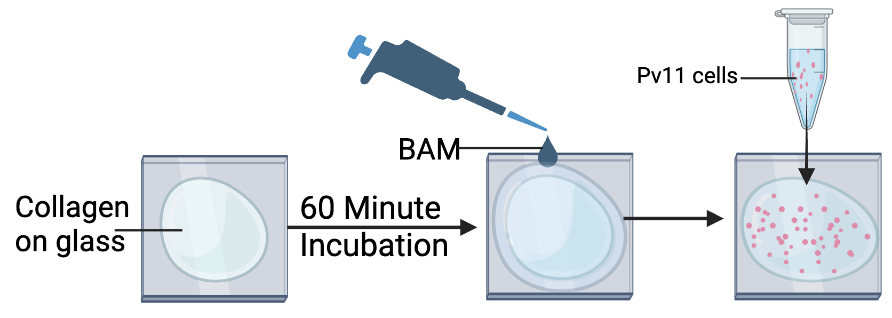
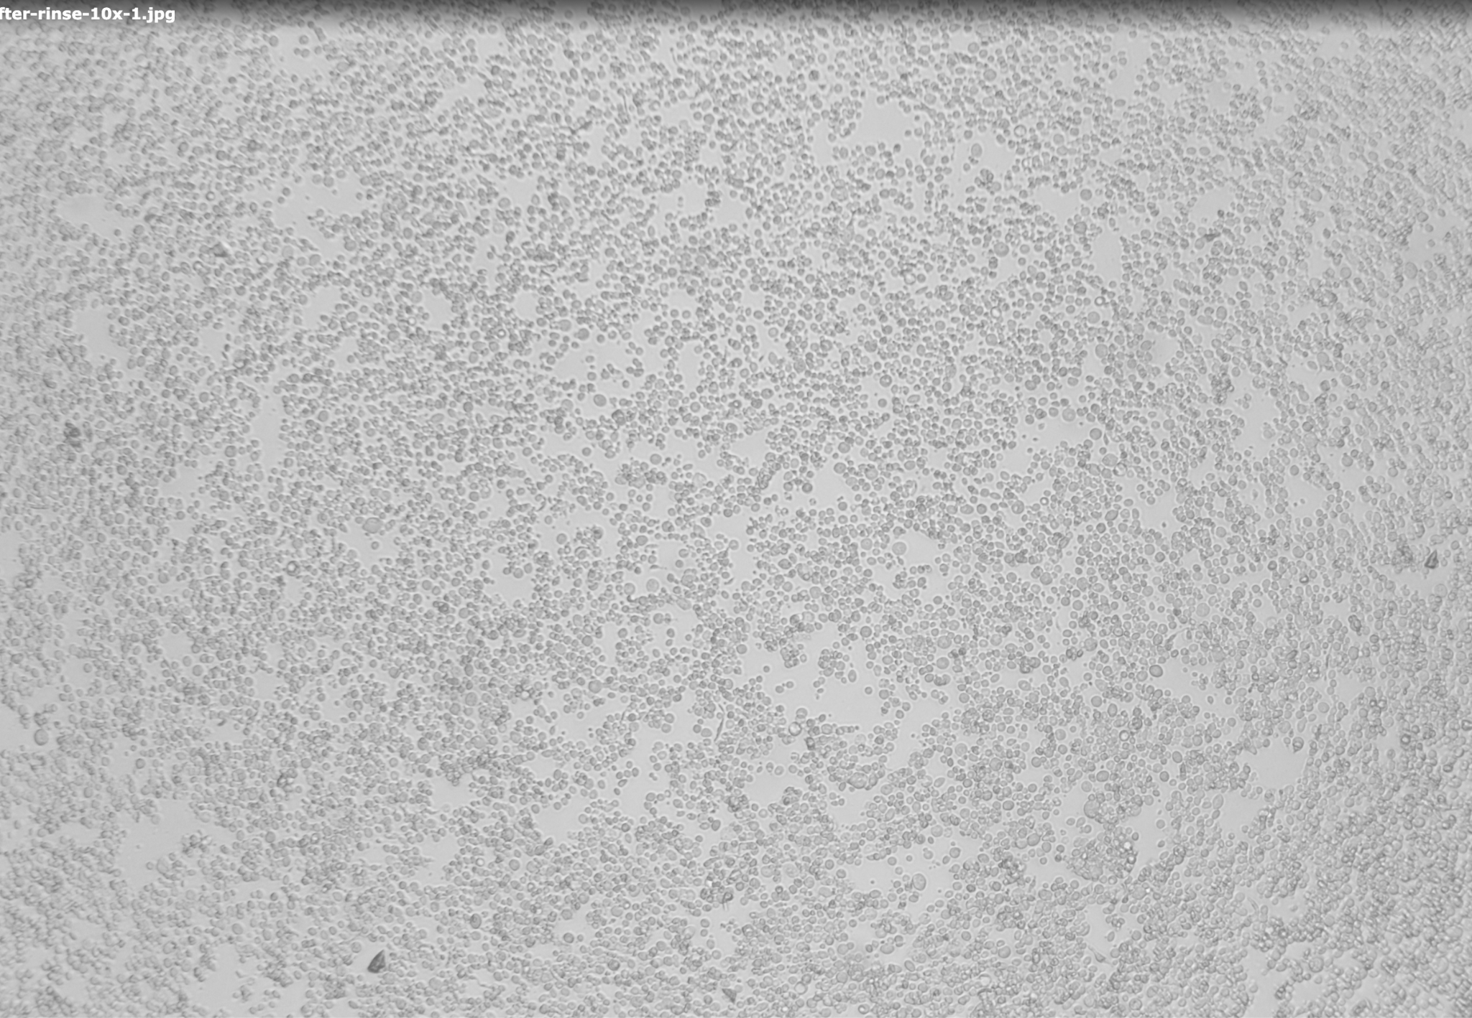
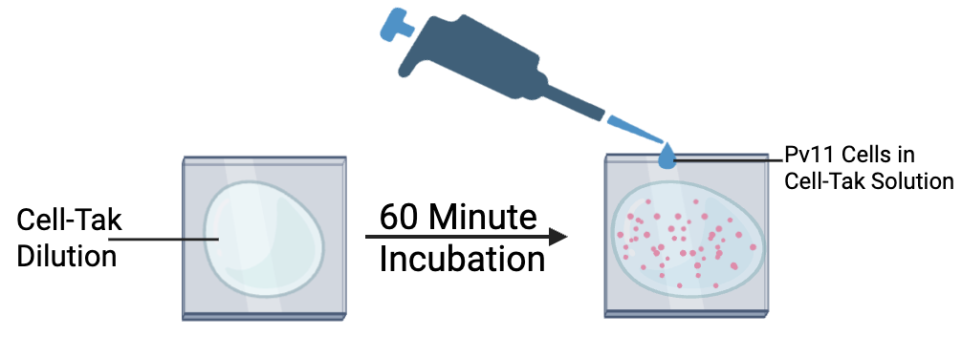
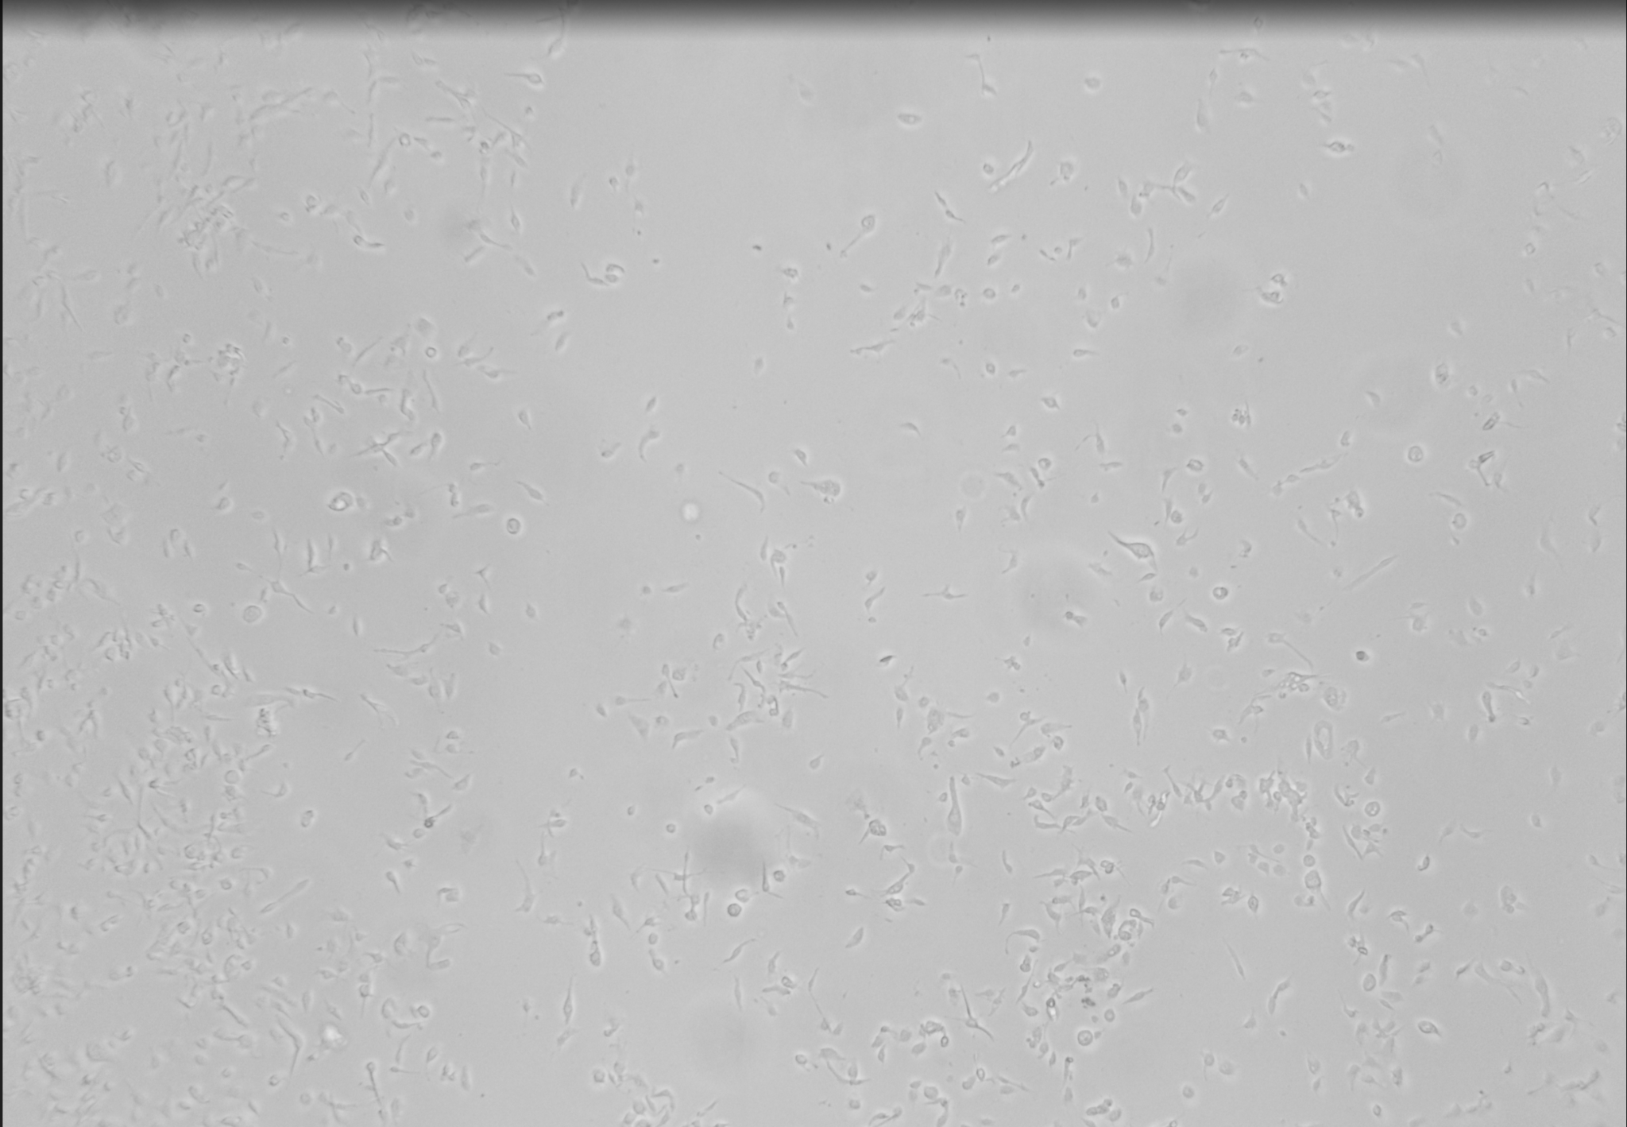
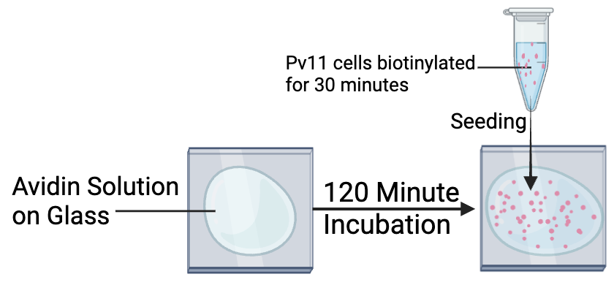
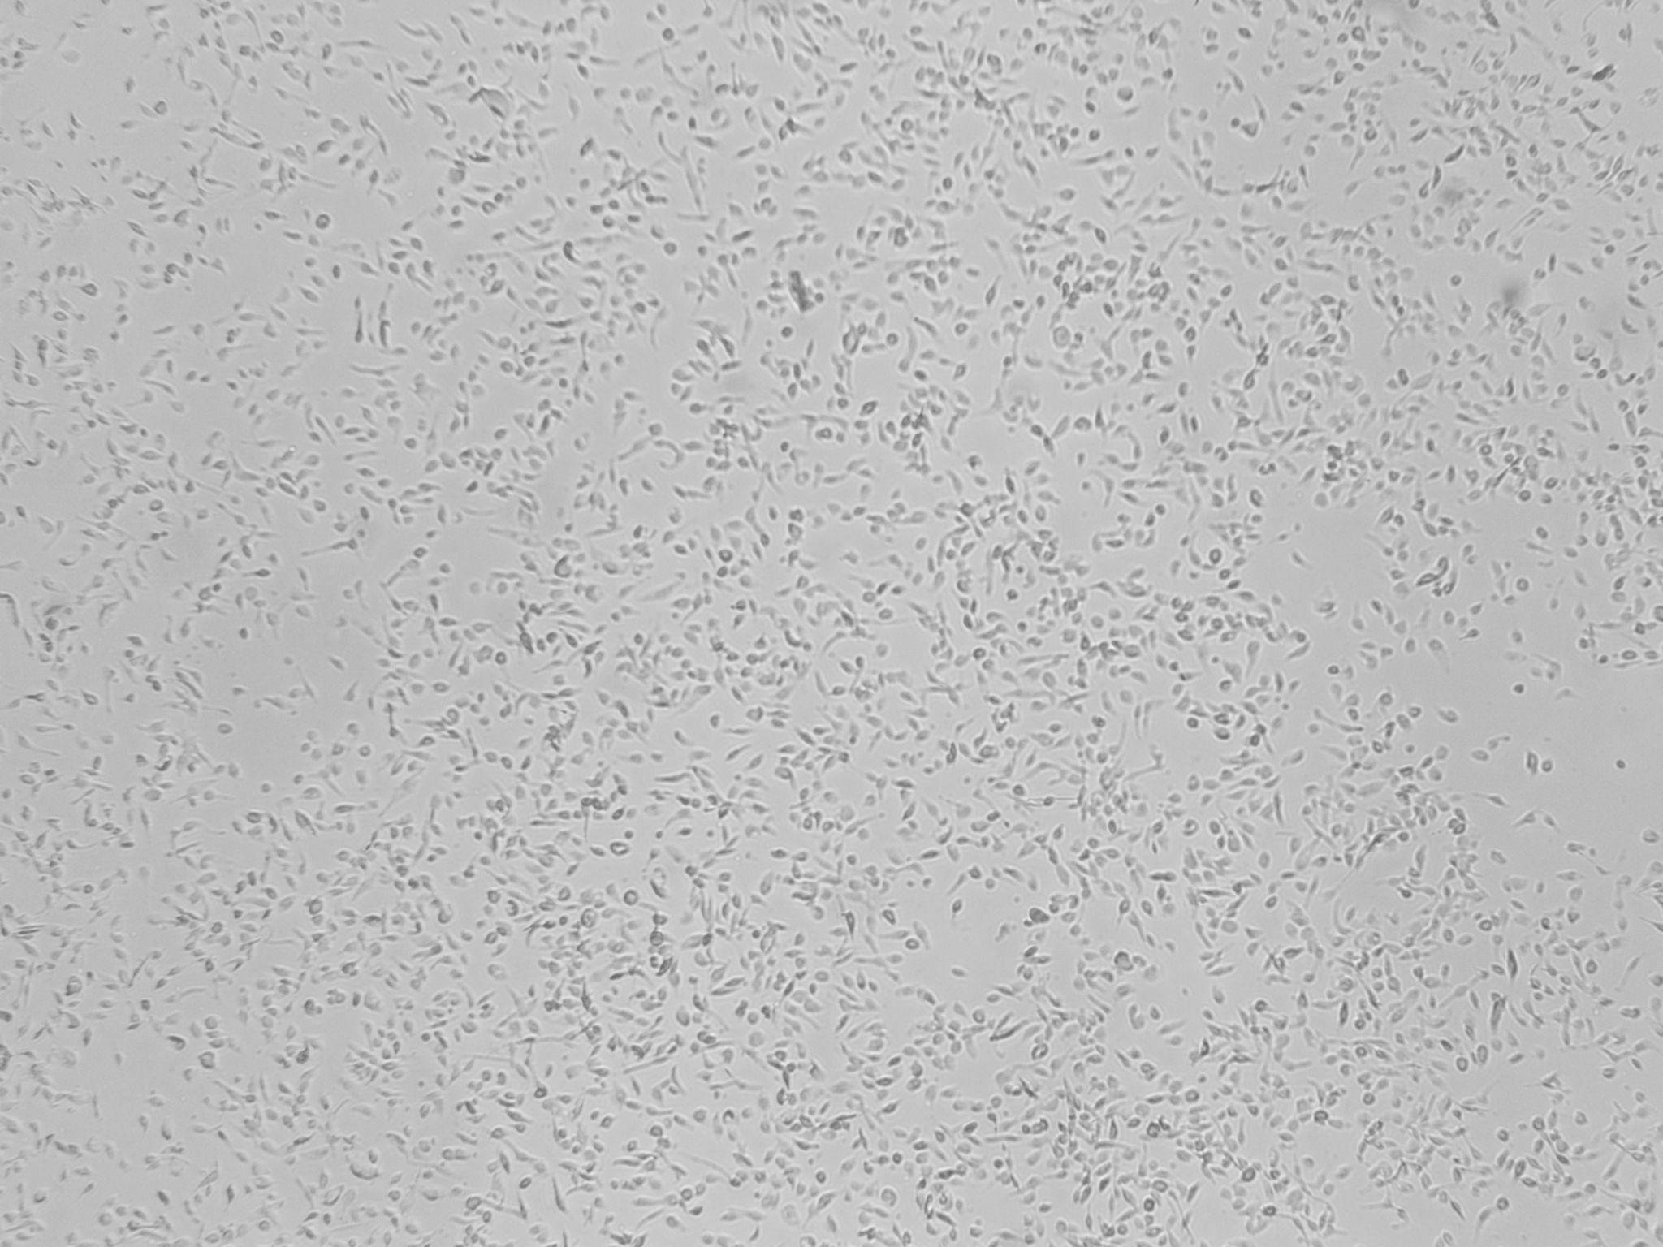
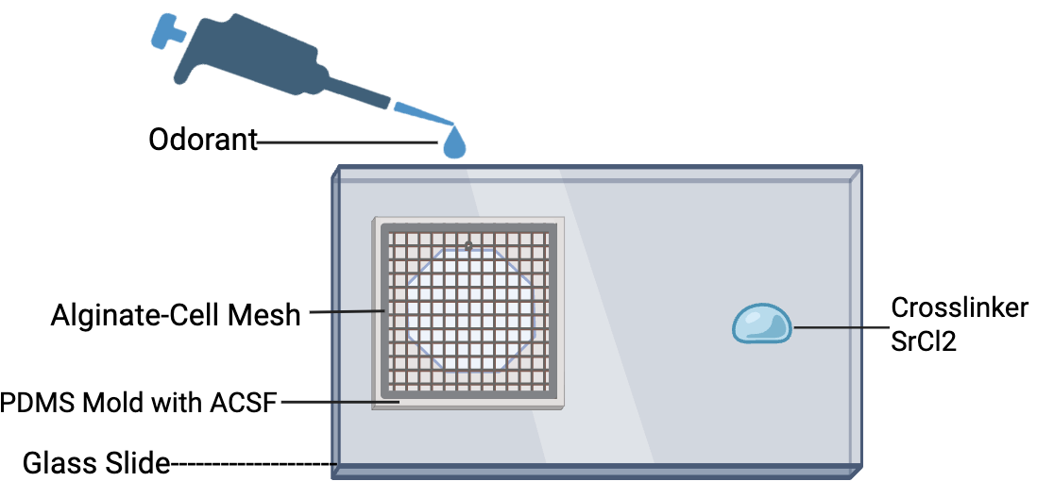
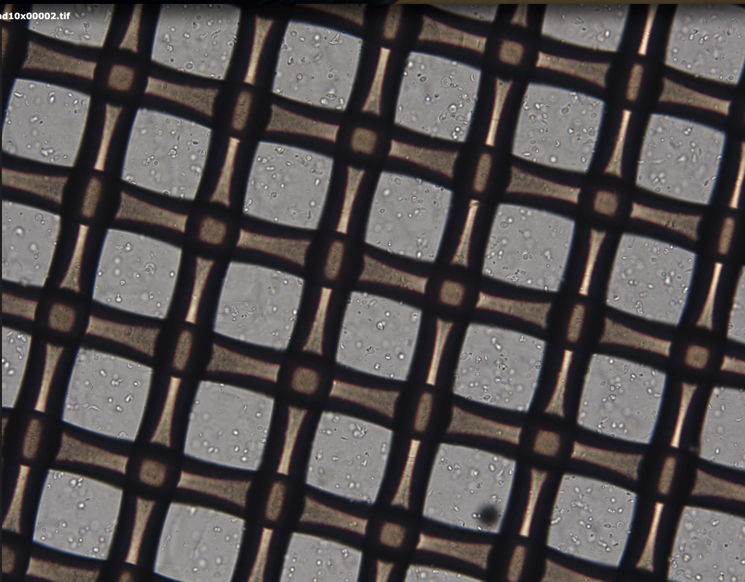
Evaluation of Pv11 Cell Immobilization Techniques Across Substrates
Dylan Chang, Roy Anderson, Ricardo C. Araneda, Elisabeth Smela
University of Maryland, College Park
INTRODUCTION
METHODS
RESULTS
DISCUSSION
The development of an electronic nose for odor identification has applications in many fields, from health care to security. Cell-based sensors are of interest because they span the chemical space and can simulate the high specificity and sensitivity of biological systems. However, such sensors have been limited to use in laboratories, rather than implanted in hand-held instruments, due to strict cell culture requirements, such as temperature and humidity. The Pv11 cell line, derived from Polypedilum vanderplanki, is uniquely desiccatable, which allows the cells to shut down all physiological processes and withstand a wide range of environmental conditions in the dry state until ready for use. A line of Pv11 cells has been developed to express the ionotropic odorant receptor Or47a, which responds to pentyl acetate, and the fluorescent protein GCaMP6f. However, Pv11-OR47acells are non-adherent and must be immobilized for a sensing device. We examined existing protocols for immobilizing cells and applied them to the Pv11 cell line on glass and polyester substrates.
Collagen-BAM
Collagen-BAM is our standard method of immobilizing Pv11 cells. It reliably adheres a high cell density uniformly and consistently throughout the substrate.
collagenBAM- 10x
Cell-Tak
Cell-Tak exhibited some relatively dense cell adhesion areas throughout the substrate but with much added variability between trials compared to collagen-BAM, with some trials showing no adhesion.
Cell-tak-10x
ABSTRACT
Avidin-Biotin
Avidin-biotin exhibited dense cell adhesion areas throughout the substrate especially in pockets but with much added variability throughout the substrate compared to collagen-BAM. However, all trials did show adhesion.
Avidin-biotin binding, Cell-Tak, and crosslinked alginate hydrogel were compared to collagen-BAM, our standard method, to assess how well they immobilized the cells and how the cells subsequently responded to odorants. These alternate methods exhibited high, although inconsistent, immobilization of cells, and the cells remained responsive to pentyl acetate, potentially offering new alternatives for Pv11 cell immobilization.
avidin biotin-10x
REFERENCES
Alginate-Crosslinker
The alginate-crosslinker method is the sole method that allows for cells to be suspended in gel while still available to odorant exposure. Cells are reliably adhered in the gel after crosslinking with a high and uniform density throughout the substrate and between trials.
Fuse, H., Kikawada, T., & Cornette, R. (2023). Effective methods for immobilization of non-adherent Pv11 cells while maintaining their desiccation tolerance. Cytotechnology, 75(6), 491–503. https://doi.org/10.1007/s10616-023-00592-0
Knutelski, S., Harańczyk, H., Nowak, P. et al. Rehydration of the sleeping chironomid, Polypedilum vanderplanki Hinton, 1951 larvae from cryptobiotic state up to full physiological hydration (Diptera: Chironomidae). Sci Rep 12, 3766 (2022). https://doi.org/10.1038/s41598-022-07707-1
Gel-10x
Notes:
Three methods of cell adhesion protocols were adjusted applied to the Or47a Pv11 cell line and compared to the standard method for adhesion, Collagen-BAM. All methods exhibited relatively dense cell adhesion, with Cell-tak exhibiting the least density and Avidin-Biotin exhibiting the most. However, the amount of cells plated were not controlled which may have affected appearance of cell adherence. In addition, collagen-BAM achieved noticeably more density than the other methods which was expected. The alginate-crosslinking method was unique in that it allowed cells to be wetted in ACSF but still suspended and available to gas-phase odorant. Pentyl acetate response was tested in Collagen-BAM and the alginate-crosslinker method and both achieved response, although the gel had a noticeably less intense and widespread response.

