Slide 1
n books in one,
or,
a discourse on bound-withs
on the shelf and in the catalog
Sarah Hovde
Libraries Research and Innovative Practice Forum
June 2026
Notes:
Welcome! Today, I seek to provide for you an introduction to one of the most vexatious creatures in the library collection, commonly known as a bound-with, or in some scenarios as a sammelband.

Slide 2
"Bound withs make up a small percentage of most libraries' collections, yet cataloging them fully takes an inordinate amount of time." –Patricia Ballard, 1992
"Bound-with books carry the mundane and the extraordinary, with no easy way to sort them from each other without thorough cataloging." –David Floyd, 2024
Notes:
I must caution you to steel your nerves as we first encounter and attempt to lay out a description of the bound-with, for its frustrations are many, and at times the process of cataloging one may seem perilous, even futile. With that warning, I will begin to unfold my tale.

Slide 3
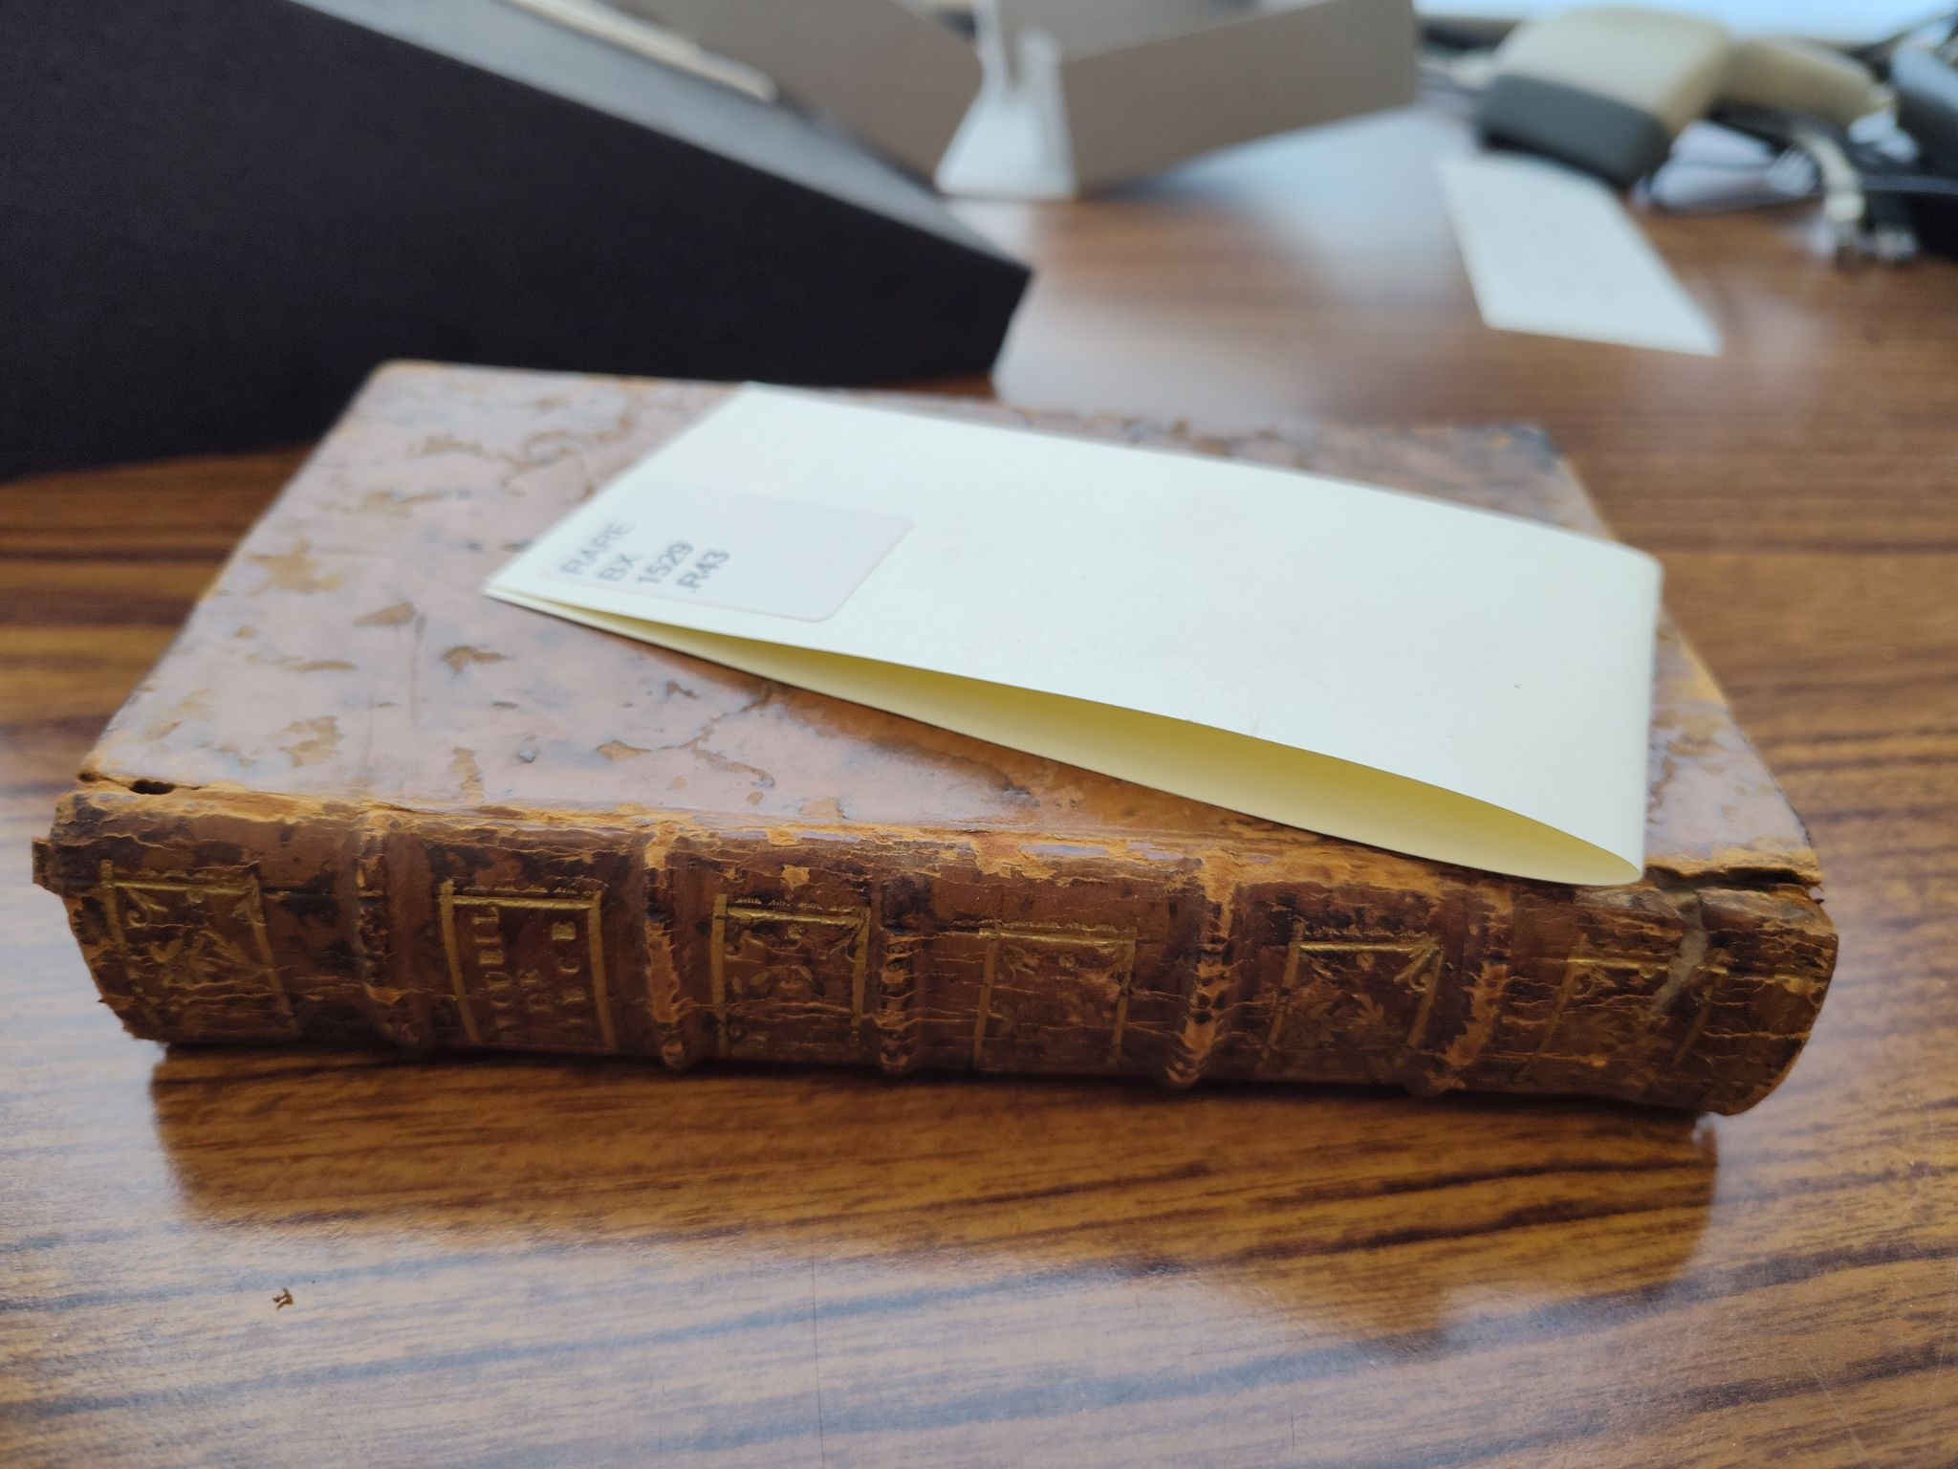
an unsettling discovery
Notes:
It may have been a day both dark and stormy, for all I knew - I myself was within the special collections stacks and could not discern the weather out of doors. Nonetheless, a chill beyond that supplied by the HVAC systems gripped me as as I reached for the next volume on the uncataloged shelf; ignoring it as my own whimsy, I continued with my task.
Returned to my desk once more a short while later (where proximity to windows revealed that the day was in fact fair), I began a casual perusal of the objects which I had carried back with me from the stacks, with especial attention to the book which had provoked the chill.
(click)
At first glance, it was an unassuming volume, bound in plain brown leather beginning to flake away, the simple words "recueil de piece" imprinted in faded gilt upon its spine. A feeling of dread stole over me - perhaps my unconscious spirit recognized the challenge foretold by those words, but my conscious mind failed to recognize their significance, and simply reached for my sweater to ward off the chill. I opened the book, beheld the title page with no unwonted interest, and carefully flipped through several pages. Turning to the final page to ascertain the final extent of the page numbering, my heart sank - for the number on the ultimate page was 24, far too small to be correct for a text block of a size such as this, and moreover the typeface was of a wholly different appearance from the earlier pages. There was some mischief afoot, but of what kind? I turned pages with increasing - though still careful - fervor, and my gaze fell upon title page after title page, confirming what I had begun to suspect: I had upon on my desk a bound-with.

Slide 4
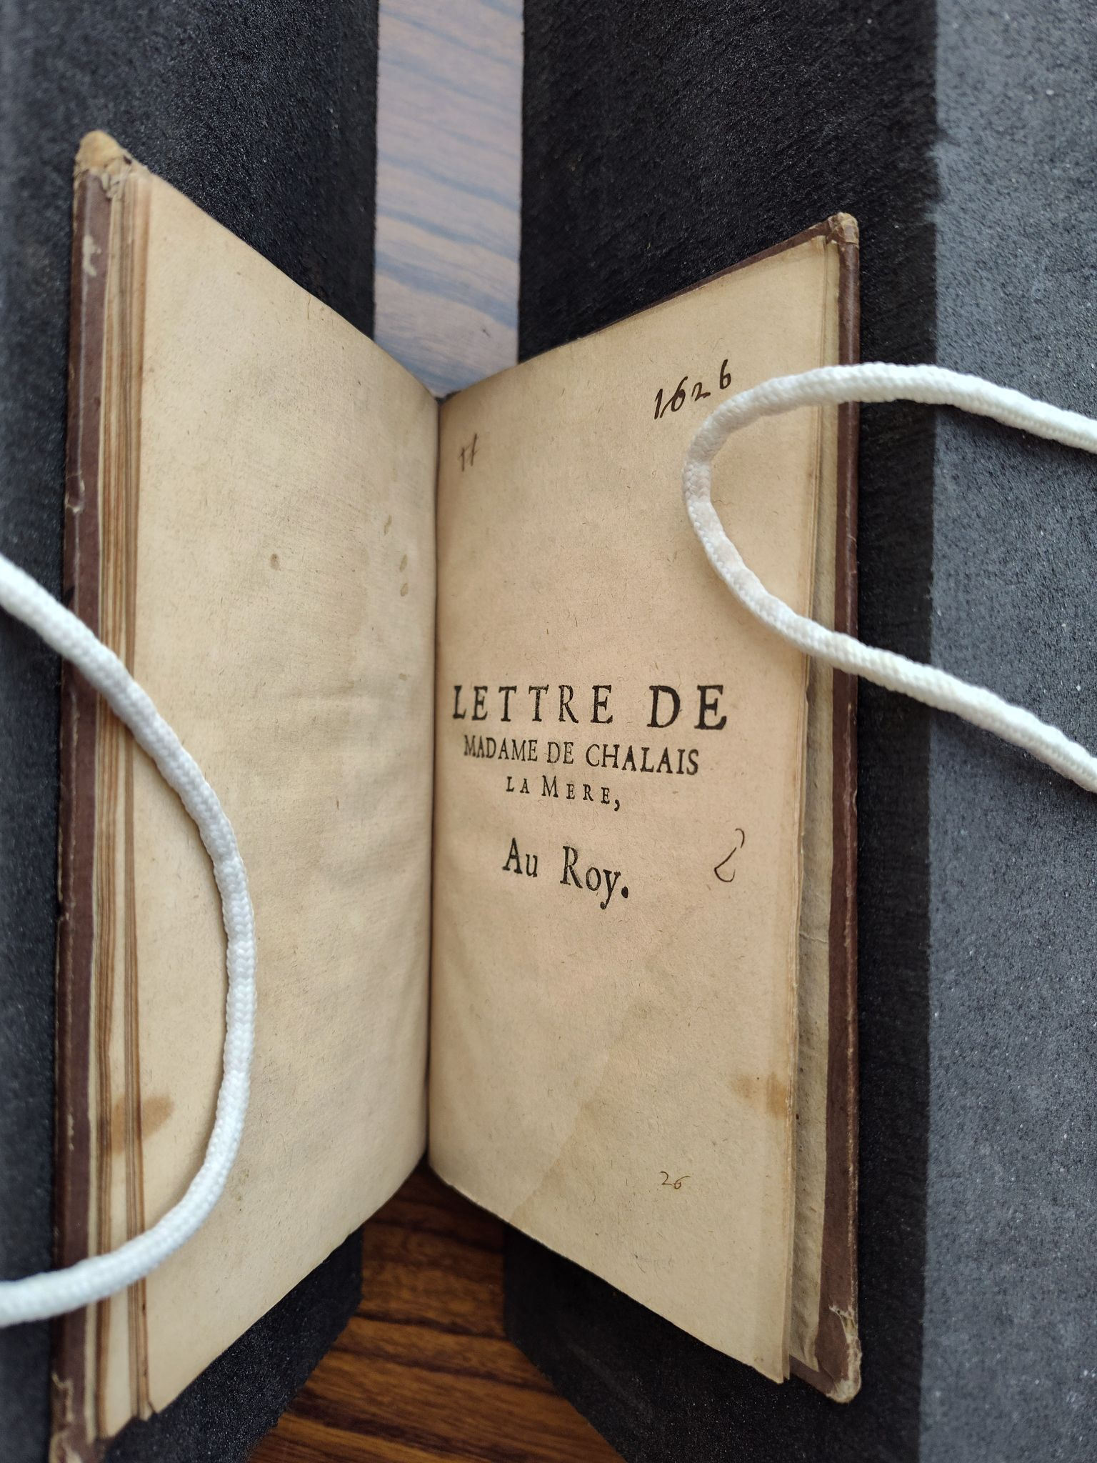
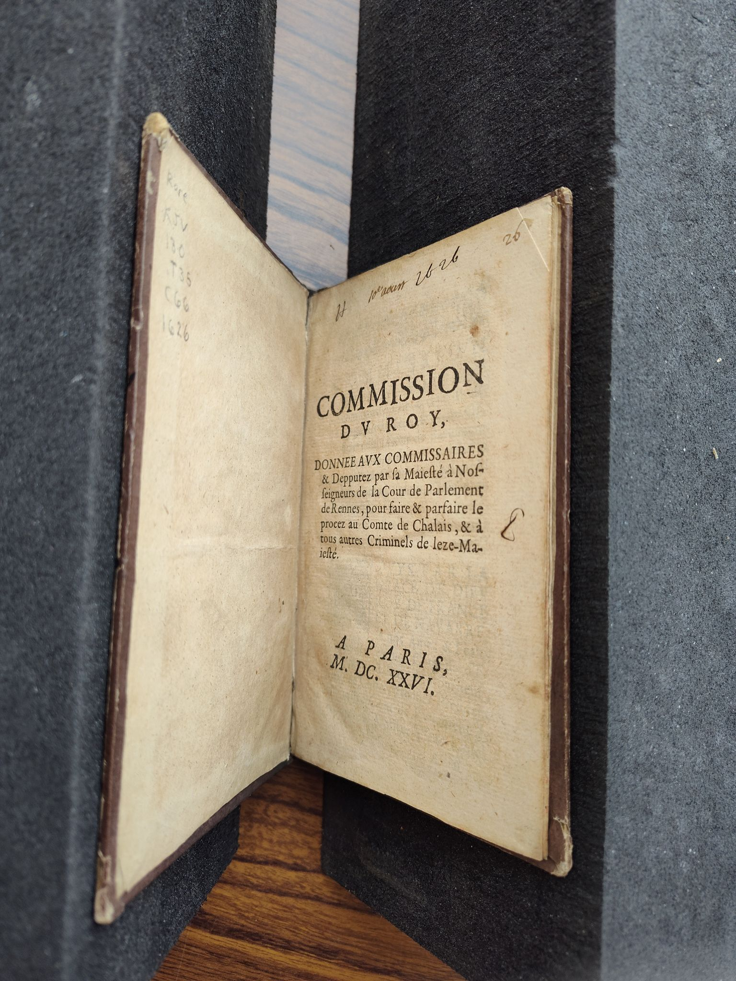
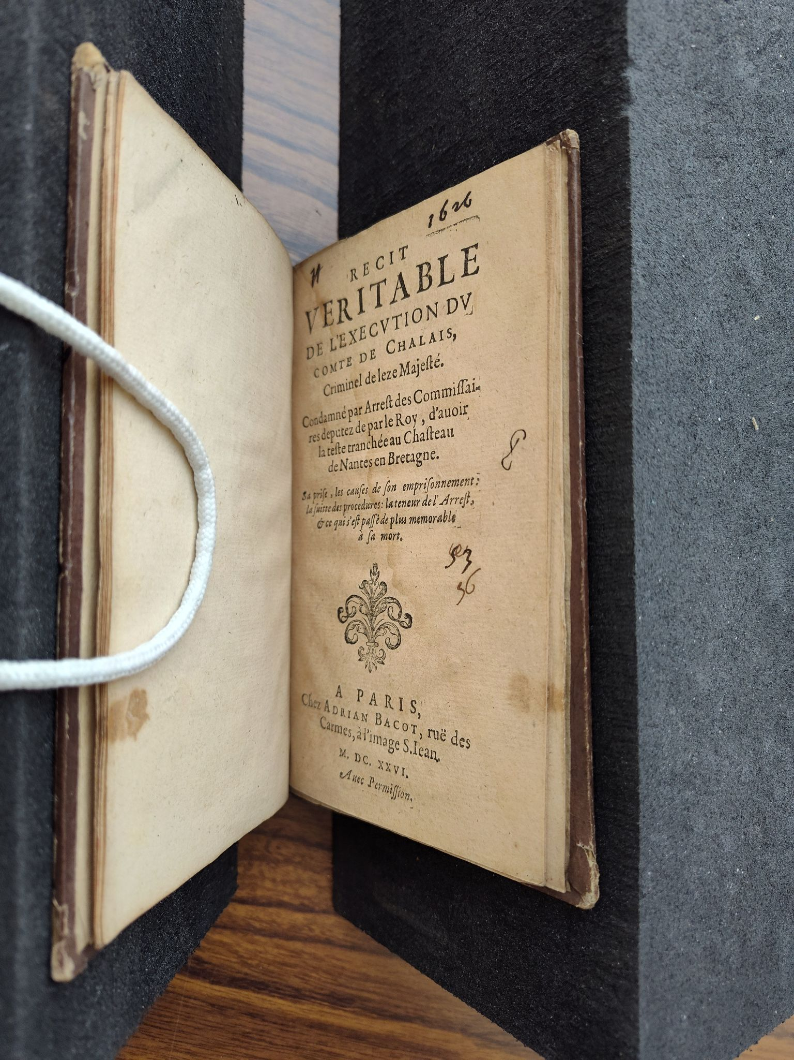
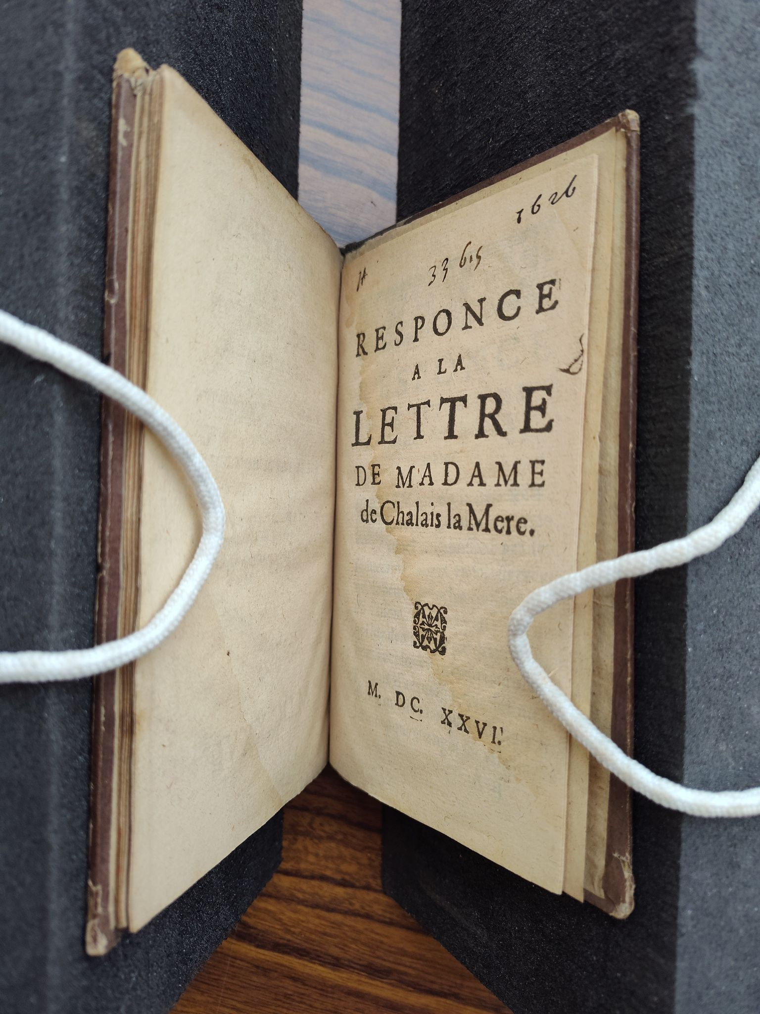
the nature of the boundwith
2
4
1
3
Notes:
Here, I shall detour briefly down the winding path of bibliography lest my audience not know of the bound-with. It is quite simply, one title which has been bound with one or more other titles. The bound-with may consist of only a few titles, or of a multitude. I, personally, once encountered a bound-with of some two dozen titles, although smaller numbers are fortunately more common. The example shown to you is a bound-with of four titles, all relating to the Chalais conspiracy, a plot against Cardinal Richelieu in France, uncovered in 1626.

Slide 5
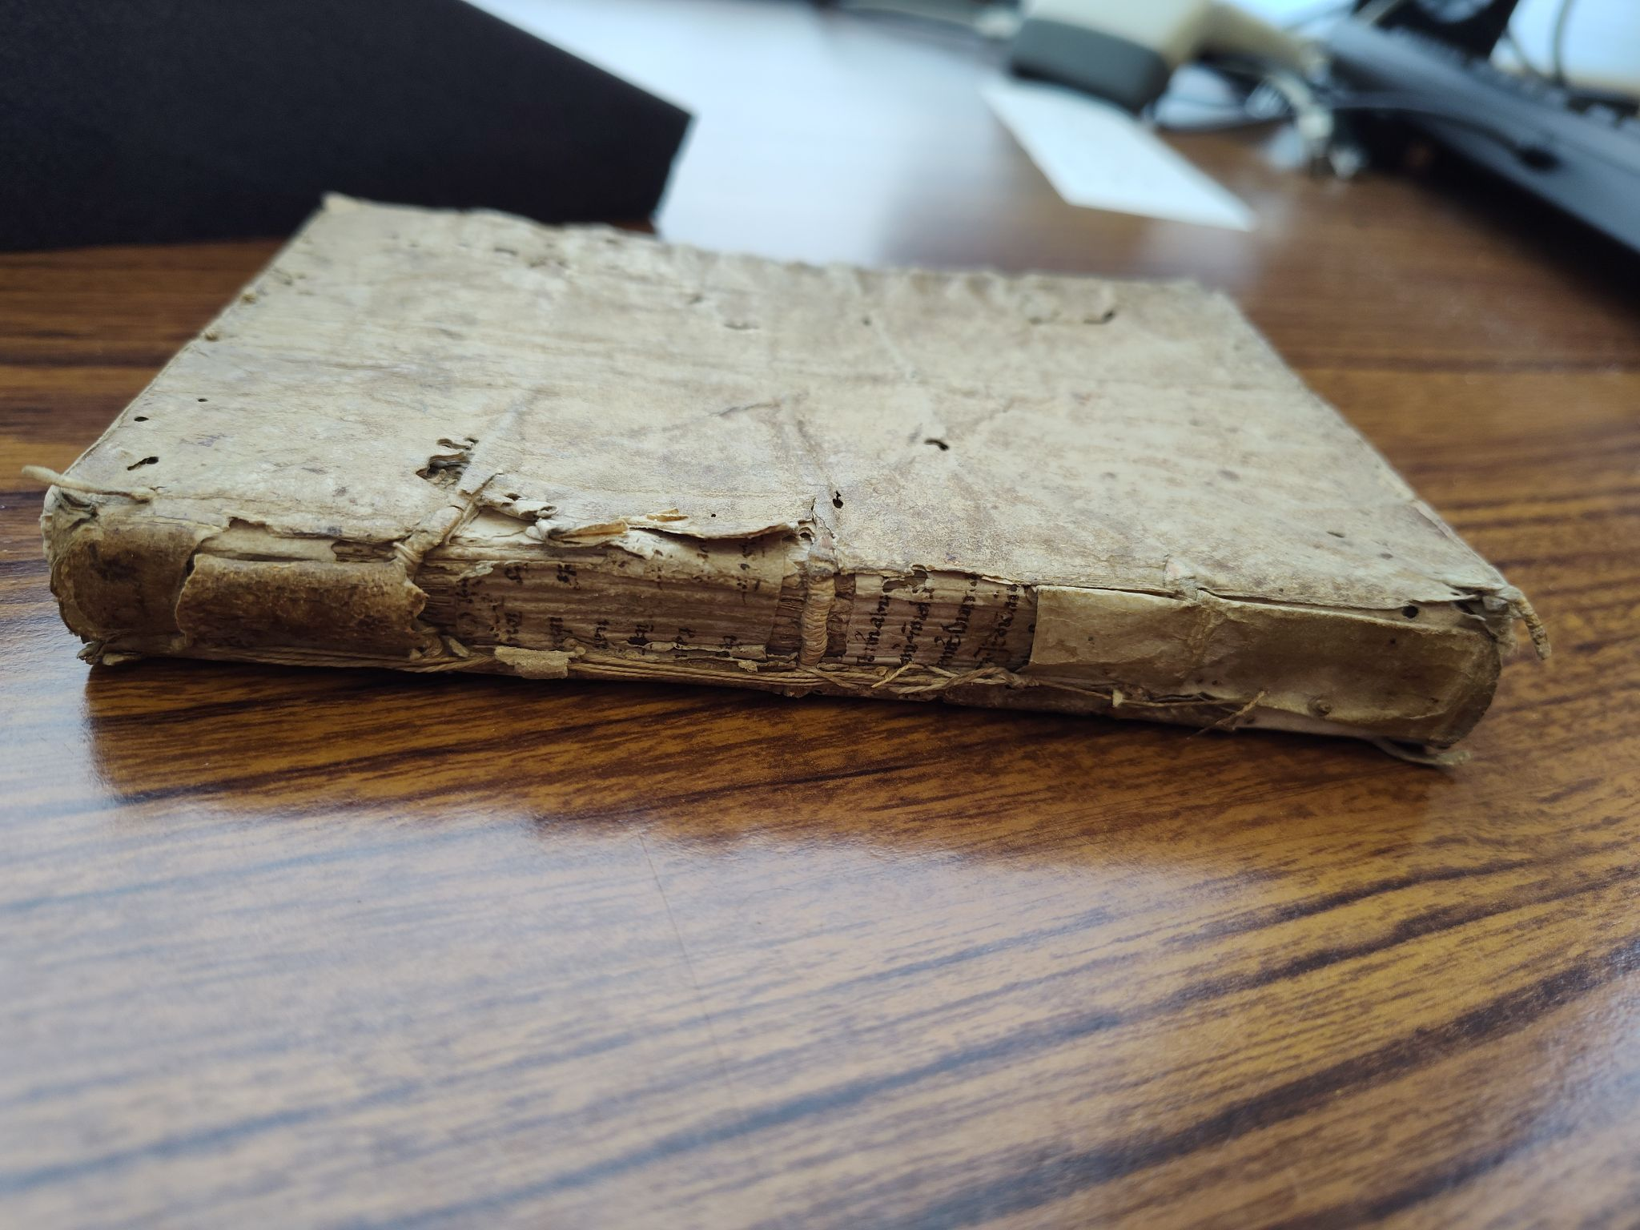
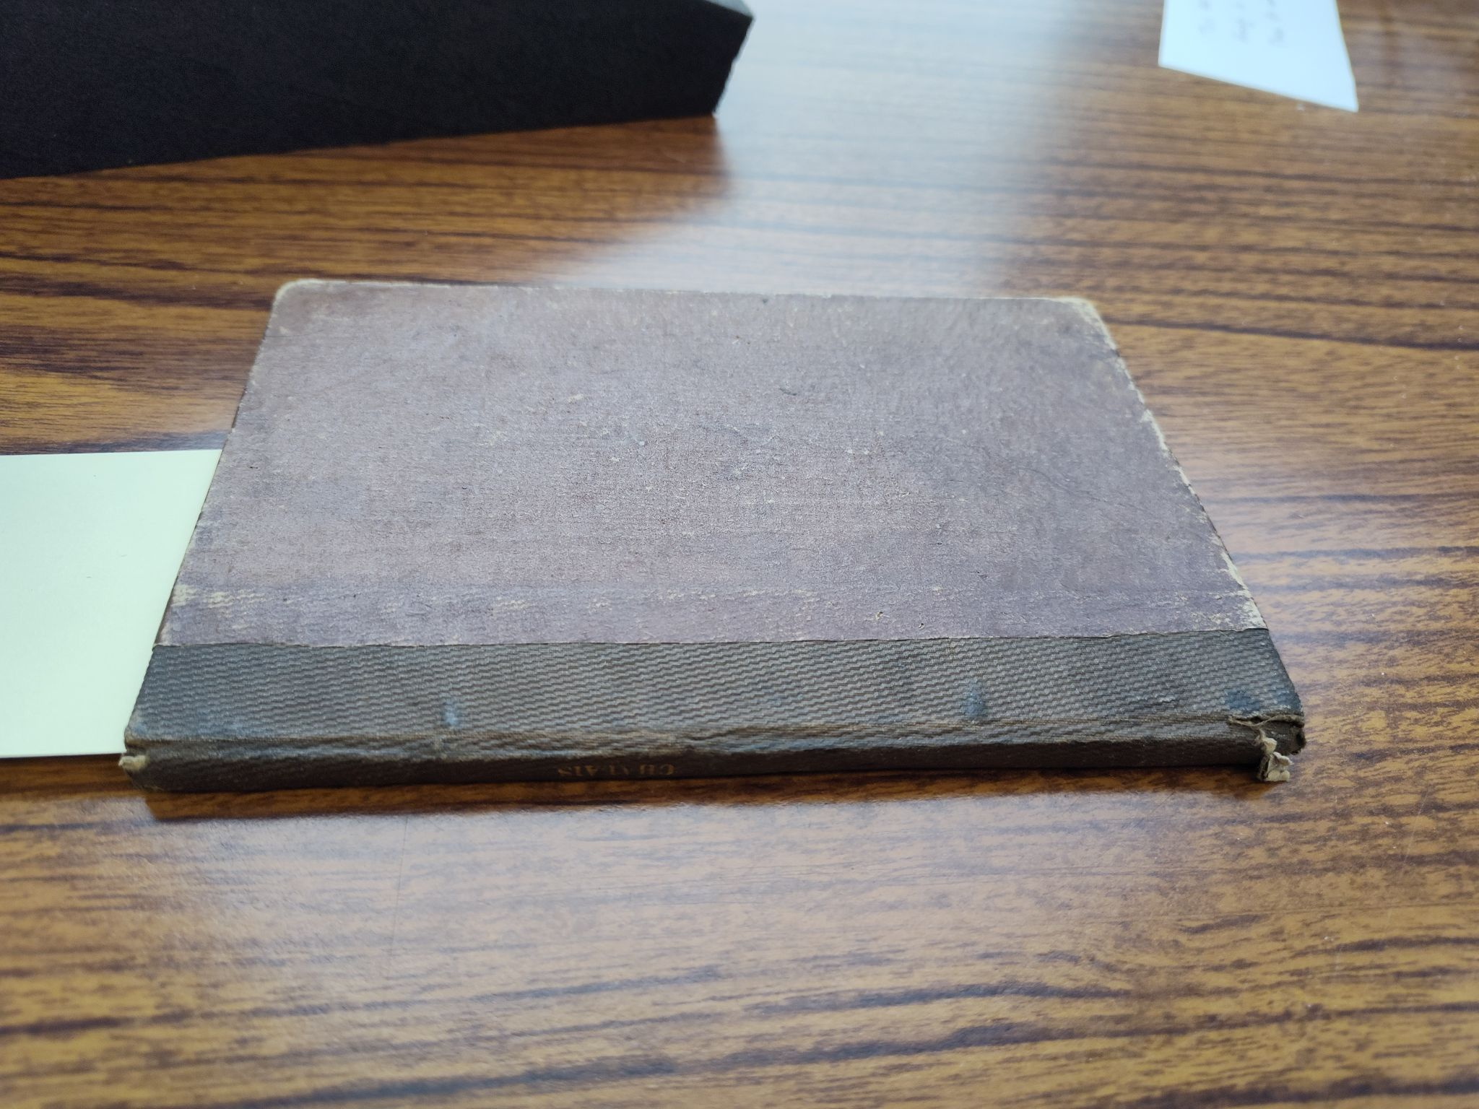
the nature of the boundwith
(cont.)
Notes:
The bound-with condition is not inherent to the nature of its titles, though, nor it is it the intent of their first publisher. It is the result of a later owner's decisions, one who seeks to create new bibliographic entities from existing ones -as one cataloger has it, "they represent the collecting intuitions of former owners." Bound-withs may have been created to save space within a collector's library; to unite together texts on a particular subject, or by a particular author or publisher; or to preserve thin works such as pamphlets, which otherwise may be overwhelmed and lost, but together find strength in numbers.
The creator of a bound-with may opt to give it a sumptuous binding, a sturdy yet decorated one,
(click)
or may neglect that step.

Slide 6
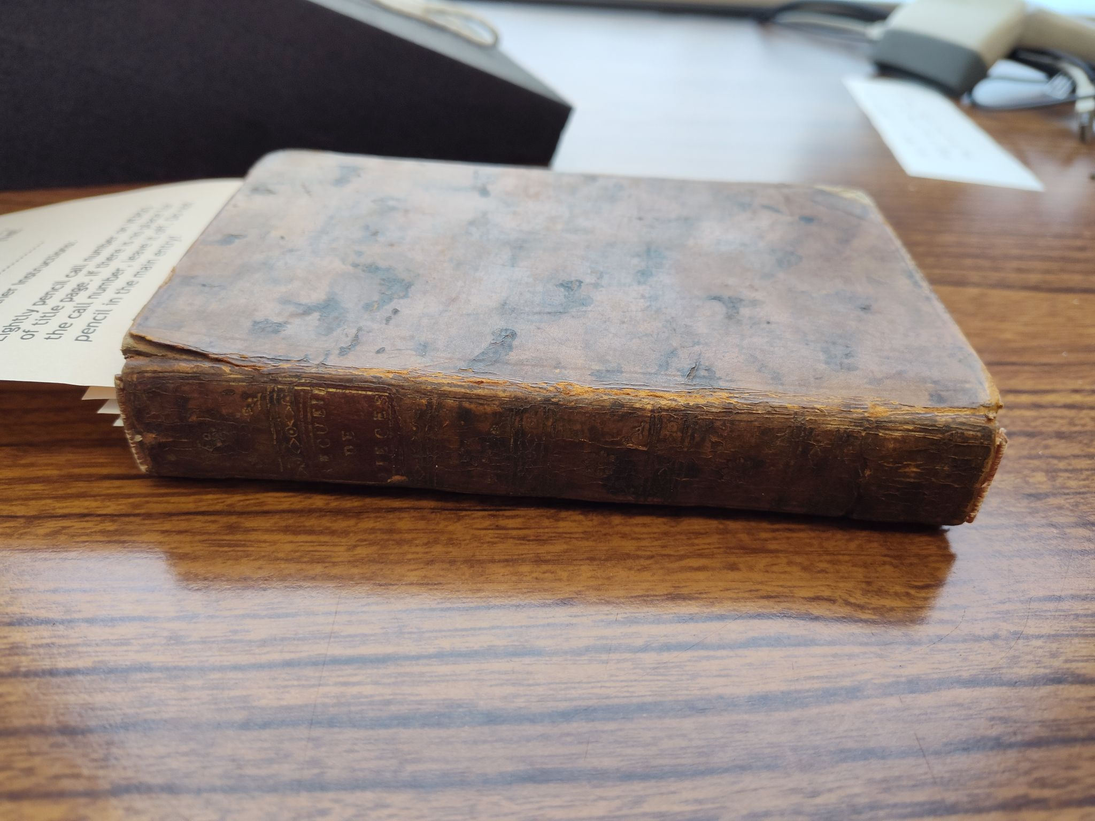
the nature of the boundwith
(cont.)
Notes:
They may often - though not always! - be identified by the generic titles on their spines, such as "plays" or "pamphlets." Extremely sharp-eyed audience members may observe that both books on this slide carry the spine title "Recueil de pièce," or collection of pieces; one is cataloged, while the other is yet to be fully described. The slips of paper in the volume on the right indicate some of the distinct titles within it.
While these curious volumes have lurked in library collections and been known to scholars and librarians for long decades ere this one, they have proved again and again to be a bibliographic difficulty. Ruth French Strout noted in a 1956 article that "The need for analytical and "bound-with" entries was recognized in the fifteenth century by the librarian of St. Augustine's Abbey in Canterbury; he met the need by the use of cross-references."
Multiple documents put forward in the first half of the twentieth century included special consideration for where on the catalog card a call number should be written for a bound-with as opposed to a non-bound-with. Later in the century, AACR2 provided additional guidance for recording notes indicating a bound-with's state in a catalog record, while more recently Original and Official RDA charged that a bound-with relationship was actually a relationship between two items, but interpretive documents still recommend recording this relationship via the means of… a note.

Slide 7
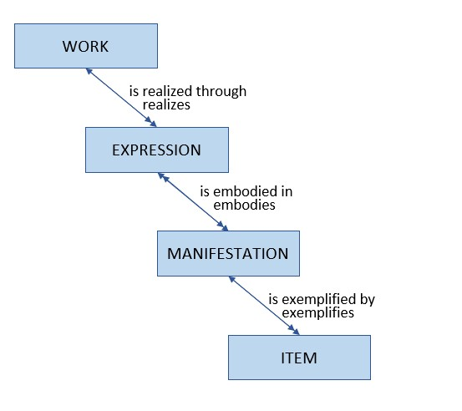
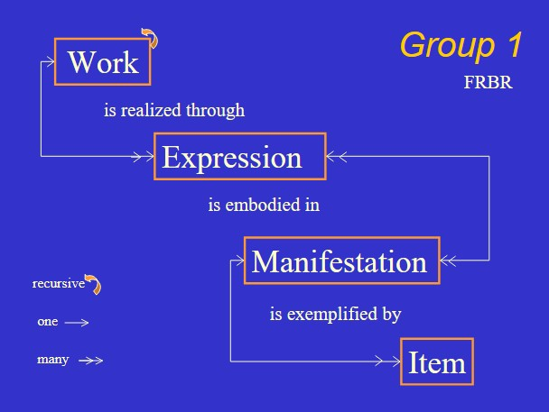
FRBR diagram from a 2003 presentation by Barbara Tillett;
LRM diagram from a 2020 training by the Program for Cooperative Cataloging
Notes:
Here I must beg your forbearance once more as we detour further, this time into the mazes of bibliographic conceptual models. In our modern age, the models known as FRBR and LRM - Functional Requirements for Bibliographic Records and its successor the Library Reference Model - upon which RDA is based - have found favor with our time's leading cataloging theorists, and thusly they are reflected in our cataloging standard and systems. A key concept ih FRBR and LRM is the structure work-expression-manifestation-item, or WEMI, for bibliographical resources: in short, the work is the conceptual idea, which is realized with particular characteristics through an expression, which is given form through a manifestation, of which there may be one or many items that librarians and patrons may hold in their hands. A MARC bibliographic record is meant to describe the manifestation, but data relating to the expression is frequently included, and work and even item data may at times appear in a bibliographic record out of descriptive necessity, to ensure that a resource is adequately identifiable and discoverable by librarians and patrons.
In a library catalog, each bibliographic record (representing, chiefly, a manifestation) may have one or more holdings (equivalent to its location within the collection), which may in turn have one or more items. A manifestation may have many associated items, if the library owns more than one copy or it is a multi-volume title; however, it is a general expectation of library systems that a given item will be associated with one and only one manifestation.

Slide 8
Work 1
Work 2
Work 3
Work 4
Manifestation 1
Manifestation 2
Manifestation 3
Manifestation 4
Item 1
Item 2
Item 3
Item 4
Bound-with Item
Notes:
Bound-withs turn this logical structure on its head: multiple items representing multiple manifestations (and by extension the works that they manifest) become one item, which is then itself the embodiment of a unique collection manifestation or aggregate, and is by extension associated with those multiple manifestations which were initially published separately and only afterwards combined. As you may imagine, it is exceedingly difficult to adequately represent a bound-with in an integrated library system, particularly while staying true to our given conceptual structures.

Slide 9
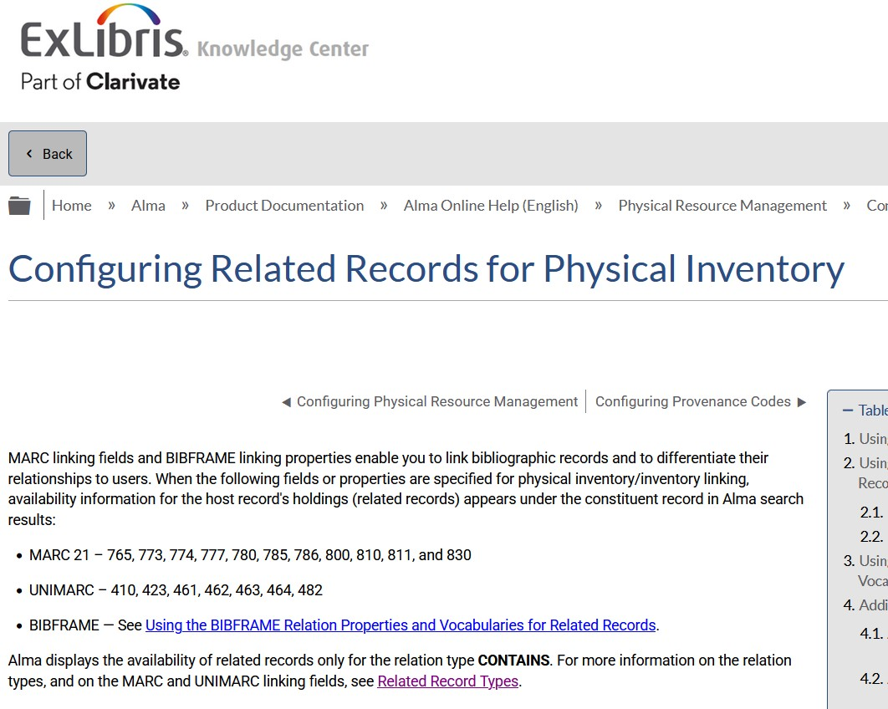
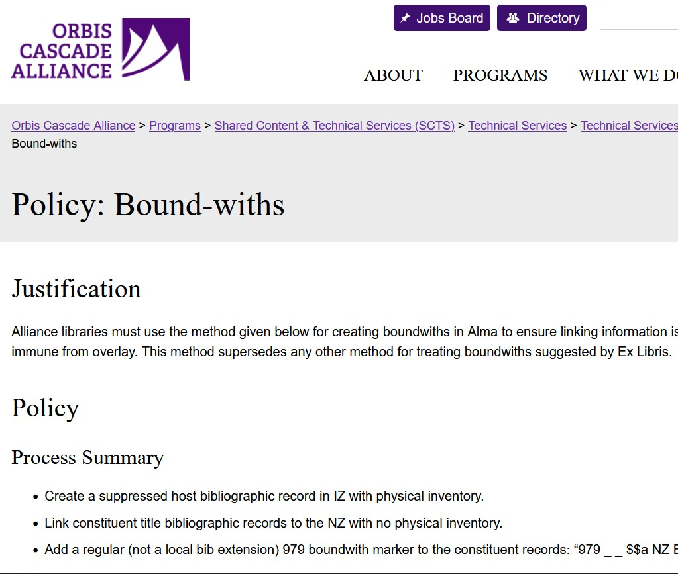
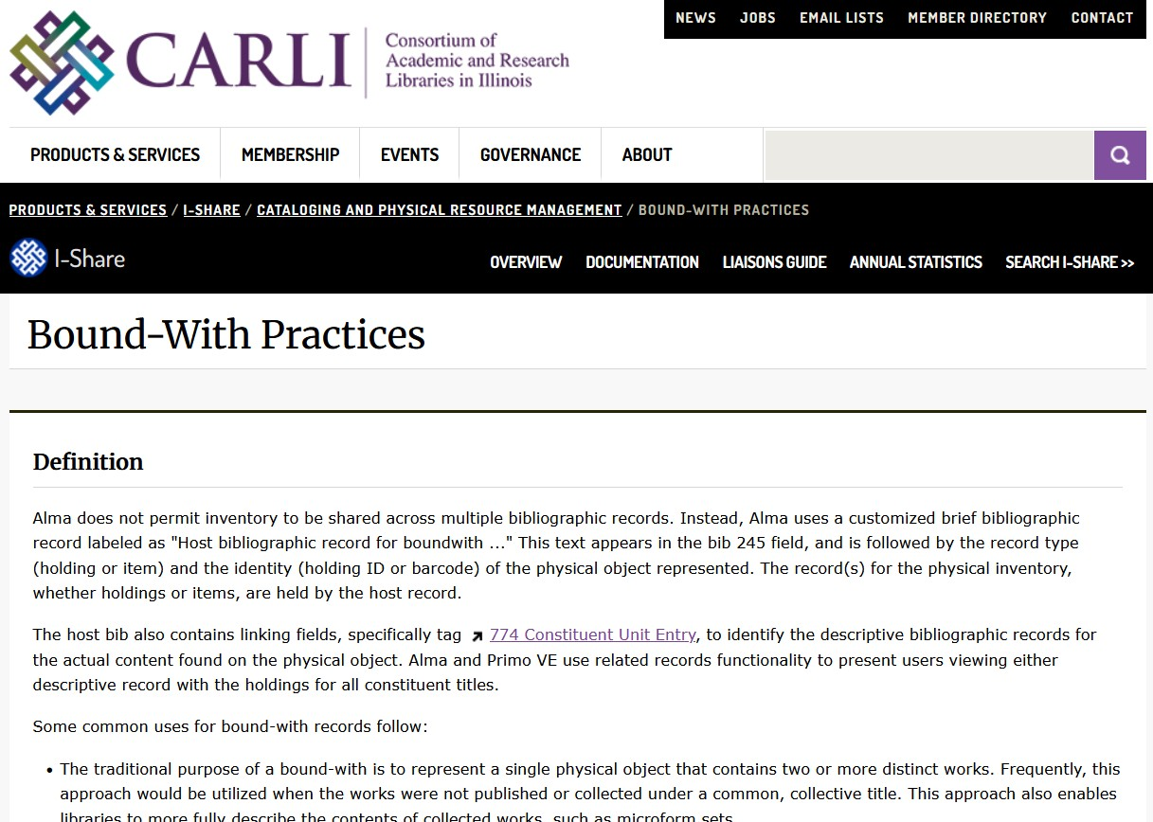
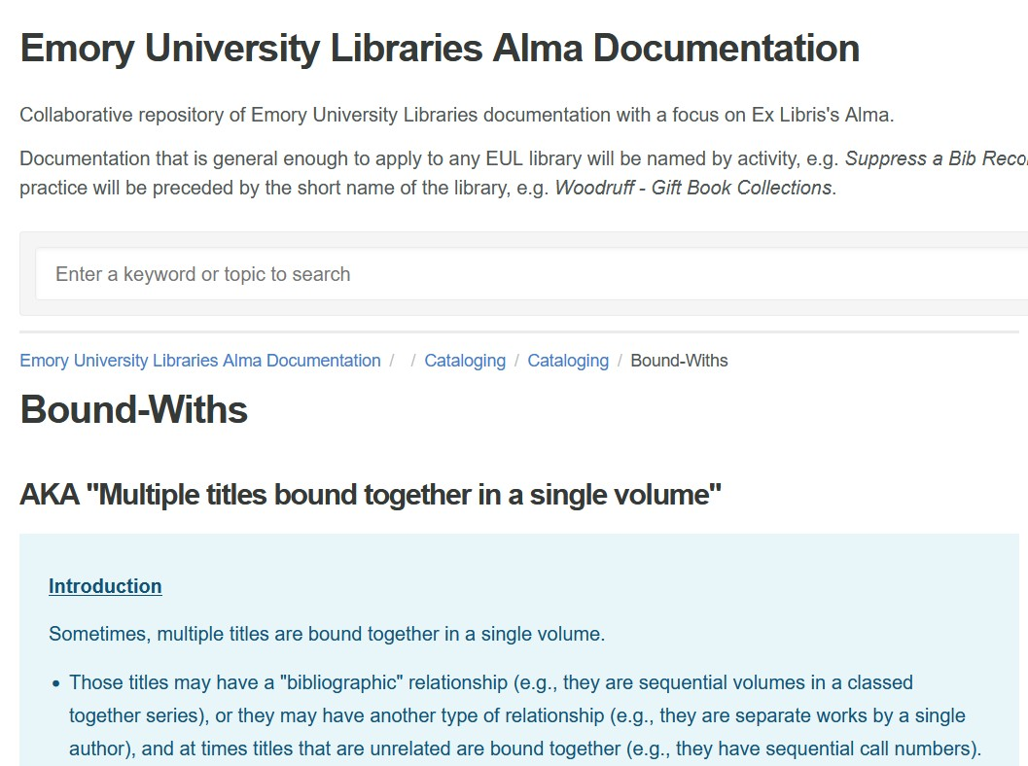
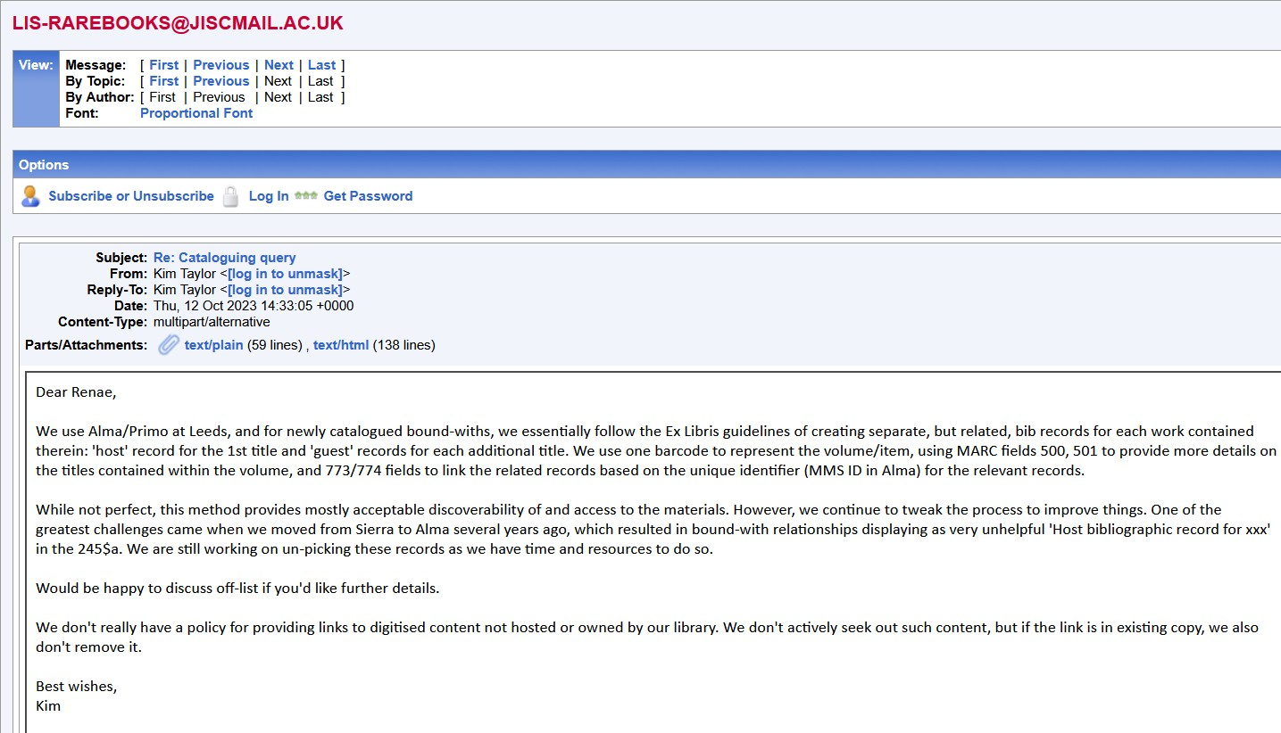
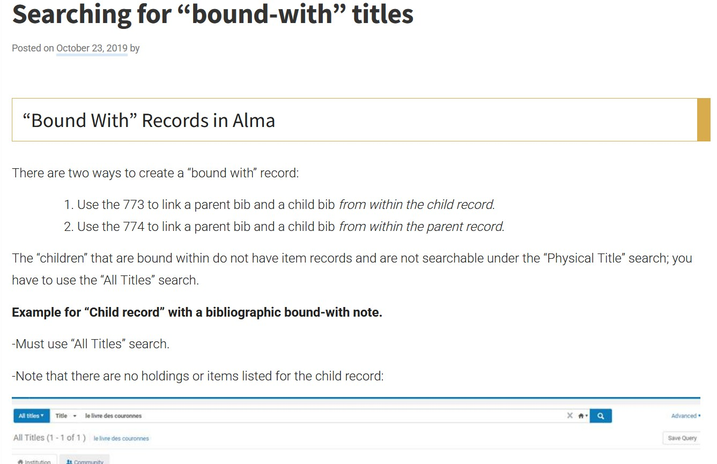
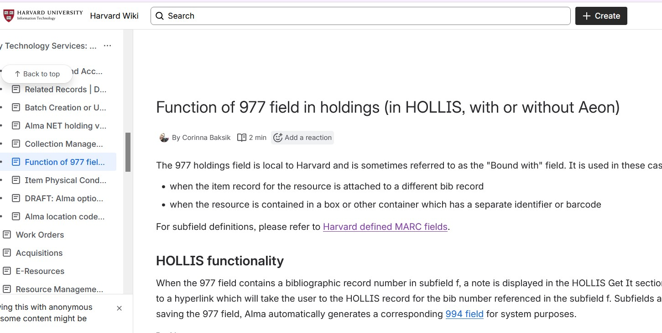
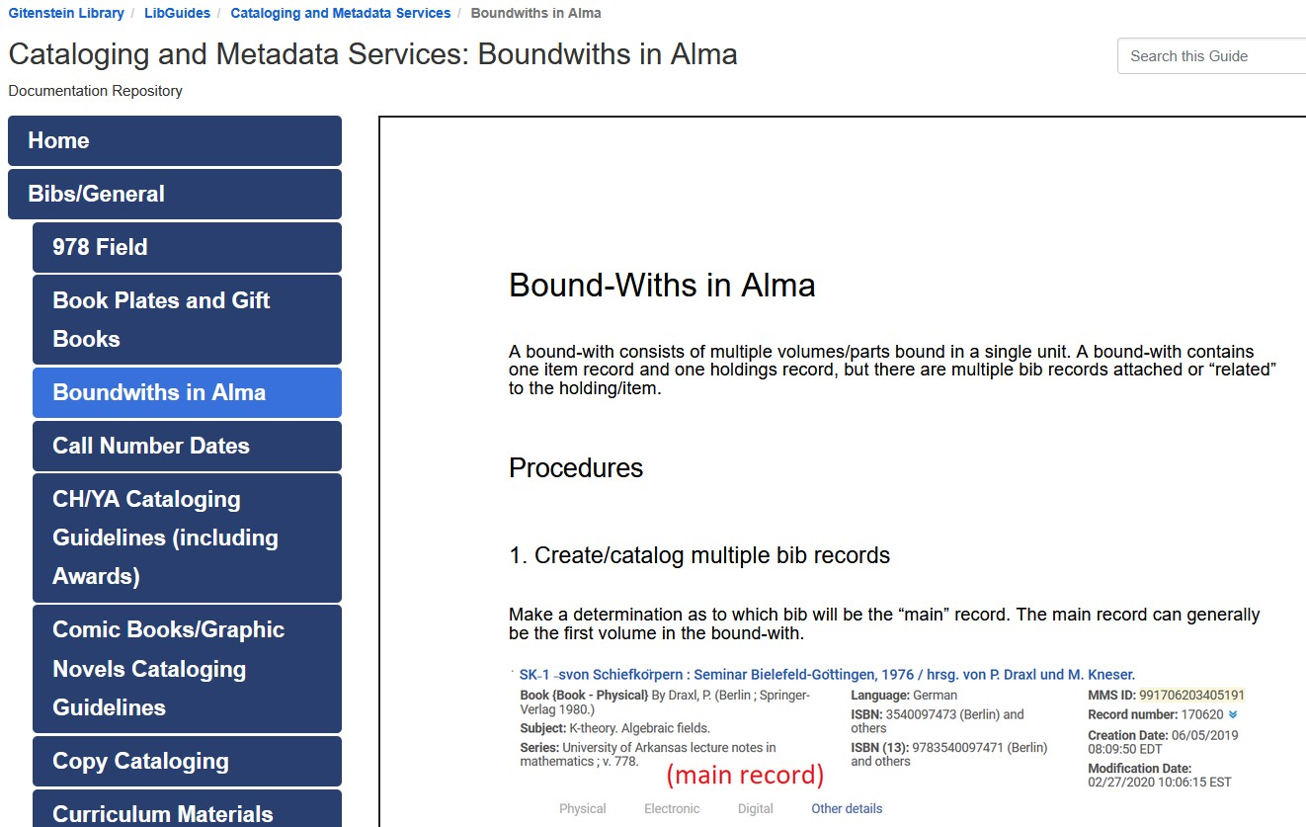
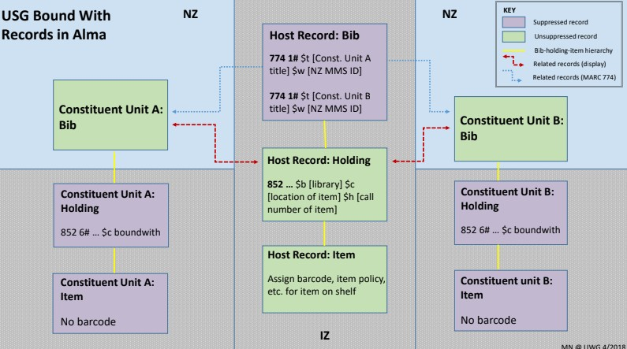
Notes:
Long have valiant catalogers striven to describe bound-with volumes in their systems, and long have brave circulation specialists sought to decipher the resulting record formations and aid users in navigating their trails of notes.
Among library systems, our own Aleph was no exception to such tangled bibliographic relations, managing them predominantly with notes and cross-references - but with the advent of the new library services platform, perhaps the hope of order could be more than a mirage, and could be made fully true. I sought the wisdom of my peers, poring over the (web) pages in which they had recorded their dearly-gained knowledge of the workings of Alma. Some libraries used only notes; some, a contrived arrangement of designating one title as the "parent" and others the "child" records; still others created an empty bibliographic "host" record to represent the bound-with as an aggregate manifestation; and some well-resourced libraries even configured their own local solutions. At every turn, confusion threatened to overwhelm me, and despair loomed-

Slide 10
an unexpected compatriot from the A.--- O. K.--- Library
multiple items in same location, only one bound-with
multiple items in different locations, only one bound-with
multiple items in different locations, multiple bound withs
multiple institutions with bound-withs for same title
try each with hidden host method and primary host record method
Notes:
-when unexpectedly, a missive arrived in my electronic mailbox from a colleague at the AOK Library in the county of Baltimore, bearing news that she too followed the same paths I thought myself treading alone, spurred by conversation with a mutual friend who had spoken to her of my plight. We resolved to combine our researches, and together worked away at the quandary of how best to make a bound-with known to both librarians and patrons within the catalog.
(click)
We set out a list of scenarios and methodologies, excerpted on screen, in hopes of addressing future questions before they could arise. What of instances where a library held multiple copies of a title, one of which was part of a bound-with and one of which stood alone? What of a title which both of our libraries held, with one or both copies part of a bound with? Were empty items required for all components of a bound-with? What is the relation between the titles within a bound-with, bibliographically and even philosophically speaking?

Slide 11
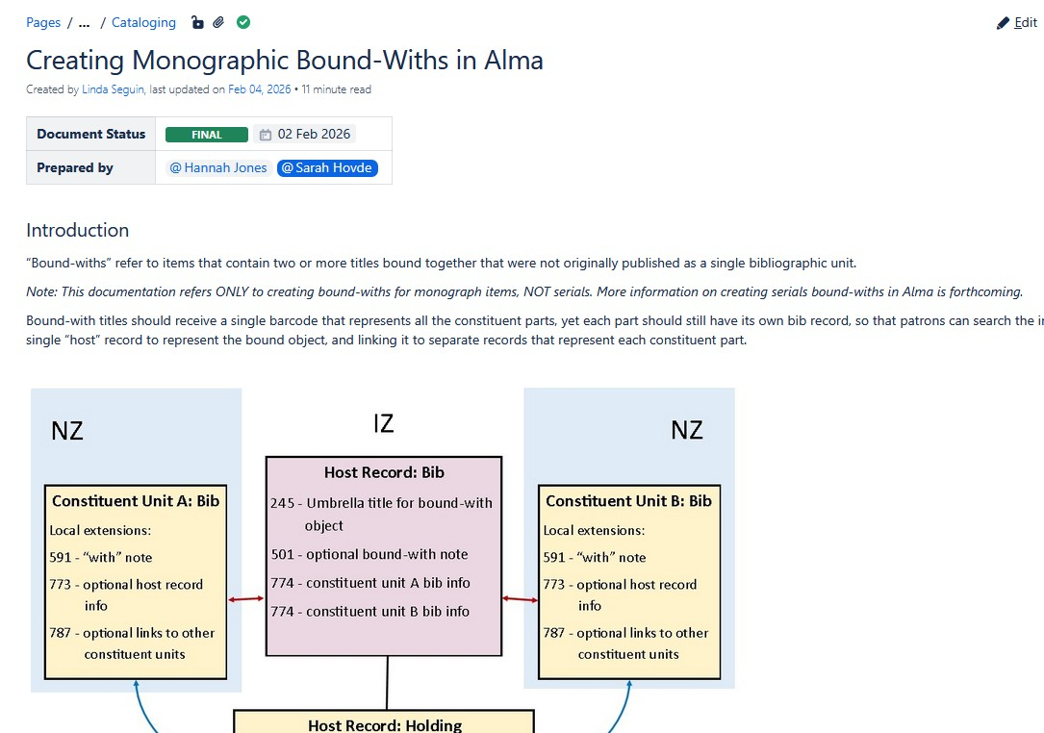
a solution achieved
Notes:
At last, after long toil, we were satisfied in our own minds with our planned approach, and we sought out a third colleague to assist us in assessing whether our plans would bear up under the weight of the real world, or rather, the real LSP. This colleague, who was adept in the ways of Network Zone Configuration, and who had the much sought after ability to run the Build Record Relations job at her will - an Alma process which facilitates the linking of records, and which is most commonly an automated nightly process - helped us determine that our course was indeed mostly passable, with some slight alterations. Our draft process complete, we sought the allowance of the USMAI Metadata Committee, a body of representatives from across the lands of the USMAI holdings, whose skills are great in cataloging, metadata, and further.
Having achieved the approbation of that august committee, we assayed to share our compositions and methods so that other catalogers could implement them within their own systems, if they so chose, and the document is available within the USMAI Portal.

Slide 12
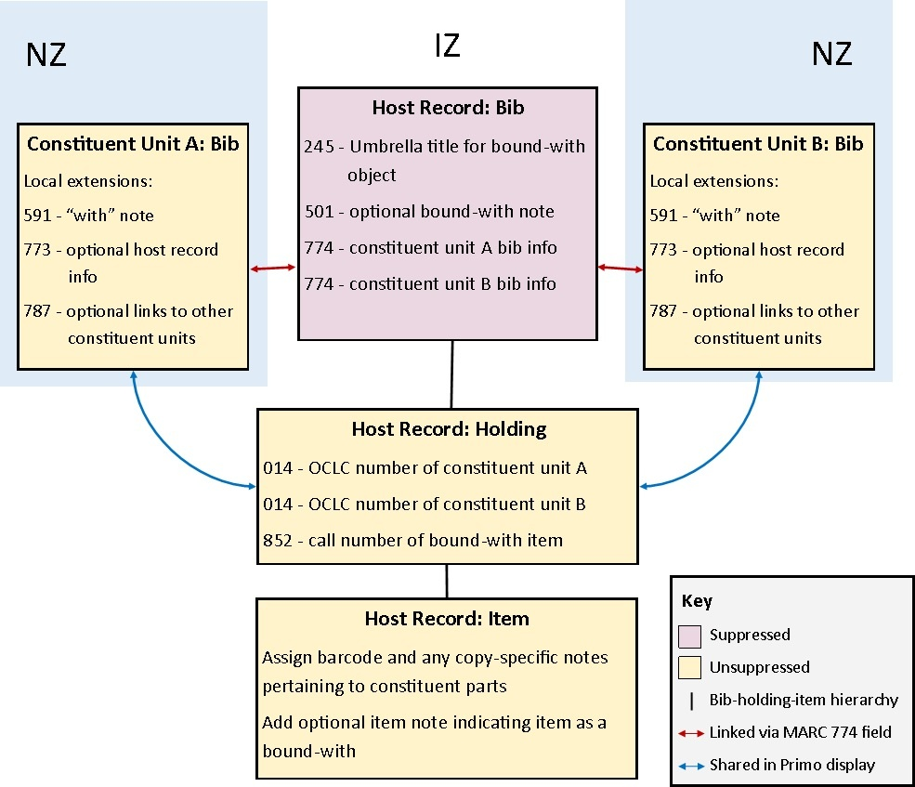
a solution shown, for the amazement of onlookers
diagram by Hannah Jones, 2025
Notes:
I would be remiss if I did not show the final outcome of our project!
As suggested by the screenshot on the previous slide, my colleague and I determined on using a hidden host record to link together the various of the bound-with, taking inspiration particularly from the libraries of the University System of Georgia. This record resides within the institution zone and is suppressed from discovery in the catalog's public interface, but includes an unsuppressed (public) holding and item record, which represent the physical bound-with. The host bibliographic record is linked to separate bibliographic records for the bound-with's component titles, treating each of them on an equal basis rather than designating one as the parent record, by means of a 774 linking field; these bibliographic records contain no holdings or items of their own (unless there is a stand-alone copy of the title), but are connected to the holding and item on the host record by Alma's record relations function, so that it displays with them for all titles in the catalog. This means that the item can be checked out (or moved, or entered into a work order), and that status will be reflected on all the titles. It is our hope that this will ensure ease for both patrons and library employees when encountering these resources.

Slide 13
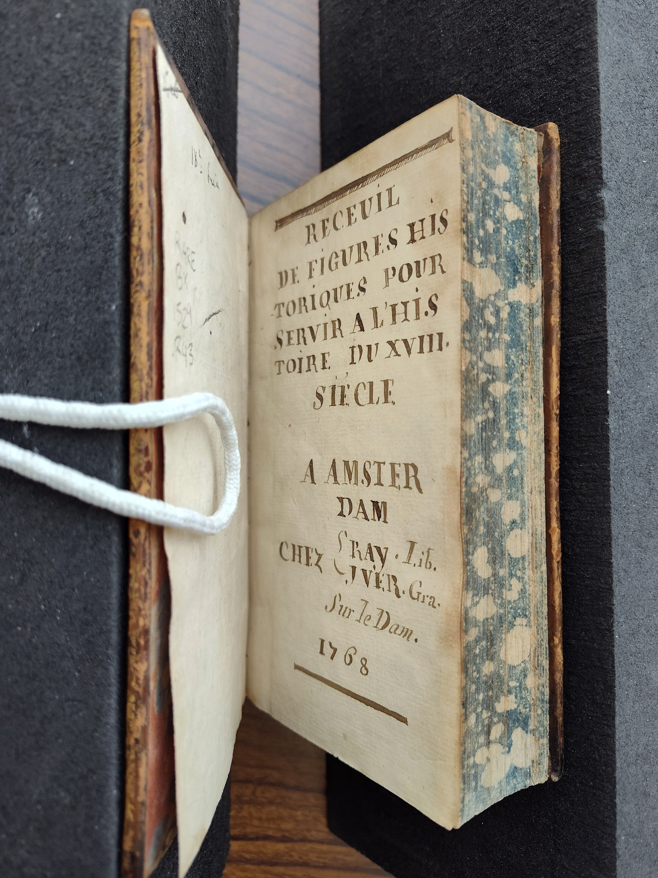
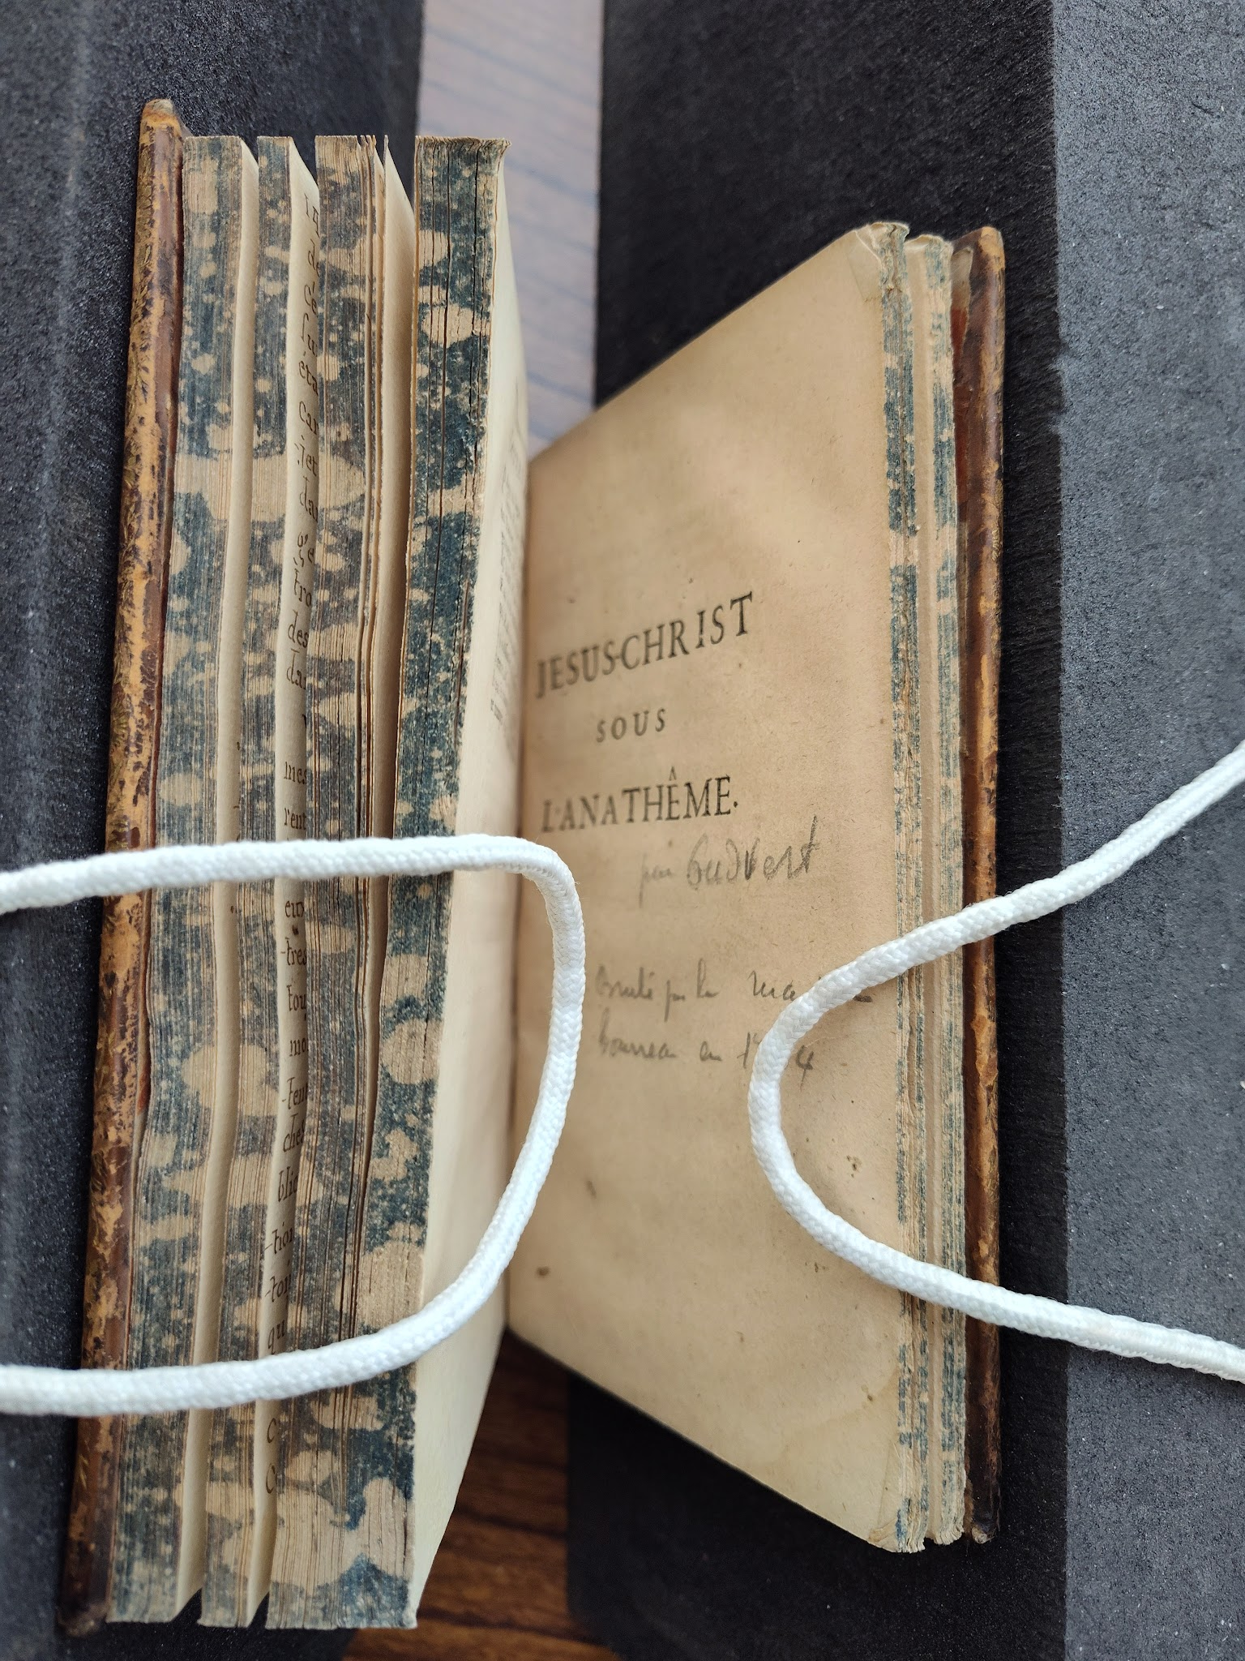
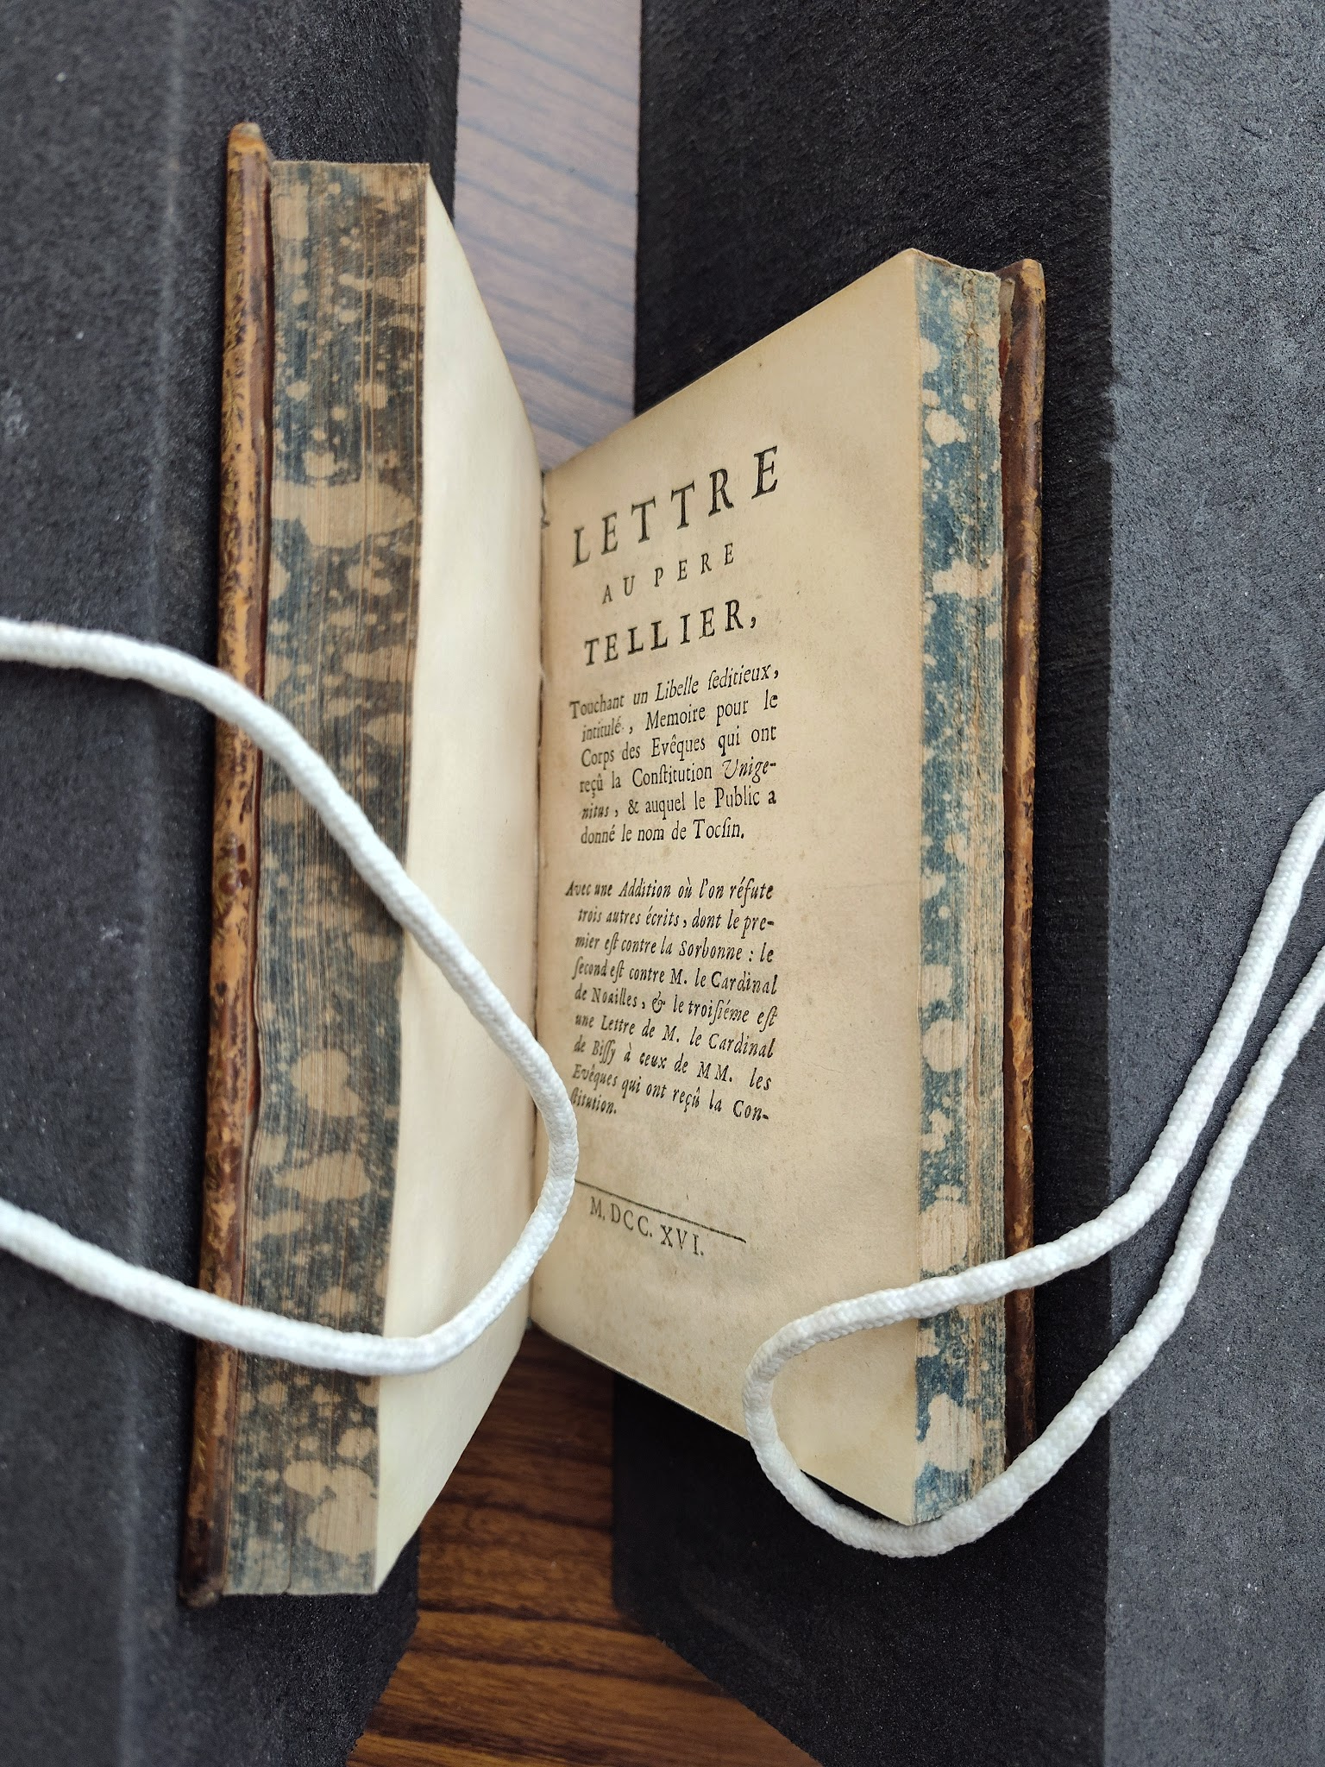
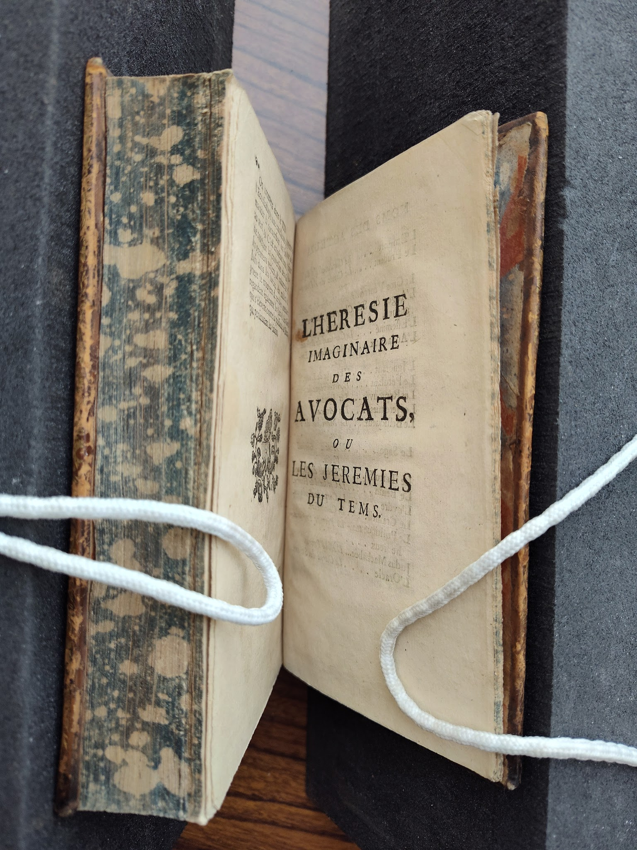
Notes:
As an example, the four titles shown here (once more, from Recueil de pièce)...

Slide 14
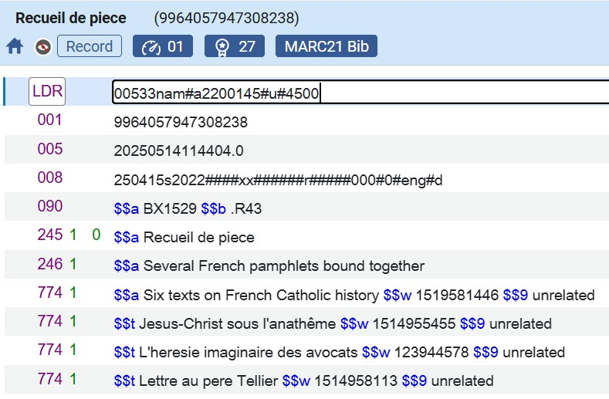

Notes:
…can be represented in one host bibliographic record, which recounts each in a 774 field alongside their OCLC record numbers (which we hope will provide protection against disarray in any future system migration). In the component bibliographic records for each title, a reciprocal 773 can be added to further explicate the relationship between the record.

Slide 15
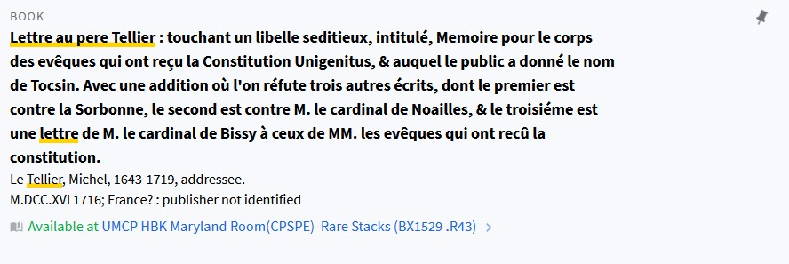
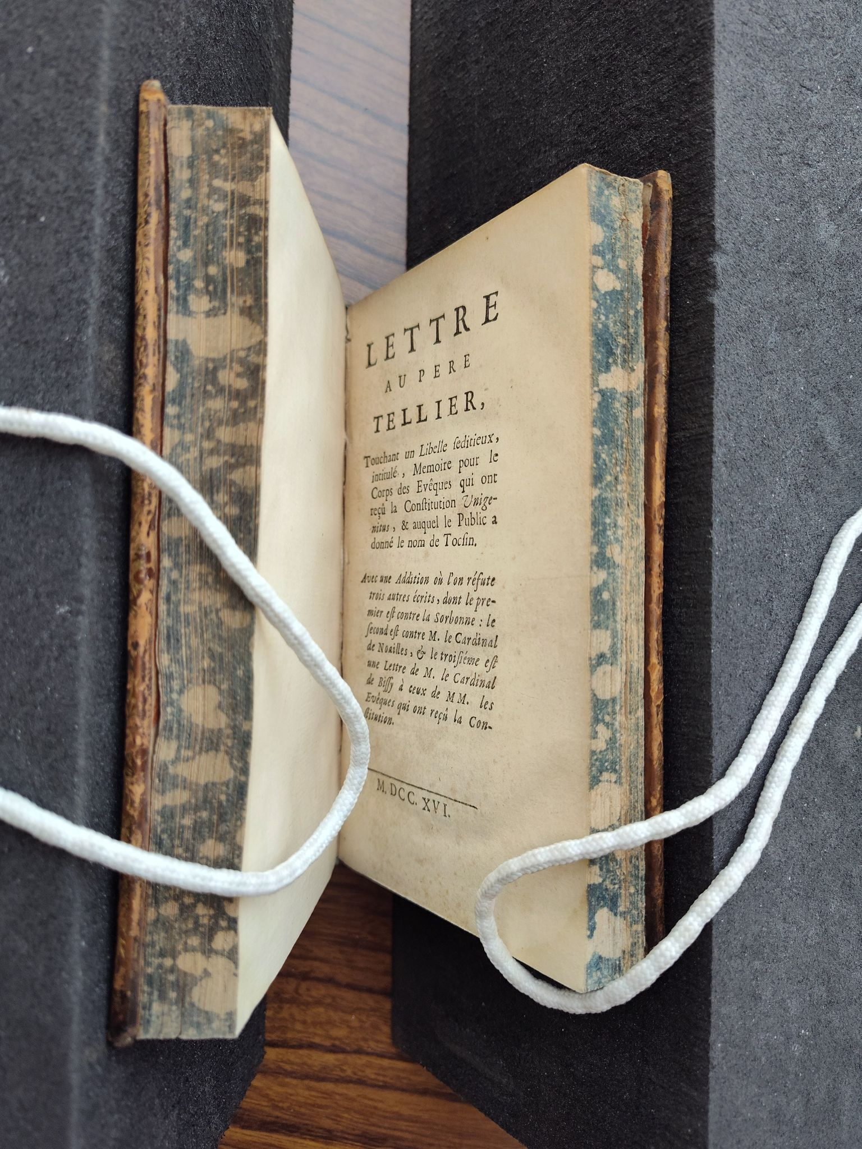
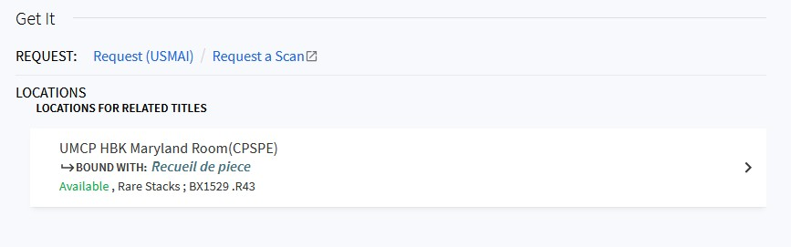
Notes:
Here, using the second title from "Recueil de pièce," is shown the resulting view in UMD Discover (Primo). The title is fully cataloged (tho' only the brief view is displayed here), and where the location information would oft be displayed, instead is shown the holding of the hidden host bib record.

Slide 16
Conclusion: in which gratitude is extended
to the many sharers of knowledge
Notes:
My endless gratitude to you, dear listeners, and to those around me who have aided me in my journey to understand that strange being known as a bound-with, in particular Andrea Schuba and Beth Guay for their dauntless co-explorations and representation of UMD on the USMAI metadata committee, my colleague Hannah Jones at the distant estate of UMBC for her parallel endeavors to define and constrain the bound-with within the catalog record, Linda Seguin for her wise counsel and Network Zone wizardry, and Kathy Glennan for sharing her deep institutional knowledge. And now, I will end on this note-

Slide 17
Additional Bound-With Questions to be Answered (but not today)
Sarah Hovde
LRIPF
UMD Libraries
June 2026
Notes:
How strange, there appears to be an additional presentation appended to this one!

Slide 18
So far…
do instructions work well for modern books?
  …for serials? for serial analytics?
  for microfilm? for gov docs??
all component titles have barcode in system, but not on book
all component titles have barcode in system and on book
some but not all component parts have barcode in system
one component title/item was moved to a new location, but not others
one component title/item was withdrawn, but not others
inconsistent notes in item records
local UMD preferences to supplement USMAI policy?
retrospective cataloging project??
Notes:
While we have a process for cataloging bound-withs in Alma, it is specific to monographic records and was created with rare materials in mind, so a number of questions and problems remain. Some of these are easier to answer than others, and some are currently being investigated. For instance: do the instructions work as well for modern circulating books, including serials and serial analytics, as for rare books? This is a distinct process from the one used when binding periodical issues as - for the most part - those are multiple items associated with one bibliographic title. Serial analytics and monographic series, though, may prove to be slightly trickier. Andrea and I are working to test out modern circulating books, coordinating with Beth who is working on serial analytics, and we're hopeful that this work will help answer other questions such as whether we need any local UMD policy decisions to supplement the USMAI policy and how to get a handle on the various barcoding situations previously in use. (Some favorites that we've encountered so far are: one title is marked missing or sent to Severn while others are still "on the shelf" in McKeldin; all item records have barcodes but there is only one barcode on the book; all item records have barcodes and there are multiple barcodes on the book.) While this process will work for new cataloging as we move forward, a retrospective cataloging project to address older titles is probably not realistic any time soon, although I have the hope of discovering a programmatic method. What further problems and solutions will be discovered? Stay tuned for a possible update at next year's LRIPF!
*How many bound-withs?
possibly 18000 total, need more analysis
4200 in Hornbake, includes some journals/series/state docs but probably most are "standard" monographic bound-withs
11400 in McKeldin, but probably majority serial analytics/series
1800 when records with series statements removed

Slide 19
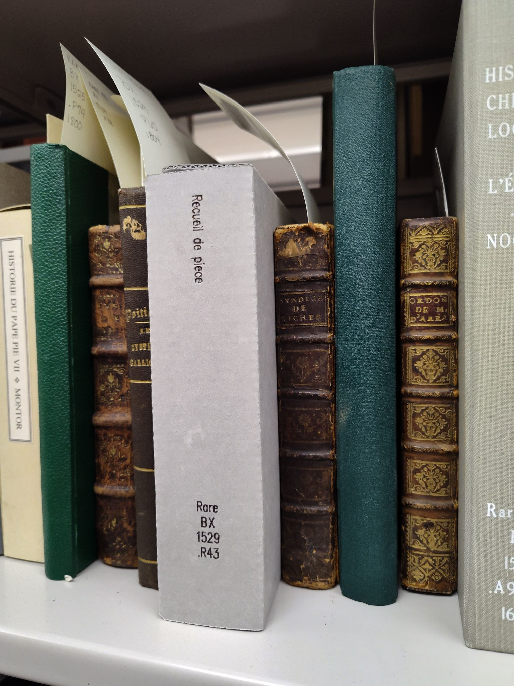
Thank you!
Notes:
And now, truly, thank you. (This is the infamous Recueil de piece one final time, in its home in the rare book stacks, in some wonderful supportive housing.)

Slide 20
bibliography
Ballard: https://ital.corejournals.org/index.php/ital/issue/view/1332/33
Strout: https://www-jstor-org.proxy-um.researchport.umd.edu/stable/4304573
Floyd : https://journals.publishing.umich.edu/nasig/article/id/6735/print/

