Slide 1
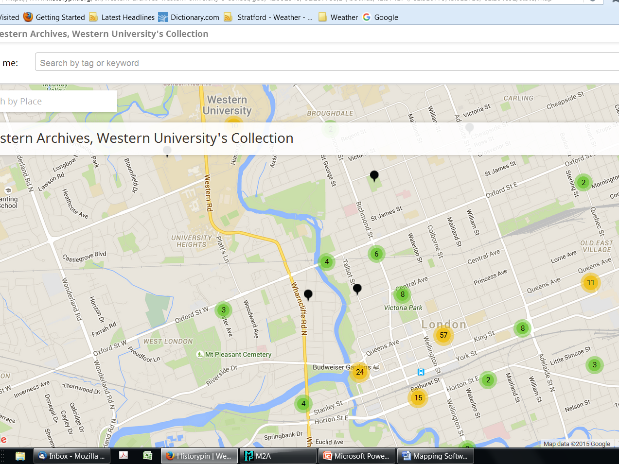
Using map TOOLS TO IMPROVE ACCESS AND COMMUNITY AWARENESS
Notes:
I am interested in the use of map interfaces or layers in providing access to, or visualizing, archival records. By mapping layers and interfaces, I am not necessarily referring to GIS software in all its full technical sophistication but any tool or layer that facilitates place, and specifically map, based access to these records. My hypothesis is that mapping online surrogates of records and finding aids improves access for many patrons of archives who are searching for place-based information.

Slide 2
Agenda
My research into map tools
Historypin map and community awareness – Western University Archives, London, Ontario
Map layer and archival catalogue – Dalhousie University Archives, Halifax, Nova Scotia
Notes:
I aim to cover three areas in my presentation: 1) a quick introduction to the topic and results of a survey of archives that I conducted in 2015, 2) a case study from my archives of use of the mapping tool in Historypin as a means of improving community awareness a local newspaper photograph collection, and 3) a brief look at the potential of one example of a map layer on top of an online archival catalogue at another Canadian university.

Slide 3
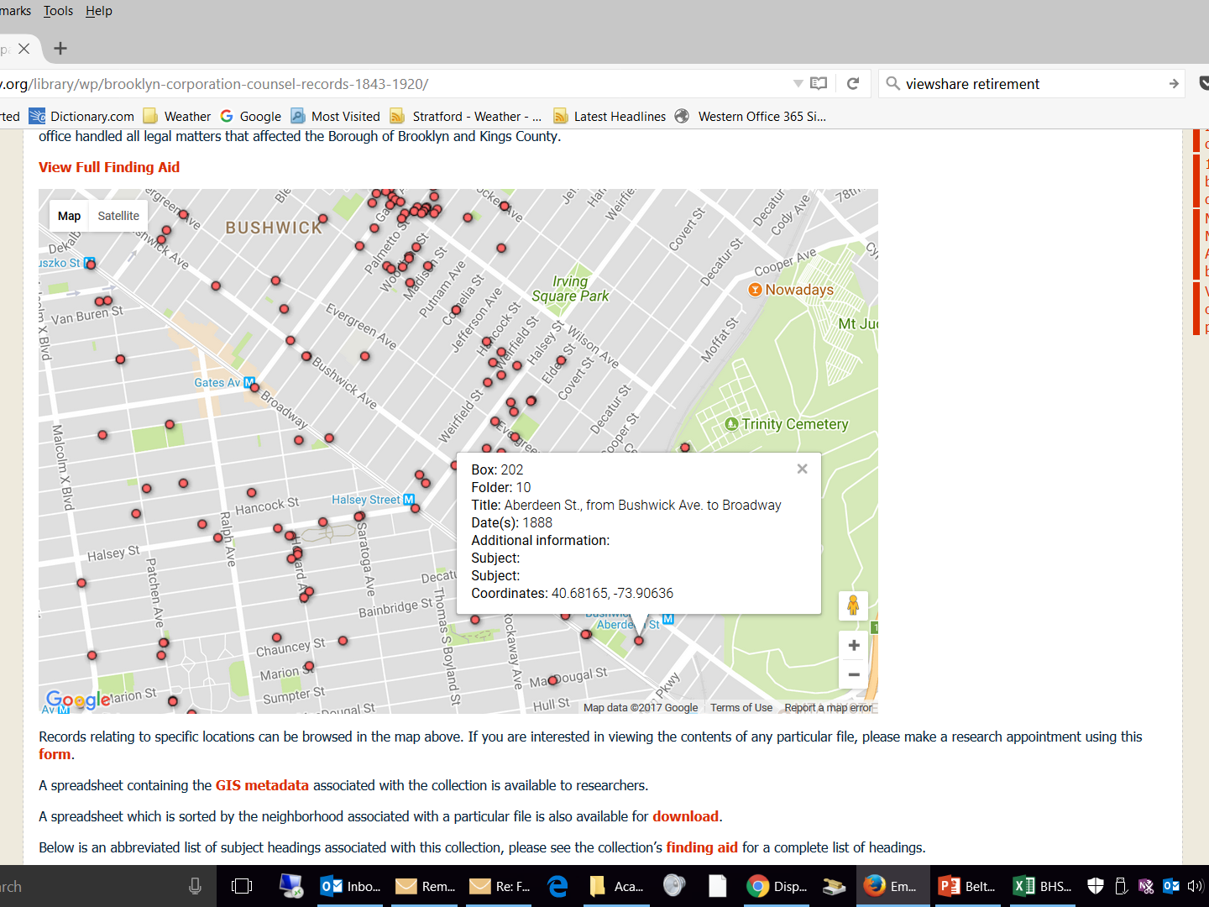
MAP TOOLS CAN PROVIDE…
Notes:
What I mean by map tools is using maps as a means of discovery of the holdings of records that include place based metadata, especially where that metadata is really helpful to understanding either the context or content of the records. Mapping layers originated with GIS software; (GIS) has become quite sophisticated over the last several decades. Several very powerful proprietary and open source tools such as ArcGIS and Quantum GIS (QGIS) have evolved to meet a variety of research and corporate needs. These applications provide the full range of functionality for managing geographic information, both on the desktop and via the web. At the same time, map tools such as Google Maps and OpenStreetMaps have become increasingly popular with non-specialist audiences. Consequently, more and more information searchers online are finding up to date information about the environment, public institutions, businesses, cultural and tourist attractions, and so on, using map interfaces. Moreover, these products often form the mapping layers for heritage oriented web services such as Historypin, Viewshare, and Visualeyes. These are tools that individuals and organizations can use to pin historic photographs and text to maps and timelines. Archives have made some use of these services in the last decade or so; in other cases, such organizations have built their own interfaces. The example on this slide is a map that provides an alternative means of access to a series of legal counsel records at the Brooklyn Historical Society.

Slide 4
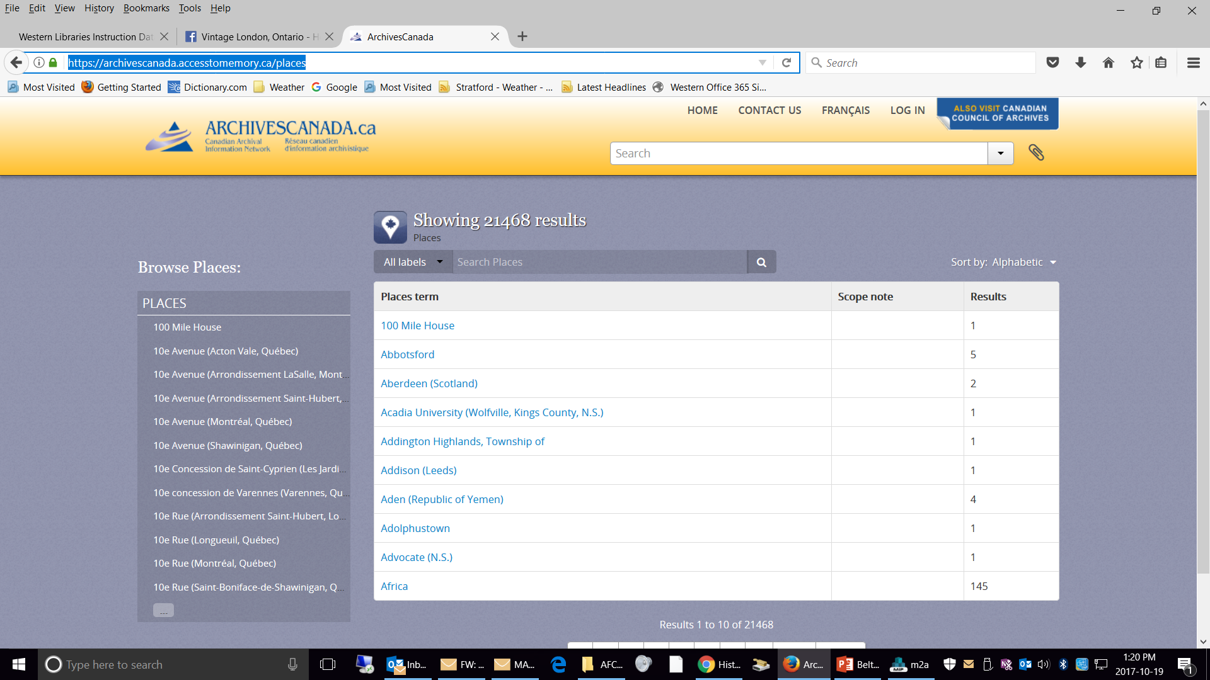
Searching by place and using maps
https://archivescanada.accesstomemory.ca/places
Notes:
Finding aids and archival catalogues are understandably focused on textual information made discoverable via browse lists and search boxes. One pertinent category of metadata is place based information. Such information is inherent in archival records, in terms of both provenance and topic. Any number of online archival catalogues (such as Archives Canada, the Canadian national catalogue seen on this slide) provide access to descriptions using place names. Who is searching for this place based information? A 2011 paper outlines an initiative at the English National Archives to gather and standardize place-based information. In 2009, an archives' in-house study had found that 20 percent of 3000 queries to its online catalog were place based, which was the second most frequent type of search. The writers go on to explain how this assessment was put to work in building initial prototypes of map based search tools for certain record sets. Building such a prototype necessitated the georeferencing (i.e. formally linking an object to its exact geographic coordinates on the Earth’s surface) of certain data sets held by the National Archives.

Slide 5
Visualization and archival reCORDS
Use of software to render digital (including archival) collections in a fashion that highlights patterns.
Visualization includes maps, among other tools, such as timelines, which work well for archival resources.
Notes:
Another way of looking at mapping layers is as one tool in the toolbox of visualization software. The increasing power and sophistication of Web resources and social media has allowed archivists to think of different, non-textual, ways of representing their holdings and associated metadata. Visualization applications are mainly used by digital humanities researchers to render their results, but they are also useful to archivists who wish to exhibit and provide access to their holdings through non-textual means. One example of a visualization tool that deliberately caters to cultural heritage institutions such as archives, libraries, and museums is “Viewshare” developed by the Library of Congress. This tool is being discontinued as of next March, and I would be curious to know why. Has there been insufficient interest among the community of memory institutions?

Slide 6
Survey of archives in North America (1)
Survey of 10 questions designed to determine the existing and potential uses of mapping software to access and/or visualize certain archival resources
Key Questions:
Whether or not archives has an online catalogue or database that provides access via a map interface
Whether or not archives has online exhibits that provide visualizations of archival resources via a map interface
Whether or not archives’ patrons benefit, or would benefit, from such map interfaces
Which patrons would benefit the most from such map interfaces
Notes:
As part of my research into the use and feasibility of map tools, I undertook a survey in May and June of 2015. I wanted to survey archivists and special collections librarians as to their views of the existing and potential value of such tools to their institutions and patrons. My immediate instinct was to define these uses quite broadly to include everything from online exhibits to catalogues. It included pinning photographs to a map in Historypin or devising in-house mapping layers, including any visualization or GIS tool, as long as it captured the records to some degree to inform or engage any existing or potential audience. I was interested in any use of map tools to improve either access or awareness.

Slide 7
Survey of archives in North America (2)
Questions (cont’d)
What are the obstacles to providing visualizations using a map interface?
What are the tools used to provide map interfaces?
What are the primary digital objects connected to maps?
What are the purpose of providing access or visualizations via maps?
Notes:
I also wanted to know what the obstacles and objections to the use of mapping interfaces were. Were they primarily practical or matters of principle? From those archivists who were actively using map tools, I wanted to learn what tools they used, what records they focused on, and what the purpose of the mapping was. The survey was structured to allow respondents who had no interest in the topic to answer a few questions about their objections and quit the survey. Those who had used maps carried on to answer several more questions.

Slide 8
Survey results (1)
Around 75% of institutions neither provide access to catalogues/finding aids nor online exhibits via map interfaces
By contrast, around 85% of respondents responded that patrons would benefit a great deal or somewhat from such interfaces
Main barriers are insufficient resources and lack of technological expertise
Respondents who use map interfaces favour use of photographs and other graphic resources to support community outreach
Notes:
Three quarters of respondents did not provide any form of map interface to their records or finding aids. This probably reflected the prevalent notion that descriptions of archival records should be provided through the use of purely textual resources such as finding aids. What really struck me was that, despite this reality, 85% of the respondents felt their patrons would benefit a great deal or somewhat from such maps; in particular, over half, 53%, felt that their patrons would benefit a great deal.
In particular, respondents made clear that local historians would benefit the most, pointing to the importance of community outreach and awareness. The main barriers (insufficient resources and lack of expertise) were not surprising given the small size and budgets of many smaller archives. Main items mapped were photographs and other graphic materials, but textual records were not ignored. Respondents felt that the main purpose of maps was to enhance geographic access to holdings and promote community outreach. Where tools were being used, most of them were relatively simple collaboration tools such as Historypin, Viewshare, Flickr as well as mapping layers from Google Maps, Open Layers. Full blown GIS software has been used in a few instances.

Slide 9
Survey Results (2)
Relatively simple standalone tools or tools embedded into larger systems are more likely to be used as there is little need for technological sophistication.
The issue of resources needed to scan and upload digital objects and associated metadata requires more streamlined work processes.
Patron needs should be identified more precisely
Notes:
The survey results seemed to point to the use of simple tools and add-ons. Even where such tools are used, digitization and upload of archival resources and associated metadata requires a re-focusing of work processes.
To digress briefly, geocoding and mapping archives are not simply one activity but rather a series of at least three interconnected activities, the first two of which are particularly labor intensive. The activities are: 1) standardizing a georeference (i.e. the latitude and longitude of a place) and/or place names over time, 2) embedding and encoding these georeferences in descriptive records and 3) installation of mapping layers on archives catalogs or sites. Archivists and others have made progress in standards and techniques for geocoding in description; for example, one may find the tag “geographic coordinates” in the Encoded Archival Description tag library. A challenge in implementing georeferencing relates to the presence of historic place name data that may be difficult to associate with current locales. However, the addition of mapping layers to metadata is quite feasible, if geographic coordinates are present in the record.
Of course, not all records or finding aids need to be georeferenced, but doing so can be integrated into other metadata related processes. A key point is that geolocations are required for any kind of batch uploading of digital objects.
Pinning items to a map one at a time in something like Historypin is straightforward, but not highly productive; what if patrons prefer that large amounts of records be associated with a place, not just a sample. This reinforces that patron needs should be identified more precisely. I am in the process of conducting surveys of historians as case studies of actual patron demand in this area. Speaking of relatively simple tools such as Historypin…

Slide 10
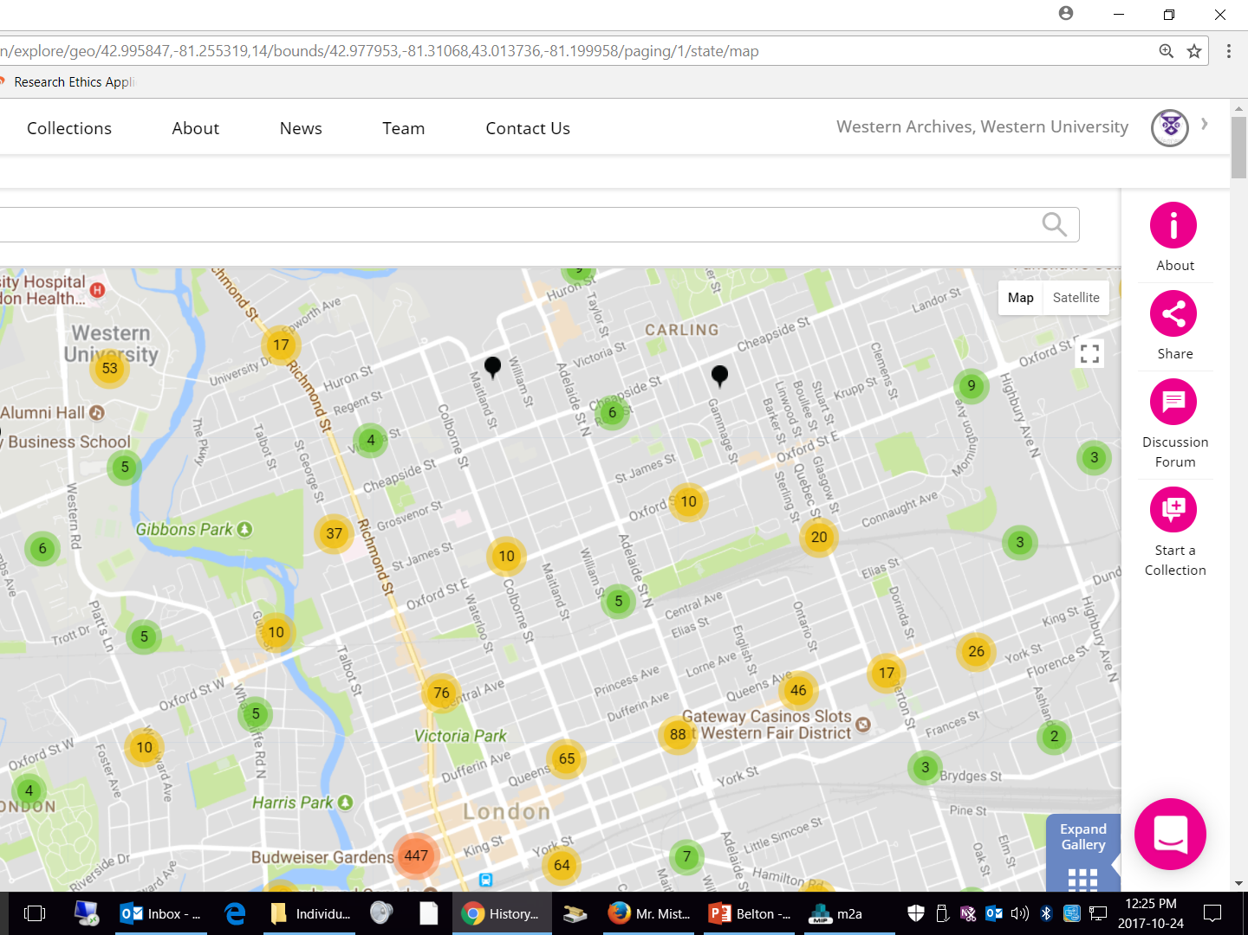
Historypin MAP and Community AWARENESS IN LONDON, ONTARIO
Notes:
The second part of my presentation is a brief case study of an attempt to use the Historypin tool to improve access to, and community awareness of, a large collection of newspaper staff photographs, for which I am responsible. Many, if not most, of you are familiar with Historypin, which is a tool for pinning archival records (usually photographs) to a map where anyone can browse items and collections of interest. By the way, I should mention that our current archives mandate includes responsibility for management of records of the university and the university community, but we also inherited from our former Regional Collection a local history collection of considerable size and reputation. Furthermore, our university’s strategic plan includes a strong incentive to engage in broader community outreach. I have used Historypin for several years to post portions of the photograph archive of our local newspaper, the London Free Press. We have been selectively digitizing this collection since 2013 and have accumulated a significant volume of digital material, in the neighborhood of 50,000 images that document the work of the newspaper’s main and regional offices throughout southwestern Ontario.
One of current projects is systematically posting London Free Press images from the year 1967, Canada’s Centennial Year. We are doing this as one of our university’s contributions to Canada’s 150th birthday celebrations this year. We felt that there might be interest in the year 1967 as a side effect of commemoration of the year 1867. We also hypothesized that many baby boomers in the southwestern Ontario region would be excited to engage with photographs from their youth fifty years ago. Coincidentally, each date in 1967 corresponds exactly to its day of the week in 2017 (i.e. October 28, 1967 was also a Saturday), so it allowed us to identify and steadily disseminate material throughout the course of the year exactly 50 years later. In other words, the project didn’t have to, nor could it, be released all at once.
To disseminate this large volume of material efficiently and for maximum impact, we ruled out using our archives descriptive database, as storage capacity was limited. Having said that, there has been some duplication of effort as we have endeavored to upload information. Additionally, we didn’t feel our institutional repository was the best place to engage the non-campus community. Moreover, given my interest in maps, I wanted to experiment with pinning the photographs to a map in sufficient volume that to ensure that a good portion of well known city neighborhoods and satellite town locations contained content. Most of the photographs can be mapped fairly easily to very specific locations. If you combine the 1967 photographs with samples from other years we previously uploaded, we are up to around 2000 postings. Within the city of London, the pins tend to be clustered in commercial or industrial districts where the photographers spent most of their time, with only occasional outliers in other areas. In smaller communities, there is less of an immediate need to pin items precisely to an address.

Slide 11
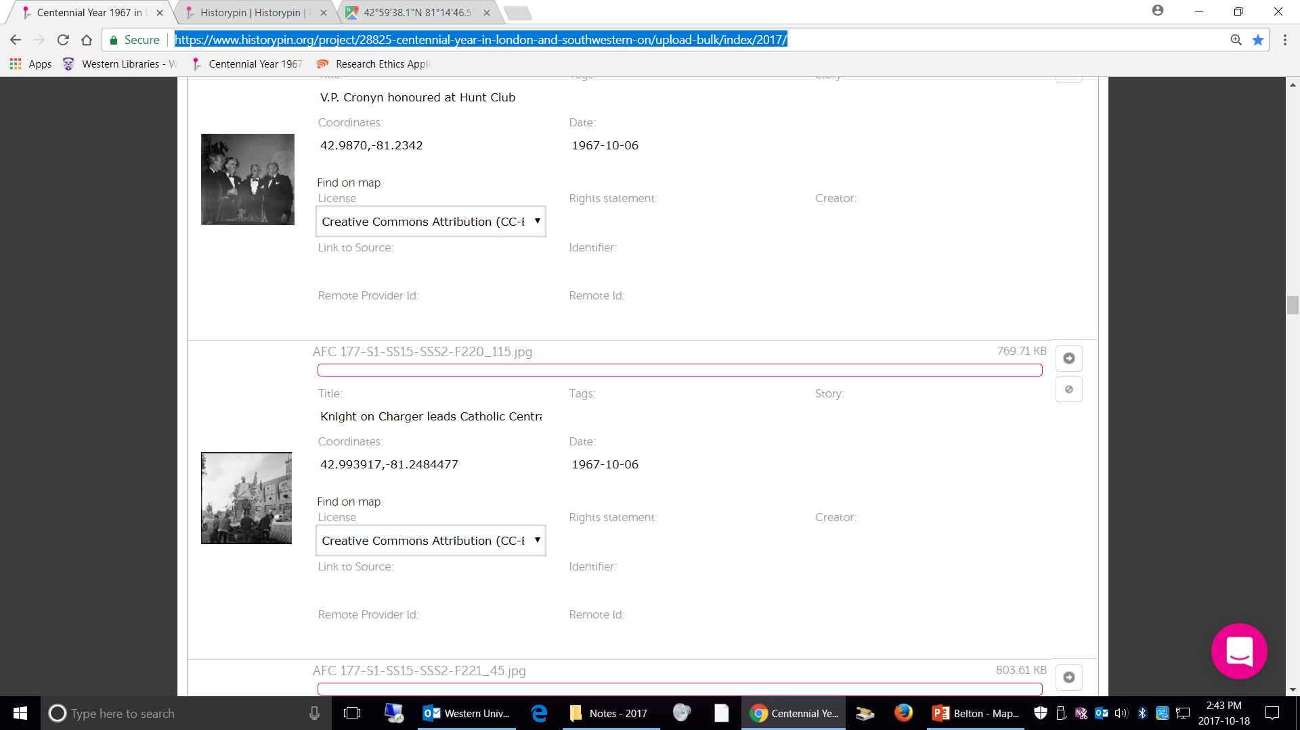
Historypin and Community AWARENESS
Notes:
Because of the sheer volume of these photographs (for instance, we may end up posting as many as 3000 photographs from the year 1967 alone), I have made use of Historypin’s bulk uploading template. This .csv template works well with our many spreadsheets of photograph listings, but does require the addition of latitude and longitude coordinates in order to be able to “pin” the image to the map. By contrast, pinning items one at a time does not require knowledge of latitude/longitude as the pinning process is done using a small inset map. The bulk uploader also requires the inclusion of the file names of the items being pinned, and their titles and dates. The main advantage to using the bulk uploader is that, once the .csv file is loaded, a thumbnail of each file to be uploaded and its associated metadata is visible and editable on the relevant webpage, as you can see.
The bulk uploader allows for rapid posting of hundreds of images as long as basic metadata is in the .csv file. Specifically regarding geocoding, I have had some success in simply grabbing latitude/longitude coordinates from Google Maps and amending the template. Usually, what I do is search Google Maps for a place found in the .csv file, and then cut and paste the information into the upload webpage. This information can be extracted from gazetteers but not with same level of precision. In any event, it is often impossible or at least too time-consuming to identify precisely where an item should be pinned. Historypin also allows for the pinning of images to a rough location, which usually corresponds to a community, not an address. However, in the bulk uploader, this would still entail the a specific set of latitude and longitude coordinates, which can be copied to multiple spreadsheet cells.
Regarding impact on the community, as many of you know already, Historypin has not really turned out to be a community engagement tool, at least not for memory institutions, even though it was designed for this purpose. The reasons for this are beyond the scope of this presentation. Though I have not done formal research, my sense is that Historypin is being used as more of a static exhibit project tool, although items can be exported to social media reasonably well most of the time. Many Historypin sites have not been recently updated. Basic user view statistics for these exhibits of collections and items are available, but these statistics do not allow one to determine to what extent patrons use the map interface to locate objects as opposed to browsing the collections of photographs or otherwise searching. Regardless of these limitations, I can tell you that our posting of newspaper photographs has had a significant indirect impact both on our own social media tools, but even more importantly, on Facebook and other local history social media groups. You have all likely seen equivalents of these in your communities (e.g. Vintage Buffalo, If you Grew Up in Syracuse, etc.) Our Historypin items are regularly shared with credit given, although sometimes not, depending on the level of integrity of the group. Unlike many repositories, we have not watermarked our images but will review this approach if necessary. Note that none of these facebook and other groups currently uses a mapping layer. In effect, Historypin has served as a pipeline for improving community awareness of the collection on other platforms.

Slide 12
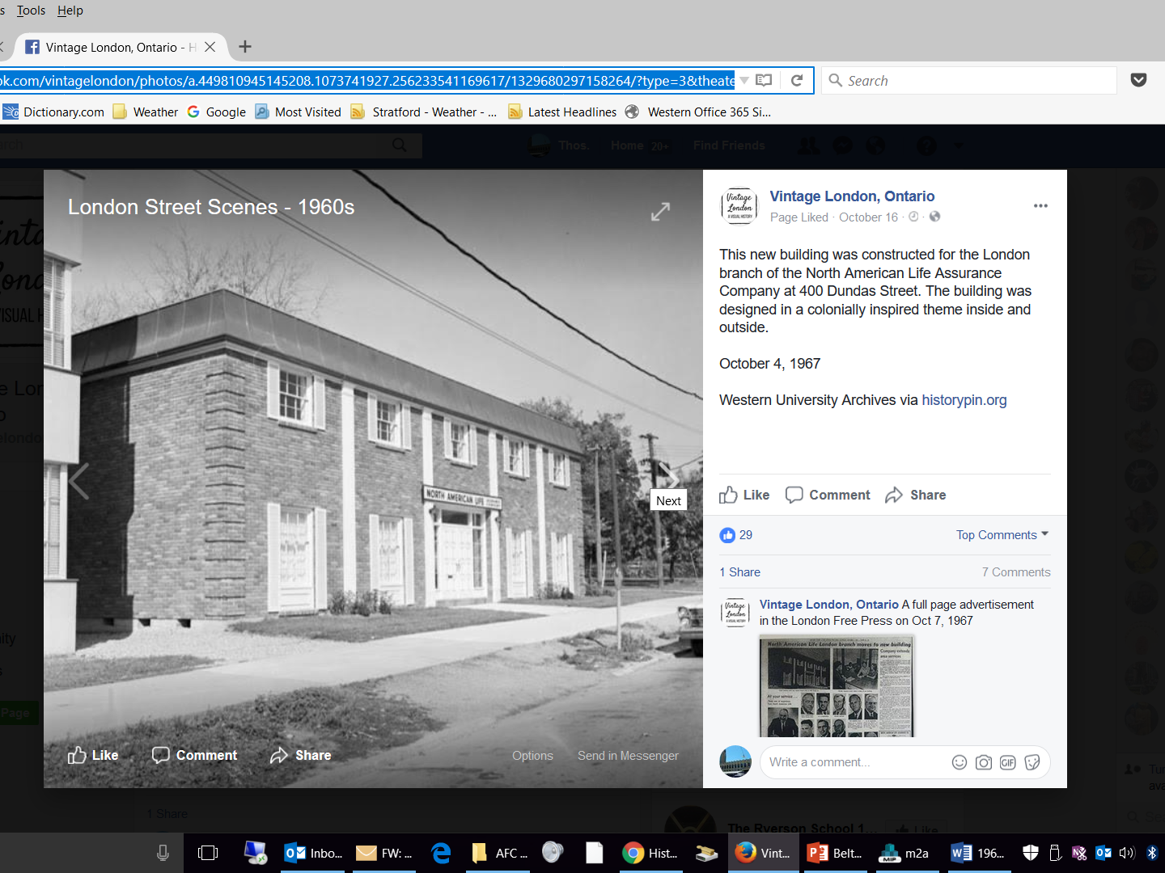
Historypin and Community AWARENESS
Notes:
In many cases, the images that have been shared to the these other platforms have resulted in additional metadata being captured about the image (e.g. the newspaper caption and/or story associated with a particular image when it was published) as well as additional histories or recollections of the event being documented. I have made some effort to link to the additional image related metadata in the comment section of the Historypin posting while leaving the recollections (some of which can be quite colorful and even problematic) to the social media pages. (Example). One of the things that I have noticed with the recollections of the 1960s era images is a recurring thread of what I like to call toxic nostalgia, taking the attitude of “those were the good old days” to its logical extreme of “everything is awful now”.
It would have been nice if our Historypin site itself was the home of this crowd sourced data and conversations, but the relative obscurity of the tool has worked against that in our case, and I suspect in others as well. Another disadvantage of using Historypin or social media for this purpose is that the pinned items and associated metadata, whether uploaded by our staff or crowd sourced elsewhere, exist outside the main archives catalogue or finding aid repository. Why spend time uploading valuable images and metadata to a website that your sponsor doesn’t own? Of course the purpose of archival catalogues and finding aid repositories is not community awareness, but access. However, they are related activities both in terms of the collections and patrons that they bring together. Speaking of mapping layers, archival catalogues, and access….

Slide 13
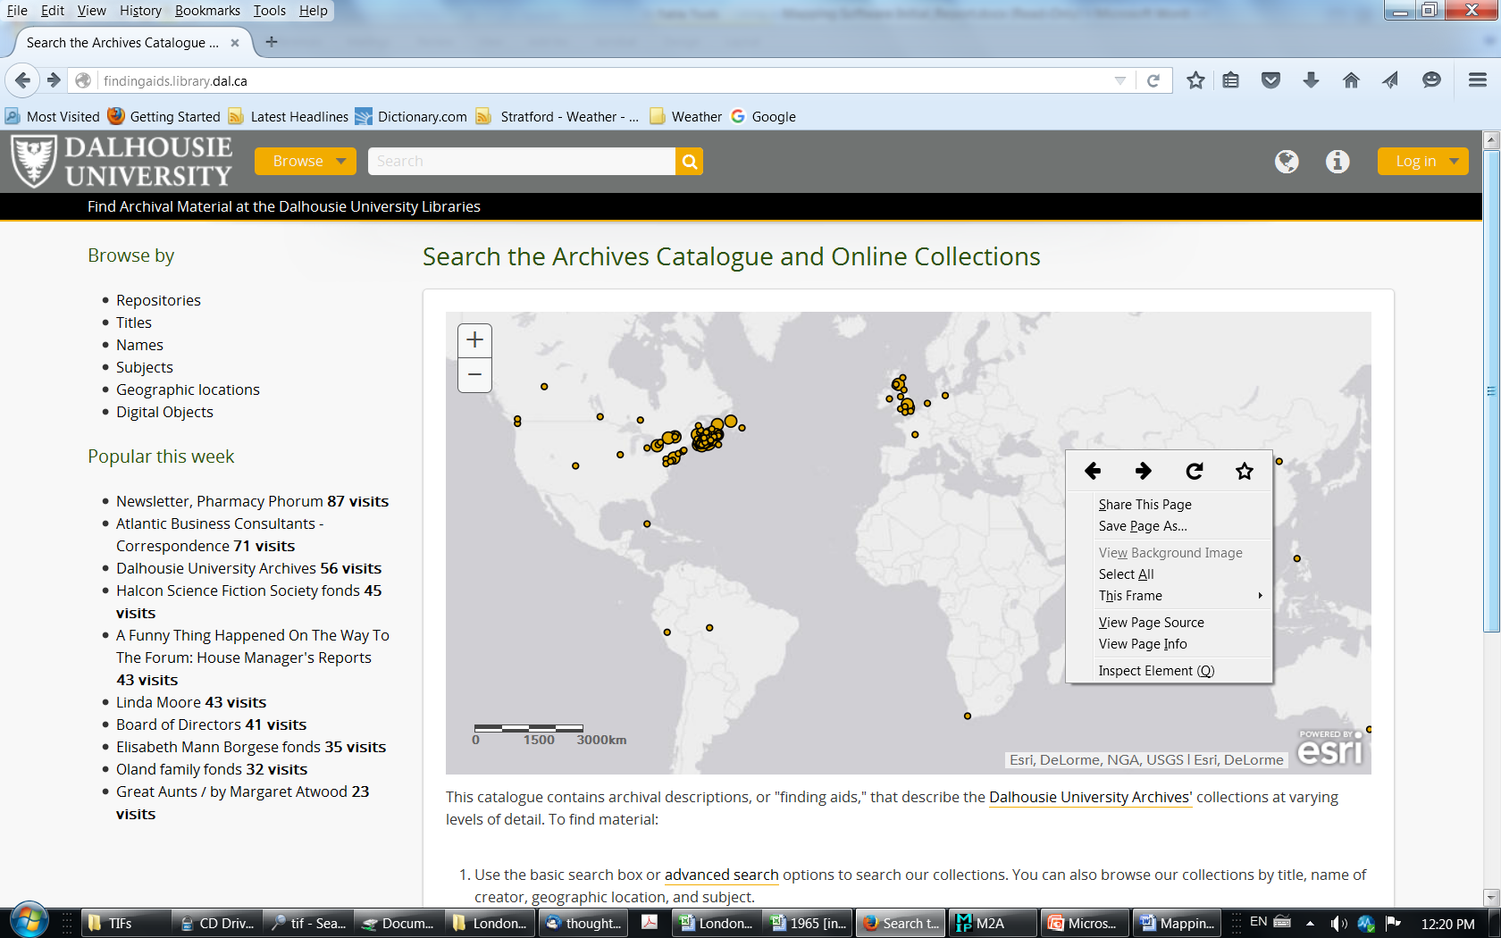
Dalhousie University ARCHIVES, HALIFAX, NOVA SCOTIA
http://findingaids.library.dal.ca/
Notes:
The last part of my presentation is about the more unusual idea of using a map layer on archival descriptive catalogues or finding aids. Most maps found on archives websites, or tools like Historypin, provide direct access to digitized copies of records (such as photographs) along with some metadata. What is very rare are maps that provide access to descriptions or finding aids. The website of the Dalhousie University Archives in Halifax, Nova Scotia, is one. This map layer functions alongside the more conventional search and browse options that you see on the left hand side of the page. I’d like to thank Creighton Barrett, Digital Archivist at Dalhousie for providing most of the details that I am about to give you. The public descriptions site is based on the AtoM open source description software, with which some of you may be familiar. It is a product of Artefactual Systems, which also developed the Archivematica digital preservation software. Incidentally, this software also underlies the Archives Canada aggregator that I showed you on a previous slide. The map layer as it exists now was built using GIS software, specifically ArcGIS. Dalhousie has leveraged the place based access points built into AtoM to create its map but it has to date been a quite labour intensive process.

Slide 14
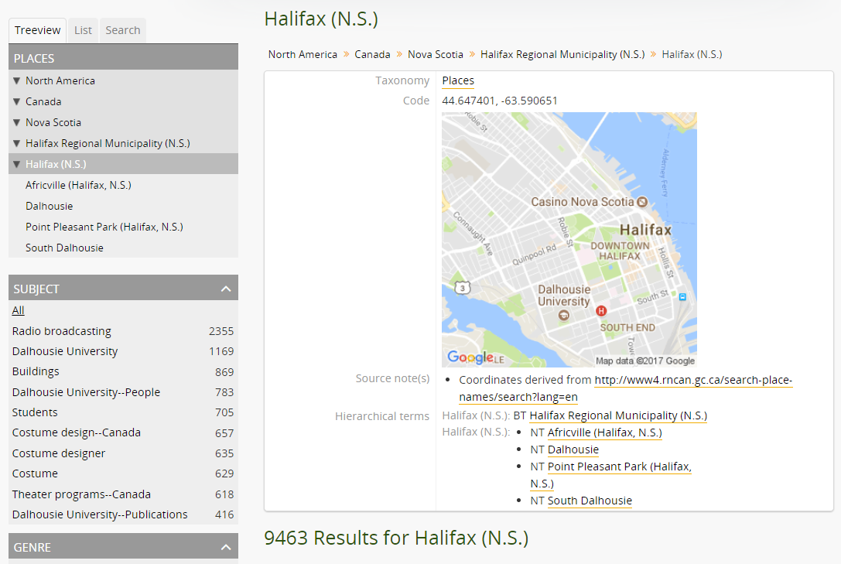
Dalhousie University ARCHIVES, HALIFAX, NOVA SCOTIA
Notes:
Work is now underway to embed actual latitude and longitude codes within the AtoM software so that the map can be updated more easily. Because the location codes are place name based, they will not be as precise as they could be (i.e. not down to the level of a specific address) but they will likely be as precise as they need to be depending on the level of description of the entity in question. In this slide, you can see that the location of Halifax, Nova Scotia, is linked to its general latitude and longitude coordinates. Geographic data such as this will be periodically exported to update the ArcGIS map layer. Note that place names will not necessarily be based on provenance, but also place of authorship and subject matter, so the geocodes documents that aren’t necessarily related to Nova Scotia. Not surprisingly, Dalhousie has reinforced the pre-eminence of using a map for an archives discovery project, such as this. Despite this, they have considered the pinning of certain items such as land deeds and architecture plans to specific addresses, such as we did in Historypin, although we focused on photographs. One could characterize this as a sort of digital humanities project, whereas I would characterize it somewhat differently, as an archives community outreach/awareness project. In any case, the work being done at Dalhousie on its archives discovery layer could serve as a model, particularly for the many Canadian archives and networks running the AtoM software. It would require an interface between open source software and proprietary, software, which might prove problematic for some.
Conclusion: There are two different ways of using Google Maps and equivalents to find place based information. One is to do a Google Search and go look at the associated Google Map to see the results, perhaps find more details and browse a bit more. Another approach would be to use Google Maps itself to search and browse these place based resources. Maps are a vital tool in Google’s arsenal, and a crucial one to some searchers. I think the future for archives discovery could be similar. Maps and geocoded descriptions and content have the potential to be tools in every archivist’s toolkit.
Thank you very much.

