Slide 1
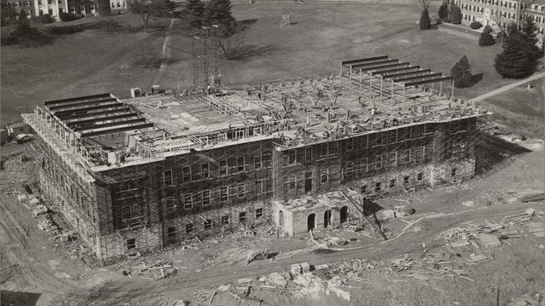
Developing library programming for non-departmental student programs
Jordan S. Sly, University of Maryland
jsly@umd.edu
@jordanssly
Towson Conference for Academic Libraries 2020
Photo: UMD Special Collections, https://flic.kr/p/9H7xZQ

Slide 2

Photo: https://www.theguardian.com/lifeandstyle/2018/aug/05/why-libraries-are-about-so-much-more-than-books

Slide 3
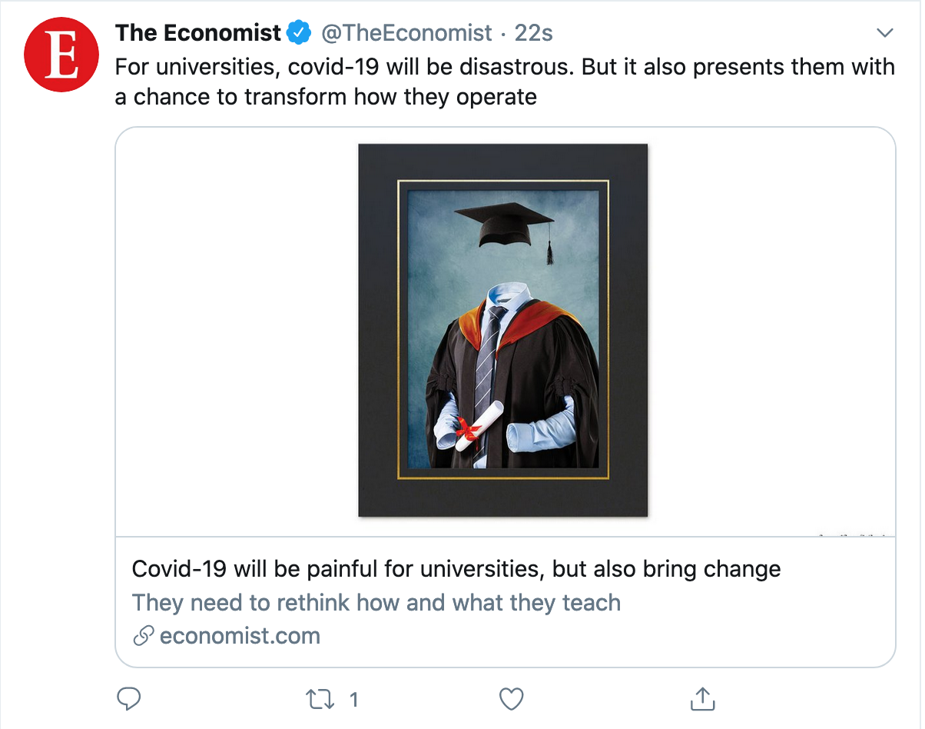

Slide 4
Basic outline
Thinking about strategy
Example
Lessons learned
Applying the lessons
Discussion and questions

Slide 5
Background and Thinking about Strategy

Slide 6
Good grief, what an outdated reference
Strategery.

Slide 7


Slide 8
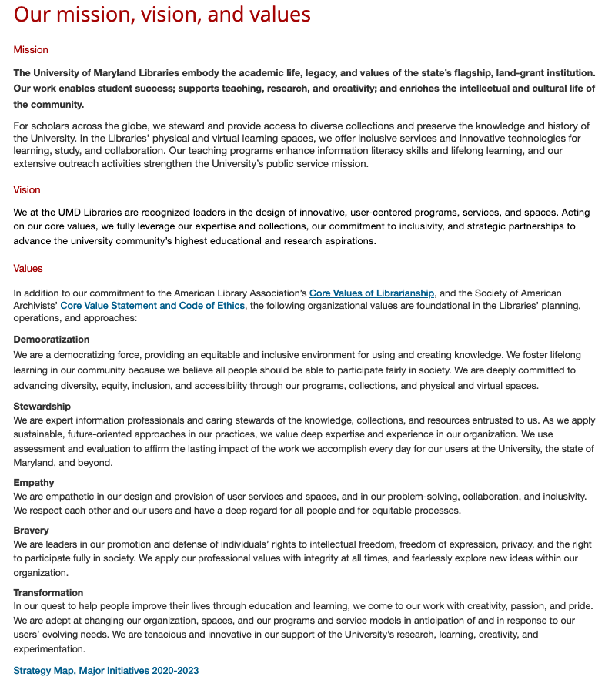

Slide 11
Great, but what do we mean?

Slide 12

Why is a particular population within your community a strategic opportunity and not just another place to direct or divert attention?

Slide 13
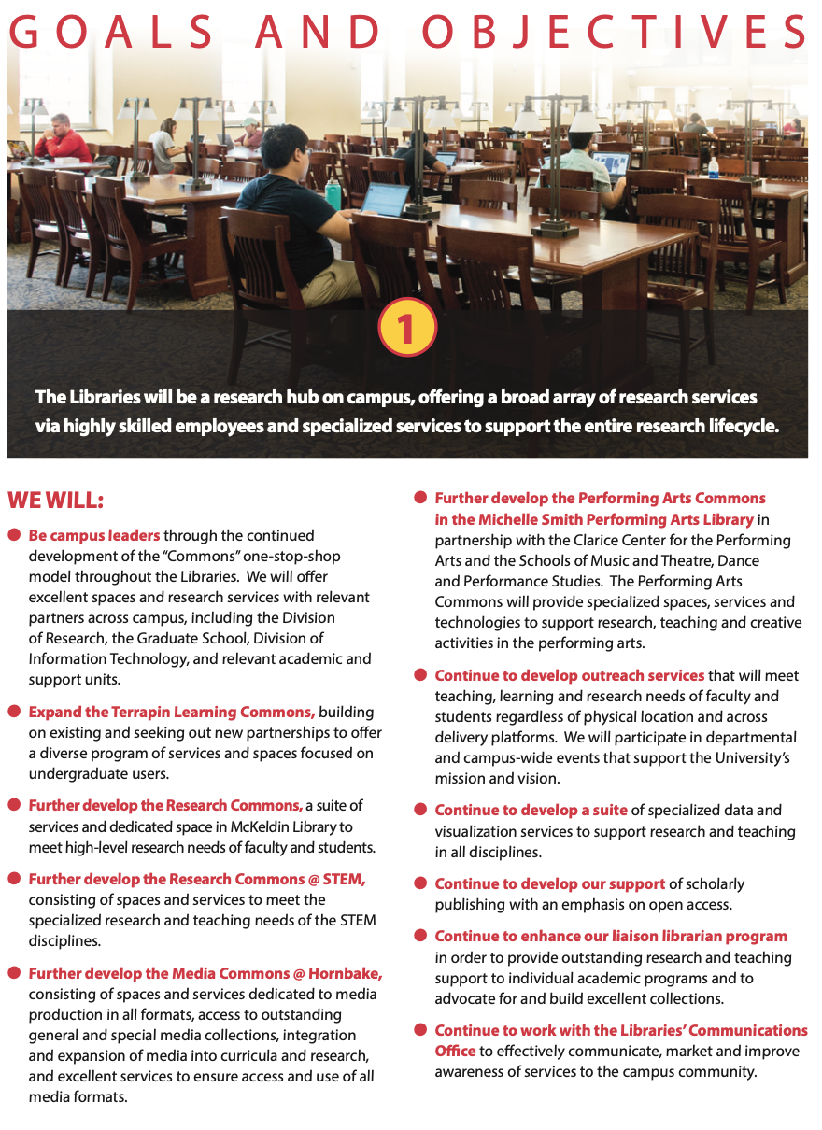

Slide 19
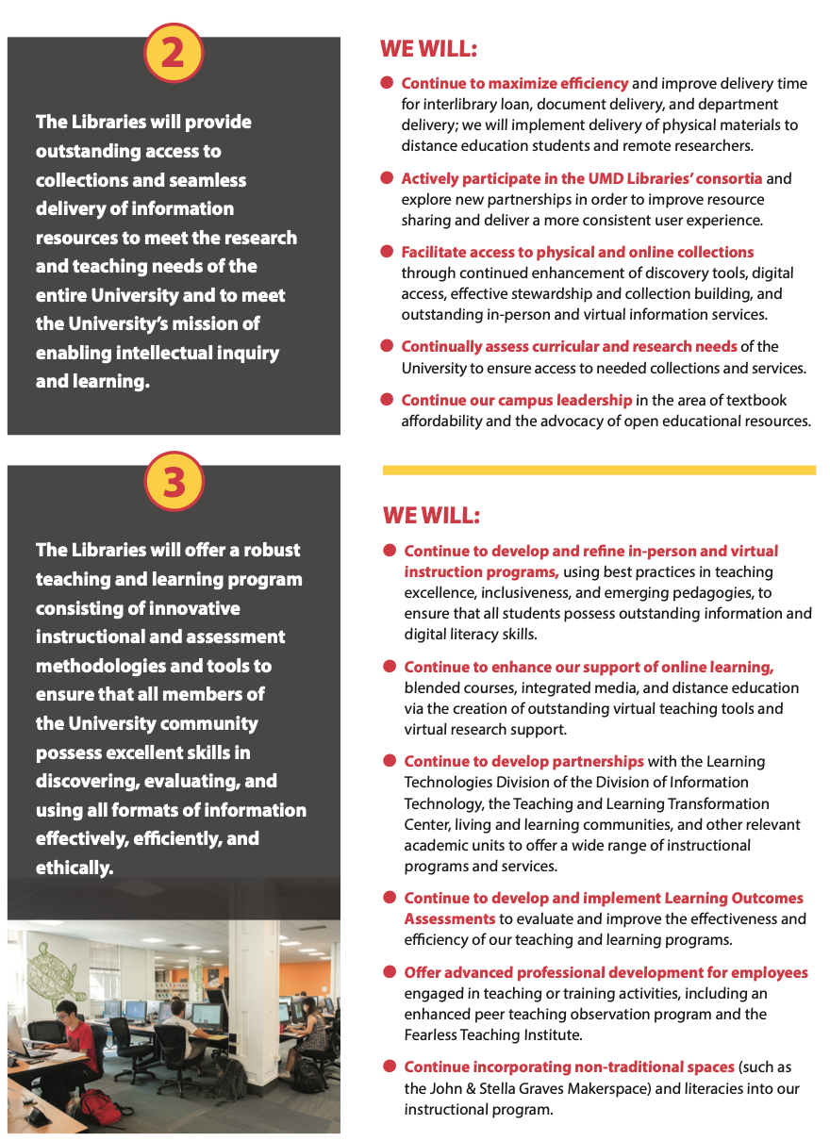

Slide 20
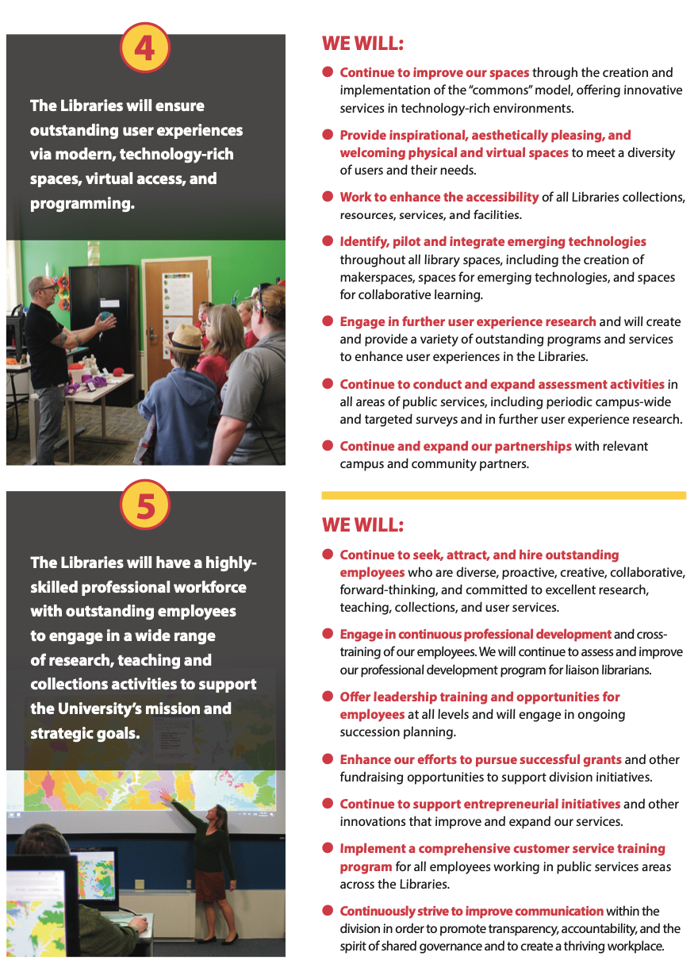

Slide 21
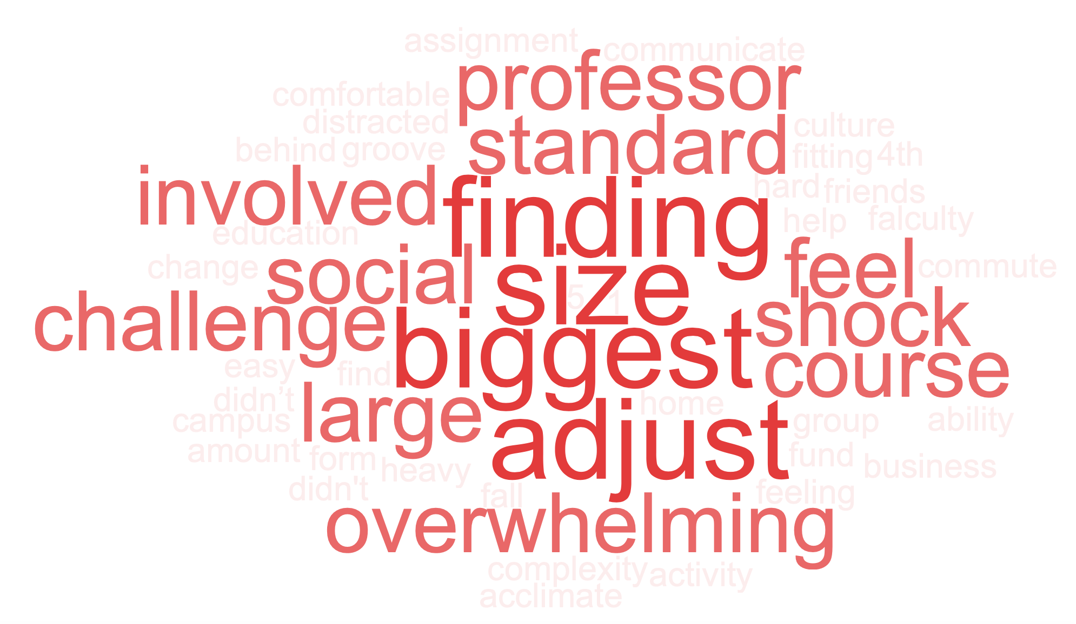
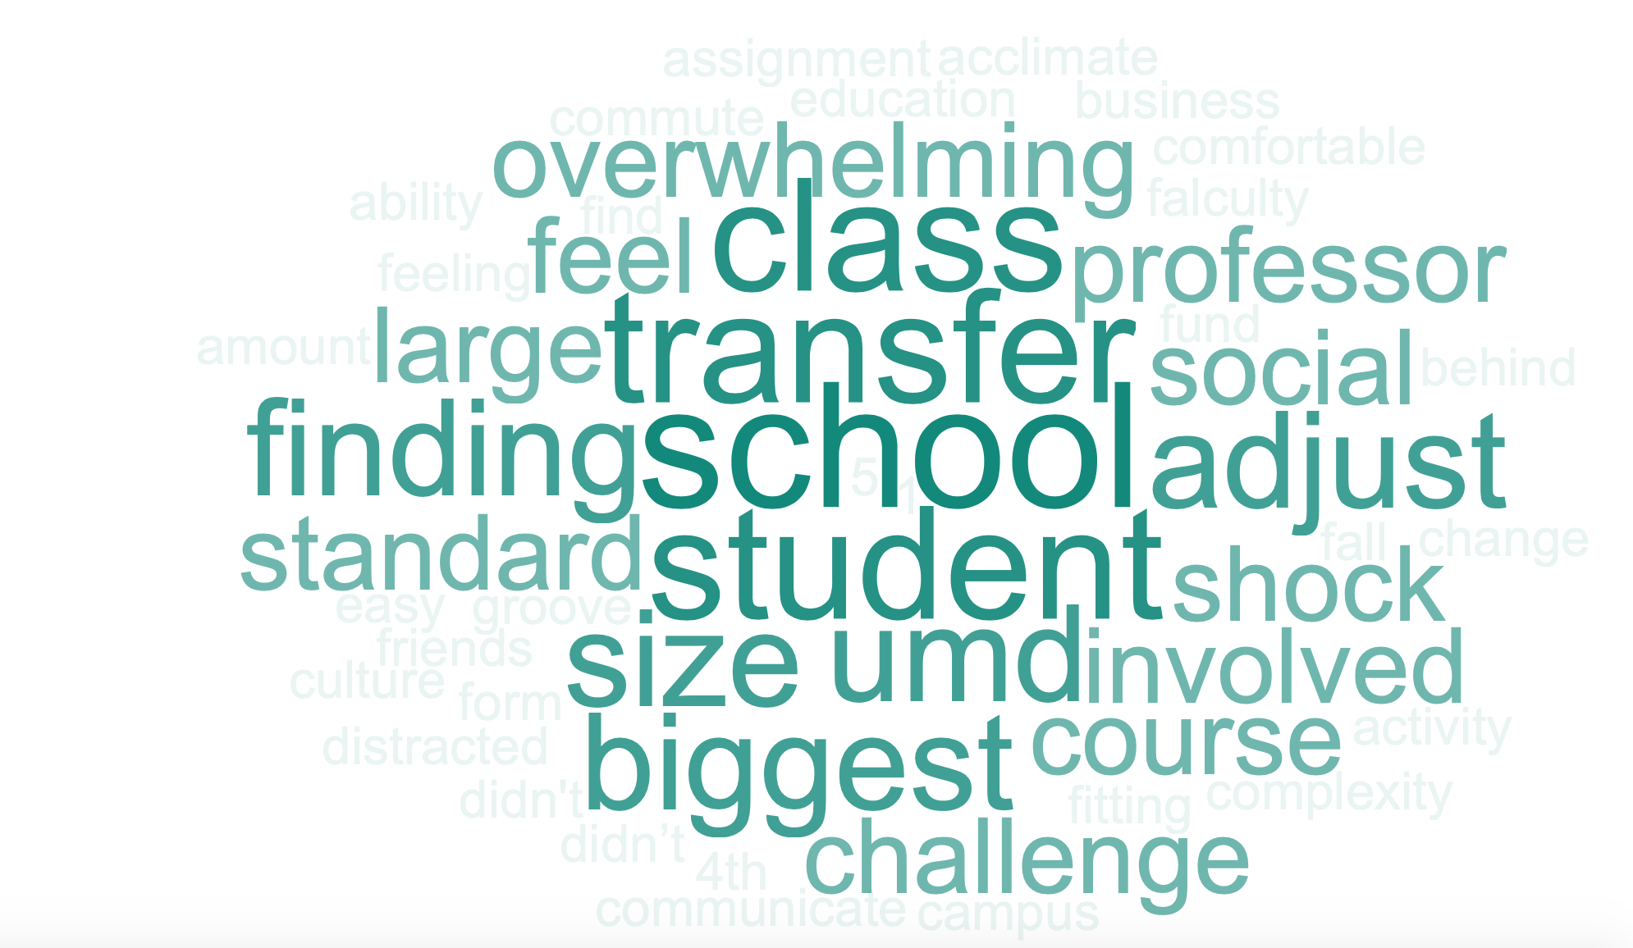

Slide 22
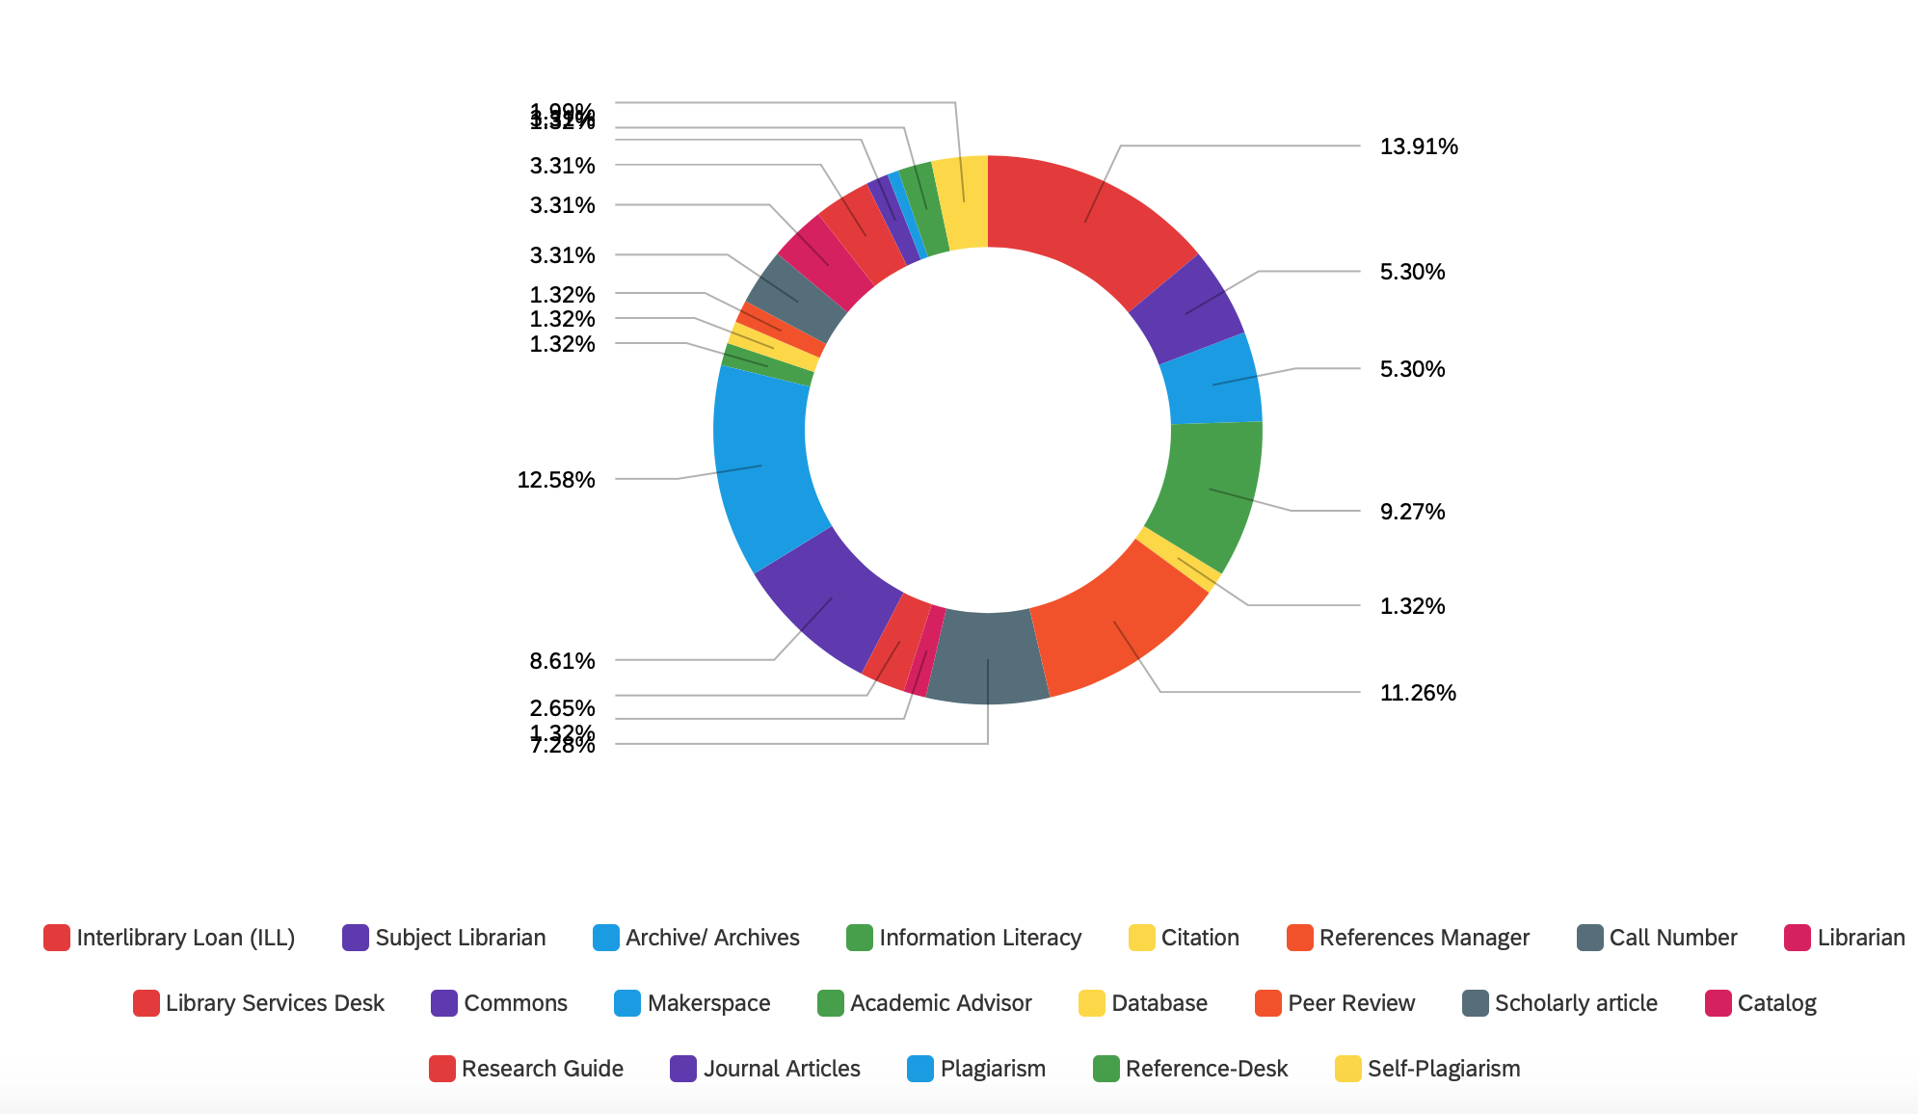

Slide 23
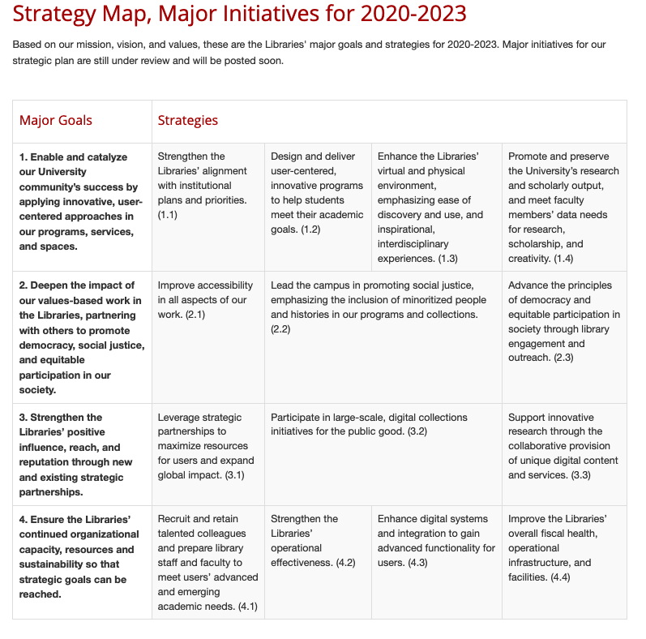

Slide 24
So What?

Slide 25
I couldn’t think of an image for Mission Creep, so here is a creepy diorama of a mission
Image: https://images.app.goo.gl/MjK6iAoX5MxhNh3e7

Slide 26
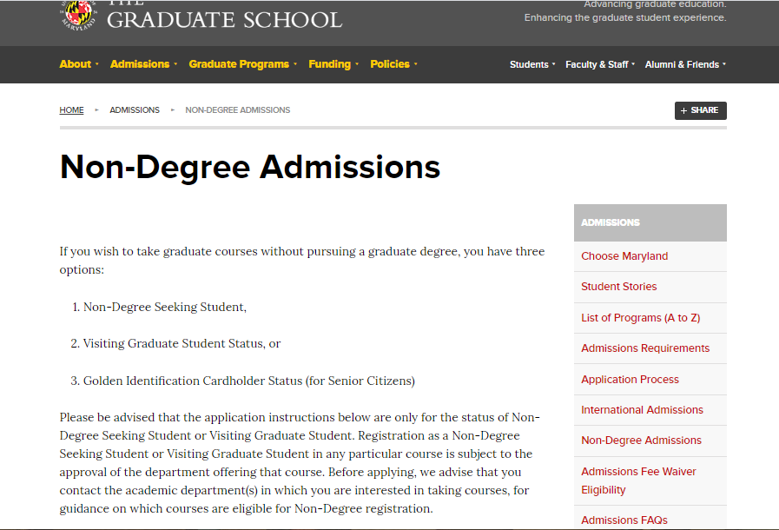

Slide 29
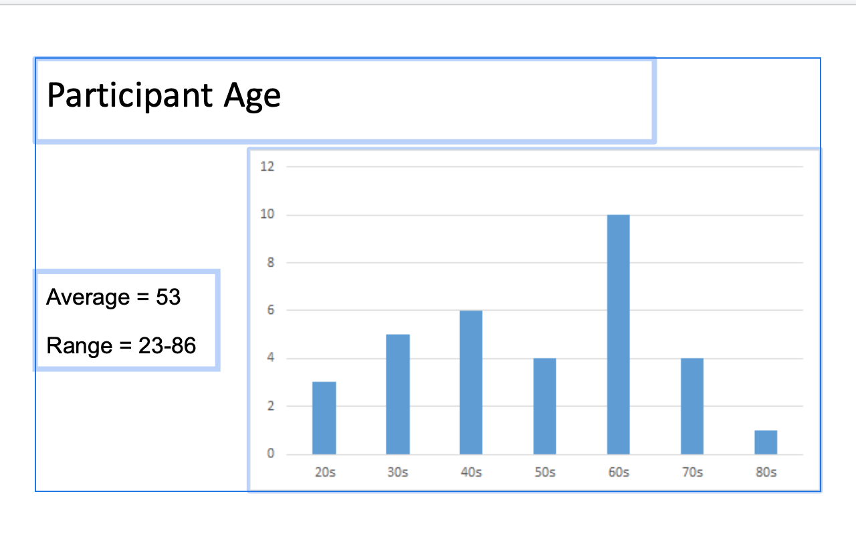

Slide 30
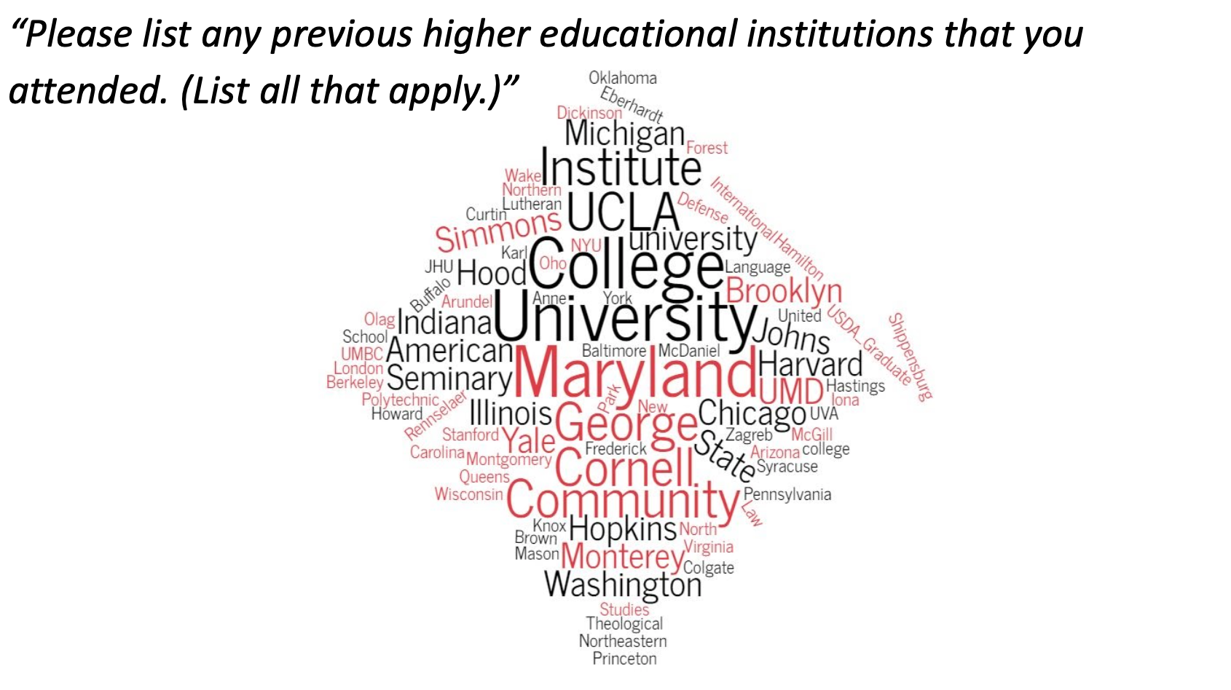

Slide 31
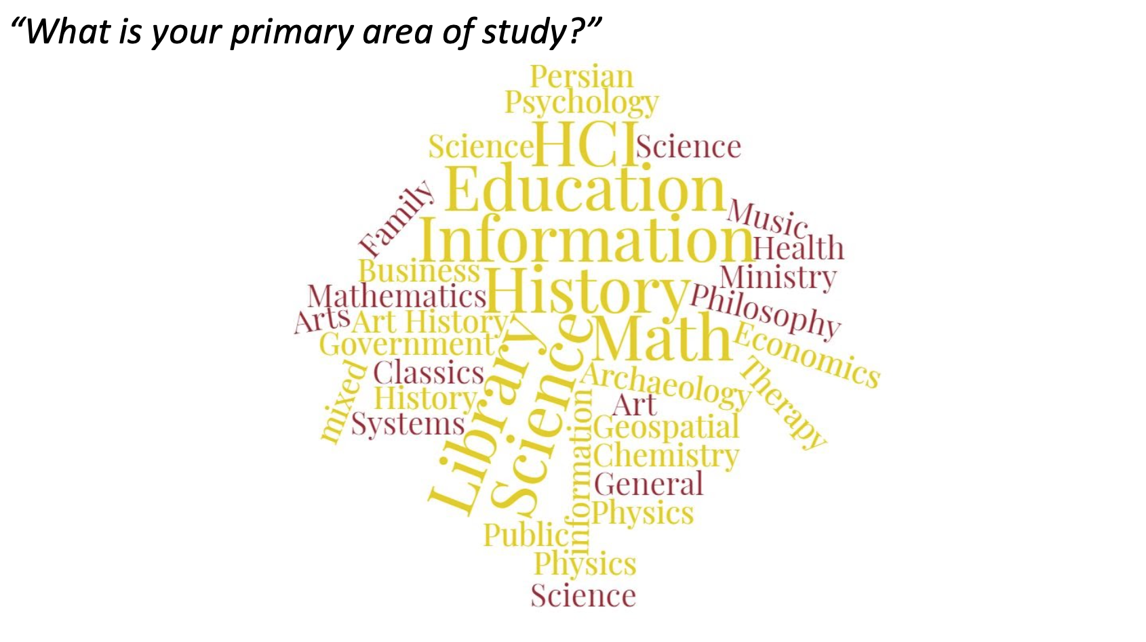

Slide 32
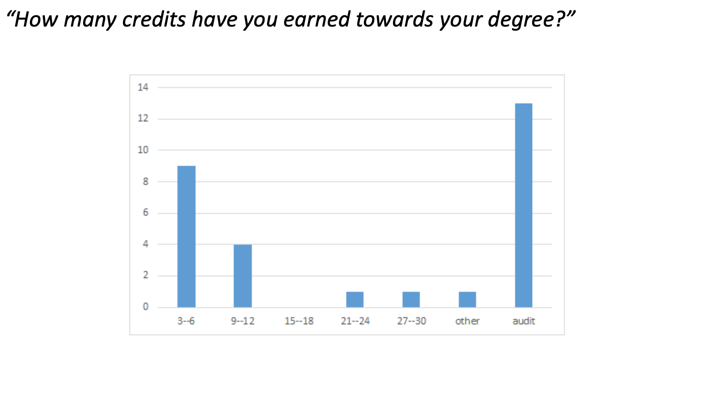

Slide 33
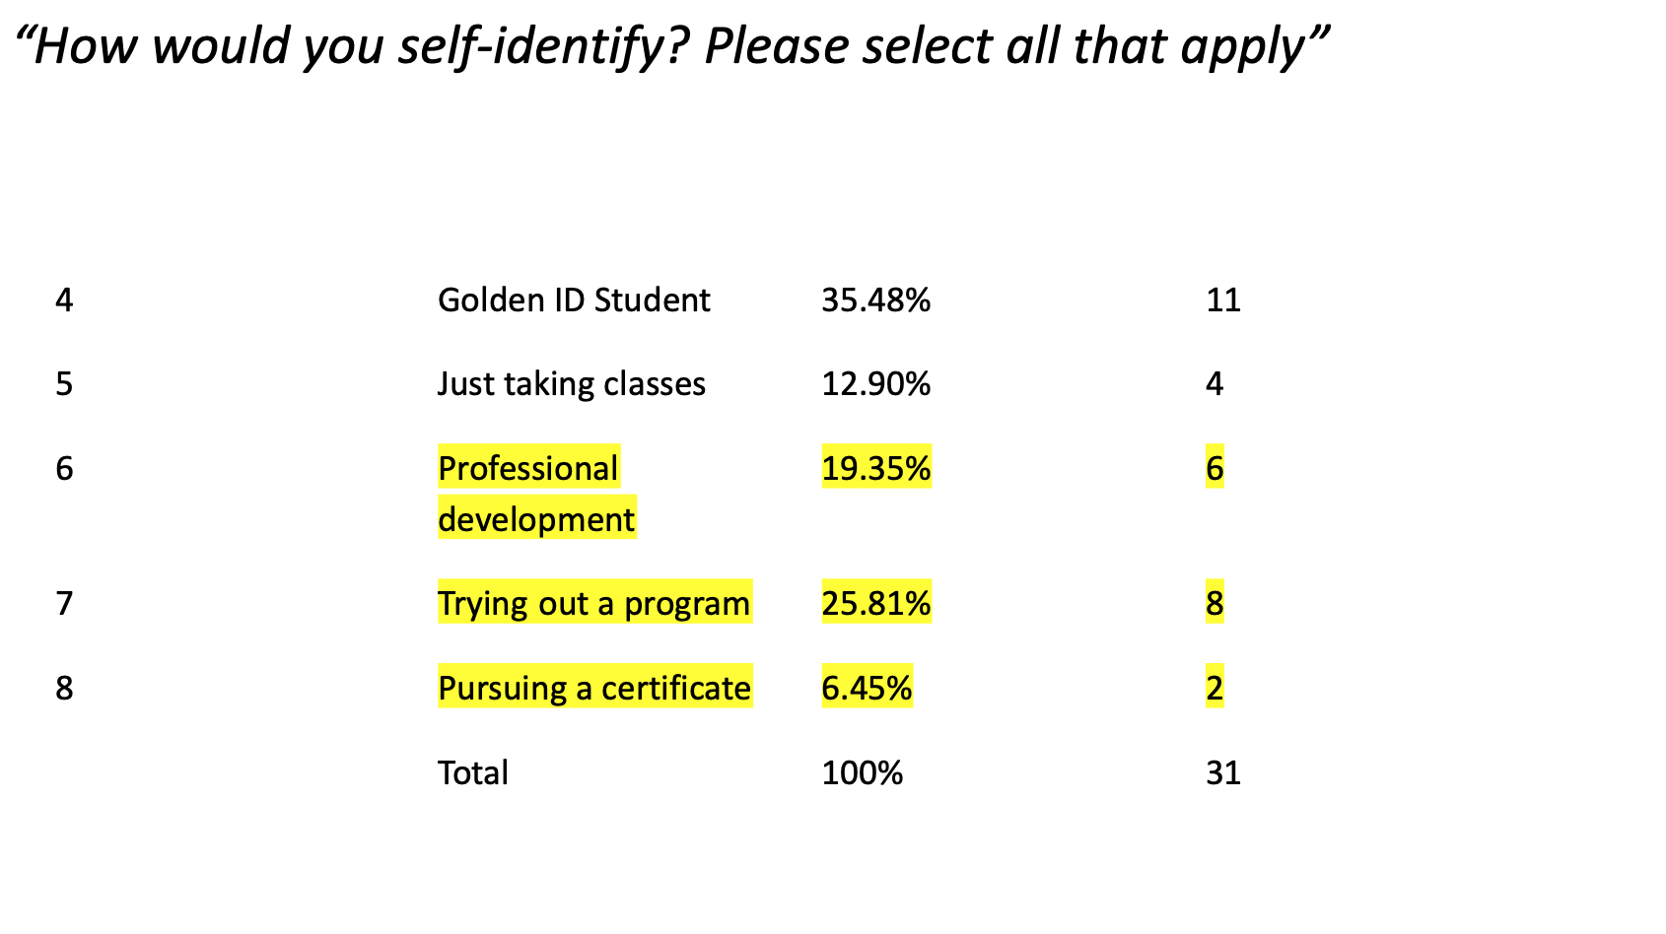

Slide 34
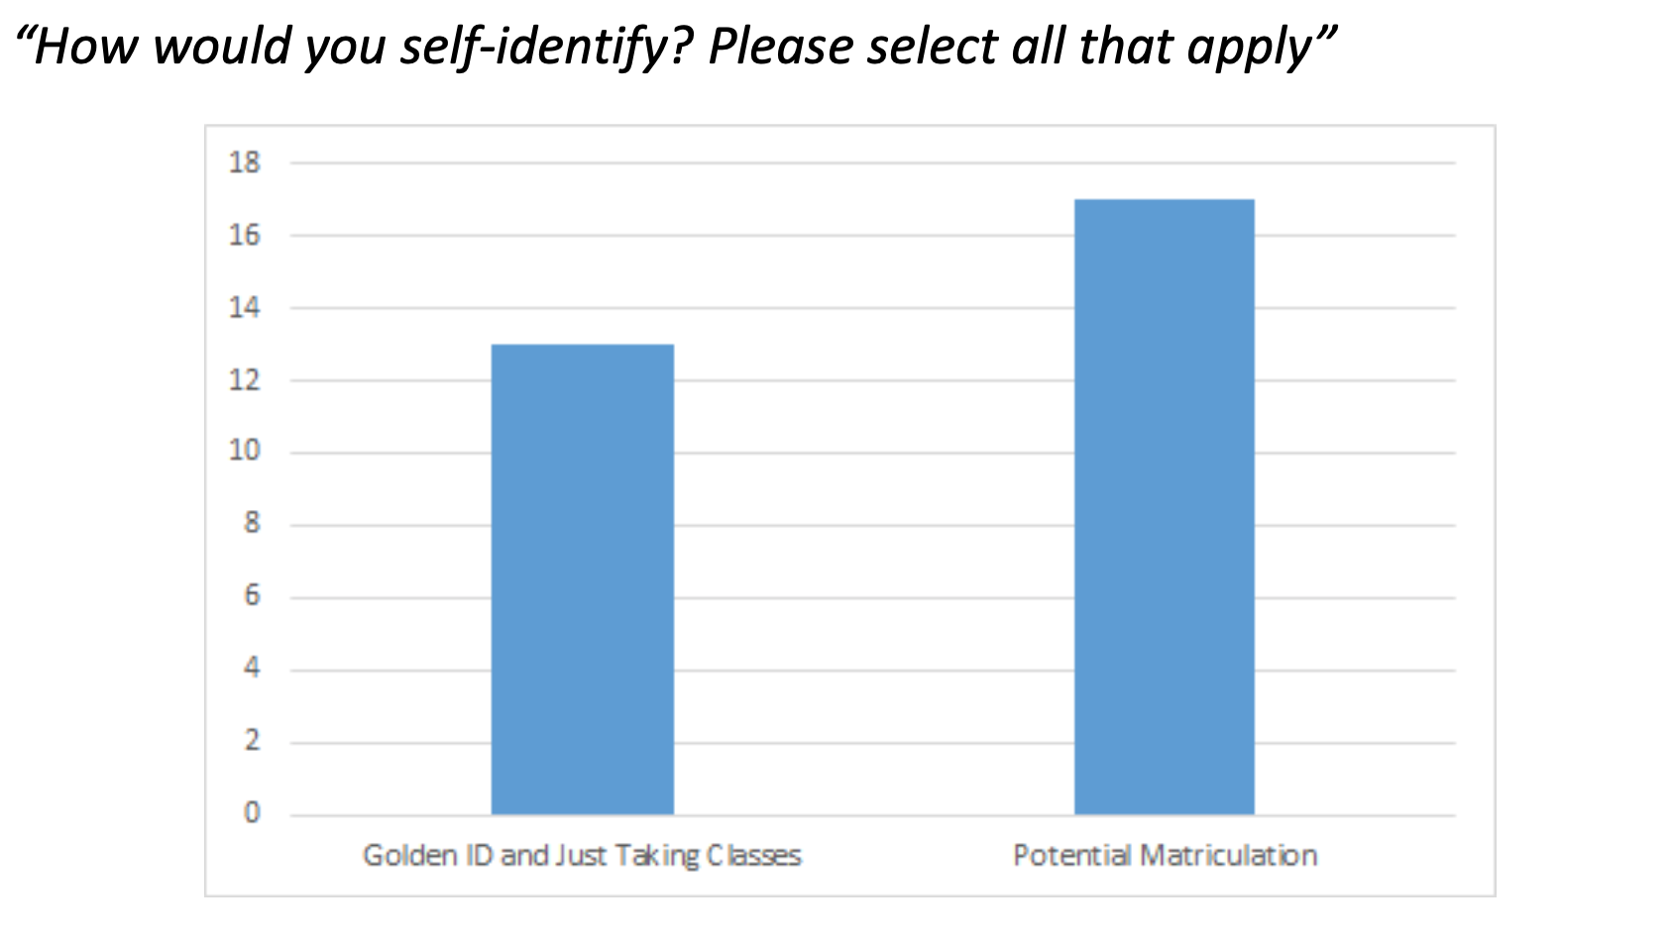

Slide 35
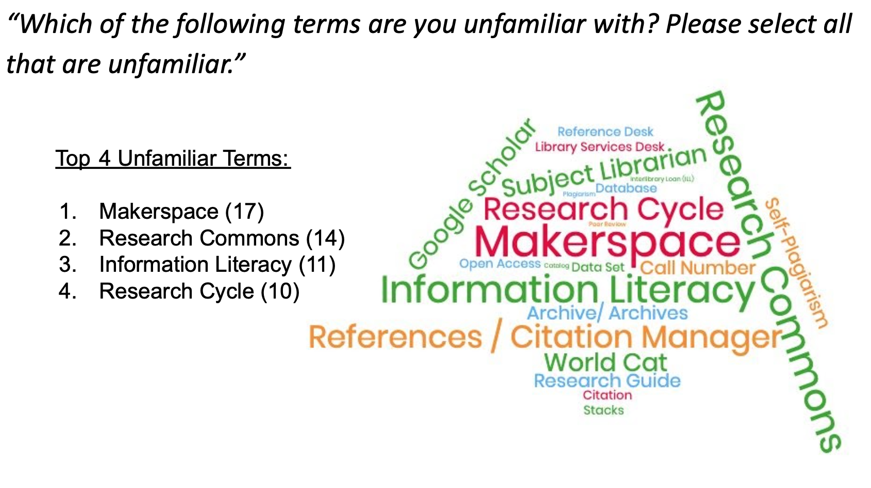

Slide 36
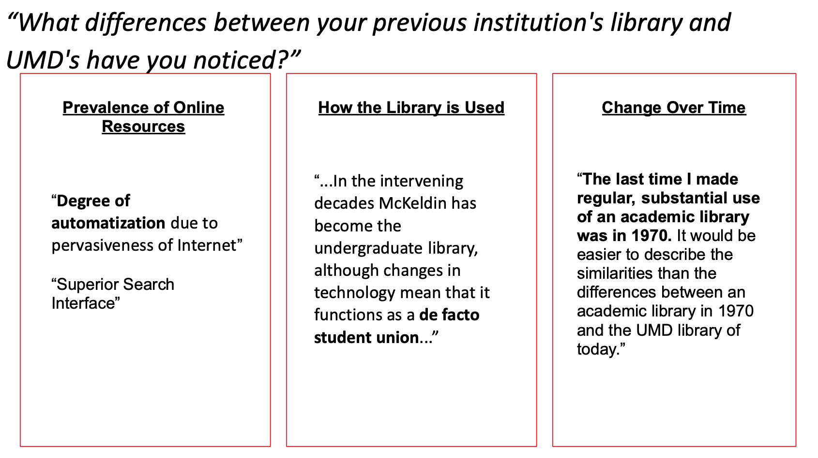

Slide 37
Thank You!

Slide 38
1) Is there a group, office, or other service on campus you'd be interested in developing a partnership with?
What have your obstacles been?
Do you see alignment with your library's plan?
What steps have you taken?
What does each partner gain from the partnership?
2) Has the pandemic revealed any new potential or actual partnerships?

