Slide 1
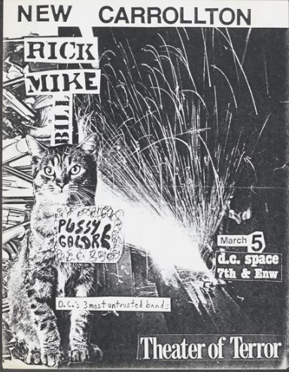
Great Expectations:
Community Engagement in Processing the Punk Archive
Ray Barker | Archivist | DC Public Library
Special Collections/Washingtoniana
Mid-Atlantic Region Archives Conference (MARAC) Friday Nov 8 2019 1:30 – 3PM
From: DIGDC.DCLIBRARY.ORG
Notes:
SLIDE 1: Hello, I'm Ray Barker, an Archivist in the Special Collections Department at the Washington, DC , MLK Memorial Library. I've been in this position for 2 ½ years.
Today I’m speaking about how I manage donor expectations by allowing members of the DC Punk music and related communities a peak “behind the processing curtain” so to speak, to more closely observe the status of their individually donated collections, through traditional means – like open house events, and public programs – and through less traditional ways: allowing donors to see the collection in the processing stage, and in some cases give individuals the opportunity to actually contribute to processing, or provide input in the description, through contributions to the biographical note in the finding aid.
I’ll share details regarding some of these examples today.
Because I’m speaking specifically about a music collection – or collections - the presentation section titles follow the general structure of a song. When we get to “extended guitar solo” you’ll know we’re near the end.
And you’ll notice a preponderance of Courier New font ahead…

Slide 2
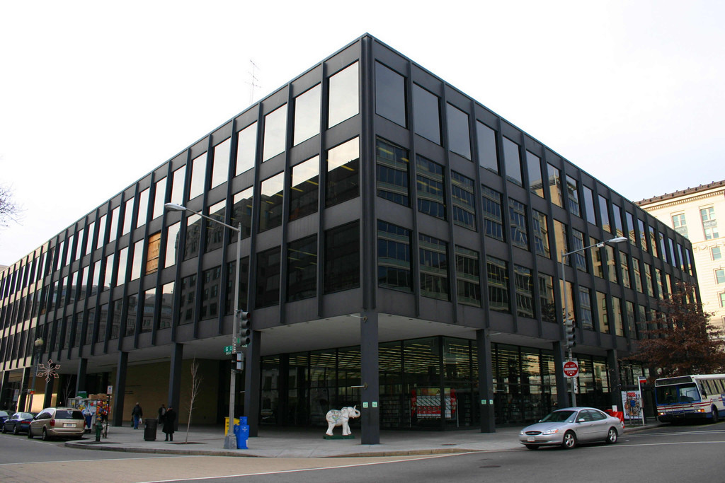
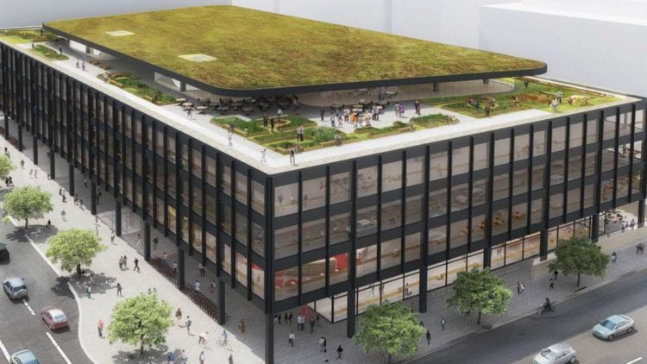
2020
INTRODUCTION
2019
Notes:
SLIDE 2: In theory I work at the building on the left: the Martin Luther King, Jr. Memorial Library, downtown DC. It opened in 1972.
But as of March, 2017 library services were suspended here when modernization efforts began. So I’ve never actually worked in that building.
The new library [the rendering on the right] is slated to open about a year from now. Included in the “modernization” work is brand new archival storage, a reading room, special collections exhibition space, and a café [all not pictured]. A rooftop garden terrace is one of the more outstanding features.
Special Collections staff –including myself – are currently working out of several sites across the District.
So next time you’re in DC, provided it’s some time after fall 2020, please stop in on the third floor and say hi. Or not.

Slide 3
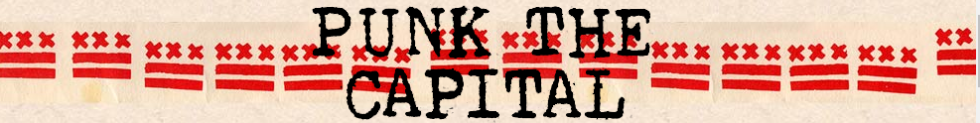
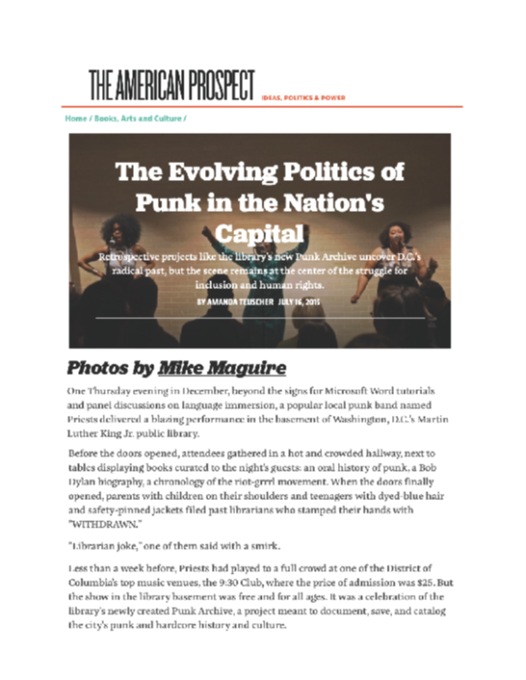
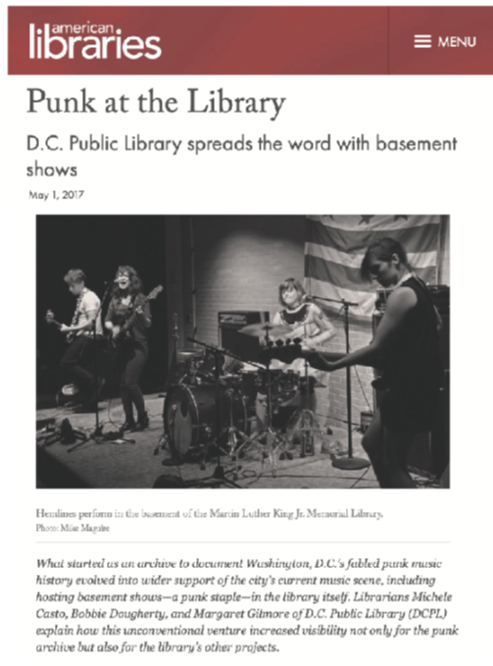
FIRST VERSE
HOW
WHEN
WHAT
WHO
WHY
?
Notes:
SLIDE 3: Here’s a brief history on the Punk Archive itself:
It started several years before I began at the Library by my colleagues Michele Casto, Bobbie Dougherty, and Maggie Gilmore, through their personal connections with DC filmmaker, James Schneider, whose documentary film, Punk the Capital was released in June of this year.
Here are a few articles on the Archive from its earlier days: the article on the left published in 2015, and on the right an article appeared in American Libraries a couple years ago focusing on the punk shows hosted by DCPL in the Library’s basement.
The Punk Archive itself is comprised of collections from approximately 40 donors, with donor Mark Andersen’s being the largest collection.

Slide 4
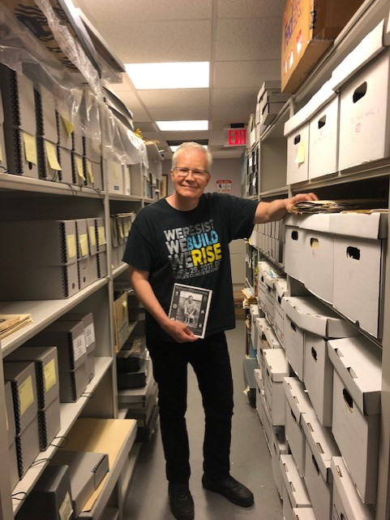
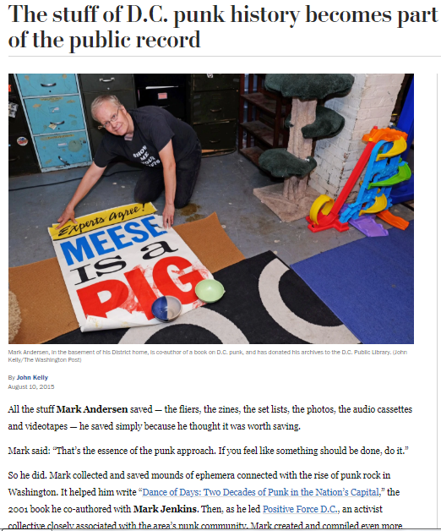
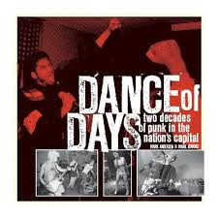
CHORUS
Donor: Mark Andersen
15
Notes:
SLIDE 4:
On the left is a feature in the Washington Post from 2015, on Mark. Now Mark is NOT a musician, but is a huge punk music fan, a community activist, and has worked with many punk bands to sponsor benefits for various local, national, and international causes starting in the mid 1980s. He’s one of our biggest advocates and donors, having contributed approximately 80 LF of materials: flyers, zines, audio and video recordings, and ephemera. Included in his donation are the research files for his book on DC music and activism, Dance of Days, whose cover is shown here.
Mark visited the Archives about a year ago, so I could show him the progress we’d made on his collection. (He’s holding a copy of a zine he created to give out to families and friends at Christmas.)
We are halfway through processing his collection.

Slide 5
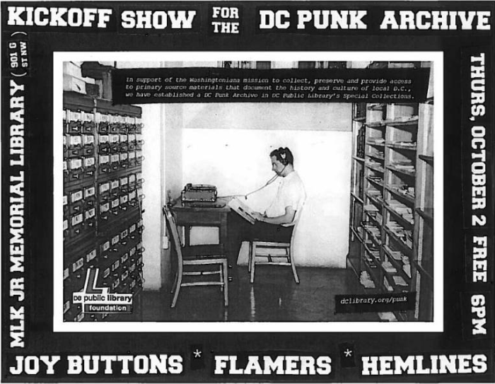
CHORUS
Notes:
SLIDE 5: Nearly from its inception, a part of creating awareness of the Archive then and now still is through hosting live music performances by local bands in the basement of the MLK Library, and other locations throughout the Library system.
In keeping with popular punk flyer documentation practices, the year of the advertised event is not included on this flyer, but it’s likely from a show in 2014.

Slide 6
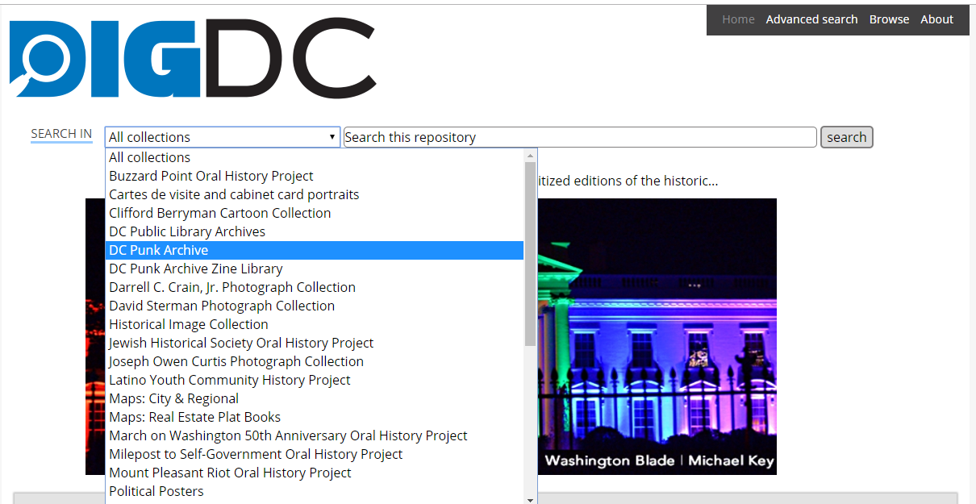
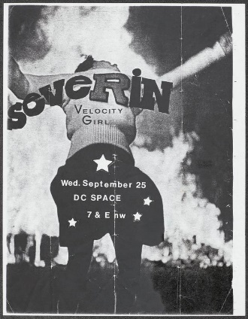
CHORUS
DIGDC.DCLIBRARY.ORG
Notes:
SLIDE 6:
Much of the born digital and digitized content of the Punk Archive is discoverable in our online portal, DIG DC. The DC-area zines and flyers from the Mark Andersen collection, and from other donors, are routinely being added, and made accessible here.

Slide 7
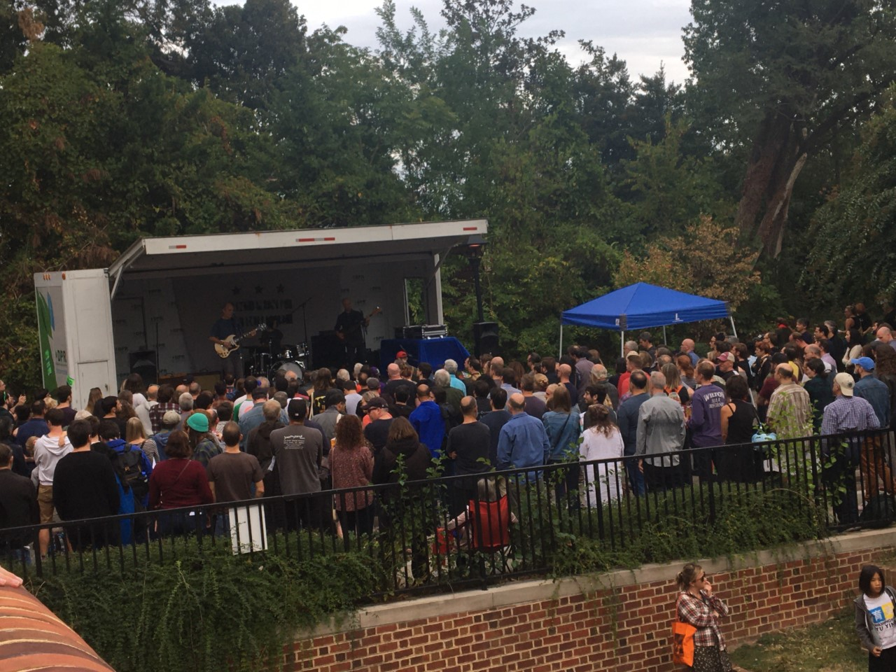
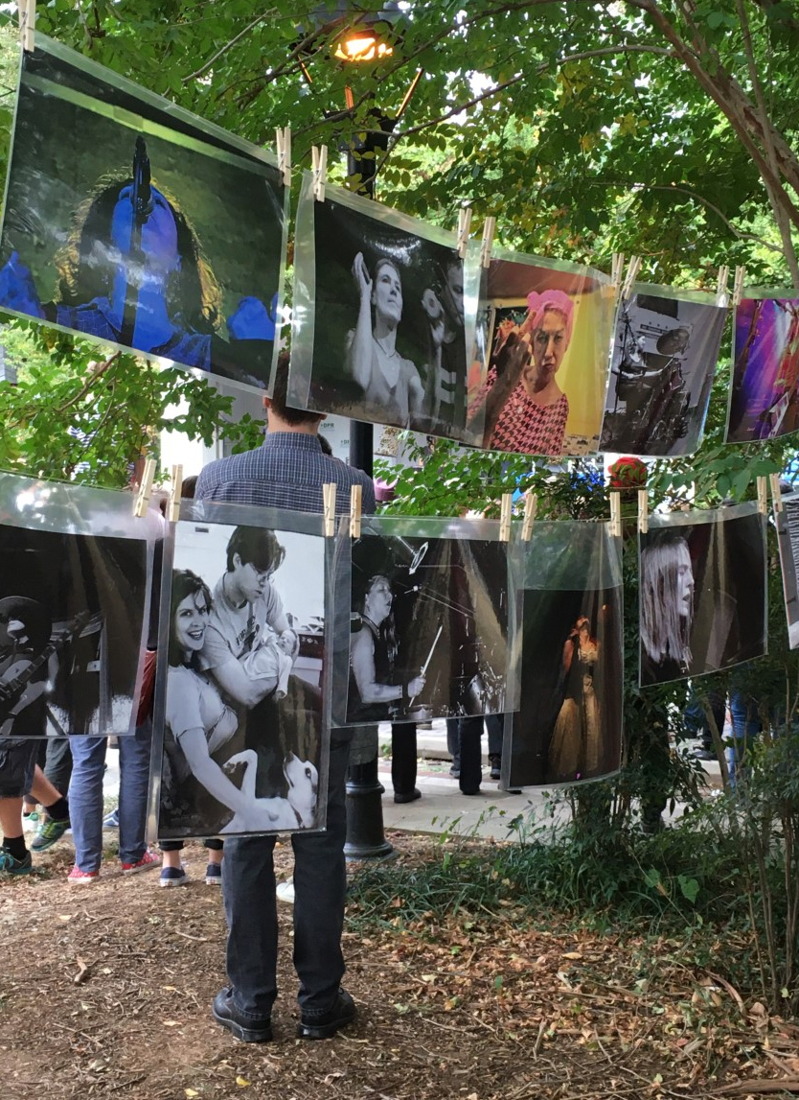
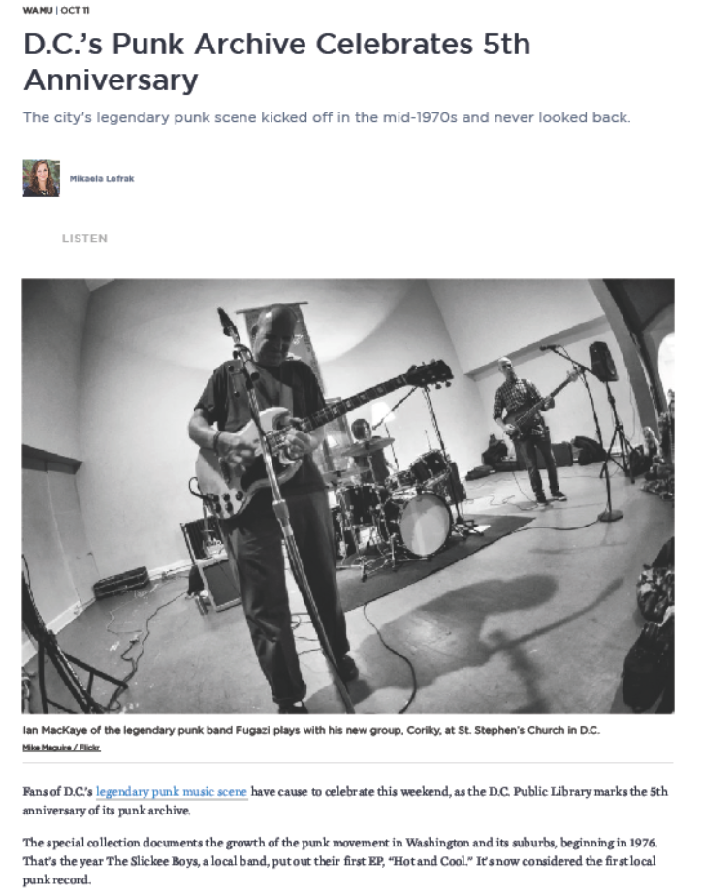
5 YEARS OLD
!
SECOND VERSE
Concert and photo exhibit
behind Georgetown Public Library SAT OCT 12 2019
WAMU/NPR article
11 OCT 2019
Notes:
SLIDE 7:
The Archive officially turned five last month.
That slow-moving underline is indicative of how the collections have trickled in over the years, but also exemplifies our processing rates as we’ve worked with a rotating - but always dedicated - team of volunteers and interns over the years.
In honor of its birthday, we hosted a public program at the Georgetown Branch Library – where the archive is stored - a few Saturdays ago.
Behind the Library – the image on the LEFT – features a photo exhibit by a photographer promoting her recently published book: Frame of Mind: Punk Photos and Essays from Washington, DC, and Beyond.
.
And on the RIGHT is a photo of the newly and covertly formed band Coriky – with members of the band Fugazi. And the local NPR affiliate published a brief story on the Archive’s anniversary.
It was a great turnout, and to my knowledge, the neighbors did not call the police with any noise complaints.
While that was occurring outside, inside the Library’s reading room…

Slide 8
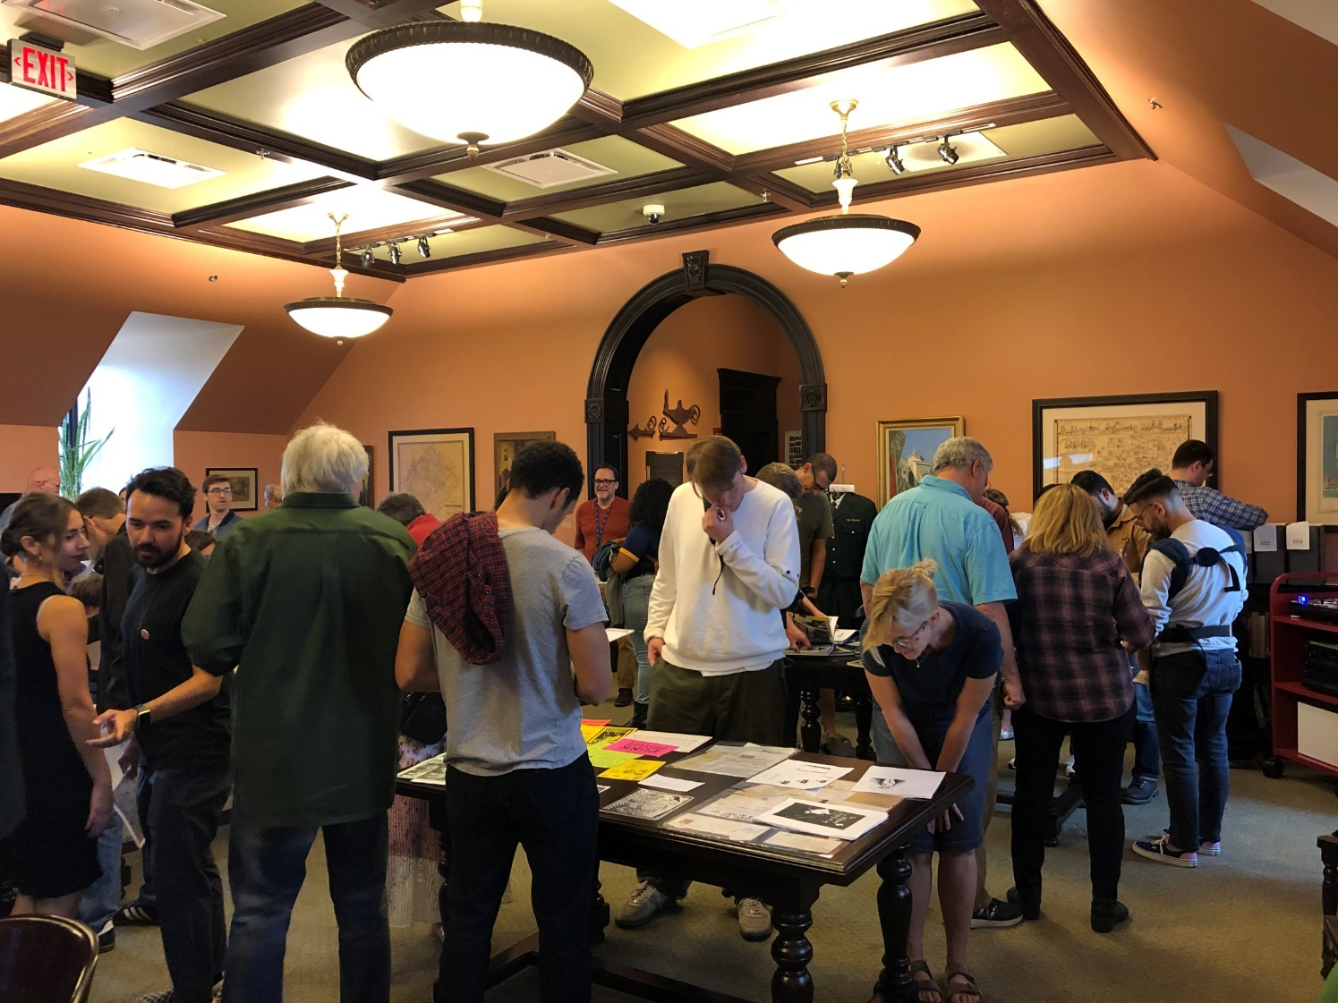
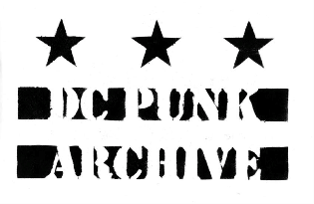
SECOND VERSE
Punk Archive Open House
Peabody Room Georgetown Public Library
SAT 12 OCT 2019
Notes:
SLIDE 8: …we held an open house. This is the room where I work with volunteers to process the collection, but it’s also where it’s accessed by researchers.
(That’s me in the back looking somewhat contentedly at the proceedings…)

Slide 9
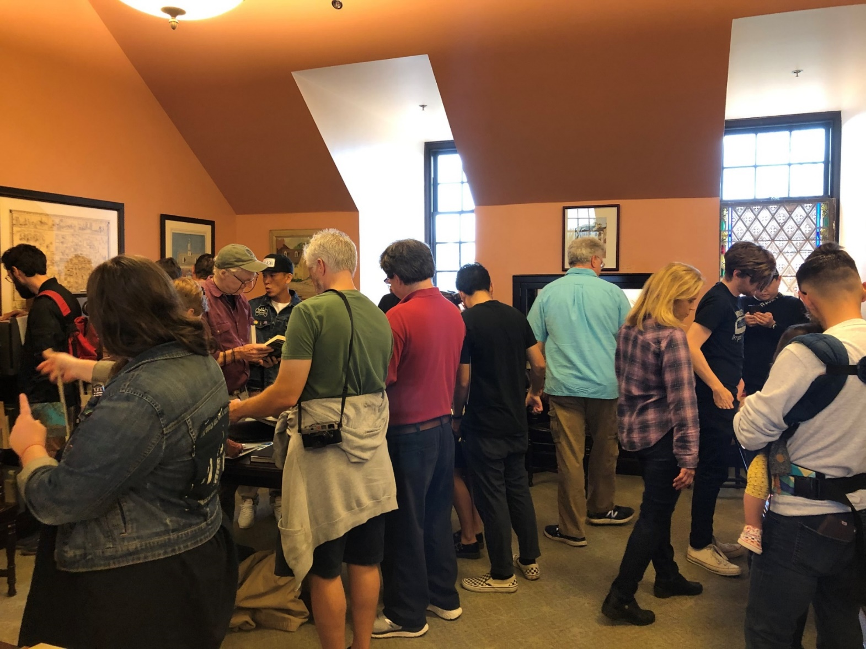
“Archivists will be on hand to discuss items from the collection…and how the collections have been used by researchers.”
--WAMU/NPR article
11 OCT 2019
Punk Archive Open House
Peabody Room Georgetown Public Library
SAT 12 OCT 2019
11
Notes:
SLIDE 9:
We featured many materials from our collection: selected flyers, Riot Grrrl correspondence, user and reference data, and a book, zine, and stereo corner for visitors to peruse, and play records from the collection [that’s all that activity in the far corner].
We had over 200 people attend, and for many, this was their first time seeing selections from the collection, half of which is unprocessed.

Slide 10
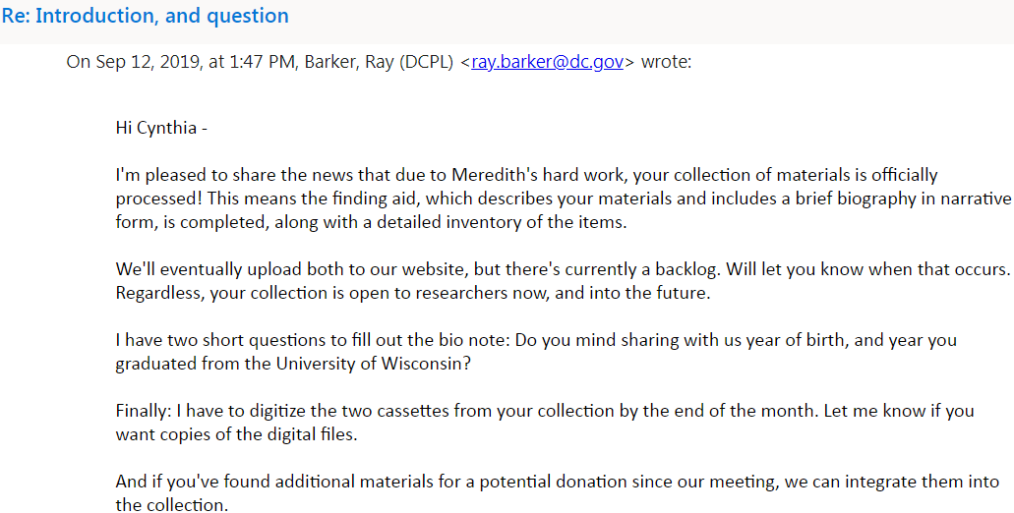
Second Verse
Donor: Cindy Uleman
15
Notes:
SLIDE 10:
One of the attendees was a donor, Cynthia Uleman. Featured in the next two slides is my email exchange with Cindy, informing her that her collection is processed, and of what “processed” means. I’m asking for additional information re: her birth year and college graduation status, since
for her biographical note, we asked her to provide details of her life, and how she started collecting – details she provided in a lengthy biographical narrative via email.

Slide 11
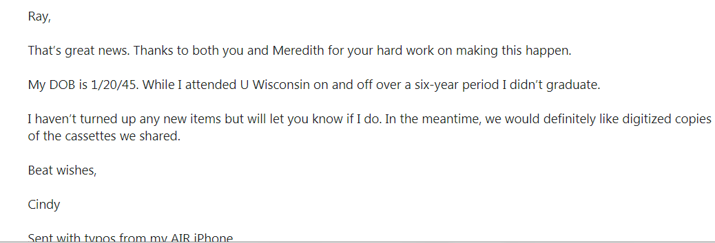
Second Verse
Donor: Cindy Uleman
15
Notes:
SLIDE 11:
And this is her reply, providing that missing information, and confirming she’d like digitized copies of the cassette tapes she donated to us—something I’d promised to do when she initially made the donation.

Slide 12
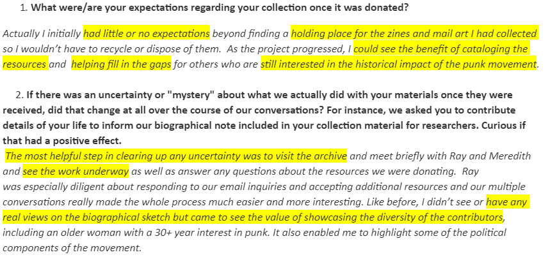
Second Verse
Donor: Cindy Uleman
15
Notes:
SLIDE 12:
And for the purposes of this presentation, I asked Cindy a couple of questions re: her expectations for her donation – which is about 3LF of zines, flyers, and an amazing/strange collection of post card art. She says she had little or no expectations regarding the collection once it was donated, aside from the Library’s archive serving as a (quote) “holding place for zines and mail art I had collected,” end quote. But that she could (in quotes) “see the benefit of cataloging the resources” as the project progressed and we provided updates.
And (2.) secondly I asked her if through the process of corresponding, if it removed any sense of mystery about what we did. She said her visit to the Archive and in seeing the processing work in action was most helpful in clarifying any uncertainty she had.
She said through that process she began to see how she fit along with the other donors to the archive.

Slide 13
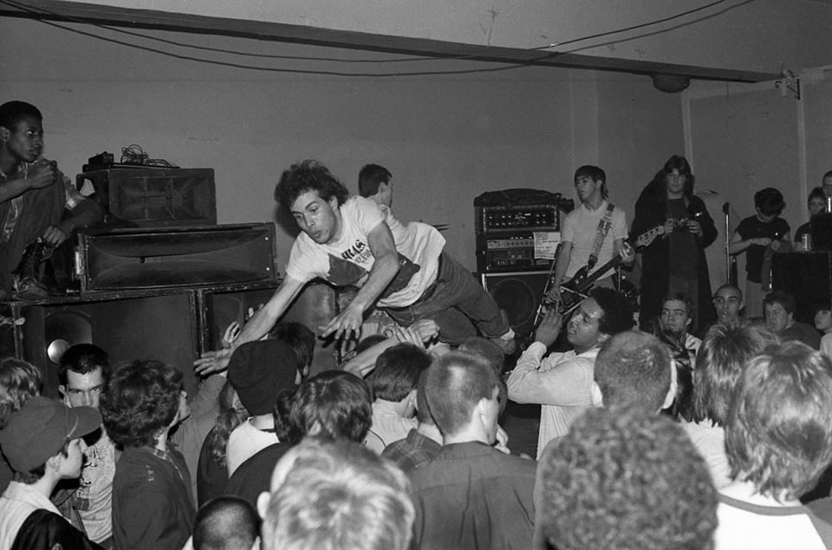

CHORUS
Tom Berard:
15
Musician, fan, “scenester”, donor, volunteer, stage-diver…
Double-O at the Wilson Center Washington DC, Ca. 1982
Photo: Ellie Moran
Notes:
SLIDE 13:
An extremely active member of the music scene, Tom Berard, who attended the open house I mentioned earlier, is a: musician, music fan, talking head in most of the DC punk documentaries [credited as a “scenester”), he’s a collector, donor, once upon a time stage-diver, and as a volunteer helped sort the Mark Andersen materials. I recorded a brief interview with Tom to include in this presentation, to get his thoughts on what his expectations were re: the punk archive in general and his collection in particular, and how he expects the material to be accessed - online or at the Library – among other questions.
I talked to Tom as he drove from NYC to DC last week. I think at the beginning you can hear his turning signal. It sounds like he’s chewing his gum loudly – he’s not.
The clip is six minutes long.
“So, Tom: Would you expect people to find your collection online?”
SWITCH SLIDE AT END OF QUESTION PORTION

Slide 14
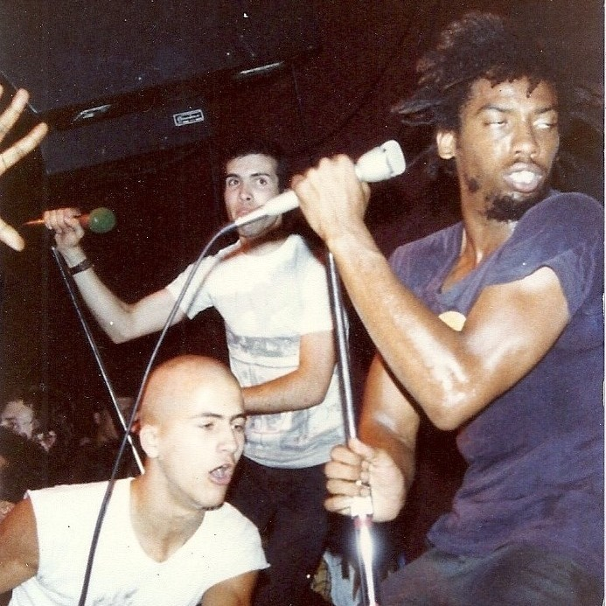
CHORUS
15
Tom, on left, with HR - Bad Brains
9:30 Club Washington DC Ca. 1983
Notes:
SLIDE 14:
Tom with HR from Bad Brains CLICK WHEN I SAY “FLYERS”

Slide 15
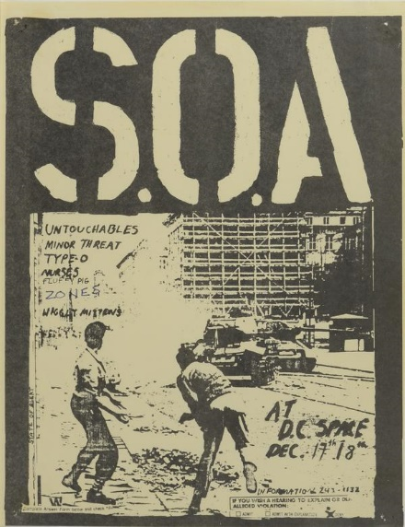
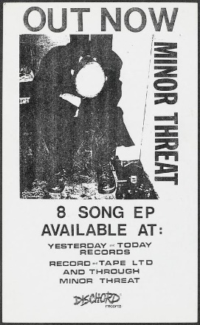
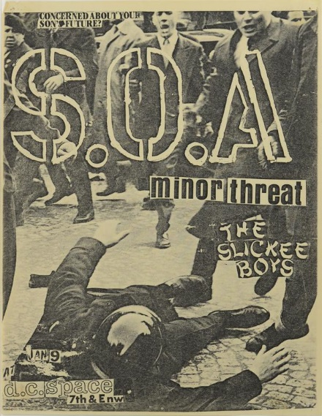
CHORUS
FLAG?
Available: DIGDC.DCLIBRARY.ORG
Selected flyers from the Tom Berard Collection
DC Public Library Special Collections
Notes:
SLIDE 15:
CLICK TO REVEAL “FLAG?” AND AT “SETLISTS”

Slide 16
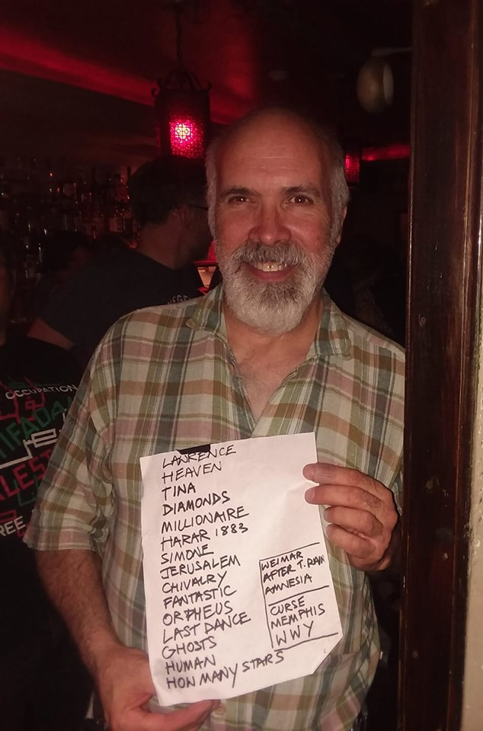
GUITAR SOLO
15
Tom today, with
The Mekons set list from a show
*Not in the Punk Archives (yet)
Notes:
SLIDE 16: Tom today with The Mekons set list from a show
CLICK AT…?

Slide 17
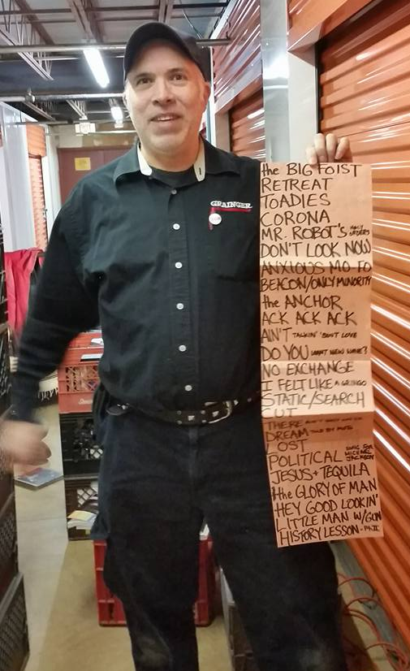
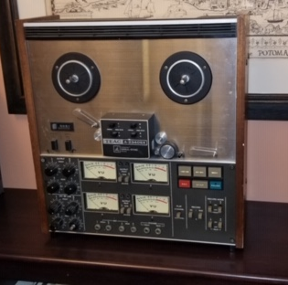
EXTENDED GUITAR SOLO
15
Inner Ear Studio 4-track recorder
The Minutemen set list from show
*Also not in the archives
Notes:
SLIDE 17:
Tom and another set list – The Minutemen and Inner Ear Studios 4-track recorder [CLICK TO SEE]

Slide 18
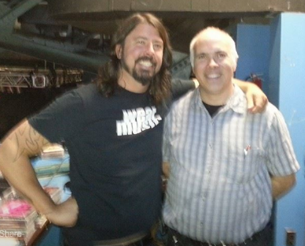
CHORUS
15
Tom, on right
Notes:
SLIDE 18:
It sounds like I’m explaining in advance why is collection isn’t processed yet, but I just wanted a more specific answer from him regarding a timeline.
And not that Tom is representative of the entire punk community in DC, but some of what he says I find helpful: He doesn’t have a real sense of what the details involved in processing, and has no real expectations re: a timeline. He might be an anomaly in this case, but I found his comments helpful, in at least how it applies to his collection.

Slide 19
OUTRO
But Why?
Why not?
Including donor sets “appropriate” expectations
Donor has unrealistic expectations re: timeline or importance
Can inform accuracy of bio note
Give donor a little, a lot taken
May want to “sanitize” bio note
Removes mystery
And also…
Institution determines approach
Notes:
SLIDE 19:
So Why do this? Why be so transparent with donors?
Benefits:
--I do believe it sets their expectations appropriately if we include them – select donors only – in the process
--As with the Uleman collection, donor can provide helpful information to make a more complete biographical note
--Provides a more clear picture of our work and what we do
Drawbacks:
--Creates opportunity for unrealistic expectations, such as the donor expects ALL: Item-level description; expect their collection to be first in the queue; inflate the value
--May provide donor with a sense of ownership to the collection and decisions they don’t actually have
--And relatedly, may be allowing for them to make editorial choices re: descriptive details of the collection
Additionally, the type of institution where one works likely defines what is possible. Because I work in a Public Library, where access is theoretically open to everyone, it allows for this more democratic and collaborative approach which I’ve just shared with you.

Slide 20
Fade Out
Thank you
!
ray.barker@dc.gov
Notes:
SLIDE 20
Thank you

Slide 21
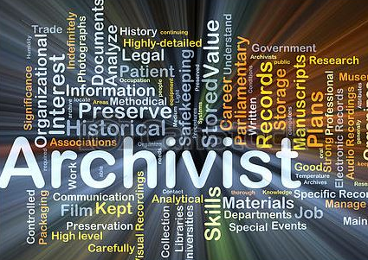
A Day in the Life of An...
INTRODUCTION
Notes:
SLIDE 3: START READING IMMEDIATELY
As an Archivist in Special Collections, some of what I do is not listed in this slide:
I process our backlog of unprocessed collections; supervise the processing, and description of the Punk Archive and other archival collections; create and conduct public programming; work with donors; conduct reference and outreach, and conduct oral histories.

