Slide 1
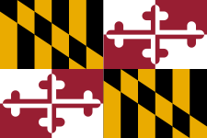
Dan Ramirez
Maryland Room Librarian
Prince George’s County Memorial Library System

Slide 2
Background
MLS University of Maryland 2012
Took Special Collections Class in fall of 2010
Over Half a Decade of Work Experience at Maryland State Archives (2006 -2013)
Current Trainings with Digital Maryland have been helpful regarding Scanning, Oral History Workshops, etc.

Slide 3
Current Challenges
Time Famine
Library Branch Renovation-December 2016
Additional Staff Support Needed
Limited Resources
Need to Refine Collection Scope
What to do with materials outside of scope?
Cataloging Needed
Task Prioritization

Slide 4
Challenges Continued
Juggle
Standard librarian duties
Librarian leadership duties
Passport duties
Attend trainings: Public Librarianship Regulated Industry

Slide 5
Solutions
Reality is negotiable
Ask for additional staff
Find volunteers from MLS programs
Encourage fellow staff to take an interest and work on the collection
Ask for time to work on the collection
Can I have two days to work on the collection?
At least get one day to work on the collection

Slide 6
Accomplishments
Programming Partnership with Prince George’s County Historical Society
Networking
Social Media Blitz: Throwback Thursdays
Digital Maryland Scanning of the Wilfong Project
Inventorying Collection
Relocating material to other institutions
Two Staff Members to Help
Two Volunteer MLS Interns

Slide 7
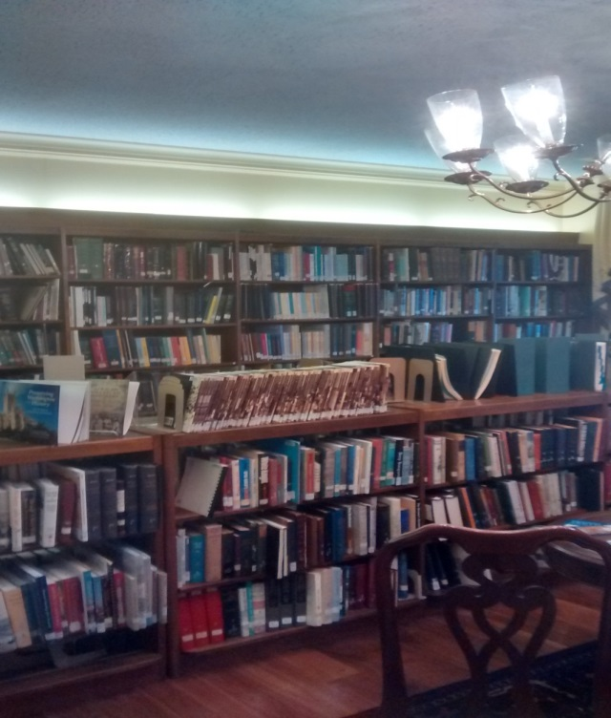
View of the Collection

Slide 8
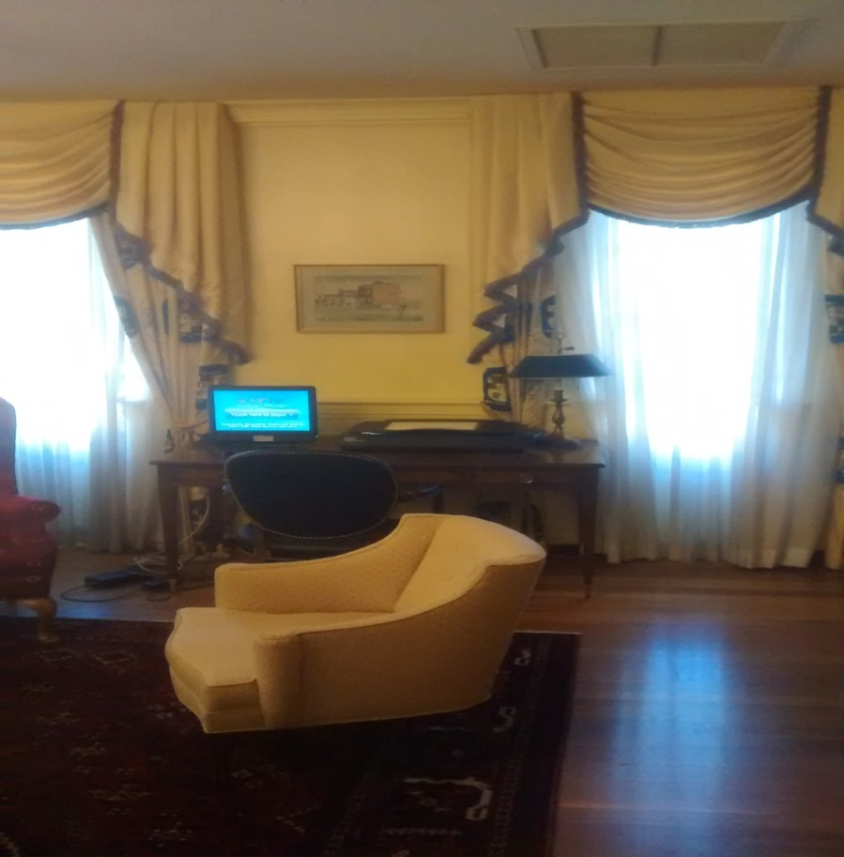
View of the Collection

Slide 9
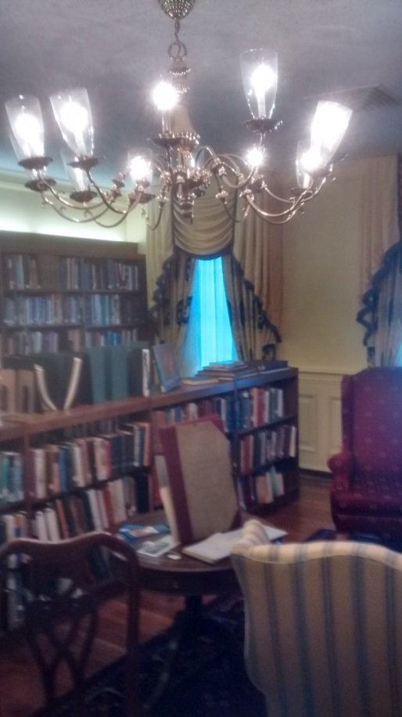
View of the Collection

Slide 10
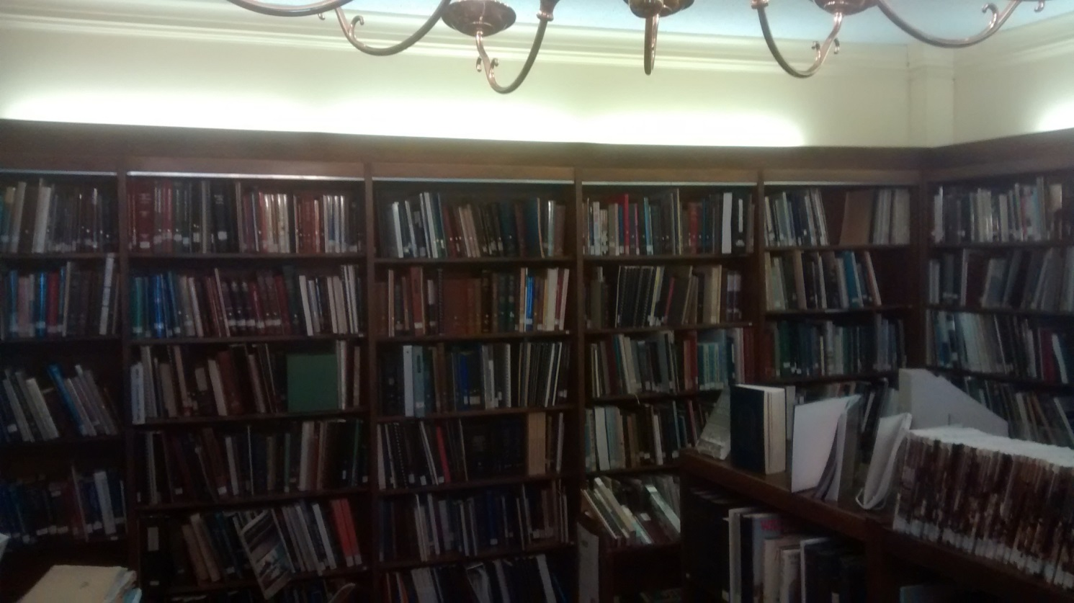
View of the Collection

Slide 11
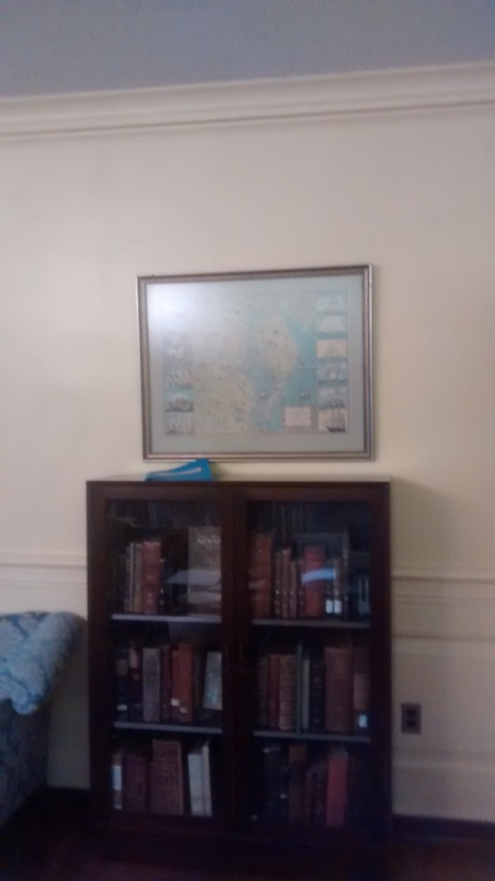
View of the Collection

Slide 12
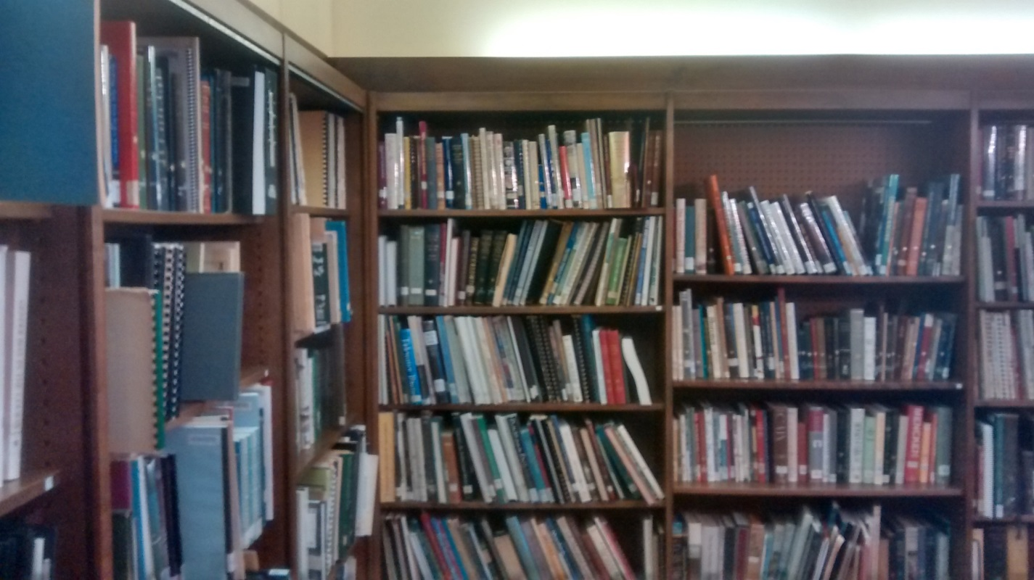
View of the Collection

Slide 13
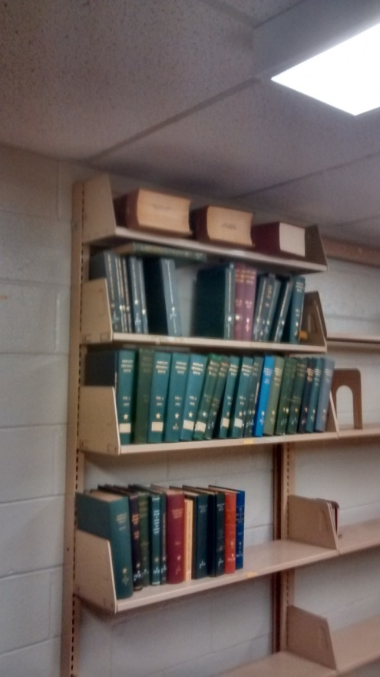
Storage

Slide 14
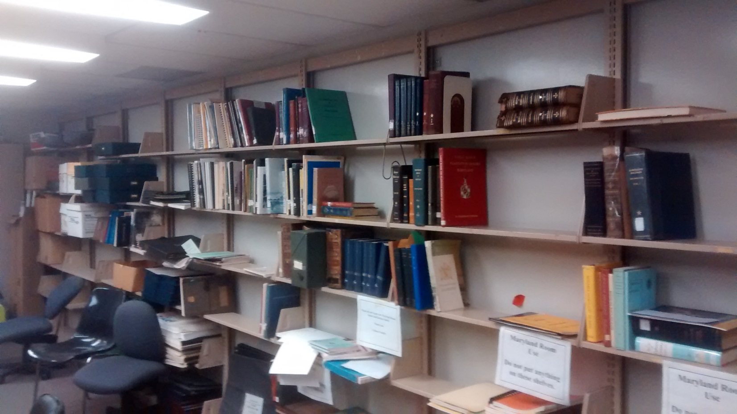
Storage

Slide 15
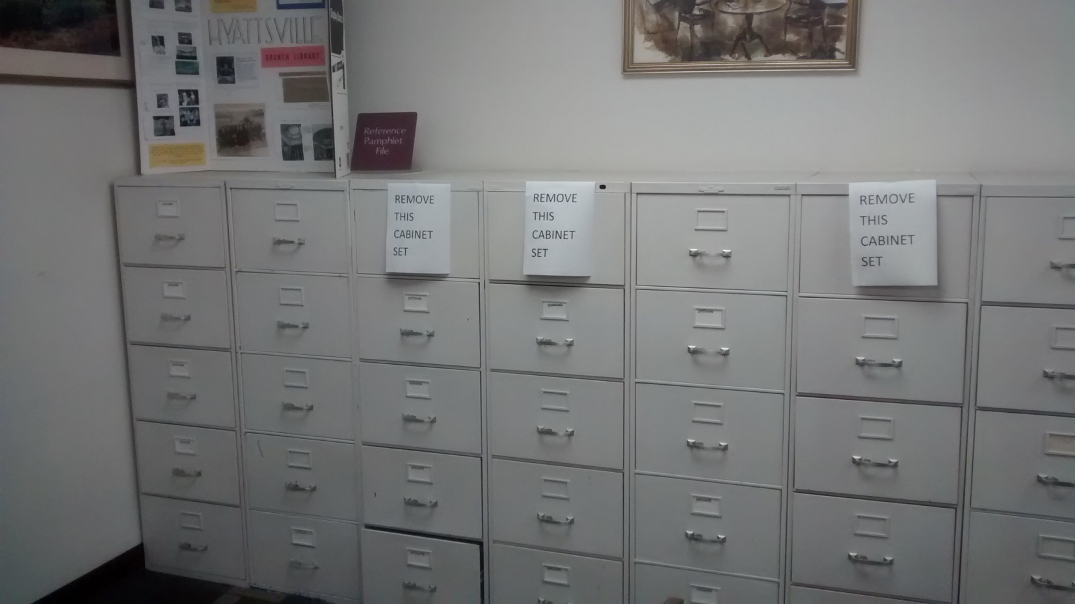
Vertical File

Slide 16
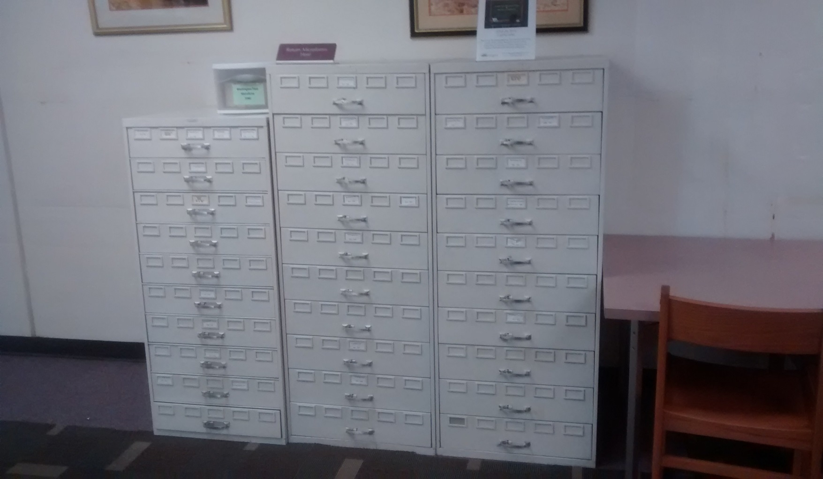
Microfilm

Slide 17
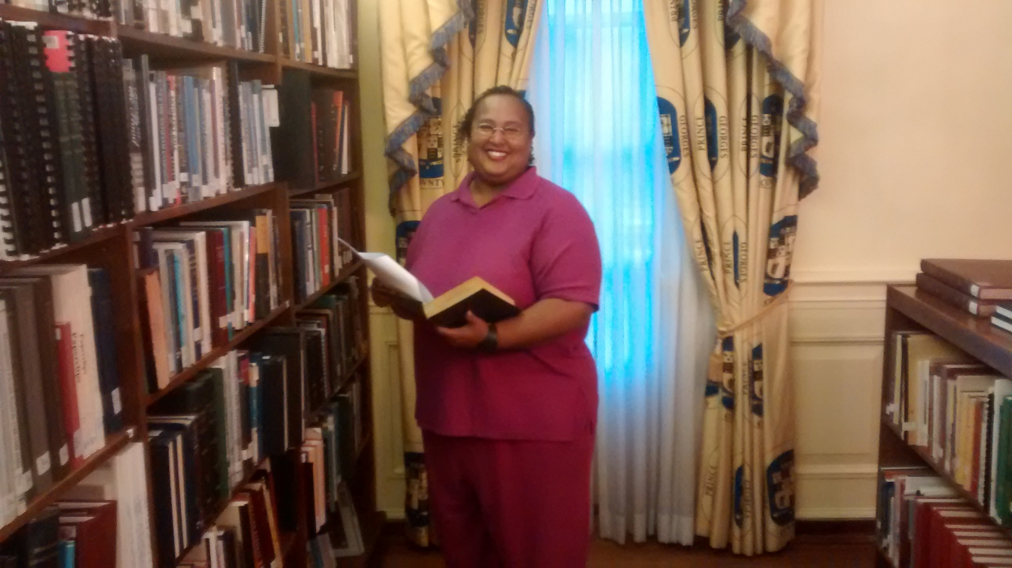
Intern Shana

Slide 18
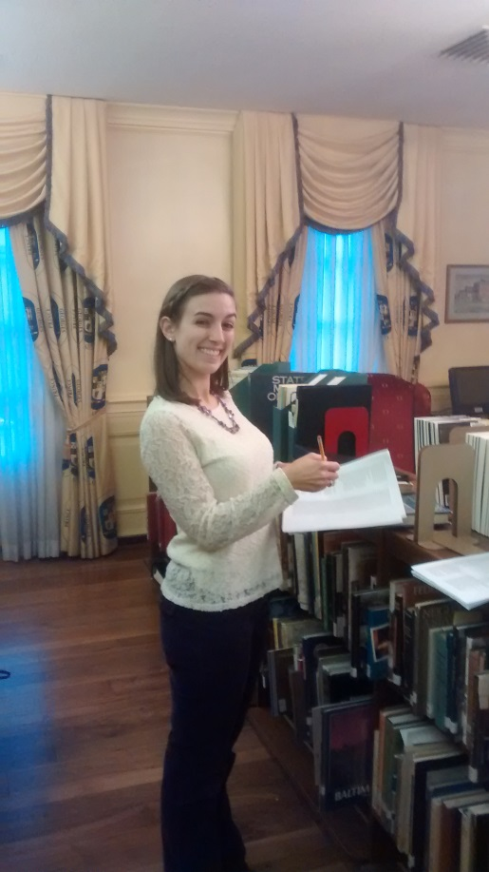
Intern Joanna

Slide 19
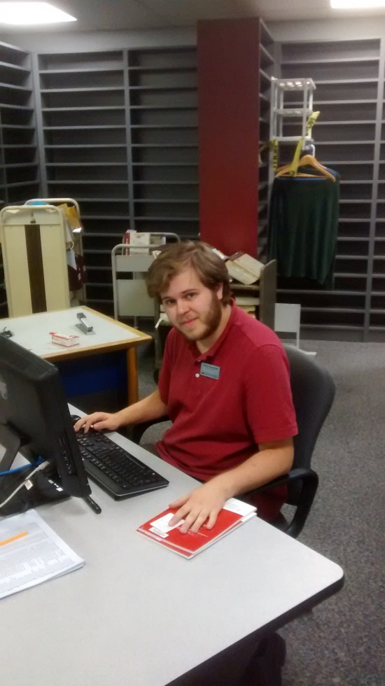
Caleb: Staff

Slide 20
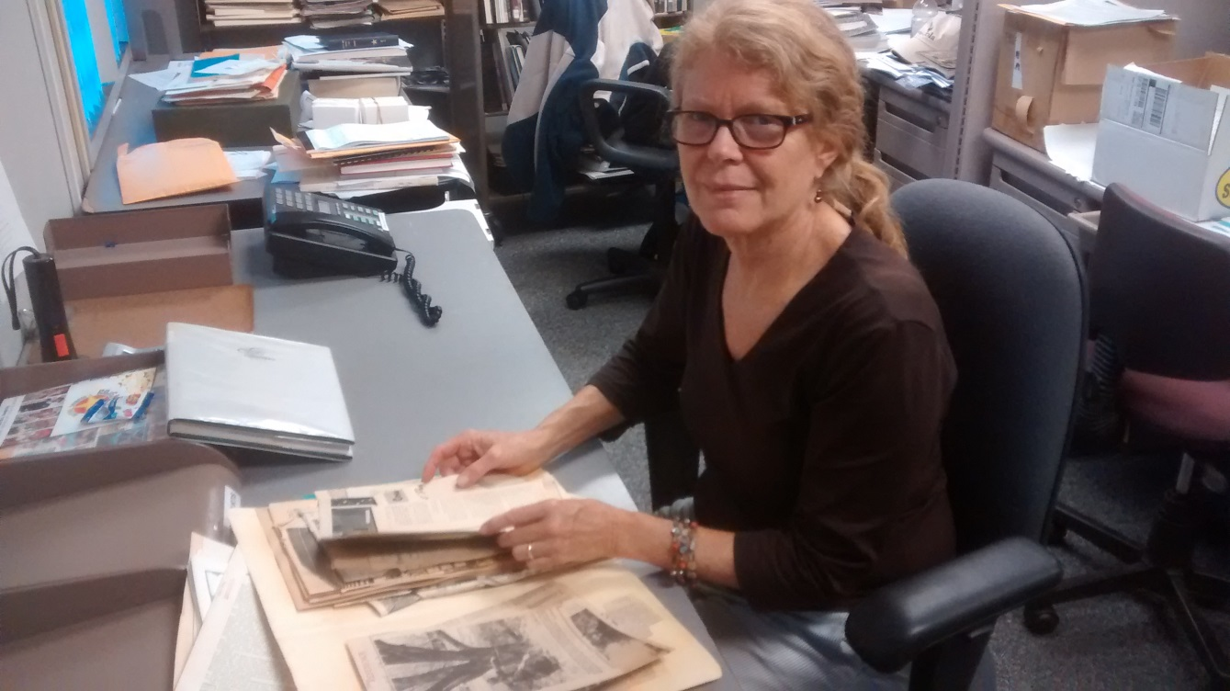
Susie: Staff

Slide 21
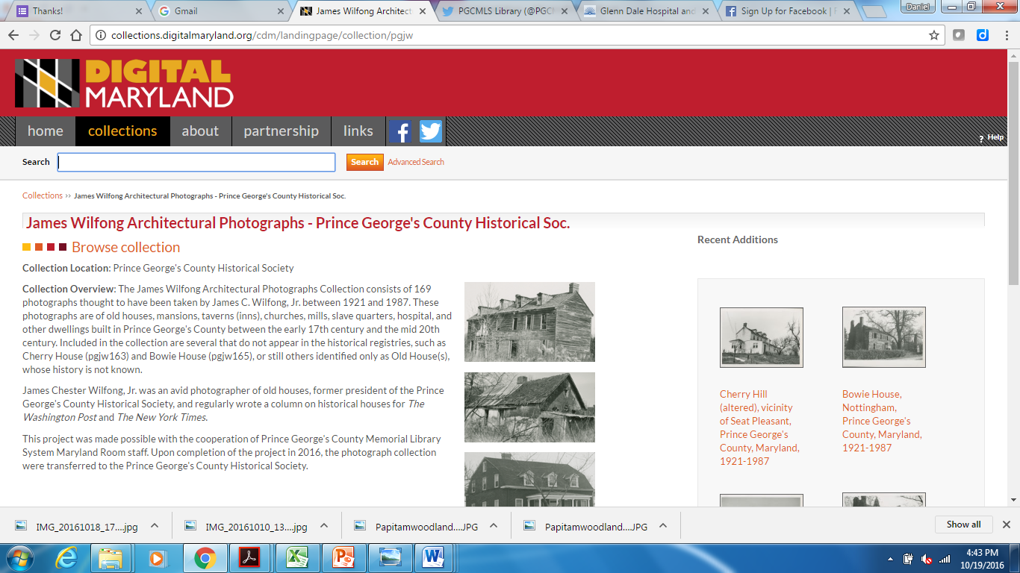
Digital Maryland Project

Slide 22
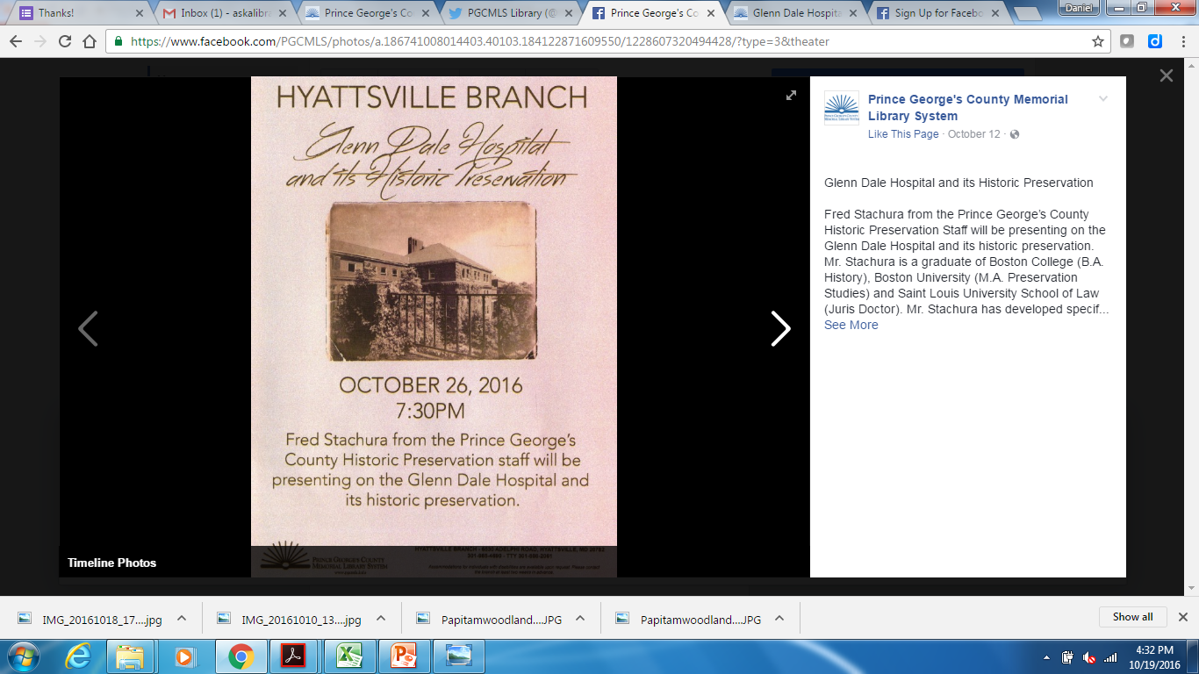
Social Media Posting

Slide 23
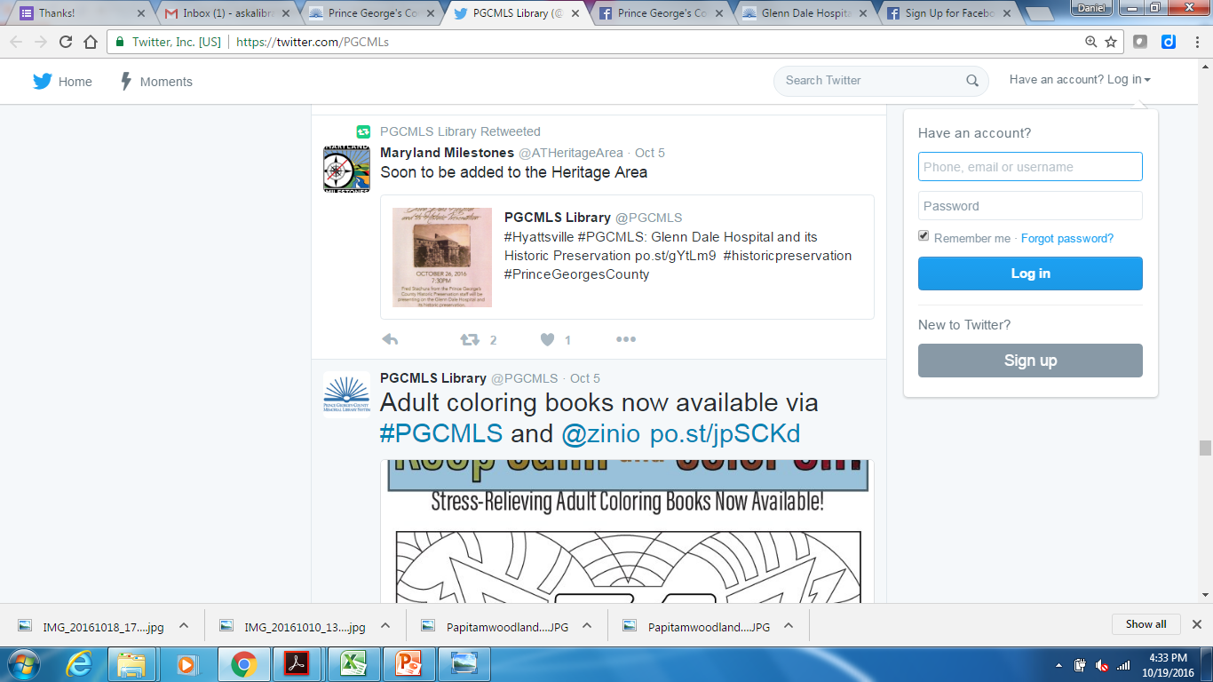
Social Media Posting

Slide 24
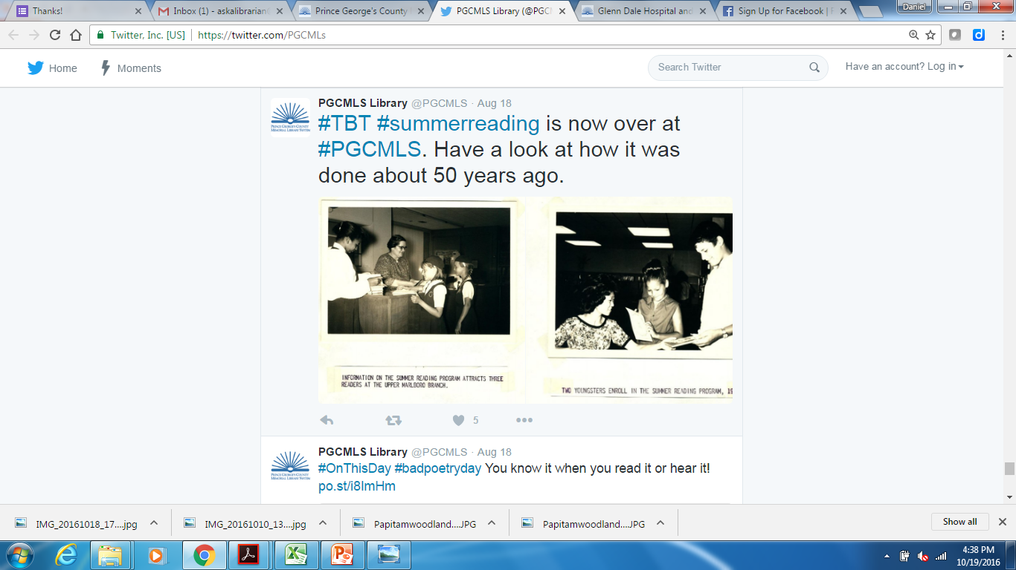
Throwback Thursday

Slide 25
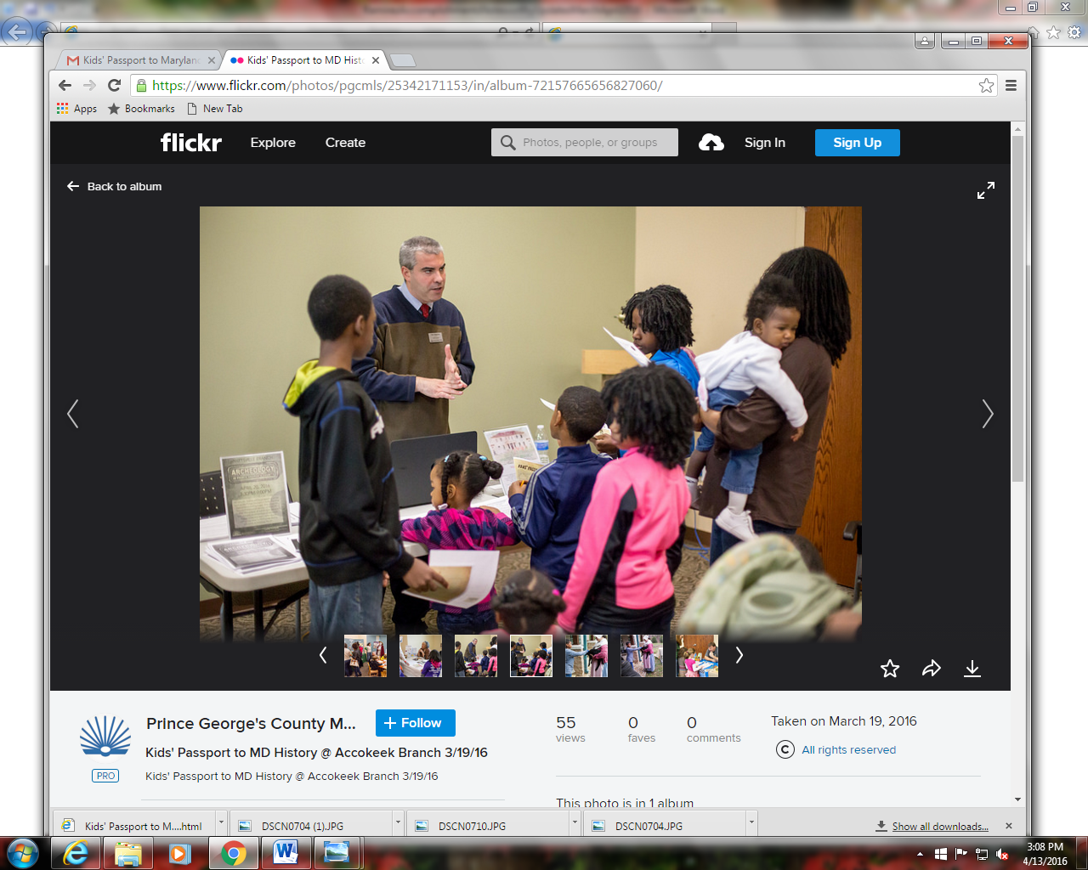
Outreach

Slide 26
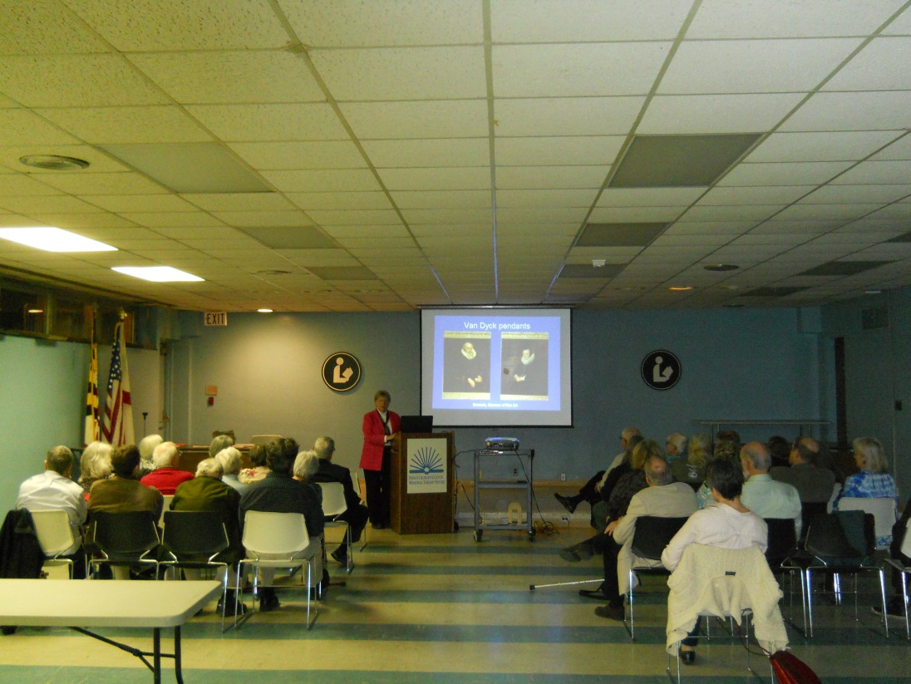
Programming

Slide 27
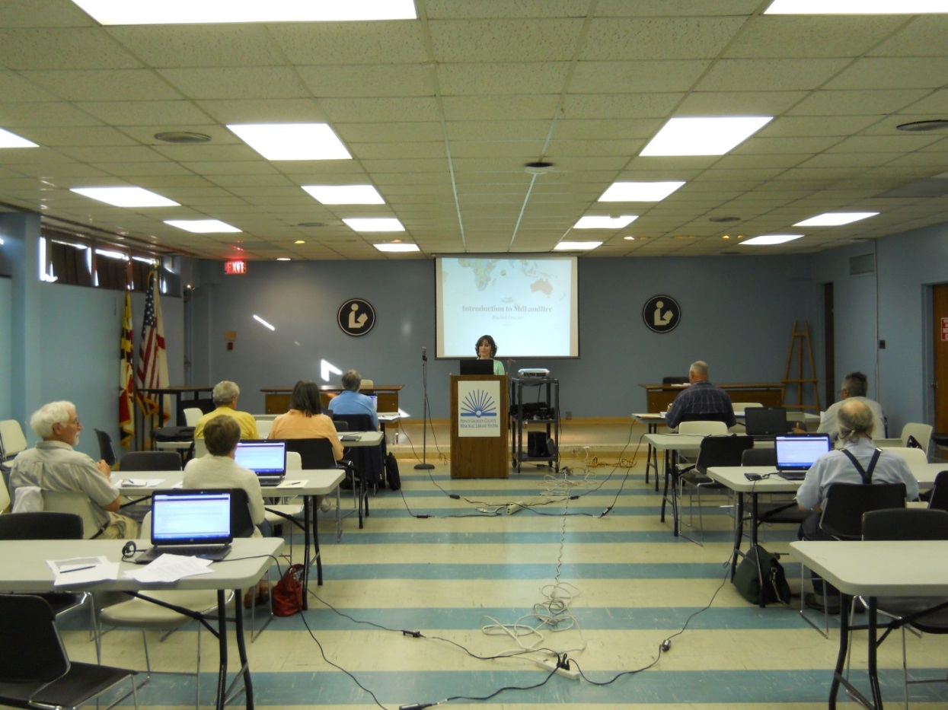
Programming

Slide 28
Projects post renovation
Revamp our MD Room special collection’s website
Increasing collaboration with Prince George’s County Historical Society
Continue with Prince George’s Historical Consortium
Scanning projects with Digital Maryland
Foster rapport with Maryland State Archives
Start a rapport with the National Archives

Slide 29
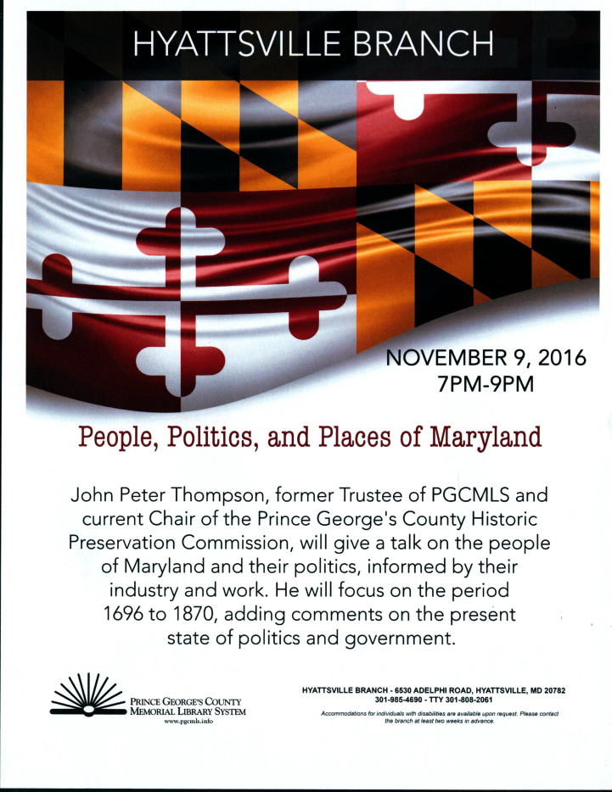
Next Event: November 9

