Slide 1

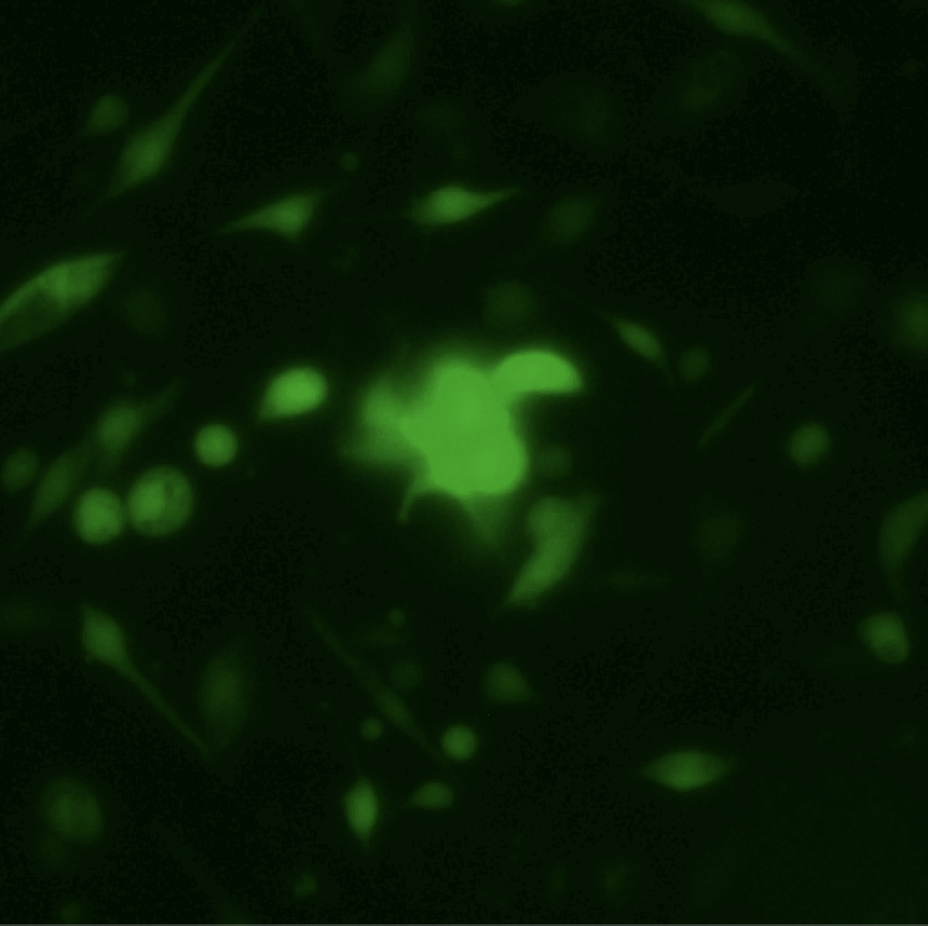
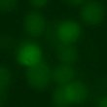

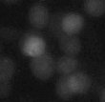

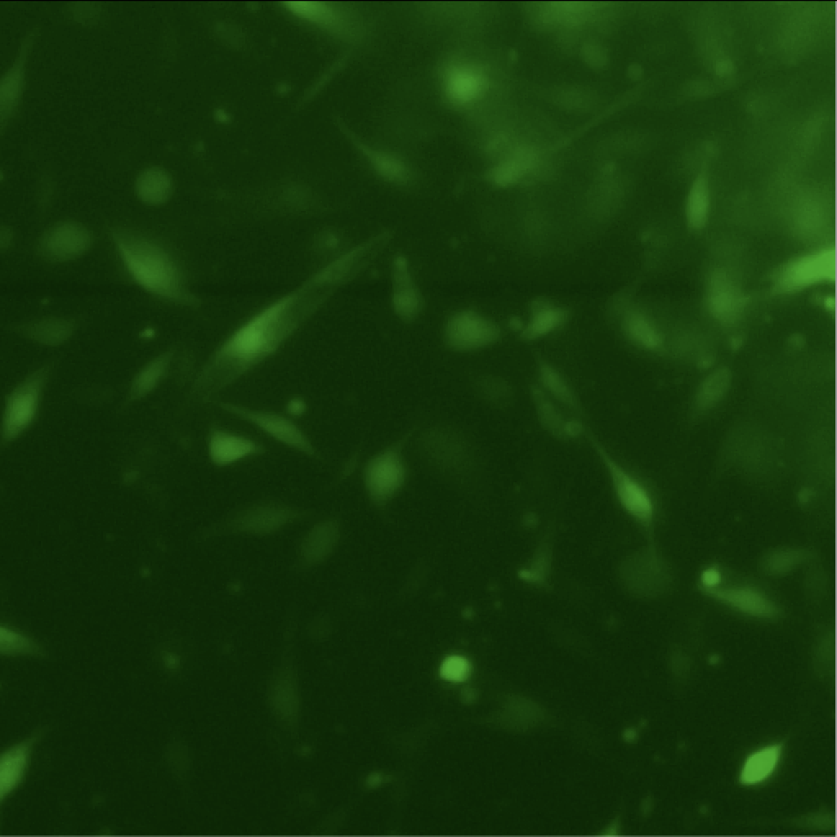
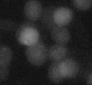

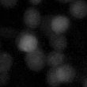

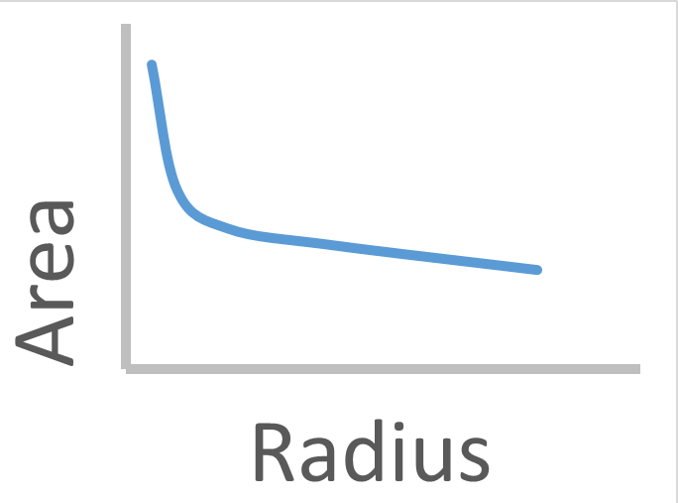
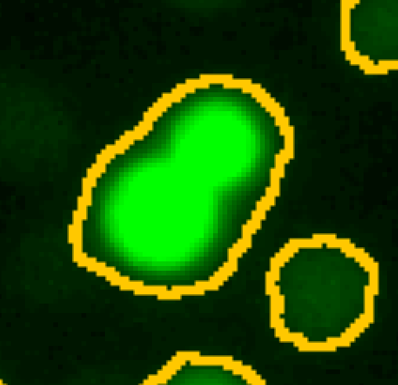
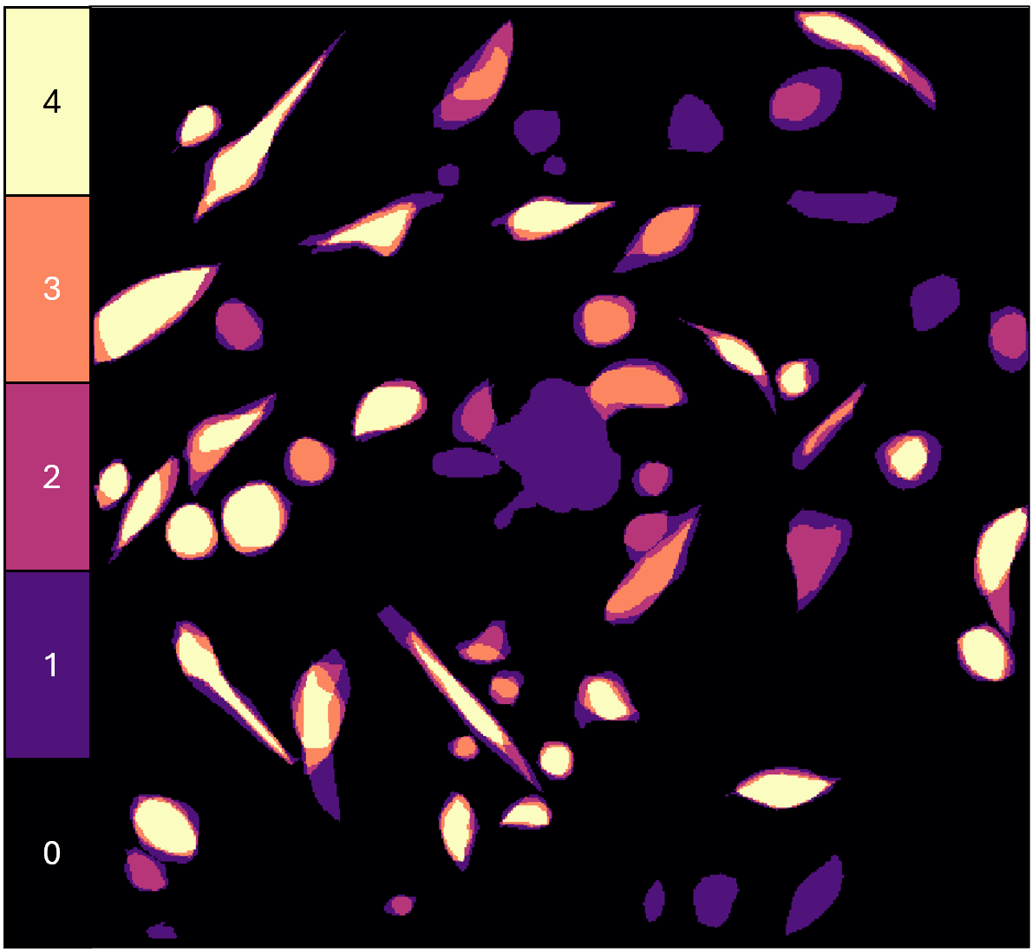
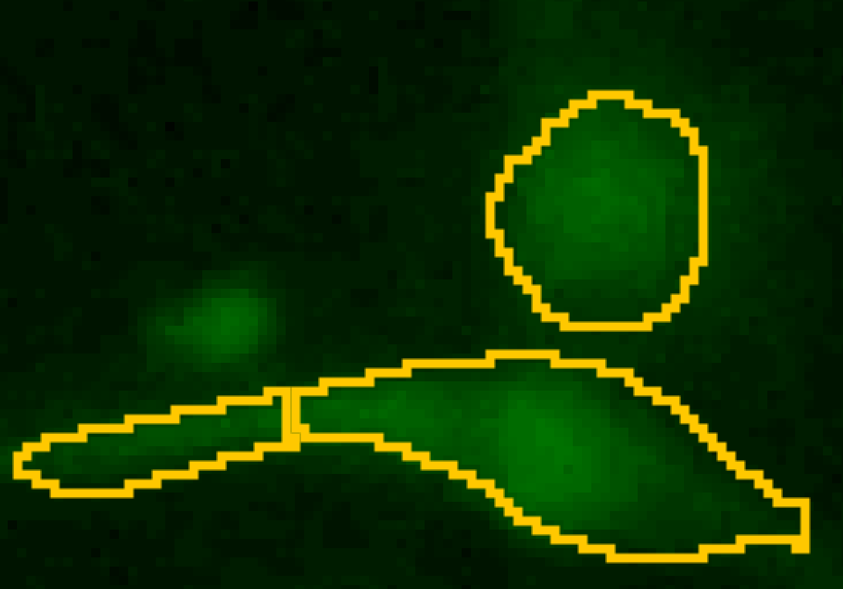
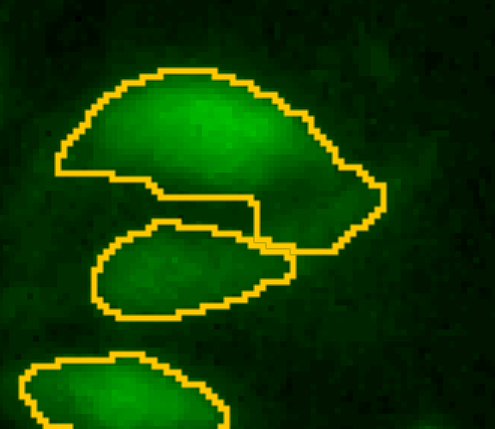
Automated Cell Identification Methods for Stained Images using FIJI
Laura A. Vargas Munoz*, Robert Tudor*, Roy Anderson, Redwan Haider, Ricardo Araneda, Elisabeth Smela
*equal co-authors
Motivation
Methods
Accurate identification of stained cells in images is critical for many applications. This particular study was motivated by the development of
APPROACH 1
APPROACH 2
Original Hoechst Image of Nuclei
Original Calcein AM Image
an electronic nose for odor identification using living cells, which requires determining their viability and fluorescence response to odorants. However, varia-tions in cell morphology, fluorescence intensity, and back-ground artifacts hinder automated segment-ation methods. Although traditional approaches—such as manual annotation, threshold‐based detection, and feature‐driven classification—have been widely used for cell identification, in this study we specifically leverage automated segmentation to streamline and standardize the analysis. Segment-ation refers to the process of partitioning images into distinct, meaningful regions that correspond to individual cells, as opposed to the surrounding background, clusters, and noise. This is achieved computationally through a series of pre-processing and thresholding steps that enhance cell boundaries and suppress background variability.
40 μm
Original (Target) Image
Isolate Green Channel and Invert
Apply Auto Local Threshold
Pre-Process
Despeckle and Open
Convert Grayscale
(8-bit)
Despeckle
Get Segmentation Lines
Blur and
Subtract
Background
Example of a cell cluster.
CLAHE (Enhanced Local Contrast)
Remove Outliers
Segment Green Cells
Enhance Local Contrast (CLAHE)
Subtract Background
Watershed and Remove Outliers
Apply Size Filter
Convert to 8-bit Image
Example of non-uniform illumination.
40 μm
Apply Bernsen Auto Local Threshold
Performance Evaluation
We developed two approaches, both of which use automated image analysis in the software Fiji (ImageJ), to try to improve, compared to current methods. the segmentation of cells stained with Calcein AM, a green fluorescent metabolic stain. One is based on these images alone, using standard image processing steps. The other makes use of a second image: fluorescent blue stained (Hoechst) cell nuclei, which are located near the cell centers, to assist in locating cells.
Approach 1. The original color target image was converted to a grayscale image (8‐bit format). The CLAHE (contrast limited adaptive histogram equalization) operation enhances local contrast, making cell edges clearer. Subtracting the background reduced non-uniform illumination. The image underwent an auto local threshold operation (Phansalkar), which isolated cell regions from background. De-speckle and remove outlier steps eliminated noise and non‐cell artifacts. Finally, watershed segmentation was used to separates adjacent cells.
Approach 2. Both green Calcein AM-stained cells and corresponding blue Hoechst-stained nuclei were used. (Top Left) Nuclei were identified using standard image processing. The Voronoi operation was used to create separation lines, which was later used for segmentation. (Right) The green channel was selected. The image was blurred, and the blurred image was subtracted to remove non-uniform background. As in Approach 1, CLAHE was applied to improve local contrast. The image was converted to 8-bit, required for local thresholding, which requires selection of a window size. The thresholded area was found as a function of window size and the slope determined, as shown in the plot. The window size right before the slope doubles was selected. De-speckle and open (erosion followed by dilation) operations were applied to remove noise. The previously found separation lines were used to segment the cells. Objects smaller than 50 pixels were eliminated.
The objective is to evaluate the performance of each compared to areas manually identified by members of the lab. We will evaluate the accuracy by calculating the following metrics.
Human Segmentation
Future Work
Number of correctly identified cells.
Number of false positives: cells found by the algorithm where none were identified by manual counting.
Number of false negatives: cells missed by the algorithm.
Number of “under-counts”: multiple cells that were identified as one.
Number of “over-counts”: single cells that were identified as two or more.
“Affiliation errors”: cell areas that were incorrectly segmented, resulting in their being affiliated with a neighboring cell.
“Intersection over union”: a parameter that determines, pixel-wise, the normalized overlap area of machine- and human-counted cells.
Example of undercount.
Human identification of cells is used to establish a reference for evaluating the efficacy of the automated approaches. Four independent observers manually identified cells in two images.
Manual Count Variability There was considerable variability in the marking of cells that were faint or overlapping, as shown in the figure.
Implications for Validation Without an agreed-upon “true” cell count, we cannot begin to evaluate algorithm performance. Our interim focus is therefore on refining a manual selection protocol and creating a consensus image.
Standardize Labeling Protocol We plan to develop clear guidelines so that multiple human annotators can perform consistent cell identification.
Expand Reference Data Additional images and annotations have been collected to account for varying staining intensities, morphological differences, uneven background and illumination, and cell density.
Refine Automated Pipeline We will adapt image processing parameters based on the consensus images to improve performance.
Compare Methods Once a reliable baseline is established, we will compare the results of both pipelines against human annotated masks, other cell identification methods, and machine learning techniques using the metrics in Performance Evaluation.
Example of over-count.
The regions of consensus among four independent people who marked the cells in an image. The color bar indicates the number of people who marked those pixels. Lighter colors indicate that multiple annotators agreed on the presence of a fluorescing cell.
Example of affiliation error.

