Slide 1
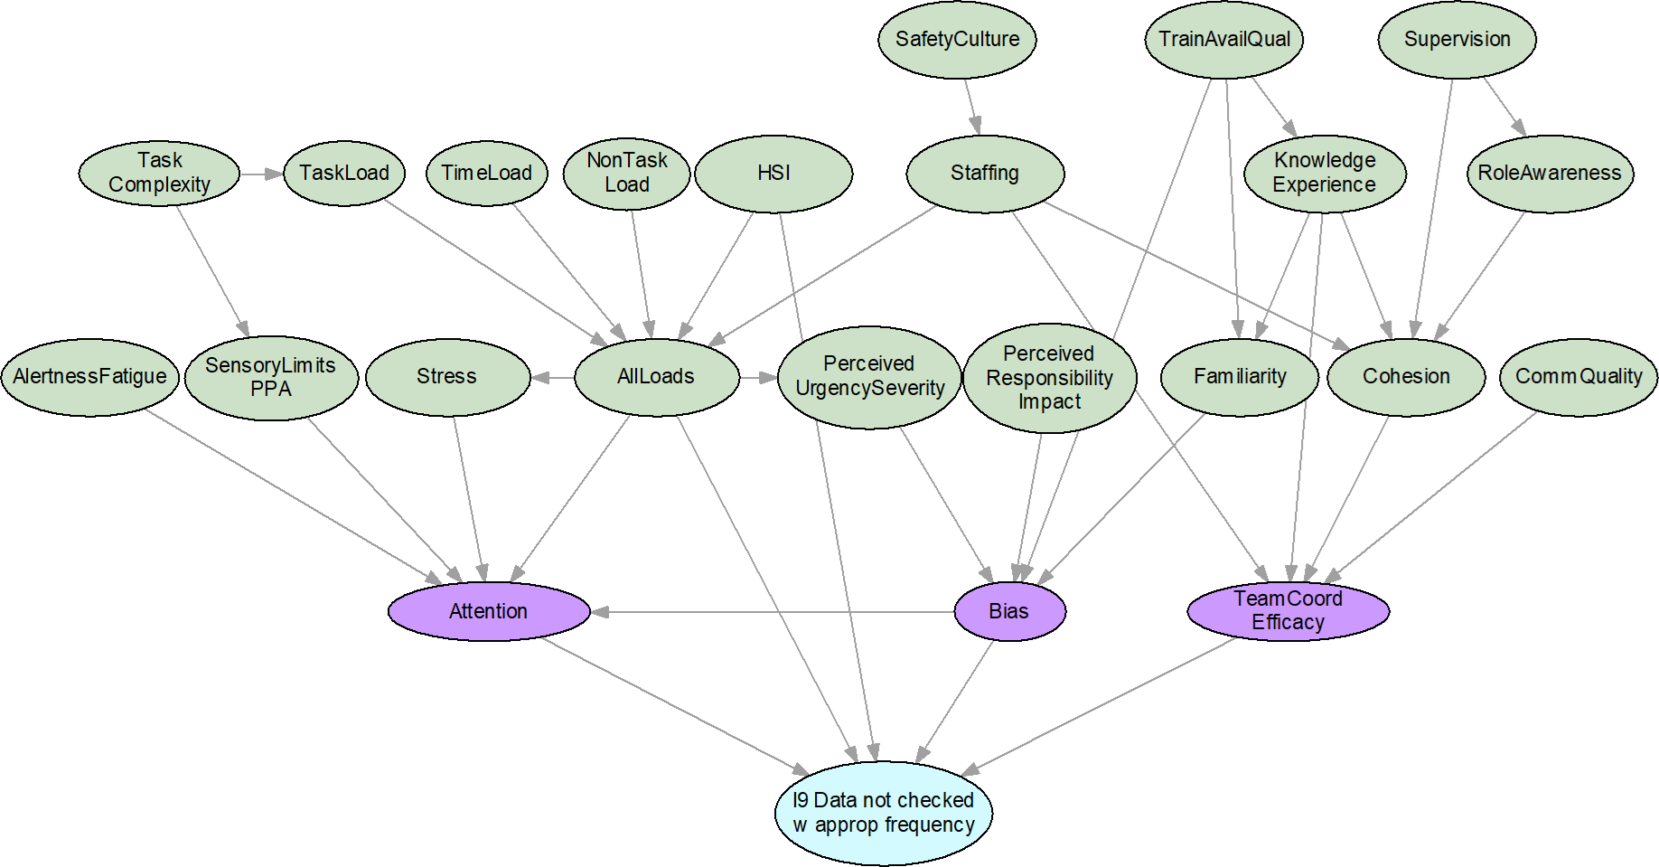
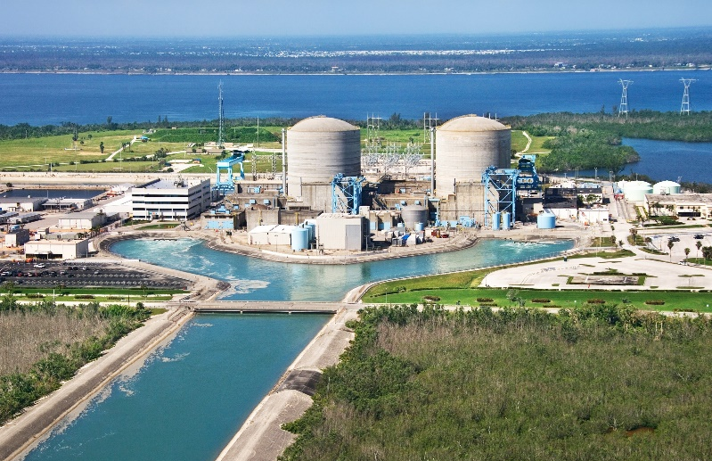
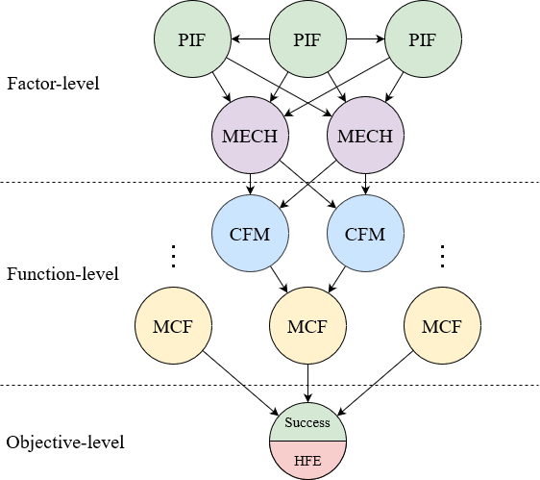
Why Do Human-Machine Teams Fail: Investigating Failure Mechanisms in Human Reliability Analysis
Vincent P. Paglioni^{a,b}, Camille S. Levineª, Ahmad Al-Douriª, and Katrina M. Grothª
ªSystems Risk and Reliability Analysis (SyRRA) Lab, Center for Risk and Reliability, University of Maryland, College Park
^{b}Risk, Reliability, & Resiliency Characterization (R3C) Lab, Department of Systems Engineering, Colorado State University
NPIC&HMIT 2023, Knoxville TN
July 18, 2023
Notes:
Hello and good morning everyone. My name is Camille Levine, and today I’ll be presenting on current research at the University of Maryland in human reliability analysis, specifically regarding human failure mechanisms.

Slide 2
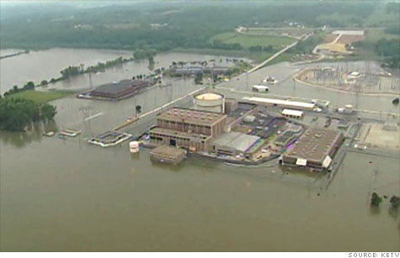
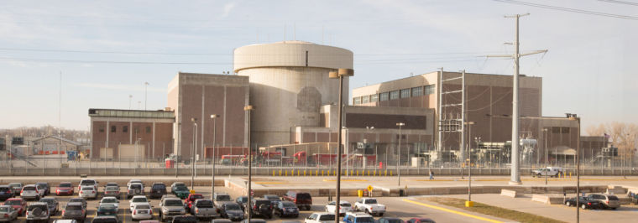
Motivation: More true-to-life models
HRA is an important process within PRA that identifies potential errors arising from the human-machine team in a complex engineering system
Currently, HRA lacks models that can explain why errors occur
HRA focuses on failure modes (e.g., how failures occur), but there is little focus on failure mechanisms to explain why the failures occur
Mitigation strategies might be different depending on underlying issue!
Notes:
As I’m sure you all appreciate, HRA is a very important part of PRA. In today’s world, complex engineering systems cannot operate without humans, or human-machine teams. Therefore, it’s important to accurately characterize human failure events. Models need to be retrospective, able to diagnose how errors are brought about; and predictive, able to describe what errors are likely to happen given a set of initial contextual conditions. Both types of analysis allow you to identify the largest contributors to risk, and allow managerial/plant staff to mitigate these root causes of error directly.
This work actually came about as part of a larger effort to enhance the causal basis of HRA. Most currently-used methods incorporate aspects of error context, but don’t fully explain the mechanisms through which the errors are brought about, or the why. For example, a maintenance crew might be told that a given pipe failed due to fracture- a common failure mode. They would want to know whether it happened due to fatigue, overstress, or some other failure mechanism, because the mitigation strategies associated with each failure mechanism are different. Similarly, wouldn’t a human reliability expert want to know whether an operator’s failure mode of “Failure to obtain key data” was brought about by an attentional failure from overloading, or by internal biases introduced from their level of knowledge and expertise? The distinction is important, because the associated mitigation strategies would be different.
The goal of this work is to add realism/develop causally robust models, with traceable, explainable results.

Slide 3
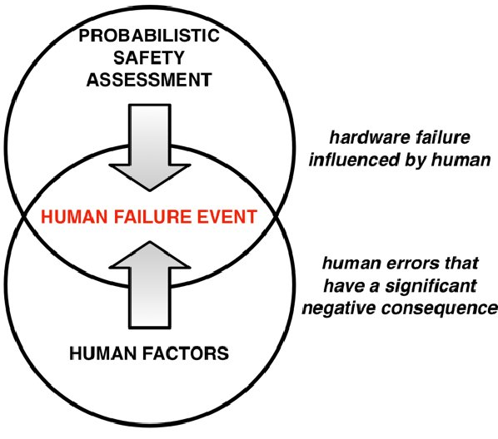
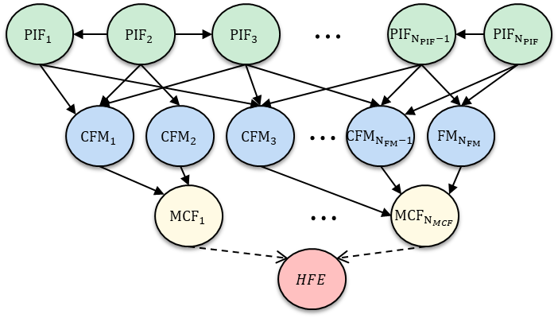
Motivation: External Hazards Probabilistic Risk Assessment (XHPRA)
Determine human and human-machine actions and decisions involved in plant response.
Select factors relevant to human-machine performance in flooding hazard response.
Encode causal relationships using Bayesian networks (BNs)
T4.1 Identification of human failure events (HFEs)
T4.2 Identification of performance influencing factors (PIFs)
T4.3 Development of framework for PIF-human failure mechanisms for XHPRA
Objective: Identify drivers of uncertainty in modeling human reliability for XH
Adapted from Al-Douri, Levine & Groth 2022; Boring 2014
Notes:
This work was motivated as part of a larger project centered around identifying the uncertainty drivers in probabilistic risk assessment for external hazards. Our team was responsible for three main subtasks on this project- identifying human failure events associated with response to a flooding incident, selecting relevant performance influencing factors, and then encoding the causal relationships between these components into a Bayesian network. This paper represents part of our work on the third task here, based on results that emerged while we were developing this Bayesian network.
Quick shoutout- there’s an update on this project that will be presented by Dr. Bensi from UMD, this Wednesday at 3pm!

Slide 4
Method: Human Failure Events (HFEs) & their structure
Human cognition is very complex, with multiple underlying layers of causality
Can represent using Bayesian networks
Causal dependence exists between layers
Probabilities of child node states modified by parent node states
PIF
Performance Influencing Factor: Multi-dimensional characteristics of the performance context.
MECH
Human Failure Mechanism: Cognitive/physical process leading to the failure mode.
CFM
Crew Failure Mode: Failure pathways that define failure to achieve a function.
The HFE is the culmination of the failure process; there are multiple different mechanisms that might bring about an HFE.
MCF
Major Crew Function: High-level actions taken during a scenario.
HFE
Human Failure Event: Highest-level failure considered; includes at least one failed Major Crew Function.
Notes:
Building complete, scientifically accurate models means acknowledging the complexity of what a human failure event truly is. Paglioni, Mortenson, and Groth define the human failure event as the culmination of the entire failure process, which can be described by multiple causally connected layers as shown in the image here. PIFs, in light green, represent contextual factors, such as stress, workload, or level of training. Mechanisms in purple- I’ll get back to this soon. CFMs in blue- these are the crew failure modes, such as “misinterpret data” or “fail to check data at the correct frequency”. CFMs are observable ways in which the failure manifests. Next, MCFs in yellow- these are major crew functions, high-level actions important to the functioning of the system, like implementing a procedure or performing a diagnosis. Lastly, the failure of an MCF defines the occurrence of an HFE, shown in green/red for success and failure respectively.
This is shown here in a Bayesian network, or BN, structure. BNs are great tools for conducting this causal reasoning between, and among, layers. The probabilities of the child node states are modified conditional on the parent node states, with arrows indicating causality between nodes. It allows you to reason backwards- given that an HFE, or a CFM, happened, what were the most likely causes of it? Then the BN also allows you to reason forwards- given that these contextual factors are present, what are the most likely crew failure modes to arise?
The Human Failure Event, HFE, is described by the activated pathways through this Bayesian network- for example, a cluster of PIFs in a degraded state will activate a mechanism which raises the likelihood of a CFM, defining the way an MCF is failed, which then defines the occurrence of the HFE.

Slide 5
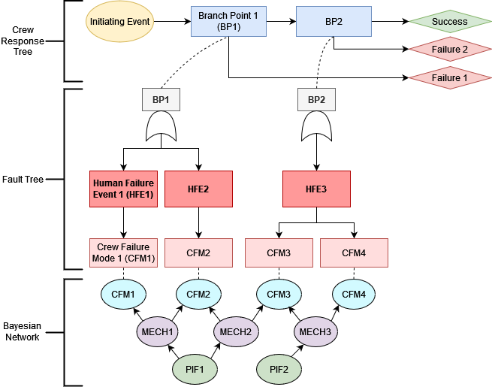
Methods: Phoenix HRA Framework
Phoenix is one of the most mature cognitively-based HRA methods- it is a framework for identifying the causal drivers of human error.
Adapted from Ekanem, N. J., Mosleh, A., & Shen, S. H. (2016). Phoenix–a model-based human reliability analysis methodology: qualitative analysis procedure. Reliability Engineering & System Safety, 145, 301-315.
Notes:
TRANSITION There are three main layers to the Phoenix method- the crew response tree, which is an event tree showing the progression of a scenario and all the opportunities for task errors. This is then used as an input to a fault tree analysis, which allows the analyst to break down the HFEs into the applicable crew failure modes. Finally, there is a Bayesian network layer to provide further insights about the likelihood and origins of each CFM.
It was used for this project in the identification of potential external flooding HFEs, and constitutes a framework for tracing the causal origins of human failure events, in both directions. You can see what caused it, and you can see where the HFE fits into the overall scenario tasks.

Slide 6
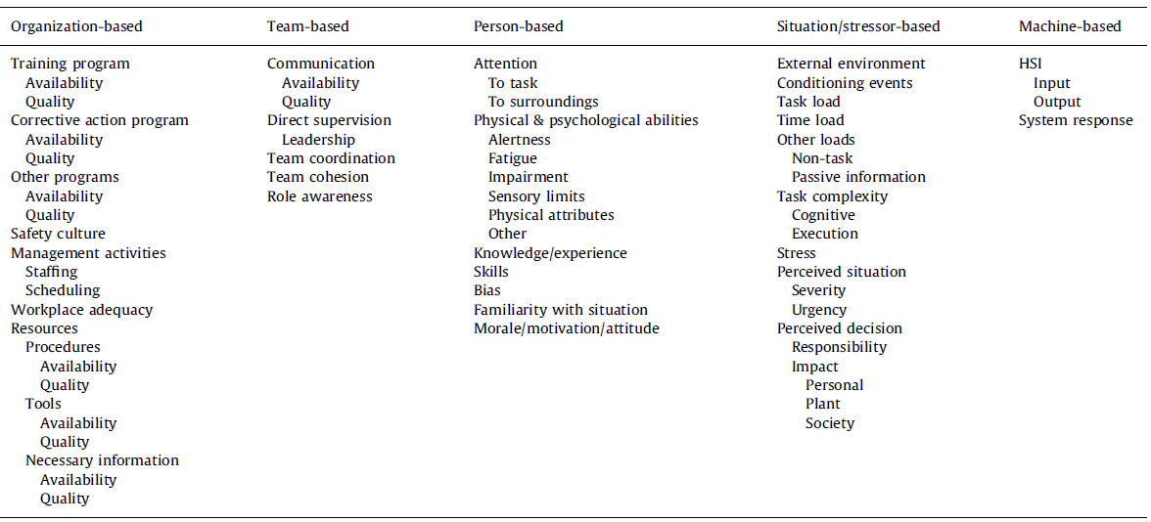
Methods: Performance Influencing Factors (PIFs) Hierarchy
Organized – The taxonomy delineates PIFs into five categories: organization, team, person, situation, and machine-based.
Versatile – The hierarchy of PIFs can be collapsed or expanded to meet a given objective.
Orthogonal – PIFs are clearly defined, with impact on individual/team as the main consideration.
Groth, Katrina M., and Ali Mosleh. "A data-informed PIF hierarchy for model-based human reliability analysis." Reliability Engineering & System Safety 108 (2012): 154-174.
Notes:
The performance influencing factors hierarchy used in this work is based off of 2012 work by Groth and Mosleh. We used this for three main benefits that it provides: it is organized, with five PIF categories each relating to a different aspect of operations (organization, team, person, situation, and machine); it is versatile, with multiple layers of PIFs so that you can use the more specific or less specific set depending on your objectives, and finally, it is orthogonal, with each PIF in the hierarchy clearly defined through a human-centric perspective, the impact on the individual or the team members is the main focus.

Slide 7
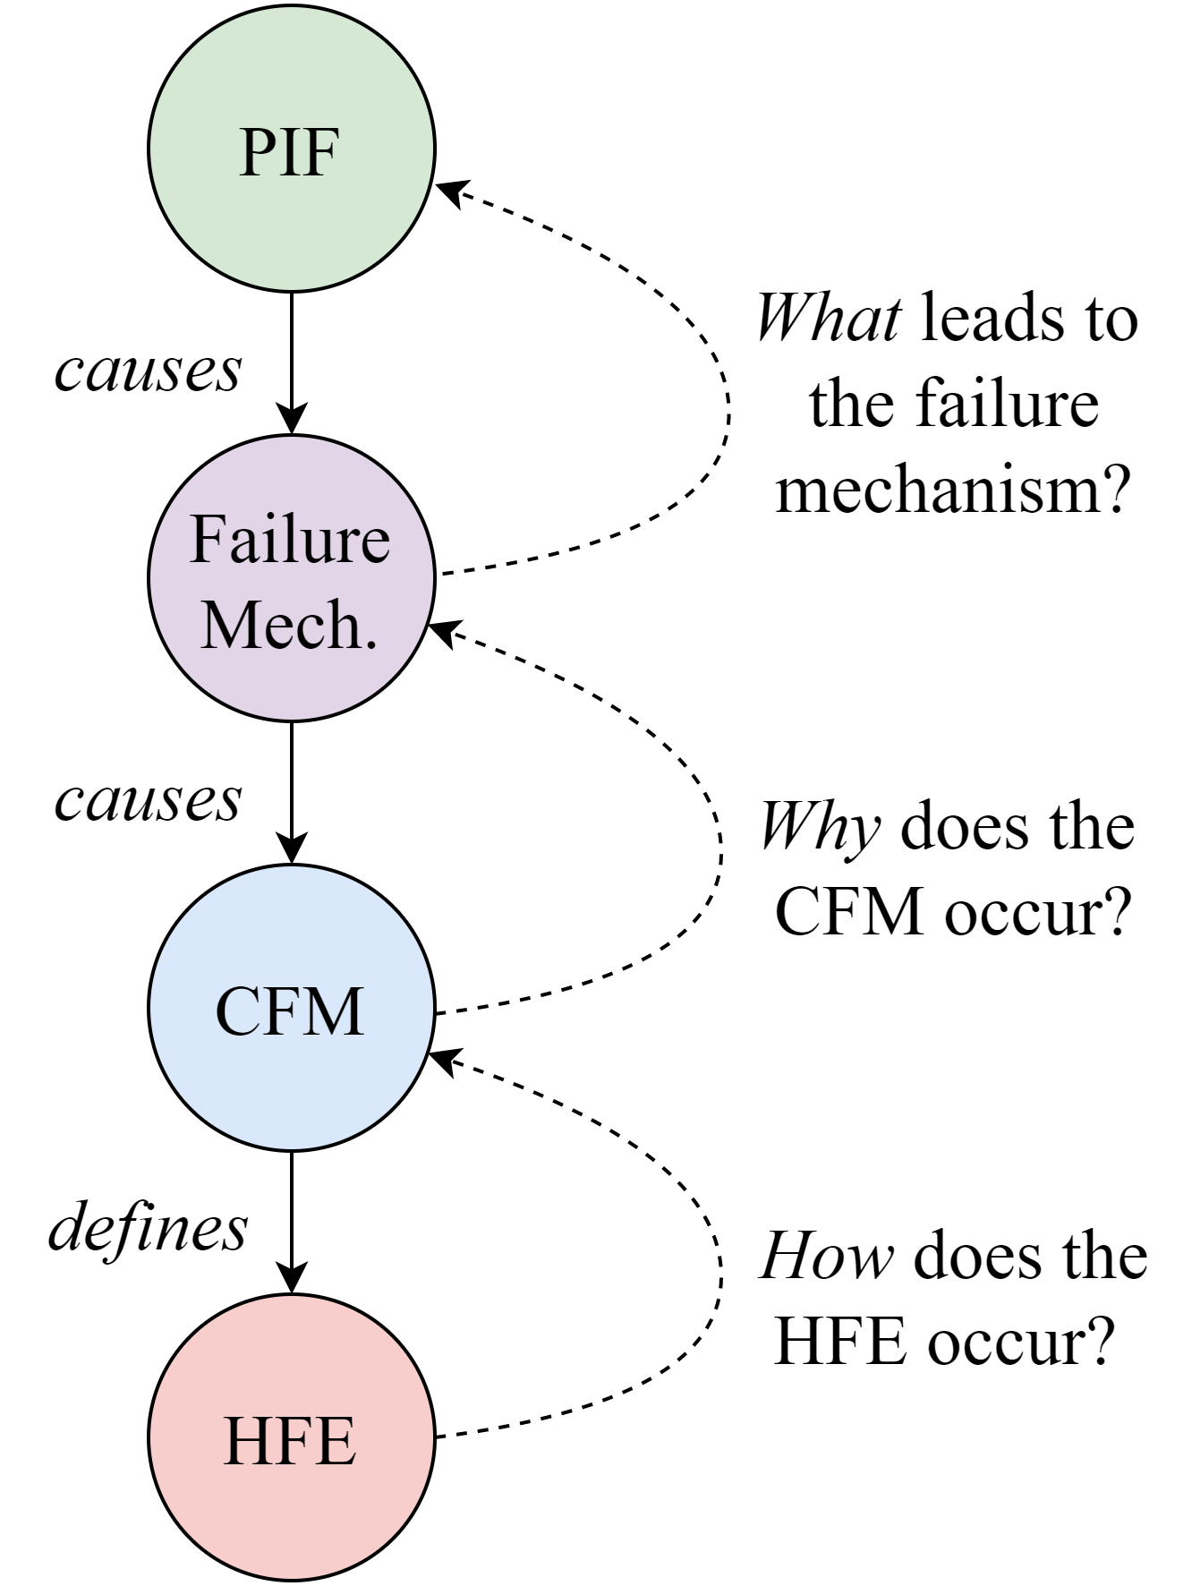
Result: What is a Human Failure Mechanism?
The mechanism bridges the contextual factors (PIFs) and observable failure modes (CFMs).
The human failure mechanism is the catalyzing context of a crew failure mode (CFM) that describes the cognitive/physical process that results in the failure mode.
It is a causal component of the decomposed HFE that is part of the pathways leading from the PIFs to the CFMs.
Notes:
As mentioned on the previous slide, a mechanism is an intermediate causal factor between the human performance influencing factors and the observed crew failure mode. Most HRA methods don’t get this specific- they encode this implicitly by increasing the human error probability given degraded PIF states. Other HRA methods call CFMs, “mechanisms”. There has not been an overall standardized treatment for this phenomenon, the why of failure.
This work posits the following definition for the Human Failure Mechanism: “The failure mechanism is the catalyzing context of a crew failure mode (CFM) that describes the cognitive and/or physical process that resulted in the failure mode. The failure mechanism is a causal component of the decomposed HFE that is part of the causal pathways leading from the PIFs to the CFMs.”
Like the CFM defines how the HFE occurs, and the PIFs are causes that describe what leads to failure, the Human Failure Mechanism is a cause that describes why a CFM is brought about by a given set of PIFs, bridging this gap in describing the casual factors of an event.

Slide 8
Result: Modeling human failure mechanisms
Bayesian network shows ways a failure in information-gathering could happen.
While developing this model, clusters of PIFs that represent known psychological mechanisms emerged.
Here, we can see that task and personal factors bring about attentional failures, personal factors bring about bias, and team factors in coordination issues.
Failure mechanisms manifest as a multi-layer cluster of contextual factors that directly give rise to the failure mode.
Causal structure of PIFs hierarchy is directly apparent in these mechanisms.
Notes:
[This model uses the IDAC framework, which breaks human actions up into Information, Decision, and Action macrocognitive functions. This refers to the higher-level psychological nature of the task, like “Drive forklift” -> Action. There are also nested Info, Decision, and Action functions within this, such as “Monitor roadway”, “Decide to take alternate path”, and “Move actuators”. In this example, we’ll just be looking at a single crew failure mode for Information-Gathering.]
This work was part of a larger effort to employ the IDAC method alongside the Phoenix HRA method to further develop the causal basis of HRA, particularly in external hazards applications. We developed three literature substantiated Bayesian Networks for the Info-Decision-Action phases. During the development of this model, clusters of PIFs began to emerge, such as the task and personal factors that bring about attentional failures, such as task complexity, loads and stress, human-system interface, and alertness. We can also see personal factors that bring about bias failures, such as training, knowledge, familiarity, and perceived urgency and responsibility. Lastly, team factors such as staffing, supervision, role awareness, cohesion, and communication quality, that all brought about errors through the efficacy of team coordination. Crucially, bias is a unique mechanism because it can cause misallocation of attentional resources.

Slide 9
Result: When does a contextual factor become a mechanism?
Does it directly cause a CFM?
No
PIF
Yes
Is it the direct effect of two or more distinct PIFs?
No
Yes
Consider: Is it a previously defined PIF in the hierarchy?
Failure Mechanism
Notes:
These mechanisms seemed to emerge naturally from the model structure in the form of larger, more important PIFs. However, for future analyses, we determined there were three main common threads running between all of the mechanisms that were identified. These are summarized here in the form of a flowchart.
In this HRA BN framework:
First, it must directly cause a CFM. If it is not the direct cause of a CFM, i.e., if there are intermediate nodes, then that means that the mechanism itself can be described better, and that the node in question is actually a PIF. For example, alertness/fatigue is not a mechanism, because it leads to issues with focusing and attention.
Second, the mechanism must be the direct effect of two or more distinct PIFs. This portion of the definition relates to how mechanisms bridge the gap between CFMs and PIFs. They occupy a level in the HFE decomposition that is distinct from both the CFMs and the PIFs. Training availability and Knowledge/Experience are not mechanisms, but they are PIFs, since they are not caused by a combination of PIFs in this model.
Meeting the first two criteria means it’s a mechanism- but it’s still important to consider-
A third item to consider, it is likely to be a previously identified PIF from the framework- for example, generally mechanisms like “Bias” or “Coordination” are present, which are noted as PIFs in the framework we used, but also mechanisms such as “Procedure Error” might arise, which is not a PIF in the framework. In the case of Procedure Error, a new mechanism was developed due to the definitions of each CFM in Phoenix- the basis of the BN construction was the original Phoenix method- and this arose in several of the CFMs- this was part of bridging the PIFs and Phoenix frameworks.

Slide 10
Conclusion & Implications
Increased accuracy and completeness
Scientific correctness
Bridges the observed and non-observed components of failure event models
Accuracy of human error probability end results
Increased understanding and simplicity of results
More modular networks = easier to build and analyze, traceable
Targeted recommendations for improving human reliability
Next steps: identify additional mechanisms of failure
Notes:
In conclusion, the addition of mechanisms to HRA results in increased accuracy and completeness of the model, through this designation you have improved scientific correctness, as well as a way to bridge the observable CFM and the sometimes unobservable contextual factors of the models. A more valid qualitative model will form the basis of a more valid quantitative model, thus giving more accurate error probability estimates.
The mechanisms will also lead to an increased understanding and simplicity of results. Even though it seems like this makes modeling more complex, it actually makes for more modular model structures, which in turn makes them easier to build and analyze. Since these mechanisms are also based in psychological literature, it means that they are traceable back to theory. In addition, it makes it easier to develop targeted mitigation strategies for improving human reliability.
Finally, the next steps of this work will involve identifying additional mechanisms of failure- checking this work for completeness as well as identifying failure mechanisms associated with failures outside of information-gathering, such as decisionmaking or failures to take an action.

Slide 11



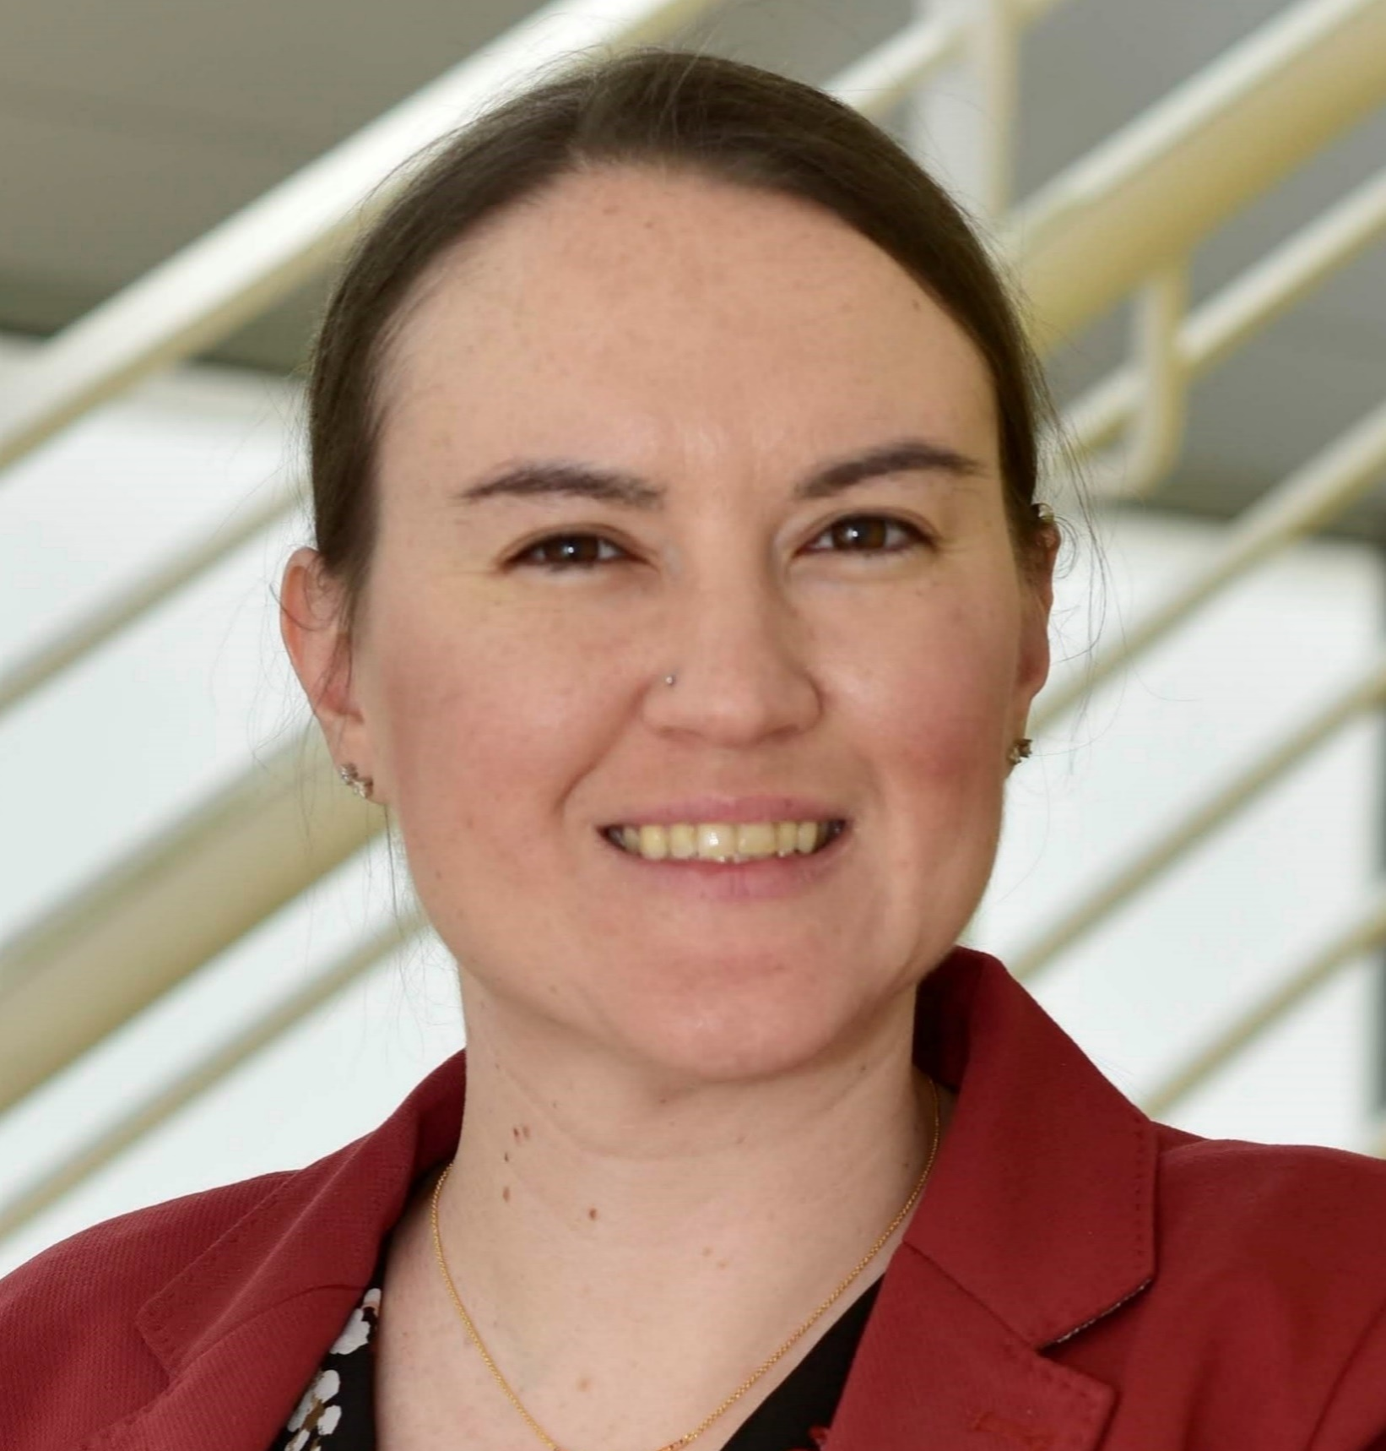
Thank you!
Vincent P. Paglioni
Camille S. Levine
Ahmad Al-Douri
Katrina M. Groth
Vincent.Paglioni@colostate.edu
clevine1@umd.edu
aaldouri@umd.edu
kgroth@umd.edu

