Slide 1

Using Google Lens for Photograph Identification
ASHLEY BROOKER
WEST VIRGINIA & REGIONAL HISTORY CENTER
Notes:
Hello. My name is Ashley Brooker. I am an Archives Processing Specialist at the West Virginia & Regional History Center. Today I am going to talk about using Google Lens for Photograph Identification.
I recently finished digitizing a scrapbook of photographs that had no identification from a Governor’s trip to Russia. With the help of Google Lens I was able to identify major landmarks along his journey, including that he visited more than just Russia on that trip.

Slide 2
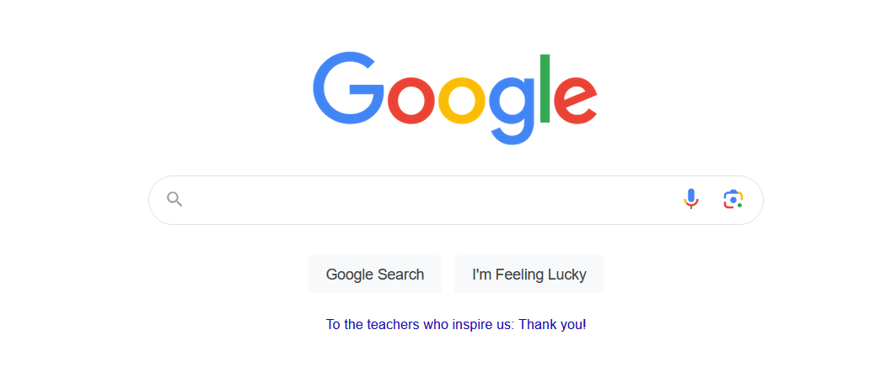

How to Find Google Lens
Notes:
Google Lens is easy to find and use.
It can be found on any Google search bar.
The icon is a multi-colored camera and is located at the end of the search bar by the search by voice icon.
Google Lens can be useful for identifying places, people, and translation of text.

Slide 3
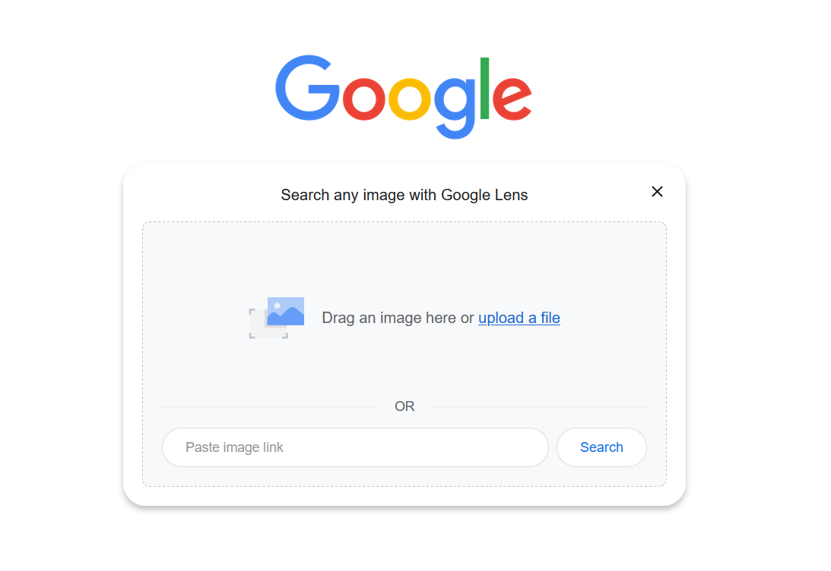
Using Google Lens
Notes:
Once you click the icon you will get an upload box.
Unfortunately, If your institution uses .tif files you will have to convert your photographs to .jpg or .png before you upload them.
You may also need to make an image smaller if you scanned the photo at a high resolution.

Slide 4
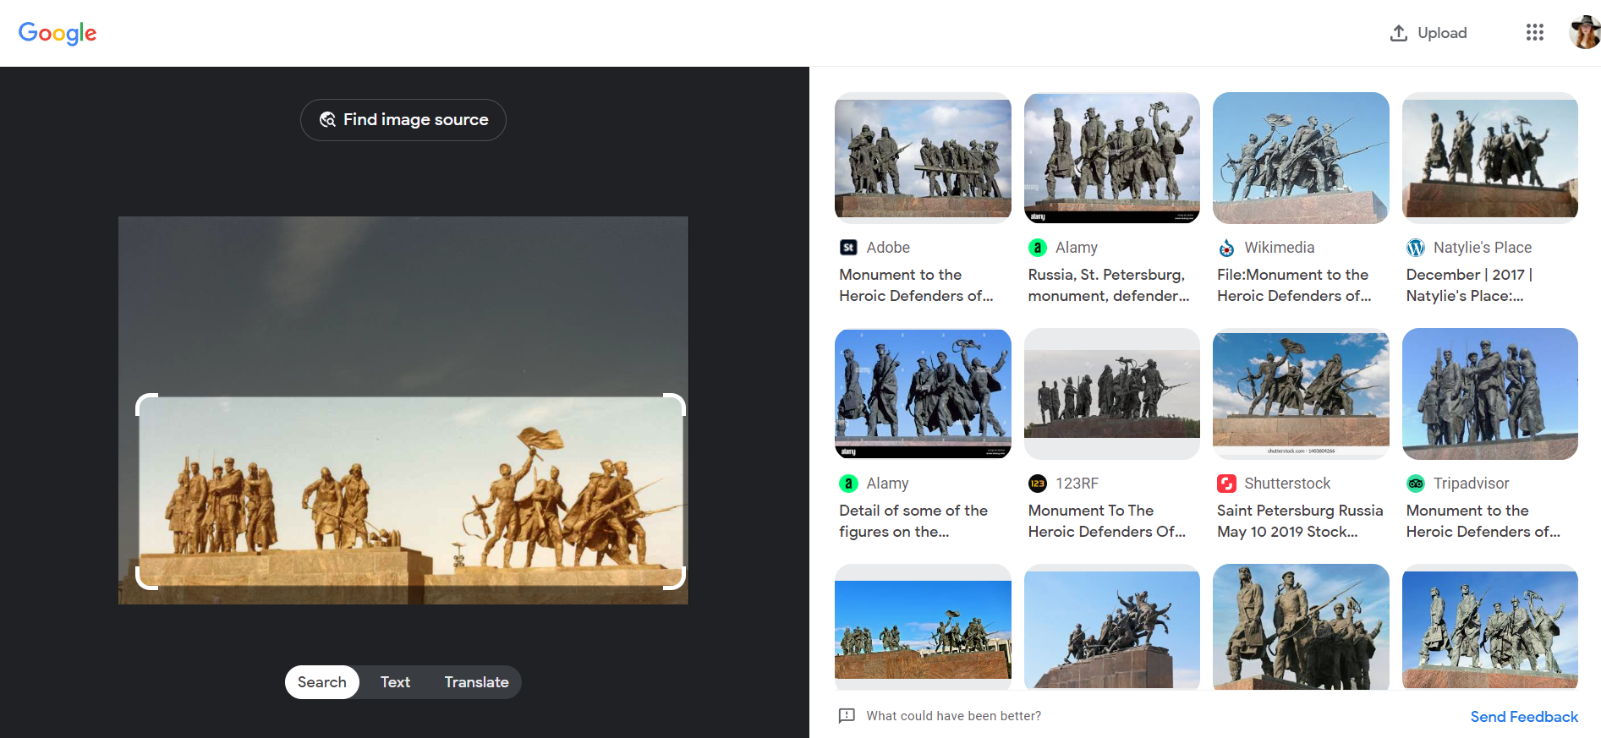
Google Lens Results
Notes:
This is what the results will look like once you upload an image.
As you can see, Google Lens was able to identify this statue as the Monument of the Heroic Defenders of Leningrad.
Now that we have identified this monument, a quick search of it can provide more information, such as the location, which is
Victory Square in Saint Petersburg, Russia.

Slide 5
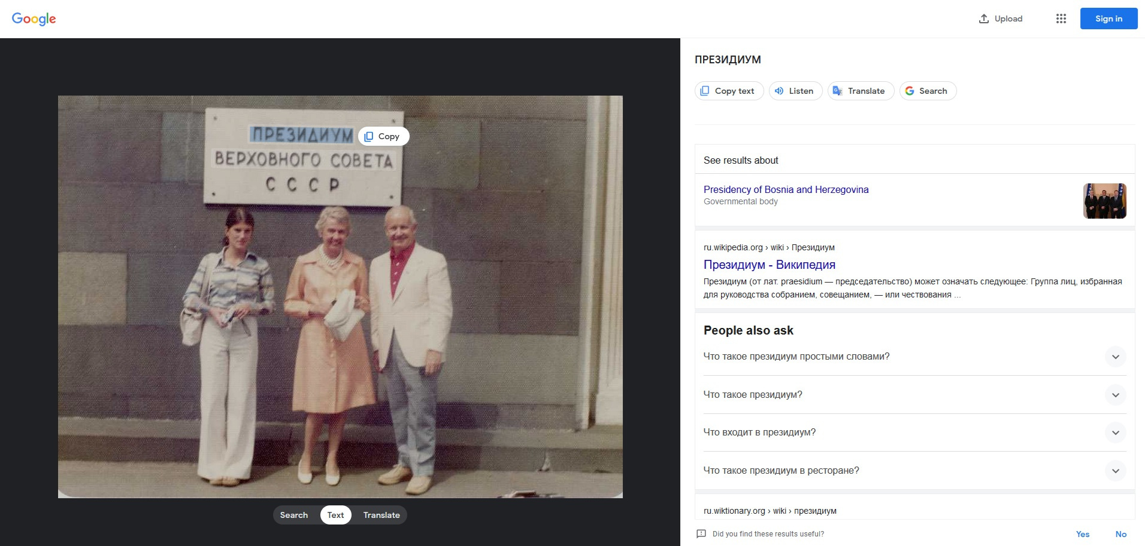
Google Lens with Text
Notes:
If you have a photograph with text, you can use Google Lens to identify what it might say.
To do this, upload the image and switch over to the text option that you can see at the bottom of the photograph.
When the text is identified a light gray box appears around the text. It can be a bit hard to see on some photographs though.
When you click on the box it will ask if you want to copy the text, listen, translate or search that part of the text. Because it splits each word up in its own box, you will have to highlight all of the text to get accurate results.
But as you can see here, the bottom row of text is not highlighted. The text identification doesn't always identify all the text, which can cause problems for when trying to translate text.

Slide 6
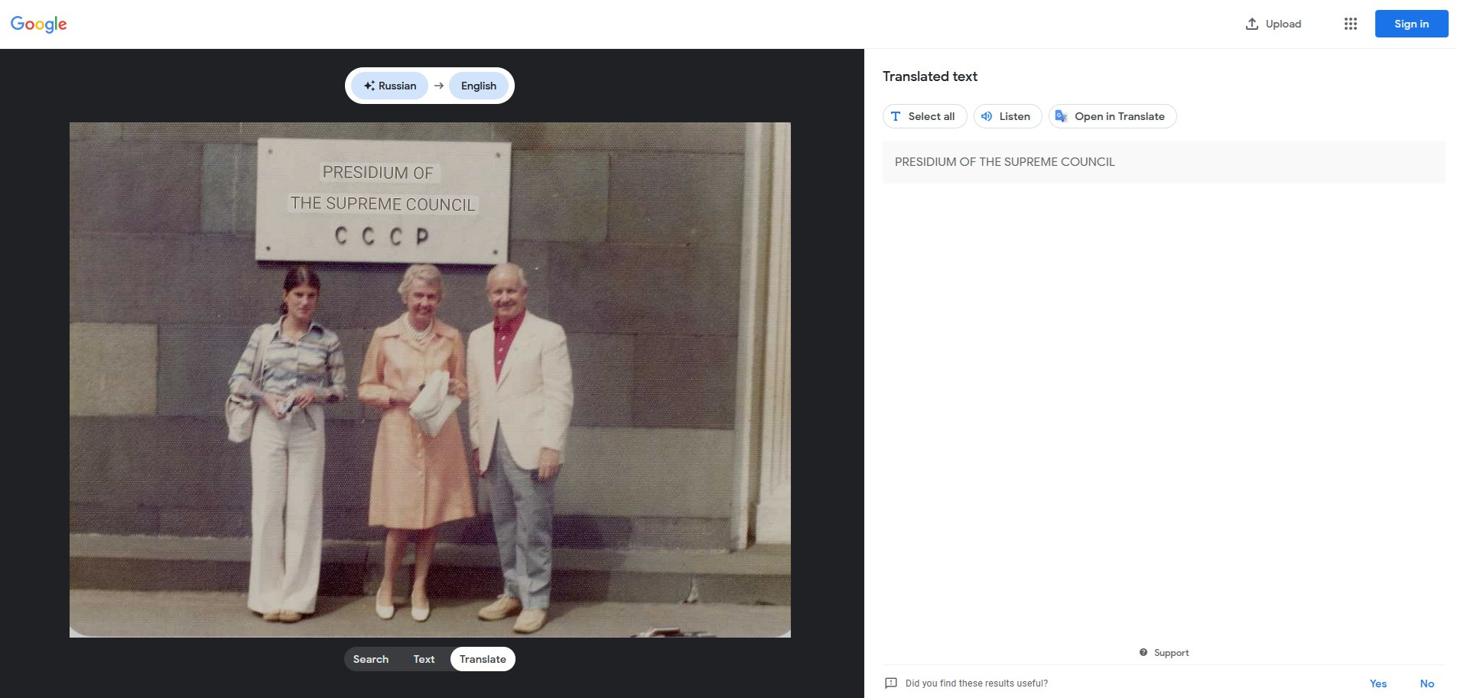
Google Lens for Translation
Notes:
If you switch to the translate tab the text that was identified is translated.
It automatically translates the text over the original text. As you can see this text says, Presidium of the Supreme Council.
This translation isn't always the most accurate. So I suggest copying the text and using another translation programs to double check the translation.
After double checking this translation with a separate service, we now know that this is a photograph of Governor Arch Moore standing with his daughter, Shelley, and an unidentified woman in front of the Presidium of the Supreme Soviet Council building.
Now lets talk about some pros and cons of using this service.

Slide 7
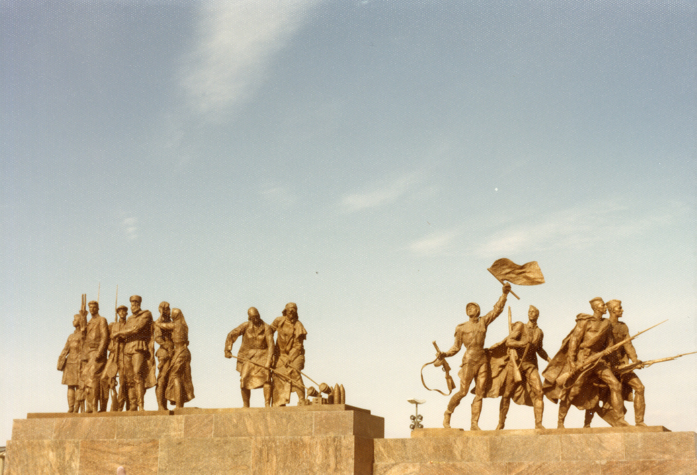
Pros
Can identify photographs of places and people that were unidentified
Can provide richer metadata for photographs in your digital collections.
Can translate text on photographs
Notes:
The pros of using Google Lens is that you can identify some photographs in your collection that have no information, like the one pictured.
Because of this you can provide richer metadata for your digital collections.
Google Lens can also provide text translation for photographs, but it is limited.

Slide 8
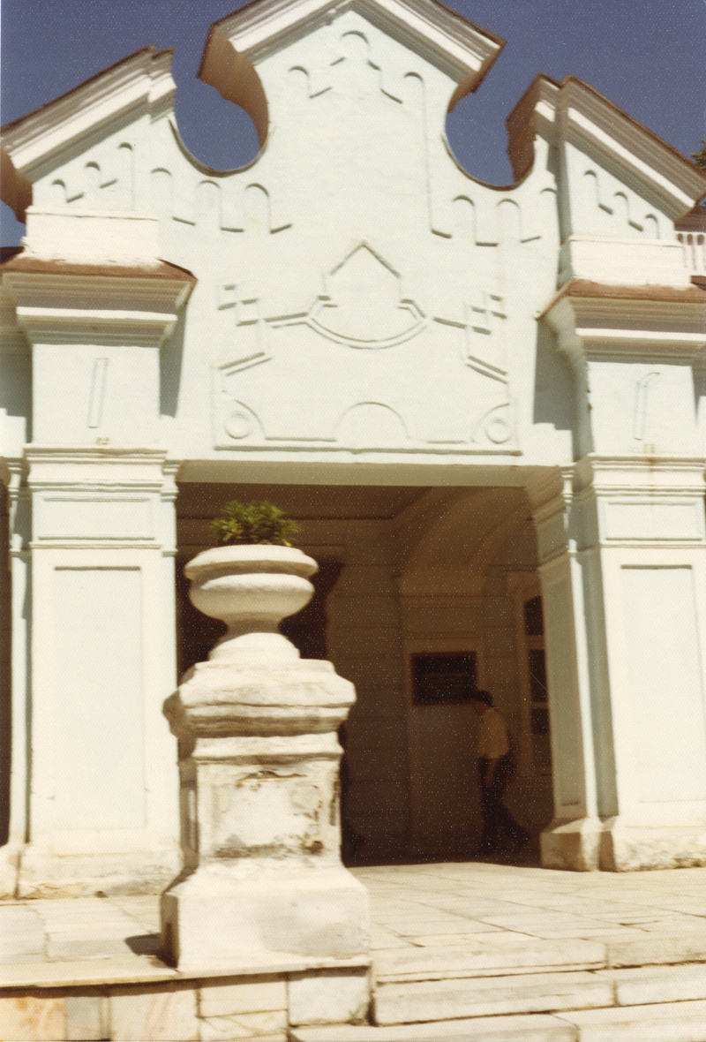
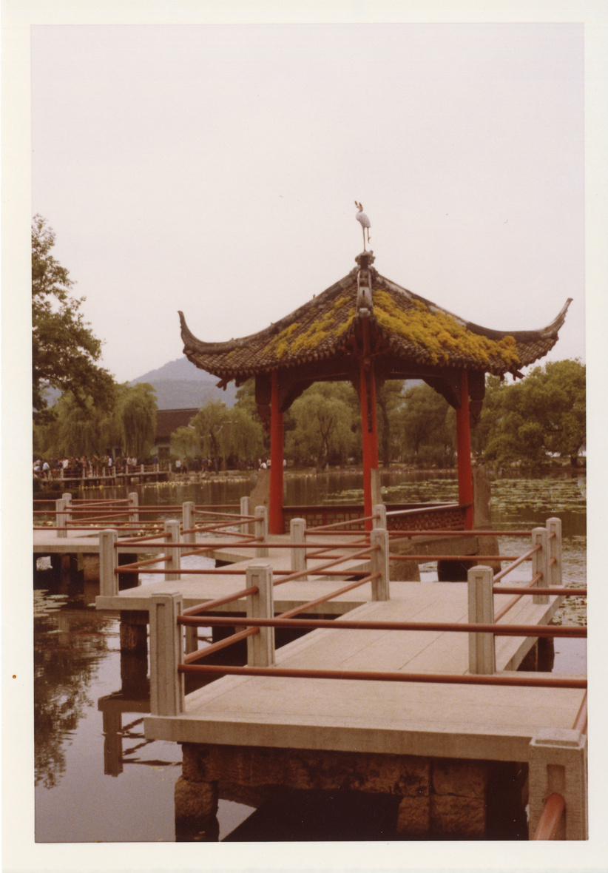
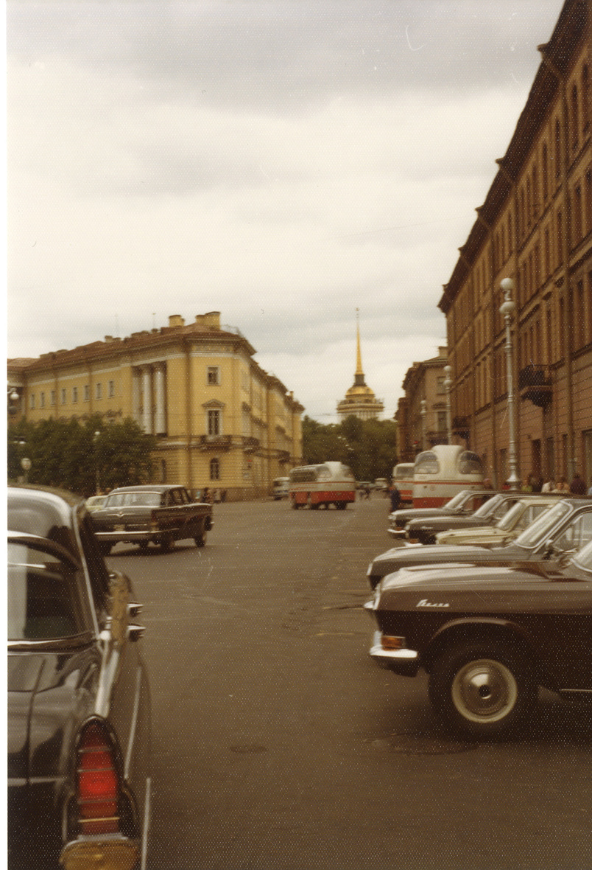
Cons
This works best with unique landmarks and locations.
Identification of people is spotty and usually only works for big name people, like Presidents
Text identification doesn't always work great
.Tif files don’t work so you will have to convert files to .jpg or .png
Using Lens will add more time to your workload but you can potentially get richer metadata in the end
Notes:
But, as you can imagine, this service doesn't work for all photographs.
Google Lens works best with photographs of unique landmarks. So photographs of fields, landscapes, streets, etc. most likely won't get any accurate results, such as the photos pictured here.
Identification of people is spotty and usually only works for big name people, like presidents, senators, actors, and such.
Text translation doesn't always work great. It frequently won't pick up all the text from the image, which causes errors in the translation.
Google Lens won't accept .Tif files so you will have to take the time to convert files to .jpg or .png before uploading. Also there is a file size restrictions so some photos may need to be resized.
And lastly, using Lens will add more time to your workload for each photograph. But you will get the benefit of potential richer metadata.

Slide 9

Ashley Brooker
ashley.brooker@mail.wvu.edu
West Virginia & Regional History Center
https://wvrhc.lib.wvu.edu/
Notes:
Thank you for taking the time to listen to my presentation and if you have any questions, feel free to email me.
If you would like to know more about the West Virginia & Regional History Center here is the link to it as well.

