Slide 1
Accessibility in Open Access Institutional Repositories
Caitlin Carter, University of Maryland iSchool, M.L.I.S. 2017

Slide 2
Overview of Accessibility Issues in Repositories
Metadata
Web Design
Policies

Slide 3
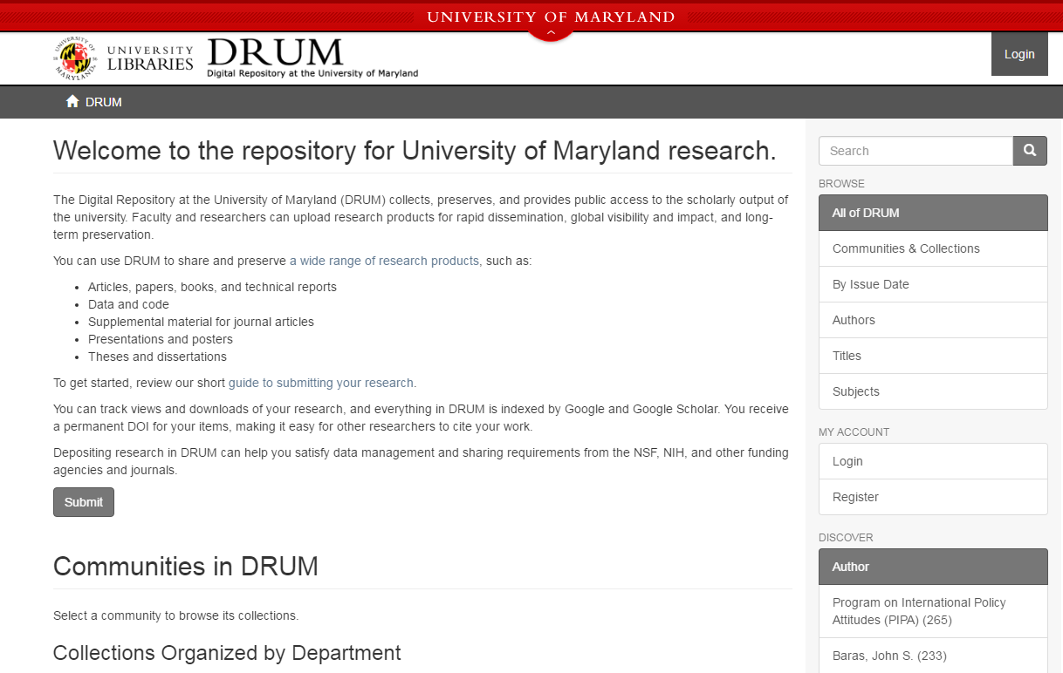

Slide 4
Open Access is Far-reaching
Benefits of OA Institutional Repositories
Greater access to research
Low cost for researchers
Library-centric
Creates Citation Bias
Free publicity!

Slide 5
But is it inclusive…?

Slide 6
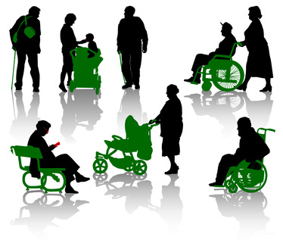
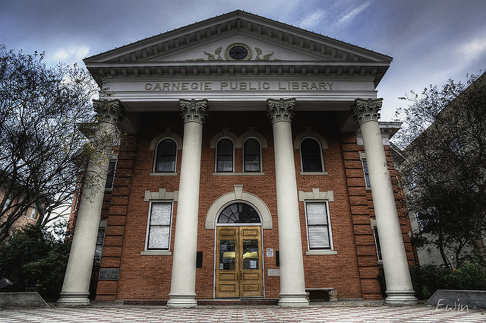
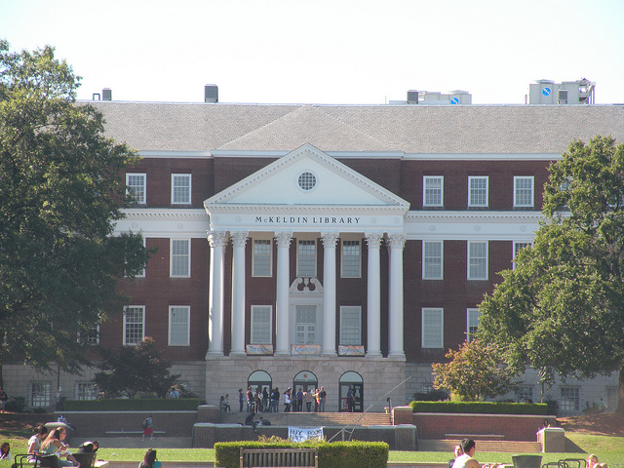

Slide 7
Issue 1: Metadata: How to simplify the deposit process
Good metadata simplifies the deposit process and allows for easier discovery

Slide 8
Metadata: How to simplify the deposit process
NISO¹: 6 principles to applying good metadata to your collection:
  Metadata is appropriate to the collection
  Supports interoperability
  Uses controlled vocabularies
  Includes a clear statement on the conditions or terms of use for the digital object
  Is authoritative and verifiable
  Supports long-term management
¹National Information Standards Organization. (2004). Understanding Metadata. Retrieved from http://www.niso.org/publications/press/UnderstandingMetadata.pdf.

Slide 9
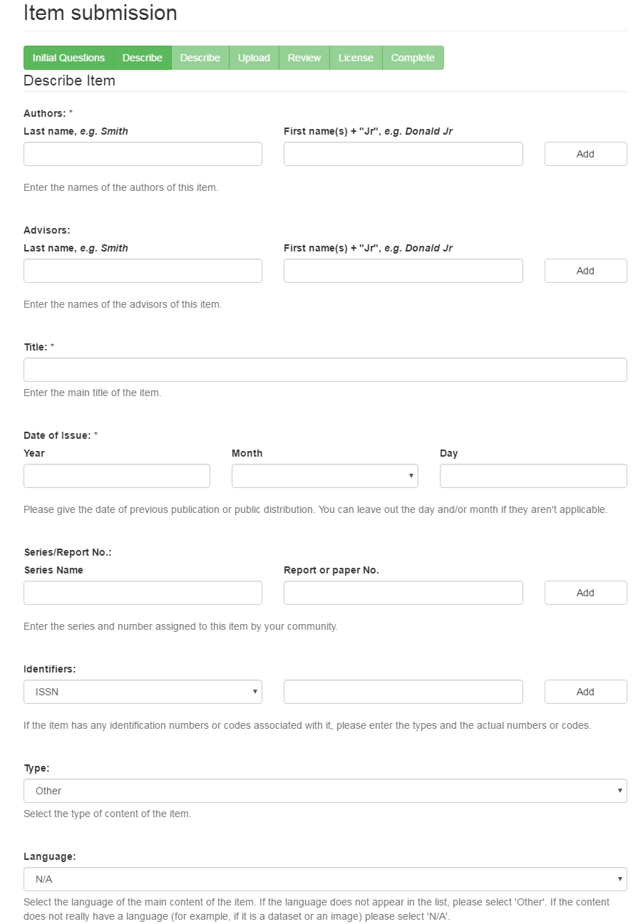
The Digital Repository at the University of Maryland (DRUM)

Slide 10
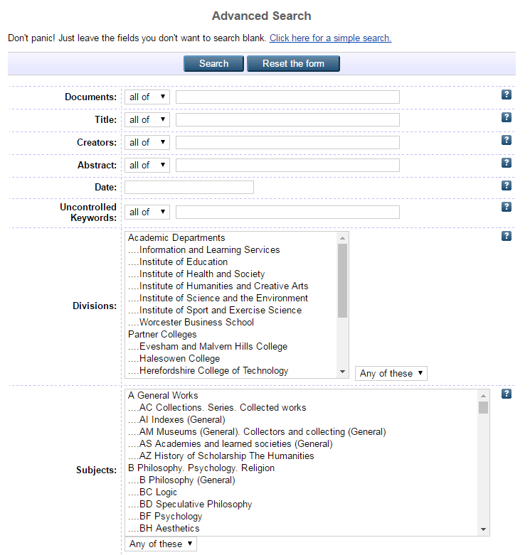
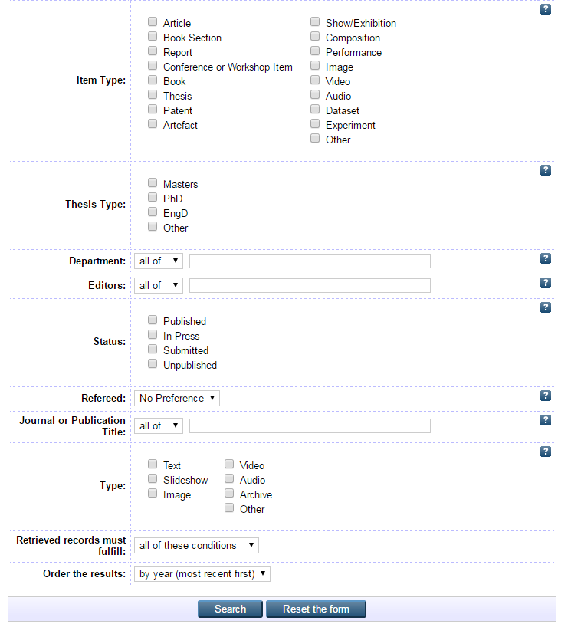

Slide 11
Simplifying Deposit and Search in Review
Use Controlled Vocabulary when possible
Allow faculty/students to use existing credentials
Customize your platform
Reach out and let the campus know that you can help

Slide 12
Issue 2: Accessible Content for Users with Disabilities
Inclusive access = mindful and equal content

Slide 13
Issue 2 Continued: Accessible Design
Common Features with Inaccessible Content:
  Videos without captions
  PDFs without Optical Character Recognition (OCR)
  BookView
  https://repository.library.georgetown.edu/handle/10822/553806
Notes:
Equitable, but not equal, which can present problems.

Slide 14
Practical Tips:
Audio and Video files should include captions.
Users who are unable to deposit their own research should have access to a faculty member who will deposit on their behalf.
Responsive Design
Research works will be accessible by keyboard-only capability along with the mouse.
The Help Desk number should be linked on every page to encourage feedback.
Notes:
These are tips I have discovered through working with my supervisor on DRUM and throughout my studies into accessible technology options.

Slide 15
Issue 3: Transparency: Policy Development for Repositories
Content Policy
Preservation Policy
Accessibility Policy
Good example: Accessibility Statement from Trinity College Digital Repository
Notes:
Policy development is the way that I see metadata and accessible web design come full circle to help facilitate the academic library’s mission of an equitable program.
When the repository team creates these three policies and provides access to them, it is not only a good faith effort to accessible content, but also…

Slide 16
List of Resources
W3C WAI WCAG: https://www.w3.org/WAI/WCAG20/glance/
Ohio State University Digital Preservation Framework: http://er.educause.edu/articles/2014/7/digital-preservation-policy-framework-a-case-study
Ensuring Adobe PDFs are accessible with Screen Readers: http://www.adobe.com/content/dam/Adobe/en/accessibility/pdfs/accessing-pdf-sr.pdf
Section 508-compliant multimedia: https://www.digitalgov.gov/2013/06/26/making-multimedia-section-508-compliant-and-accessible/
Sample Accessibility Statement from Trinity College Digital Repository: http://digitalrepository.trincoll.edu/accessibility.html

Slide 17
Image Credits:
Public Library (no changes made): Edwin S., https://flic.kr/p/iR5nEk
McKeldin Library (no changes made): carmichaellibrary, https://flic.kr/p/8HnPYV
Users with Disabilities (no changes made): jean-louis Zimmermann, https://flic.kr/p/ekiidv

