Slide 1
Evaluating characterization of fire extent and fire spread in boreal and tundra fires of Alaska from coarse and moderate resolution MODIS and VIIRS data
Tatiana Loboda, Kelley O’Neal, Qi Yang
University of Maryland

Slide 2
The premise…
MODIS fire detections have become a “necessity” in fire management and science
MODIS is aging
VIIRS is the future but…
  largely still unknown
  challenges in access

Slide 3
Objective
Provide background on MODIS and VIIRS instruments and data streams
Quantify the performance of active fire detection datasets over Alaskan fires 2014 – 2016
  detection rate
  earliest detection
  area burned estimate
  duration estimate
  daily area burned (fire spread)
Illustrate some differences visually
Summarize the relevance for fire management/science

Slide 4
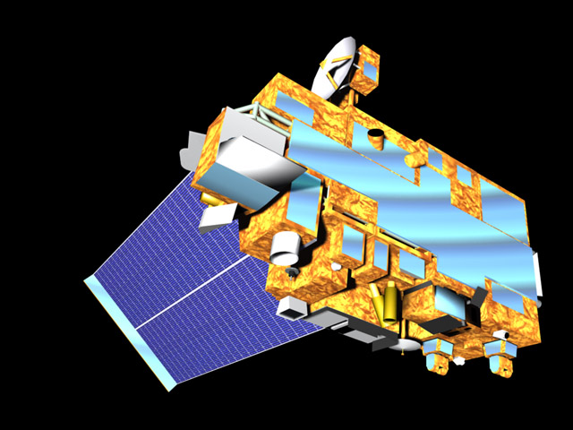
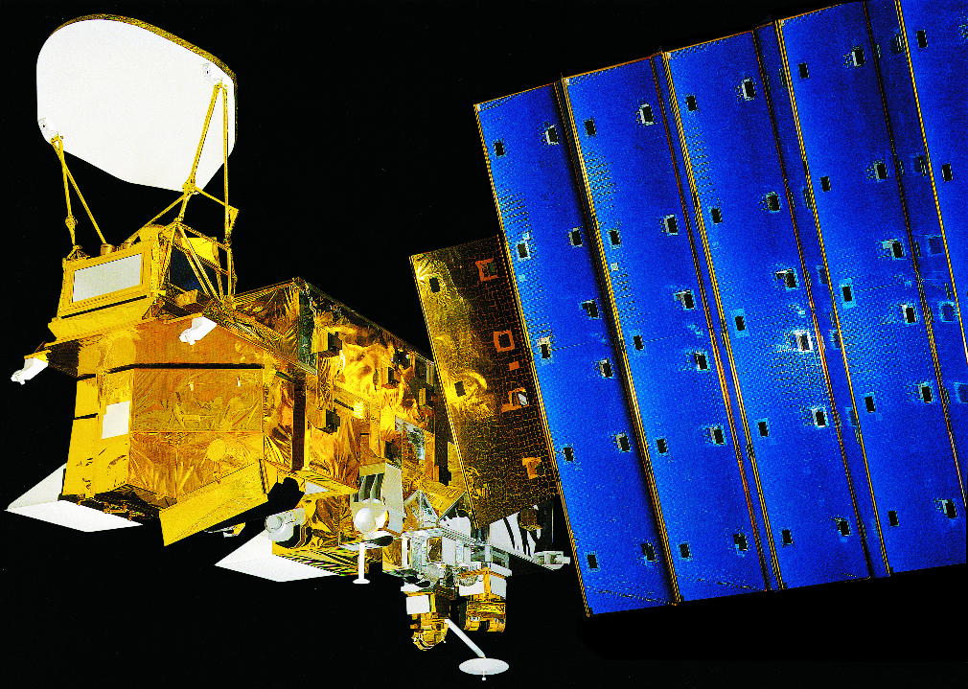
MODIS
Terra: launched Dec 18, 1999
Terra
Mid-morning
(~10:30 am)
Same instrument (different satellites)
Same algorithm
One combined product
http://visibleearth.nasa.gov/
Aqua: launched May 4, 2002
Aqua
Early afternoon
(~1:30 pm)
http://visibleearth.nasa.gov/

Slide 5
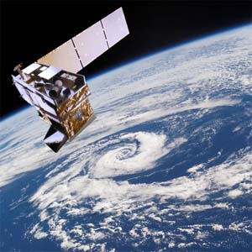
VIIRS
Two resolutions (750, 375)
Slightly different algorithms
Two products delivered in different data streams
Suomi NPP: launched Oct 28, 2011
Early afternoon overpass (1:30 pm)
www.noaanews.noaa.gov

Slide 6
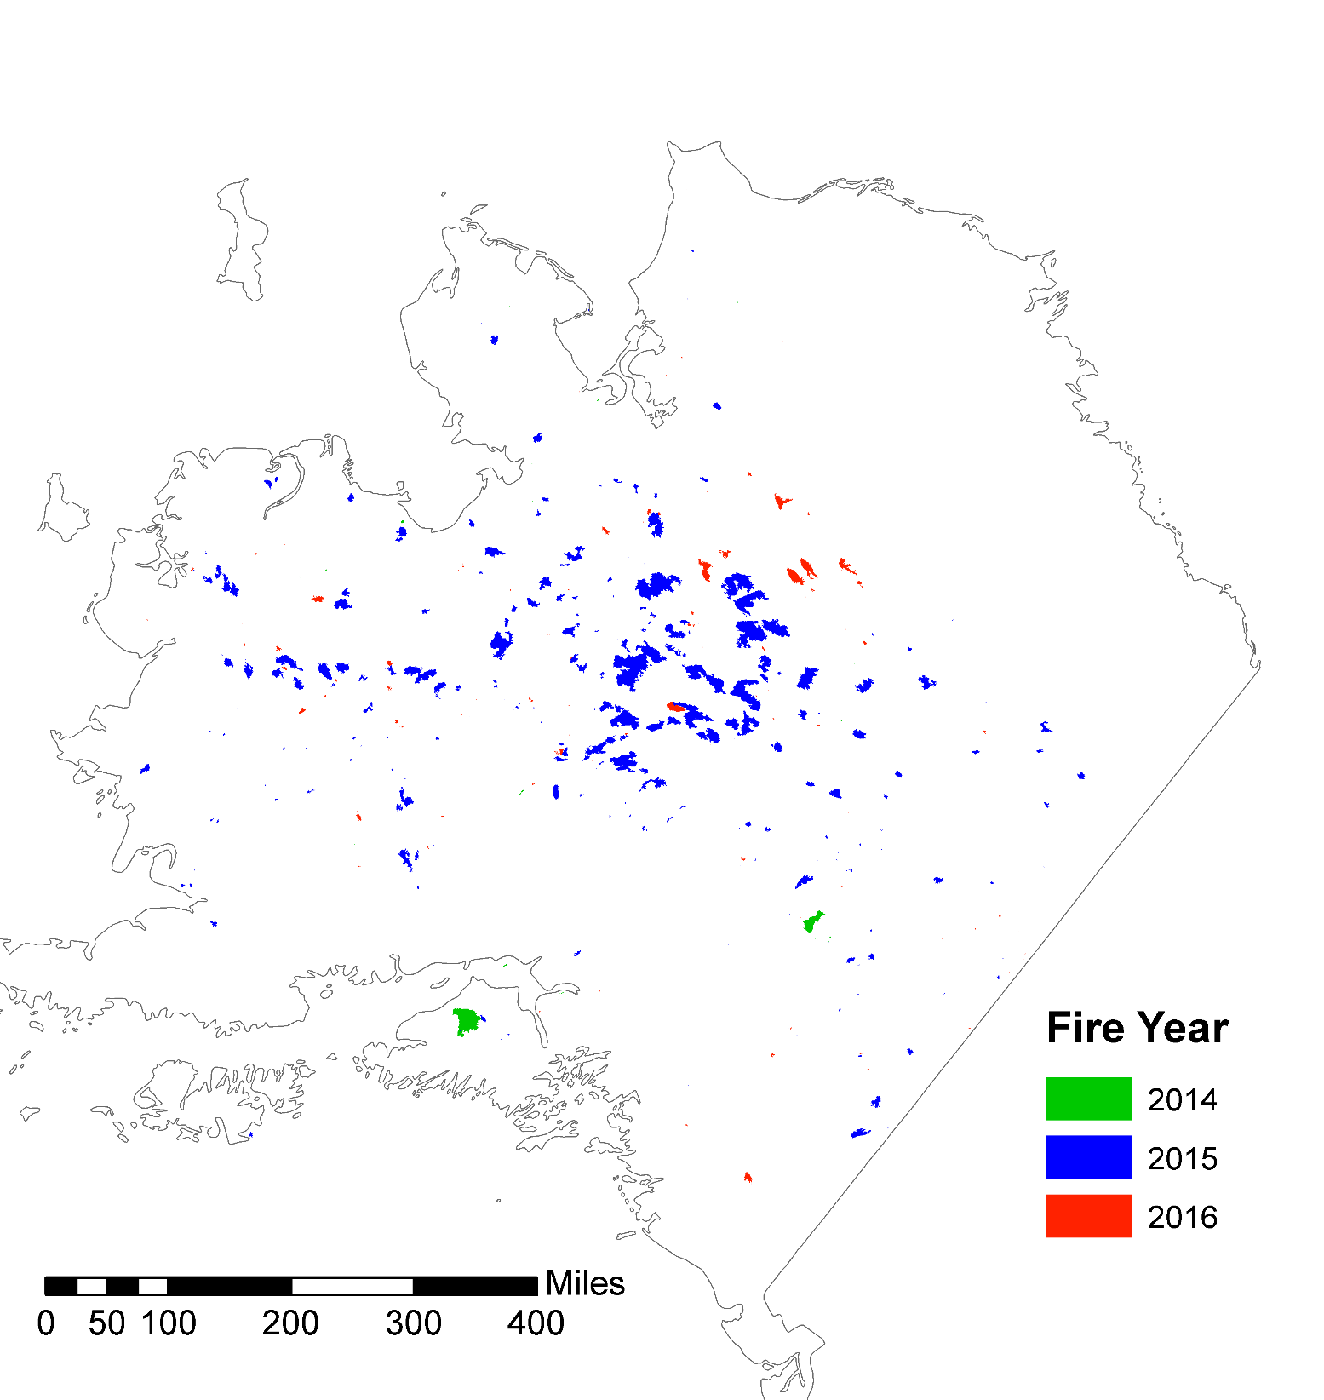
Fire record in Alaska Large Fire Data Base 2014 - 2016
~5.1
~0.5
~0.3

Slide 7
2014 Fire season summary
28 fire events = 288,269 acres total
By cause:
  Human 5 ; Lightning 14 ; Prescribed 9
By size:
  <100 acres 7
  100-500 acres 9
  500 – 1000 acres 6
  1000 – 10,000 acres 3
  10,000 – 50,000 acres 1
  50,000 – 100,000 acres 1
  >100,000 acres 1

Slide 8
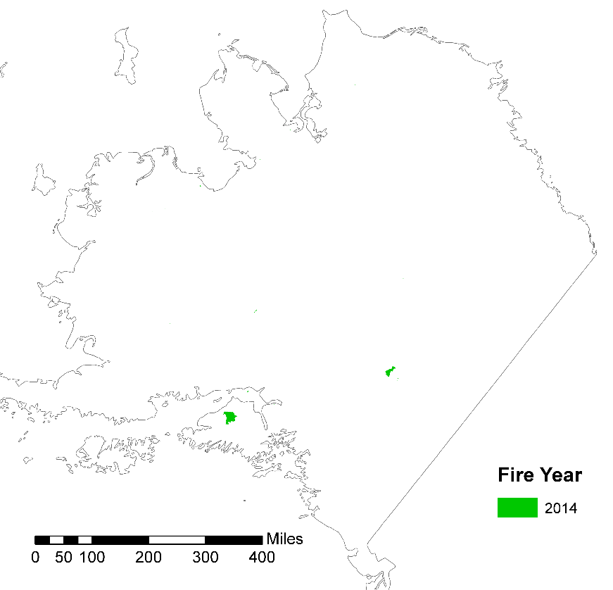
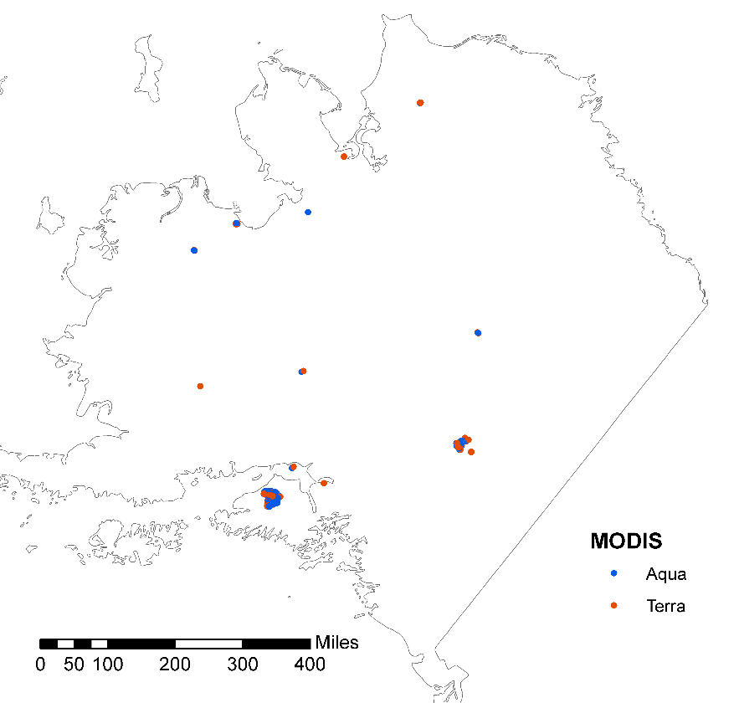
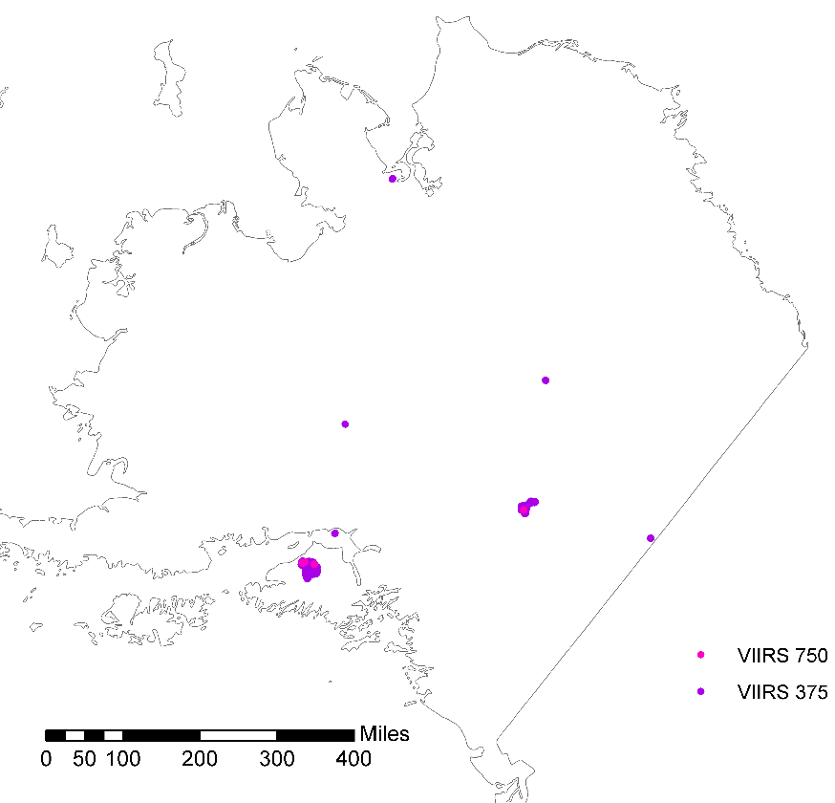
ALFD
2014
MODIS
VIIRS

Slide 9
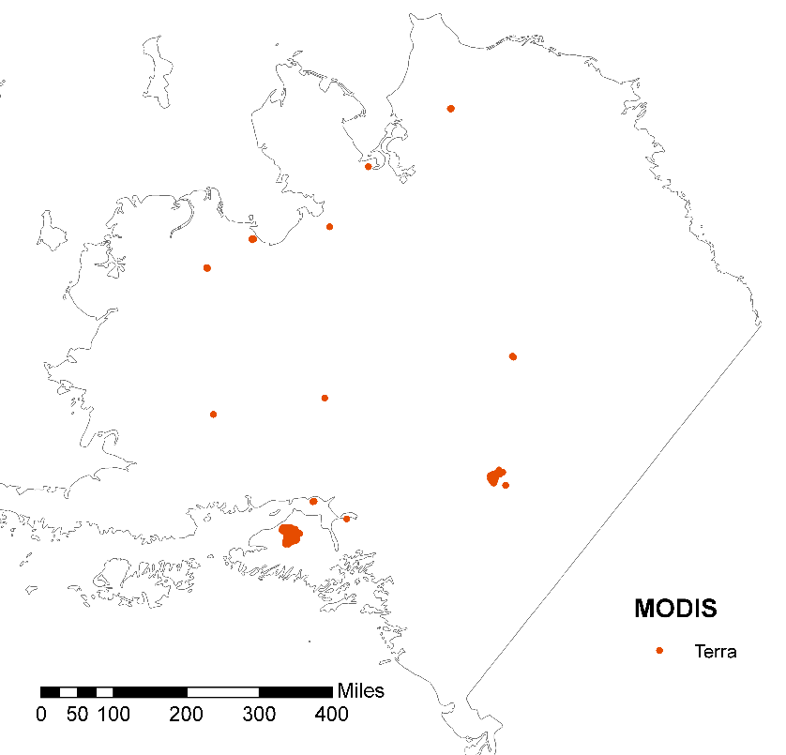
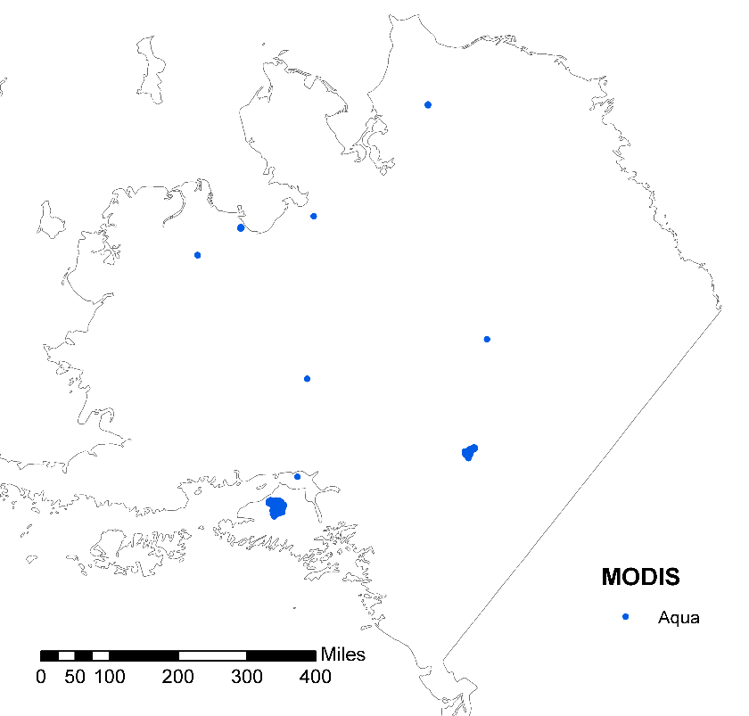
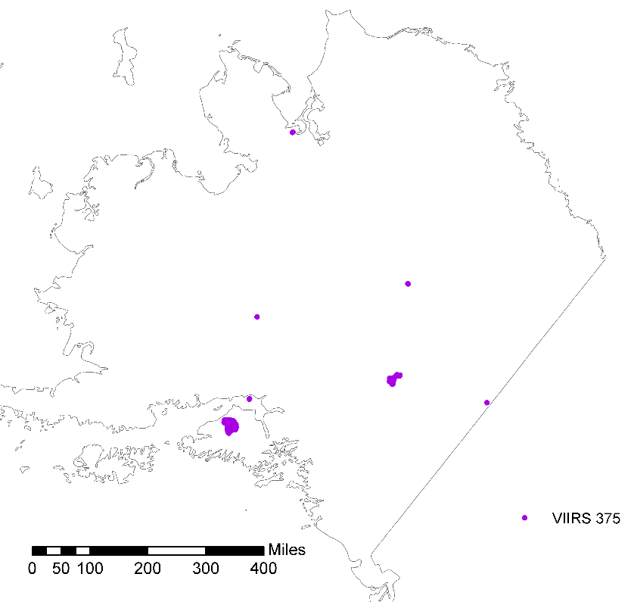
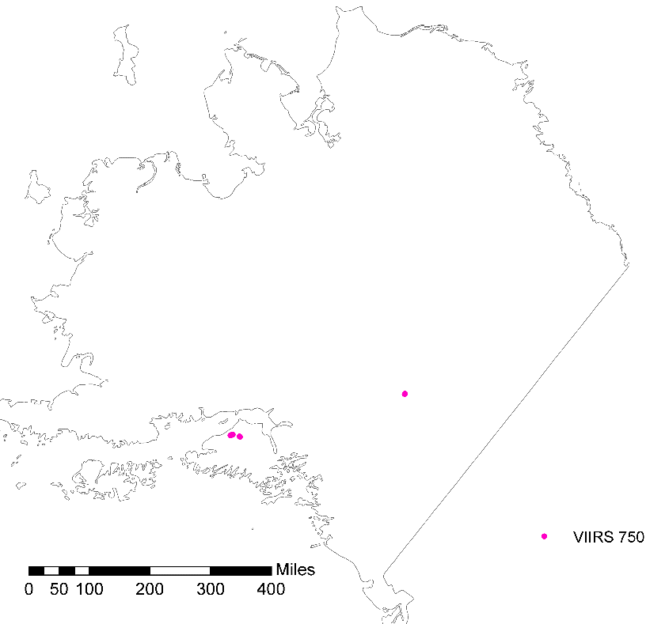
MODIS Terra
MODIS Aqua
2014
VIIRS 375
VIIRS 750

Slide 10
2014 active fire detection summary
14 (of 28) were flagged by at least one active fire product
  MODIS combined 14
    MODIS Terra 14
    MODIS Aqua 10
  VIIRS 750 2
  VIIRS 375 7

Slide 11
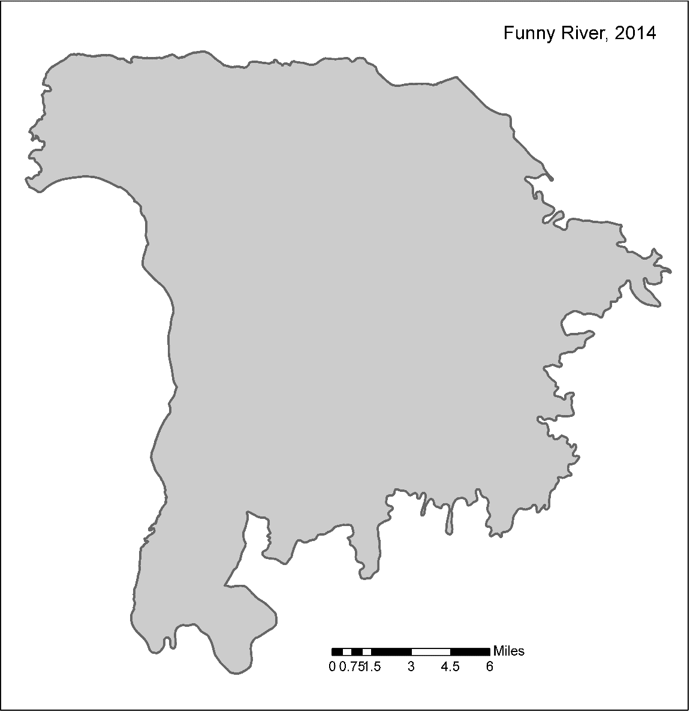
2014 area estimates (cumulative modeled pixels)
ALDF perimeter

Slide 12
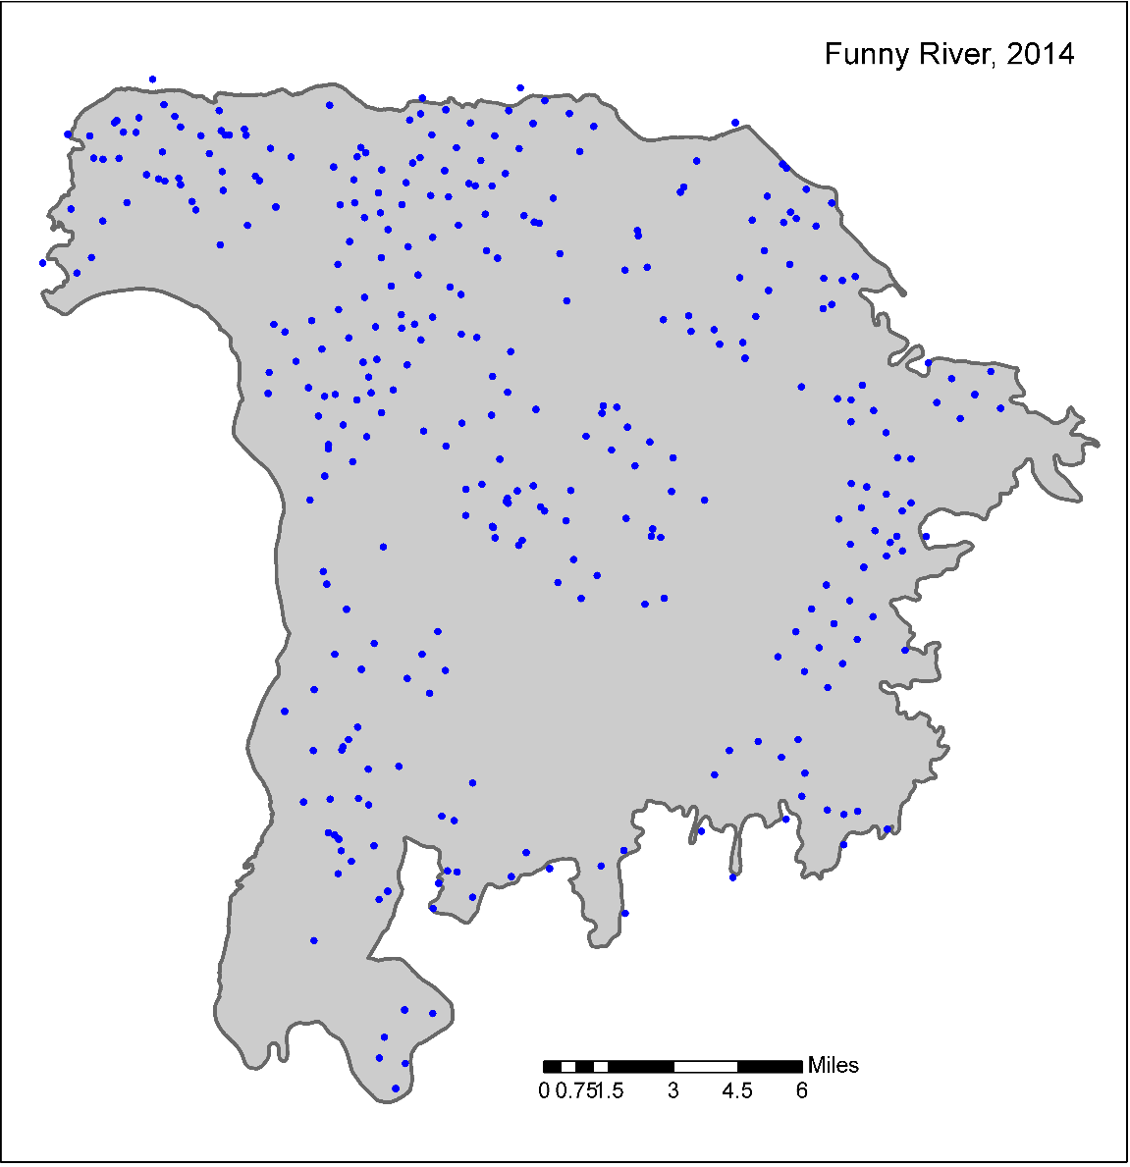
2014 area estimates (cumulative modeled pixels)
MODIS Aqua active fire points

Slide 13
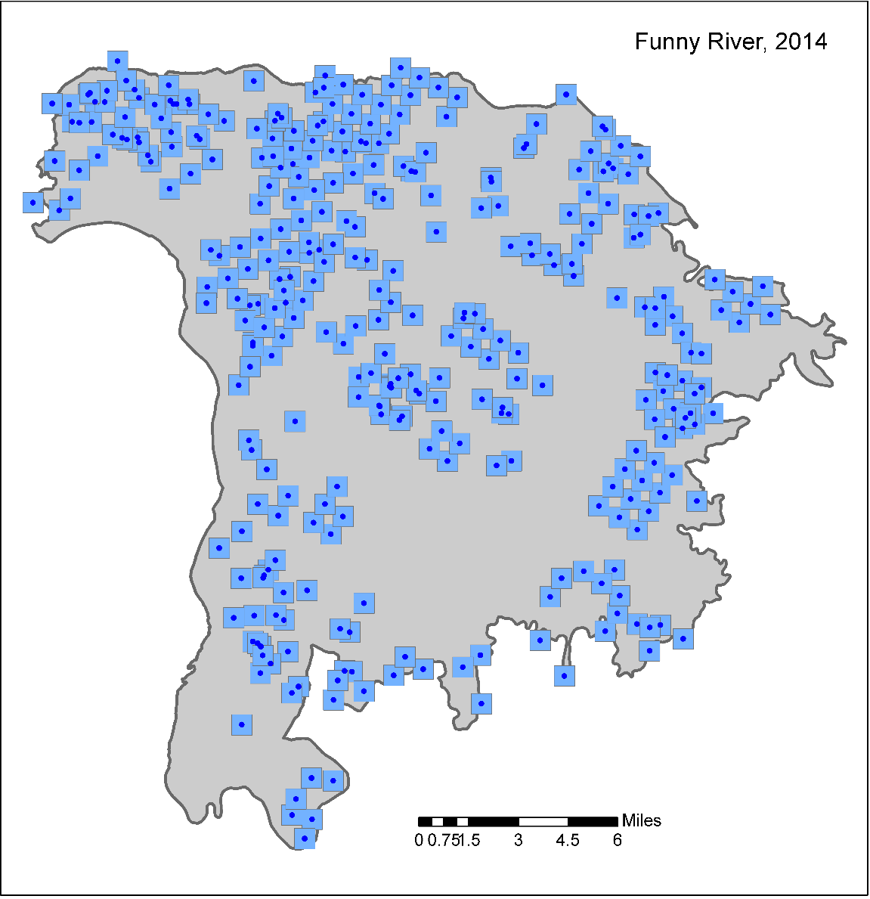
2014 area estimates (cumulative modeled pixels)
MODIS Aqua ~1 km modeled pixels

Slide 14

2014 area estimates (cumulative modeled pixels)
MODIS Aqua modeled burned area

Slide 15
2014 area estimates
Fire Name | Area burned (acres)
 | ALFD | MODIS Aqua | MODIS Terra | MODIS combo | VIIRS 750 | VIIRS 375
Funny River | 196,610 | 63,699 | 91,868 | 119,543 | 1,051 | 21,642
Oklahoma (DTA West) | 55,241 | 9,294 | 15,005 | 20,736 | 278 | 4,021
100 Mile Creek | 23,270 | 2,436 | 3,788 | 5,474 |  | 1,064
The Sisters | 2,622 | 1,904 | 1,914 | 2,304
Sheep Creek 1 | 1,995 | 45 | 35 | 80 |  | 30
Tyonek | 1,906 | 193 | 396 | 590 |  | 137
Jarvis Complex | 967 |  | 246 | 246
JBER Clunie Creek Complex | 792 |  | 116 | 116
Noatak River | 750 | 480 | 225 | 561
Duck Creek #3 | 573 |  | 147 | 147 |  | 37
Allman Lake | 560 | 315 | 431 | 437
Dalton River Crossing | 403 | 72 | 64 | 127 |  | 85
Titnuk | 317 |  | 166 | 166
Ungalik River | 214 | 128 | 44 | 131

Slide 16
2014 temporal estimates
Fire Name | Earliest Detection | Estimated duration (days)
 |  | MODIS combo | VIIRS 750 | VIIRS
Funny River | MODIS | 22 | <1 | 16
Oklahoma (DTA West) | MODIS | 2 | <1 | 1
100 Mile Creek | MODIS | 16 |  | 9
The Sisters | MODIS | 2
Tyonek | MODIS | 2 |  | <1
Noatak River | MODIS | <1
Allman Lake | MODIS | 1
Jarvis Complex | MODIS | <1
Titnuk | MODIS | <1
Duck Creek #3 | MODIS | <1 |  | <1
Ungalik River | MODIS | <1
Dalton River Crossing | VIIRS375 | <1 |  | <1
JBER Clunie Creek Complex | MODIS | <1
Sheep Creek 1 | VIIRS375 | <1 |  | <1

Slide 17
Fire Spread reconstruction
ALFD perimeter

Slide 18
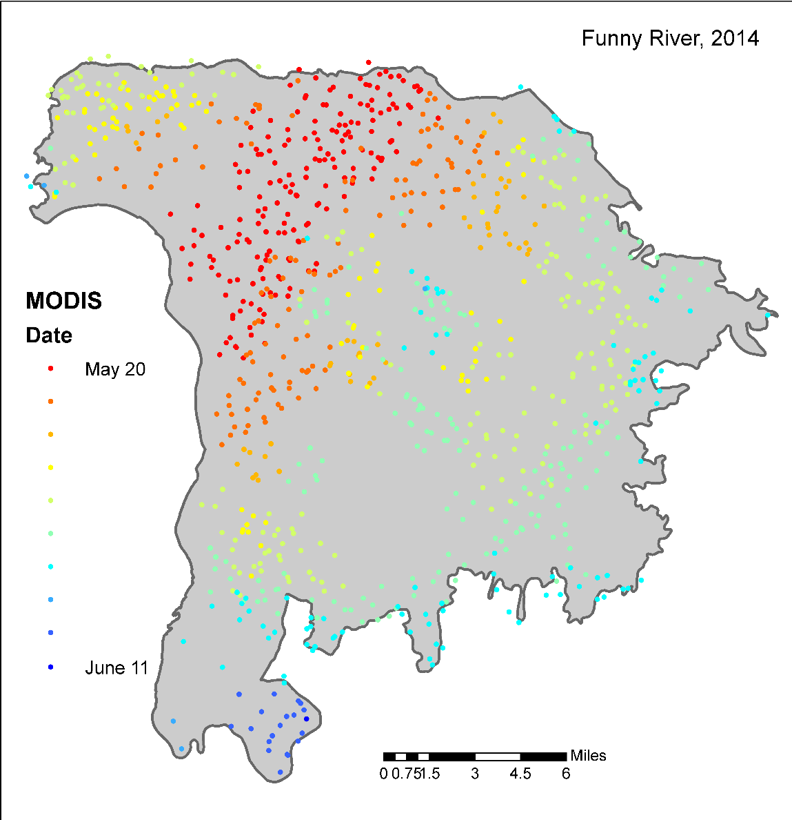
Fire Spread reconstruction

Slide 19
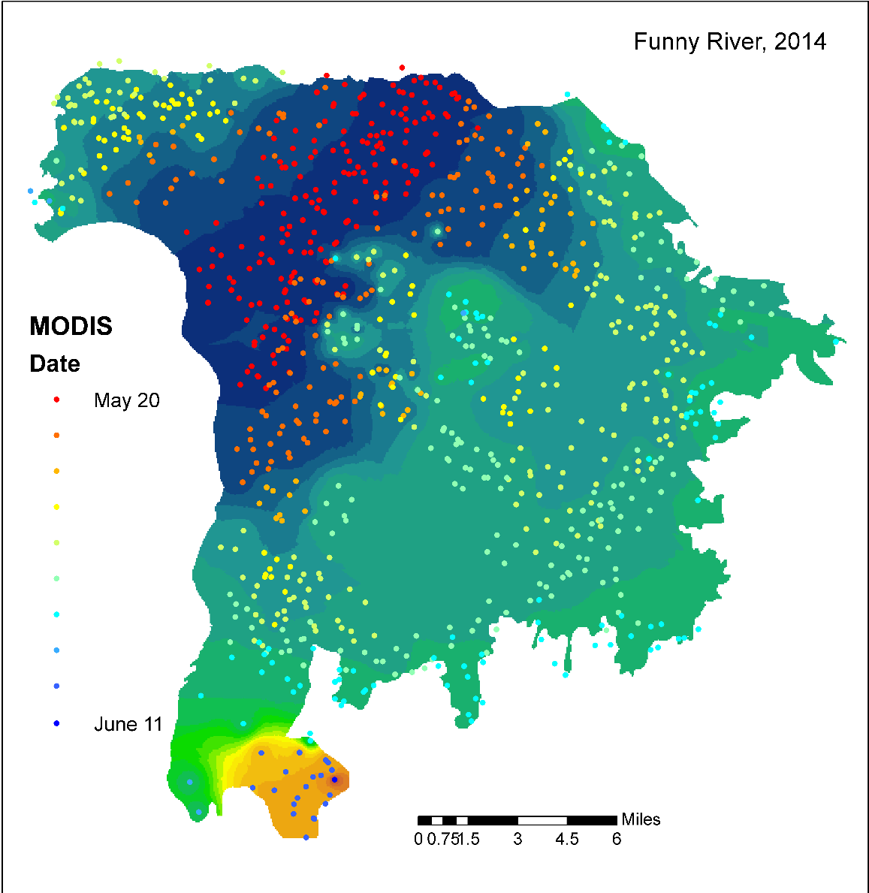
Fire Spread reconstruction

Slide 20
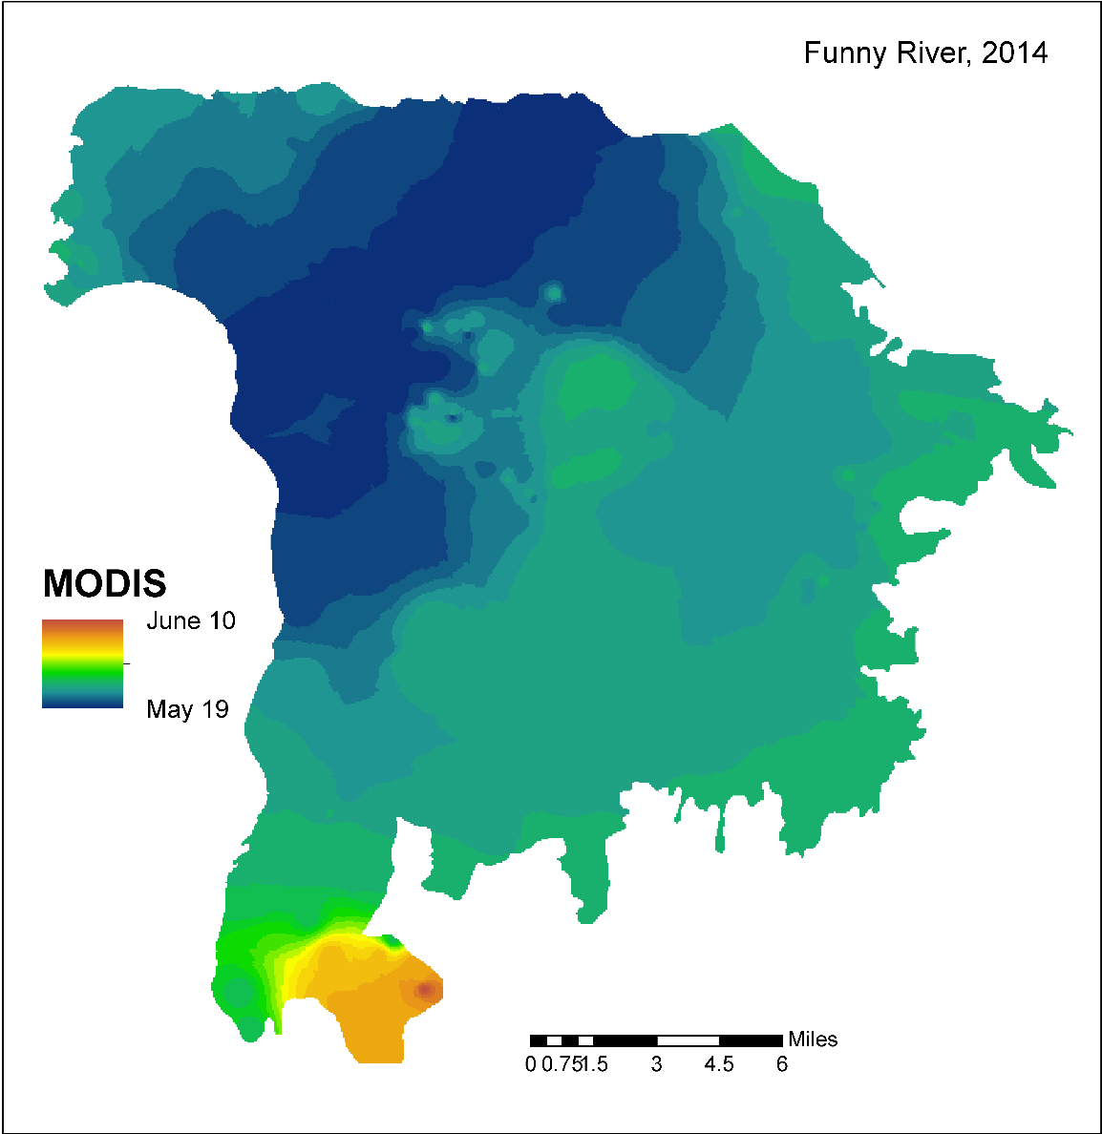
Fire Spread reconstruction

Slide 21
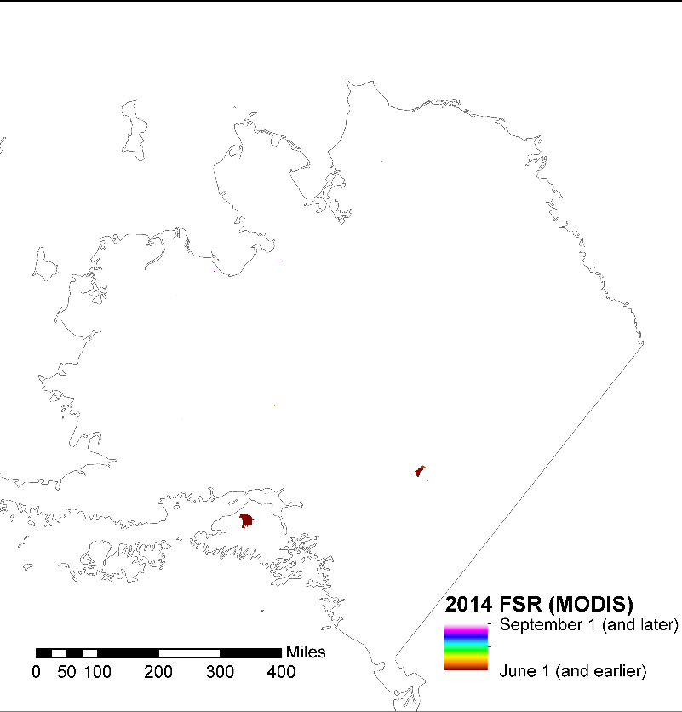
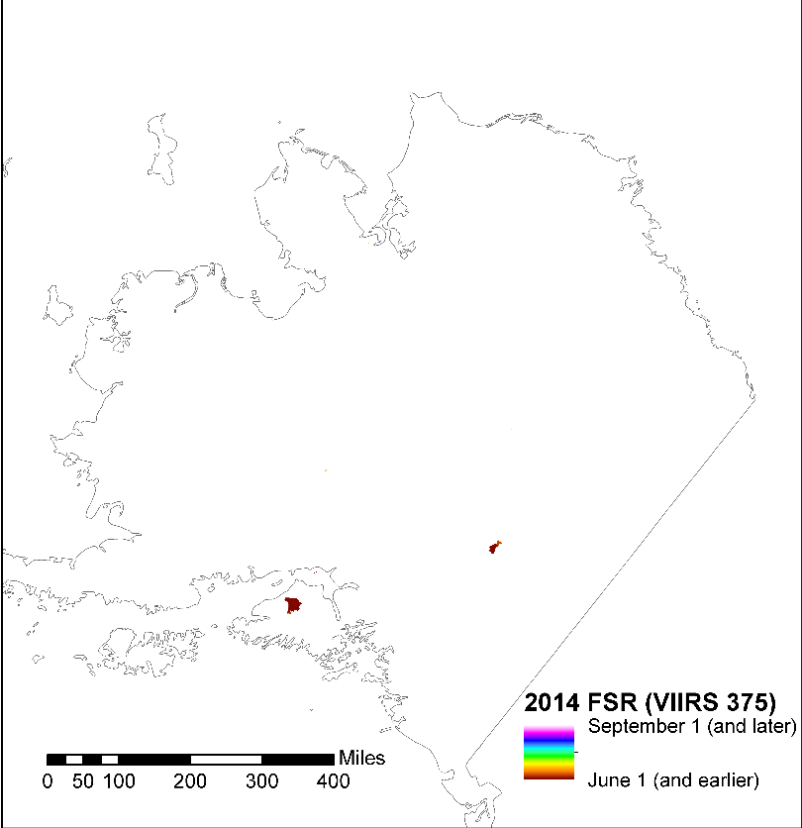
2014 Fire Spread
MODIS
VIIRS 375

Slide 22
2014 Fire Spread

Slide 23
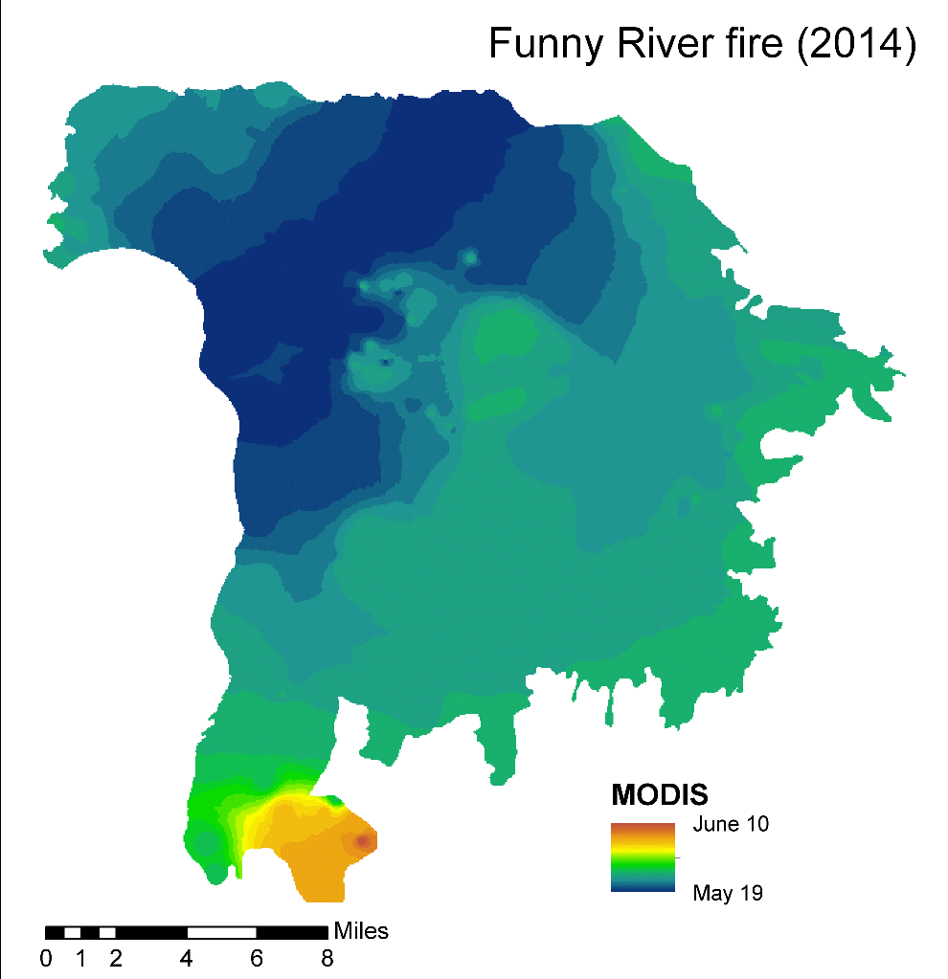
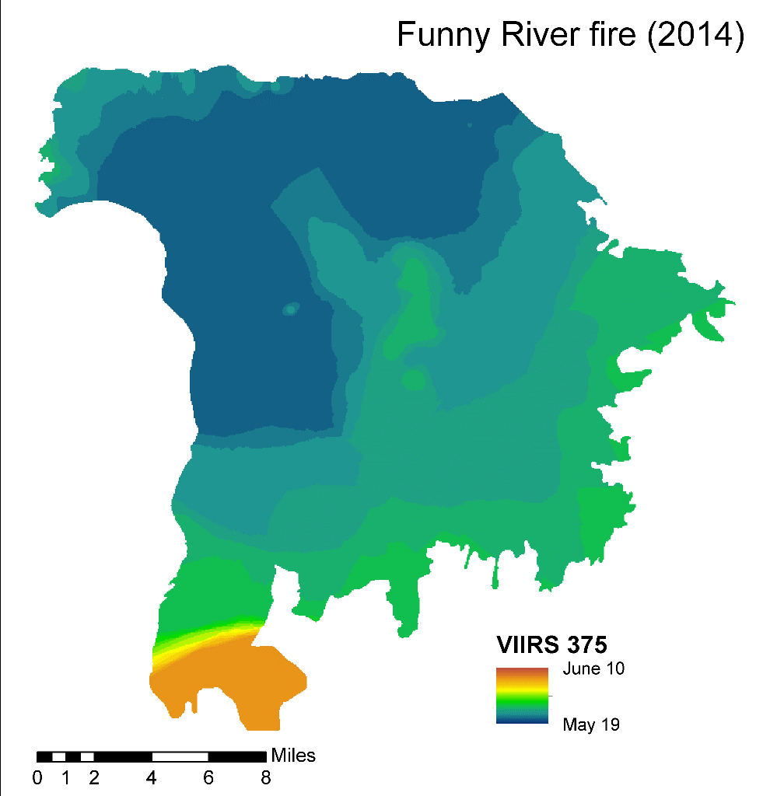
2014

Slide 24
Funny river fire area burned by date

Slide 25
2014 total area burned by date

Slide 26
2015 Fire season summary
334 fire events = 5,146,921 acres total
By cause:
  Human 27 ; Lightning 302 ; Prescribed 5
By size:
  <100 acres 53
  100-500 acres 49
  500 – 1000 acres 22
  1000 – 10,000 acres 106
  10,000 – 50,000 acres 79
  50,000 – 100,000 acres 15
  >100,000 acres 10

Slide 27
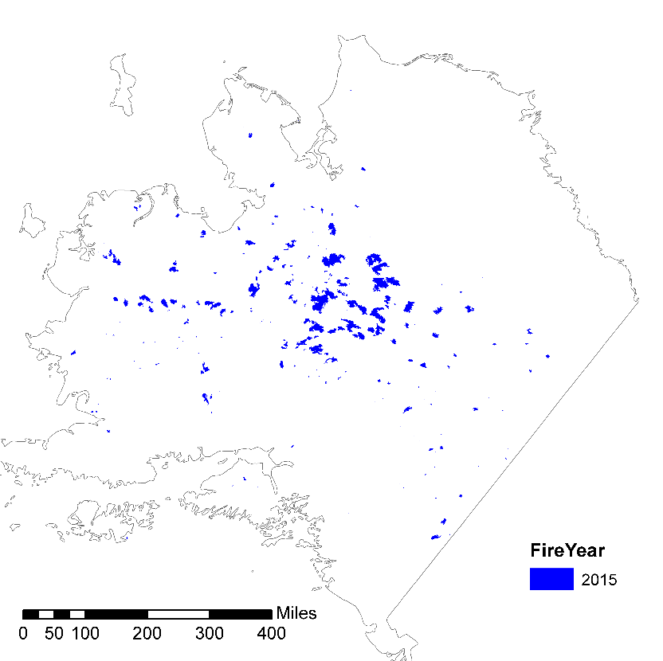
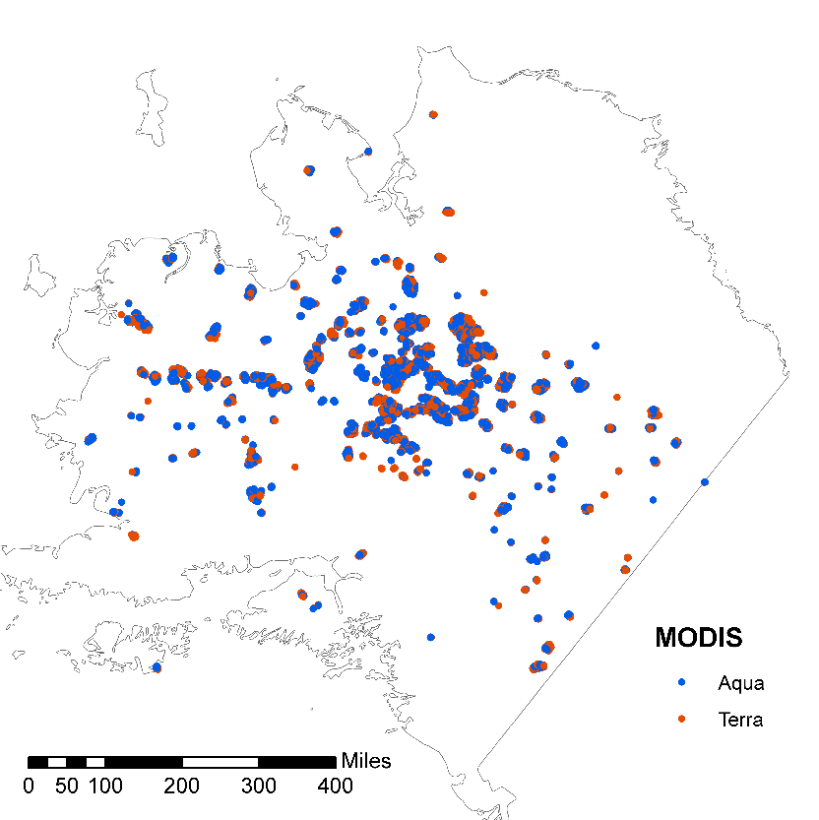
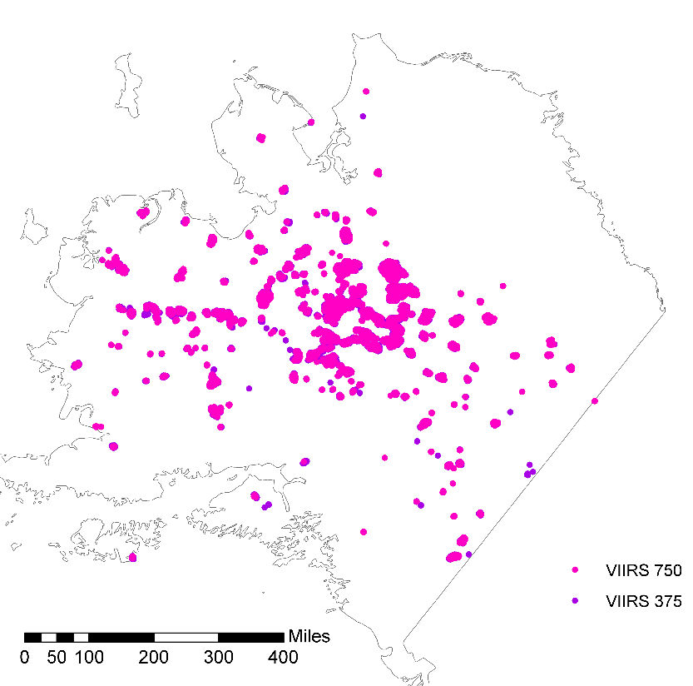
ALFD
2015
MODIS
VIIRS

Slide 28
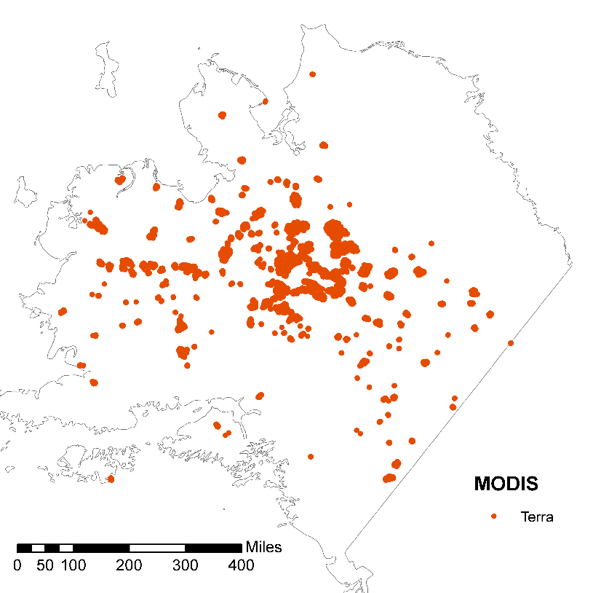
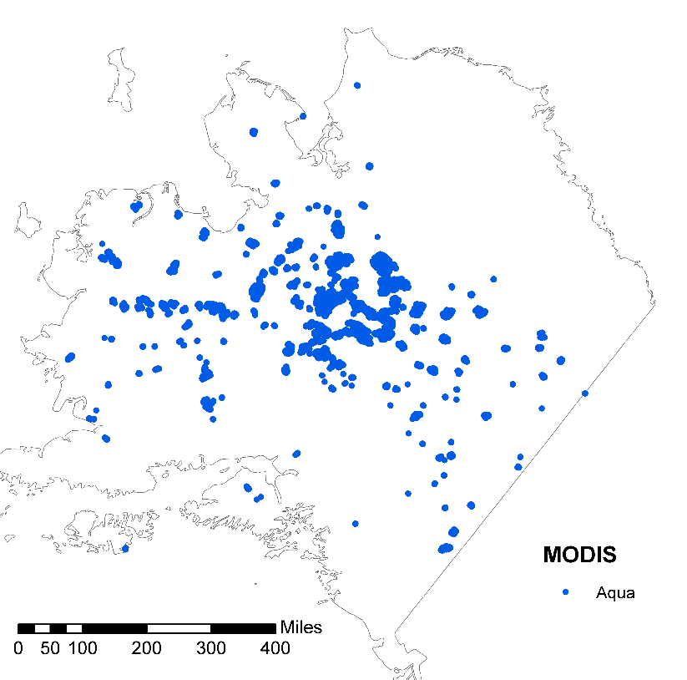
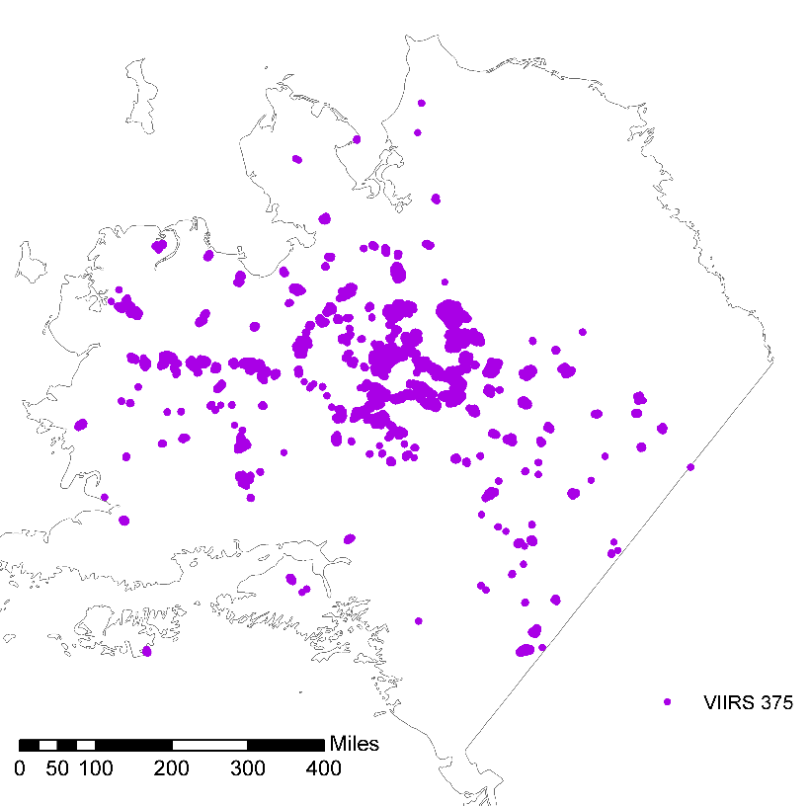

MODIS Terra
MODIS Aqua
2015
VIIRS 375
VIIRS 750

Slide 29
2015 active fire detection summary
271 (of 334) were flagged by at least one active fire product
  MODIS combined 258
    MODIS Terra 255
    MODIS Aqua 245
  VIIRS 750 241
  VIIRS 375 259

Slide 30
2015 Area burned estimates
334
258
255
245
241
259

Slide 31
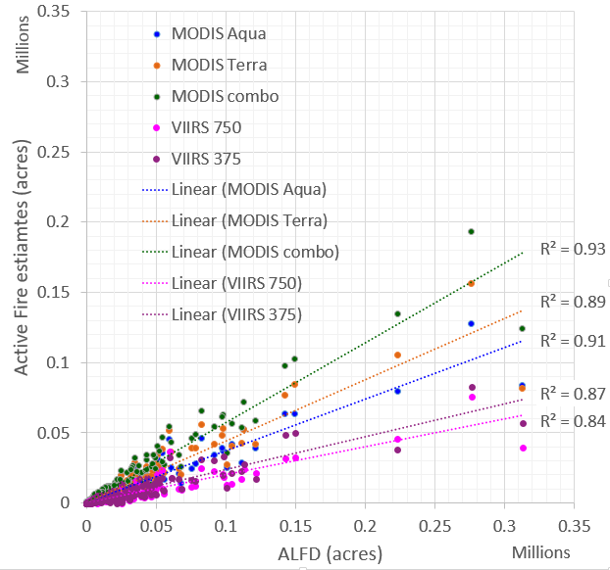

Slide 32
2015 Earliest detection
MODIS 149 (55%)
VIIRS 375 73 (27%)
VIIRS 750 49 (18%)

Slide 33
2015 Fire event duration estimates

Slide 34
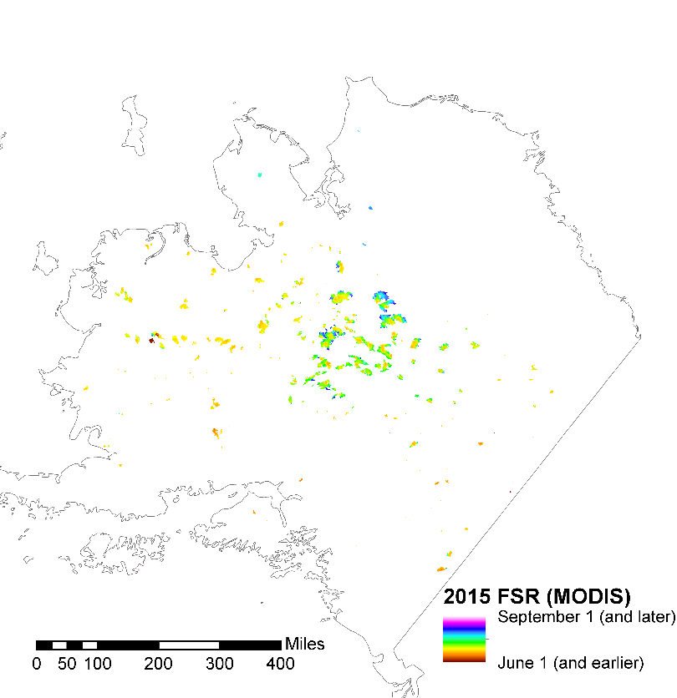
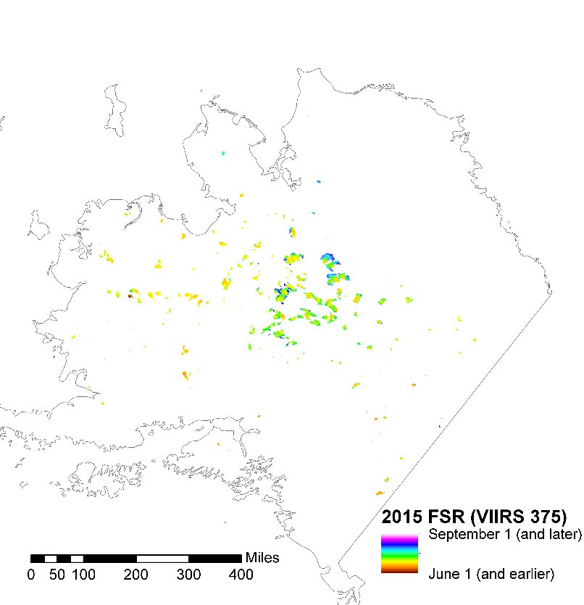

2015 Fire spread
MODIS
VIIRS 375
VIIRS 750

Slide 35
2015 Fire spread
MODIS
VIIRS 375
VIIRS 750

Slide 36
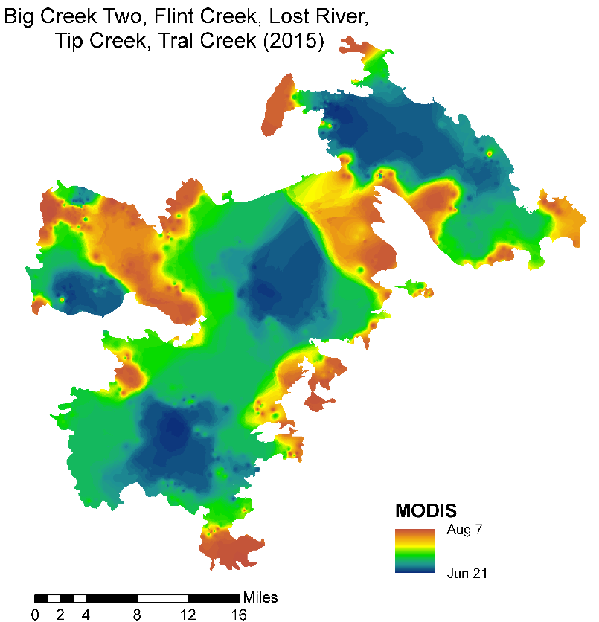
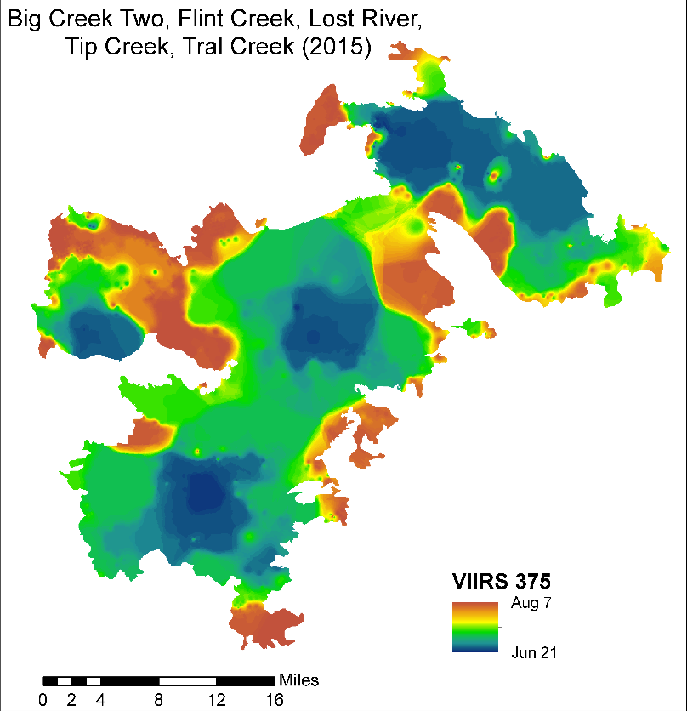
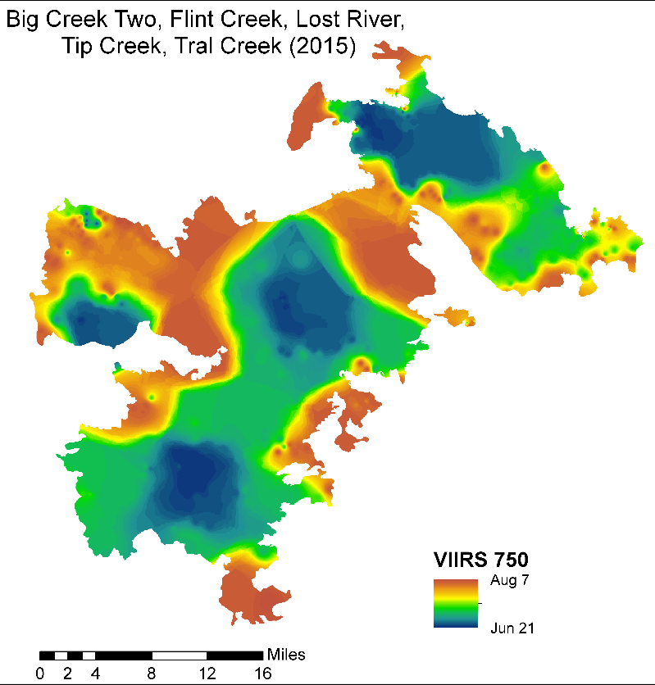

Slide 37
2015 complex area by date burned

Slide 38
2015 total area burned by date

Slide 39
2016 Fire season summary
153 fire events = 456,485 acres total
By cause:
  Human 21 ; Lightning 132 ; Prescribed 0
By size:
  <100 acres 58
  100-500 acres 33
  500 – 1000 acres 18
  1000 – 10,000 acres 35
  10,000 – 50,000 acres 6
  50,000 – 100,000 acres 5
  >100,000 acres 0

Slide 40
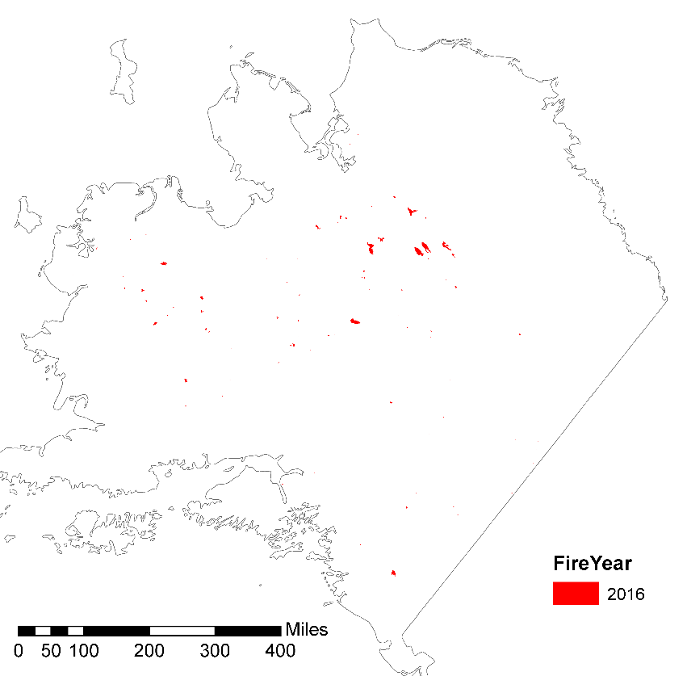
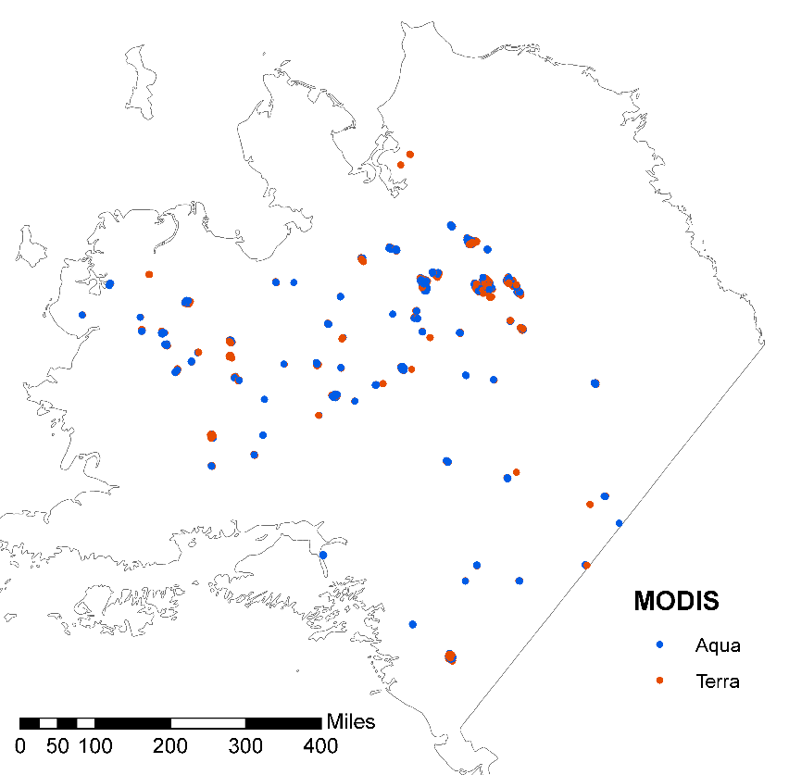
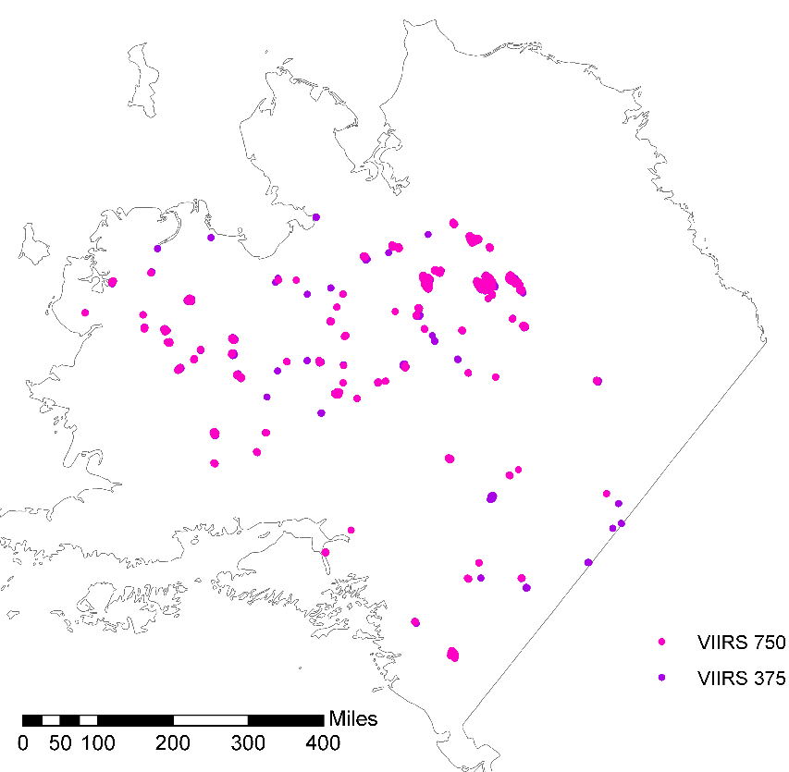
ALFD
2016
MODIS
VIIRS

Slide 41
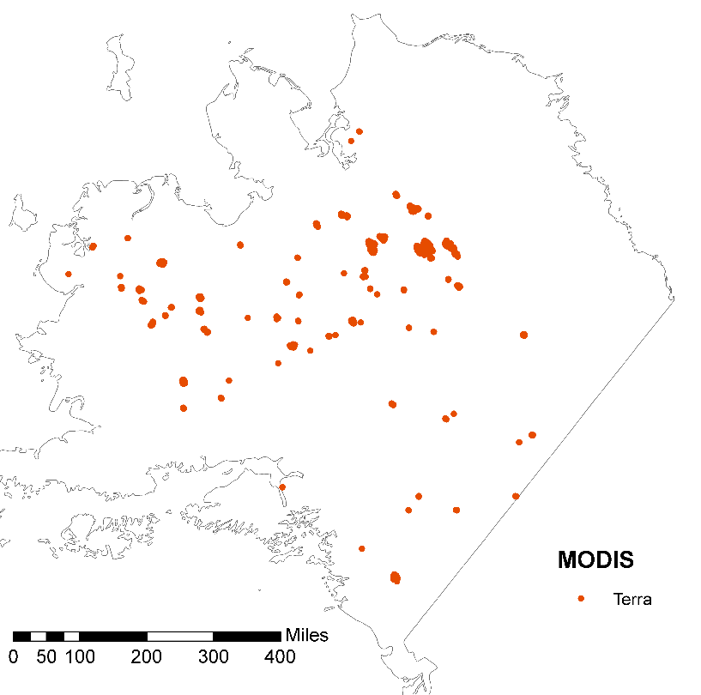
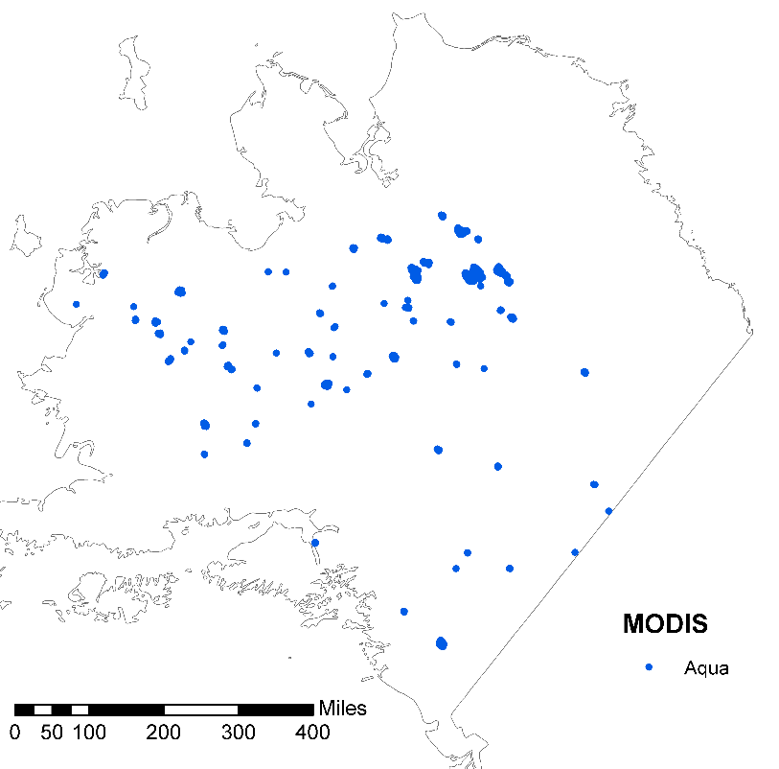
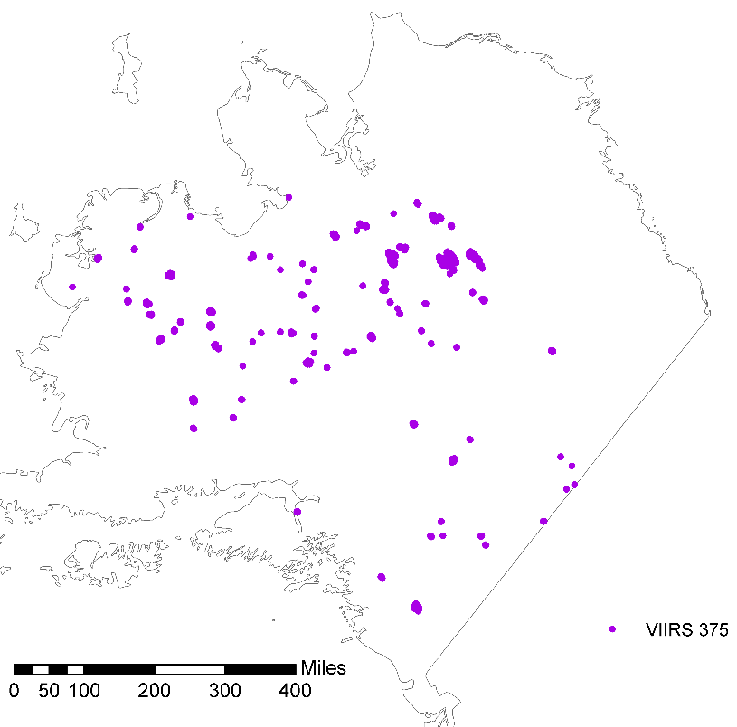
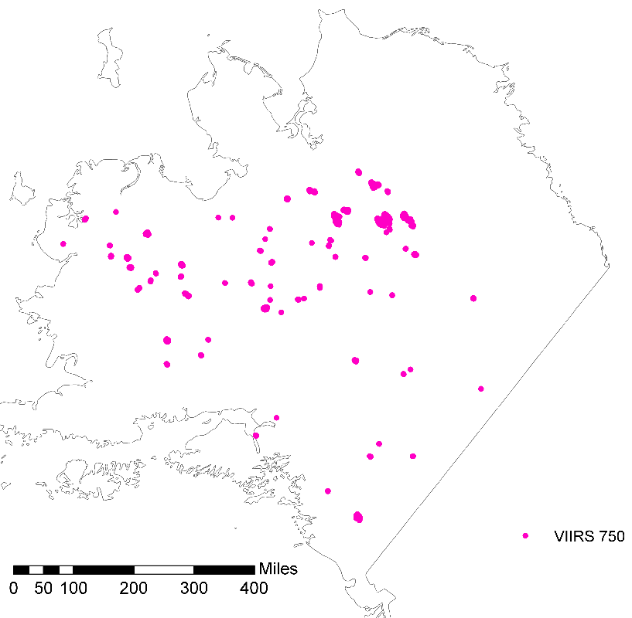
MODIS Terra
MODIS Aqua
2016
VIIRS 375
VIIRS 750

Slide 42
2016 active fire detection summary
103 (of 153) were flagged by at least one active fire product
  MODIS combined 80
    MODIS Terra 76
    MODIS Aqua 70
  VIIRS 750 73
  VIIRS 375 95

Slide 43
2016 Area burned estimates

Slide 44
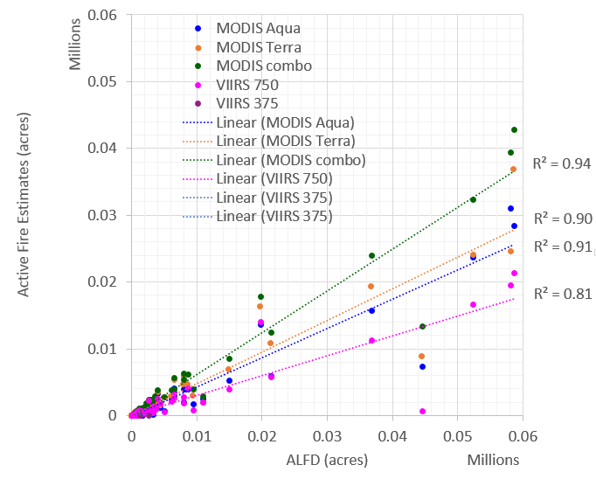

Slide 45
2016 Earliest detection
VIIRS 375 51 (50%)
MODIS 35 (34%)
VIIRS 750 17 (17%)

Slide 46
2016 Fire event duration estimates

Slide 47
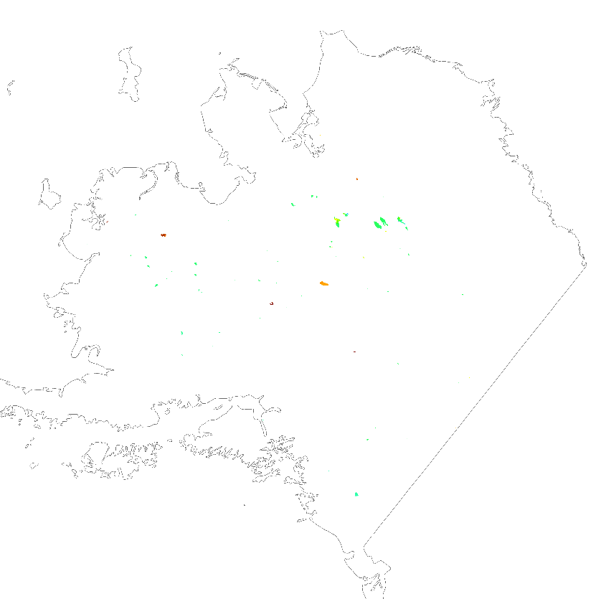
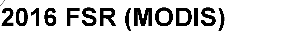

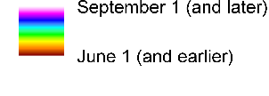
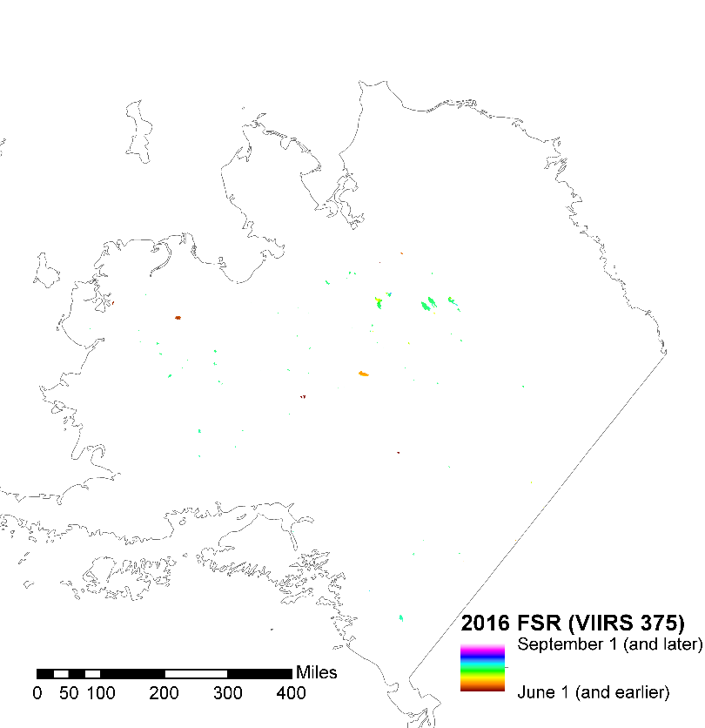

MODIS
2016 Fire spread
VIIRS 375
VIIRS 750

Slide 48
MODIS
2016 Fire spread
VIIRS 375
VIIRS 750

Slide 49
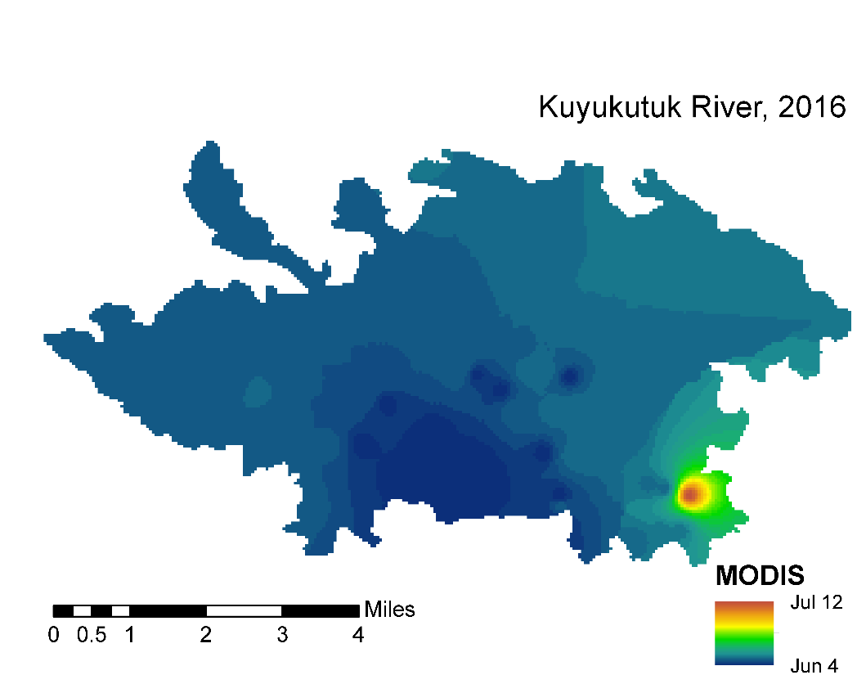
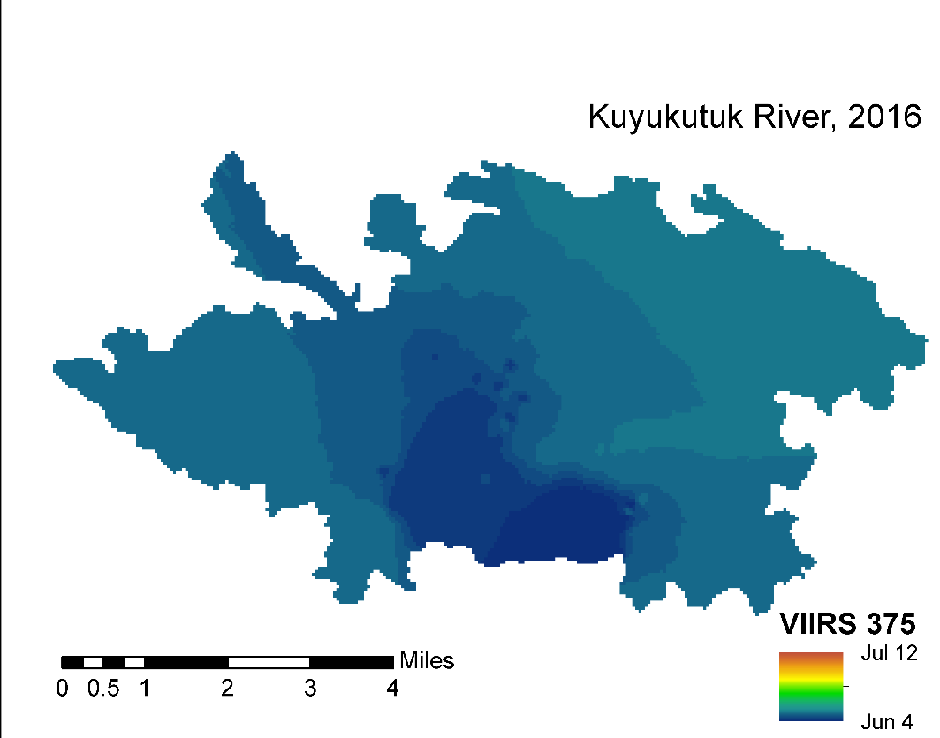


Slide 50
2016 kuyukutuk river area by date burned

Slide 51
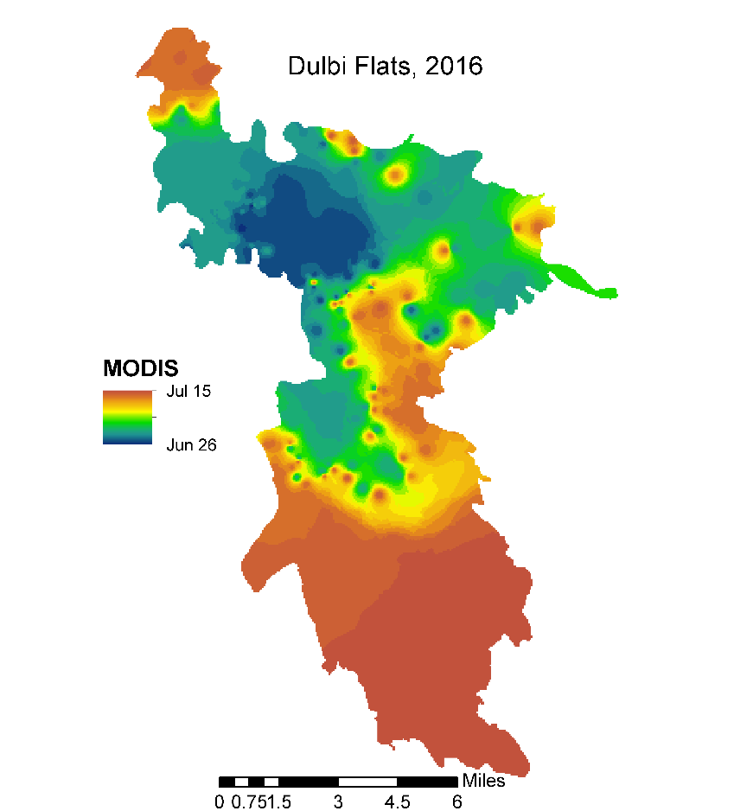
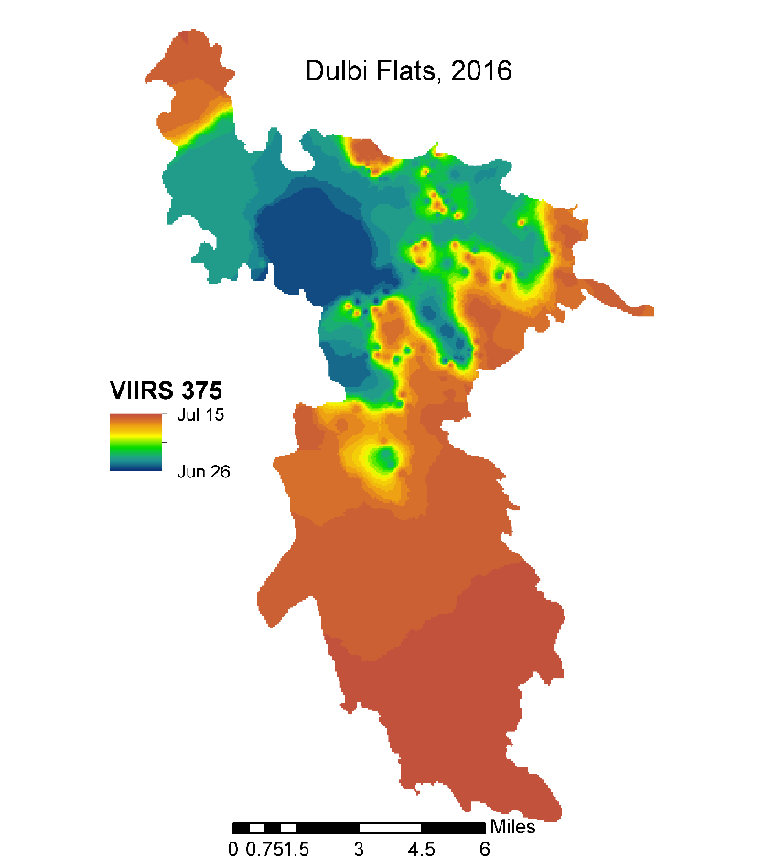
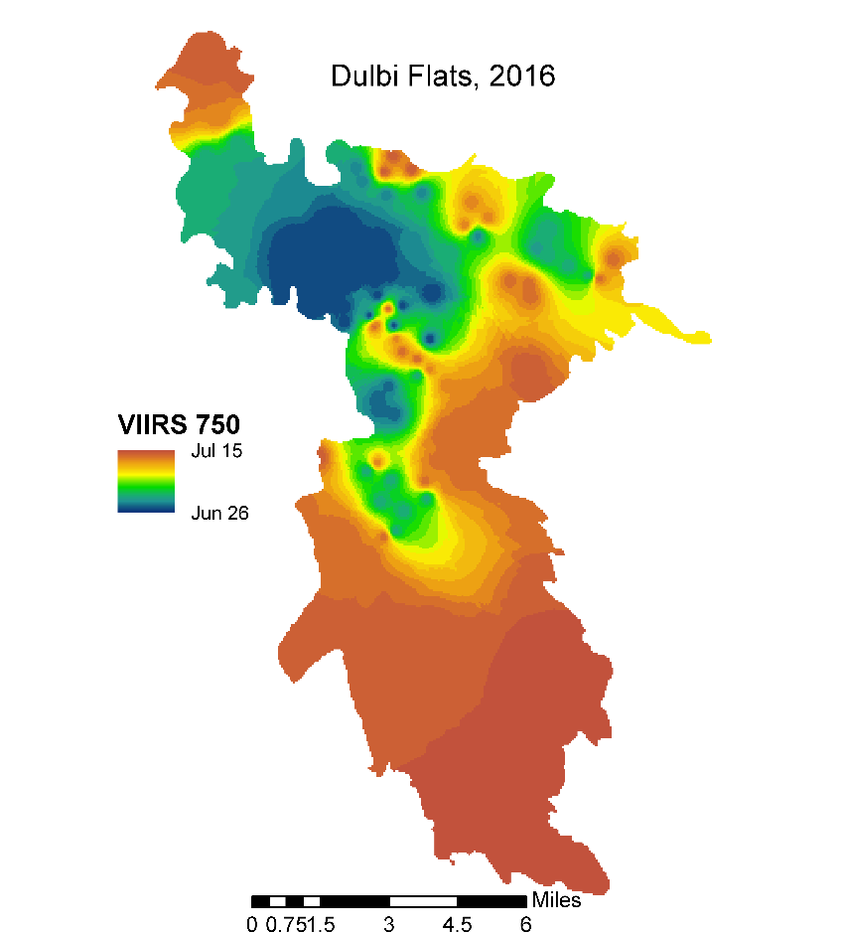

Slide 52
2016 Dulbi Flats fire area by date burned

Slide 53
2015 total area burned by date

Slide 54
Summary and Take home message
No single “best” product – use the full suite
Strong predictive capability for individual fire size (if early estimates are a goal)
Highly variable estimates of duration and fire spread – potentially combining data from all products is a “MUST”

