Slide 1
Can Google Scholar Give Us Everything We Need?
Evaluation of Research Literature Databases for Subject Scope and Search Retrieval in the Sciences
Stephanie Ritchie
Libraries Research & Innovative Practice Forum
June 8, 2017

Slide 2
Agricultural Database Comparisons
Research Project I: Subject Coverage
The purpose of this research is to determine the most comprehensive database(s) for agricultural literature searching in terms of the scope of agricultural subject content provided by each database. A known set of items from current agricultural research literature will be evaluated in each of the eight selected databases for inclusion. This evaluation will determine if significant difference in content available across databases exists and if subject subtopics or content format impact the scope of content found in each database.
Research Project II: Search Analysis
This follow-up research will help determine the relevancy and completeness of search results from agricultural literature databases. Common information retrieval metrics of precision and recall will be compiled for identical searches across databases. This analysis will provide information about how useful the content provided in each agricultural database is likely to be for a typical agricultural researcher.

Slide 3







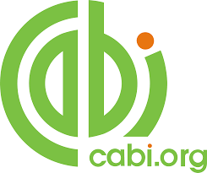
Agricultural Database Comparisons
Eight Databases Compared
Organized by Type
Comprehensive Sub-topical Multi-disciplinary
AGRICOLA BIOSIS Google Scholar
AGRIS Scopus
FSTA
CAB Web of Science

Slide 4
Research Project I: Subject Coverage

Slide 5
Subject Coverage Methodology
A literature review was conducted to determine which methodology should be selected for the subject coverage comparison. Several types of methods were found in recent and foundational literature:
1) Bibliography method: Utilizes literature review articles or comprehensive bibliographies as sources for citations to check in each database. Often a unique strategy is employed to reduce, normalize, or randomly select citations compiled from the review articles or bibliographies.
2) Subject profile method: Compares the number of citations retrieved from each database for a subject specific search strategy. Retrieved citations may be evaluated based of database characteristics in comparison to other databases such as total years covered or types of materials.
3) Journal method: Assesses coverage of whole journal titles in each database, not just articles or issues. Journal lists may be compiled using various methods.
4) Custom core list method: Creation of a set of core literature based on expert review of literature using discipline variable criteria.

Slide 6
Subject Coverage Methodology
Review articles for three different, multi-subject agriculture topics were selected as sources for core lists of citations:
1. Baum, C., El-Tohamy, W., & Gruda, N. (2015). Increasing the productivity and product quality of vegetable crops using arbuscular mycorrhizal fungi: A review. Scientia Horticulturae, 187, 131–141. http://doi.org/10.1016/j.scienta.2015.03.002
Disciplines: Agronomy, Plant Science, Soil Sciences, Pest and Disease Management
2. Jones, A. D., Hoey, L., Blesh, J., Miller, L., Green, A., & Shapiro, L. F. (2016). A Systematic Review of the Measurement of Sustainable Diets. Advances in Nutrition: An International Review Journal, 7(4), 641–664. http://doi.org/10.3945/an.115.011015
Disciplines: Nutrition, Food Science, Health, Environment, Sustainability, Energy
3. Stankus, T., Laincz, J., & Linck, R. (2015). Reviews of Science for Science Librarians: Meat Science around the World, 1980–2014. Science & Technology Libraries, 34(3), 167–227. http://doi.org/10.1080/0194262X.2015.1072491
Disciplines: Meat Science, Animal Science, Veterinary Medicine, Economics, Marketing

Slide 7
Subject Coverage Methodology
Each citation in the article references lists was numbered (if not already numbered)
30 citations from each review article were randomly selected using a random number generator. These 30 citations were the core list for each topic.
Each selected citation was searched in all 8 databases during Nov 2016-Jan 2017
Each selected citation was marked if it was found in each database
  Citations were considered covered by a database if a full bibliographic record was found that included a direct link or if a record could easily be used to locate the correct item using a simple title search in Google.
  Items were most often searched using unique title strings in quotations (or as a phrase if database syntax did not allow quotations) or by a combination of title, keyword, journal source or author field if unable to be located by unique title string.
  Items were not found using these search strategies, they were considered not included in coverage for that database.

Slide 8
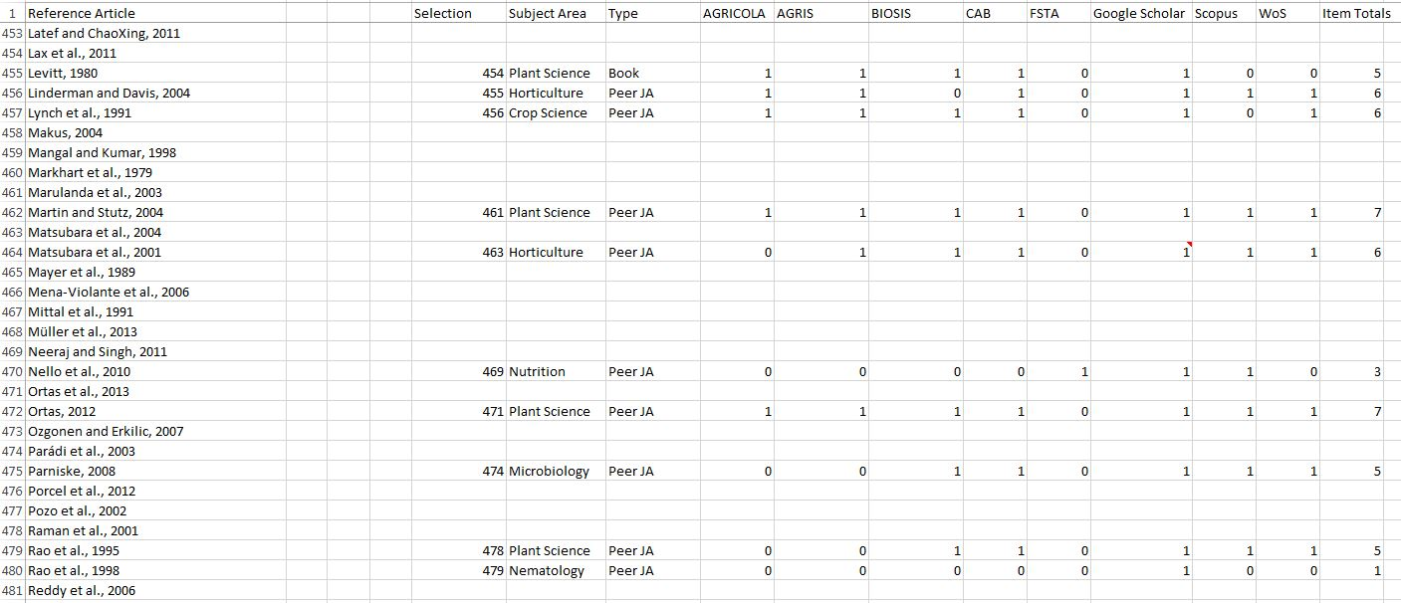
Subject Coverage Raw Data

Slide 9
Subject Coverage Results
Overlap among eight agricultural databases was calculated using simple matching where overlap is defined as the proportion of articles that were found and not found (counts both mutual presences and mutual absences) in both databases.
Simple Matching Coefficient (SMC)
SMC = number of matching attributes
number of attributes
Databases were also analyzed by type for insights into expected results based on published scope of database subject coverage

Slide 10
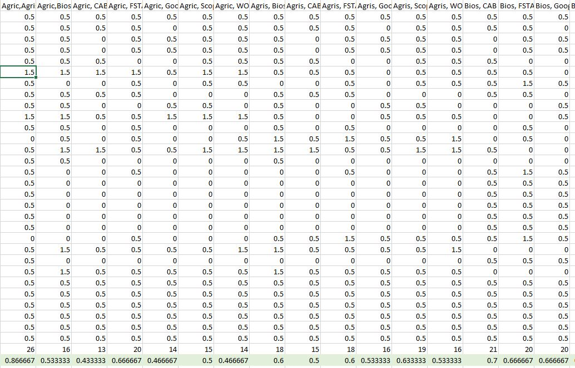
Subject Coverage Results

Slide 11
Subject Coverage Results
Overlap among eight databases used to find articles for a sustainable diets review article. The greatest overlap was between Scopus and Web of Science, and Google and Scopus. The least overlap was between Agricola and Google, and Agricola and Scopus.
Google Scholar (GS)
contained 27 of 30
citations. The items
not found in GS were
also not found in Web
of Science or Scopus.
AGRICOLA only
contained 7 items,
one of which was not
in Google Scholar.
 | Agricola | Agris | Biosis | CAB | FSTA | Google | Scopus | WOS
Agricola | 1.00 | 0.53 | 0.50 | 0.43 | 0.53 | 0.27 | 0.30 | 0.37
Agris | 0.53 | 1.00 | 0.57 | 0.70 | 0.67 | 0.40 | 0.50 | 0.57
Biosis | 0.50 | 0.57 | 1.00 | 0.53 | 0.70 | 0.43 | 0.60 | 0.67
CAB | 0.43 | 0.70 | 0.53 | 1.00 | 0.70 | 0.63 | 0.60 | 0.73
FSTA | 0.53 | 0.67 | 0.70 | 0.70 | 1.00 | 0.40 | 0.57 | 0.63
Google | 0.27 | 0.40 | 0.43 | 0.63 | 0.40 | 1.00 | 0.83 | 0.77
Scopus | 0.30 | 0.50 | 0.60 | 0.60 | 0.57 | 0.83 | 1.00 | 0.87
WOS | 0.37 | 0.57 | 0.73 | 0.73 | 0.63 | 0.77 | 0.87 | 1.00

Slide 12
Subject Coverage Results
Overlap among eight databases used to find articles for a agronomy review article. The greatest overlap was between Google Scholar, Web of Science, CAB and BIOSIS. The least overlap was between FSTA, and Google Scholar, Web of Science, and CAB.
Food Science and
Technology Abstracts
(FSTA), only contained two
of the citations, as agronomy
is outside the subject scope
of this database.
BIOSIS, CAB, Google Scholar,
and Web of Science contained
the highest number of items.
 | Agricola | Agris | Biosis | CAB | FSTA | Google | Scopus | WOS
Agricola | 1.00 | 0.77 | 0.53 | 0.57 | 0.47 | 0.50 | 0.50 | 0.57
Agris | 0.77 | 1.00 | 0.57 | 0.53 | 0.37 | 0.60 | 0.40 | 0.60
Biosis | 0.53 | 0.57 | 1.00 | 0.77 | 0.33 | 0.77 | 0.70 | 0.77
CAB | 0.57 | 0.53 | 0.77 | 1.00 | 0.17 | 0.80 | 0.73 | 0.80
FSTA | 0.47 | 0.37 | 0.33 | 0.17 | 1.00 | 0.17 | 0.43 | 0.23
Google | 0.50 | 0.60 | 0.77 | 0.80 | 0.17 | 1.00 | 0.73 | 0.87
Scopus | 0.50 | 0.40 | 0.70 | 0.73 | 0.43 | 0.73 | 1.00 | 0.73
WOS | 0.57 | 0.60 | 0.77 | 0.80 | 0.23 | 0.87 | 0.73 | 1.00

Slide 13
Subject Coverage Results
Overlap among eight databases used to find articles for a meat science review article. The greatest overlap was between Scopus and Web of Science, and AGRICOLA and AGRIS. The least overlap was between AGRICOLA and CAB. CAB also had very little
overlap with AGRIS. CAB
has high overlap with
Scopus and Web of Science.
For meat science content,
CAB more closely resembles
the Multidisciplinary group
of databases rather than the
Comprehensive group.
AGRICOLA and AGRIS include
less than half the content of
CAB or Web of Science.
 | Agricola | Agris | Biosis | CAB | FSTA | Google | Scopus | WOS
Agricola | 1.00 | 0.87 | 0.53 | 0.43 | 0.67 | 0.47 | 0.50 | 0.47
Agris | 0.87 | 1.00 | 0.60 | 0.50 | 0.60 | 0.53 | 0.63 | 0.53
Biosis | 0.53 | 0.60 | 1.00 | 0.70 | 0.67 | 0.67 | 0.77 | 0.80
CAB | 0.43 | 0.50 | 0.70 | 1.00 | 0.70 | 0.70 | 0.80 | 0.77
FSTA | 0.67 | 0.60 | 0.67 | 0.70 | 1.00 | 0.67 | 0.70 | 0.73
Google | 0.47 | 0.53 | 0.67 | 0.70 | 0.67 | 1.00 | 0.83 | 0.73
Scopus | 0.50 | 0.63 | 0.77 | 0.80 | 0.70 | 0.83 | 1.00 | 0.90
WOS | 0.47 | 0.53 | 0.80 | 0.77 | 0.73 | 0.73 | 0.90 | 1.00

Slide 14
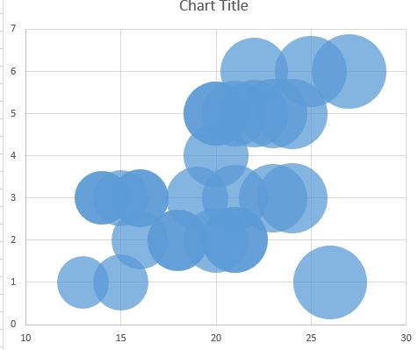
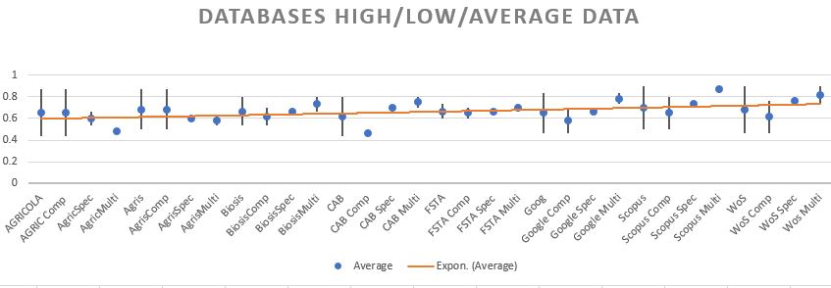
Data Visualization

Slide 15
Research Project II: Search Analysis

Slide 16
Search Analysis Methodology
Three search strings that could easily be replicated across databases were developed for each agricultural topic included in the previous research project.
Sustainable Diets
"sustainable diet" OR "sustainable diets" OR "econutrition" OR "sustainable food consumption" OR "sustainable nutrition" OR "ecological diet" OR "ecological diets" OR "resilient diet" OR "resilient diets" OR "biodiverse diet" OR "biodiverse diets“
Agronomy
mycorrhiz* AND vegetabl*
Meat Science
“meat quality” AND retail*

Slide 17
Search Analysis Methodology
Search results were limited by date to 2015 and earlier years to account for uneven database indexing times for new materials
Only the first 100 items were captured for analysis
- to limit the amount to citations to review for precision calculations
8 database x 3 searches x 100 citations = 2400 items to review
- some databases have poor citation download technology, meaning individual citations needed to be captured and saved
- to more closely mimic a typical user review of database results (i.e., most users would be unlikely to review more than 100 search results)

Slide 18
Search Analysis Methodology
24 spreadsheets - one for each search in each database – containing 100 citations are marked for relevancy to the search topic.
Precision is the fraction of retrieved documents that are relevant to the query
Precision = number of relevant records retrieved
total number of records retrieved
Recall is the fraction of relevant documents retrieved of all relevant documents
Recall = number of relevant records retrieved
total number of relevant records

Slide 19
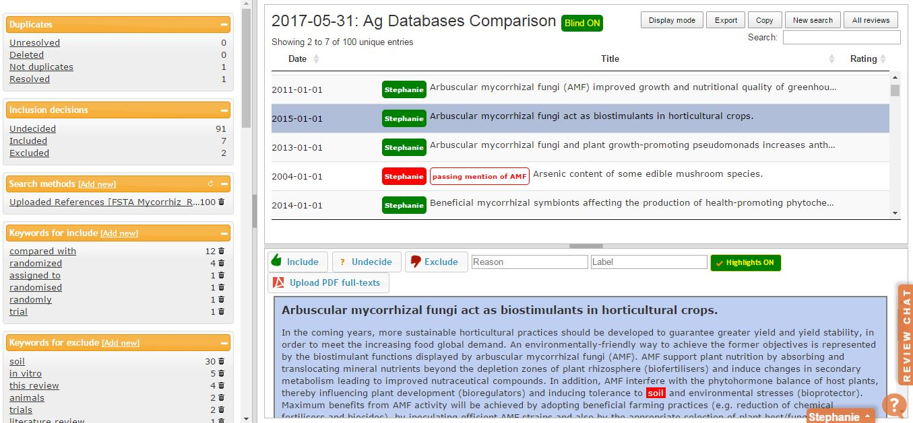
Search Analysis Methodology
We are exploring the Rayyan tool (developed for group work on systematic reviews) to collaborate on precision analysis with partners.

Slide 20
Search Analysis Results
Meat Science Precision – Preliminary Results
In meat sciences, very little difference between types of databases was found.
Mycorrhizae Precision – Preliminary Results
In agronomy, the comprehensive (and biology- focused) databases retrieved more relevant results than the multi-disciplinary databases, although Google Scholar also performed well.

Slide 21
Thank You
and
Stephanie Ritchie
sritchie@umd.edu

