Slide 1

Keep Teaching:
Leveraging Disruption as a Catalyst for Change
Rachel Gammons & Lindsay Inge Carpenter
May 11, 2021

Slide 2
Hello!
Rachel Gammons (she/her/hers)
Head of Teaching and Learning Services
Liaison to the iSchool
University of Maryland Libraries
rgammons@umd.edu
Lindsay Inge Carpenter (she/her/hers)
Pedagogy Librarian and Research Education Program Lead
Liaison to the Second Language Acquisition Program
University of Maryland Libraries
linge@umd.edu
Notes:
Before COVID, we had four primary arms of our teaching program. The first is the Libraries overall instruction led by both subject librarians and our teaching and learning librarians, which has taken place primarily in person and serves around 20,000 students per academic year. To support that program, we offer the Fearless Teaching Institute, which is an in-house professional development program focused on strengthening the teaching and assessment skills of library teachers, which has relied heavily on in-person events such as workshops. Within the Libraries’ overall teaching program, our unit, Teaching and Learning Services, manages the general education instruction. We are fortunate to be embedded in the syllabus for English 101 and we lead between 240 to 280 in-person information literacy sessions for that course alone. To support our ability to teach on that scale, we developed and now oversee the Research and Teaching Fellowship, which is a three-semester teacher training program for MLIS students, who teach the bulk of those English 101 sessions.

Slide 3
Pre-COVID
In-person instruction program
Fearless Teaching Institute
Teaching and Learning Services
ENGL101 (Academic Writing Program)
240 - 280 in-person ENGL101 sessions
Research and Teaching Fellowship
Notes:
Before COVID, we had four primary arms of our teaching program. The first is the Libraries overall instruction led by both subject librarians and our teaching and learning librarians, which has taken place primarily in person and serves around 20,000 students per academic year. To support that program, we offer the Fearless Teaching Institute, which is an in-house professional development program focused on strengthening the teaching and assessment skills of library teachers, which has relied heavily on in-person events such as workshops. Within the Libraries’ overall teaching program, our unit, Teaching and Learning Services, manages the general education instruction. We are fortunate to be embedded in the syllabus for English 101 and we lead between 240 to 280 in-person information literacy sessions for that course alone. To support our ability to teach on that scale, we developed and now oversee the Research and Teaching Fellowship, which is a three-semester teacher training program for MLIS students, who teach the bulk of those English 101 sessions.

Slide 4
During COVID
Entirely online instruction program
Online Fearless Teaching Institute
Teaching and Learning Services
ENGL101 (Academic Writing Program)
130 synchronous online ENGL101 sessions
Research and Teaching Fellowship
Temporarily online
Notes:
We continue to offer a large and varied instruction program. Although our number of students has decreased in some disciplines during COVID-19, in others the online format elicited increased requests for instruction. Before COVID, the Fearless Teaching Institute had a small but loyal contingent of participants. Over the summer of 2020, we redesigned this program and its offerings. It is now conducted entirely online and participation has dramatically increased. This is something that we had not even considered prior to COVID, but have continued even now that we are able work safely in person. In Teaching and Learning Services, we had expected to scale back our teaching for English 101, but were surprised when the program asked to continue synchronous sessions to all sections of ENGL101. Fall 2020 we taught about 140 synchronous sessions for that course using Zoom. We continued around that same number when we moved to hybrid teaching in Spring 2021 and have held constant at that level this year. Because English 101 moved online, we also moved the Research and Teaching Fellowship online. Although it has online format has required more intentionality in our programming and engagement, building an online community was not been as much of a departure as we might have expected, although resumed primarily in-person activities for that program as soon as it was safe to do so.

Slide 5

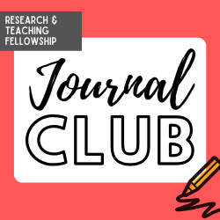

Online Fearless Teaching Institute
Teaching Workshops
Test-It-Out Tuesdays
Journal Club
Office hours
Notes:
Before COVID-19, the Fearless Teaching Institute was an entirely in-person program. The transition to online learning reduced barriers to participation and increased opportunities for staff from across the libraries to attend. From 2018 to March 2020, the FTI hosted approximately 15 events. After the relaunch, from March 2020 to May 2021, the institute hosted more than 50 events with a combined attendance of more than 400 library faculty, staff, and student workers. Much of the increase was due to the shift in the modality of instruction but also benefited from streamlining our online registration process and diversifying our programming. The FTI also now offers a greater variety of events, ranging from hour-long teaching workshops to short informal conversations over lunch called “Test it Out Tuesdays,” to monthly conversations about recently published literature in the field. After the return to in-person teaching in Spring of 2021, FTI hosted events focused on the transition to hybrid instruction and navigating challenges of our new campus climate. The revamped FTI is now an agile and essential arm of the UMD Libraries’ teaching program. In program evaluation forms, participants highlighted the ease of registration and attendance, the variety of sessions, the relevance of programming to their immediate needs and situation, and the supportive atmosphere provided by instructors. One participant noted, “The Fearless Teaching Institute saved me when I had to create several videos in early April without much time to prepare. I am so thankful to have learned the skills to be able to teach online on my own!”

Slide 6

Research & Teaching Fellowship
Curricular Support
Job-Seeking Support
Community
Notes:
Fellows prepare for IL instruction through a series of observations, co-teaching, and engagement with pedagogical theory in credit-bearing courses. During the summer of 2020, the credit-bearing courses were redesigned to include the theory and practice of online instruction. Content for the fall 2020 semester included facilitating online group work, developing asynchronous learning materials, and conducting assessment in the online classroom.
In spring 2020, graduating Fellows faced a particularly challenging job market. Hiring freezes, budget reductions, and a new-normal of remote interviews resulted in a competitive job search process that was especially demanding for applicants. The volatility of the job market also disrupted the search timeline; rather than job hunting in the spring semester, Fellows continued their search through the summer and fall. The extended timeline increased their need for support, including a greater demand for reference letters, application review, mentorship, and job coaching. To prepare for video interviews, Fellows participated in mock interviews and job presentations on Zoom. As the pandemic progressed and employers increasingly requested that applicants demonstrate efficacy as online instructors, we worked with Fellows to develop sample lesson plans and review digital learning objects for their interviews.
Each year, Fellows identify the sense of community as the single greatest benefit of the Research and Teaching Fellowship. Continuing to foster a collaborative, supportive environment became even more important as Fellows contended with the personal and professional impacts of the pandemic. Many staples of the program, such as in-person office hours and professional development workshops, moved to synchronous online platforms. We fostered a sense of community through informal social Zoom sessions and weekly overlapping online office hours. In lieu of an in-person graduation ceremony in spring 2020, the team compiled a video that featured congratulations, encouragement, and advice from librarians and former Fellows.
To increase opportunities for community, program managers launched an alumni network to better connect current and former Fellows. The network includes regular communications, such as a biannual newsletter highlighting professional achievements of current and former Fellows and an e-mail list to share job advertisements, research and professional opportunities, and support from members of the community. Alumni offered online mentorship and served as guest instructors in the credit-bearing courses, which enabled current Fellows to benefit from the professional expertise of alumni while expanding their professional networks.

Slide 7
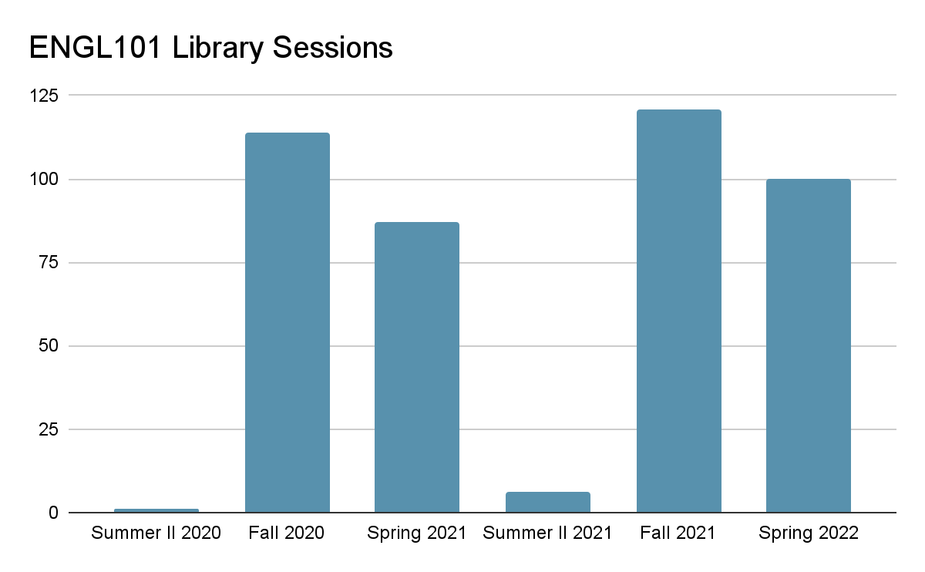
ENGL101 Online
Communication and Logistics
Lesson Plan and Activities
Asynchronous Resources
Notes:
To manage the transition to online instruction, the Head of TLS created an ENGL101 Information Literacy Steering Committee. The steering committee met monthly throughout the summer and included stakeholders from the TLS unit, the Academic Writing Program, and the Research and Teaching Fellowship.
Typically, ENGL101 IL instruction sessions take place between the second and sixth week of the semester. To accommodate the additional training needed for online teaching, the authors delayed the start of fall 2020 teaching by two weeks and instituted a co-instructor model, with two library instructors per instruction session. The primary instructor led the class, and the support instructor monitored the chat, visited breakout rooms, and responded to technical challenges. Support instructors were included until the lead instructor felt confident teaching independently.
We also changed our scheduling process. Rather than claiming individual sessions on the calendar as we did in the past, library instructors were asked to partner with a specific ENGL101 instructor and work directly with that person to schedule and deliver library sessions for each section. The new process represented a substantial increase in responsibility for the Research and Teaching Fellows, who served as the single point of contact between the course teacher and the libraries. To reduce the burden on the library instructors, TLS staff developed extensive protocols and e-mail templates to guide communication between the two groups of instructors.
TLS instructors use a lesson plan mapped to the ENGL101 standard syllabus. In partnership with the steering committee, we identified online tools to adapt our activities to the Zoom classroom, including Padlet, Mentimeter, and breakout rooms. This allowed us to continue employing active learning techniques.
To supplement synchronous instruction, the TLS team created a Canvas module and the “Get It Done Guide to Undergraduate Research,” both of which featured video tutorials and information on troubleshooting digital access and connecting with a librarian remotely.

