Slide 1
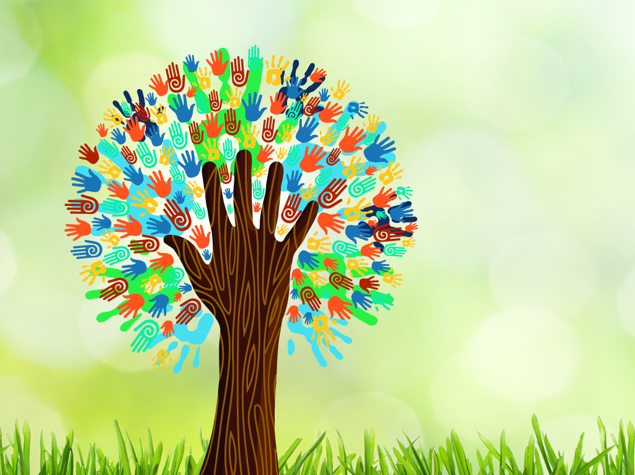

Out with the old, in with the new A reliable workflow in writing a report on diversity and inclusion
Jamie Edwards
Sharon Epps
Andrew Horbal
Cynthia Sorrell
Nedelina Tchangalova
Lisa Wheeler
Library Research & Innovative Practice Forum
University of Maryland, College Park
June 8, 2016
Notes:
SHARON
In our presentation today, we will give you an overview of the Libraries Diversity Advisory Committee’s work on our Diversity Climate Assessment Survey and Report. We will talk about our somewhat non-traditional, out of the box approach to our work. Our intent was not to reinvent the wheel, but rather to tap into available campus resources and expertise for advisement and assistance.
Our final report was well received by Library Administration. We hope the information we share with you today might be helpful to keep in mind as you begin work on these types of projects. This is easier than you think it is!!
INTRODUCTIONS
Sharon Epps - Head of Employee Development & Faculty Services, Diversity Officer
(1_Purpose) (2_Successes and Challenges and Wrap-up)
Jamie Edwards - Research and Assessment Analyst, Institutional Research, Planning and Assessment
(Campus Partnerships)
Cynthia Sorrell - Assistant Head, Collection Development & Liaison Librarian - Arabic and Persian Studies (Methodology)
Lisa Wheeler – Executive Administrative Assistant, Employee Development & Faculty Services
(Survey Analysis)
Nedelina Tchangalova - Physical Sciences and Public Health Librarian
(Report Design)
Andy Horbal – Head of Learning Commons (He is currently attending another conference and can’t be with us today but he assisted in the planning of our presentation)
Template design by Smile Templates
http://www.smiletemplates.com/powerpoint-templates/isolated-diversity-tree-hands-illustration-vector-file-layered-for-easy-manipulation-and-custom-col/10214/

Slide 2

Purpose
I
N
C
Assess diversity health of UMD Libraries
Identify successes and areas for improvement
Diversity and inclusion strategic plan
L
U
S
D
I
V
E
R
S
I
T
Y
O
N
Notes:
SHARON
1. Assess Diversity and Inclusion Health of Libraries – Purpose of the survey was to assess the diversity and inclusion health of the UMD Libraries.
Identify Successes and Areas for Improvement - DAC snapshot reports findings on how library faculty, staff and student workers perceive the current state of diversity and inclusion within the Libraries. It assisted us in identifying areas where we are doing well and where improvements can be made.
Diversity and Inclusion Strategic Plan - Survey report provides recommendations about what organizational changes, training, and programs will be most beneficial to library staff. This information will be used by DAC in drafting our diversity and inclusion strategic plan for the Libraries.

Slide 3
Partnerships
Creating the survey
Analyzing the results
Writing the report
Maryland’s iSchool: College of Information Studies Paul Jaeger
Office of Diversity and Inclusion Mark Brimhall-Vargas Beth Douthirt Cohen
Office of Institutional Research, Planning and Assessment (IRPA) Emily Foley Stephanie Dolamore
Thomas Dobrosielski
Office of Institutional Research, Planning and Assessment (IRPA) Emily Foley Stephanie Dolamore
Division of Information Technology (DIT) John Davies
Campus Assessment Working Group (CAWG) Emily Foley
Notes:
JAMIE
Creating the survey: Before we created the survey we met with Paul Jaeger, professor and diversity officer at the iSchool, to discuss how they designed and implemented their own diversity survey. With their permission, we took many of their questions and used their survey as a template for ours. We also worked closely with the Office of Diversity and Inclusion to vet some of the questions we were considering.
Analyzing the results: Emily Foley and Stephanie Dolamore from the Office of Institutional Research, Planning & Assessment helped us think through some of the design, and were especially helpful in guiding us through the process of identifying the best ways to analyze our results. Tom Dobrosielski, the IRPA liaison to the Libraries, also helped us get demographic information for the report. John Davies from Division of Information Technology showed us how to use Qualtrics to look at the data.
Writing the report: Once we were ready to write the report, we talked with IRPA about their Campus Assessment Working Group (CAWG) snapshots. The brief visual presentation of the CAWG snapshots inspired the final design of our report.

Slide 4
Methodology
Design and rollout
Basis of survey design
Communication plan
1
2
3
Notes:
CYNTHIA
Design and rollout
Basis of Survey Design
Communication plan

Slide 5
Methodology continued
Design and rollout
Basis of survey design
Communication plan
1
Identified/assessed available and effective tools
20 closed questions; 5 open-ended questions
Voluntary participation
Responses remain confidential
Online survey open – 3 weeks
2
3
Notes:
CYNTHIA
Design and rollout:
- Diversity Advisory Committee (DAC) members identified and assessed available and effective tools from various campus offices. We contacted the following units:
the President's Commission on Disability Issues
UMD Office of Diversity (ODI)
University Human Resources
iSchool's Diversity Officer
Library Leadership & Management Association’s (LLAMA) Diversity Officers Discussion Group
Senate Staff Affairs
Resident Life were contacted
- We also reviewed Association of Research Libraries’ (ARL) Spec Kit #319: Diversity Plans and Programs regarding various universities' assessments of their diversity surveys.
- Survey participation was voluntary and responses were confidential. The survey included 20 closed questions and 5 open-ended questions.
- Initial rollout : July 21-August 11, 2014; Reactivated for additional week per UMD Libraries’ Dean Pat Steele: September 15-21, 2014

Slide 6
Methodology continued
Basis of survey design
Basis of survey design
Communication plan
2
Selected iSchools' Mixed Assessment Model
Six demographics identified
2
3
Notes:
CYNTHIA
Basis of Survey Design
We selected iSchool's Mixed Assessment Model with UMD Libraries using Qualtrics rather than iSchool's Survey Monkey instrument.
Demographics identified: Race/Ethnicity, Disability Status, Marital Status, Role in Libraries, Sexual Orientation, Gender/Gender Identity.
Questions were designed to provide critical information regarding organizational changes, training, programs, and recommendations for next steps to benefit diversity climate in libraries.
We (Libraries) plan to do focus groups to look at concerns in the survey just like iSchool did.

Slide 7
Methodology continued
Communication plan
Basis of survey design
Communication plan
3
DAC developed a robust marketing plan in tandem with the roll out of the survey – achieved 78% response rate.
Presented DAC report to Administration – Dean (11/24/2015); LMG (12/1/15).
Approved document sent to Library Staff – Discussed at Library Assembly (2/16/16)
Next steps based on staff's recommendations
2
3
Notes:
CYNTHIA
Communication plan
DAC developed a robust marketing/communications plan which we ran in tandem with the roll out of the survey, which we believe contributed to our high response rate of 78%.
Presented DAC report to Administration: Dean (11/24/15) and Library Management Group (LMG) on 12/1/2015
Emailed to library staff & presented at Library Assembly (LA) Meeting: 2/16/2016

Slide 8
Survey analysis
Division of work
DAC – Likert scale and multiple responses
Subgroups – open text questions
Graduate Assistant – deeper analysis
Themes
Climate
Recruitment/Retention
Leadership
Education & Training
Community Engagement
Define Diversity/Inclusion
Education/Training
Outreach/Awareness
Organizational Commitment
Notes:
LISA
DAC’s work performed in two phases:
DAC identified themes for each question and created bullet points about the data for the report
Decide how we wanted to dig into the data. With separate group coding for open ended questions
We organized responses in Google Doc spreadsheet by themes. Themes identified were then grouped by the 5 subject areas above.
With separate group coding for open ended questions we divided into 2 sub-groups. Subgroups decided to label these responses in categories from bottom to top, (see pyramid above). After ​analyzing the data from the themes identified in the open ended questions, we continued analyzing the results from the multiple choice questions and the pyramid (above) represents a graphic illustration of ALL of our work.
Graduate Assistant was tasked to dig deeper into the survey and identify any statistical significance. However, because of the small sample size, IRPA recommended that we just report out the number of responses.
We plan to use the Graduate Assistant's findings and recommendations for designing any future surveys.

Slide 9


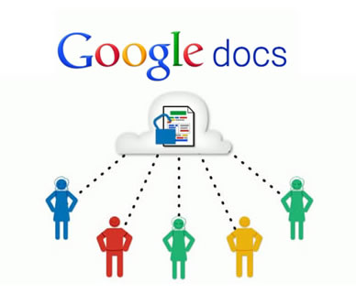




Survey analysis
Tools used
Notes:
LISA
Qualtrics for assessment survey instrument;
Exported the survey results from Qualtrics to Excel for preliminary analysis
Next used Google Sheets
R software and SPSS was used for deeper analysis by GA
IRPA demographic statistics

Slide 10
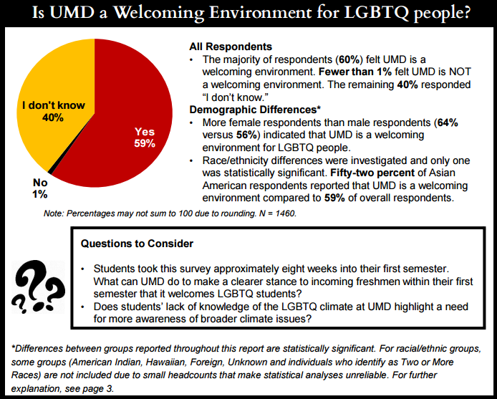
Report design – IRPA sample
Using a model from IRPA’s Campus Assessment Working Group (CAWG)
Graphs & charts
Details
Main points
Notes:
NEDELINA
No one has the patience to read lengthy reports, right? So, we were looking to get some inspiration in sharing the results from this survey in a more visually appealing and user friendly format. The UMD Campus Assessment Working Group, one of our partners, offered their help and shared with us the practice they have in their unit. They shared a sample report you see here on this slide. In addition to the textual information, they use graphs and charts to present the results from their surveys. The main points stand out in a separate section, so the reader can immediately jump to the section of interest.

Slide 11
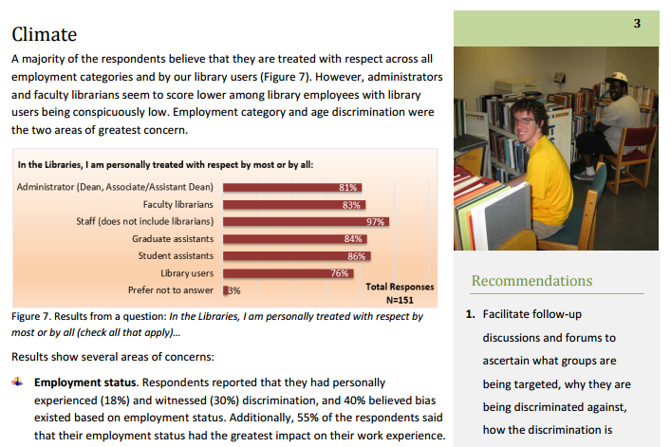
Report design – UMD Libraries’ report
Details
Graphs & charts
Main points
Notes:
NEDELINA
Following the best practices from the office of the Campus Assessment Working Group, we designed our report using a business template available in MS Word program. We have similar elements included in the report:
Details in textual form.
Graphs and charts. Eric Bartheld, our Director of Communications, shared pictures taken in our own libraries for inclusion in our report.
The Recommendations section is clearly outlined on every page for easy access and reference.

Slide 12
Challenges
Strategies/approaches in design, analysis, results
Baseline knowledge of Qualtrics
Competing workloads
Turnover in DAC membership
Successes
Diversity as a priority
Collaborations with other campus resources
Committee worked well together as a team
Survey report product
Notes:
SHARON
Challenges: Some of the challenges we faced included:
(1) agreeing upon the different strategies/approaches we should take in designing the survey, analyzing the data, and reporting out the results.
(2) Not every member of the committee had the same level of skill and knowledge of Qualtrics, so we had training to insure that everyone at least had a baseline knowledge/skill of the tool.
(3) As you know, we all work in an extremely busy environment, which meant we had to juggle competing projects and deadlines along with this one in order to accomplish our work.
(4) Finally, we did experience some turnover in membership during the time span of the project, however, several members were willing to extend their service on the committee until the survey analysis and final report to library administration and staff was completed.
DAC members are very thankful to UMD Libraries’ Interim Dean, Babak Hamidzadeh, who has been very supportive of our work.
Successes:
(1) We were fortunate to have our former Dean, Pat Steele, proclaim diversity as a priority during her final years as Dean of Libraries. She was very supportive of our work throughout the process, even providing funding for a graduate student to work with us during summer 2015.
(2) Our collaborations with various resources on campus, which have been pointed to earlier, were very successful and assisted us in creating a polished product.
(3) The committee members worked very well together on this project. We pulled from each other’s strengths and expertise in dividing up our work and this strategy worked very well.
(4) Finally, the survey report is one that the UMD Libraries can be very proud of!!

Slide 13
DAC Committee members
who worked on survey project:
Otis Chadley
Jamie Edwards
Sharon Epps (Chair)
Jeremy Garritano
Andrew Horbal
Celina Nichols McDonald
Cynthia Sorrell
Nedelina Tchangalova
Lisa Wheeler
Report available in:
DRUM - http://hdl.handle.net/1903/17439
Libi - http://libi.lib.umd.edu/sites/default/files/DACSurveyReport_ Final_rev_3-16-16.pdf

Slide 14
Thank you

Slide 15
?
Do you have any questions?
?
?

