Slide 1
The Future of Subject Librarianship:
Using Assessment Data to Guide the
Continuing Education and Professional Development of Subject Liaison Librarians
11th Qualitative and Quantitative Methods in Libraries
International Conference
28-31 May 2019
European University Institute
Florence, Italy
Yelena Luckert, Director, Research and Learning
Gary W. White, Ph.D., Associate Dean, Public Services
University of Maryland Libraries, College Park, Maryland, USA
Notes:
Gary

Slide 2
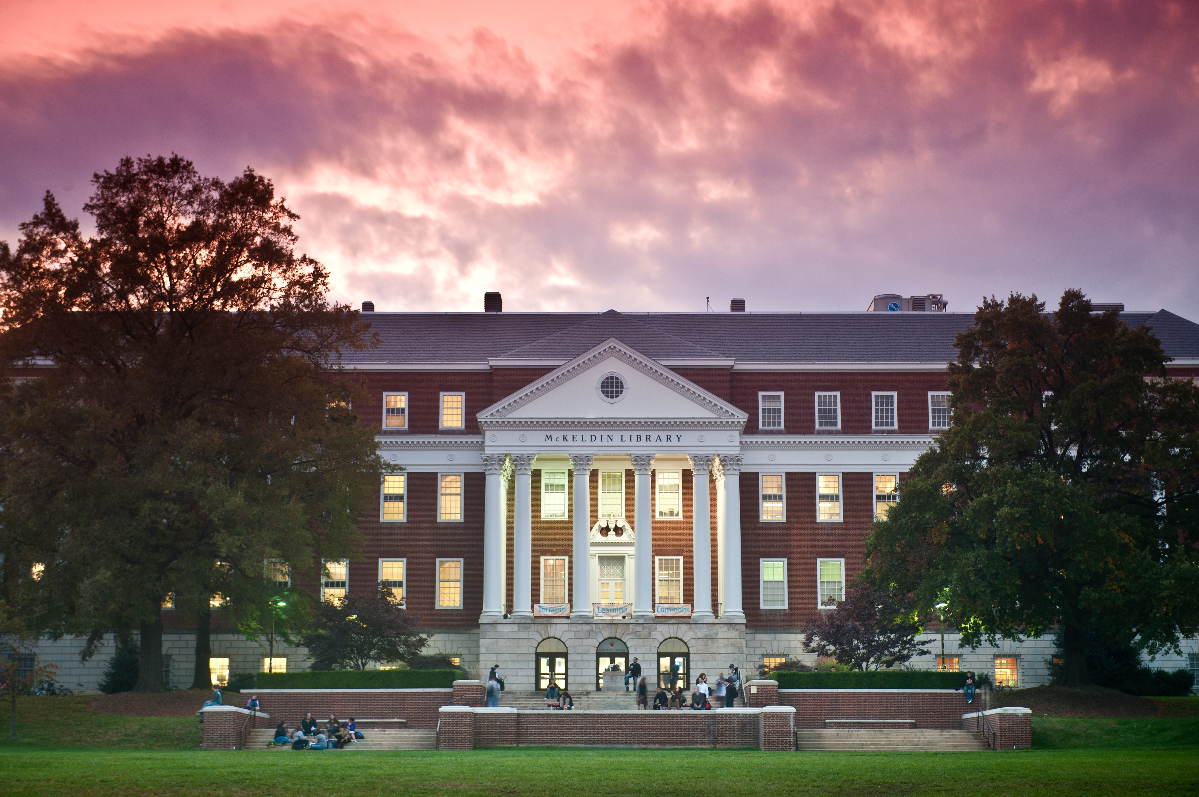
Introducing the University and the Library
University of Maryland is a large research university
  26,000 undergraduates and 10,000 graduate students
  100 undergraduate majors and 200 grad programs
University Libraries
  8 libraries
  Over 4 million items in collections
  Ranked at 42nd on the ARL list by
  expenditures
Notes:
Gary

Slide 3
  Liaison Services Task Force (LSTF), October 2012-June 2013, http://drum.lib.umd.edu/handle/1903/17456
  Developed framework for subject liaison librarianship at UMD:
    Role of subject librarians at UMD
    Core areas of responsibilities, both subject and skill based
    Best practices for each core area
    Recommendations
Notes:
Gary

Slide 4
LSTF Recommendations
CORE Competencies for liaison librarians (both subject specific and soft skills)
Assessment methods to evaluate liaison work (annual reviews, not liaison program)
Marketing and promotional plan (to advertise liaison work and accomplishments on campus and within the Libraries)
Training program
Notes:
Gary

Slide 5
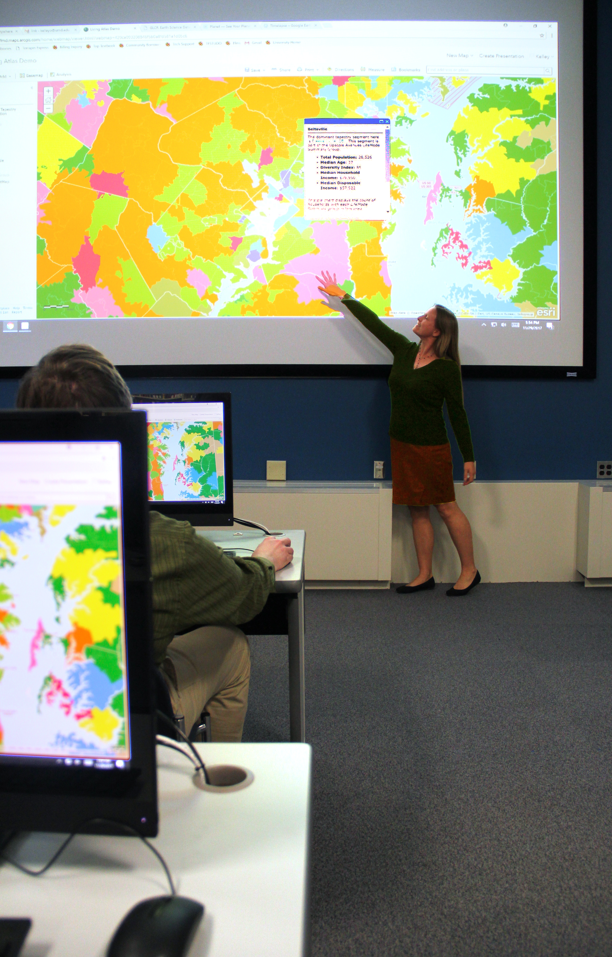
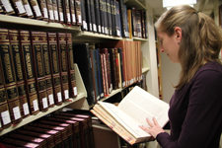
5 Broad Areas of Responsibility
Collections Content and Access
Reference and Research Consulting and Mentoring
Teaching, Learning, and Literacies
Engagement and Outreach within the University and Beyond
Scholarly Communications and Information Technology
Notes:
Gary

Slide 6
Annual Reviews of Liaison Librarians
Prioritized annual reviews as one of the most important in organizational change
Complex process combining annual reviews and merit assessment
Feeds into the overall Library’s annual assessment process
Library’s assessment consists of three categories: Librarianship, Service and Scholarship
  Librarianship for liaisons is based on 5 broad areas of responsibility identified in LSTF
Self-assessment is equally important as supervisor’s assessment
Notes:
Yelena

Slide 7
Annual Review Framework
Based on 5 core areas of responsibility as defined in LSTF Final Report
Meaningful, manageable, sustainable, motivational
Actionable:
  Demonstrate impact
  Show individual growth (ok to fail)
  Point to the areas where improvements are needed and identify training
  Highlight special achievements
Twofold: Goal Setting and Annual Reporting (+ mid-year meeting for non-tenured)
Notes:
Yelena

Slide 8
Core Competencies http://hdl.handle.net/1903/17457
Developmental tool designed to:
  Guide our work
  Be self-motivating
  Inform annual assessments and outcomes
  Provide training framework for existing liaisons and new hires
Notes:
Yelena

Slide 9
Annual Reviews to Identify Professional Development Needs
A developmental tool: a conversation between a librarian and supervisor/s
An indicator of engagement
Benchmarking that shows support for institutional goals, in line with:
  the Libraries strategic goals
  Promotion and tenure review policies and processes
Continual work in progress: shifts with changes in our environment, strategic priorities and overall growth.
Annual reviews identify individual areas of strength and weaknesses, and help draft individual development plans
Notes:
Yelena

Slide 10
Professional Development Program
Recommendation of LSTF
Encompasses all types of skills and competencies
  Subject knowledge
  Non-subject based skills, such as
    Computer based skills
    Emerging pedagogies
  Participation in service
  Scholarship
Life-learning and Learning Organization
Goal: improvement of library services, enhancing institutional reputation
Notes:
Yelena

Slide 11
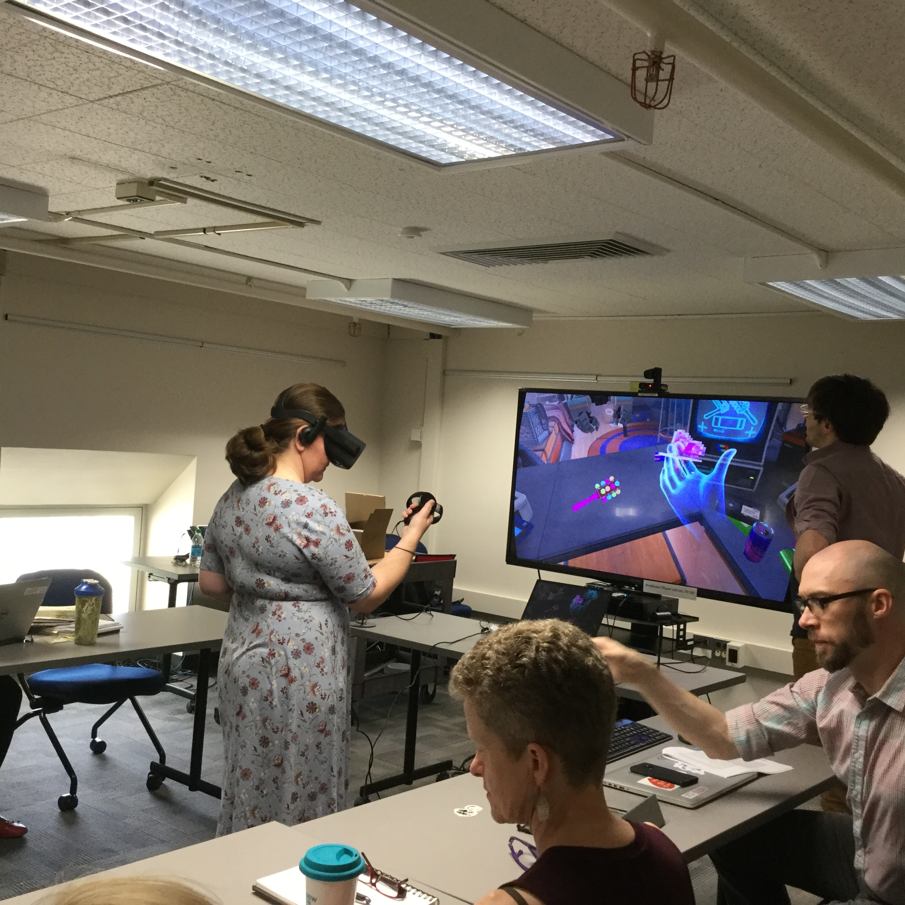
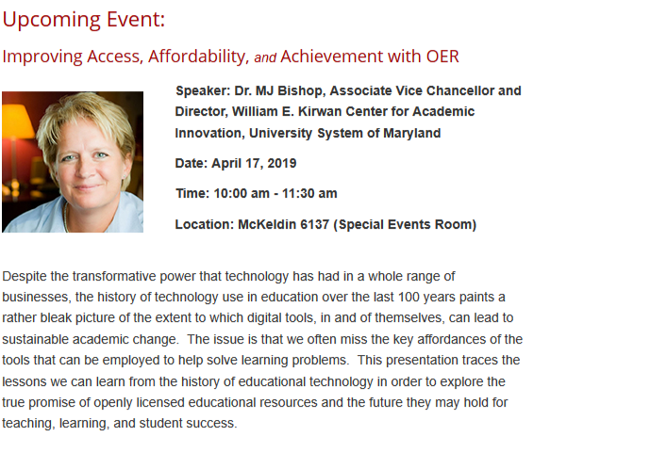
In-house, Informal Training
Orientation Checklist for new liaison hires, https://drum.lib.umd.edu/handle/1903/17458
On a job training by functional coordinators, like instruction, reference, collection management
Monthly Research & Learning Forums
Workshops, like Multigenerational Workforce, Communications
Speaker series from industry experts
Notes:
Yelena

Slide 12
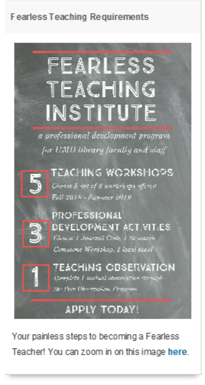
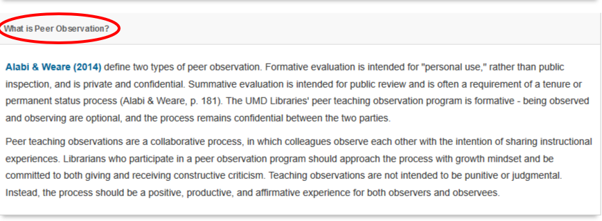
More In-house Training
Identifying and hiring positions that will benefit others: Pedagogy Librarian
Train-the-trainer techniques
Systematic organizational approach:
lib.guides.umd.edu/c.php?g=869159&p=6247046:
  Peer Teaching Observation Program
  Libraries’ Fearless Teacher Institute
Notes:
Yelena
Pedagogue Librarian
Send people for training and have them train others: Systematic Reviews

Slide 13




Campus Partnerships
Teaching and Learning Transformation Center
Division of Technology
Campus and departmental conferences, discussions, events, lectures, presentations
Attending classes
Matriculation in degree granting programs, including at a Ph.D. level
Notes:
Yelena

Slide 14
Administrative Support
For
Availability of funds
Professional webinars
Attending outside conferences
Participation in research
Professional workshops, training outside campus
Professional development funds
  Activities chosen by librarians
Additional administrative support
  To supplement activities of librarians
  Send individuals to cover library priorities
Notes:
Gary

Slide 15
Administrative Oversight
Annual assessment and CORE Competencies
Supervisors
Peer Review Committees
Faculty Mentors
Notes:
Gary

Slide 16
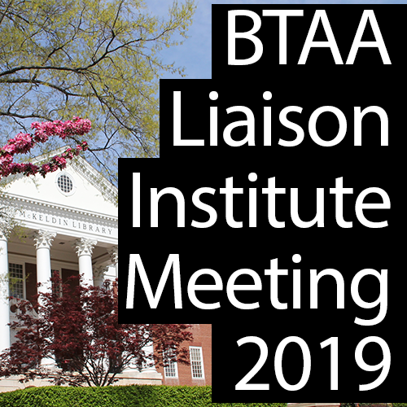

FUTURE DIRECTIONS
BTAA Liaison Institute, June 21, 2019, will meet at University of Maryland.
  BTAA = Big Ten Academic Alliance
  Consortium of 14 large research institutions,
  of which University of Maryland is a member
  University of Maryland is leading this effort
  A full-day summit to gather all liaison librarians of BTAA
  Goals of the Institute
    Collaboration among universities
    Establishing of sustainable and accessible peer network of
    liaison librarians to share experiences, participate in joint training,
    partnerships and other opportunities
Notes:
Gary

Slide 17
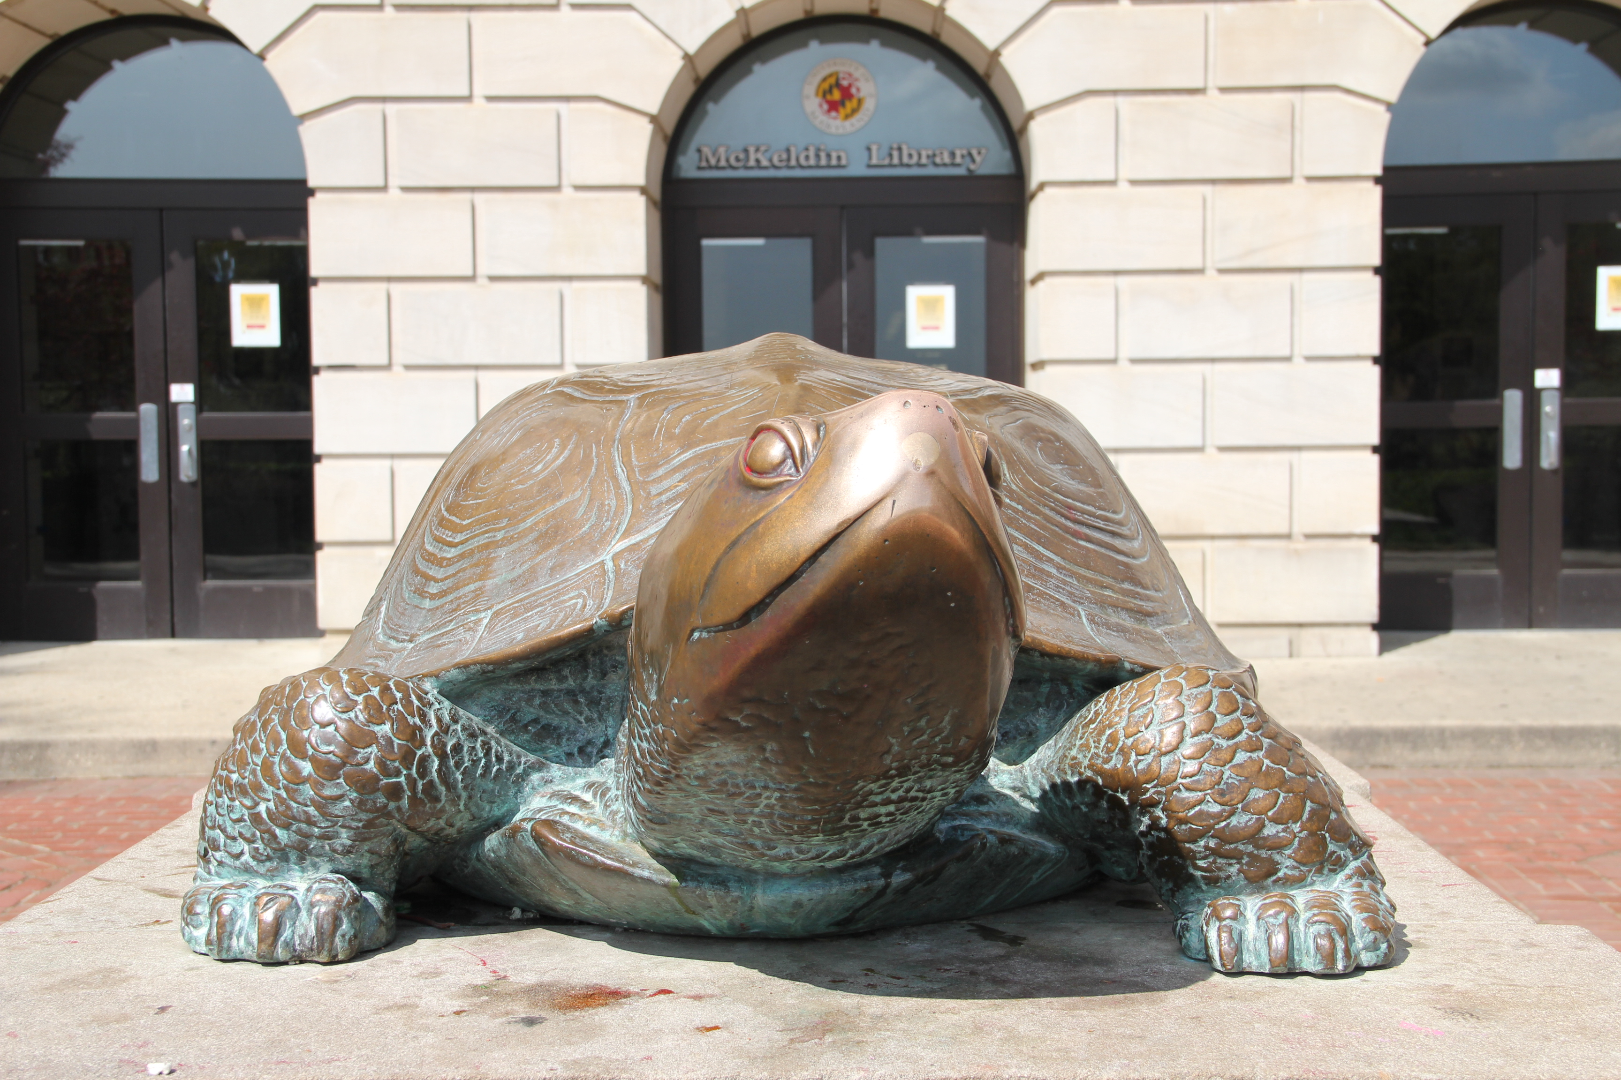
Questions or comments?
Yelena Luckert: yluckert@umd.edu
Gary White: gww2@umd.edu
Notes:
Gary

