Slide 1

Strategic Planning, Partnerships & Professional Development
Eileen G. Harrington
Assistant Director and Health & Life Sciences Librarian
Priddy Library, The Universities at Shady Grove
eharring@umd.edu

Slide 2
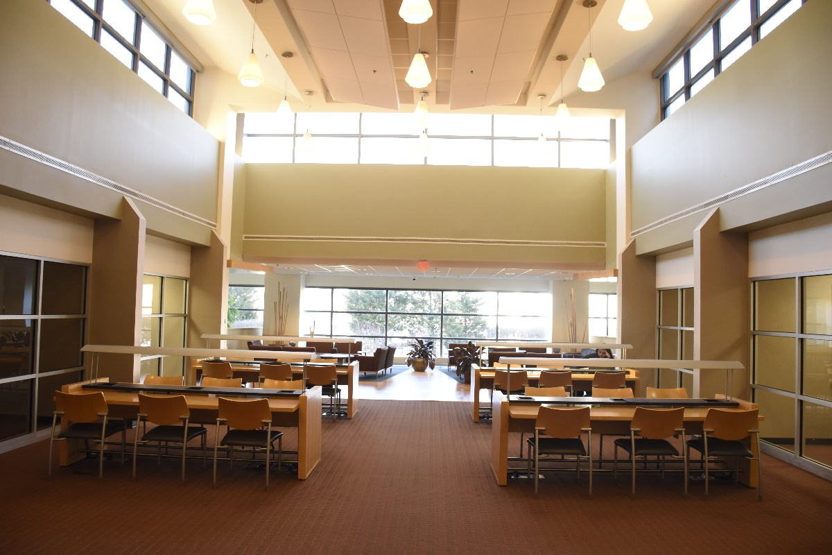
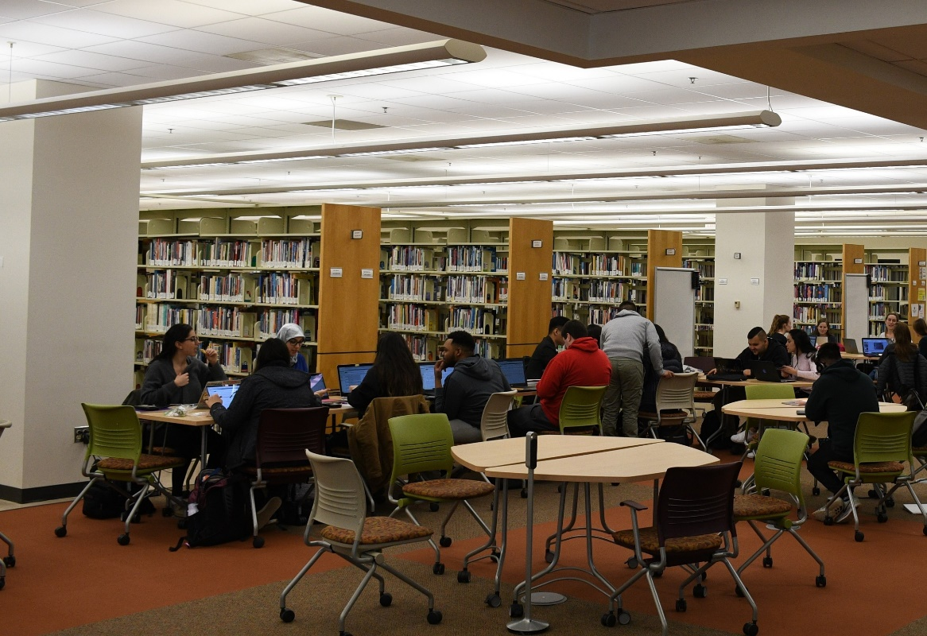
Renovations & New Staff
Notes:
Like many academic libraries, the use of our library space is constantly shifting as users’ needs change. We have found we need a mixture of more collaborative spaces with flexible/movable furniture, but also maintaining areas for quiet, individual study. We wanted to shift furniture from one area to another and purchase new furniture similar to another area we had redesigned/repurposed. We also have a larger project to create a Data Management and Visualization Lab, which we have been trying to get off the ground for a while. Met with push back from Executive Director about having strategic plan prior to starting any redesign or major initiatives to see how they fit into the overall direction we want to go.
Also had several new hires some of whom haven’t previously worked in an academic library and really wanted the clear guidance of a strategic plan.

Slide 3
Charge from USG Executive Director
“Working in collaboration with a consultant the Library staff will develop a 3-5 years strategic plan outlining the vision, mission, goals and objectives related to providing high quality services and resources to its patrons.”
Include a proposed budget and assessment plan
Notes:
Executive Director provided us with charge. Also wanted us to include budget, which unusual in strategic plans, but also will be helpful with future initiatives, including the redesign. I am leading this effort for the Library.

Slide 4



USG/Priddy Library at a Glance
9 USM institutions offer 80 upper-level undergraduate, graduate degree and professional certificate programs
75% of undergraduates transferred from Montgomery College
Priddy Library a branch of UMD Libraries
Notes:
A little background on The Universities at Shady Grove and the Priddy Library for those who are not familiar with it. Collaboration key to institution and have so many different constituents with whom work so knew we needed to align with other strategic plans: USG (still in development), UMD Libraries, Public Services Division of UMD, and USMAI. We also looked at strategic plans from other libraries of partner institutions that offer programs at USG, as well as other USMAI libraries.

Slide 5
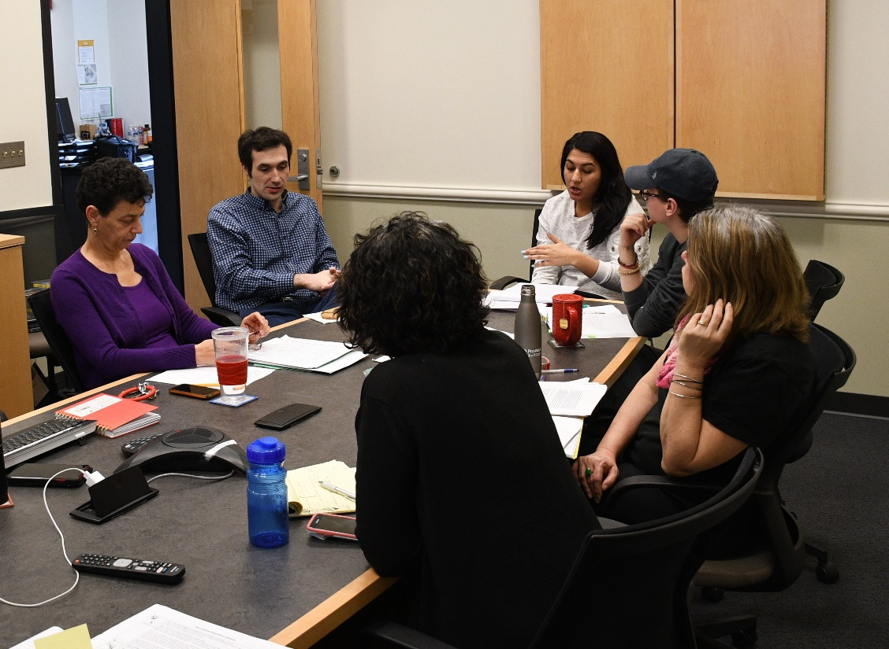
Strategic Planning Committee
Entire Priddy Library faculty/staff
Ex Officio members—representative of constituents
Working with outside consultant
Notes:
We wanted an inclusive and collaborative process. We really wanted all staff to take ownership of the plan and not have become something that is completed and then gets filed away or simply looks pretty on our website. We really wanted everyone to embody it in their work. So, the entire staff is part of the strategic planning committee, unlike in most academic libraries where administration will develop a plan and then get feedback/input from the staff. Or they might have a committee that creates it with representatives from different areas of the library (Matthews, 2005; Tooey, Bodycomb, Hinegardner, Mayo, & Prince, 2019). We are a small staff of eight people, making it easier to do this, though, so we are all working on the project in a very direct way.
We also invited several people to be Ex Officio members who participated in a focus group with us and will be reviewing drafts of the plan. These included representatives from different service centers at USG (OIT,, Center for Academic Success, Transfer Access Program), program directors/faculty from programs at USG that have worked closely with the Library and/or whose students are heavy users of the Library, Executive Director of USG, Associate Dean for Public Services at UMD Libraries, USG Student Council and Graduate Student Association representatives and Executive Director of USMAI.
Several of us had gone through a strategic planning process, but none had ever led it so we hired an outside consultant with experience in public and federal libraries leading strategic planning initiatives, to help guide us through this process. He stressed from the beginning, though, that he would not write the plan for us, that we should write it ourselves.

Slide 6

SWOT Analysis
Each did 2 versions
Large degree of overlap in findings
Staff emerged as key asset
Helpful to compare with feedback from focus groups/surveys
Notes:
One of first things the Priddy Library faculty/staff did was a SWOT (strengths, weaknesses, opportunities and threats). Something that the Executive Director really wanted us to include in strategic planning process. Each staff member did two versions of the SWOT analysis: one as ourselves and one in persona of faculty, staff or student. We had a great deal of agreement/overlap in what staff identified as our internal and external factors that will influence our strategic plan, which was positive in starting this undertaking, knowing that we all are coming from basically the same place. Also, useful to compare with feedback we would be getting from future focus groups/surveys with our key constituents.

Slide 7
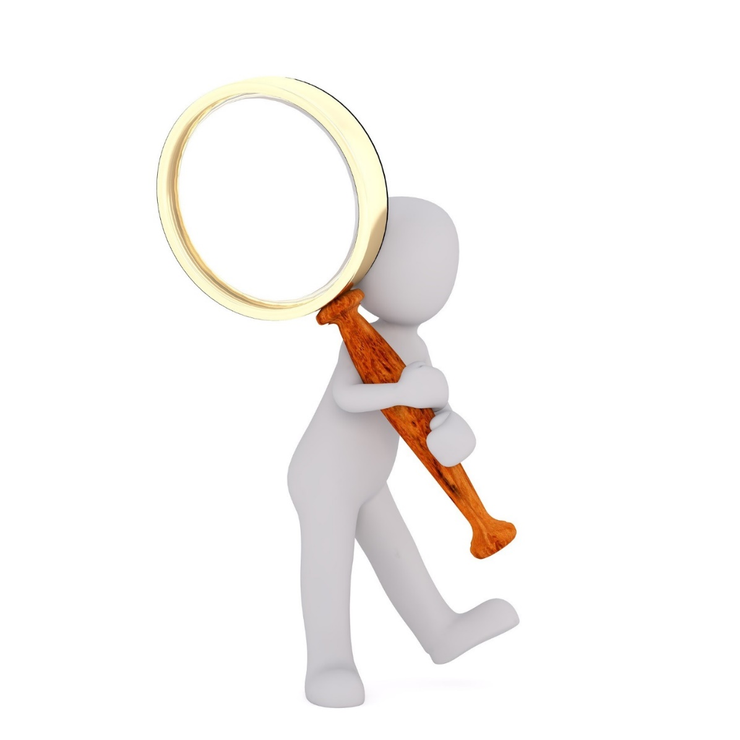
Environmental Scan
Priddy Library statistics, user satisfaction surveys, budgets
Montgomery County demographics/economic development
Reports on trends in academic libraries, higher education, transfer students, non-traditional learners
Strategic plans of peer and aspirational institutions
Higher education and library standards
Notes:
Played to strength of each staff person in gathering information for environmental scan. For example, we have one librarian who manages our library data so she collated this. Another who is an expert at Excel and working with budgets. Also, used project assistant I was able to hire to help with gathering this information

Slide 8
Individual Interviews
Others:
Executive Director of USMAI
Director of Library and Information Services and Research & Teaching Associate Director, Montgomery College
From USG:
Executive Director
Chief Strategy Officer
Chief Operating Officer
Chief Advancement Officer
Chief Student Affairs Officer
Director of OIT
Director of Administration and Talent Management
Director of Economic Development and Workforce Initiatives
From UMD:
Interim Library Dean
Associate Dean for Public Services
Associate Dean of Collections
Notes:
Conducted by consultant and myself in-person. Consultant provided original draft questions, which entire committee edited/added to. Each interview lasted about one hour.

Slide 9
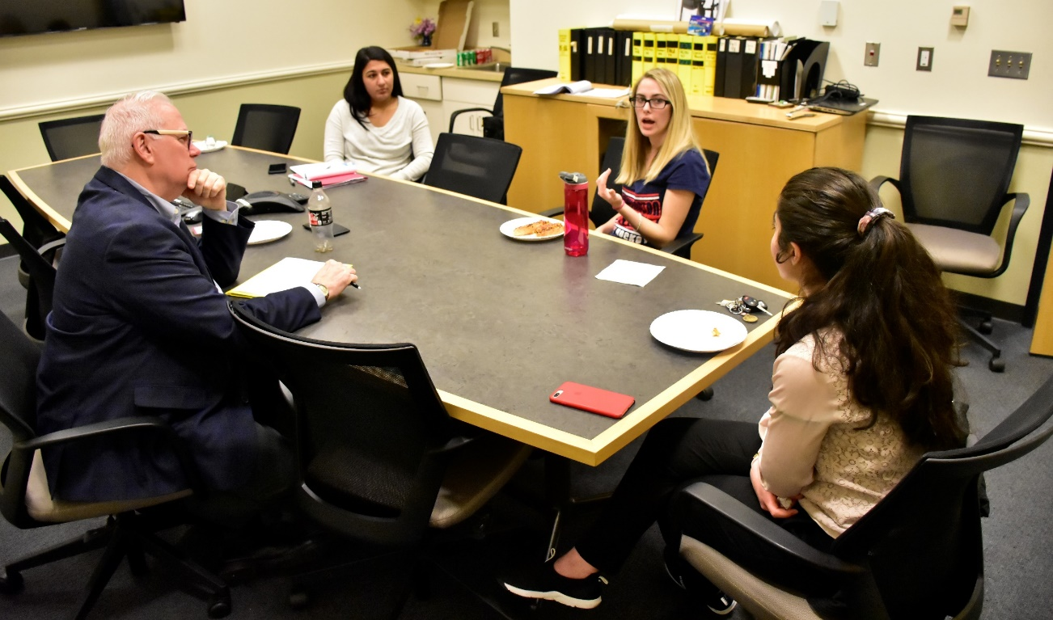
Focus Groups
USG Service Center Staff
USG Partner Institutions Faculty/Staff
USG Students
UMD Libraries Faculty/Staff
Priddy Library Student Workers
Ex Officio Members of Strategic Planning Committee
Notes:
Focus groups and interviews a way to get feedback, but also a way to increase awareness about what library has to offer, discover new avenues for collaboration and strengthen already existing collaborations. For example in focus group with faculty members many were not aware of how much we connect students to the broader community and the ways in which we work to support not only their academics, but also workforce skills.
For focus groups also offered online form for those that couldn’t make it in person.

Slide 10

Online Surveys & Phone Interviews
Current and past USMAI Library Deans/Directors
Former Priddy Library Employees
Partnership Organizations
Notes:
Consultant conducted phone interviews with four former USMAI Library Deans. We also contacted former employees from the past five years and community and governmental organizations with whom we have partnered on various projects, such as the National Library of Medicine and Rockville Art League.

Slide 11

Writing the Strategic Plan
Entire committee involved
Several versions for different audiences
Include marketing and assessment plan (Saunders, 2016)
Completed by mid-June
Notes:
Now, we’re taking all the information we gathered during the environmental scan phase and our findings from SWOT analysis to write the plan. Consultant adamant that we write it so that we take ownership of it. Very much collaborative effort of entire staff. Had a three hour meeting during which we began to hash out our mission, vision and values with consultant. Have regular meetings every other week where have continued this work. We hope to have done by mid-June.
We are incorporating marketing and assessment plans into it the final strategic plan, as well. As budgets are tightening everywhere, showing the value of libraries has become more and more important. In addition, there is a drive for evidence-based or data-driven decision-making so this is why having a detailed assessment plan will be important. In a content analysis of academic libraries’ strategic plans, Saunders found that many lacked explicit assessment plans, which limits their ability to concretely demonstrate that they are achieving their goals and contributing to the larger institution. Assessment is an area that is a priority for USG and will be a priority for us, as well.

Slide 12

Avenues for Professional Development
Project assistant—recent graduate
New outreach librarian—marketing plan
All staff—recognition of skills and expertise have and areas where growth needed
Myself—first major project in new role; developing leadership and project management skills
Notes:
In the title of this talk, I had professional development because I feel like a strategic planning process is an opportunity for professional development. In our case, since the entire staff is working on it, this means professional development for all staff: Project assistant just graduated from library school so this good experience for her. We also have a new outreach librarian who is working on marketing plan and will be designing different versions of final plan/ongoing marketing. For all of the staff, we have tapped into the skills and expertise that we already have during this process. Some might be ones that had previously gone unrecognized. Also, as we are uncovering new areas we want to work in/new initiatives we want to undertake, we are analyzing the skills we have and what areas we might need/want to grow and develop more. A group of my colleagues will also be presenting on their experiences with this process at a conference at College Park in June.
For myself, this is the first major project I am leading in my new role as Assistant Director of the Library. It has given me the opportunity to continue to hone my leadership and project management skills.
writing strategic plan.
Overall, the strategic planning process not only provides you with a guide for the future, but can also bring about other benefits for your library.

Slide 13


Slide 14
References
Matthews, J. R. (2005). Strategic planning and management for library managers. Westport, CT: Libraries Unlimited.
Saunders, L. (2016). Room for improvement: Priorities in academic libraries’ strategic plans. Journal of Library Administration, 56(1), 1–16. https://doi.org/10.1080/01930826.2015.1105029
Tooey, M. J., Bodycomb, A., Hinegardner, P. G., Mayo, A., & Prince, J. D. (2019). Strengthening strategic planning through diverse collaborations. In J. P. Shipman, & M. J. Tooey (Eds.), Strategic collaborations in health sciences libraries : best practices for success (pp. 109-124). Cambridge, MA: Chandos Publishing.

