Slide 1

Teach for Knowledge, Mentor for Success
Preparing Students to Enter the Workforce
Nedelina Tchangalova, nedelina@umd.edu
Francy Stilwell, fstilwel@umd.edu
Engineering & Physical Sciences Library
University of Maryland
International Conference on Technology-Enhanced Learning (ICTEL), Sofia, Bulgaria
July 25-27, 2011

Slide 2
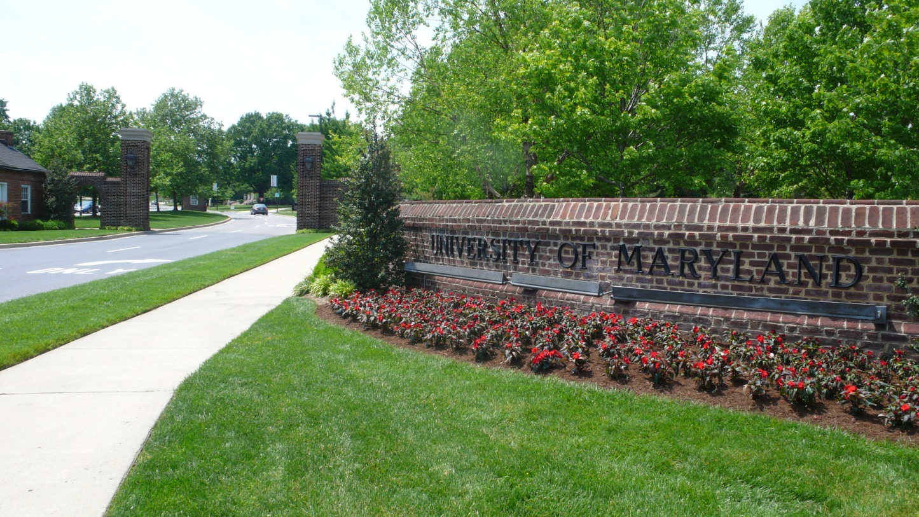
Who Are We?
Fall 2010 Enrollment
Undergraduate: 26,922
Graduate: 10,719
Total Enrollment: 37,641
Fall 2009 UM Employees
Full-time Faculty: 3,060
Part-time Faculty: 936
Total Faculty: 3,996

Slide 3
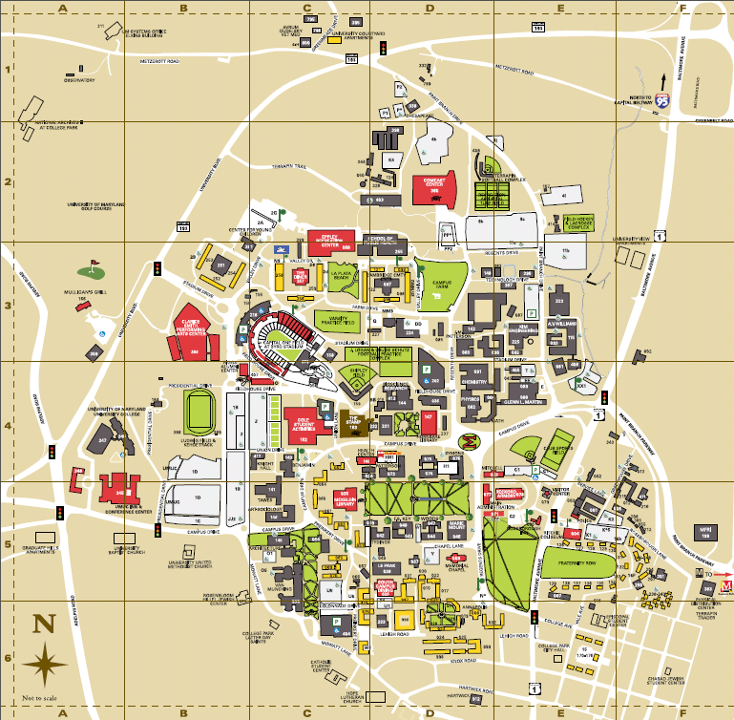
UMD Campus Map
Area:
1250 acres or 5 km²

Slide 4
How many libraries are there at UMD?
1
3
6
8

Slide 5

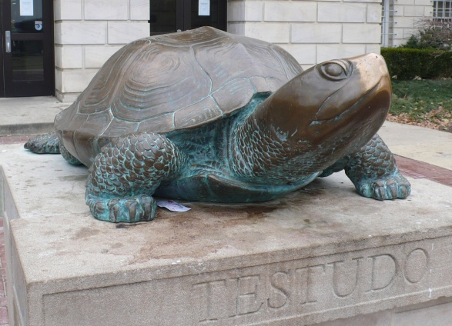
University of Maryland Libraries
McKeldin Library
Architecture Library
Art Library
Engineering and Physical Sciences Library (EPSL)
Hornbake Library
Michelle Smith Performing Arts Library
Shady Grove Library (located off campus)
White Memorial Chemistry Library
The main library on campus
Testudo – university mascot since 1932
Notes:
Rubbing his nose is supposed to bring good luck (hence Testudo's unusually shiny nose).

Slide 6

The Students
Digital natives
Highly motivated
Highly competitive
“The best way to further our learning is to utilize all available resources, and seek guidance with experts whenever possible.”
Gemstone Team “Dietary Information and Evaluation Technologies” (DIET), 2011

Slide 7

Honors Programs at UMD

Slide 8
Teaching with emerging technologies
Faculty members
1. Enterprise Learning Management System (ELMS)
2. Wimba
3. DRUM
⇨ Course materials
⇨ Discussion board
⇨ Students’ grades
Librarians
4. Clickers and laser pointers
5. Digital reference
6. Subject guides
⇨ Information literacy skills

Slide 9
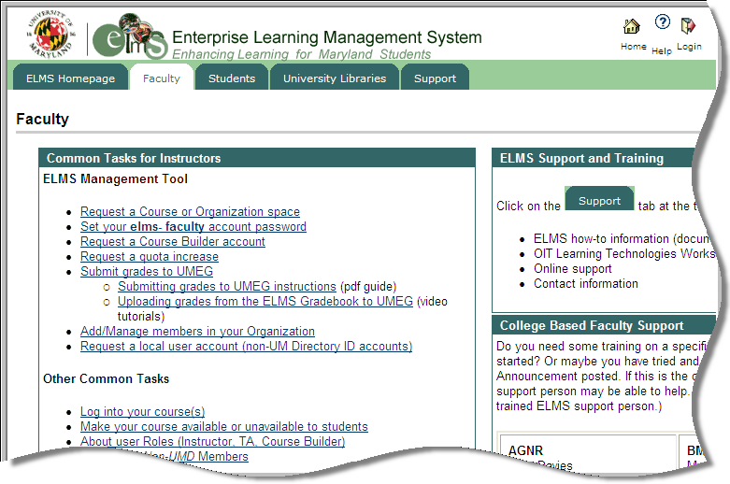
Enterprise Learning Management System (ELMS) for faculty

Slide 10
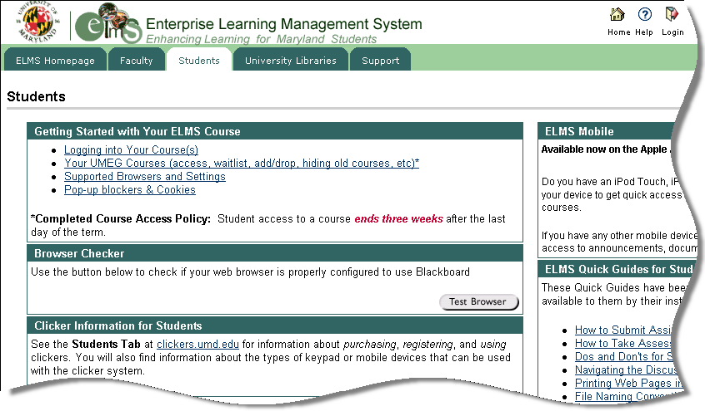
Enterprise Learning Management System (ELMS) for students

Slide 11
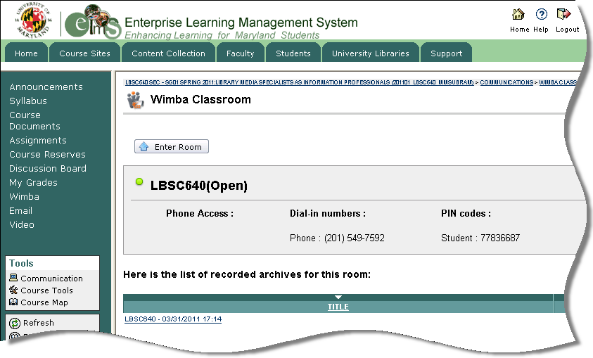
Wimba classroom

Slide 12

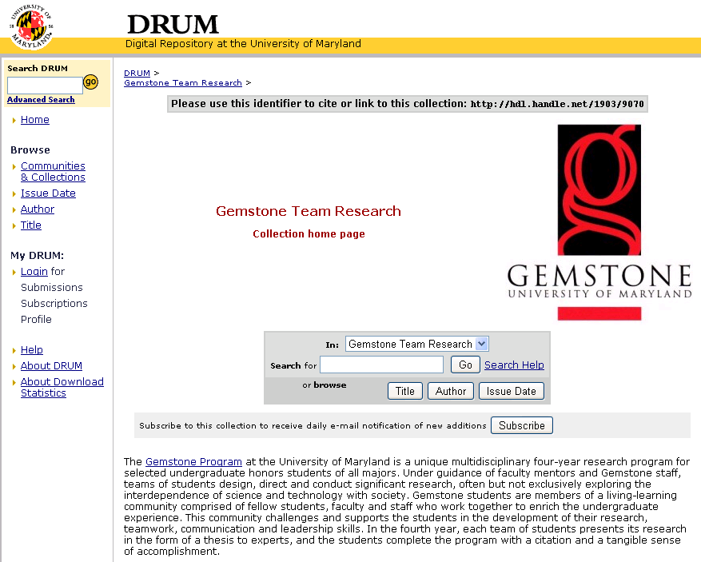
Digital Repository at the University of Maryland
(DRUM)

Slide 13
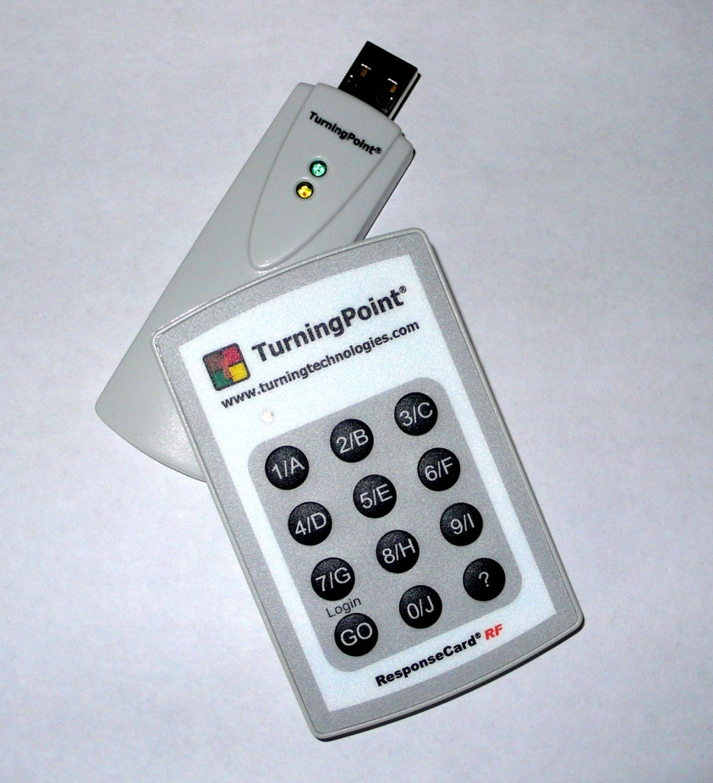
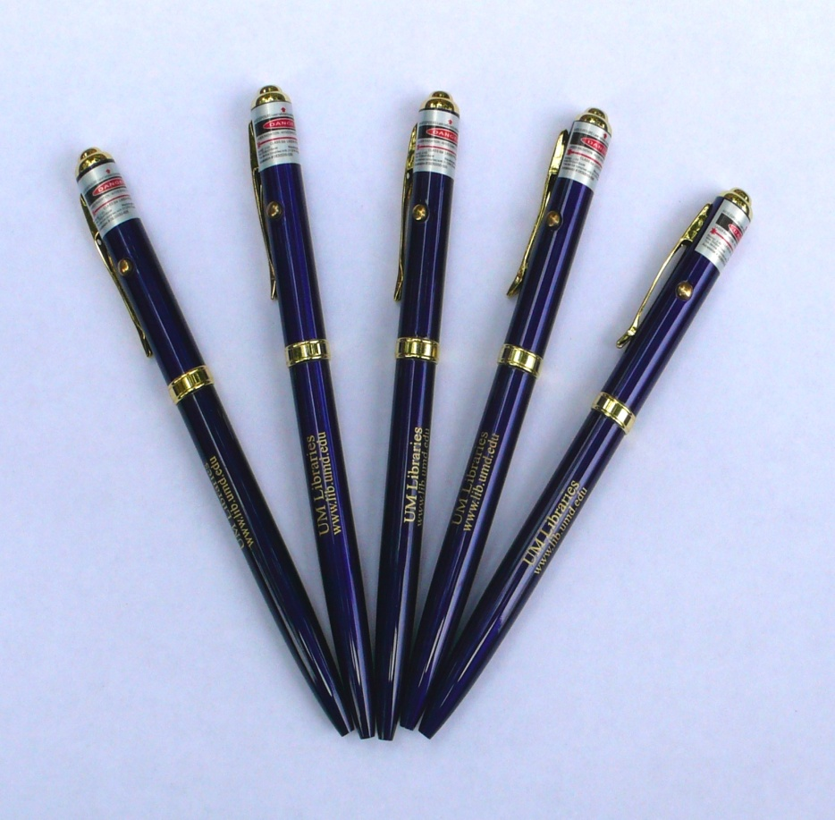
Interactive devices
Clickers
Laser pointers

Slide 14
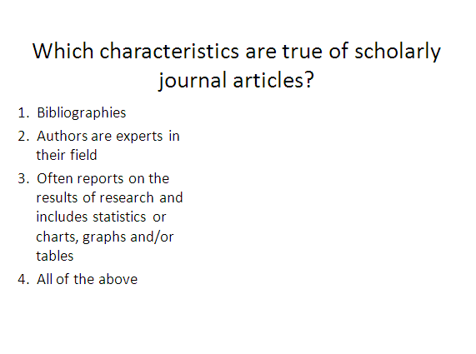
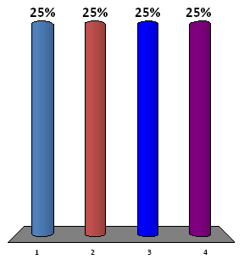

Clickers example

Slide 15
Now let’s try another question!
Notes:
Press F5 or enter presentation mode to view the poll
In an emergency during your presentation, if the poll isn't showing, navigate to this link in your web browser:
http://www.polleverywhere.com/multiple_choice_polls/NTE3MDg1NjIz
If you like, you can use this slide as a template for your own voting slides. You might use a slide like this if you feel your audience would benefit from the picture showing a text message on a phone.

Slide 16
Did you have fun? Try this one!

Slide 17

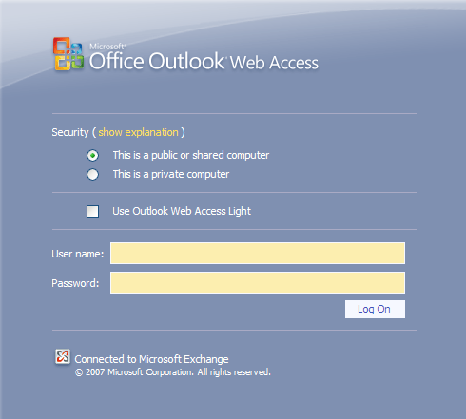
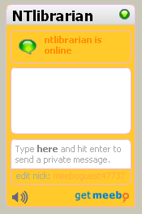
Digital reference
Librarians are teaching life-long information literacy skills through:
Library instruction
E-mail
Chat

Slide 18
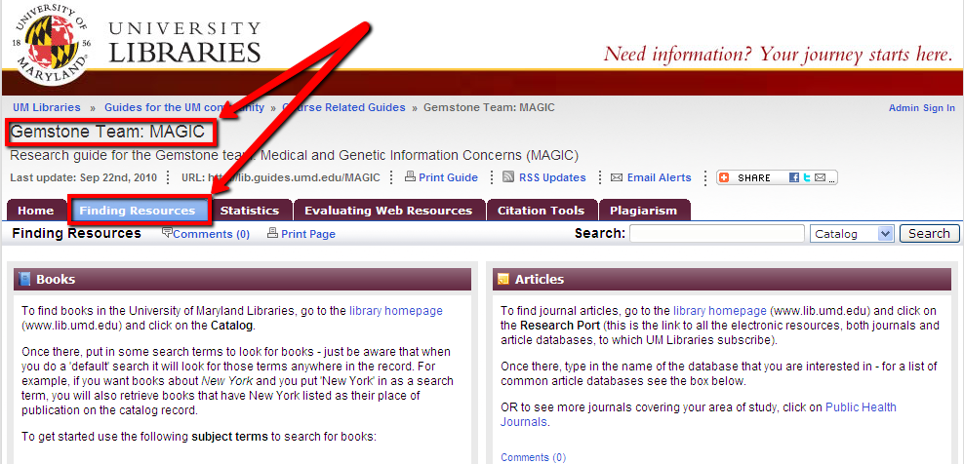
Subject guides
Librarians are teaching life-long information literacy skills through the creation of research guides:

Slide 19
Mentoring
Students
Librarians
Faculty members
Faculty members share their expertise and skills
Librarians teach life-long information literacy skills
Students achieve success above and beyond

Slide 20

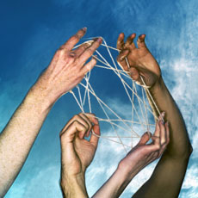
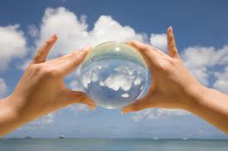
Conclusions
Move out of your comfort zone!
Establish
your role!
Have a vision!
Be a passionate collaborator!
http://www.positivityblog.com/index.php/2009/10/14/how-to-step-out-of-your-comfort-zone/
http://sedu731fall09.wikispaces.com/Why+Collaborate%3F
http://balancedlifeskills.com/home/2011/01/03/1535.html

Slide 21

Thank you for your attention!
Questions?

