Slide 1


This slideshow is licensed under a Creative Commons Attribution Non-Commercial 3.0 United States license. For more information about this license see http://creativecommons.org/licenses/by-nc/3.0/ (In short, you can copy, distribute, and adapt this work as long as you give proper attribution and do not charge for it.)

Slide 2
Editing Directions
This is a READ ONLY Google Slide Presentation. You need to MAKE YOUR OWN COPY of this slideshow so you can edit it and create your own version of the Jeopardy game.
To make your own copy, first be sure to be logged into your Google account, then click “File” and “Make a copy…” in the menu above.
Once you have your own copy of the slideshow you can now make your changes.
Edit the title slide as needed to name your Jeopardy game.
Everything is already hyperlinked to go to the correct slides, so no links need to be added.
All other text and items on each slide are linked back to that same slide so the user will not accidentally move to the next slide.
Delete this slide when done creating your Jeopardy game.

Slide 3
JEOPARDY BOARD
FINAL JEOPARDY
Ideals of the Founding Era | Writing and Arts | Black Military Service | Life in the Colonies | Slavery and Resistance
$100 | $100 | $100 | $100 | $100
$200 | $200 | $200 | $200 | $200
$300 | $300 | $300 | $300 | $300
$400 | $400 | $400 | $400 | $400
$500 | $500 | $500 | $500 | $500

Slide 4

Ideals of the Founding Era - $100 Question
This 1787 document begins with the famous phrase “We the People” and established the structure of the federal government.
Click to see answer

Slide 5


Ideals of the Founding Era - $100 Answer
The Constitution of the United States
Click to return to Jeopardy Board

Slide 6
Ideals of the Founding Era - $200 Question
This 1784 document established America’s system for adding new states to the Union and prohibited slavery in the Northwest Territory.
Click to see answer

Slide 7
Ideals of the Founding Era - $200 Answer
The Northwest Ordinance
Click to return to Jeopardy Board

Slide 8
Ideals of the Founding Era - $300 Question
Written by Alexander Hamilton, James Madison, and John Jay under the pseudonym “Publis,” these 85 essays argued for the ratification of the Constitution.
Click to see answer

Slide 9
Ideals of the Founding Era - $300 Answer
The Federalist Papers
Click to return to Jeopardy Board

Slide 10
Ideals of the Founding Era - $400 Question
This 1219 document, which helped inspire the Declaration of Independence, established the right to due process, equality before the law, and trial by a jury of peers.
Click to see answer

Slide 11
Ideals of the Founding Era - $400 Answer
The Magna Carta
Click to return to Jeopardy Board

Slide 12
Ideals of the Founding Era - $500 Question
This 1783 treaty, signed in Paris, formally ended the American Revolutionary War and recognized American independence from Great Britain.
Click to see answer

Slide 13
Ideals of the Founding Era - $500 Answer
The Treaty of Paris
Click to return to Jeopardy Board

Slide 14
Writing and Arts - $100 Question
This woman was the first African American to publish a book of poetry.
Click to see answer

Slide 15
Writing and Arts - $100 Answer
Phillis Wheatley
Click to return to Jeopardy Board

Slide 16
Writing and Arts - $200 Question
This person is known as the founder of African American literature.
Click to see answer

Slide 17
Writing and Arts - $200 Answer
Jupiter Hammon
Click to return to Jeopardy Board

Slide 18
Writing and Arts - $300 Question
This person was an astronomer and mathematician who published 6 almanacs in his lifetime.
Click to see answer

Slide 19
Writing and Arts - $300 Answer
Benjamin Banneker
Click to return to Jeopardy Board

Slide 20
Writing and Arts - $400 Question
The artist Joshua Johnson was one of the first African Americans to make a career as an artist doing this type of work.
Click to see answer

Slide 21
Writing and Arts - $400 Answer
Portraits
Click to return to Jeopardy Board

Slide 22
Writing and Arts - $500 Question
Written by Lucy Terry, this is the earliest existing poem by an African American poet.
Click to see answer

Slide 23
Writing and Arts - $500 Answer
Bars Fight
Click to return to Jeopardy Board

Slide 24
Black Military Service - $100 Question
This colony, now a state, proclaimed that Black men could serve in the British Militia.
Click to see answer

Slide 25
Black Military Service - $100 Answer
Virginia
Click to return to Jeopardy Board

Slide 26
Black Military Service - $200 Question
At their largest, there were this many segregated companies of soldiers.
Click to see answer

Slide 27
Black Military Service - $200 Answer
Five
Click to return to Jeopardy Board

Slide 28
Black Military Service - $300 Question
The company of Veteran Black soldiers was formed at this major battle site.
Click to see answer

Slide 29
Black Military Service - $300 Answer
Valley Forge
Click to return to Jeopardy Board

Slide 30
Black Military Service - $400 Question
These were the three roles Black men could have in the Patriot Army.
Click to see answer

Slide 31
Black Military Service - $400 Answer
Drummer, fifer, and private soldier
Click to return to Jeopardy Board

Slide 32
Black Military Service - $500 Question
This woman served as a cook in George Washington’s military household in 1776 to around 1780.
Click to see answer

Slide 33
Black Military Service - $500 Answer
Hannah Till
Click to return to Jeopardy Board

Slide 34
Life in the Colonies - $100 Question
Many African captives in these colonies adopted this religion, blending it with their own traditions.
Click to see answer

Slide 35
Life in the Colonies - $100 Answer
Christianity
Click to return to Jeopardy Board

Slide 36
Life in the Colonies - $200 Question
This African indentured servant had his punishment changed to lifetime servitude after running away with two white servants in 1640.
Click to see answer

Slide 37
Life in the Colonies - $200 Answer
John Punch
Click to return to Jeopardy Board

Slide 38
Life in the Colonies - $300 Question
This 1654 court case declared that John Casor would be a servant for life, marking a legal step towards institutionalized slavery.
Click to see answer

Slide 39
Life in the Colonies - $300 Answer
Casor v Johnson
Click to return to Jeopardy Board

Slide 40
Life in the Colonies - $400 Question
This 1705 law declared that all non-Christian servants brought to the colonies would be automatically enslaved.
Click to see answer

Slide 41
Life in the Colonies - $400 Answer
Virginia Slave Law of 1705
Click to return to Jeopardy Board

Slide 42
Life in the Colonies - $500 Question
The first representative assembly in the American colonies, established in Virginia in 1619.
Click to see answer

Slide 43
Life in the Colonies - $500 Answer
The House of Burgesses
Click to return to Jeopardy Board

Slide 44
Slavery and Resistance - $100 Question
This abolitionist, in an Independence Day celebration in 1852, proclaimed, “What to the slave is the Fourth of July?”
Click to see answer

Slide 45
Slavery and Resistance - $100 Answer
Frederick Douglass
Click to return to Jeopardy Board

Slide 46
Slavery and Resistance - $200 Question
This was the year that the first enslaved people were brought to America.
Click to see answer

Slide 47
Slavery and Resistance - $200 Answer
1619
Click to return to Jeopardy Board

Slide 48
Slavery and Resistance - $300 Question
In this South Carolina rebellion, almost 100 enslaved people, led by a man named Jemmy, gathered to march in St. Augustine, FL., in hopes of obtaining their freedom.
Click to see answer

Slide 49
Slavery and Resistance - $300 Answer
The Stono Rebellion
Click to return to Jeopardy Board

Slide 50
Slavery and Resistance - $400 Question
This New Year’s Eve ritual was started on December 31, 1862 when enslaved Black people gathered in churches to wait for the Emancipation Proclamation to take effect.
Click to see answer

Slide 51
Slavery and Resistance - $400 Answer
Watch Night
Click to return to Jeopardy Board

Slide 52
Slavery and Resistance - $500 Question
Harriet Tubman, known for being the conductor of the Underground Railroad, led this military operation in 1863 that freed 700 enslaved people.
Click to see answer

Slide 53
Slavery and Resistance - $500 Answer
Combahee Ferry Raid
Click to return to Jeopardy Board

Slide 54
FINAL
Topic: Entrepreneurship in the Founding Era
Click to see question

Slide 55
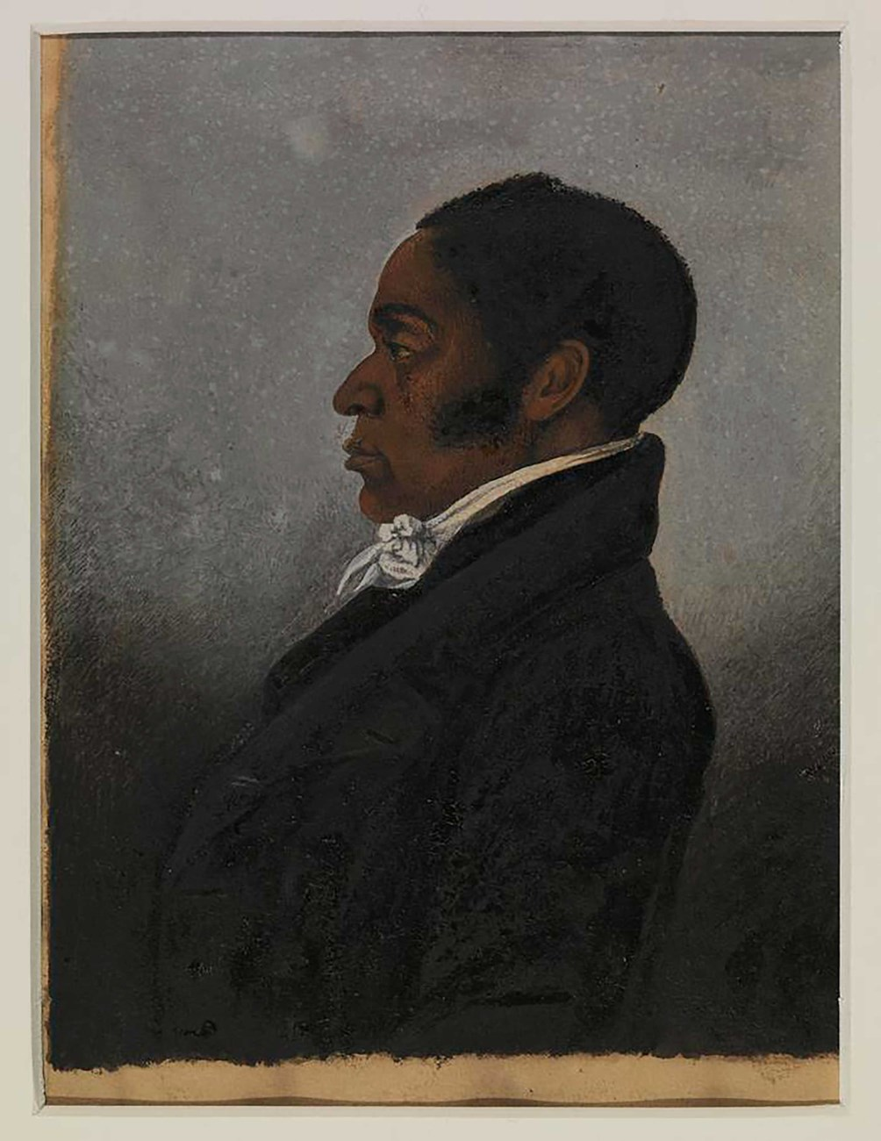
Final Jeopardy Question
Born free on September 2, 1766, this man was known for his work as an exquisite sailmaker amongst all patrons, white and Black; a trade he learned from his father, Thomas, who was also born free.
Click to see answer

Slide 56
Final Jeopardy Answer
James Forten
Click to return to Jeopardy Board

