Slide 1
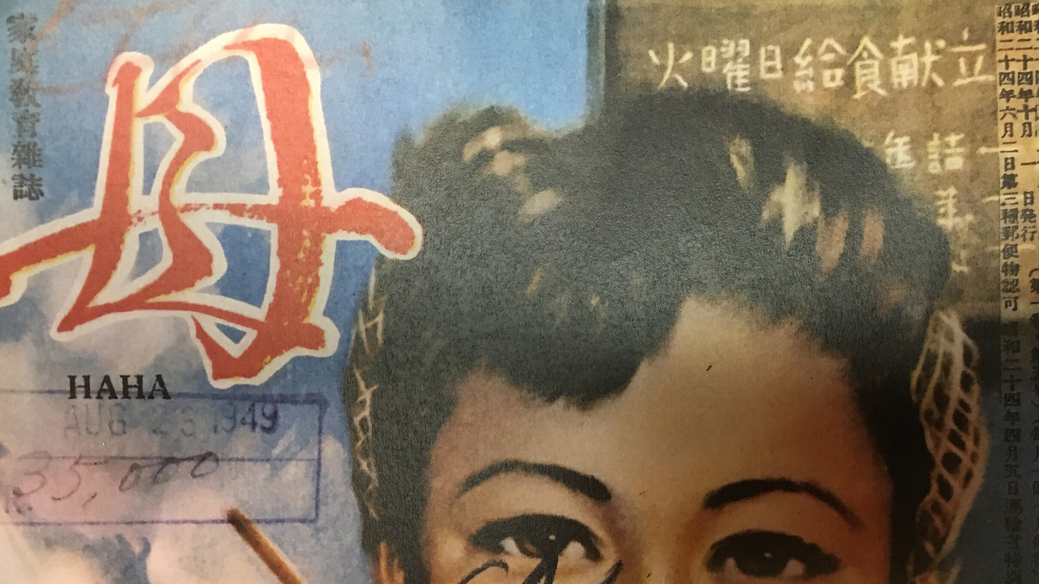
What’s on the Menu Today?:
The School Lunch Program in
Occupied Japan
Kana Jenkins
Curator, Gordon W. Prange Collection
East Asian Studies Librarian
University of Maryland
New England Association of Asian Studies Conference, 11/1/2019

Slide 2
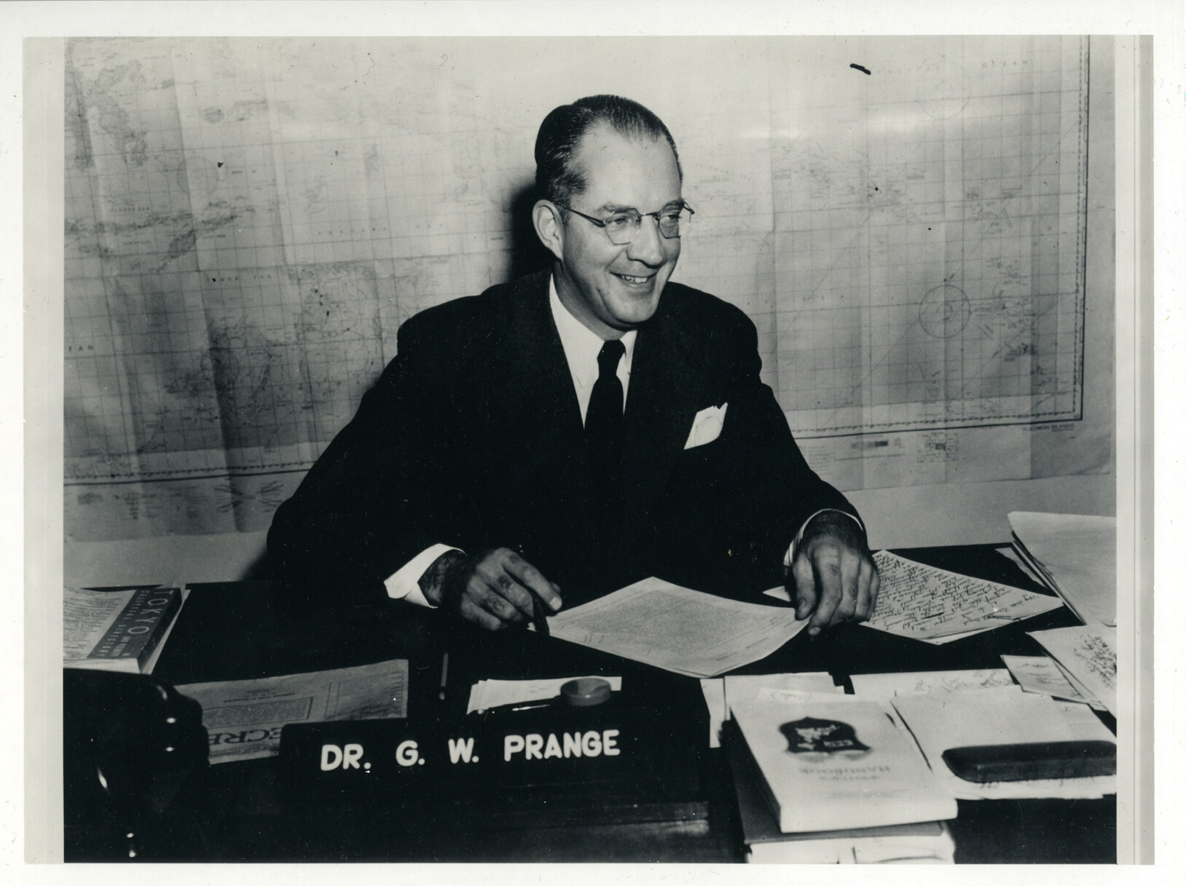

Gordon W. Prange Collection
  Japanese publications between 1945 to 1949.
  File copies of Civil Censorship Detachment (CCD), a censorship unit
  Holdings include almost every subject
  Holdings include: books, magazines, newspapers, posters, color slides, photographs, oral histories, ephemera, and much more.

Slide 3
School
Lunch
Program
in
Occupied
Japan
Major changes in:
  Varieties of ingredients
  Ingredients providers
  Numbers of children receiving school lunches
  Menus

Slide 4
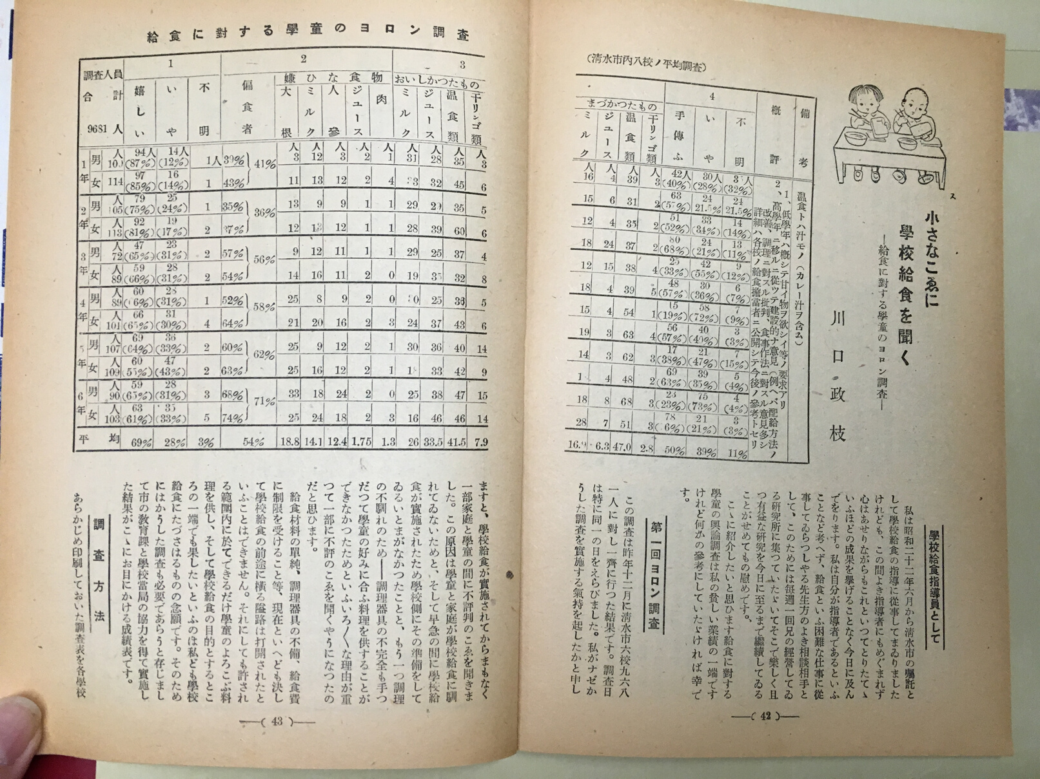
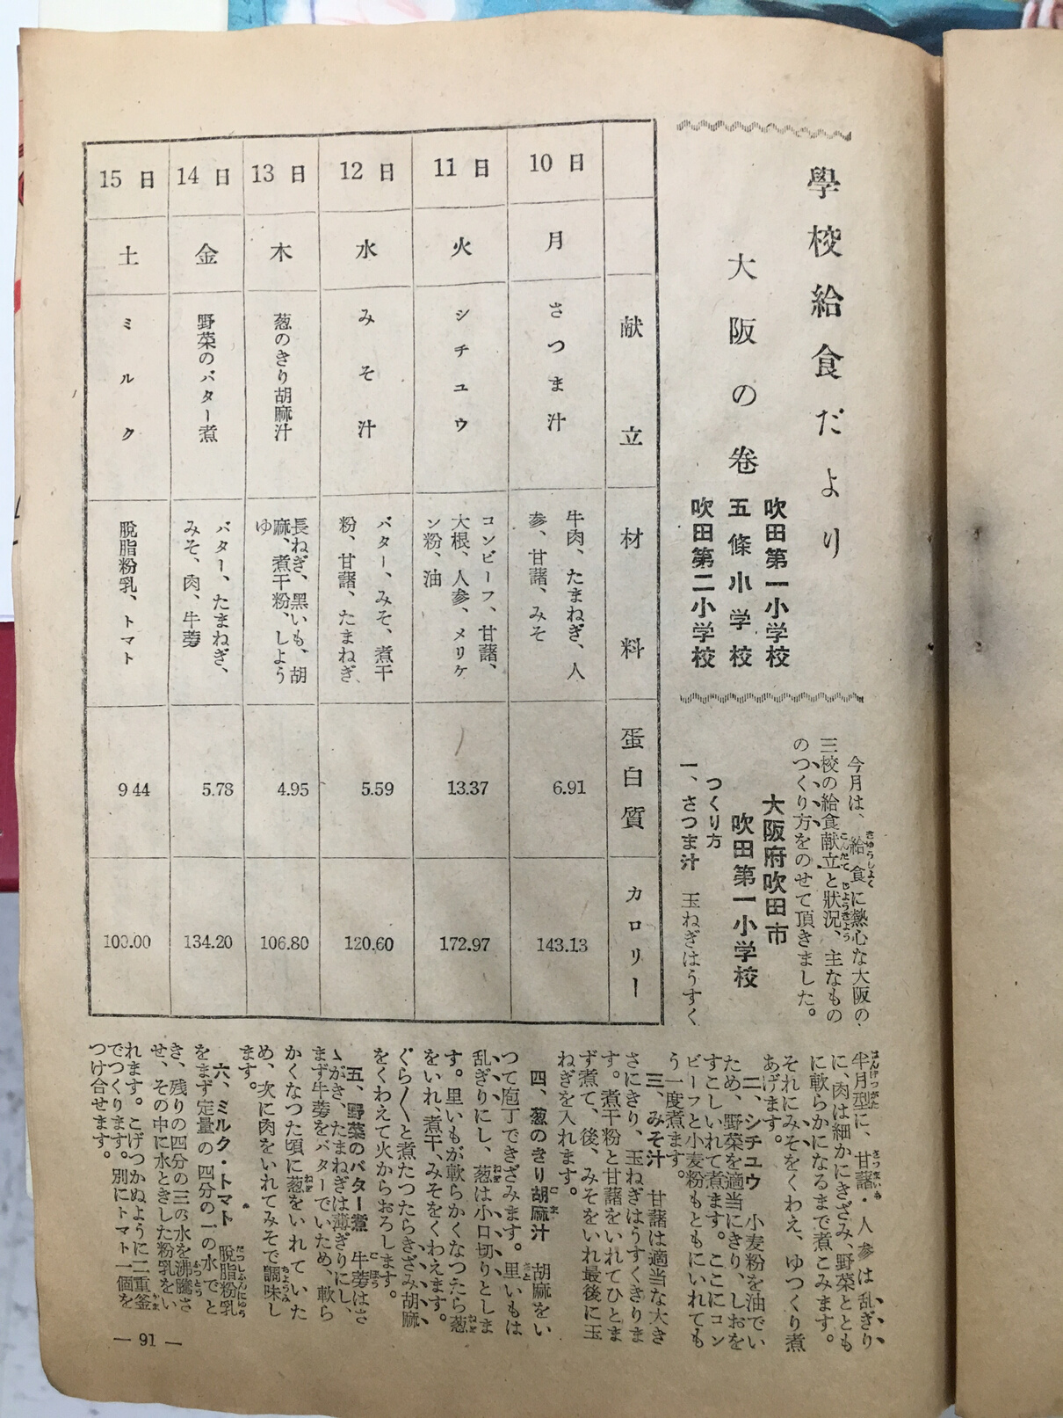
Magazine articles featuring School lunch menus
Eating Habits 475（1948）
Mother 1, no. 5 (1949)

Slide 5
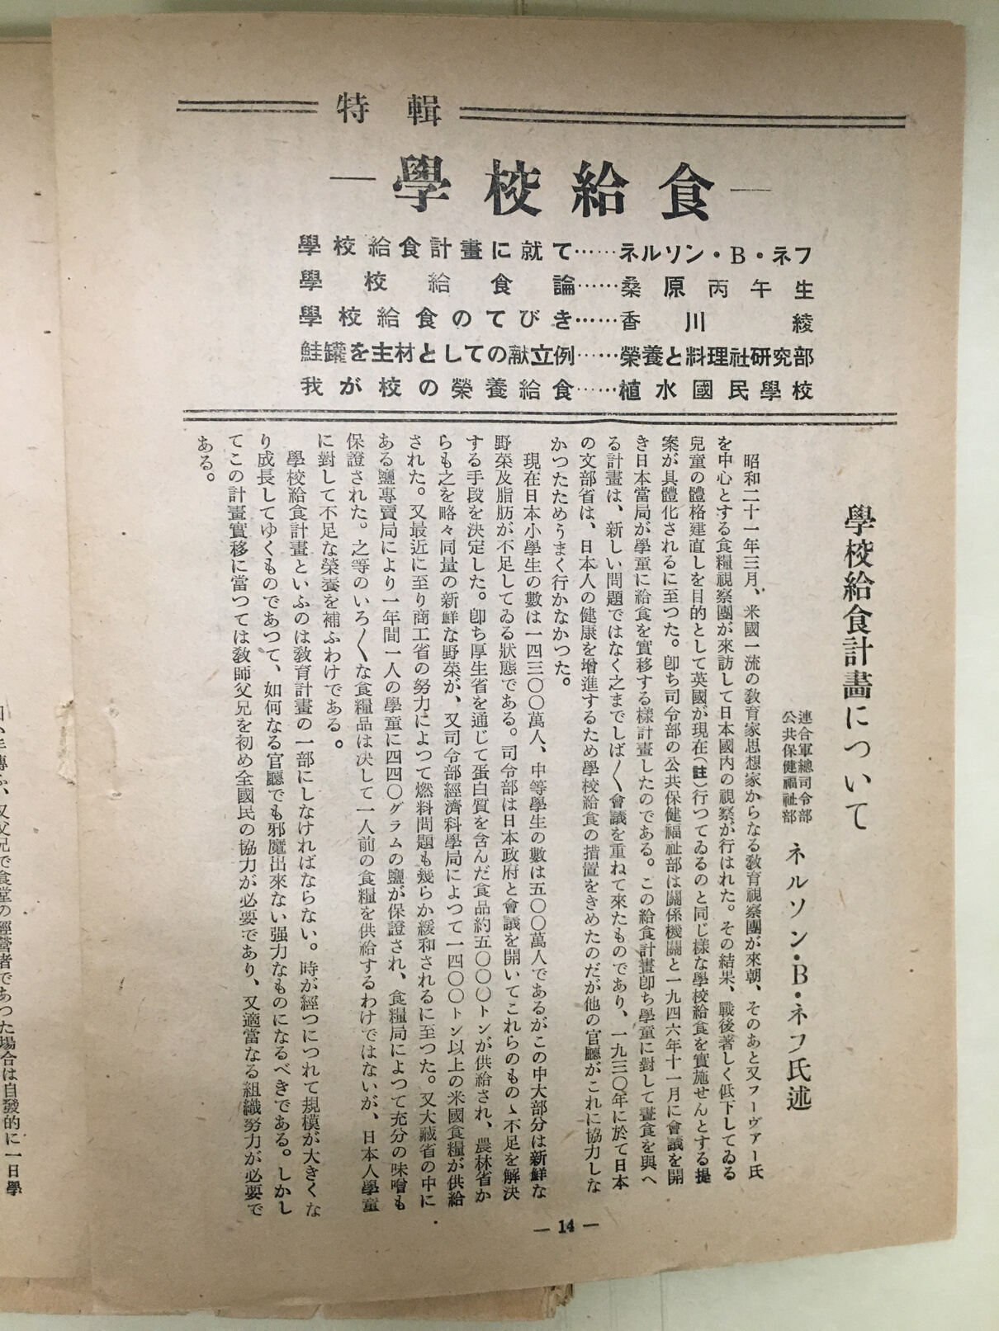
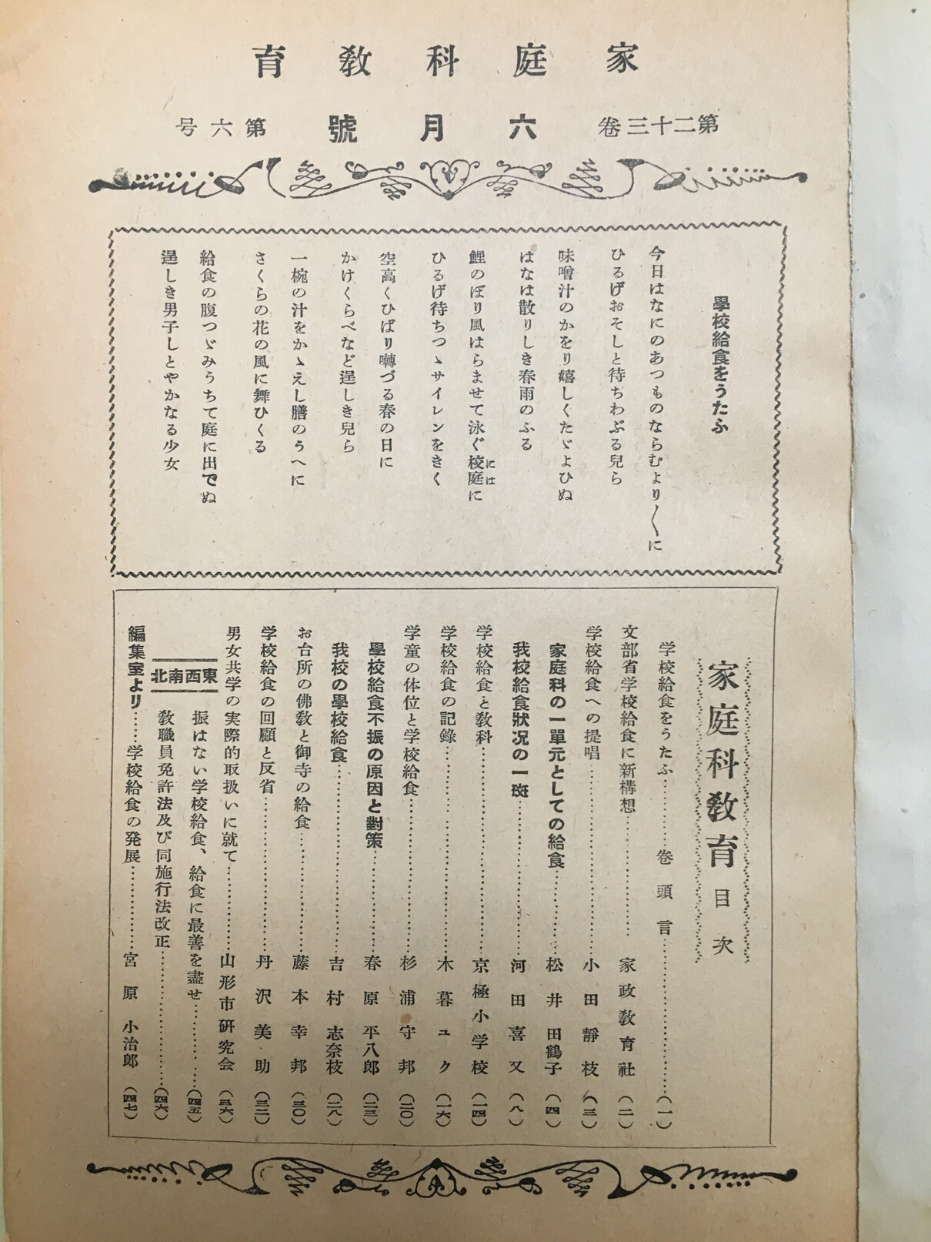
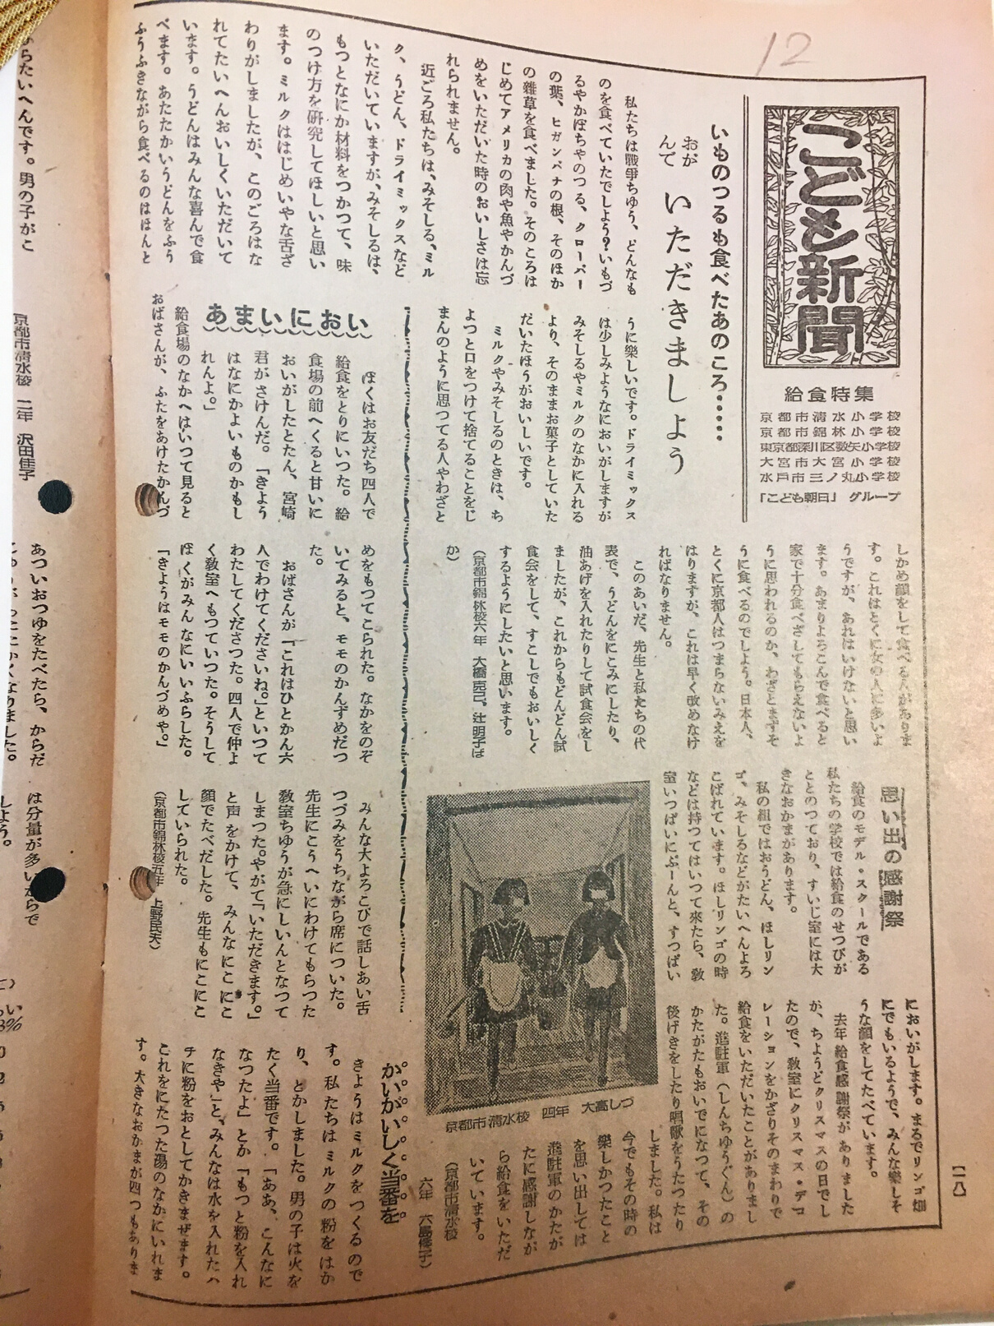
Magazine issues devoted to School lunch programs
Nutrition and Cooking 13, no. 3 (1947)
Home Economics Education 23, no. 6 (1949 )
Kodomo Shimbun, Nov 15, (1948)

Slide 6
Main Questions:
  Why did publishers printed many school lunch menus?
  What are the historical value of these menus?

Slide 7
SCAP/GHQ's Agenda
Democratization of Japan
"...[SCAP/GHQ policies] focused on the 'Three D's': demilitarization, democratization, and decentralization of wealth and power."
Nancy Stalker, Japan: History and Culture from Classical to Cool (2018)
"...the Americans imposed a root-and-branch agenda of 'demilitarization and democratization' that was in every sense a remarkable display of arrogant idealism - both self-righteous and genuinely visionary."
John Dower, Embracing Defeat (1999)

Slide 8
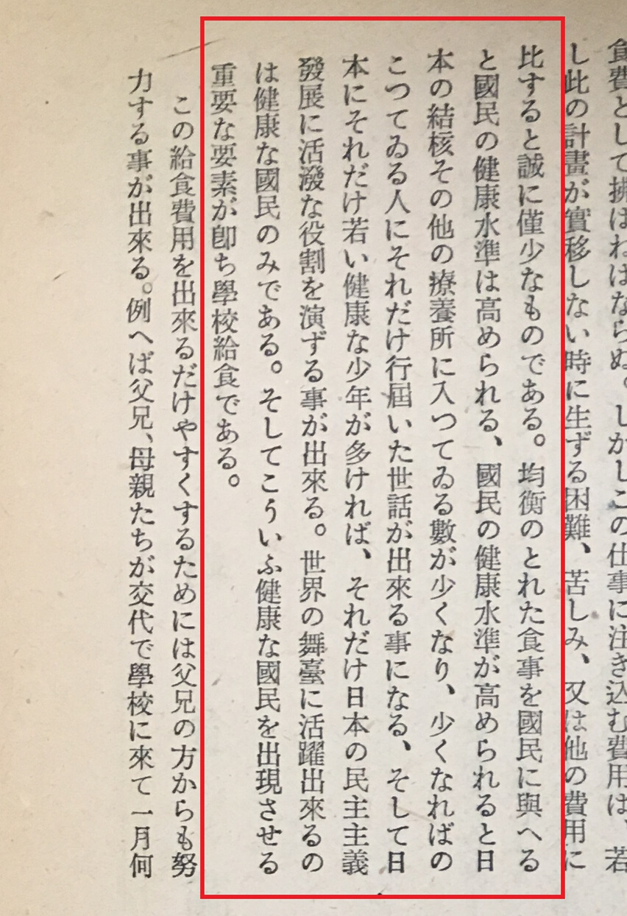
Democratizing Japan through School lunch program? (1/2)
"A balanced food brings up citizen’s health standard; the better health standard means that less people would be admitted in sanatoriums for tuberculosis or other diseases; Less sick people means better care for those who are sick, and more healthy young people in society; Young healthy people are the key to develop democratized Japan. Only healthy and active citizens can be an active member of global society. The school lunch program plays an important role to produce these healthy and active citizens.”
Nelson Neff, "School lunch program plan" in Nutrition and Cooking (1947)

Slide 9
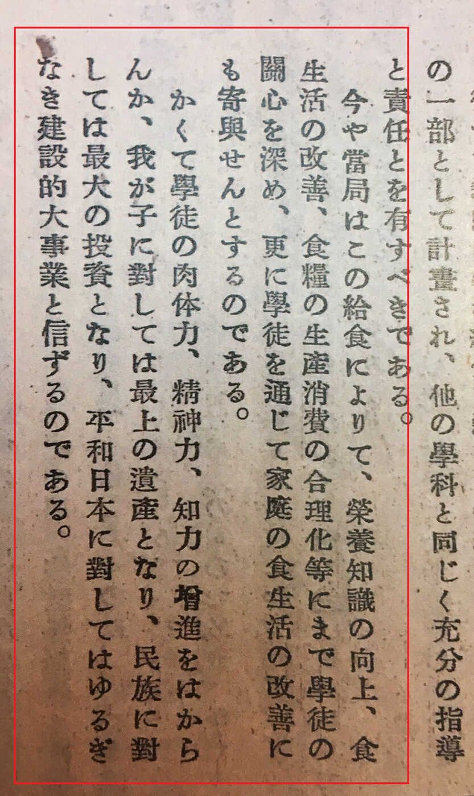
Democratizing Japan through School lunch program? (2/2)
"It is now a time for students to improve their level of nutrition knowledge, dietary practice, as well as to learn how to consume food more efficiently. In addition, we can expect the students would bring a positive influence to their households’ dietary practices.
I believe that the school lunch program is for increasing physical, emotional and intellectual powers of students; It is the best gift to leave for our children; it is the best investment for the Japanese country; it is the best and the most constructive project for peaceful Japan."
Shizue Oda, "Popularization of school lunches" in Home Economics Education (1948)

Slide 10
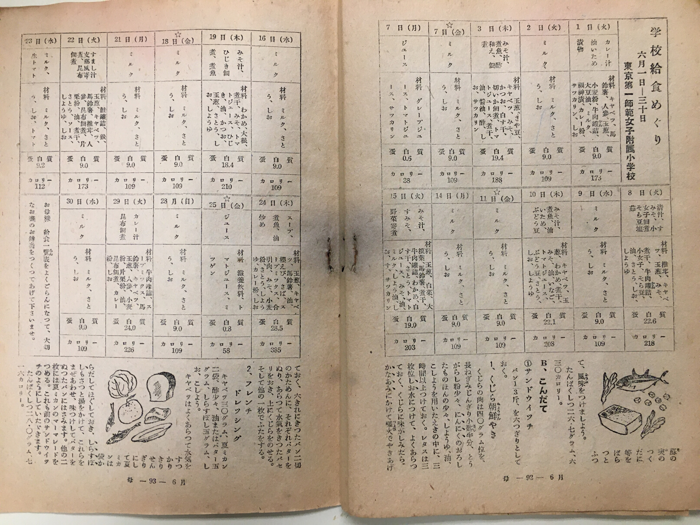
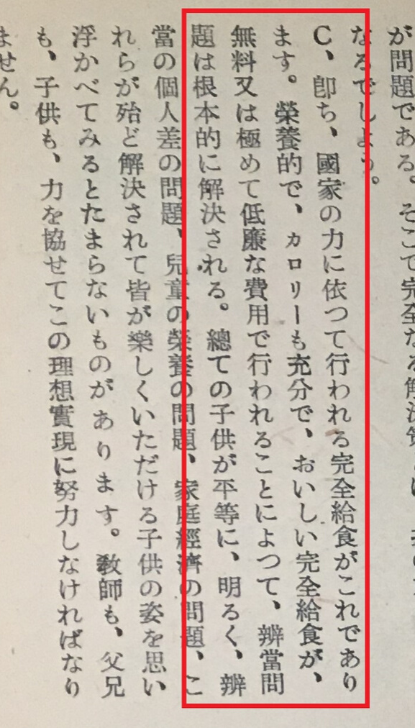
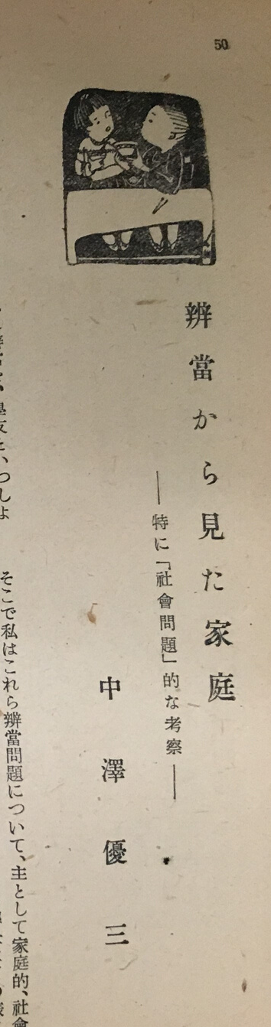
School lunch & Bento
Mother, 1, no. 2 (1949)
nd Cooking 13, no. 3 (1947)

Slide 11
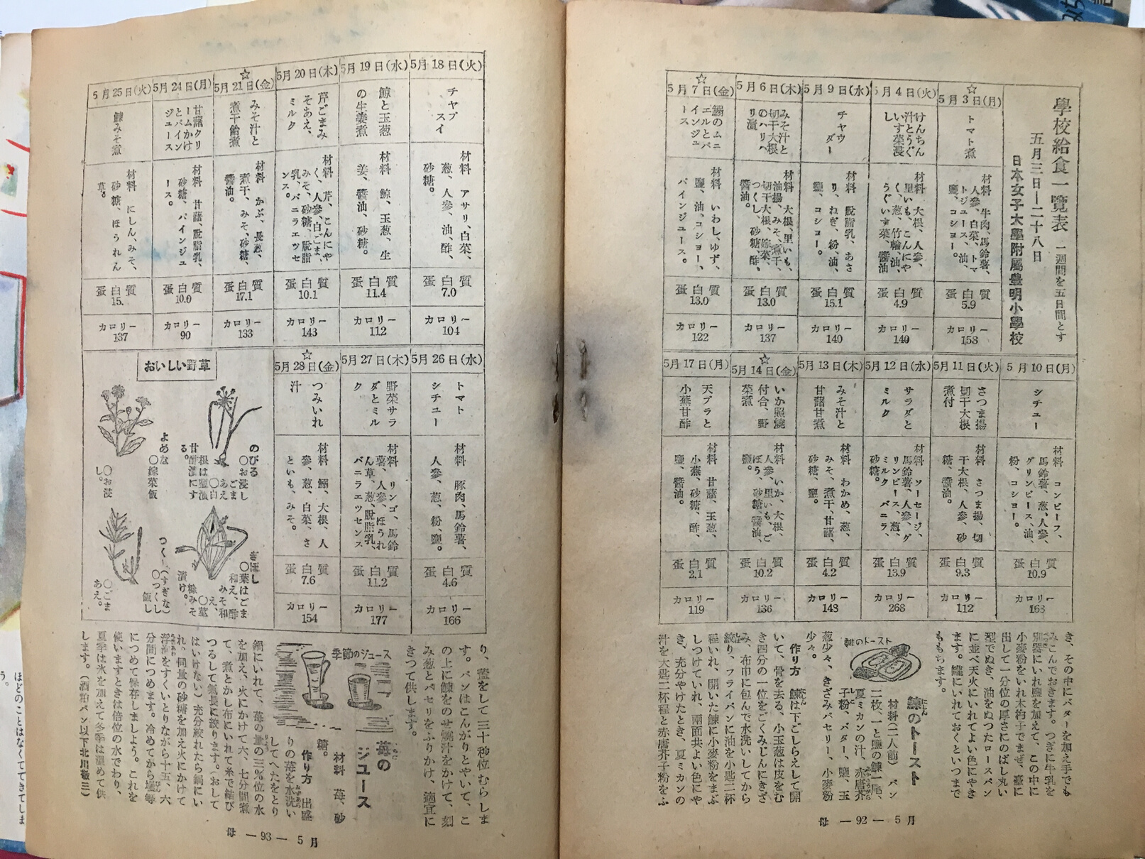
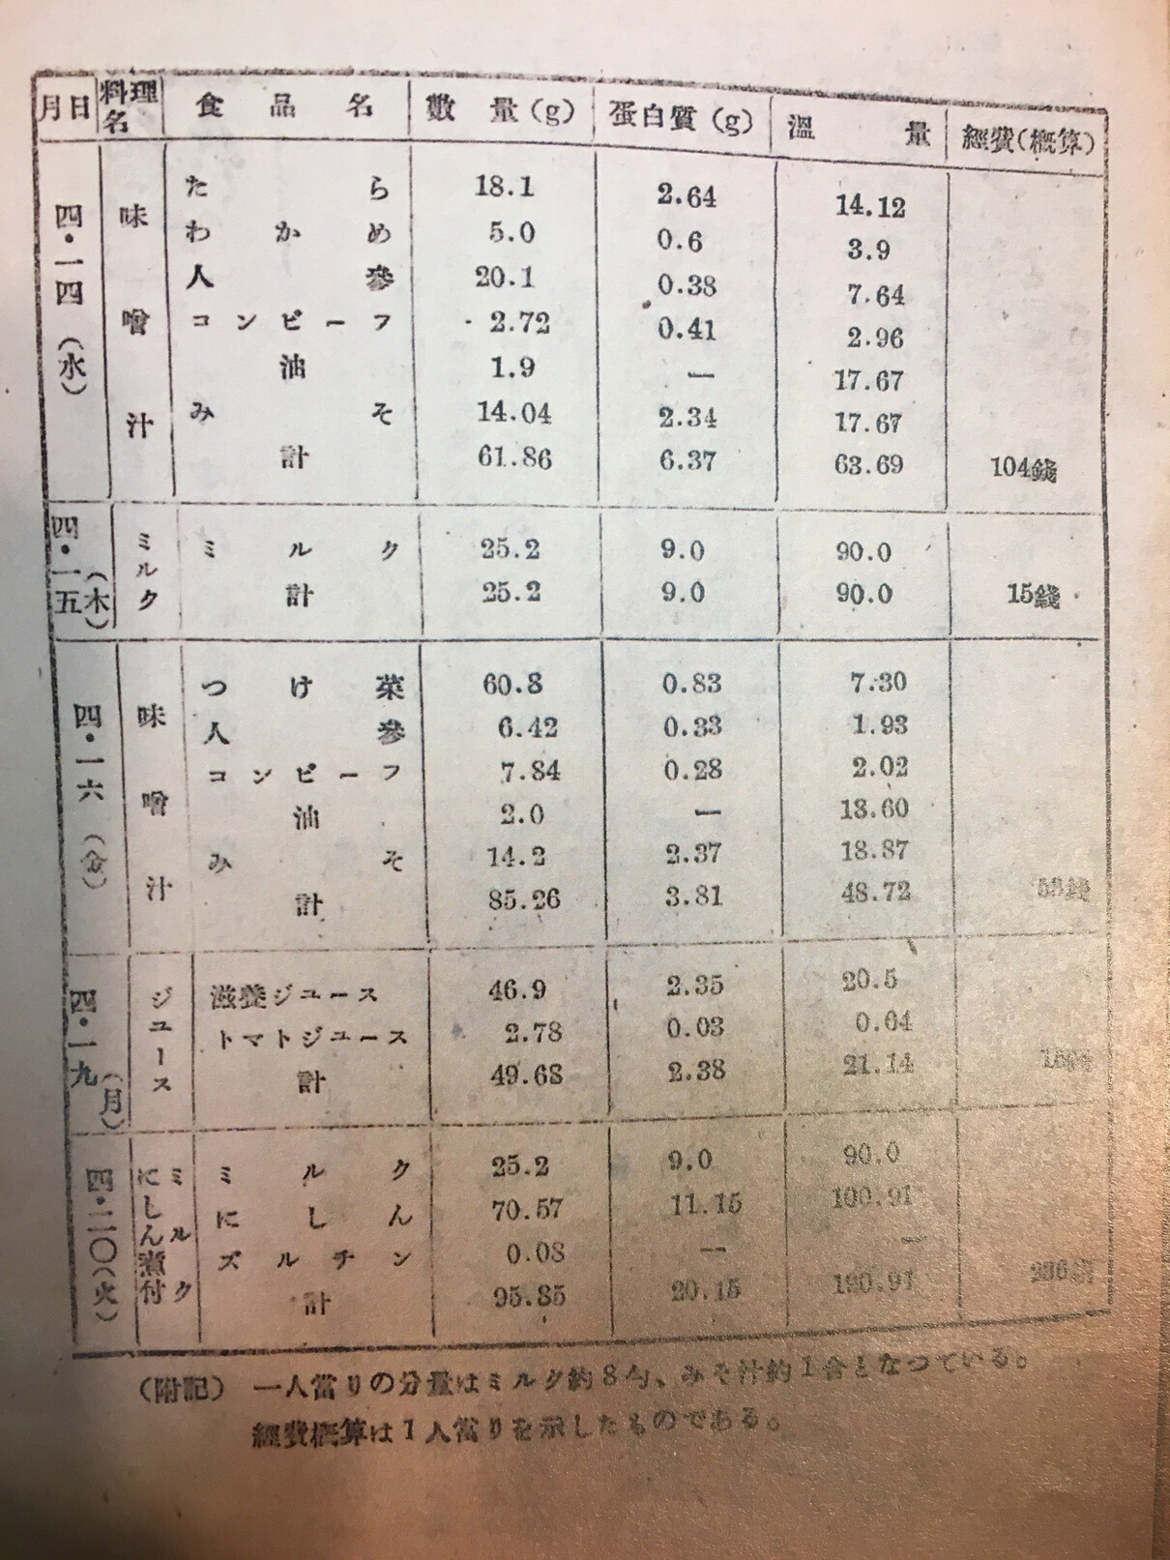
School lunch as Model
Mother, 1, no. 1 (1949)
Home Economics Education 22, no. 7 (1948)

Slide 12
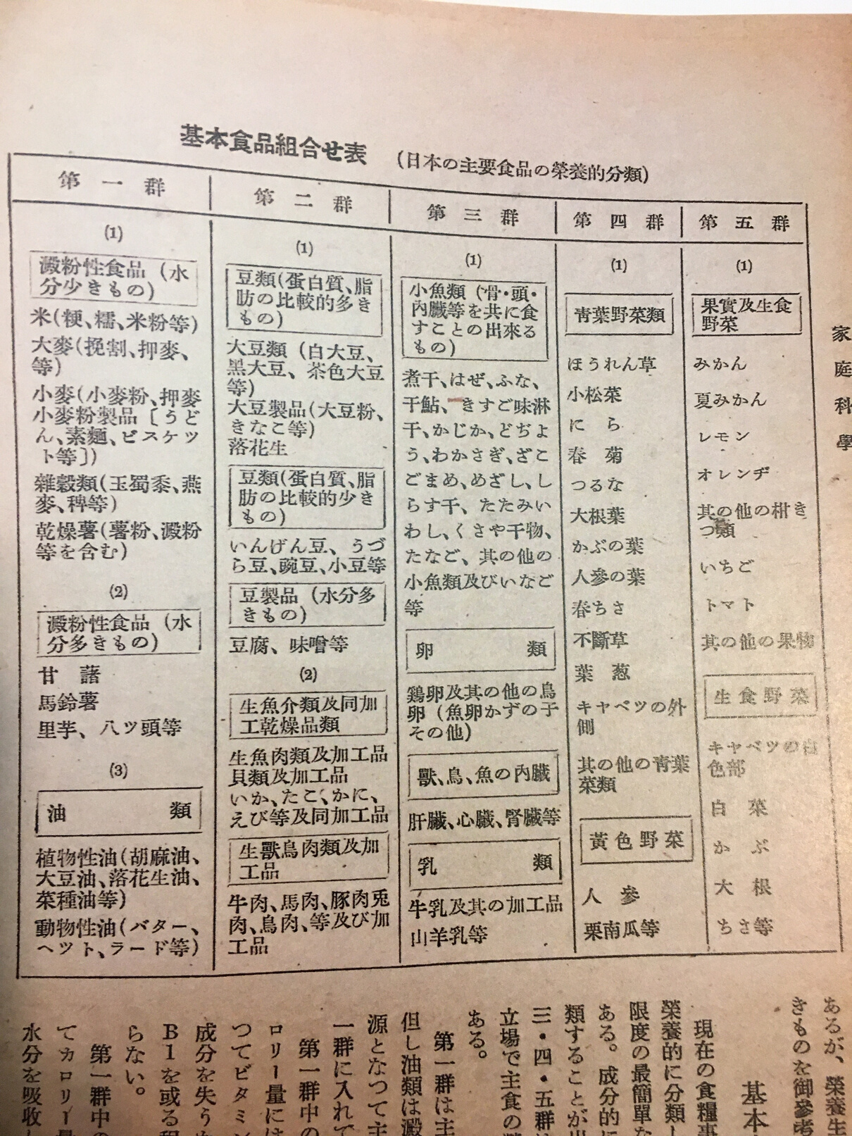
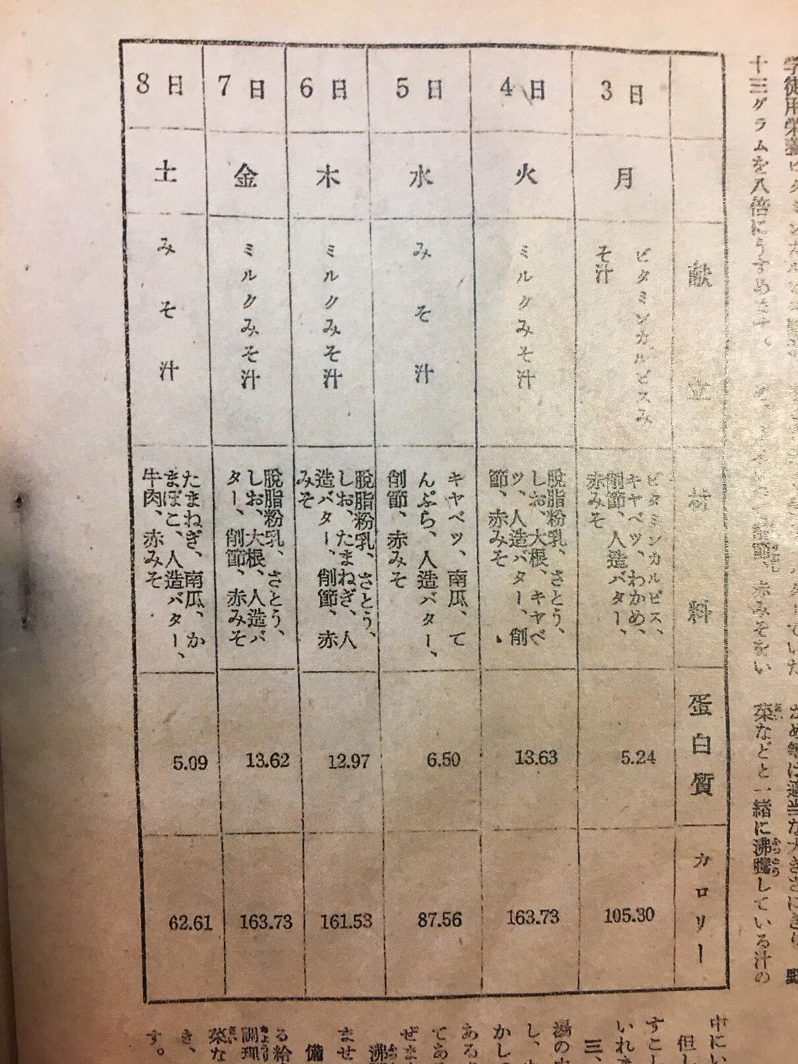
Gap between Ideal and Reality
Home Science 114 (1948)
Mother 1, no. 5 (1949)

Slide 13
Conclusion:
"Children are future adults. What they eat today reflects future citizens' public health level."
Shizue Oda (1948)
  School lunch program as a vehicle to "democratize" Japan and to bring up its social standard.
  The ideology is reflected in many magazine articles accompanied the menus.
  School lunch as a model of recommended dietary practice.
  School lunch menus as an important historical documentation for:
  Records of available ingredients in Occupied Japan
  Records of how people perceived the school lunch program
  Records to show the gap between the official's ideal at national level and the reality at local level.

