Slide 1

Navigating User Limits and E-book Device Compatibility Testing
Cinthya Ippoliti & Nedelina Tchangalova
USMAI Forum, University of Maryland University College (UMUC)
October 29th, 2013
Notes:
CINTHYA: Good morning and thank you for attending our session!
Session description:
“Navigating User Limits and E-book Device Compatibility Testing”
With the increased presence of ebooks in our collections, ebooks present specific challenges for our users. The UMD Libraries are attempting to address these needs by conducting an internal usability testing project to identify issues such as accessibility, discoverability and general functionality. This project will lead to the creation of a troubleshooting guide for users as well as accompanying programming slated for Spring in the form of an open house where we will work with our campus community to get readers and devices e-book ready.
Presenters:
Cinthya Ippoliti
Head, Teaching and Learning Services
McKeldin Library, University of Maryland, College Park
Nedelina Tchangalova
Physical Sciences and Public Health Librarian
Engineering and Physical Sciences Library, University of Maryland, College Park

Slide 2
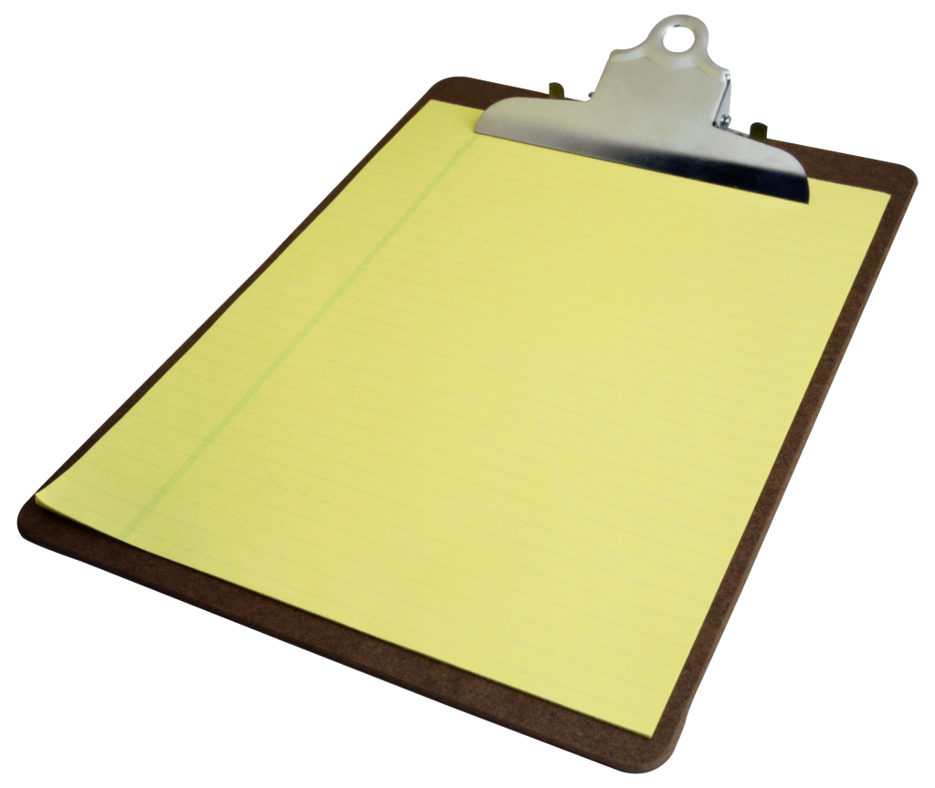
Outline
General facts and figures about our e-book collections
Accessibility and downloading issues
Project details
Results
Next steps
Questions
Notes:
CINTHYA: Today Nedelina and I would like to cover the following areas and we will leave plenty of time for questions afterwards. We will also give you our contact information in case you have follow-up questions. Read Outline.

Slide 3
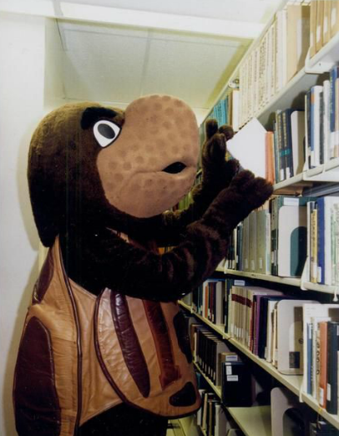
Testudo looking at books on the shelf at McKeldin Library, University of Maryland
Used with permission from UMD Libraries Digital Collections
Available at http://hdl.handle.net/1903.1/7242
Notes:
NEDELINA: Most of our users, like Testudo back in 2003, are still looking for books on the shelf.

Slide 4
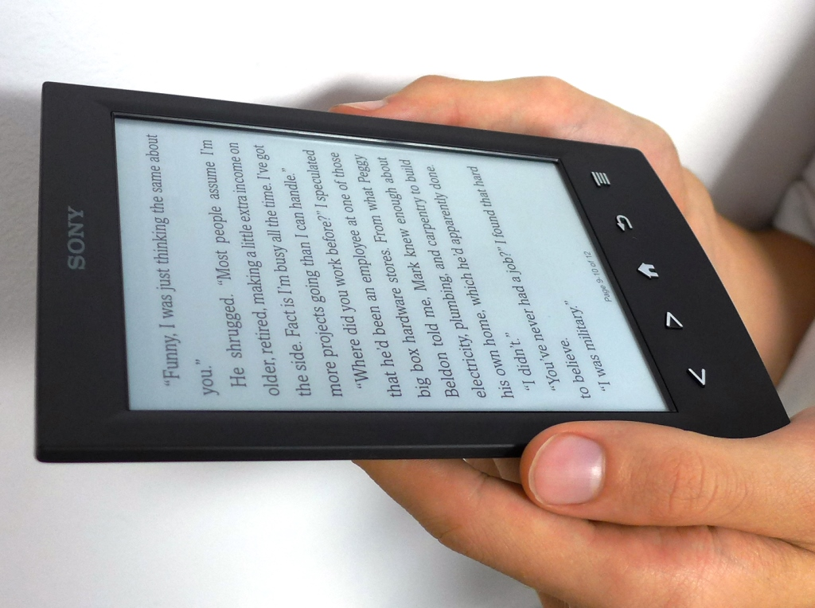
Increasing demand for e-content
Notes:
NEDELINA: However, with the lack of physical spaces and increasing demand for electronically accessible library content, UMD Libraries are acquiring a great number of electronic books. UMD Libraries statistics show that our e-book collections are heavily used by our users.

Slide 5

Background
Number of e-books by fiscal year
374,033
599,198
917,372
FY 13
FY 12
FY 11
Notes:
NEDELINA: Our e-books have indeed grown over the last few years. Every year we double the amount of books in electronic format because we have consciously made decisions to buy more e-books (packages, e-approvals, etc.). Our books are discoverable due to all of the good work that our Acquisitions staff (Rebecca Kemp and Nathan Putnam) are doing to make sure those e-books we have purchased in the past are now discoverable for our patrons in WorldCat UMD.
Here are the numbers we reported from our ARL stats for the past three years:
FY11- 374,033
FY12 - 599,198
FY13 - 917,372

Slide 6







Background cont.
Vendors
Notes:
NEDELINA: We have purchased access to many different vendors, including Springer, Gale, SIAM, Wiley, ebrary, World Scientific and of course EBSCO e-book collection.

Slide 7

General issues
Data from LibAnswers
~ 208 total hits to our e-book and WorldCat Knolwedge Base
~ 33 e-book related questions
~ 132 WorldCat related questions
Most of them are in regards to accessing specific titles
They either cannot tell if we own a specific item
The link is not working when we should have access
A few are about downloading e-books
Notes:
CINTHYA: Most of our e-book issues have to do with discoverability and accessibility. Patrons simply don’t know what titles we have available. We have had very few questions regarding e-book downloading to a particular reader. Most users simply want access - we have not had too many questions regarding check-out or keeping permanent copies either. It seems that most people have a particular chapter or section they need and as long as they can get access to that content, that’s their priority.

Slide 8
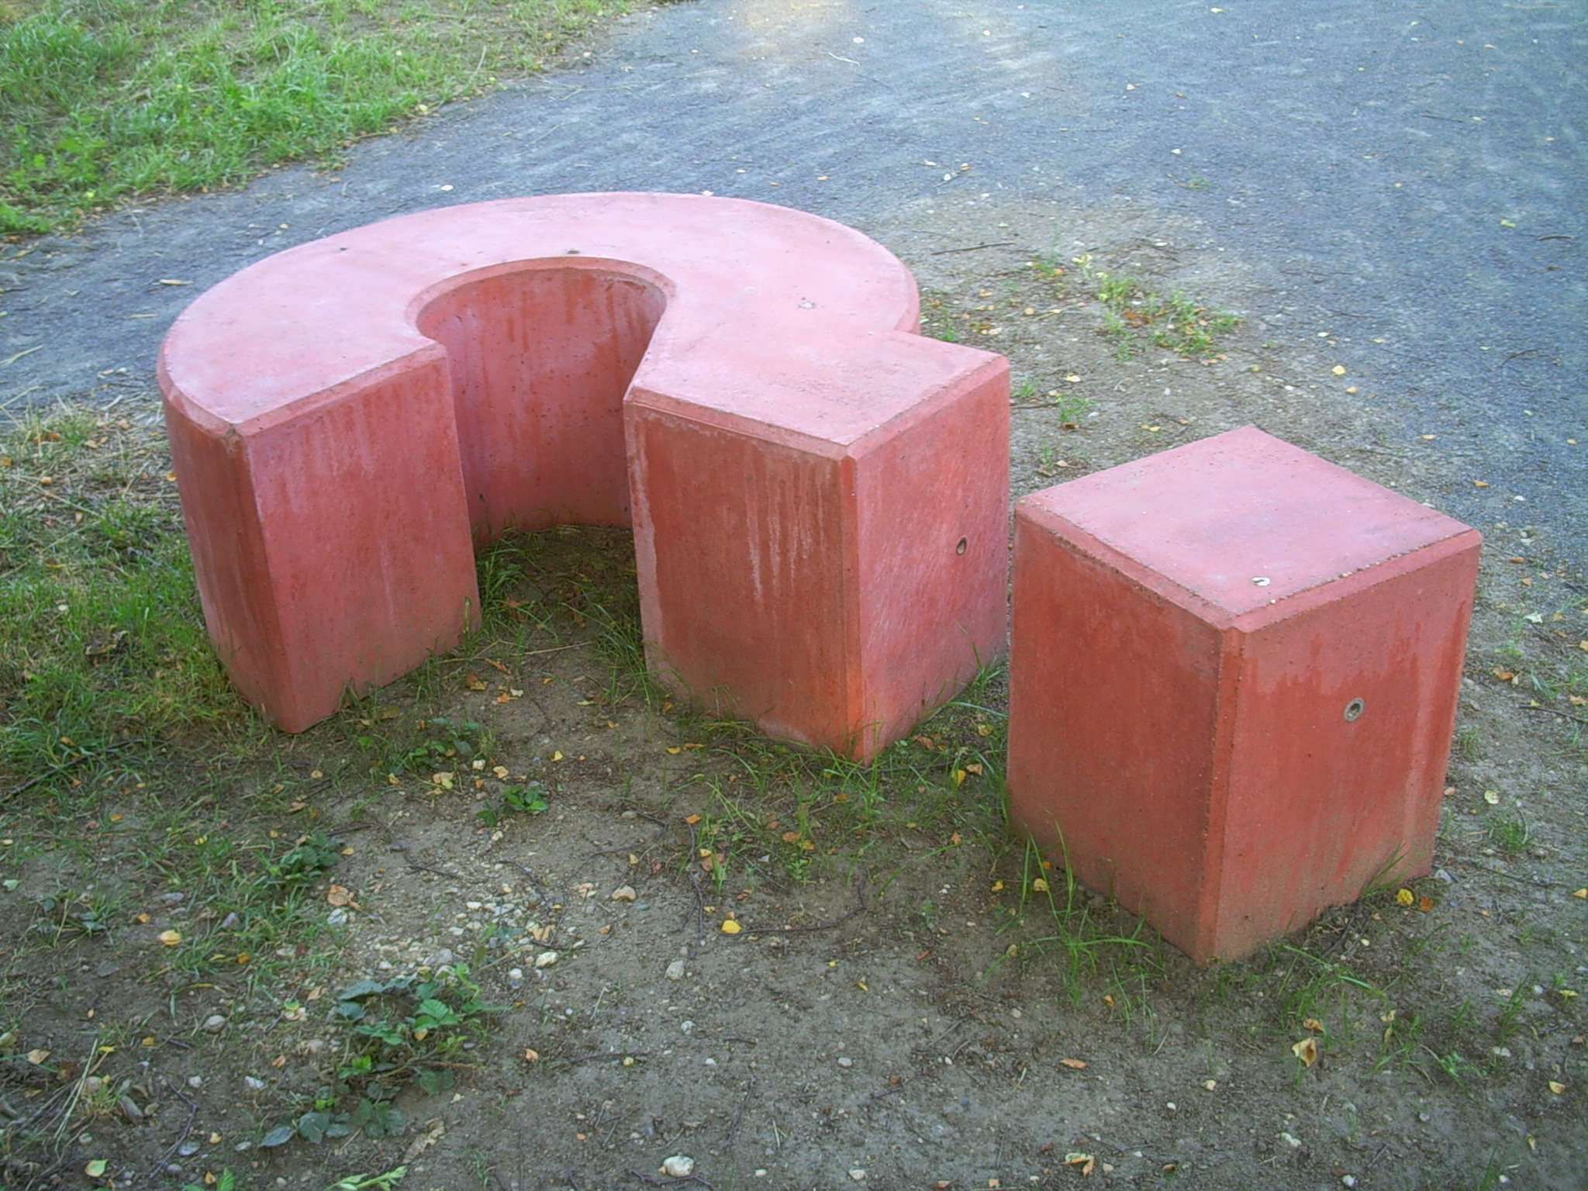
General issues cont.
Data from LibAnswers
Anecdotal evidence via liaisons that faculty are asking questions about accessing specific titles
Liaisons themselves are not sure who to go to for questions:
We do not have a system in place for general e-book troubleshooting
We do have an Acquisitions Helpdesk link for accessibility related issues
“Question mark in Esbjerg” by Alexander Henning Drachmann
http://www.flickr.com/photos/drachmann/327122302/lightbox/
Notes:
CINTHYA: We’ve also heard from liaisons that they are getting questions from faculty about how to use e-books and we don’t have a good system in place for referring them to additional support. While we can troubleshoot accessibility issues such as links to titles we should own, there is no one area of the libraries that deals with the other sets of problems, such as vendor imposed limits on checking items out, formatting/printing and self-service options for more advanced users.

Slide 9

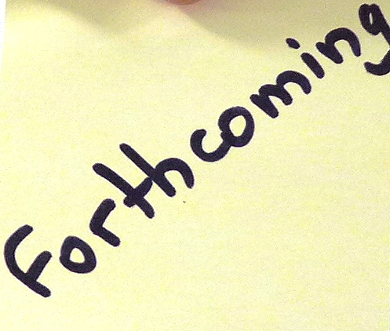
General issues cont.
Data from e-book research at UMD in 2012
Survey was distributed to three colleges:
Arts and Humanities
Behavioral and Social Sciences
Education
Goals for the survey:
Preferred book format for using different types of materials (e.g., scholarly monographs, edited collections, reference works, etc.),
Issues in identifying, accessing, and using e-books
Suitability of e-books to research methods in these disciplines
Preliminary results available at http://hdl.handle.net/1903/12875
Article publication is in Project MUSE
Notes:
NEDELINA: This survey was conducted by our colleagues with the aim to determine how familiar users were with our e-book collection, how they used our e-books and what issues they identified.

Slide 10
Questions 8 and 9: Compared to three years ago, my use of e-books for Research/Recreational Reading has _____.
Increased
Stayed the Same
Decreased
Hackman, T. & Corlett-Rivera, K. (2012). Faculty & Student Use and Opinions of E-Books at UMD. Brown bag presentation for the Library Faculty Research Fund Committee, UMD Libraries, College Park. Available at http://hdl.handle.net/1903/12875
Notes:
NEDELINA: One of the questions asked in the survey was (read the slide).
A summary of the results indicate that:
Research: Overall, 60% use e-books for Research at least once a semester or more
Recreational Reading: Just over 50% use e-books for Recreational Reading at least once a semester or more

Slide 11
Question 18: Please share any additional comments or suggestions on e-books at the UMD Libraries.
Top 8 Responses
Hackman, T. & Corlett-Rivera, K. (2012). Faculty & Student Use and Opinions of E-Books at UMD. Brown bag presentation for the Library Faculty Research Fund Committee, UMD Libraries, College Park. Available at http://hdl.handle.net/1903/12875
Notes:
NEDELINA:
When our colleagues tabulated the “Other” responses, they had both positive and negative responses about the e-books. What is interesting to note is that the largest percentage of 22% comes from user who don’t know about e-books and 21% are not sure what to say about e-books, and another 13% prefer print.
On the other hand, as you see from the graph, 16% of respondents are looking for more e-books to be available and accessible through our library system.

Slide 12
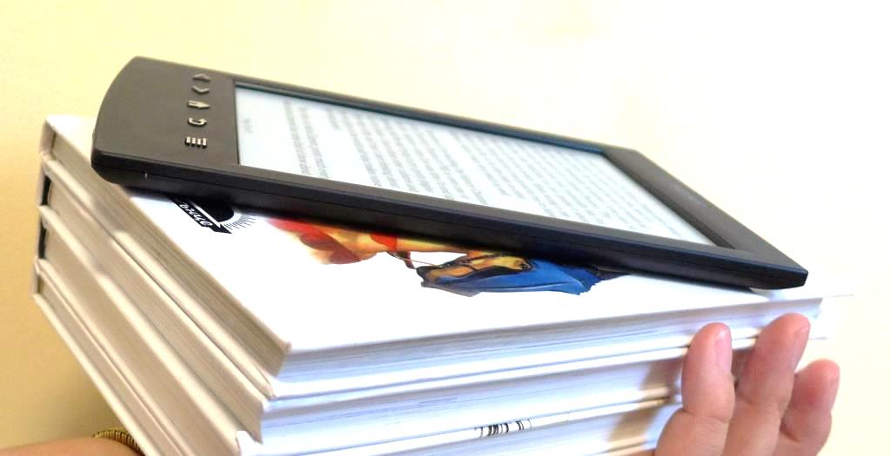
Internal Usability Project -Background
Goals
Test titles on our own so we can identify issues
Become comfortable with a variety of readers, vendors and platforms
Collect data and apply it towards more strategic efforts to assist our users
Contribute to an overall improved “user experience” for our e-book collections
Volunteer group from across various units – 12 people
Notes:
CINTHYA: We decided to take a more structured approach to this issue and instead of having one person take on this responsibility, we asked for volunteers. We were able to provide readers for all those who did not already have them and we decided that we first needed to put ourselves in the shoes of the users and test everything out. Here are the goals we had.
NEDELINA: We decided to use the survey results to come up with a list of the most popular mobile devices our users own.

Slide 13
Question 10: Do you own any of the following e-book readers?
All Responses
Hackman, T. & Corlett-Rivera, K. (2012). Faculty & Student Use and Opinions of E-Books at UMD. Brown bag presentation for the Library Faculty Research Fund Committee, UMD Libraries, College Park. Available at http://hdl.handle.net/1903/12875
Notes:
NEDELINA: Great! (compare the audience results with the ones from the survey)
According to the survey, half of the respondents DO NOT own an e-reader, and the other half – DO. From the group that have e-readers, the most popular was Kindle, Nook and iPad.

Slide 14
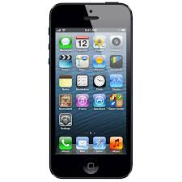
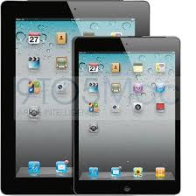
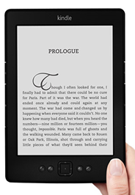
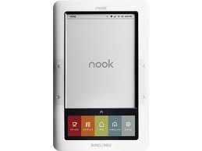
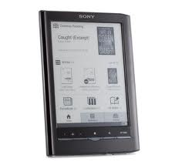
Internal Usability Project - Process
Group met and identified the following needs:
Specify what vendors and titles to test
Have a good variety of devices
Try to “break” each e-book and test all possible options
Each person should be testing every title
We will then combine results from those who are using the same or similar devices for a comprehensive look at all the issues based on vendors, platforms and readers
Readers/Devices Used
iPhone 5
iPad or other tablet (Dell tablet and Android)
iPad mini
Kindle
Nook
Sony
Microsoft surface
Notes:
CINTHYA: So, the group met and decided to test the following devices.

Slide 15
Question 13: Which of the following e-book collections
have you used in the past year?
Hackman, T. & Corlett-Rivera, K. (2012). Faculty & Student Use and Opinions of E-Books at UMD. Brown bag presentation for the Library Faculty Research Fund Committee, UMD Libraries, College Park. Available at http://hdl.handle.net/1903/12875
Notes:
NEDELINA: Again, as I mentioned earlier, we used some of the survey results to guide our planning and testing. We identified e-book titles from the vendors listed on this slide and came up with a list of titles for testing (CLICK for next slide).

Slide 16
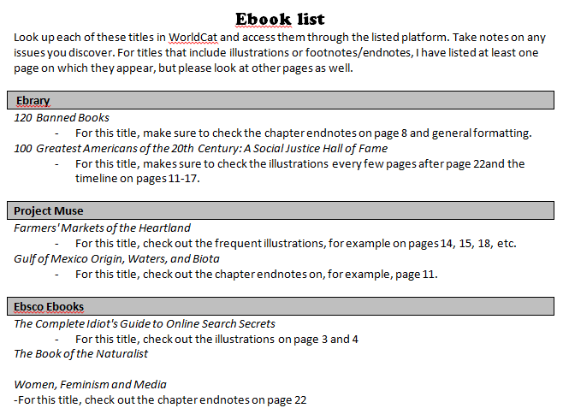
Internal Usability Project - Process
Title List
Notes:
CINTHYA: We tried to get a good variety of vendors, titles, types of books and topics as well as books with footnotes and illustrations to make it as “difficult” as possible.

Slide 17

Internal Usability Project - Process
Questions to answer
What is the time limit?
What happens when you reach the time limit?
Can you download the entire book at once?
Can you download the entire chapter at once?
Is there a download amount limit?
Do you need 3rd party software to access the item?
Do you need separate hardware to access the item?
How many simultaneous users are allowed?
How do images show up?
Are there any formatting issues?
Can the reader take notes or highlight?
How are footnotes displayed?
Is keyword searching possible?
Can the notes and highlighting be saved?
Can content be accessed from off campus?
Do out-of-copyright books have different limits?
Is the help page helpful?
What is the file format of the e-book?
Can you zoom?
Does the vendor allow printing and if so, can you print from the device itself?
Referred question to DSS
Other notes
Notes:
CINTHYA: Go over questions. We also agreed that we would contact our IT Helpdesk (DSS) in case we got really stuck.

Slide 18
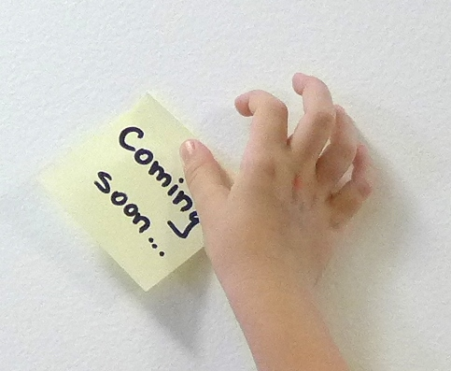
Internal Usability Project - Results
Notes:
NEDELINA: The group hasn’t finished testing their devices yet, as we will be meeting again later this month. But my experience with Sony Reader revealed that this device is better used for recreational reading rather than research. The screen is black & white and in the sciences, there are many colorful pictures that can’t be viewed in their fullest on this device. Also, most of our e-books can be downloaded as .pdfs and the screen resolution is not very good.
CINTHYA: The iPad was very easy to use and most of the issues revolved around vendor limitations placed on titles and features as opposed to iPad related issues. There was no distinguishable difference between using a desktop computer and the iPad except for the obvious functionality challenges that come with the iPad such as typing and screen size.

Slide 19
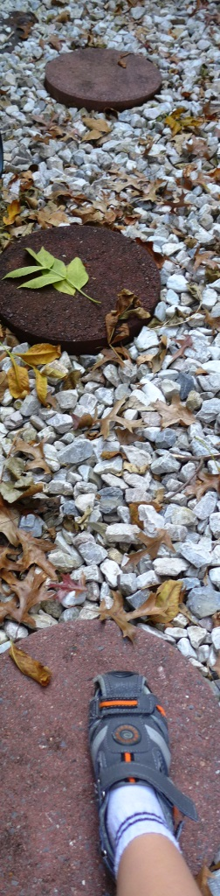
Next steps
Create a troubleshooting guide
Host an e-book open house in Spring 2014 based on a “petting zoo” approach:
Users bring their own devices to get them set up
We can troubleshoot on the spot
Help them pre-load specific titles
Notes:
CINTHYA: Next steps will include the testers who had the same devices getting together to come up with a guide for that particular device. This will turn into a master guide that will be available online similar to what other institutions are doing. In addition, thanks to our colleague Robin Dasler’s idea, we will hold an open house in the Spring to allow users to get their readers ebook ready. It will involve on-the-spot troubleshooting help, access to our documentation as well as a chance to test out other devices. If they have specific titles they want, we will also help them get access to them.

Slide 20
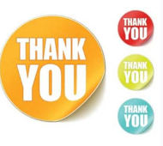
Acknowledgments
Thank you to these individuals who are testing the devices and writing the instructions for troubleshooting e-books readers….
Uche Enwesi
Paula Greenwell
Stacey Grijalva
Kevin Hammett
Eileen Harrington
Cynthia Larimer
Johnnie Love
Christine Morris-Sumlin
Toni Negro
Joshua Westgard
Robin Dasler
… and for the idea of a “petting zoo” approach…
Notes:
CINTHYA: We wanted to thank the following people!

Slide 21
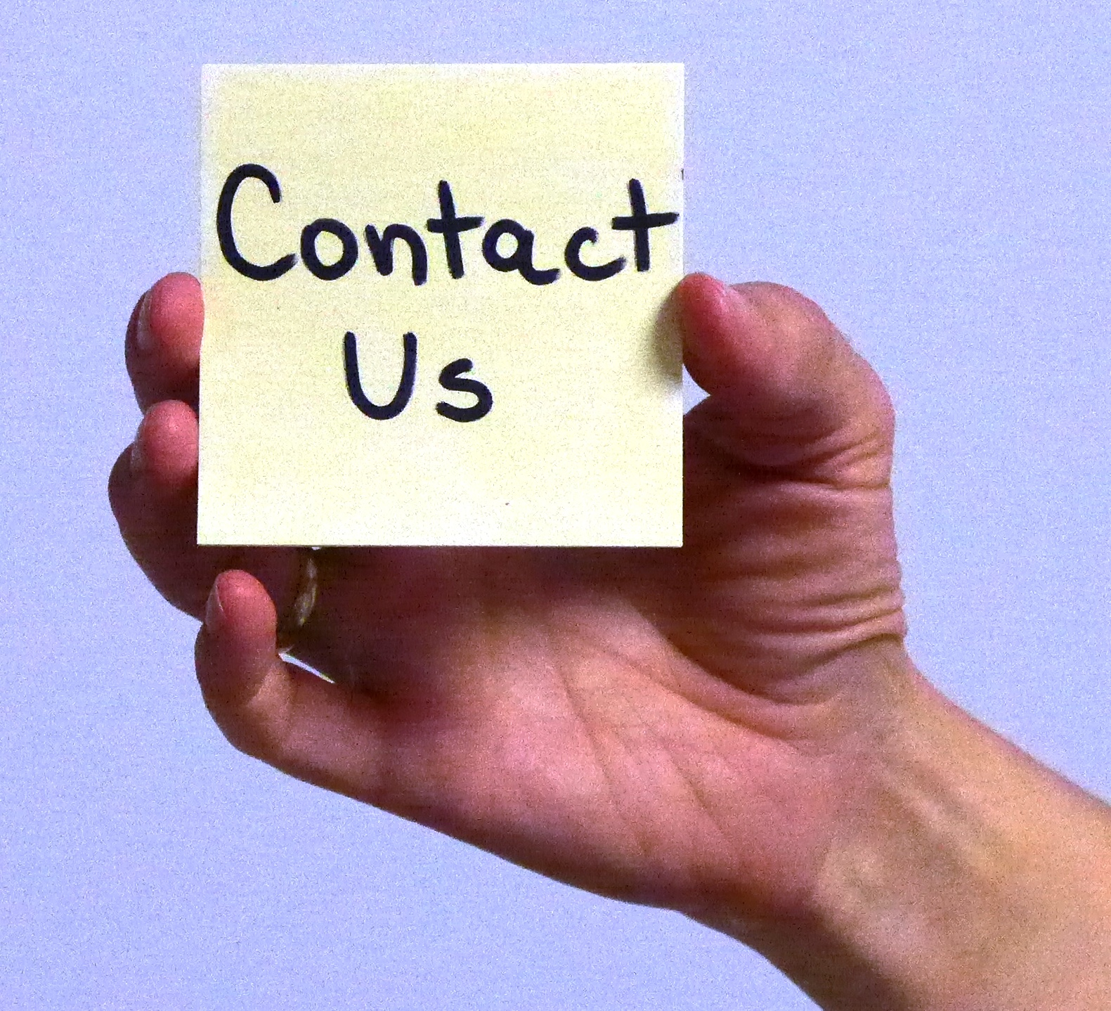
Thank you!
Questions now?
Or later… Contact us:
Cinthya Ippoliti, cippol1@umd.edu
Head, Teaching and Learning Services
McKeldin Library
Nedelina Tchangalova, nedelina@umd.edu
Physical Sciences and Public Health Librarian
Engineering & Physical Sciences Library
Notes:
NEDELINA: Thank you for being such good listeners! Now, the floor is open for questions.
CINTHYA: If you are too shy to ask your question now, contact us later. Here is our contact information.

