Slide 1
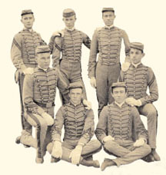
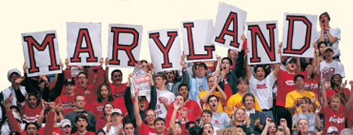
HIST 429F: History of the University of Maryland
The Good, the Bad, and the Ugly
Notes:
TODAY I WILL BE DESCRIBING THE COLLABORATION OF THE UNIVERSITY OF MARYLAND ARCHIVES WITH OUR HISTORY DEPARTMENT AND 1 OF THE VISIBLE PRODUCTS OF THIS COLLABORATION, A STUDENT POSTER SESSION AT OUR UNIVERSITY-WIDE OPEN HOUSE.
JASON SPECK, OUR MODERATOR FOR TODAY, AND I SERVED AS CO-INSTRUCTORS FOR THIS CLASS, WHICH WE TAUGHT FOR THE FIRST TIME IN SPRING 2014.

Slide 2
The Good
History Dept. took little persuading to let us teach course
Class offered at 400-level
Class generated a lot of excitement among students and campus staff
Decent-sized enrollment for a new class
Number of students from Maryland Images, our campus tour guides
High-ranking UM administrators as guest speakers
Notes:
CLASS HAD ALWAYS BEEN A DREAM OF THE UNIVERSITY ARCHIVES. JUST TOOK A LITTLE PERSUADING FROM ONE OF THE SENIOR MEDIA SPECIALISTS IN UNIVERSITY COMMUNICATIONS FOR US TO GET OFF THE DIME. WHEN WE APPROACHED THE HISTORY DEPARTMENT CHAIR, HE ACTUALLY NEEDED LITTLE CONVINCING TO LET US START THE CLASS. WE HAD BEEN READY FOR A FIGHT WITH ALL SORTS OF GOOD ARGUMENTS, WHICH IN THE END WE DIDN’T NEED.
CLASS WAS OFFERED AT 400-LEVEL, SO BOTH GRADUATE AND UNDERGRADUATE STUDENTS COULD TAKE IT. MANY STUDENTS AND STAFF MEMBERS TO WHOM WE TALKED ABOUT THE CLASS WERE VERY EXCITED ABOUT IT. DECENT-SIZED ENROLLMENT FOR NEW CLASS.
GOOD CHANCE TO GIVE MD IMAGES STUDENTS SOLID INFORMATION ABOUT UMD HISTORY, SO THEY WOULDN’T KEEP REPEATING MIS-INFORMATION PASSED DOWN TO THEM OVER THE YEARS.
READY AGREEMENT FROM ALL OUR INVITED GUEST SPEAKERS—USM CHANCELLOR, 2 VICE PRESIDENTS AND 1 FORMER VICE PRESIDENT, MAYOR OF THE CITY OF COLLEGE PARK, WHERE THE UNIVERSITY IS LOCATED, DIRECTOR OF ATHLETICS
THERE WERE A LOT OF POSITIVES THAT WE TOOK AWAY FROM THE FIRST ITERATION OF THE CLASS.

Slide 3
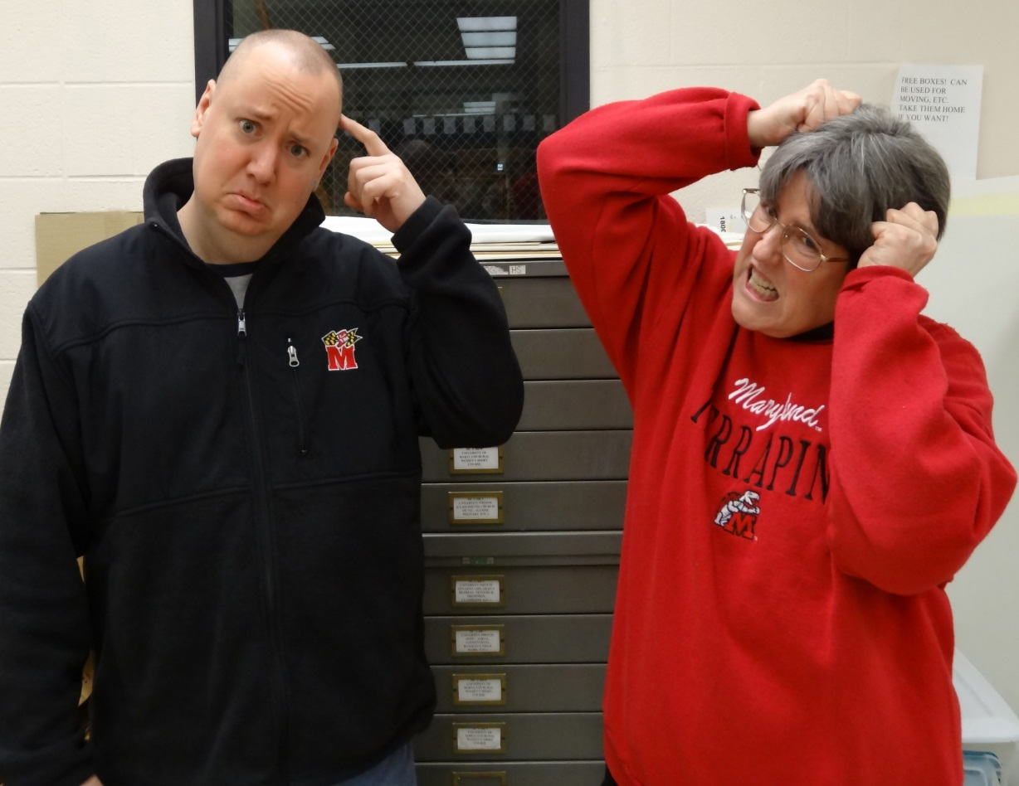
The Bad
Little support
from History
Dept. for course
preparation
Students looking
for an easy “A”
Students didn’t
do readings
Original research paper a mostly
failed experiment
Notes:
WE HAD LITTLE SUPPORT FROM THE HISTORY DEPARTMENT FOR COURSE PREPARATION—NO REAL GUIDANCE ON CRAFTING A SYLLABUS, FOR EXAMPLE, AND THE CONTACTS WE HAD WITH A FULL-TIME HISTORY DEPARTMENT FACULTY MEMBER WHO WAS SUPPOSED TO BE ASSISTING US WITH PREP WERE SPORADIC, WITH LONG SILENCES IN BETWEEN
WE ENDED UP WITH A LOT OF STUDENTS LOOKING FOR AN EASY “A,” WHICH WAS FRUSTRATING, AND WE WERE ABLE TO DETERMINE THROUGH OUR COURSE MANAGEMENT SYSTEM THAT MOST OF THE STUDENTS WERE NOT DOING THE ASSIGNED READINGS
ORIGINAL RESEARCH PAPER ASSIGNMENT WAS MOSTLY A FAILED EXPERIMENT—EVEN THOUGH WE MADE STUDENTS PICK THEIR TOPICS EARLY IN THE SEMESTER, AND WE KEPT TELLING THEM THAT THE RESEARCH WOULD TAKE A LOT LONGER THAN THEY COULD IMAGINE. WE ENDED UP RE-DESIGNING THE FINAL PAPER ASSIGNMENT AT MID-SEMESTER.
WE WERE DETERMINED TO MAKE THE CLASS WORK AND MADE MANY ADJUSTMENTS TO OUR DOCUMENTATION, OUR ASSIGNMENT LIST, AND OUR TEACHING PHILOSOPHY AS THE SEMESTER PROGRESSED.

Slide 4
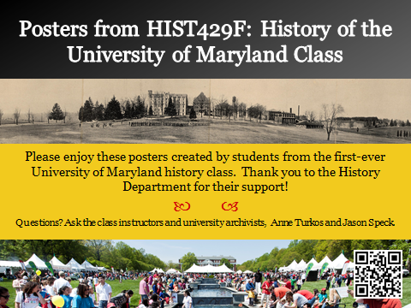
The Poster
Notes:
ONE OF THE GOALS FOR THE CLASS ABOUT WHICH THE HISTORY DEPARTMENT WAS QUITE FIRM WAS THAT THE DEPARTMENT WANTED TO HAVE A VISIBLE OUTCOME OF THE CLASS TO SHARE WITH THE 75,000-90,000 VISITORS TO CAMPUS ON MARYLAND DAY, OUR CAMPUS –WIDE OPEN HOUSE HELD THE LAST SATURDAY IN APRIL EACH YEAR. WE CHOSE TO HAVE OUR STUDENTS DIVIDE INTO SMALL GROUPS AND CREATE A POSTER ABOUT A UMD HISTORICAL TOPIC OF THEIR CHOICE.
AND THIS IS WHERE THINGS WENT FROM BAD TO UGLY.

Slide 5
The Ugly
Glue stuff to posterboard???
Struggles with design phase
Pushback about cost of producing poster
Poster quality a bit uneven
Some students didn’t pay attention to which version of poster they printed
Notes:
WE KNEW WE WERE IN TROUBLE WHEN WE INTRODUCED THIS ASSIGNMENT IN CLASS, AND 1 STUDENT ASKED IF THEY COULD GLUE STUFF TO POSTERBOARD.
SOME STUDENTS STRUGGLED A BIT WITH THE DESIGN PHASE, BUT EVERYONE ENDED UP WITH A DECENT-LOOKING POSTER, ALTHOUGH THE QUALITY WAS A BIT UNEVEN.
THERE WAS A BIT OF CONCERN ABOUT THE COST OF PRINTING AND MOUNTING THE POSTER. WE REMINDED THE CLASS THAT THEY HAD NOT HAD TO BUY A TEXTBOOK FOR THIS COURSE, AND THAT THERE WERE 3 MEMBERS IN EACH GROUP TO SHARE THE COSTS INVOLVED.
IN THE RUSH TO FINISH UP FOR THE IN-CLASS PRESENTATION, SOME STUDENTS DIDN’T END UP PRINTING THE VERSION OF THEIR POSTER THAT CONTAINED THE FINAL CORRECTIONS THAT JASON AND I MADE.

Slide 6
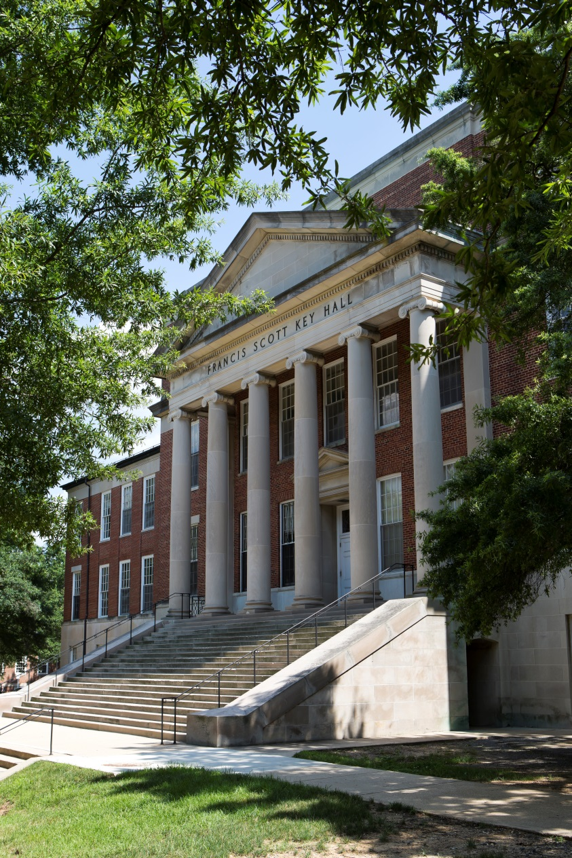
The Ugly
Publicized poster location was indoors in Key Hall on a beautiful day
Room number listed in program turned out to be a janitor’s closet
Scrambled to get room change publicized on Maryland Day
Notes:
ONCE WE HAD THE POSTERS IN HAND, THEN THINGS GOT EVEN MORE UGLY. THE HISTORY DEPARTMENT’S ATTEMPTS TO PUBLICIZE OUR POSTER SESSION REALLY FELL FLAT. THE LOCATION PUBLICIZED IN THE PRINT PROGRAM AND ON THE MARYLAND DAY WEBSITE WAS INDOORS, ON WHAT TURNED OUT TO BE A GORGEOUS SPRING DAY, AND WE WERE THE ONLY EVENT SCHEDULED IN THAT BUILDING, ON THE SECOND FLOOR, NO LESS.
THERE WAS A GREAT DEAL OF CONFUSION OVER WHICH ROOM WE WERE SUPPOSED TO USE, AND THE ROOM NUMBER MOST WIDELY PUBLICIZED TURNED OUT TO BELONG TO A JANITOR’S CLOSET. THERE WAS A SIGNIFICANT SCRAMBLE ON MARYLAND DAY TO REDIRECT VISITORS SEEKING THE POSTER DISPLAY TO THE LOBBY OF OUR SPECIAL COLLECTIONS LIBRARY.

Slide 7
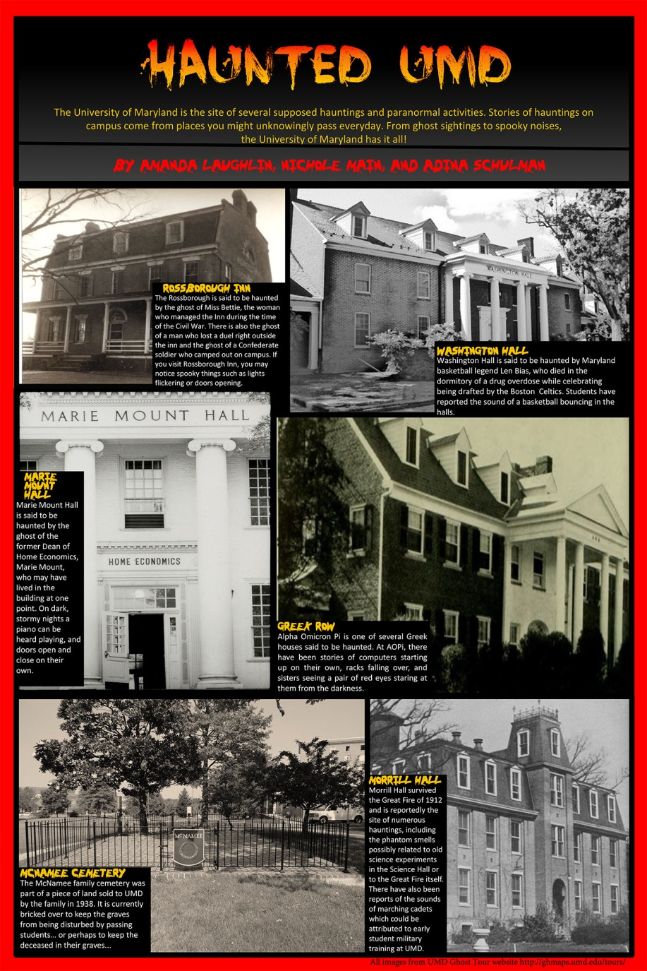
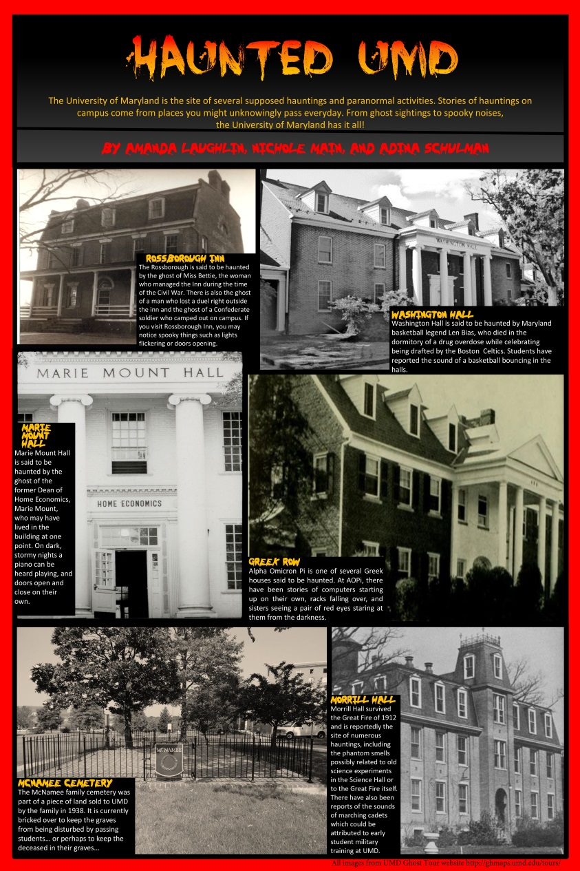
Good Wins Out
Poster project got students thinking about UMD history in a more creative way than just writing a paper
Notes:
DESPITE ALL THOSE CHALLENGES ON MARYLAND DAY, THE POSTER SESSION WAS VERY SUCCESSFUL. THE PROJECT GOT OUR STUDENTS THINKING ABOUT UMD HISTORY IN A MORE CREATIVE WAY.

Slide 8
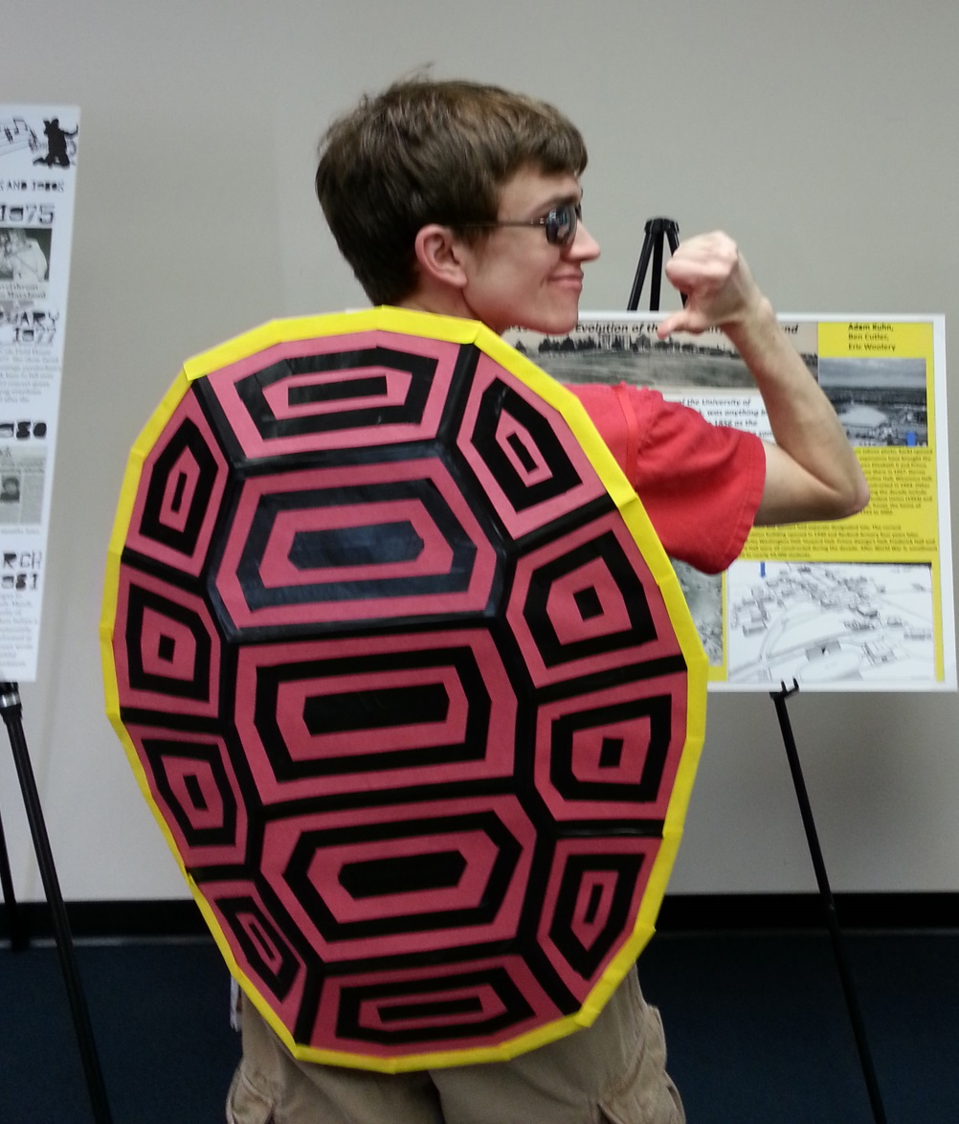
Posters a Hit
Posters the students created were very popular on Maryland Day
Student Union staff wanted posters for display during Homecoming Week
Notes:
POSTER DISPLAY WAS VERY POPULAR ON MARYLAND DAY. MANY PEOPLE STOPPED BY, NOT JUST OUR STUDENTS AND THEIR FAMILIES.
STUDENT UNION STAFF REQUESTED POSTERS FOR DISPLAY IN THE UNION DURING HOMECOMING WEEK. HOPING THIS BECOMES AN ANNUAL EVENT.

Slide 9
Good Wins Out
Class was successful—many positive evaluations
History Dept. asked us to teach again, and we were able to redesign the course
History Dept. wants to hard-number course into catalog so it becomes a permanent part of the curriculum
Have more students this semester, including 1 grad student
No snafu with location of poster session in 2015!
Notes:
CLASS WAS SUCCESSFUL—62.5% OF STUDENTS (15 OF 24 STUDENTS) SUBMITTED AN ONLINE EVALUATION—MANY CITED THAT THEY HAD LEARNED A LOT FROM THE CLASS AND SOME SAID IT WAS THE BEST CLASS THEY HAD EVER TAKEN AT MARYLAND
WE WERE ASKED TO TEACH AGAIN AND WERE ABLE TO RE-DESIGN THE COURSE TO BUILD IN MORE GUIDED, HANDS-ON TIME IN THE ARCHIVES, SO THERE’S LESS FLOUNDERING AND MORE CHANCE OF SUCCESS.
WILL BE WORKING WITH THE HISTORY DEPARTMENT TO HARD-NUMBER THE COURSE.
CLASS IS FULLY SUBSCRIBED THIS SEMESTER—30 STUDENTS
POSTER SESSION IS SCHEDULED IN OUR LIBRARY THIS YEAR, SO WE WILL AVOID THE JANITOR’S CLOSET!

