Slide 1
Performance of Link Slab Using ECC and UHPC
University of Maryland, College Park
Spring 2019
Naiyi Li
Advisory Committee:
Dr. Chung C. Fu, Chair
Dr. Allison Reilly
Dr. Brian M. Phillips

Slide 2
Introduction
Motivation
Objective
Methodology

Slide 3
Motivation
Overall condition of bridges in the United States is C+.
Approximately 40% of the bridges are at least 50 years old.
Bridge rehabilitation cost estimated to be $123 billion.
New solutions needed to improve bridge sustainability.

Slide 4
43
9.1%
188 million
Average age of bridges in the U.S.
Of the bridges are structurally deficient.
Trips on structurally deficient bridges every day.

Slide 5
Objective
Study link slab performance.
Investigate material properties of ECC and UHPC.
Verify ECC and UHPC are suitable for link slab application.
Test sensor systems.
Serve as a pilot project for future field test.
Come up with a plan for future field test.

Slide 6
Methodology
Lab test
Field Test
FEM Analysis

Slide 7
Literature Review
Link Slab
ECC
UHPC

Slide 8
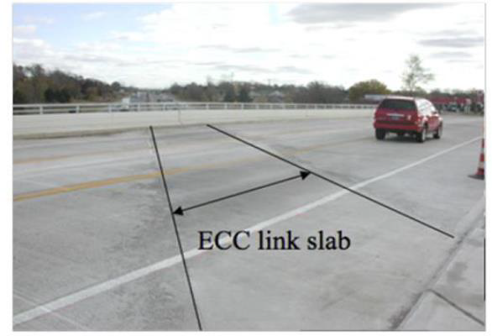
ECC
Engineered Cementitious Composites.
High tensile strength and ductility.
Compressive strength ranges from 4351psi to 13052psi.
Can be modified to meet specific requirements.

Slide 9
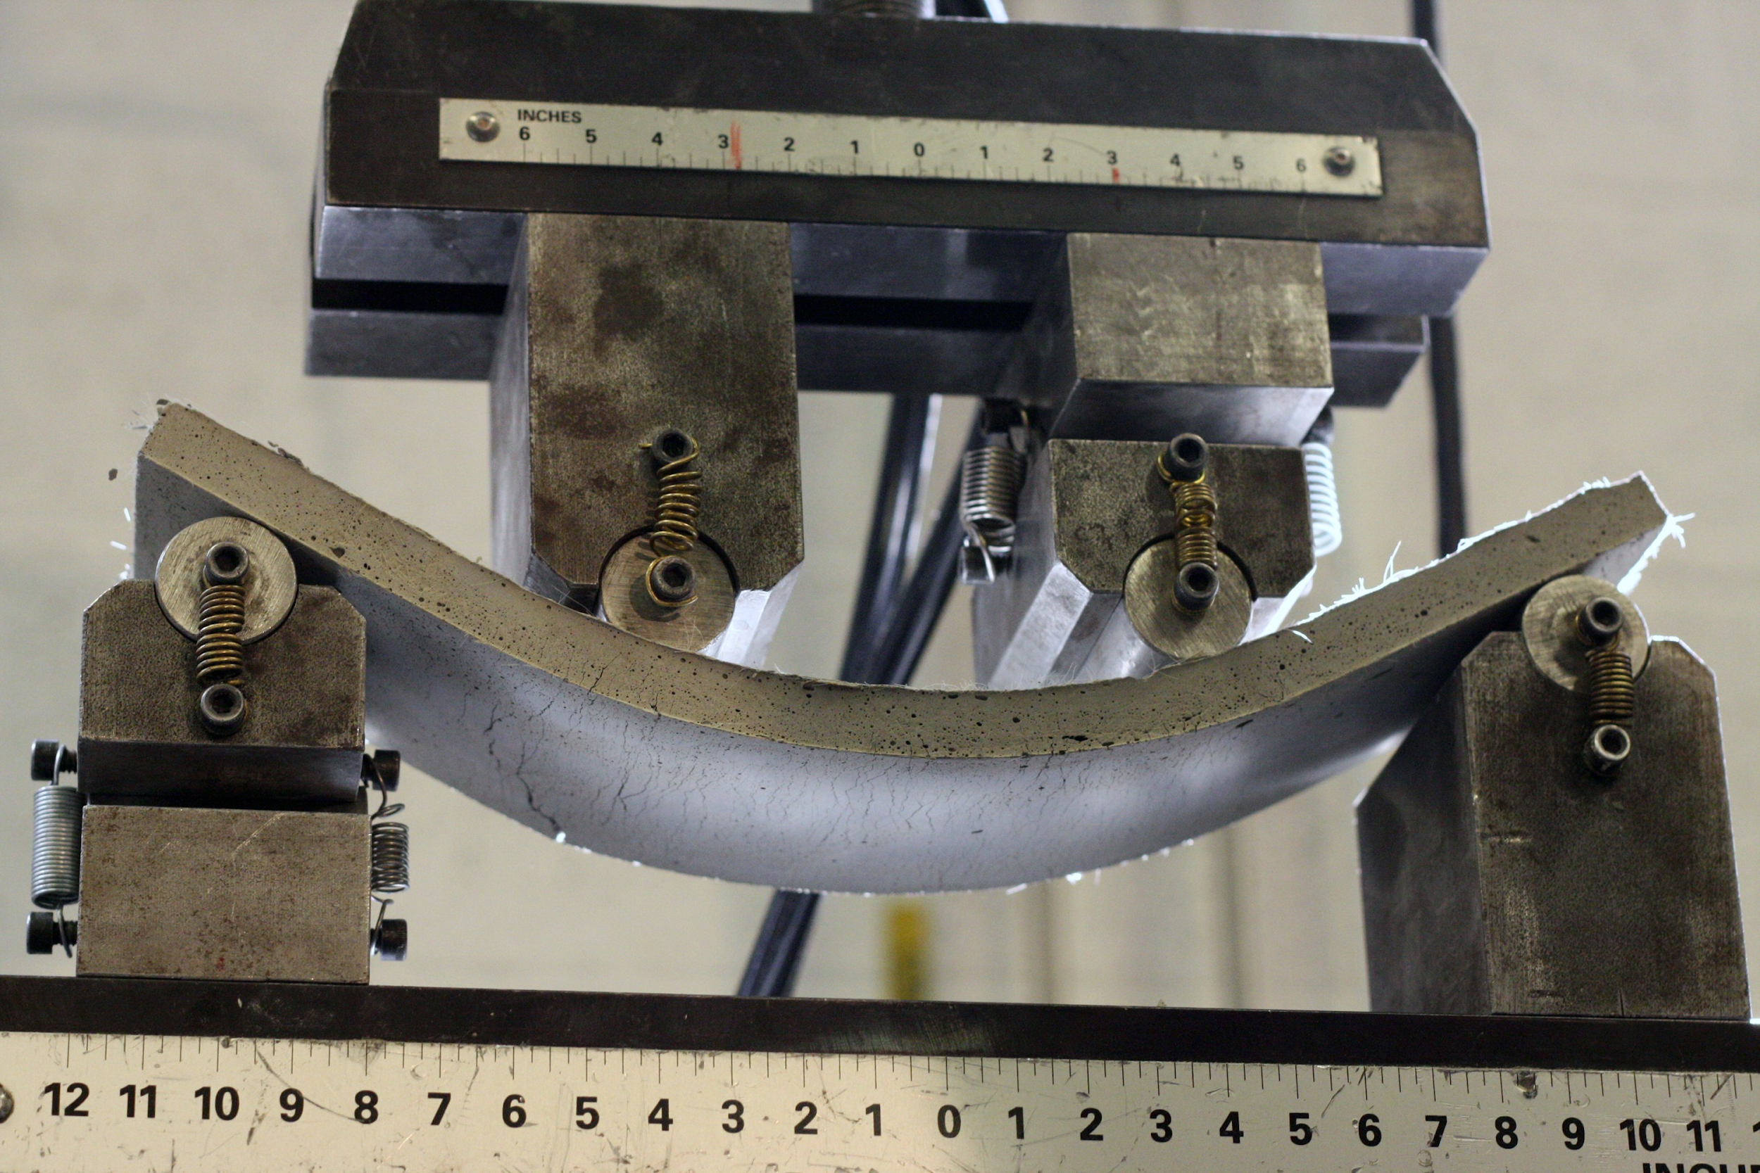
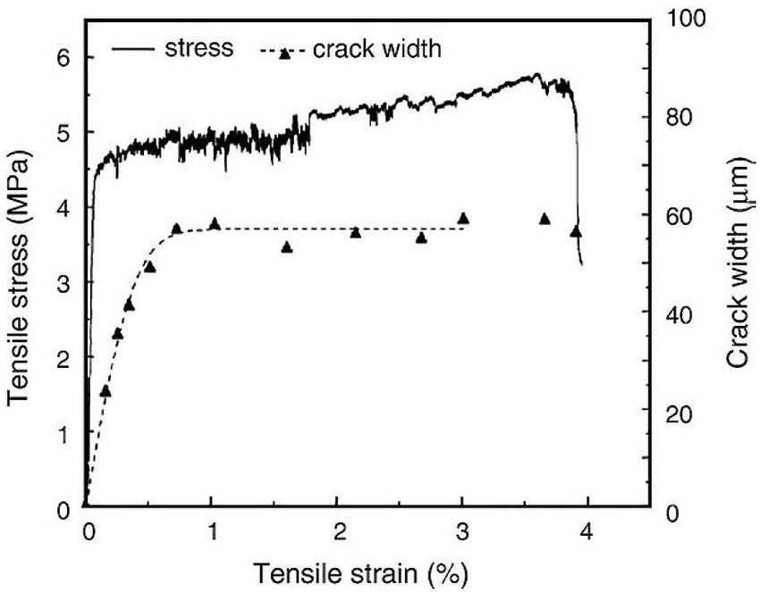
ECC
“Metal-like” behavior.
Deformation with large curvature.
First fine crack occur at “yield point”.

Slide 10
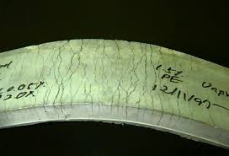
ECC
Fine crack development.
Alleviate damages by water penetration.
Protects girders and other substructures.

Slide 11
UHPC
Ultra-High-Performance Concrete.
Similar to ECC, but much stronger.
High tensile strength and ductility.
Compressive strength up to 29000psi.
Allows elimination or reduction of passive reinforcements.
Making the structure lighter and easier to be built.

Slide 12

UHPC
First UHPC bridge in the world.
Built in 1997 in Sherbrooke, Canada.
Sherbrooke footbridge, Canada

Slide 13
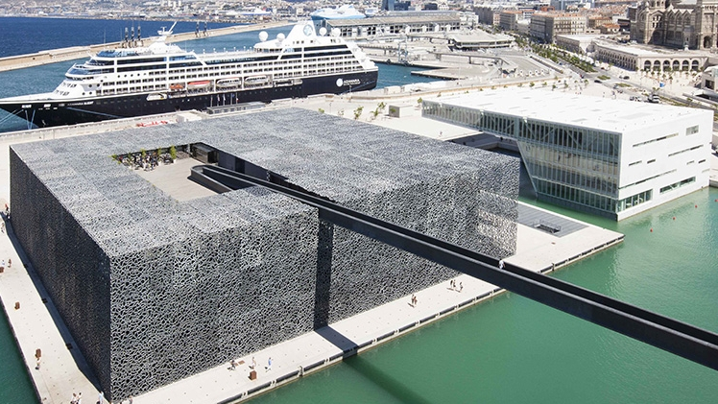

UHPC
Has been used in mass production.
Promote innovated and optimized shapes.
MuCEM museum in Marseille, France

Slide 14
Link Slab
Foundation work by Dr. Caner and Dr. Zia in 1998.
Critical problem in bridge:
Chloride-contaminated water penetration.
Debris accumulation.
Solution: replace expansion joints with link slab.
The bridge spans will remain simply-supported.
5% of debonded zone requried to reduce stiffness.

Slide 15
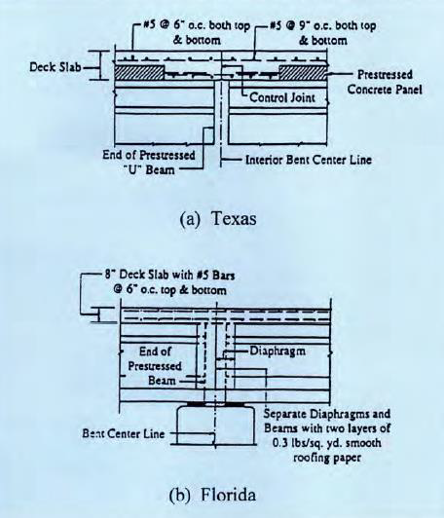
Link Slab
Typical jointless bridge configuration.

Slide 16

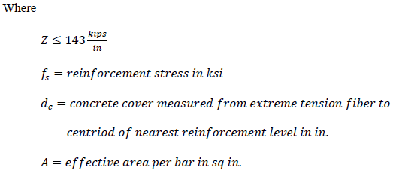
Link Slab
Crack control specifications according to AASHTO.
Acceptable to have cracks during mix.

Slide 17
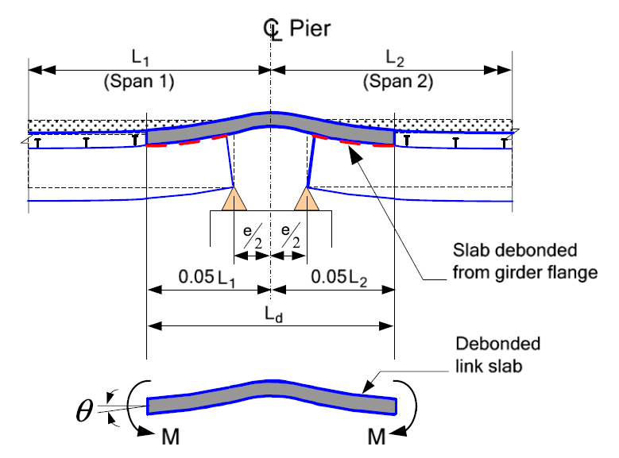
Link Slab
Subjected to girder end rotations.
Link slab is subjected to negative moments.
Deck spans become continuous.

Slide 18

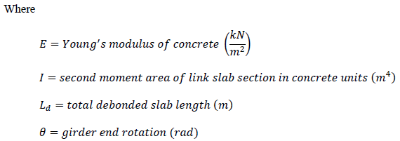

Link Slab
Determine Young’s modulus based on girder end rotations.
Account for compatibility between link slab and girder.

Slide 19
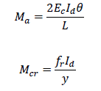
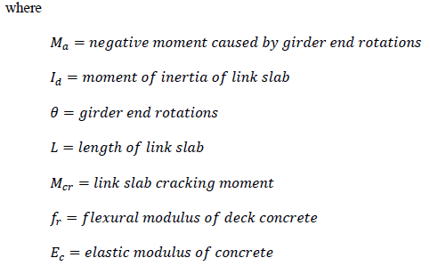
Link Slab

Slide 20
FEM Analysis
Objective
Bridge Description
FEM Models
Results

Slide 21
Objective
To obtain a preliminary assessment of bridge performance .
Create a platform for future implementation of link slab.
Only the super-structure will by included.
Bearing conditions modeled as boundary condition.
FEM programs:
Ansys® Workbench, Release 19.1
CSiNBridge®, Release 19.0

Slide 22
Bridge Description
An overpass bridge on Winch Road, crossing i-95.
215.5 feet long and 31.17 feet wide.
Four simply-supported spans with skell angle of 6.4 degrees.
Expansion joints considered as non-structural components.
Bearings are pins and rollers, no rotational restriction.

Slide 23
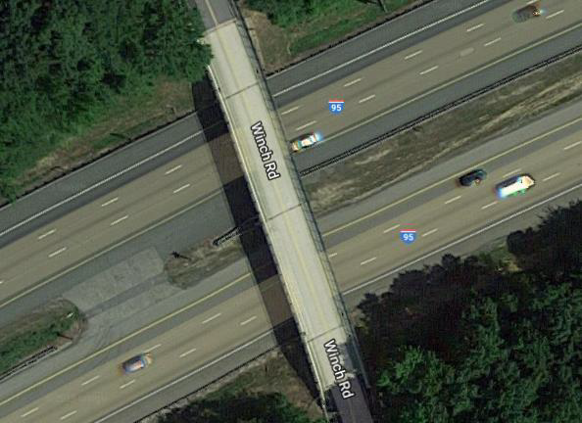

Bridge Description

Slide 24
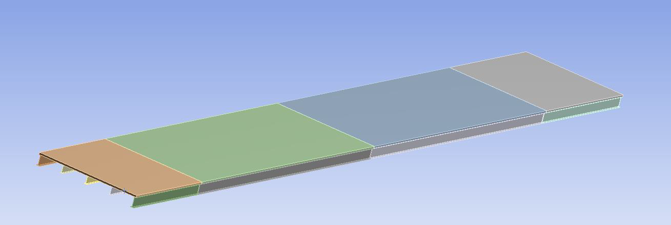
FEM Models Using Ansys® Workbench
Modeled using solid elements.
Numerical simulations focus on:
First six modal frequencies.
First three mode shapes.

Slide 25
FEM Models Using Ansys® Workbench
First six model frequency results.
Modes | Frequency (Hz)
1 | 2.5307
2 | 2.7159
3 | 3.0581
4 | 3.3124
5 | 5.8249
6 | 6.1092

Slide 26
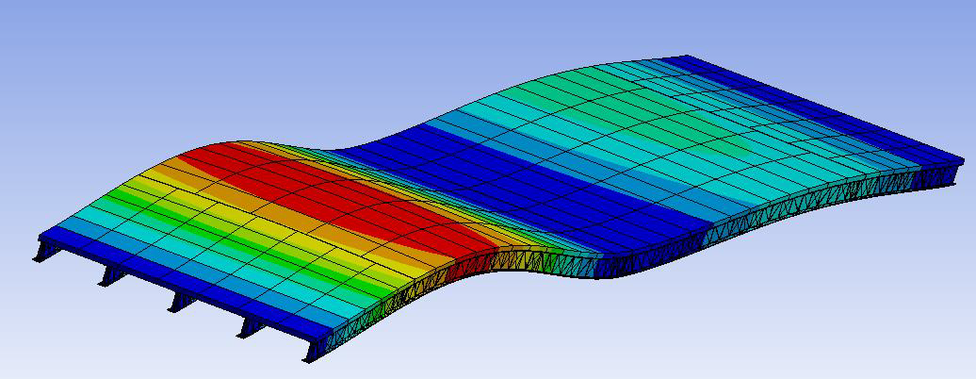
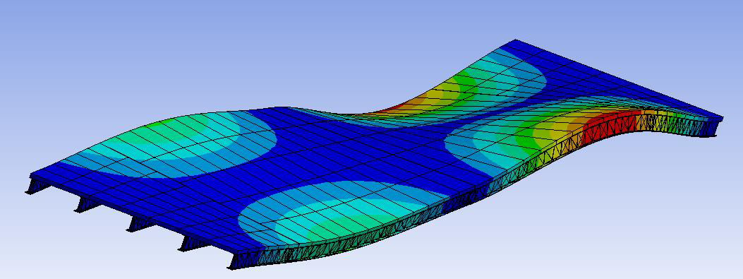
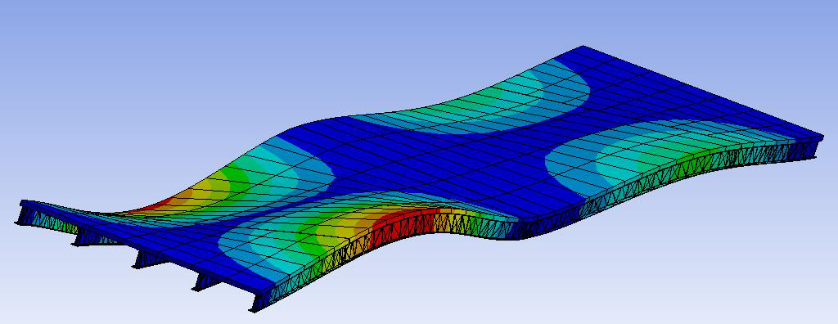
FEM Model Using Ansys® Workbench
First three mode shapes.

Slide 27
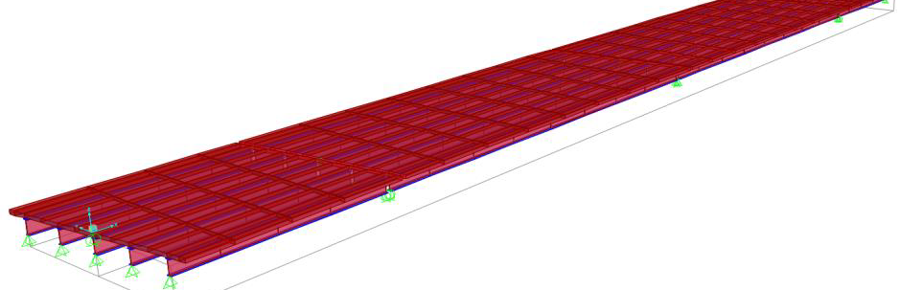
FEM Model Using CSiBridge®
Modeled as shell elements.
Production-oriented software.
Faster computation time.
Shell elements are less prone to negative Jacobian error.

Slide 28
FEM Model Using CSiBridge®
First six model frequency results.
Modes | Frequency (Hz)
1 | 2.4636
2 | 2.6572
3 | 3.6629
4 | 3.8235
5 | 7.5090
6 | 7.8355

Slide 29
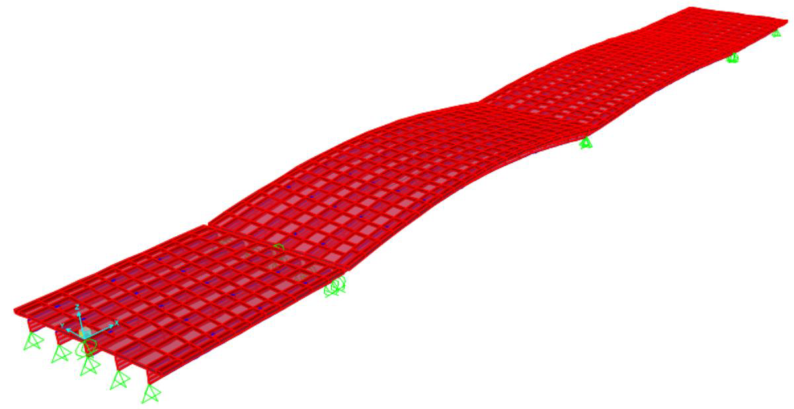
FEM Model Using CSiBridge®
First mode shapes.

Slide 30
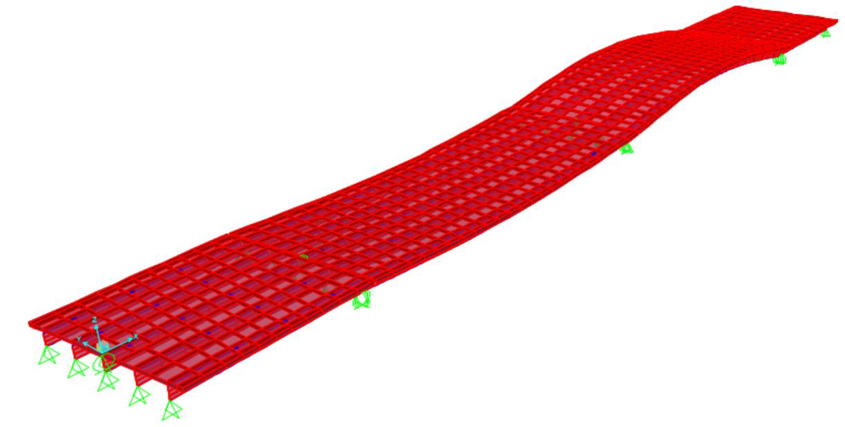
FEM Model Using CSiBridge®
Second mode shapes.

Slide 31
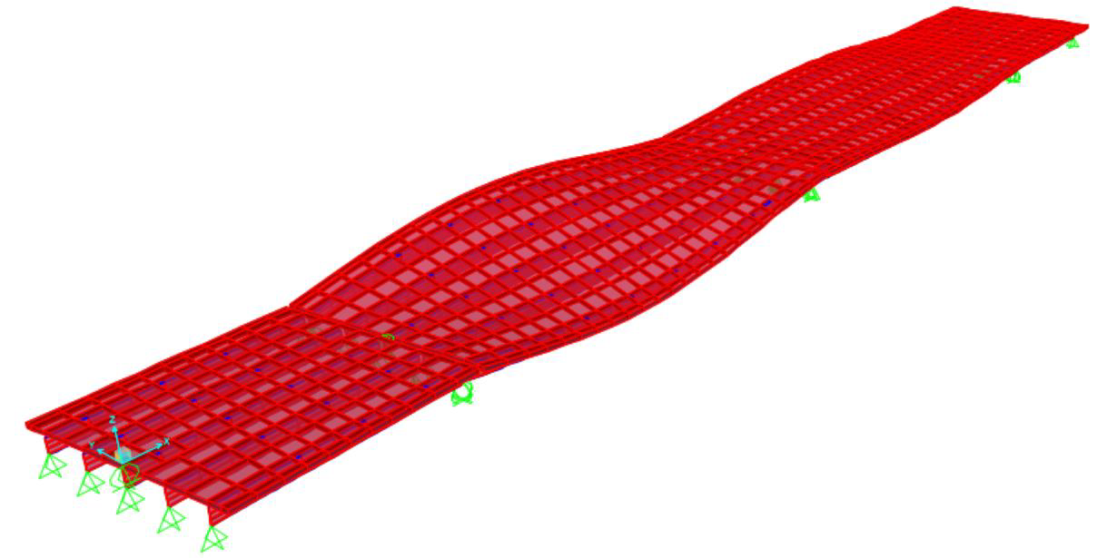
FEM Model Using CSiBridge®
Third mode shapes.

Slide 32
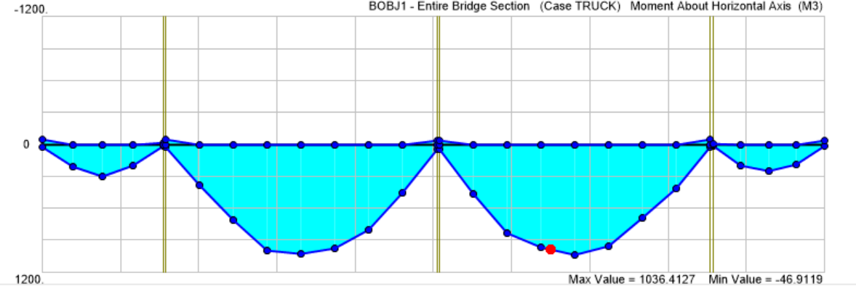
FEM Model Using CSiBridge®
Maximum moment envelope under truck load.
Maximum positive moment is 1036.41 kip-ft.
Maximum negative moment is 46.92 kip-ft.

Slide 33
Experiments
Objective
Sensor system
Procedure

Slide 34
Objective
To obtain a hands-on experience on ECC and UHPC mix design.
Test material properties.
Investigate sensor reliability.
Come up with recommendations on future field test and long-term monitoring.

Slide 35
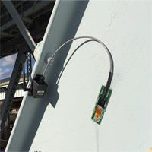
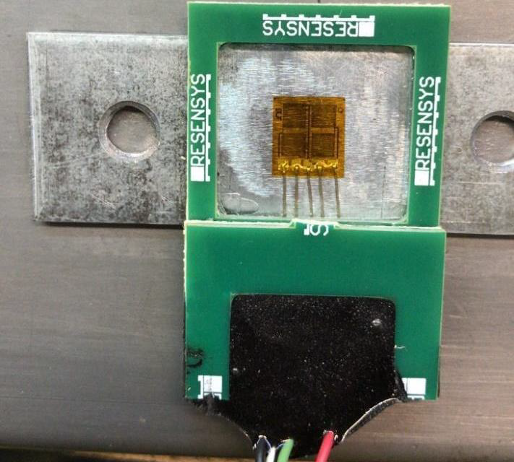
Sensor System
SenSpotTM strain gauge provided by Resensys LLC.
To simulate working condition of the sensors.
Two types of sensor configuration:
Strain gauge directly installed on concrete.
Strain gauge mounted on steel plate.

Slide 36
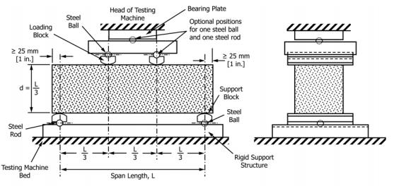
Procedure
Fourteen link slab specimens casted.
Specimens were subjected to three-point bending test following ASTM C78/C78M-18.
35 sensors were installed on 14 specimens.

Slide 37
Field Test
Sensor Layout
Data Acquisition
Construction

Slide 38
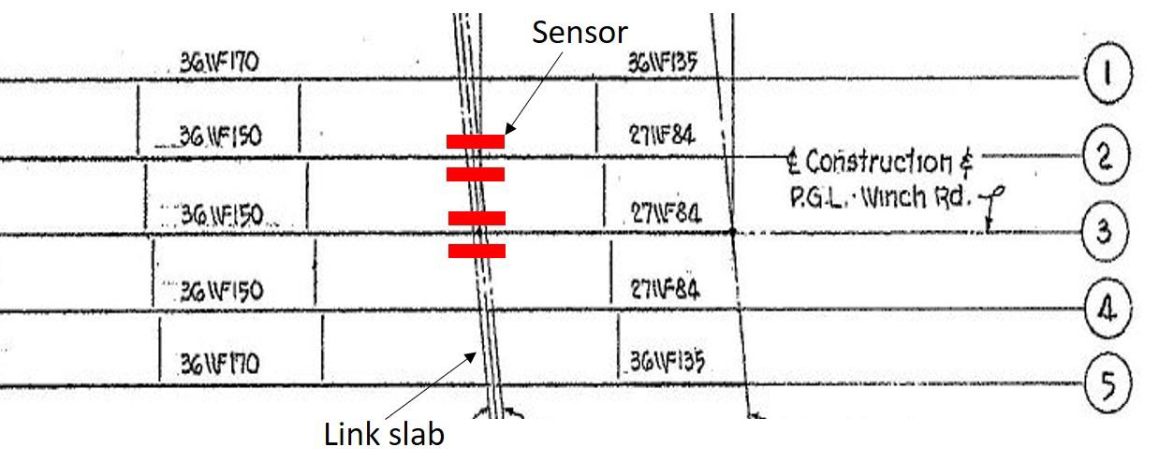
Sensor Layout
Sensors will be placed on top and bottom of the link slab.
Two pairs of sensors on each link slab.
Only one sensor system is activated, the other one is for redundancy.

Slide 39
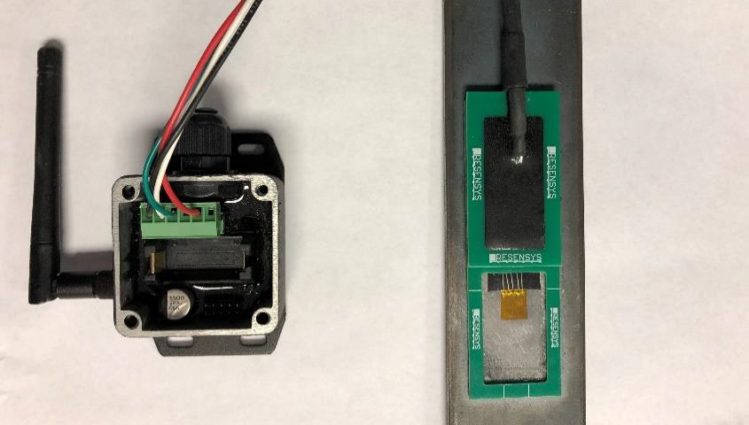
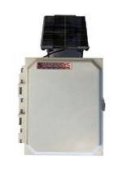
Data Acquisition
Strain data transported to a transmitter via wire.
Transmitter communicate with a data acquisition system (DAQ) wirelessly.
DAQ deliver the data to a remote server using commercial cellular service.

Slide 40
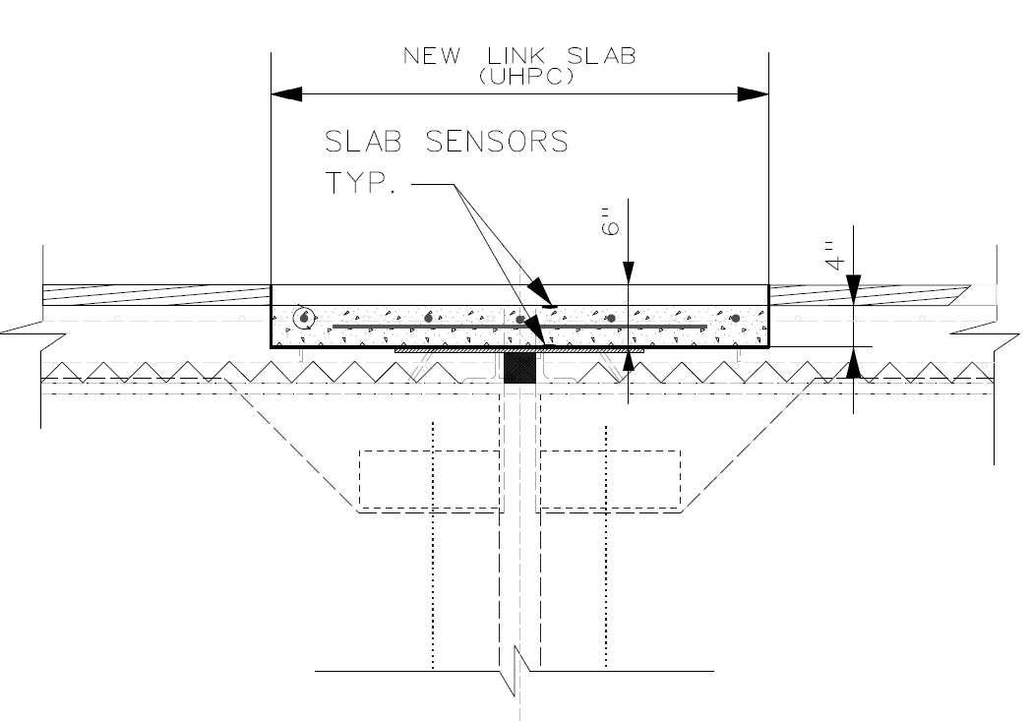
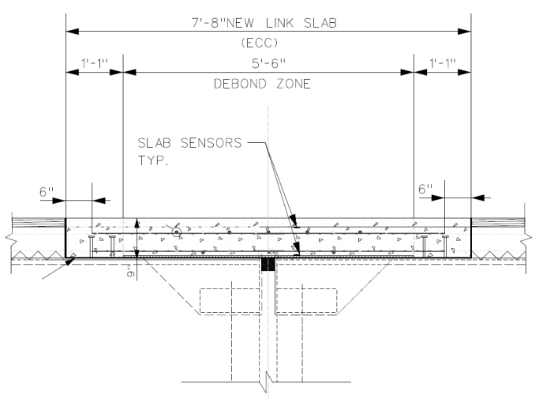
Construction
Existing expansion joints are to be removed.
Deck concrete partially removed.
New link slabs will be casted on site.
UHPC Link Slab
ECC Link Slab

Slide 41
Experimental Results
Strength
Stress-Strain Curve
Sensor Performance
Fine Cracks

Slide 42
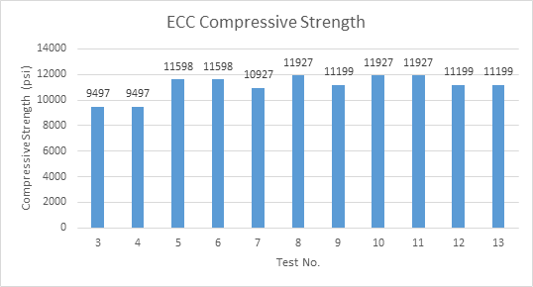
Strength
Maximum compressive strength.
Average strength of ECC is 11135.97 psi.
Expected strength of UHPC is 14000 psi.

Slide 43
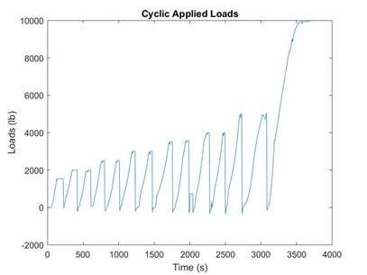
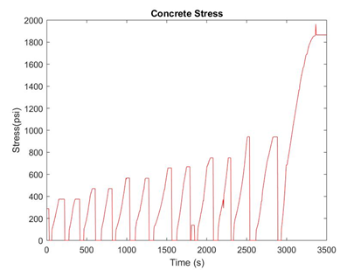
Stress-Strain Curve
Cyclic loading pattern.
Response is independent to the number of cycles.
Essential to link slab application on bridges.

Slide 44
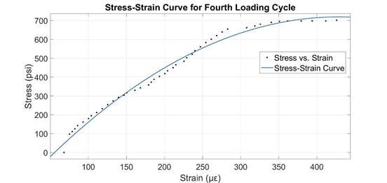

Stress-Strain Curve
Created by Curve Fitting ToolboxTM in Matlab®.
Reflects ductile behavior.

Slide 45
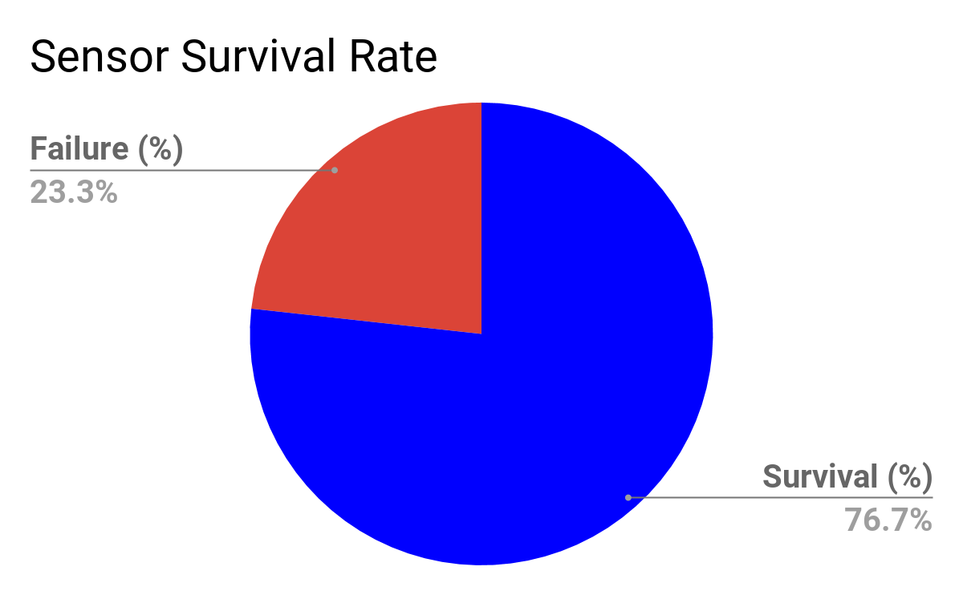
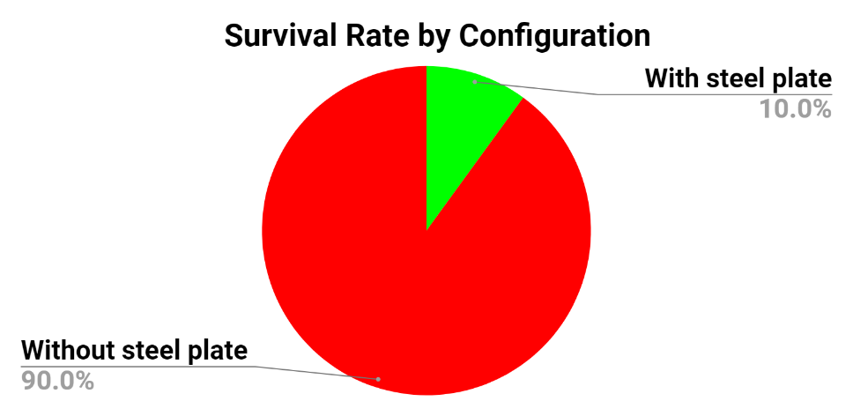
Sensor Performance
Evaluated based on reliability and consistency.
Overall sensor survival rate is satisfactory.
A total of 10 failures out of 43 sensors.

Slide 46
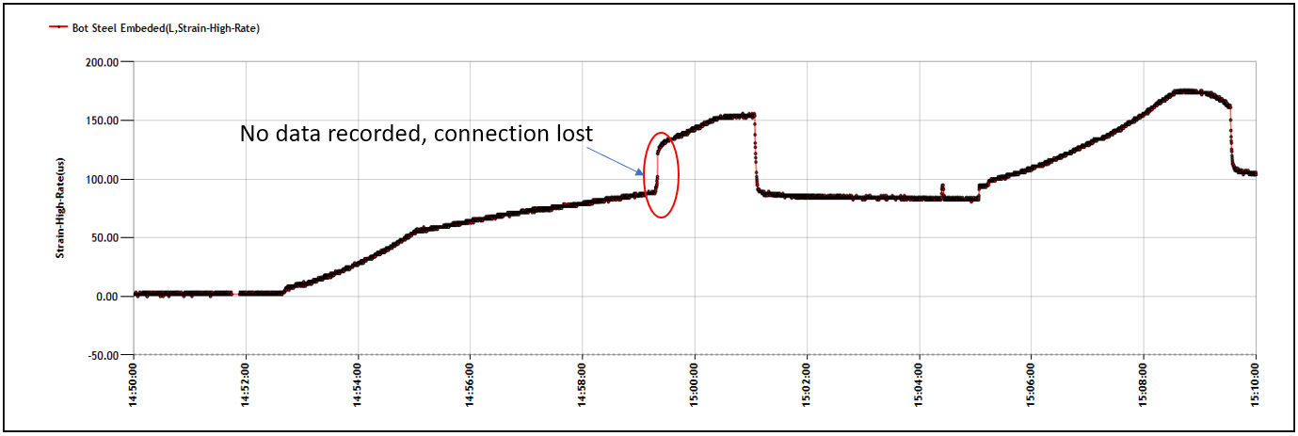
Sensor Performance
Sensor failure due to lost condition.
Temporary lost signal, could be recovered.

Slide 47
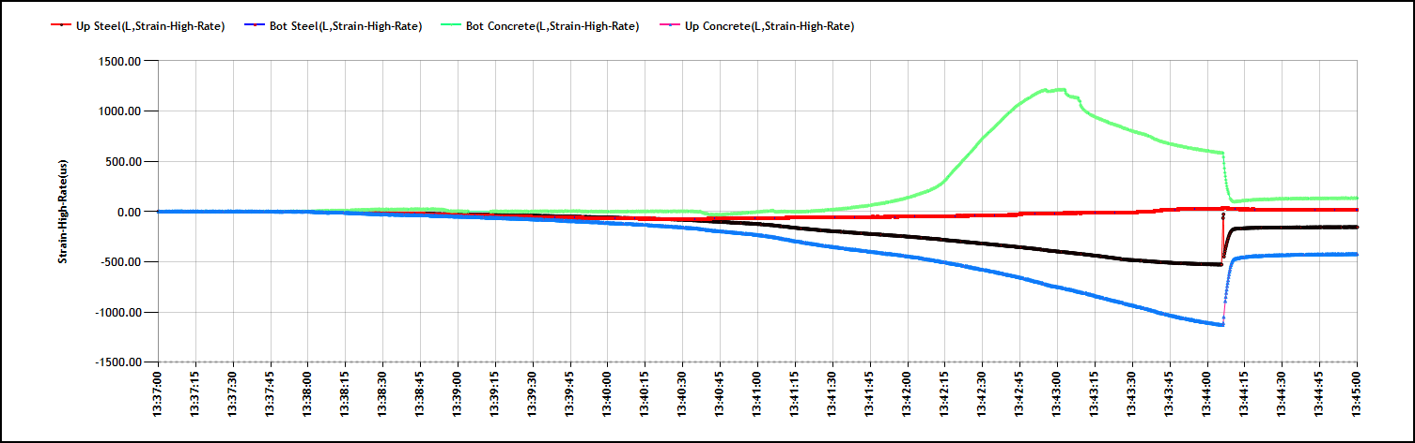
Sensor Performance
Complete sensor failure.
Cannot be recovered.
Can be attributed to faulty sensors.

Slide 48
Sensor Performance
Feasible range for measurement.
To satisfy compatibility of both types of sensor configurations.
Outside this range, sensors lost compatibility.
Can be accommodated by calibration.
Material | Max Strain in Compression | Max Strain in Tension
ECC | 340*10⁻⁶ | 200*10⁻⁶
UHPC | 890*10⁻⁶ | 304*10⁻⁶

Slide 49
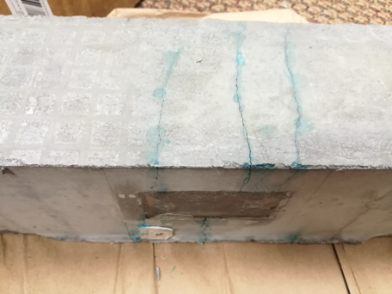
Fine Cracks
Fine cracks developed along the width of the specimen.
Hairline in width, effectively limit water penetration.

Slide 50
Conclusion
Findings
Future Work

Slide 51
Findings
Performance of link slab is independent to number of loadings.
ECC and UHPC displayed high strength.
ECC and UHPC had a “metal-like” behavior.
Feasible range for measurement was concluded.
Fine cracks on ECC and UHPC are small enough to prevent leakage.
ECC and UHPC are desired materials for link slab.

Slide 52
Bibliography
Kewalramani, M. A., Mohamed, O. A., & Syed, Z. I. (2017). Engineered Cementitious Composites for Modern Civil Engineering Structures in Hot Arid Coastal Climatic Conditions. Procedia Engineering,180, 767- 774. doi:10.1016/j.proeng.2017.04.237
Caner, A., & Zia, P. (1998). Behavior and Design of Link Slabs for Jointless Bridge Decks. PCI Journal,43(3), 68-80. doi:10.15554/pcij.05011998.68.80
Au, A., Lam, C., Au, J., & Tharmabala, B. (2013). Eliminating Deck Joints Using Debonded Link Slabs: Research and Field Tests in Ontario. Journal of Bridge Engineering,18(8), 768-778. doi:10.1061/(asce)be.1943-5592.0000417
Li, V. (2008). Engineered Cementitious Composite (ECC). Concrete Construction Engineering Handbook. doi:10.1201/9781420007657.ch24
Ulku, E., Attanayake, U., & Aktan, H. (2009). Jointless Bridge Deck with Link Slabs. Transportation Research Record: Journal of the Transportation Research Board,2131(1), 68-78. doi:10.3141/2131-07
Wing, K. M., & Kowalsky, M. J. (2005). Behavior, Analysis, and Design of an Instrumented Link Slab Bridge. Journal of Bridge Engineering,10(3), 331-344. doi:10.1061/(asce)1084-0702(2005)10:3(331)
Gunes, O., Yesilmen, S., Gunes, B., & Ulm, F. (2012). Use of UHPC in Bridge Structures: Material Modeling and Design. Advances in Materials Science and Engineering,2012, 1-12. doi:10.1155/2012/319285
Su, Y., Li, J., Wu, C., Wu, P., & Li, Z. (2016). Effects of steel fibres on dynamic strength of UHPC. Construction and Building Materials,114, 708-718. doi:10.1016/j.conbuildmat.2016.04.007

Slide 53
Bibliography
Abbas, S., Nehdi, M. L., & Saleem, M. A. (2016). Ultra-High Performance Concrete: Mechanical Performance, Durability, Sustainability and Implementation Challenges. International Journal of Concrete Structures and Materials,10(3), 271-295. doi:10.1007/s40069-016-0157-4
ASTM, standard test method for flexural strength of concrete (using simple beam with third-point loading). Designation: C78/C78M—18. ASTM International, 2018.
ASTM, Standard Test Method for Flexural Properties of Unreinforced and Reinforced Plastics and Electrical Insulating Materials by Four-Point Bending. Designation: D6272—17. ASTM International, 2018.
Kato, H., Tottori, Y., & Sasaki, K. (2013). Four-Point Bending Test of Determining Stress-Strain Curves Asymmetric between Tension and Compression. Experimental Mechanics,54(3), 489-492. doi:10.1007/s11340-013-9791-9
Chen, L., & Graybeal, B. A. (2012). Modeling Structural Performance of Ultrahigh Performance Concrete I- Girders. Journal of Bridge Engineering,17(5), 754-764. doi:10.1061/(asce)be.1943-5592.0000305
Keoleian, G. A., Kendall, A., Dettling, J. E., Smith, V. M., Chandler, R. F., Lepech, M. D., & Li, V. C. (2005). Life Cycle Modeling of Concrete Bridge Design: Comparison of Engineered Cementitious Composite Link Slabs and Conventional Steel Expansion Joints. Journal of Infrastructure Systems,11(1), 51-60. doi:10.1061/(asce)1076-0342(2005)11:1(51)
Şahmaran, M., & Li, V. C. (2010). Engineered Cementitious Composites. Transportation Research Record: Journal of the Transportation Research Board,2164(1), 1-8. doi:10.3141/2164-01

Slide 54
Thanks!
Any questions?

