Slide 1
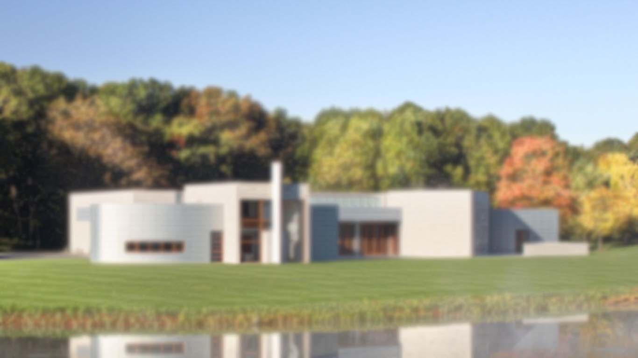
Introduction
Ray Barker
Chief Archivist/Librarian
Cale McCammon
Assistant Archivist
Notes:
Ray and Cale:
Greetings –
Name, title, length of employment
Ray background: public library, university library, contract Army work, project management (supervisory processing, management) – primarily physical
Cale background: small nonprofits, local history collections, university records (processing and accessioning) – primarily physical
Glenstone museum

Slide 2
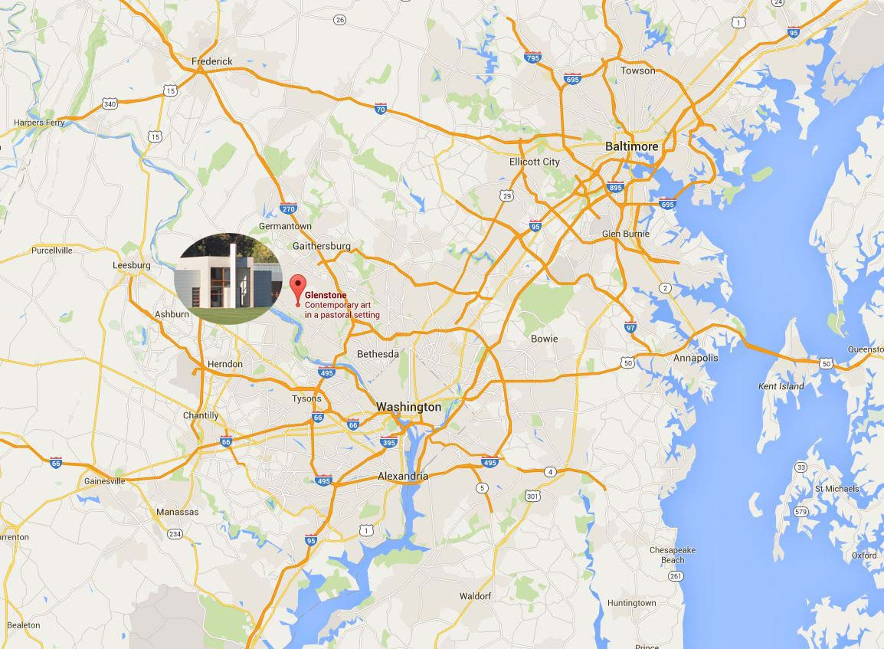
Notes:
RAY:
Private art museum 25 miles outside of DC
Goal: provide contemplative environment that integrates art, architecture, and landscape -- > next slide

Slide 3
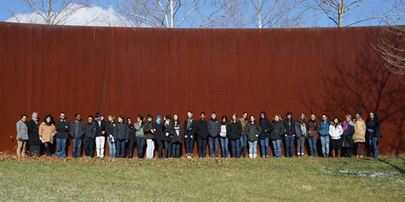
Brief History
From private farm to world-class museum
Founded in 2006 by collectors Mitchell and Emily Rales (10 years, 5 exhibitions)
Modern art, permanent outdoor sculptures, sustainable landscape
Free and open to the public
Expansion underway
Notes:
RAY:
FREE!
Founded: 2006 by founders Mitchell and Emily Rales
10-year anniversary in September
Originally FARM w/alpaca, horses, sheep…
Contemporary and modern art (mostly post-WWII)
A “get-away” alternative to urban experience
Open to public by appointment
Employs ~60 people (includes part time and full time); hosts school groups and community groups;
walkthrough of the gallery and guide-led tour of grounds – not didactic;
5 exhibitions – Jackson Pollock, Jeff Koons, de Kooning, Twombly

Slide 4
Inherited Landscape
Inventory: What are the archives?
Space: Where are the archives?
Workflows: How do the archives work?
Culture: Who are the archives?
Notes:
CALE:
So I think the takeaway is really how peculiar our context is. I’ve heard about some colorful places that archivists work (I’m sure some of you are from those places), and from my conversations with other folks museums in particular tend to do things very very differently. One of the common themes I’ve heard from people is the matter of inheritance, and it was really no different from our experience. So in light of that, we’ll talk about four things that we inherited – inventory, space, workflows, and culture. However, I think it’s more helpful to frame these in the sort of descriptive questions we had to ask ourselves in stepping into a position like this.
What are the archives?
Where are the archives?
How do the archives work?
Who are the archives?

Slide 5
What are the archives?
The Analog:
Video tapes (many hundreds)
Architectural drawings and submittals
Gifts and ephemera
Mock-ups
Administrative documents and correspondence
One “proper” manuscript collection
Press clippings
Viewfinders? T-shirts? Soap? Crates?
The Digital:
Video and audio (many terabytes)
Artwork, landscape, and architecture images (many thousands)
Architecture and landscape submittals (some surrogates, some original)
Press clippings
Hard drive copies, entire websites, email captures, orphan documents
The primordial soup
Notes:
RAY:
Analog and digital but largely digital:
Analog
legacy video tapes of…
Digital
current influx of digitally-born footage (25+ terabytes) – timelapse, architectural videos, artist interviews, iphone snapshots (both professional and impromptu)
The main point: perpetual primordial soup—growing, dynamic collections—”live”—without evolution, or path forward

Slide 6
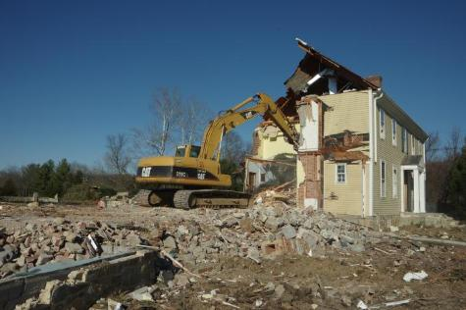
Where are the archives?
Office desks
Cabinets
Houses scheduled for demolition
External hard drives
Network drives
Collection Management System
Off-site storage
Vault
Document storage room
7+ unique spaces – all shared
Notes:
CALE:
Okay so where are the archives? The second question we had to ask ourselves
Space at Glenstone is what you could describe as quirky. For the archives and library there’s no reading room, no reference desk, no stacks. Most of the administrative staff share an open, temporary office. It’s basically a trailer. The museum wasn’t constructed to support the level of administration that we currently operate at. While there is one room dedicated to the storage of art, there was none dedicated to the storage of archives.
So when we got here things were sprawled all over the property – office desks, cabinets – and on the digital side things weren’t all that pretty. What we called archives was really just a shared network drive that we had some dominion over.
There are few things that are more unique about this context though. Some of these locations are shared with artwork storage which posed access problems since when artwork is stored there the room pretty much goes on lockdown. The expansion has also been interesting in that parts of the property are constantly changing and buildings are being demolished. So here’s just one house that contained architectural records which we managed to salvage before the place was bulldozed.
In talking about connecting theory and practice, we all know the ideal circumstances in which we’re supposed to keep things in terms of temperature, humidity, and all of that. I haven’t work at a place that had everything perfect, but if you’re out there I’d like to hear from you. Luckily we’re a museum which necessitates strict climate control to handle the artwork, but really I think climate control was the last thing we were thinking about when we stepped into our positions. We just wanted everything in as few places as possible, and hopefully in places that would still be standing within the next few months.

Slide 7

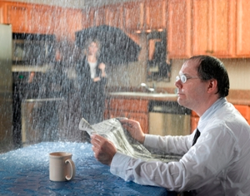

How do the archives work?
Description and cataloging
Appraisal
Accession
Trickle-In Economics
Just say YES!
Notes:
RAY:
Description and cataloging –
Processing meant creating a spreadsheet in Excel or printing out and binding some static PDF that few people would ever see
Idiosyncratic inventories – itemized spreadsheets down to single pages of correspondence—itemized description and cataloging;
Approach was not sustainable and could not keep up with pace of institutiona
Appraisal – No real hard decisions made—no analysis or appraisal decisions made—one big YES. …WHY?
Adhering to the expectations of the founders and Senior Staff; a reactive state ONLY
Accession and ingestion – how we get stuff
“Trickle-in economics” with occasional floods; individual items emailed and directed to archives (“FTA”); kind of a punchline;
dumped on a file share for long-term storage and access
---Muddles the perception of the archives both internally and externally

Slide 8

Who are the archives?
Reference Services
Grounds
Photography
Video Production
Guides
File Organization
Transcription
Curators
Outreach
Staff Training
Architects
Public Relations
Graphic Design
Facilities
Records Management
Administration
Publications
Digitization
Digital Project Coordination
Founders
Web Content Management
Registrars
Digital Asset Management
Rights Management
Conservator
Ourselves!
Notes:
CALE:
This question of who the archive was a more nuanced question that we had to ask ourselves, since it occurred to us that you don’t inherit just “stuff” but you also inherit people and how the archives has fit within the larger culture of the institution as a whole
Historically speaking, the archives has always served a support role, with the main emphasis of supporting the curatorial staff. It’s never had a public face. It’s always served staff’s needs. Over the ten years or so, there’s probably some things that you might expect: lots of turnover, lots of loss of institutional history, and so on. Archival work was typically a secondary responsibility of staff members whose duties covered publications, rights and reproduction, and so on.
So on one side I tried to illustrate this diverse responsibilities that fell within what Glenstone called archives with a convoluted mashup of those responsibilities. Some of these are familiar but others balloon out to things as basic as clerical work and software training. And many of them are weighted differently. I think the bulk of the work has been really the management of digital media. That seems to be what I spend my time on.
On the other side with nice facebook silhouettes I’m showing some of the people who have a stake in the work that we do and who bring a different perception of what archives mean, especially within the context of a cultural institution. And not even all of these folks are weighted equally. Let’s face it: we’re a museum. Of all the people, those who work with the artwork have the greatest leverage in the institution and we’re there to support them. If you were to ask some of these folks what it is that we do, they might say archivists just rename files all day or put things in boxes or “document” history – whatever that means. While each of them has sort of a vague, mystical sense of what an archive is, the stuff that they give to us pretty much falls under a few categories, at least as they perceive it:
This is really really important and needs to be in the archives.
This is really useless and we can just hand it over to the archives.
I don’t know what to do with this but it’s kind of weird so let’s give it to the archives.
In any case, it didn’t take me long to realize that folks were using the term “archives” in ways that really didn’t mesh with what I had learned in school and in what I had experienced at universities and small historical collections. This uncertainty is understandable because it’s probably the result of the archives having a hand in so many things, often in activities that don’t follow the traditional framework that you learn in school but that involve us in workflows that are active, especially when it comes to the use of media for certain projects or business practices.
So this inherited culture has upsides and downsides, but I think it’s mostly an upside. Because the museum is intertwined with the legacy of our founders, there’s always been a sense of the importance of what we’re doing, even if it’s been a bit vague, and I think we can see it as a positive that we are so involved with the active work of the people we serve. At the end of the day I began to realize that the little distinctions I made between what is archives and what isn’t archives didn’t entirely matter because there were certain needs that we still needed to serve and because archives look a little bit different at every institution, and it’s made for a platform to pursue opportunities as we’ve faced challenges in the last two years or so.

Slide 9
Post-Inheritance: A Transition
Tools: What can we use?
Space: Where can we go?
Visibility: How do we show ourselves?
Collectivize: How do we create coherence?
Notes:
RAY:
Transitional slide, with more information to follow in each respective slide. Enumerate these, please:
1. Search for usable, affordable?, manageable tools
2. Discovering, creating space
3. Visibility: How to show who we, what we do, how and why it’s important/imperative
4. “Collectivizing” –a gathering of buckets through thoughtful arrangement

Slide 10






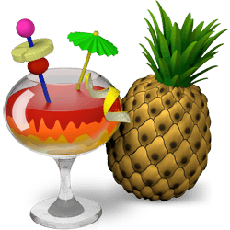

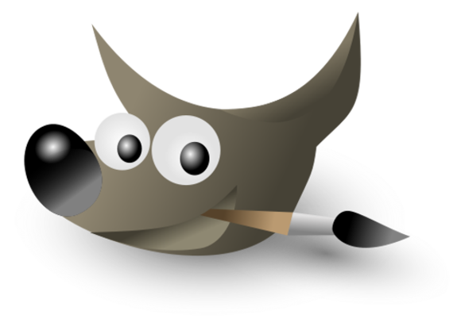
Adopting new technology…
Gaining intellectual control
Systematizing access, intake, and storage
Finding life beyond Excel and network drives
…to tackle old problems
Notes:
CALE:
So we described how we were just completely mired in spreadsheets that we couldn’t really make sense of and that really went against our instincts to think about things in the broader, collectivized manner that archivists do, and we’ve also talked about how there was a heavy, heavy reliance on file shares for accessing digital content. I really, really can’t look at an overly complicated spreadsheet without feeling sick, and I absolutely hate talking about filenames. We needed to come up with ways to help us minimize the reliance on itemized spreadsheets and the annoying file/folder structure of a file share, and for that we adopted new technology.
Like I said earlier, archives don’t hold the power at museums – the people who work with the artwork do. As the expansion project went underway, the technological needs of the curatorial staff exploded, and we were able to position ourselves in those conversations. We ended up implementing an open source collection management system called CollectiveAccess. It’s basically the central nervous system of the artwork, library, and archives collections. We did a whole separate presentation on it, but it was basically an important step in getting a database by which to systematize access and description, and it’s also given us a platform by which to apply at least some archival principles when it comes to description and arrangement.
I could go through a list of things we’ve adopted, things that largely help us de-duplicated large amounts of information or generate reports from it, but I think the most important thing was adopting technology that was wholly unfamiliar to do things that I never expected but that nevertheless fell within the purview of how archives has been defined at Glenstone. I never expected I would need to edit a video and that I would become the point person for all in-house editing, for instance, or use a command line tool to write metadata to thousands of assets at the push of a button. As a note, I highly, highly recommend learning exiftool and learning about embedded metadata if you find yourself managing large amounts of digital content. And some of these things didn’t work, and some of these were just meant to be temporary, but at the end of the day we recognized we couldn’t have the same conversations about what folder to put things in or what to name certain files, and it felt fraudulent to pretend that me dumping something on a fileshare was any different from someone else dumping something on a fileshare just because I have a degree in library science.
We still haven’t entirely found a life beyond Excel and fileshares, but we’re working on it as we carve out our long-term home.

Slide 11
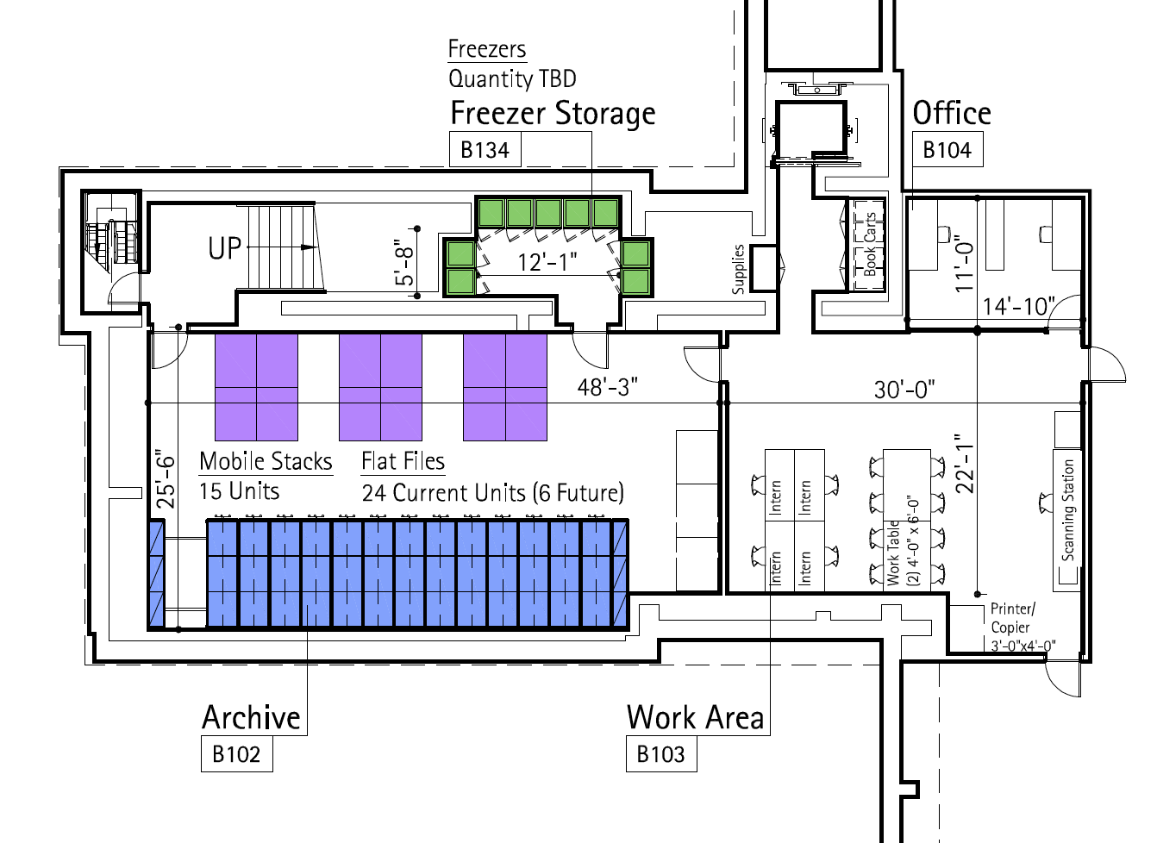
Carving out a home
Notes:
RAY:
2015 milestone: 3 shelves acquired !!!!! -- took 9 years; purchase of tubes and racks as part of architectural records project
movable shelving, cold storage, processing area, climate controlled
Despite building not being designed with dedicated archive space and despite the temporary nature of anything we’d do, we recognized our current situation presented a good opportunity to get a storage system in place prior to move now that we have a collections database
Entered into conversations about archives space during building design phase; testament to founders’ vision that they wanted to include such a space and looked at peer institutions;

Slide 12

Becoming visible
Cultivating internal and external relationships
Recognizing the value of concrete and abstract outcomes
Embracing “non-archival” roles
Notes:
CALE:
One of the things we thought about as we negotiate space and technology is how we might occupy a more visible place in the institution. When I was at academic institutions I kept hearing the world silos, and it’s been interesting at Glenstone where even when you work only several feet from another person it can be difficult to know the work that they do.
So we did a few things to cultivate relationships –
We’re starting an internship program. We hired a student to work specifically on architectural records, and this wouldn’t have been possible if we hadn’t carved out some space for her to work, and it’s helped us get our name out there to the surrounding library science programs. Also, we pay our interns.
We’ve become a regular part of the new hire process. One of the first things that our new hires do is get a tour of the library and archives and get instruction on how to find things.
-- Reciprocal tours with nearby institutions, weaseled our way into presentations, video screenings, and so on. Targeted programs to different audiences, particularly those beyond the curators.s
What I really want to say is that we didn’t limit ourselves to things that have only concrete outcomes. Sure, hiring an intern yields a concrete and measurable, but there is something to the abstract things that can’t necessarily be measured. What’s the outcome of presenting at a conference? I don’t know, but instinctively I feel like it’s just a good thing to do. It’s helped that between the two of us there has naturally become a division of labor. Ray’s good with people. I’m good with technology. That means Ray can make me do people-oriented things when he wants to me get away from the keyboard, and that also means I’m justified in avoiding Ray when I’m working technology-oriented things.
Part of that meant we’ve had to embrace non-archival roles. When you’re in a small team, it’s not helpful to cling to your job description or title or to try to enforce a definition of archives that doesn’t meet the needs of institution. I’ve already talked about this sort of expansion of responsibilities when it comes to the management of digital media, but it’s been a lot of other things as well. The other day Ray and I acted as guides, for instance. This is a lot of fun because it gets us talking with visitors and the other guides. If you call to make an appointment, it’s likely I will answer the phone.

Slide 13
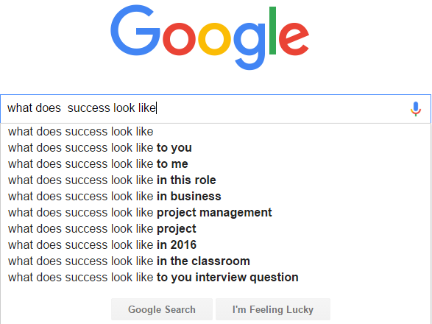
Removing the question mark
Quantifying thru metrics and surveys
Framing activities in relation to long-term strategic goals
Adapting professional practices and language to particular context
Notes:
RAY:
Quantifying and analysis thru metrics and staff surveys –
typically linear feet processed, amount accessioned, reference stats, what collections were taken in; CA → User Survey
metrics & reporting upward to senior staff, and internally: Way to record activities and determine values
Framing activities in relation to long-term strategic goals of institution—Strategic Plan: Tie it all back and add within framework
Adapting professional language/practices within Glenstone’s context:
Take professional rules, adapt per the context e.g “reference”—normal operational things; Glenstone requires some re-definition – so converting a TIFF to JPEG for “reference stat”; catalog records created per month; outreach numbers—Connecting Theory Into Practice

Slide 14
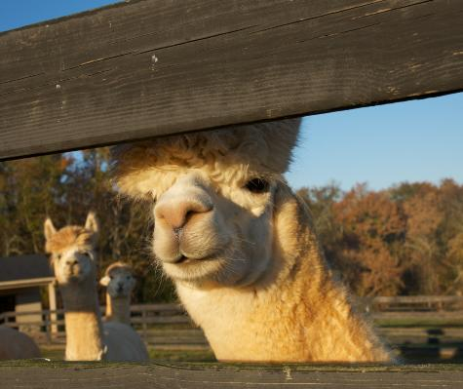
Thank you!
Thanks!
Bye!

