Slide 1

Late Night Services at the University of Maryland Libraries
Timothy Hackman
Head of Resource Sharing and Access Services
thackman@umd.edu

Slide 2
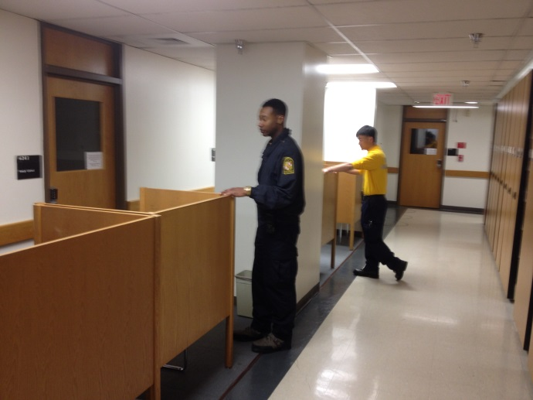
UMD Libraries Late Night Services
McKeldin Library
11pm-8am, Sunday-Thursday during
Fall and Spring semesters
Extended Friday/Saturday hours during Finals
Campus ID required for entry
Police Auxiliary provides
added security
3.5 FTE staff
~160 student hours/week

Slide 3
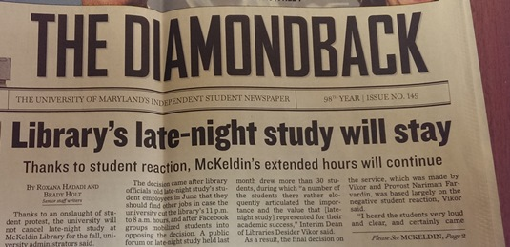
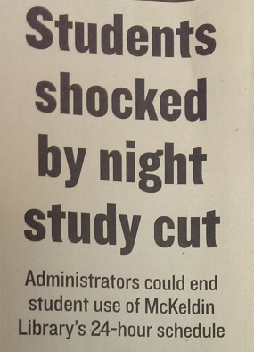
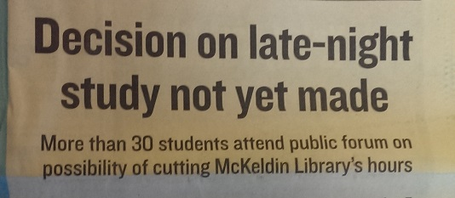
Late Night Crisis of 2008

Slide 4
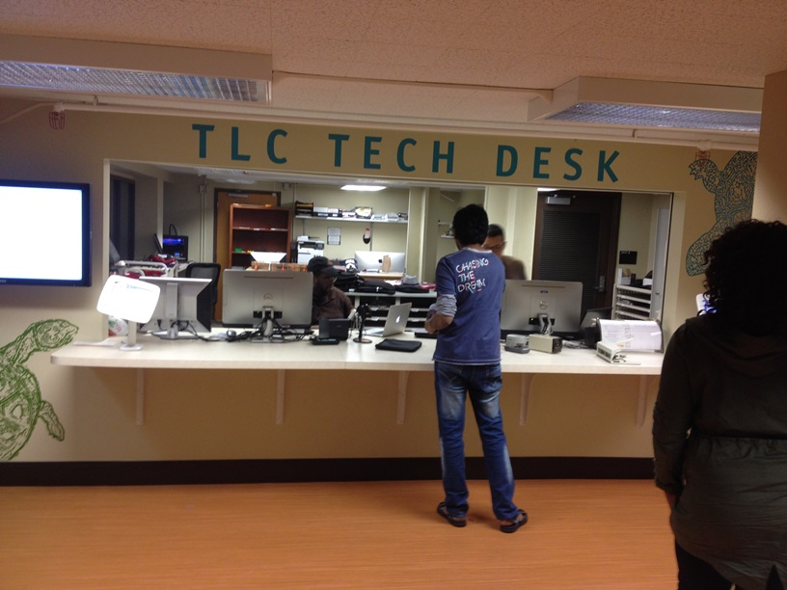
Expanding Late Night Services
2012
Expanded to all 7 floors
Began offering circulation, equipment loan, and reserves
2013-2014
Tech Desk opened overnight
Pulling books for holds and ILL
Open to USMAI patrons
Next?

Slide 6
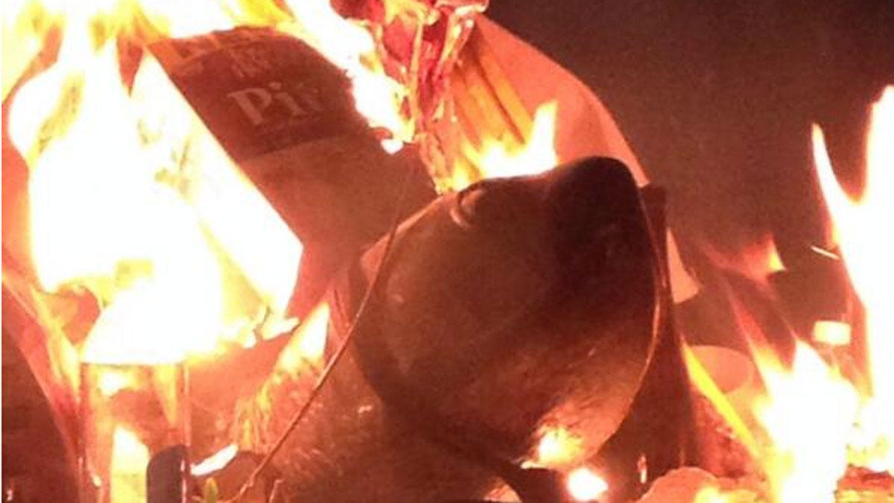
Challenges
http://washington.cbslocal.com/2013/12/18/u-of-md-s-testudo-statue-set-ablaze/

Slide 7
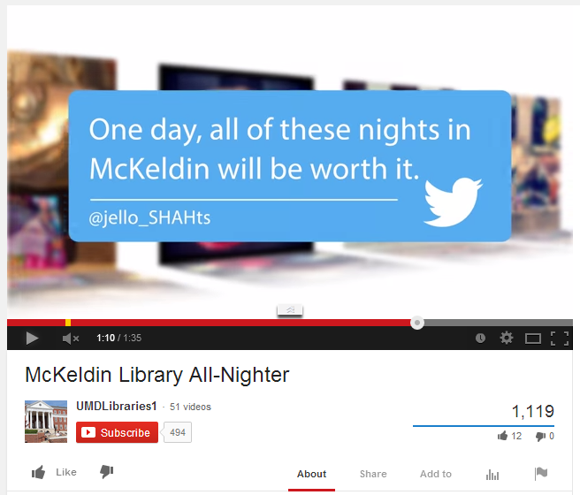
Challenges
Safety & Security
Supervision
Communication
Training
Staffing
Weather
Maintenance and
housekeeping

