Slide 1

DON’T MISS THE HIDDEN TREASURES! Ideas for Successful Library Outreach May 10, 2012
Maryland Library Association and Delaware Library Association
2012 Joint Library Conference, Ocean City, MD
Nedelina Tchangalova
Engineering, Physical Sciences and Public Health Librarian
Engineering & Physical Sciences Library (EPSL)
nedelina@umd.edu

Slide 2
Selected Outreach Efforts at UMD
Library Award for Undergraduate Research
Embedded Librarianship
International Coffee Hour
Honors Programs (e.g. Gemstone)
Speaking of Books...Conversations with Campus Authors

Slide 3
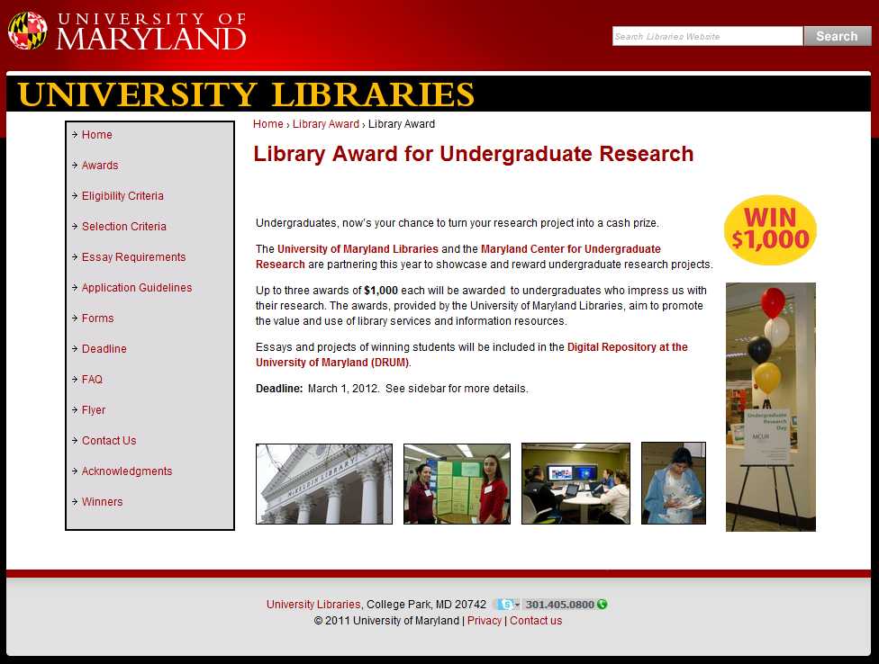
Library Award for Undergraduate Research

Slide 4
Guiding Priciples
UM Libraries is a campus center for research, education and learning.
Library prizes are offered at other academic institutions.
Develop campus collaborations to increase the visibility of UM Libraries and our subject librarians.
Offering a research prize will enhance the reputation of the library on campus.
Make undergraduate student research publicly available.

Slide 5
The Importance of Student Research
“The prize papers form an important archive of student research and writing that can inform library instruction, and support a university’s reaccreditation process.”
Jones, L. (2009). The rewards of research. College & Research Libraries News, 70(6), 338-341.

Slide 6
Timeline
October, 2010
Proposal submitted to Library Managers Group (LMG)
October, 2012
Committee members meet for the next round
March, 2011
Review of applications
December, 2010
Web site launched
2010
Future
November, 2010
Idea accepted and Task Force created
January, 2011
Application process open
April 2011
Announcing the winners and holding a reception

Slide 7
9 Task Force Members
Libraries
Director of Communications
Librarians from different divisions/departments
Coordinator of the Digital Repository at the UMD
College of Information Studies
Professor
Maryland Center for Undergraduate Research
Director

Slide 8
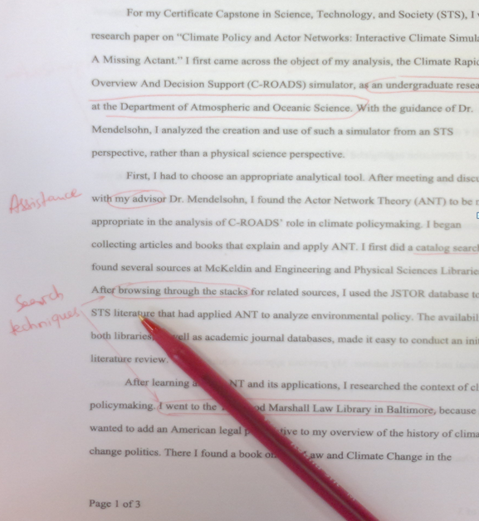
4 Review Sub-Committee Members
3 librarians
1 professor

Slide 9
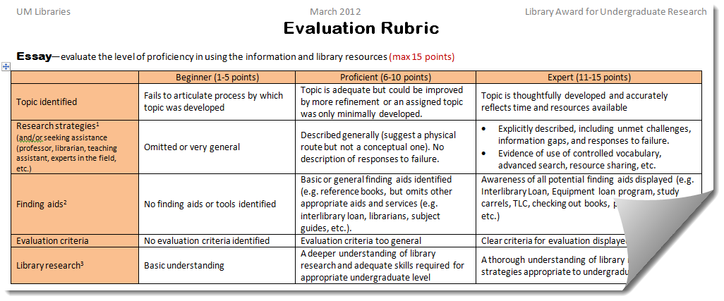
Evaluation Rubric
Adapted from:
University of Washington Libraries, Library Research Award for Undergraduates Evaluation Criteria (not available online)
Westminster College, Giovale Library Undergraduate Research Awards Judges’s Rubric (http://www.westminstercollege.edu/library/documents/award_rubric.pdf)

Slide 10
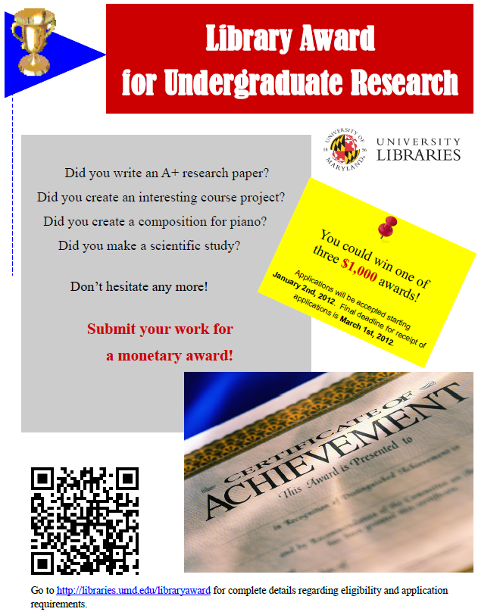
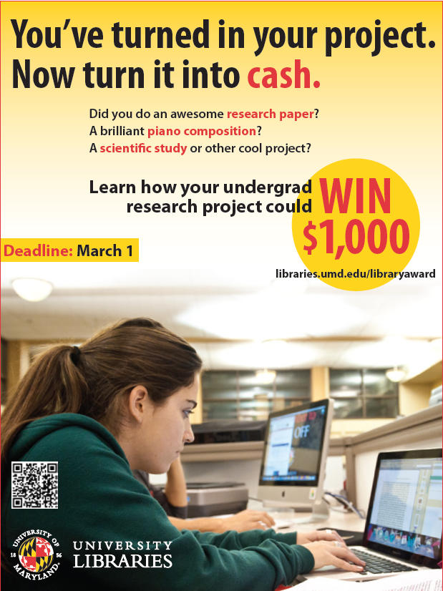
Publicity
Ad in Diamondback
E-bulletin boards
Flyers
Library blogs
Library web site
Listservs
Online newsletter
Social network sites
Subject librarians
Year 2011
Year 2012

Slide 11
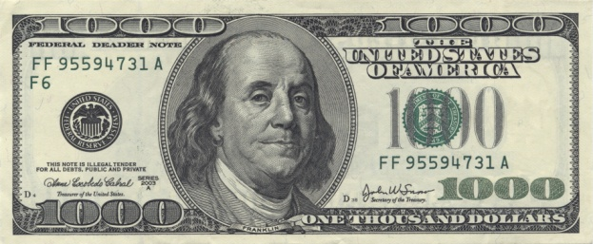
Statistics
Year 2011
Year 2012
6 Teams
27 Individual
1 Letter of Support
33 Applications + 1 ?
26 Individual
26 Applications
Each year, students are competing for three awards, $1,000 each.
Source: http://notech4u.deviantart.com/art/1000-Dollar-Bill-166227716

Slide 12
Statistics – Departments
Colleges/ Departments/ Programs | TOTAL Number of Applications
Number of Departments | Year 2011 | Year 2012
College of Arts and Humanities (80+) | 10 | 13
College of Agriculture and Natural Resources (7) | 3 | 4
College Park Scholars Program (11) | 2 | 3
College of Computer, Mathematical and Natural Sciences (10) | 0 | 2
A. James Clark School of Engineering (8) | 2 | 1
College of Journalism | 1 | 1
Robert H. Smith School of Business (6) | 0 | 1
Honors College (6) | 0 | 1
School of Public Health (6) | 1 | 0
College of Behavioral and Social Sciences (10) | 8 | 0
TOTAL | 27 | 26
Notes:
Number of Departments

Slide 13
Statistics – Individual Applicants

Slide 14
Team Applicants
Year 2011 only
Mathematics
(1)
Special Program: Gemstone (5)

Slide 15
Assistance seek
Outside Libraries
Professors
Teaching assistants
Graduate students
Experts
Family and friends
Librarians and library staff

Slide 16
Why Did Students Apply?
For the money and a glory
Instructor’s recommendation
For funding research under way

Slide 17
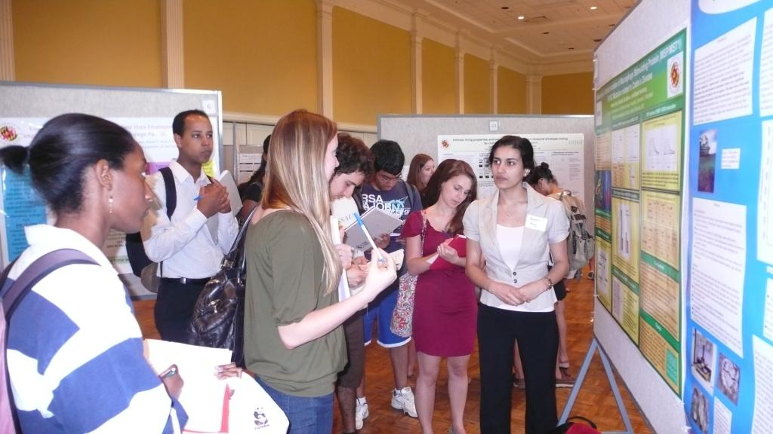
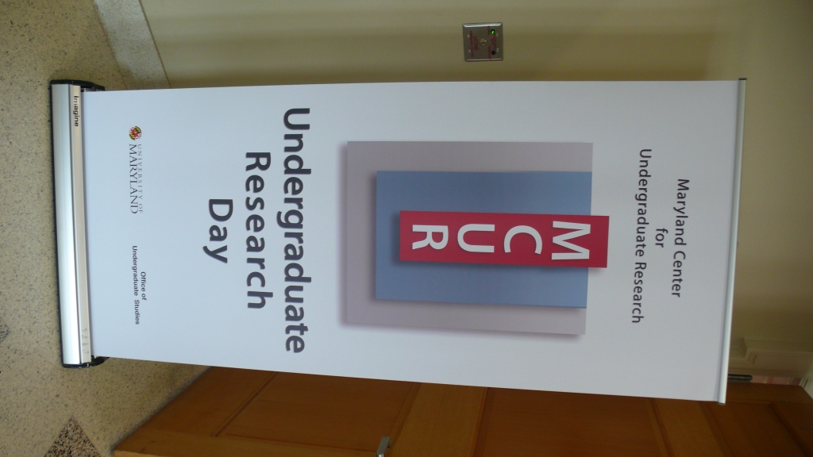
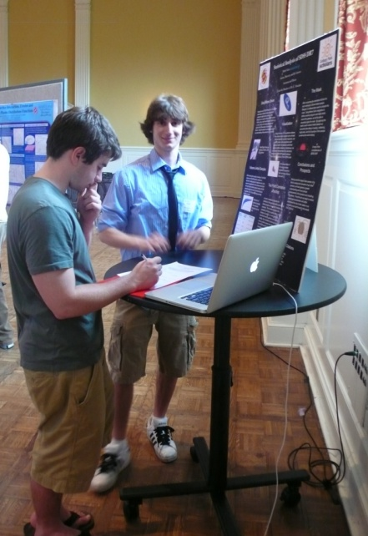
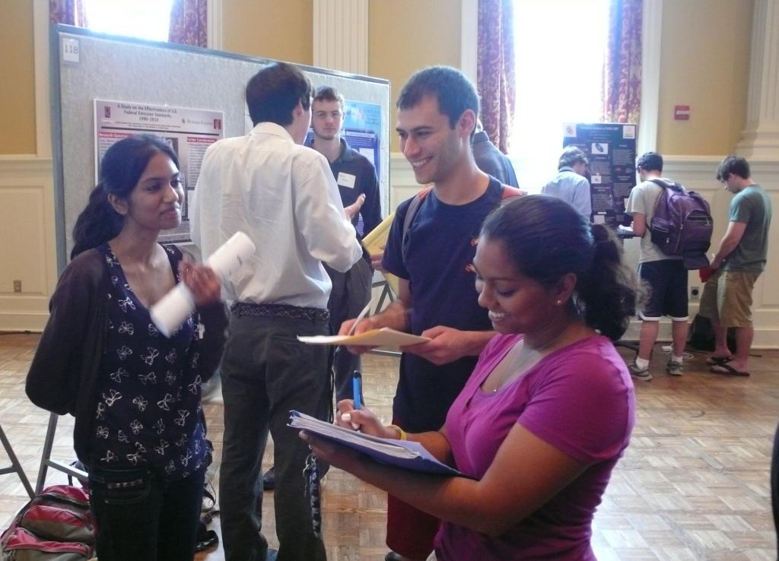
Here is the Day!

Slide 18
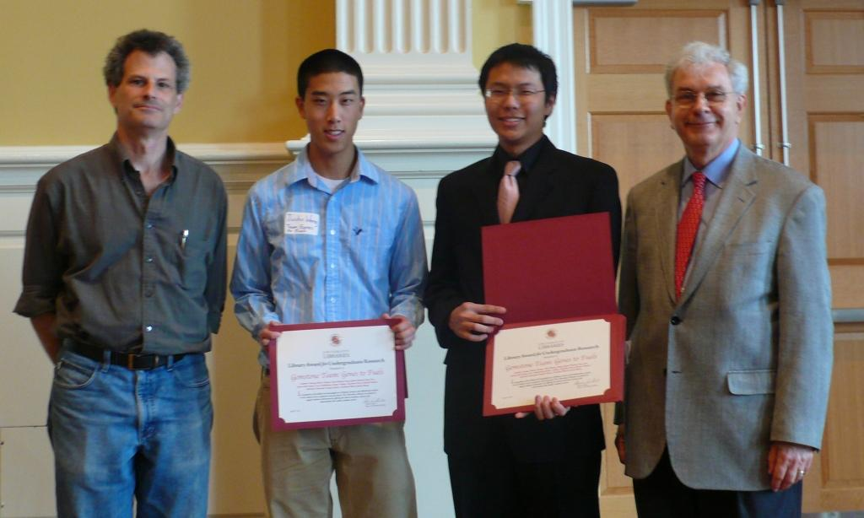
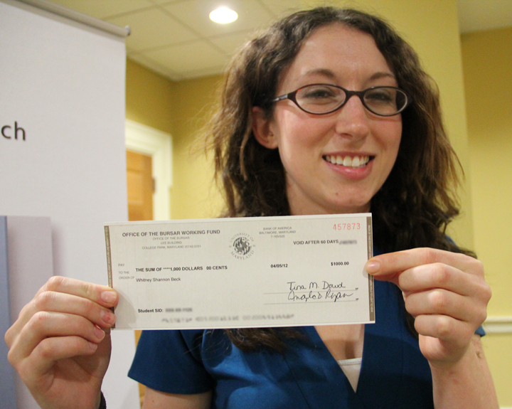
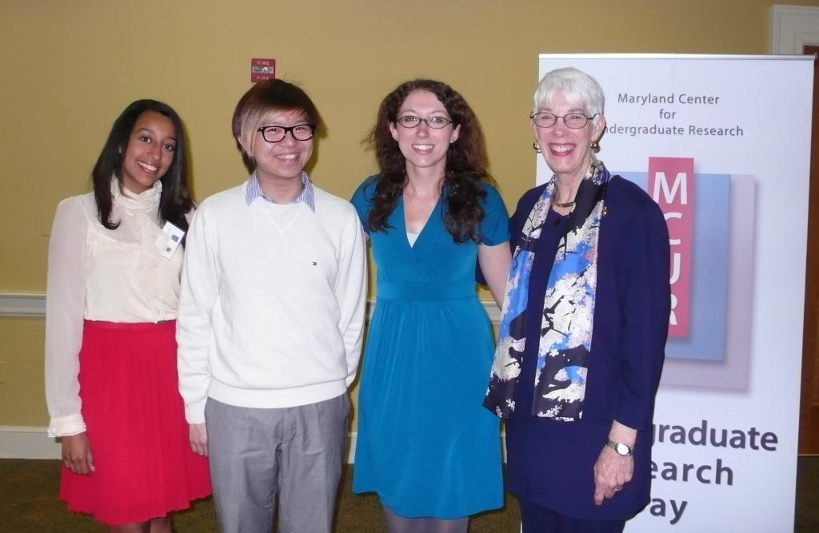
The Award Ceremony
Courtesy of Rebecca Wilson,
Graphics Coordinator

Slide 19

Lessons Learned
Make a plan
Build a team with different library responsibilities
Make sure all team members are committed to the program
Assess the program and make improvements

Slide 20
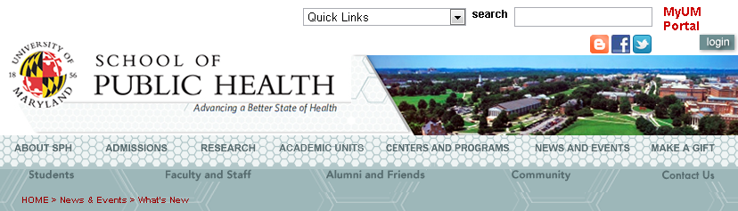
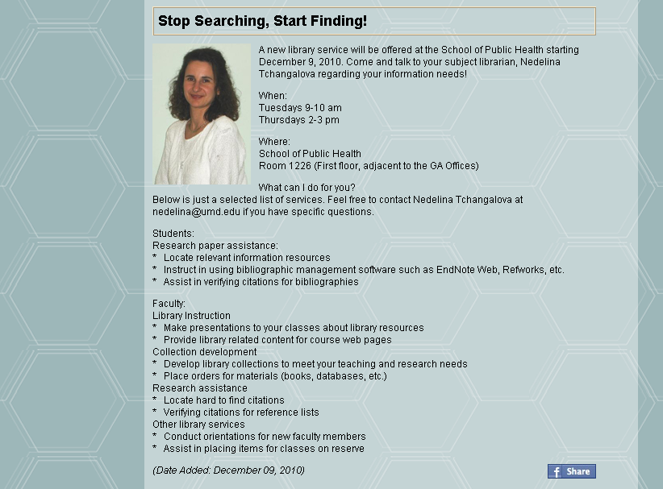
Other Outreach Ideas
Embedded Librarianship

Slide 21
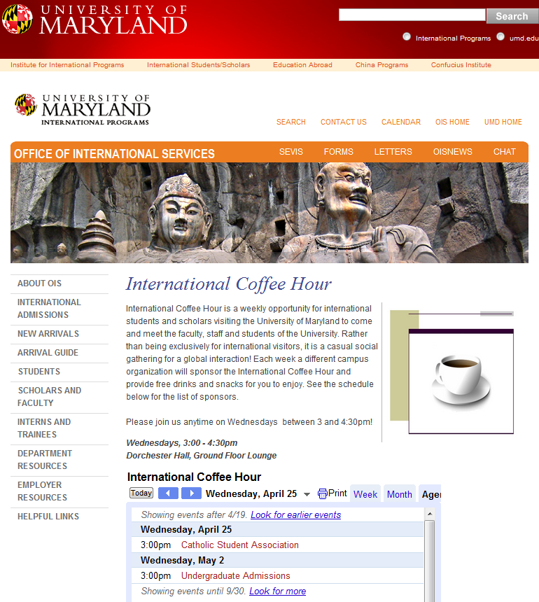
Other Outreach Ideas cont.
International Coffee Hour
http://www.international.umd.edu/ies/7490

Slide 22
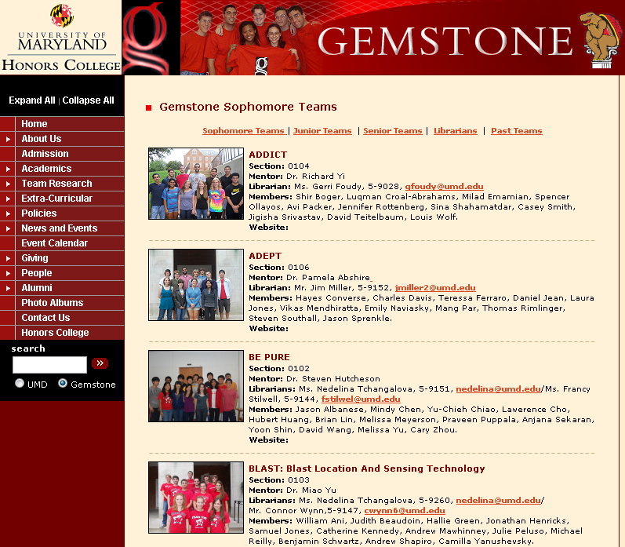
Other Outreach Ideas cont.
Honors Programs
http://www.honors.umd.edu/compare.php
Tchangalova, N. & Stilwell, F. (2011) Teach for knowledge, mentor for success: Preparing students to enter the workforce. Proceedings of the International Conference on Technology Enhanced Learning, Sofia, Bulgaria. Retrieved from http://www.ictel.innov.org/ and http://hdl.handle.net/1903/11405.
http://www.gemstone.umd.edu/

Slide 23
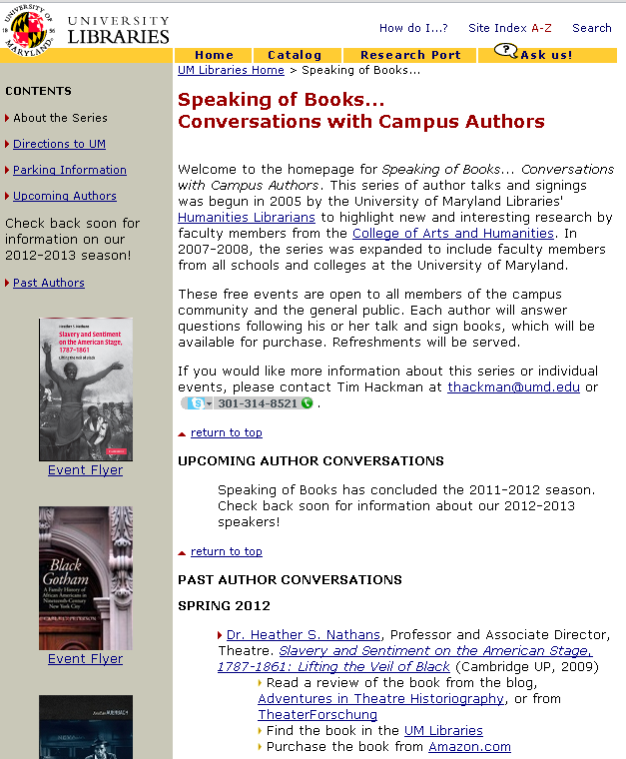
Other Outreach Ideas cont.
Speaking of Books...
Hackman, T. (Spring 2009). Speaking of books… Connecting with faculty through a campus author series. Electronic Journal of Academic and Special Librarianship 10 (1). Retrieved from http://southernlibrarianship.icaap.org/content/v10n01/hackman_t01.html.
http://www.lib.umd.edu/MCK/booktalks.html

Slide 24
Questions?
Contact:
Nedelina Tchangalova
nedelina@umd.edu

