Slide 1

LIAISON Librarianship: WHO ARE WE?
YELENA lUCKERT
Notes:
1. I am Yelena Luckert and I would like to talk about Liaison Librarianship and why some consider it to be an integral part of the success of libraries going forward. Of course, UMD libraries were engaged in many of the liaison activities prior to recent years.

Slide 2

Liaison Services Task Force (LSTF)
October 2012-June 2013 http://drum.lib.umd.edu/handle/1903/17456
  Developed framework for subject liaison librarianship at UMD
    Role of subject librarians at UMD
    CORE areas of responsibilities
      Collections, Instruction, Reference, Outreach and Scholarly Communications/Data Research
      Both subject and skill based
    Best practices for each CORE area
    Recommendations for going forward
Notes:
2. To be more deliberate, in 2012 a Liaison Task Force was set up to comprehensively look into this issue and develop the framework for liaison librarianship at UMD, defining the role, core responsibilities and best practices, and providing a list of recommendations to go forward.

Slide 3
LSTF Recommendations
  CORE Competencies for liaison librarians (both subject specific and soft skills)
  Assessment methods to evaluate liaison work (annual reviews, not liaison program)
  Marketing and promotional plan (to advertise liaison work and accomplishments on campus and within the Libraries)
  Training program
  http://drum.lib.umd.edu/handle/1903/17456
Notes:
3. The Report had a total of four recommendations, listed on the slide. All four recommendations were developed and implemented in stages, with the participation of everyone affected, and are constantly updated to reflect changes and new directions.

Slide 4
National trends
Hahn, Karla, Ed., and Association of Research Libraries. Research Library Issues: A Bimonthly Report from ARL, CNI, and SPARC. RLI 265. Chicago: Association of Research Libraries, 2009.
Jaguszewski, Janice M., & Karen Williams. New Roles for New Times: Transforming Liaison Roles in Research Libraries. Washington, D.C.: Association of Research Libraries, 2013.
Mack, Daniel. C., & Gary W. White. Assessing Liaison Librarians: Documenting Impact For Positive Change (Publications in librarianship, no. 67; ACRL publications in librarianship, no. 67). Chicago, Illinois: Association of College and Research Libraries, 2014.
Miller, Rebecca K., and Lauren Pressley. Evolution of Library Liaisons. SPEC Kit 349. Washington, DC: Association of Research Libraries, November 2015.
Rockenbach, Barbara, Judy Ruttenberg, Kornelia Tancheva, & Rita Vine. Association of Research Libraries/Columbia University/Cornell University/University of Toronto Pilot Library Liaison Institute: Final Report. Washington, DC: Association of Research Libraries, 2015.
Notes:
4. We were in step with national trends. Other academic libraries led by major professional organizations realized that rapid changes in higher education necessitated a reconceptualization of the existing norms and roles for subject librarians in order to address emerging campus trends.

Slide 5
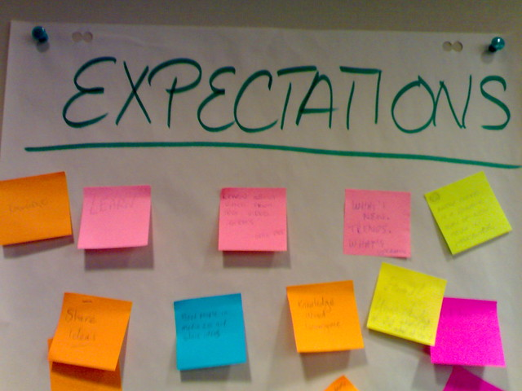
So what are the new expectations?
This Photo by Unknown Author is licensed under CC BY
Notes:
5. So what are the new expectations and how they differ from before? There is more oversight, accountability, and emphasis on being proactive in outreach and engagement with departments, students, and faculty, developing partnerships in all areas of work.

Slide 6
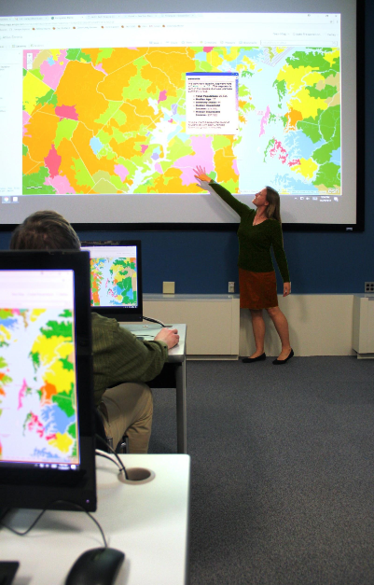
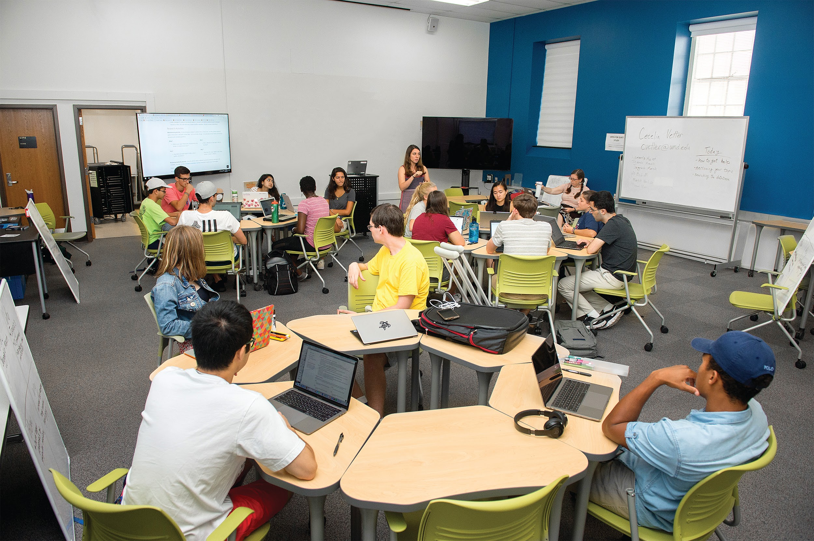
Instruction
Notes:
6 Instruction has become our biggest activity. We practice student central learning, incorporate traditional and flipped classroom methods, use flex teaching spaces, think of pedagogue, promote OER, and developed a comprehensive LOA program, praised by the campus.

Slide 7
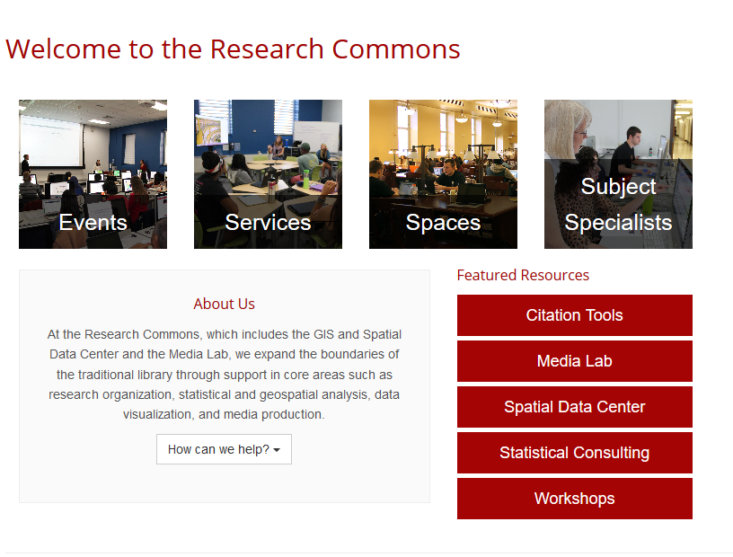
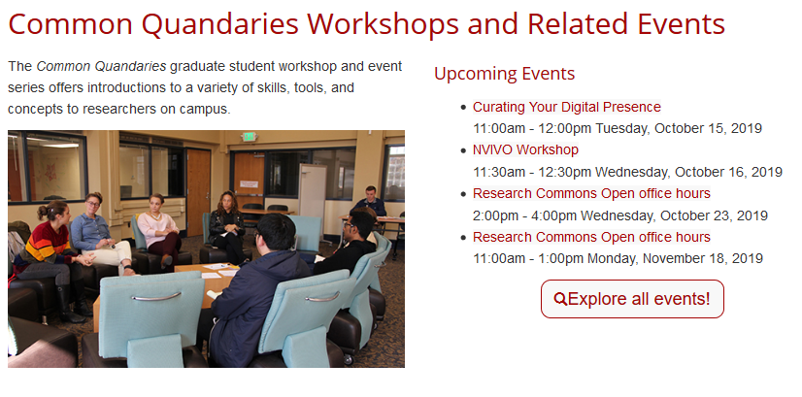
Holistic approach to user needs
Notes:
7. We practice a holistic approach to patrons’ needs. Along with traditional research assistance we provide non-traditional services for which we offer workshops and consultations through Research Commons, many of which we conduct jointly with internal and campus partners.

Slide 8
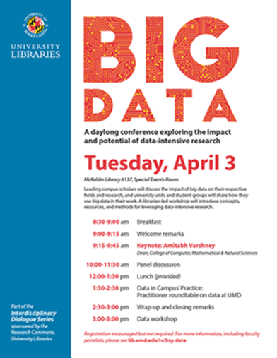
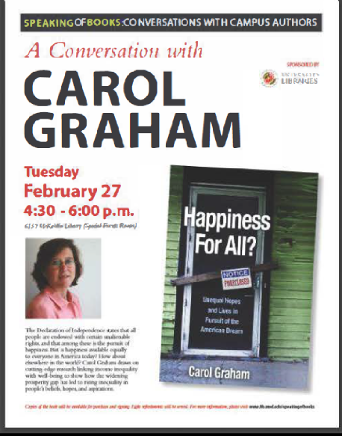
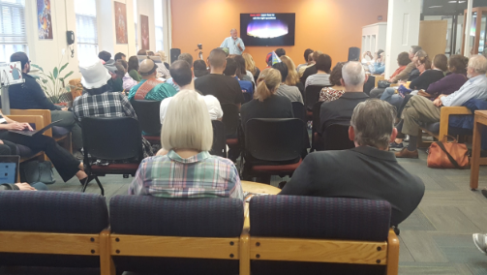
Library as Intellectual hub
Notes:
8. We aim to be an intellectual hub on campus, bringing into the libraries groundbreaking research and interdisciplinarity, including series like Interdisciplinary Dialogues, STEAM Salons, and Speaking of Books, which have become the desired outlet for faculty to present their ideas.

Slide 9
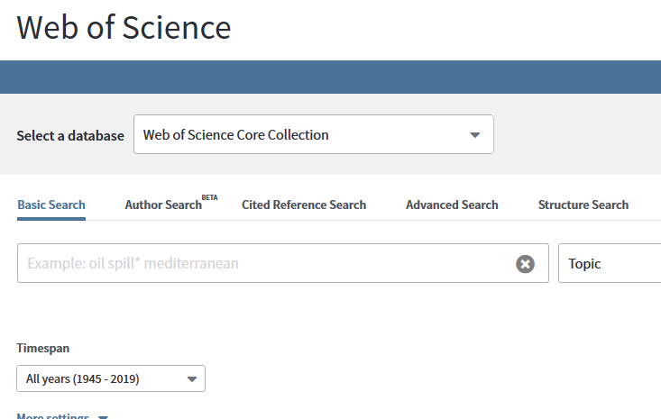
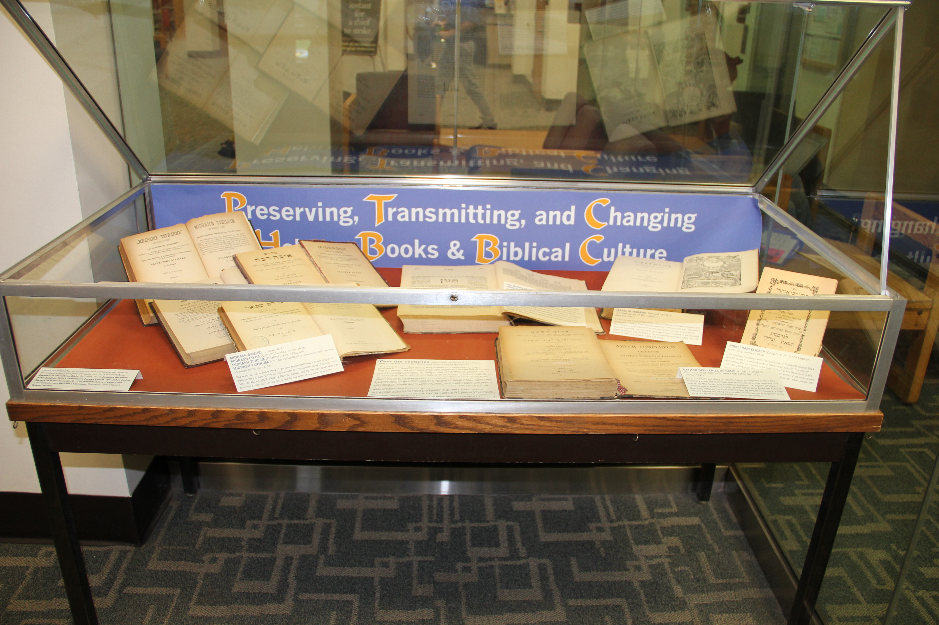
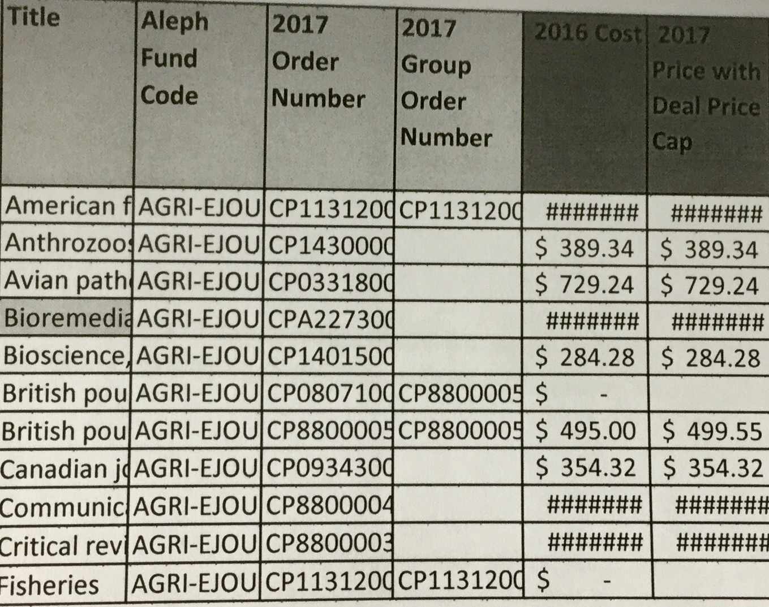

collections
Notes:
9. We curate general collections, deciding on what to purchase, realign, and unfortunately cut, based on the knowledge of our departments, faculty research, and student learning, and guided by our knowledge of disciplines. Collections is the number one faculty concern.

Slide 10
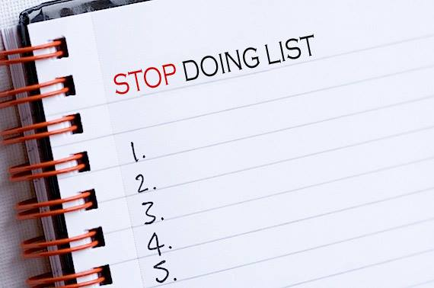
Stop doing?
This Photo by Unknown Author is licensed under CC BY-SA
Notes:
10. Some things we had to stop doing guided by meticulous research and data analysis. Like serving as a reference frontline; using more automation in collections; and scaling up and moving to online mega classes like the Professional Writing Program, over 5000 students/year.

Slide 11
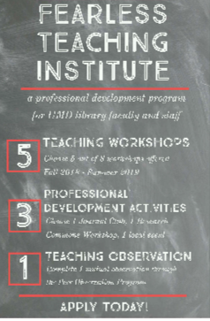
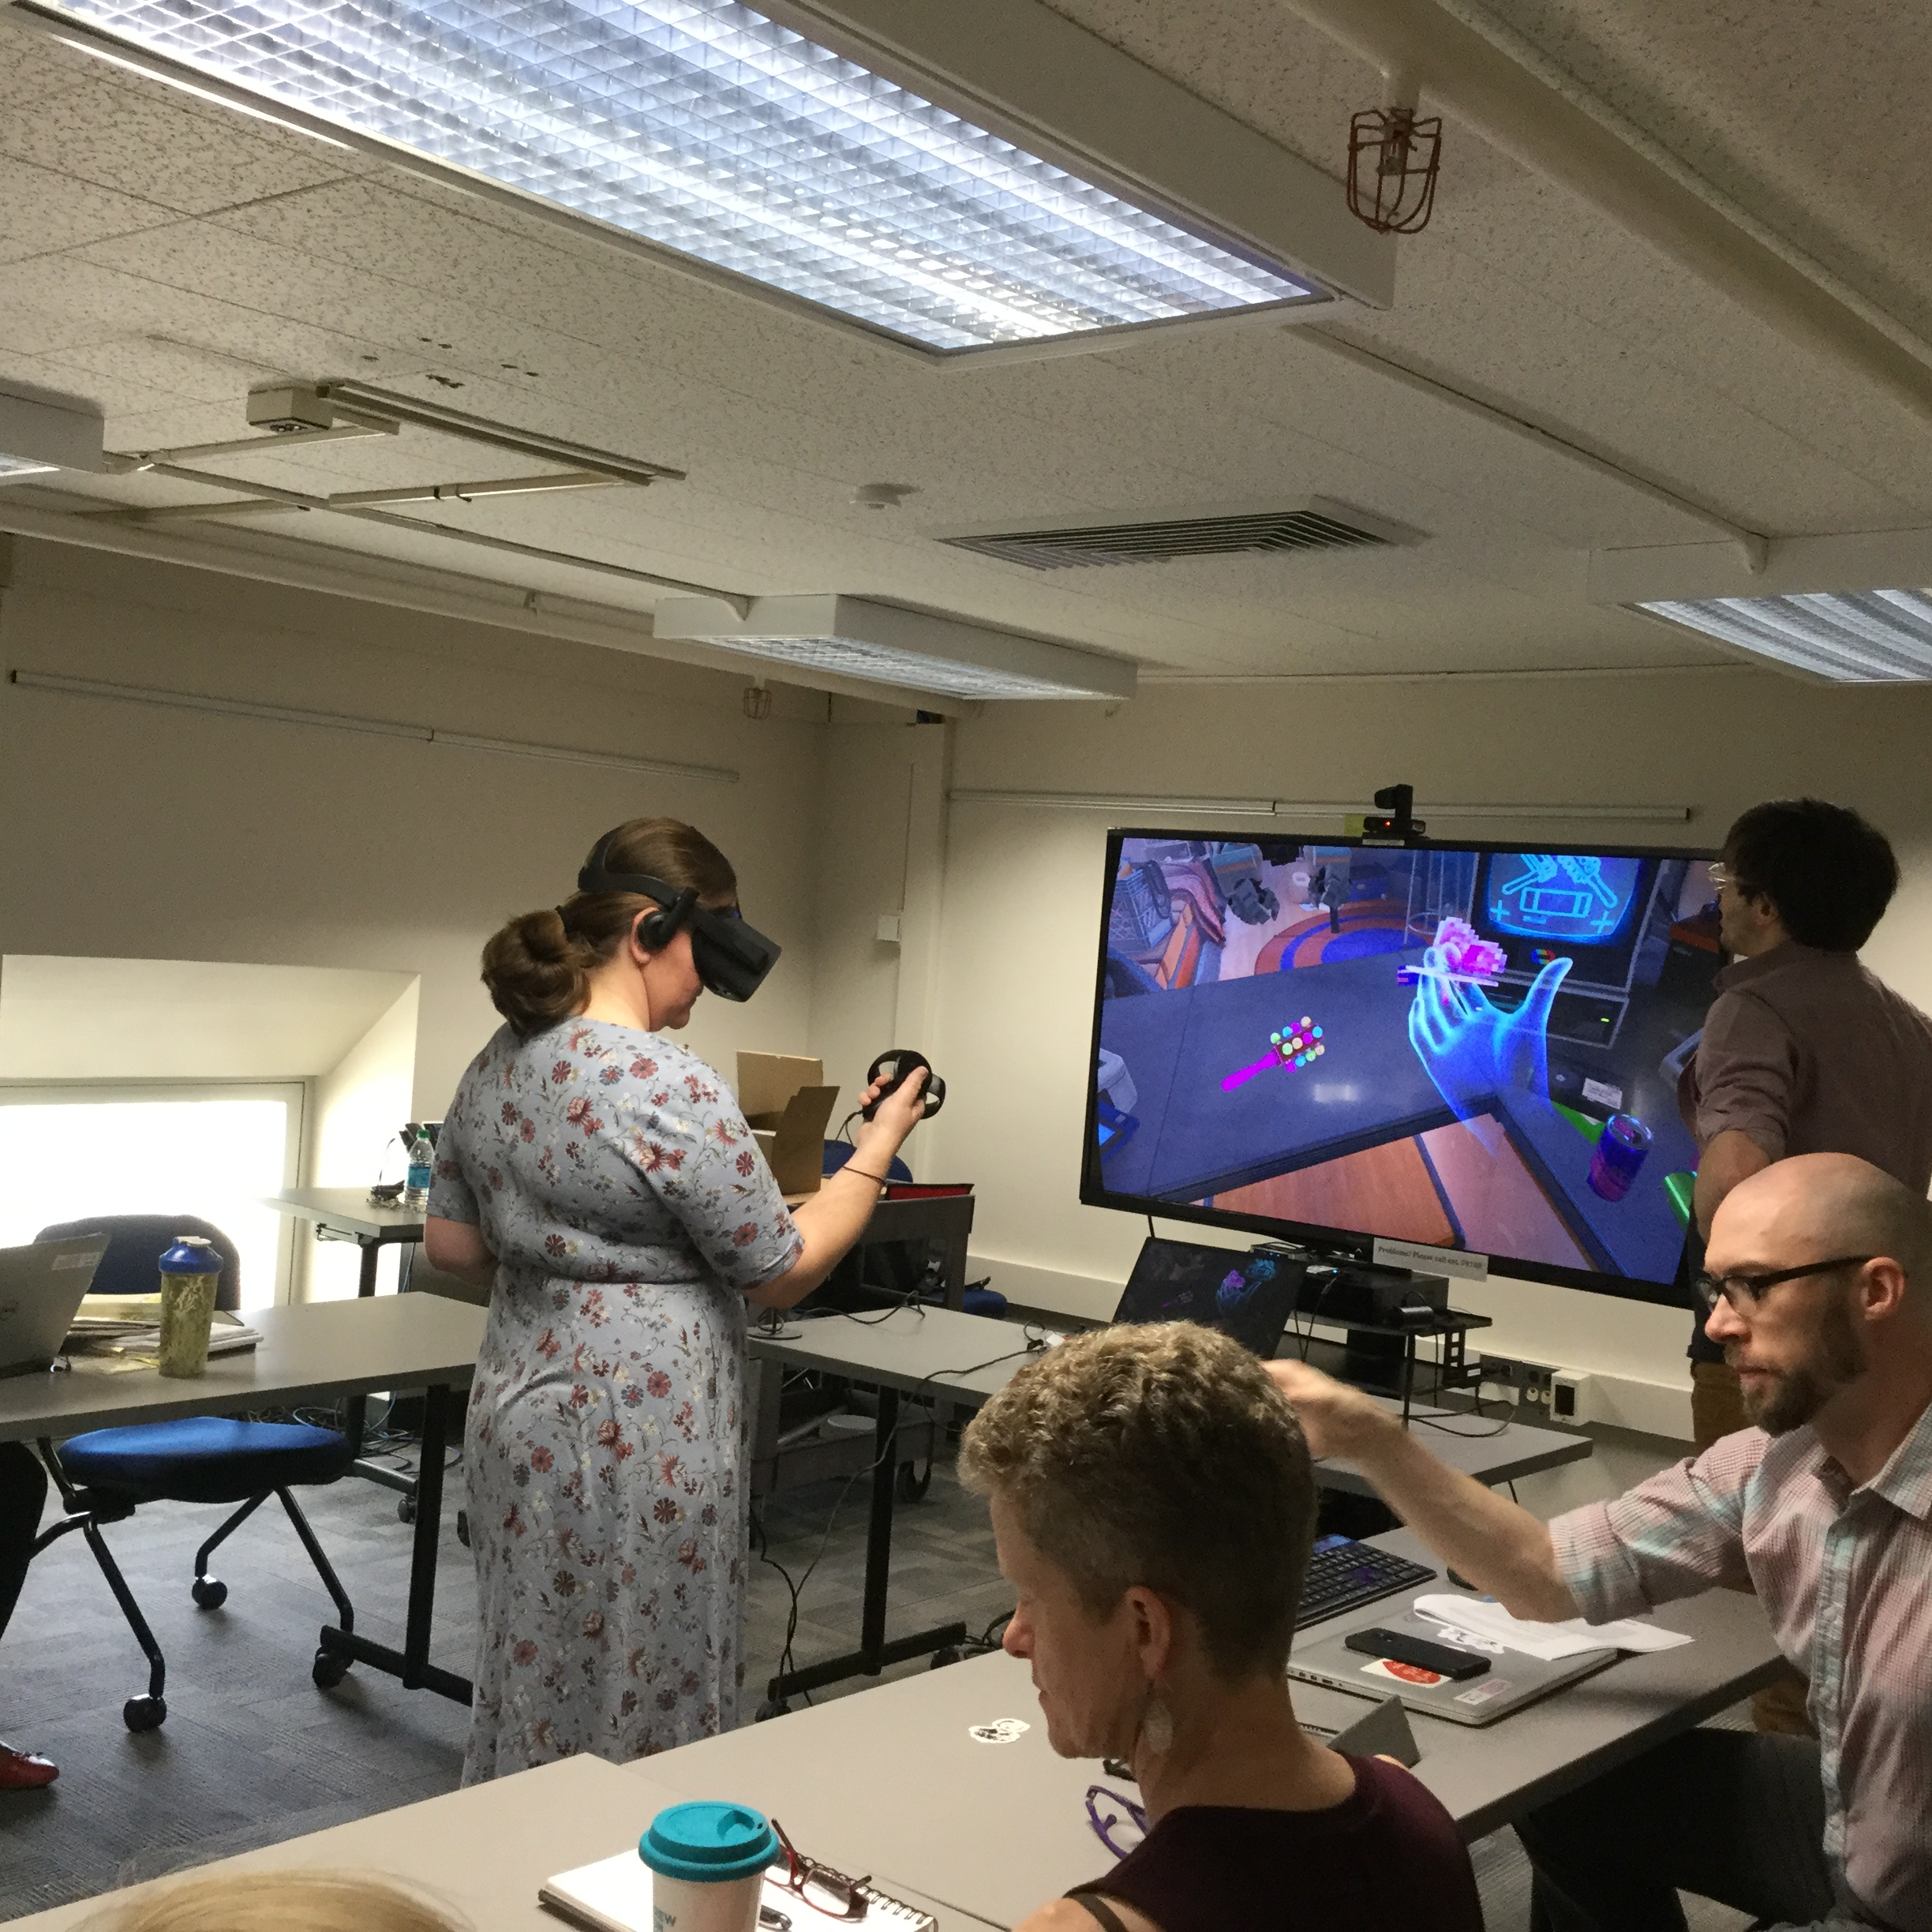
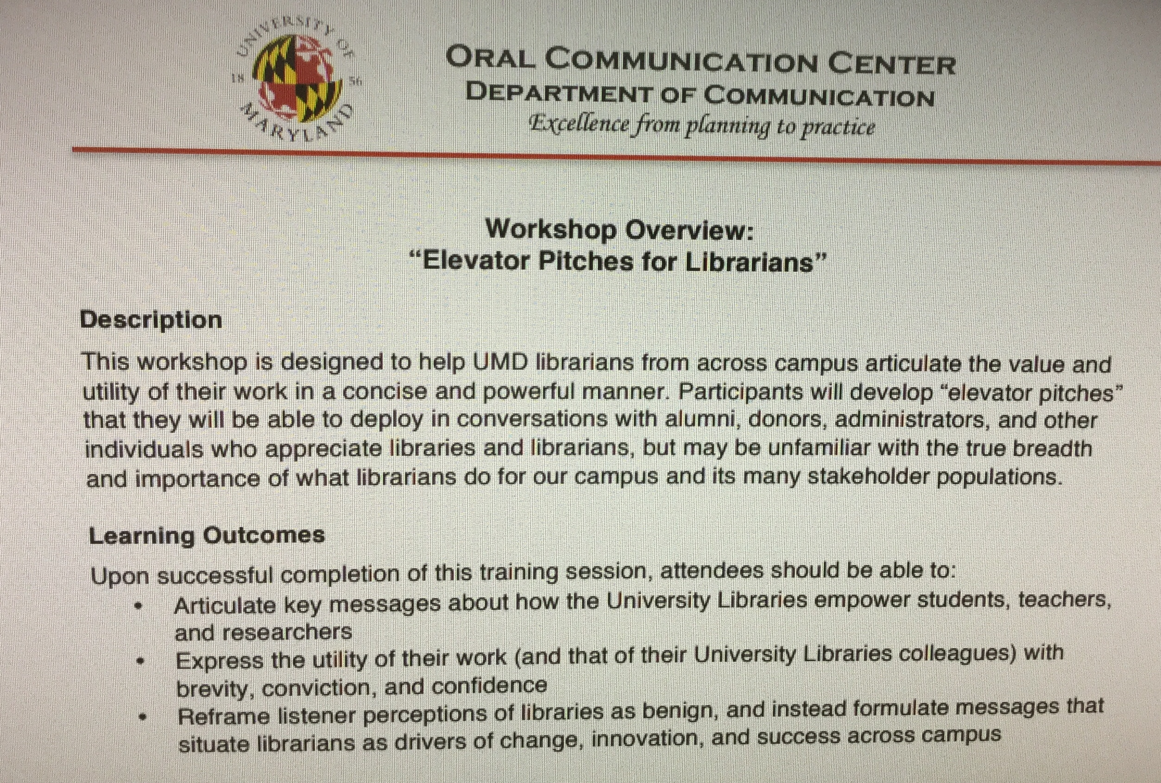
training
Notes:
11. We value training. Internally we created the onboarding checklist for new hires; monthly forums to share day-to-day work and ran one-shot Multigenerational Workplace and Kick-Ass Communication workshops. We established the Fearless Teaching Institute to help us be better teachers

Slide 12


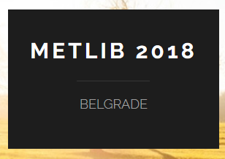










PROFESSIONAL WORK
Notes:
12. We develop programs and present at conferences, globally. We take subjects and professional classes. In June 2019 we run the first BTAA Liaison Institute to develop a liaison librarians network among the Big Ten institutions, and were asked to continue to lead this effort.

Slide 13
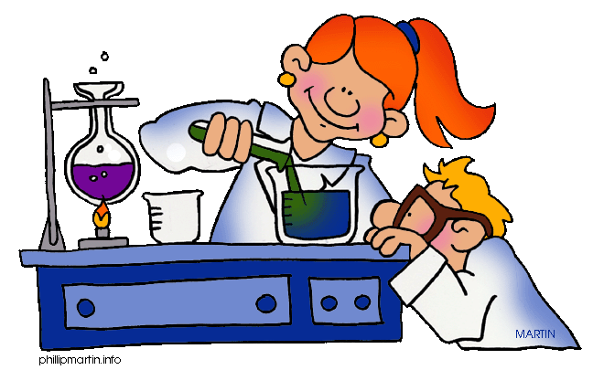
“Failure is the key to success!”
This Photo by Unknown Author is licensed under CC BY-SA-NC
Notes:
13. We allow for experimentation and do not frown on failures. We acknowledge them in our annual reviews and think of how we can use them to improve. We have highly individualized work, but we support each other by sharing experiences and partnering on projects.

Slide 14
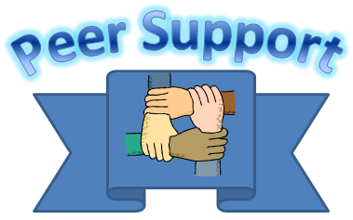
Thank you, Library, for your support!
This Photo by Unknown Author is licensed under CC BY-SA
Notes:
14. We can’t do it without support and redeployment of staff in other units, like the Services Desk staff taking over the front line operation. We are very grateful for the support of USRS, CSS, and DSS. Kudos to you!

Slide 15



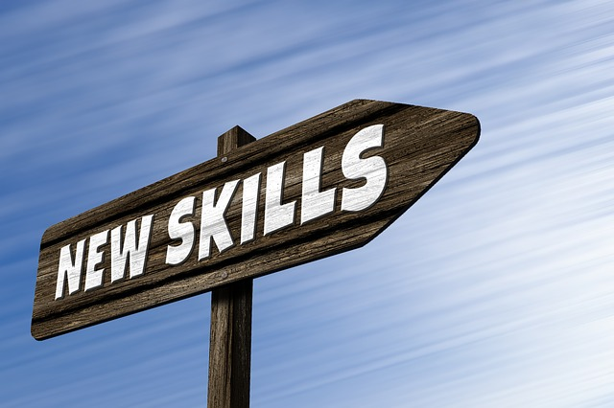
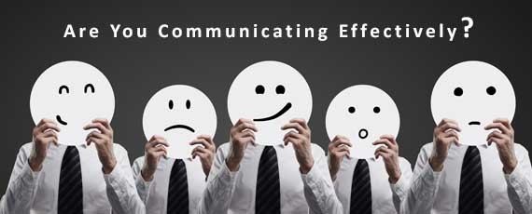

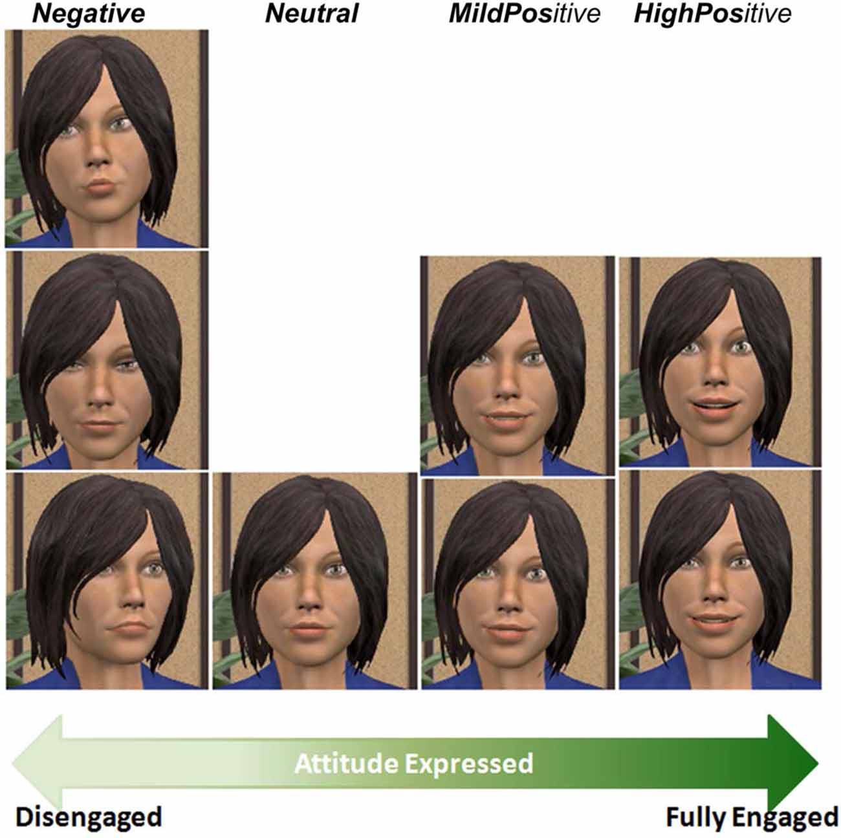
Challenges
Notes:
15. We must keep up with and learn new skills, as technology, research, teaching, disciplines, and libraries change, and maintain a high level of engagement. Communication is our biggest challenge: is it too much, too little, bad news, who paid attention?

Slide 16
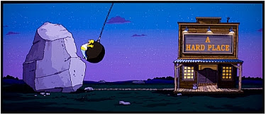
Department or Library? – Both!!!!
This Photo by Unknown Author is licensed under CC BY-NC-ND
Notes:
16. We represent both departments and the Libraries. Delivering hard news makes us vulnerable. It puts us at odds with our internal colleagues OR with patrons. In such situations, we need Libraries’ understanding and support.

Slide 17

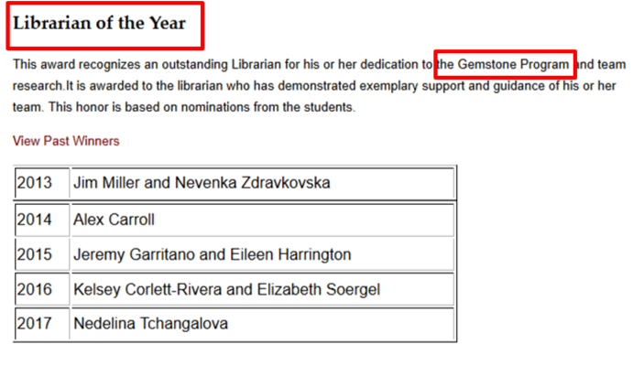
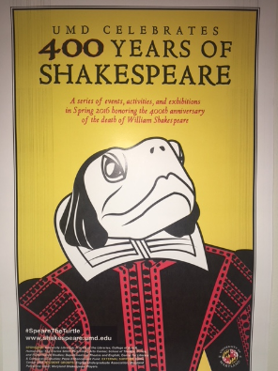
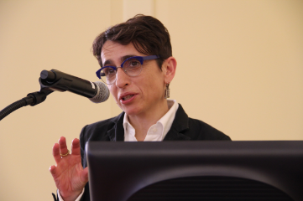
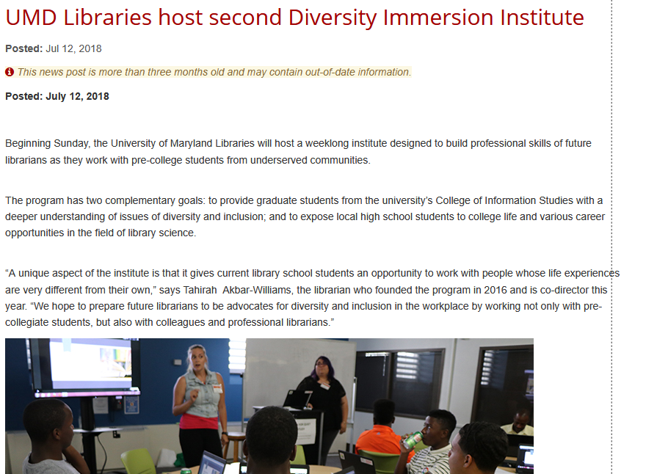
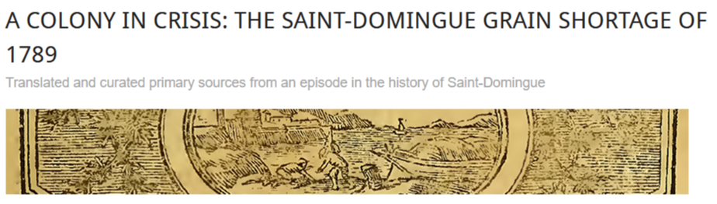
Work with faculty/departments
Notes:
17. Some departments and faculty are more excited to work with us than others and thus we have to exercise patience, perseverance, good judgment, and trust, building block by block on the reputation and work we have already done. This takes time and energy.

Slide 18
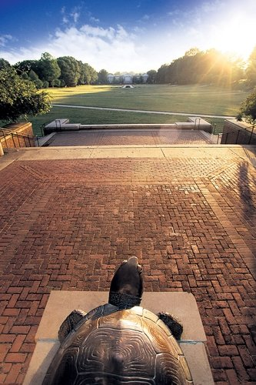
Our campus, our community
This Photo by Unknown Author is licensed under CC BY
Notes:
18. So why is the liaison work is important? It all goes back to “Community.” Campuses, libraries, and departments all differ, having their own cultures, goals, social structure and expectations. For a library to be successful, we need to develop a personal approach for each.

Slide 19

Liaison work…
This Photo by Unknown Author is licensed under CC BY-SA-NC
Notes:
19. Liaisons are that individual departmental support, best suited to bridge the communication gap between libraries and academics and to provide that individualized service based on our disciplinary engagement and our goals for the job.

Slide 20
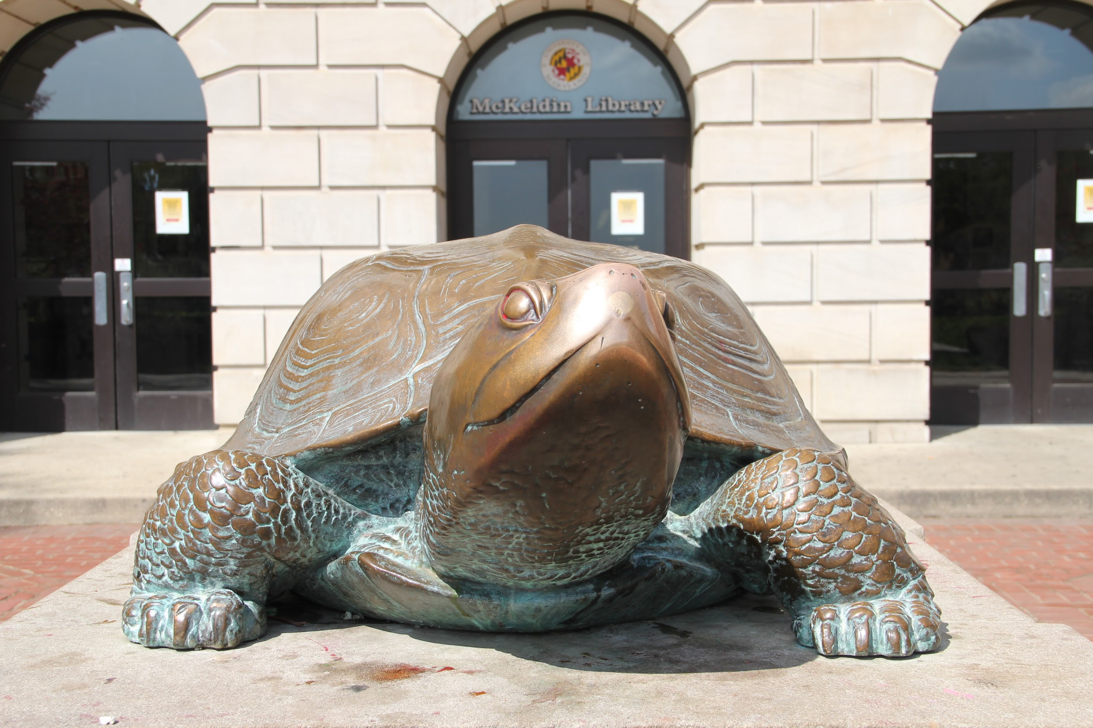
Thank you
Notes:
20. In doing liaison work we found great appreciation among faculty and students for the work we do. This has been documented anecdotally and through assessment (like LibQual), but also in established partnerships on a multitude of projects some of which I showed in this talk. Thank you.

