Slide 1

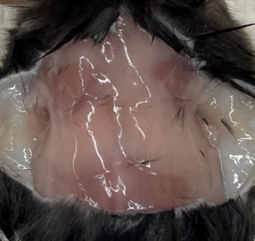
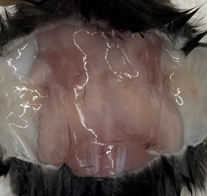
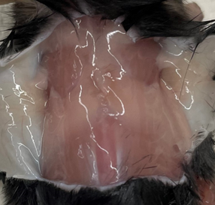
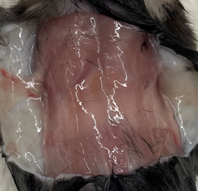
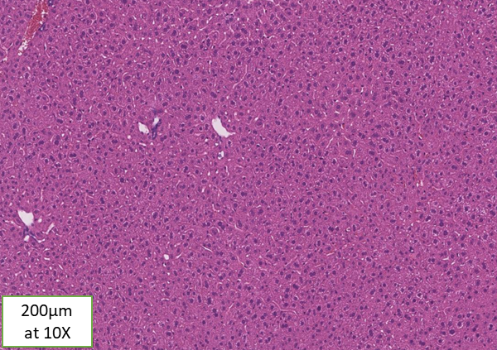
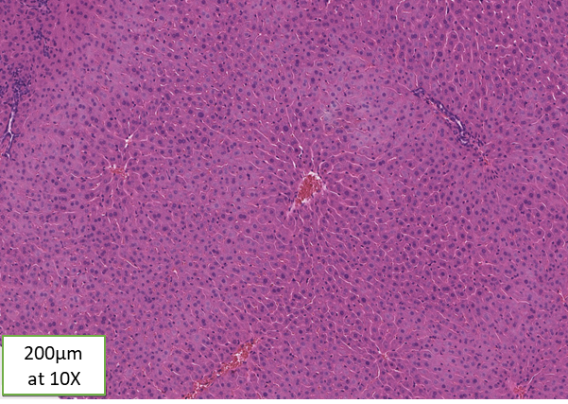
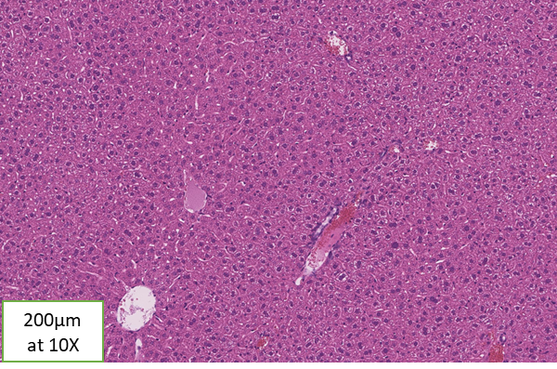
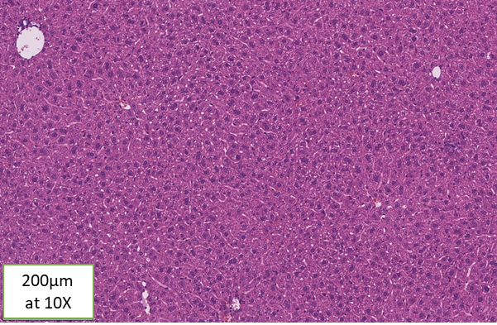
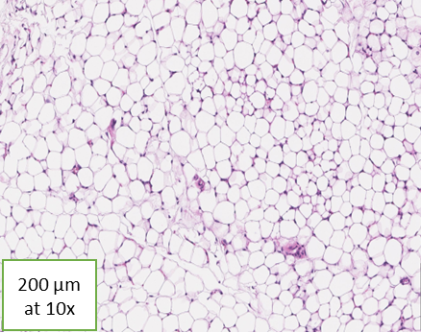
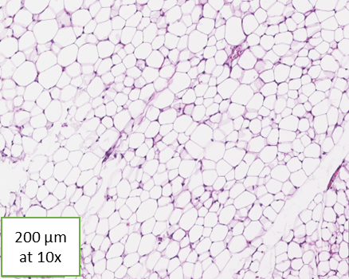
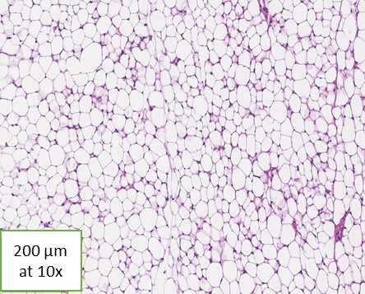
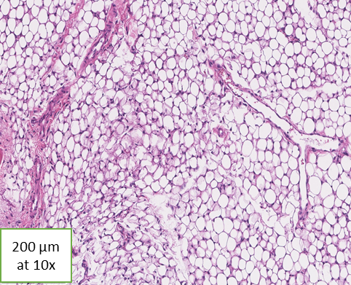
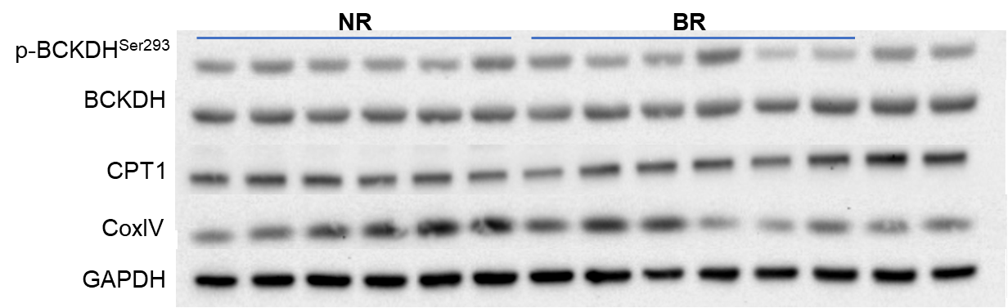
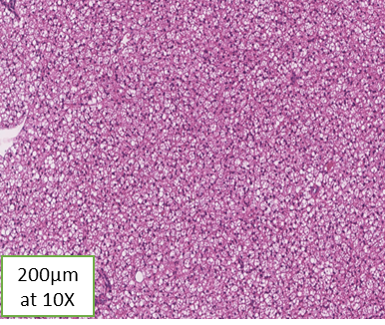
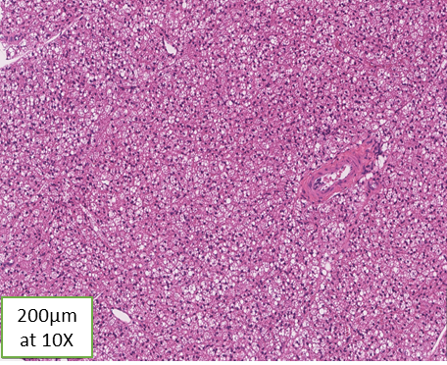
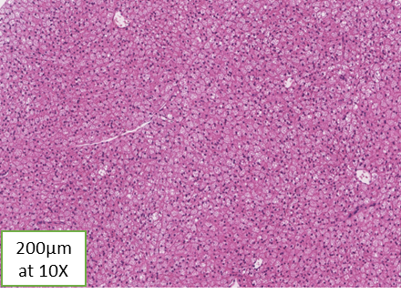
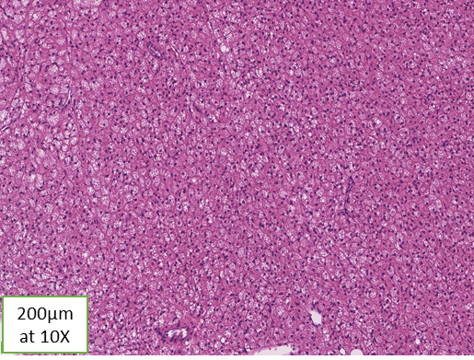
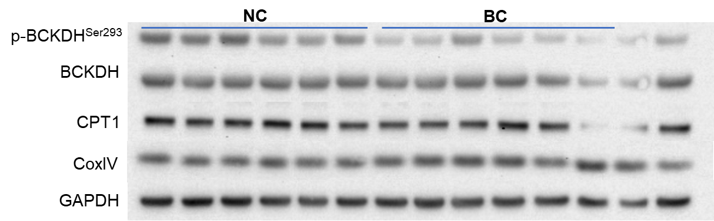
Impact of Branched Chain Amino Acids and Cold Exposure on Liver and Adipose Metabolism
Ipsa Mishra, Caitlin E. Ryan, Parama Bhattacharjee, Nishanth E. Sunny
Department of Animal and Avian Sciences, University of Maryland, College Park
Abstract
Results
Results
Branched chain amino acids (BCAAs; Valine, Leucine, Isoleucine) are the primary regulators of tissue protein synthesis. However, higher plasma BCAAs and defects in their degradation coexist with disorders of lipid metabolism during insulin resistance and NAFLD. On the contrary, BCAAs have also been shown to induce mitochondrial lipid oxidation and lower lipid synthesis in insulin sensitive livers. I used cold exposure as a stimulus to amplify the impact of BCAAs on lipid metabolism in the liver and adipose tissue. I hypothesized that in insulin sensitive mice, cold exposure + BCAAs, will prime the liver to induce mitochondrial metabolism while also priming the adipose tissue for adipogenesis. Male mice (C57BL/6NJ) were assigned to four treatments for 2-wks: 1) no BCAAs, room temp; NR, 2) BCAAs in water, room temp; BR, 3) no BCAAs, cold exposed for 5-hrs 10℃; NC, 4) BCAAs in water, cold exposed for 5-hrs 10℃; BC. All mice were given ¹³C₆ leucine in drinking water, for 24-hrs, prior to sacrifice for blood and tissue collection. Western blots of the liver tissue revealed that BCAA degradation (lower pBCKDH/ BCKDH ratio), lipid oxidation (CPT1A), and mitochondrial function (COXIV) proteins were higher in BCAA enriched groups. Tissue histology (H&E) showed no significant differences in lipid accumulation. Gas chromatography-mass spectrometry analysis of plasma ¹³C₆ leucine showed higher enrichment of ¹³C₆ leucine and its keto acid in both BR and BC groups. These results suggest that BCAA supplementation + cold exposure can be a good strategy to amplify the impacts of BCAAs on mitochondrial lipid metabolism, during insulin sensitivity and NAFLD.
Figure 1. Impact of cold exposure and BCAA supplementation on adipose tissue and liver histology
Figure 3. BCAA supplementation led to higher rates of BCAA degradation than their non-supplemented counterparts
NR
BR
NC
BC
A)
B)
C)
D)
A) Gross morphology of subscapular adipose tissue. Hematoxylin and Eosin (H&E) stained sections of B) Liver, C) White adipose tissue, and D) Brown adipose tissue.
BCAA supplemented animals degraded more leucine. ¹³C₆ leucine was provided in drinking water to follow its dilution into plasma leucine and incorporation into KIC-leucine (keto acid), an index of BCAA degradation. a = NR vs. BR, b = NR vs NC, c = NC vs. BC, d = BR vs. BC; Significance at P ≤ 0.05
Introduction
Figure 4. BCAA supplementation resulted in higher rates of BCAA degradation and changes in mitochondrial function
BCAAs (Valine, Leucine, Isoleucine) are the amino acids most sensitive to insulin action and are important regulators of protein synthesis.
Increased plasma BCAAs and defects in BCAA degradation co-exist with disorders of lipid metabolism during insulin resistance, obesity and non-alcoholic fatty liver disease (NAFLD)⁽¹⁾.
Liver and adipose tissue regulate whole body energy metabolism through hormonal regulation and diet^{(2,3,4)} and thus understanding the impact of BCAAs on liver and adipose tissue is of significance.
Hypothesis: Cold exposure together with BCAA supplementation, will induce fatty acid oxidation and increase rates of adipogenesis.
IS
Western analysis yielded hepatic differences in protein expression between experimental groups. Western blot analysis of the liver yielded differences in mitochondrial function (COXIV), lipid oxidation (CPT1), and BCAA degradation (pBCKDH/BCKDH).
Experimental Design
Figure 2. Circulating BCAAs and their corresponding ketoacids following cold exposure and BCAA supplementation
C57BL/6N male mice (n=8 per treatment for 2-wks)
1) Normal drinking water + Room temperature (NR)
2) BCAA supplemented drinking water + Room temperature (BR)
3) Normal drinking water + Cold exposure (10°C, 4-hrs/day) (NC)
4) BCAA supplemented drinking water + Cold exposure (BC)
a = NR vs. BR, b = NR vs NC, c = NC vs. BC, d = BR vs. BC;
Significance at P ≤ 0.05
Summary Points
While cold exposure induced browning of the white adipose tissue, no differences in tissue histology could be detected in response to BCAA supplementation.
Cold exposure resulted in significantly lower plasma levels of BCAAs and their corresponding ketoacids.
BCAA supplementation resulted in higher rates of BCAA degradation. However cold exposure did not impact BCAA degradation.
Further studies will evaluate the tissue specific impact of BCAA supplementation and cold exposure on mitochondrial metabolism.
Labeled leucine [¹³C₆] was supplemented to the drinking water of all groups of mice 24 hours before tissue collection.
Mice were fasted 4 hours before collection of blood and tissues. Liver, muscle, brown adipose tissue (BAT), and white adipose tissue (WAT) were flash frozen in liquid nitrogen and stored at -80°C.
Hematoxylin and Eosin (H&E) staining was conducted on paraformaldehyde fixed liver and adipose tissue.
¹³C enrichment in plasma metabolites and targeted metabolomics was conducted using gas-chromatography/mass-spectroscopy.
Protein expression was determined using western blot analysis.
References
Sunny, N. E et. al Mitochondrial Dynamics and Oxidative Stress in Disease (2015)
Kalra et. al StatPearls (2023)
Luo and Liu J Endocrinol. (2016)
Kersten EMBO Rep (2001)

