Slide 1
UPS Address Cleanup Project
University of Maryland Libraries
Austin Smith (RSR), Emily Spangler (L&P) & Taylor Vaughan (RSR)
Notes:
Emily
Thank you for attending our presentation about the UPS Cleanup Project. We are ///, ///, ///. We started this project back in the Fall semester around December and finished up in March. Just for some brief background on the project, a huge aspect of both Logistics and Periodicals and Resource Sharing and Reserves is shipping books to other schools, whether it's our books for loan or returning them to the lending library. We ship materials primarily through UPS, and last semester we were able to identify large issues with our UPS address book. This is a presentation addressing those issues and how we implemented solutions to result in more efficient shipping processes.

Slide 2
The Problems
We were being billed for incorrect UPS addresses
ILL message boards were expressing similar frustrations
Our UPS address book was cluttered, filled with duplicates and irrelevant addresses
Notes:
Austin
This project was inspired by discussion on an ILL mailing list about UPS charging for address corrections.
When we looked into this, we realized we were being charged for corrections, regularly, for addresses that should have been updated.
This was happening because of poor communication between two of our systems, ILLiad and WorldShip.
1. ILLiad is our ILL management system; it has address records for all libraries we borrow from and lend to. These address records are updated regularly.
2. WorldShip is our UPS shipping system. It keeps its own address book. Addresses in WorldShip were not being updated; new records were being added.
RSR has defined a number of address barcodes that link a record in ILLiad with a record in WorldShip, but these barcodes were defined only for a minority of all addresses.
Most records in one system could not reliably be linked to records in the other system. This made it nearly impossible to keep the WorldShip address book up to date, and let to a high rate of duplication and retention of old, incorrect data.
After analysis, we realized that this project was going to be bigger than we though, & that our existing practices were not working.

Slide 3
The Solutions
Importing a new UPS address book
Improving our relationship with UPS and our own internal workflows
Including other departments, units, and schools in this project to better ILL lending and borrowing practices
Notes:
Taylor
During the initial discussion of those problems, we determined three steps were needed:importing a new UPs address book in to our worldship account, reaching out out our UPS representative for more information, and while also evaluating how we can change our existing workflows to best minimize mistakes. We wanted to also include other departments within the library that use the UPS machine, as well as other libraries to try to get address to more consistent formatting. This presentation will go over how we created solutions and changed our workflows to have a more consistent and efficient system.

Slide 4
Old UPS Address Book
Over 5000 addresses. Included:
Duplicate addresses
Addresses we didn’t need anymore
Addresses that were incorrect or out-of-date
Notes:
Emily
After figuring out that we were being billed for incorrect addresses, we identified the main root of the problem as the UPS address book. When we first started the project, the UPS address book was almost hopelessly messy and cluttered. It had over 5000 addresses in it, of which we really only needed a quarter of it turned out. Among the irrelevant addresses were many duplicates or addresses of libraries that we simply didn’t ship to anymore or that were out of date. This, we concluded, was reason for concern because student assistants regularly process outgoing shipments. The more addresses in the address book, the more room for error there was, and the goal should really be one barcode, one library, one address.

Slide 5
Include
Before scheduling the import, we asked several departments in our library if they needed to include addresses
Our Digitization department at UMD also uses the UPS machine to ship and receive packages, so it was essential to keep them updated about the timeline of this project, as well as ask them for any addresses they wanted us to include in the import
We hope sharing this process will encourage other schools with ILL departments or heavy resource sharing workloads to assess their address book
It may also benefit ILL departments to make sure their own addresses are consistent as a best practice, to limit unnecessary UPS charges for other schools
Notes:
Emily
Of course, with any project like this that expands across multiple units, communication is key. We knew that L&P and RSR units were being heavily affected by this UPS address problem, but were other departments being affected as well? We weren’t the only department using the UPS machine to send shipments out, that much we knew, but we wanted to make sure to inform others about our intention to delete the address book and import a new one, so that no one was confused after we did the import and couldn’t find their addresses. We asked several departments in McKeldin and only the digitization department sent back a list of addresses they would like to include in the import, so that was important in the process as well, making sure we included others that may use the UPS machine. Additionally, we want to try to share this project with as many libraries as possible, so those with ILL capabilities can perhaps assess their own address book and see if improvements can be made. We think the ultimate goal of all libraries with ILL and shipping responsibilities is to strive to make these processes as efficient as possible, and sometimes that isn’t possible without some investigation into our own systems. We are also trying to encourage other libraries to make sure their own addresses are consistent, to try to limit unnecessary charges for other schools.

Slide 6
Export, Review, & Import
Through ILLiad, we identified ILL UPS addresses we currently ship to and put these addresses into two spreadsheets via Google Sheets for collaboration ease
One sheet designated as “Review Needed” for addresses that may be needed but were missing pertinent information, i.e. address line, zip code, etc., and another designated as “Ready for Import” for addresses that had no issues
About 900 addresses needed to be reviewed, so we each reviewed around 300
Once the addresses were cleaned up, they were added to the “Ready to Import” spreadsheet
Notes:
Austin
To begin with: we identified around 1400 addresses in ILLiad that we’ve shipped items to in the past five years.
This would serve as the kernel of our new WorldShip address book.
However:
These addresses are stored as plain text, not separated into fields as UPS requires. Manually formatting this data would take dozens of hours of mind-numbing work.
To avoid this, we wrote a python script to parse free-text addresses into UPS-compatible formatted fields.

Slide 7
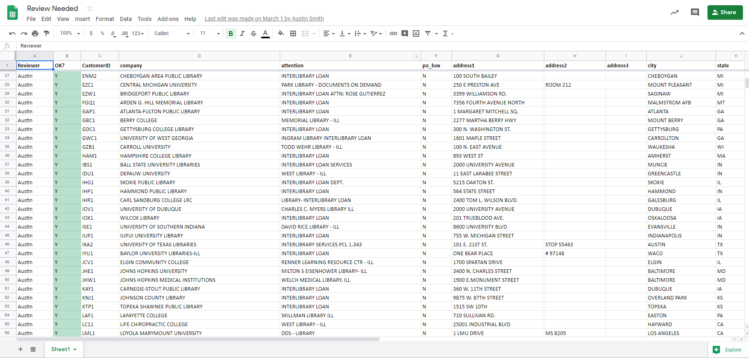
Notes:
Austin
The python script we used was able to successfully parse the majority of addresses, but we knew there would be a few errors.
We did end up manually reviewing around 900 of the addresses to ensure that the formatting was correct.
Since the script did most of the work, this only took a few hours - much faster than doing it all by hand.
The script took a while to develop, mostly because the Spring semester was quite busy. Nonetheless, the time savings were significant.

Slide 8
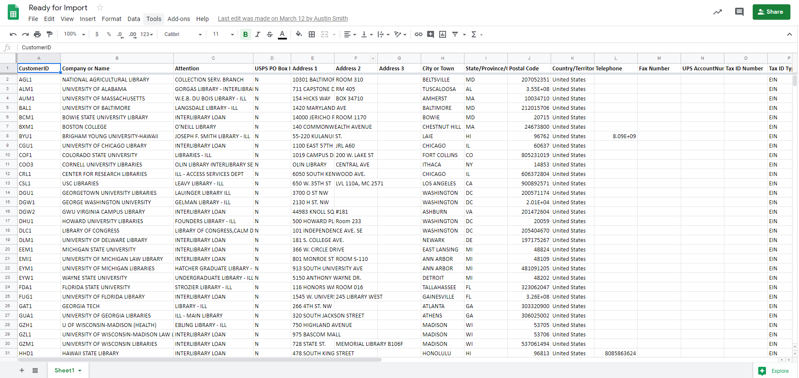
Notes:
Austin
Once we were satisfied with the formatting of the new addresses,
We deleted the existing UPS address book, and replaced it.
The python script also assigned an address barcode to each address record. These were also imported into WorldShip, ensuring a 1:1 relation between records in the two systems. This will make it much easier for us to keep records updated in the future.

Slide 9
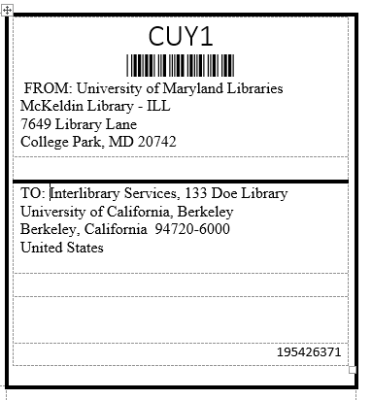
Improve
Creating UPS address barcodes will reduce the need for entering addresses manually, which often leads to duplicates or incorrect addresses
Goal is to be able to scan most UPS addresses with a barcode, which then populates the address correctly every time
Contacted our UPS customer representative as our point of contact for issues such as billing charges, address questions, and other technical help
Notes:
Taylor
So to prevent the address book from getting as bad as it was, we wanted to improve our workflows to prevent duplicate addresses. With the new shipping codes, we (Austin) were able to add those as barcodes to the shipping labels that print out with each item, so that instead of typing in address manually, students can just scan the barcode and have the correct UPS address for each library. This should eliminate the duplicate addresses and address correction billing, because they were often made because of minor typos.
I also contacted our UPS rep and had a long conversation with him, just to get in contact with him. He was able to provide some other resources that we could use, if needed.

Slide 10
Considerations
We planned to use an UPS address validator before importing, but realized the validator did not recognize some of the correct addresses
International shipping addresses were excluded from the review and import because they are always checked before a shipment
We thought this would be a relatively quick process but ended up taking 3-4 months to complete
We expect to get some invoices for incorrect addresses as a direct result of this project, but hope once those corrections are made it won’t occur as frequently
Notes:
Taylor
Throughout the project there were a few considerations that changed our plan along the way:
UPS has an address validator that could check the address, but initial testing showed it gave a large amount of false positives on incorrect address, so they were done by hand.
From the beginning we excluded international address, as they have a different workflow because of the customs forms they need; I basically check the address for each item when creating the customs form, and it is checked again at the ups machine, they also had a clear barcode.
This project took a little longer than we thought, mostly because of the shipping codes and changes to the template, as well as the corrections
We are antipating an increase in the address corrections, because we we made so many changes, but once they are done, it should be less frequent.

Slide 11
5048
1350
Addresses
Notes:
Emily
So here is just a more visual look into exactly what we were dealing with here and how the project concluded. In the initial look into our address book, we had a daunting 5048 addresses, most of them being duplicates, irrelevent, or just incorrect. Through Austin’s auditing process, we whittled it down to 1350 addresses, which makes much more sense for the volume of shipping we encounter day-to-day. This includes the ILL addresses exported from ILLiad, the libraries in the USMAI consortium that we ship UPS to, and the digitization addresses provided to us.
We scheduled the import for a specific day during the spring break back in March, where we predicted very little shipping would occur in case it took longer than expected. It was finished in hours and so far, we have not had any reported issues with finding addresses, scanning, etc.

Slide 12
Conclusions
Correcting an address book with thousands of addresses is no easy task, but with some organization and communication it can be done
The goal for this project was to improve accuracy on our shipping logistics and costs. By eliminating unnecessary addresses, we think this goal was achieved
RSR reformatted address barcodes to include most destinations, which will cut down on shipping errors and duplicates
Next steps: L&P auditing the address book once a year and consulting RSR on deletions
Notes:
Emily
So to wrap things up, this project did take longer than we thought it would, but that is because the problem was larger than we originally thought to be. We had no idea the address book had over 5000 addresses, most of them useless. Once this was discovered, we found it difficult to ignore in light of our billing issues. Taylor, Austin and I set meetings periodically and structured timelines and deliverables so that were able to complete this project in a timely manner considering the number of addresses we had to go through.
We think our goal of improving accuracy on our shipping logistics and costs was achieved primarily by eliminating unnecessary addresses from the UPS machine. This decision definitely clarifies the address book and prevents confusion. Additionally, the presence of a designated UPS rep is also helping us with improving shipping logistics by having a go-to indiivudal for both emergency and non-emergency inquiries.
Another solution that was implemented as a result of this address cleanup project was reformatting the physical address slips that accompany ILL items. Before, some of these did not have barcodes and had to be entered manually into the UPS machine by whoever was processing the outgoing shipments, namely student assistants. During the project, Austin reformatted most of these addresses so that they now have barcodes to scan and automatically populate, therefore lessening the chance of error.
In terms of next steps and maintaining the tidiness of the current address book, the goal is for L&P to audit the address book once a year and consult with RSR if certain addresses should be deleted.

Slide 13
Questions?
Austin Smith: afsmith@umd.edu
Emily Spangler: espangl1@umd.edu
Taylor Vaughan: tvaughan@umd.edu
Notes:
Emily
Thanks for listening to our presentation! Does anyone have any questions, comments or concerns?

