Slide 1

Making It Work:
Developing a Student-Centered Assessment Model for a Large-Scale Information Literacy Program
Library Assessment Conference, 2016
Rachel Gammons | @rwgammons
Lindsay Inge | @linds_librarian
Notes:
Rachel Gammons, Head of Teaching and Learning Services
University of Maryland Libraries, College Park, MD
rgammons@umd.edu
Lindsay Inge, First Year Experience Librarian
University of Maryland Libraries, College Park, MD
linge@umd.edu

Slide 2
Context
Notes:
Student Learning Assessment for the first year composition program at the University of Maryland (UMD).
Well-established program dating back to the late 1990’s
Majority of instruction is taught by graduate students (about 75%-90% depending on the semester/year).
In 2014, we began the process of overhauling the entire program - starting with how we hire and train graduate student instructors (for more on that visit us at ACRL2017!) moving up through our lesson plans, teaching techniques, and assessment
Although the presentation will focus on the assessment, everything about the program was in a state of flux.
Presentation will focus on the process, rather than the results. Detailed results, copies of all the materials used, and a more specific analysis of the process will be available in the conference paper.

Slide 3
BIG
Information Literacy + Assessment
many different instructors difficult to control
thousands of students big data
“standardized” lesson plans standardized assessment
Notes:
BIG Information Literacy is fundamentally different from a one-shot session. Many of the techniques that you would use in a one-shot session do not translate well at a program level.
IL sessions are often led by multiple instructors, which have different ways of approaching the material, different rapport with students, different techniques.
Hundreds or thousands of students produce large amounts of data. While a research journal might work well for a class of 20 or even 40 students, transitioning this to 2,000 students is not feasible.
The large number of sessions and instructors often necessitates “standardized” lesson plans. Assessment for programs has to fit within this lesson plan - it has to work regardless of the time in the semester, or library or course instructor, and it has to measure the same thing from session to session.

Slide 4
_FRAMEWORK_
for INFORMATION LITERACY for HIGHER EDUCATION
Notes:
The information literacy program at UMD was tied heavily to the Information Literacy Competency Standards. The teaching and assessment had a rigidity, influenced in no small part by these standards. The introduction of the Framework encouraged us to think about our teaching more organically, and to build an assessment that was more flexible.

Slide 5
English 101 @ University of Maryland
 | Spring 2015 |  | Fall 2015 |  | Spring 2016 |  | Fall 2016 |  | Average
Sections | 93 |  | 121 |  | 94 |  | 134 |  | 110
Students | 1767 |  | 2299 |  | 1786 |  | 2546 |  | 2100
Library Sessions | 97 |  | 123 |  | 93 |  | 136 |  | 112
Students | 1843 |  | 2337 |  | 1767 |  | 2584 |  | 2100
Instructors | 10 |  | 11 |  | 15 |  | 10 |  | 12
Notes:
English 101 Library Instruction
Led entirely by adjunct library instructors
Integrated within the "standardized" syllabus for the course.
Librarians meet with *almost* every section (95%)
Mostly one-shot sessions, but some instructors bring their students to the library twice - once for a basic IL session and a second time for a workshop - which is why the number of library sessions is slightly higher than the number of ENGL101 sections offered
On average, 12 library instructors including librarians, library staff, and graduate students

Slide 6
ENGL101 Library Research Session
Research Question
Library
Resources
Evaluating Sources
Notes:
Library Instruction takes place one or two times throughout the semester (one is more common).
Occurs at different times for different sections, but most visit the library in the first half of the semester
50 to 75 minutes to prepare students for research
Intended to reinforce what is already happening in the course
Until 2014, the library instruction was only focused on library resources
Beginning in 2014, we started adding concepts to encourage students to think about the research process holistically as an integrated part of their writing, rather than a separate activity

Slide 7
Pilot Program
spring 2015
Notes:
Fall 2014 we made changes to our teaching. In spring 2015, we started looking at

Slide 8
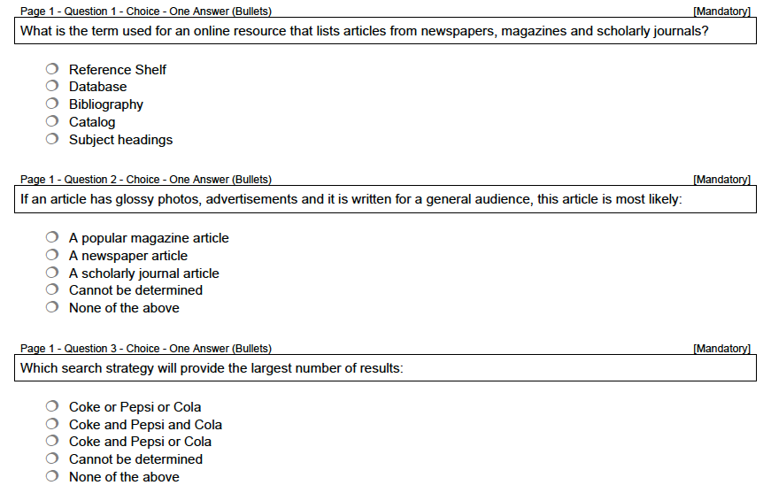
Notes:
UMD Libraries has a long history of assessing “student learning.” This presentation is not intended to diminish the work of our predecessors. The previous assessment programs built the groundwork that allowed us to push the boundaries of our assessment and challenged us to think creatively and critically about our work.
The above image is an example of a 2011 assessment for English101, or library day.

Slide 9
word memoirs
6
story
has
everyone
a
Notes:
Started with the concept of six-word memoirs. Wanted to incorporate the reflection and individualism of the memoirs, but did not have time in a 50 minute session to explain the activity and provide students with the requisite time to craft a memoir.
For more information about IL instruction and 6 word memoirs, see: Robert Miller's "I came, I saw, I Researched: Students Reflect on Library Life in Six-Word Memoirs." available at: http://crln.acrl.org/content/72/6/338.full

Slide 10

Share your a-ha moment
140 characters
  12 sessions
  142 responses
Notes:
From the six-word memoir, we ended up with the idea of using a tweet. Rather than having students share their story in six words, we asked them to share their “a-ha moment” from the session. Expanding the prompt from 6 words to 140 characters gave students a little more room to express themselves, while forcing them to synthesize their ideas into a single statement.
To pilot this assessment, we tried this assessment method in 12 library sessions and ended up with 142 total responses. Since this presentation is focused on the overhaul process, we won’t spend time detailing all the lessons we learned about twitter during that semester. What we will say, is that we quickly realized that collecting responses through twitter (which sounded great in our heads) was problematic. Early in the pilot, we added an option to submit responses through a google form, although students were still held to the 140 characters.

Slide 11
Analyzing Results
Frame | Disposition
Authority is constructed and contextual | Develop awareness of the importance of assessing content with a skeptical stance and with self-awareness of their own biases and worldview
Information creation as a process
Information has value | Respect the original ideas of others
Research as inquiry | Value intellectual curiosity in developing questions and learning new investigative methods
Scholarship as conversation | Recognize that scholarly conversations take place in various venues
 | See themselves as contributors to the scholarship rather than only consumers
Searching as strategic exploration | Seek guidance from experts, such as librarians, researchers, and professionals
 | Understand that first attempts at searching do not always produce adequate results
Notes:
To make sense of the data, we went to the framework and tried to identify what our learners in their first or second semester in college might leave with after a single 50 minute session. Because the a-ha moment asked students to share a moment of importance, we decided to focus on the “dispositions” which, “describe ways in which to address the affective, attitudinal, or valuing dimension of learning.”
Based on our learning outcomes for the session, we selected 7 dispositions from 5 of the 6 frames. These were qualities that we felt we had made an effort to focus on in our lesson plan and were attitudes /values that we hoped our students would exemplify after the session.

Slide 12
Analyzing Results
Disposition | Example
Importance of assessing content | Make sure a publisher is unbiased. #mylibrarymoment.
Respect the original ideas of others | Some books have more than one author, so you can actually cite the different chapters as different sources #mylibrarymoment
Intellectual curiosity in learning investigative methods | Learning how to use Research Port was really helpful because I was able to find so many more articles that will help me with my research.
Scholarly conversations take place in various venues | Working with my peers to find connections between our extremely different topics and sharing databases that wouldn’t at first seem to be [applicable].
Seek guidance from experts | The librarians helped me get really helpful information from Research Port
First attempts at searching do not produce results | #mylibrarymoment was that you could use synonyms to broaden your search within the same topic. I usually use the same words when I search.
Notes:
From our 142 responses, we went through each response and categorized it in the disposition we felt it best embodied. These are examples from each of the 7 dispositions.
We also had about 5 responses that just did not fit into a category such as the student that said their a-ha moment was when they “found a correlation between contracting celiac diseases and consumption of Genetically Modified Foods.” It was really cool, but it just didn’t fit nicely into our categories.

Slide 13
Analyzing Results
Frame | Disposition | % | n
Authority is constructed and contextual | Develop awareness of the importance of assessing content with a skeptical stance and with self-awareness of their own biases and worldview | 5% | 7
Information has value | Respect the original ideas of others | 6% | 9
Research as inquiry | Value intellectual curiosity in developing questions and learning new investigative methods | 49% | 70
Scholarship as conversation | Recognize that scholarly conversations take place in various venues | 9% | 13
 | See themselves as contributors to the scholarship rather than only consumers | 0% | 0
Searching as strategic exploration | Seek guidance from experts, such as librarians, researchers, and professionals | 6% | 9
 | Understand that first attempts at searching do not always produce adequate results | 21% | 29
Other |  | 4% | 5
Notes:
Our results were surprising. Although we had changed our lesson plan to emphasize the scholarly conversation, very few students identified that conversation as their a-ha moment. None of the responses were indicative of the idea that students would “see themselves as contributors to the scholarship, rather than only consumers” even though this is something we explicitly stated in our teaching.
Almost half of all responses focused on the library resources….

Slide 14
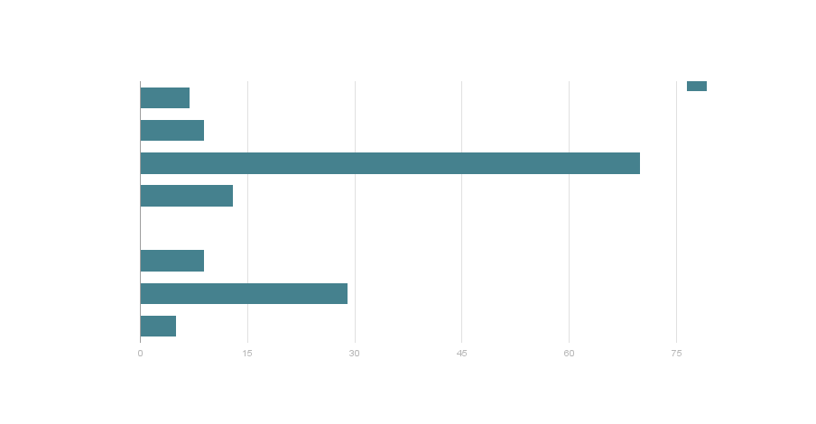
Analyzing Results
Importance of assessing content
Respect the original ideas of others
Intellectual curiosity in learning investigative methods
Scholarly conversations take place in various venues
See themselves as contributors to the scholarship
Seek guidance from experts
First attempts at searching do not produce results
Other
Notes:
… looking at the data visually, you can see that the “investigative methods” (which would have been specific resources) accounted for far more than any other category. The second highest was the “first attempts at searching” (which would have been if a student shared a response related to broadening or narrowing, key terms, subject headings, etc.) were the second highest at about 20%.
This was interesting for a couple of reasons.
We had changed our lesson plan to include materials outside of the research tools. Although the other categories were represented less often, the fact that they were present at all gave us hope that our teaching was touching on these higher critical thinking concepts.
Although we had deemphasized the databases, the fact that the majority of students associated this as their defining learning moment suggested that this was an important touchpoint for students.

Slide 15
Challenges
twitter
skills v. attitudes
granularity
Notes:
Although Twitter offered an effective platform for the pilot, expanding that model from the small number of sections in the pilot to the nearly 200 sections program-wide created logistical challenges. From privacy settings, to data duplication, to the number of students who were (or more often, were not) active on Twitter, there was no easy way to collect the amount of data needed using social media. We abandoned it completely.
We realized that in some cases, our responses were more indicative of knowledge practices rather than dispositions. In our next iteration, we would need to expand our analysis to include a broader range of categories.
We also found that the “quality” (for lack of a better word) of responses within the categories varied greatly. In some cases, we had students that articulated eloquently and precisely how they learned to value different points of view in their research, while other times they just hinted at an understanding. Our version 2.0 would need to take into account the granularity of responses.

Slide 16
Assessment IRL
spring 2016 - fall 2016
Notes:
In spring 2016, we expanded the assessment from a pilot to a full-on programmatic assessment. Here we present an overview of our assessment IRL (in real life). We made a few changes between fall and spring, but fundamentally our approach has stayed the same, so we are including both together.
The biggest transition was from data collection in Twitter/Google Forms to Qualtrics. To keep with the spirit of the original assessment idea, we continued to cap individual responses in at 150 characters (just a little more than the 140 in twitter). Switching from Twitter to Qualtrics enabled us to collect more and a higher quality of data, and also allowed us to add a customized field for students to identify their library instructor. The result is a short, quick assessment for students that provides rich data at the program and instructor levels.

Slide 17
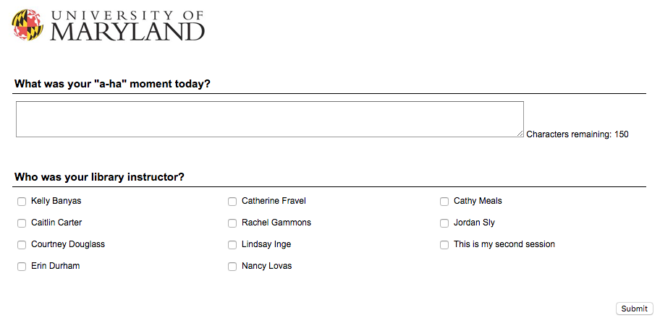
Notes:
Screenshot of the a-ha moment survey from the library website. Available on this page by clicking the “share your #librarymoment” icon on the bottom right.

Slide 18
Spring 2015 - Dispositions | Fall 2015 - Dispositions + Knowledge Practices
Develop awareness of the importance of assessing content with a skeptical stance and with self-awareness of their own biases and worldview | Understands importance of evaluating information and demonstrates self awareness of individual biases
 | Matches an information need with an appropriate resource
Respect the original ideas of others | Respects the original ideas of others
Value intellectual curiosity in developing questions and learning new investigative methods | Values intellectual curiosity in developing questions; Consider research as open ended exploration and engagement with information
Recognize that scholarly conversations take place in various venues | Seeks out conversations taking place in their research area
See themselves as contributors to the scholarship rather than only consumers
Seek guidance from experts, such as librarians, researchers, and professionals | Seeks guidance from experts such as librarians, researchers, and professionals
Understand that first attempts at searching do not always produce adequate results | Designs and refines search strategies as necessary
 | Comfort with UMD library website, physical spaces, or specific library instructor
Notes:
We started by reexamining the dispositions. In our pilot, we had pulled dispositions from 5 of the 6 frames. When we expanded,
pulled criteria from all 7 dispositions.
included knowledge practices in addition to dispositions, so for example, the search strategies we moved from “understanding that first attempts at searching do not always produce adequate results” to “design and refine search strategies as necessary.”
Added a category for UMD specific (so if a student commented on a relationship with the specific library instructor, or things about the building), giving a total of 8 criteria
Yellow = exactly the same
Green = same in spirit, different in description
Purple = brand new

Slide 19
UMD Libraries Information Literacy Dispositions Rubric
 | Beginning (1) | Proficient (2) | Advanced (3)
Authority is Constructed and Contextual
Understands importance of evaluating information and demonstrates self awareness of individual biases | Writer acknowledges information evaluation as concept | Writer articulates the rationale or importance of evaluating the credibility of a source | Writer demonstrates the value of evaluating a source, and indicates an understanding of the role of self-bias in the process
Information Creation as Process
Matches an information need with an appropriate resource | Writer acknowledges that different are resources available for research | Writer identifies a type, purpose, or title of a specific resource | Writer articulates how a specific resource address their individual information need
Information has Value
Respects the original ideas of others | Writer acknowledges attribution methods | Writer articulates the value of attribution | Writer articulates the importance of attribution and identifies resources for help/attribution methods.
Research as Inquiry
Values intellectual curiosity in developing questions; Consider research as open ended exploration and engagement with information | Writer acknowledges research as concept | Writer acknowledges research as process | Writer articulates the iterative process of developing and/or defining a research question
Scholarship as Conversation
Seeks out conversations taking place in their research area | Writer acknowledges that there are different points of view on a topic | Writer articulates the need to incorporate different points of view | Writer demonstrates the value of incorporating different points of view
Searching as Strategic Exploration
Designs and refines search strategies as necessary | Writer acknowledges search strategies for narrowing or broadening | Writer articulates specific search strategies (such as key terms, subject thesaurus, etc...) | Writer demonstrates awareness of search strategies and how they can aid in student research
Seeks guidance from experts such as librarians, researchers, and professionals | Writer acknowledges assistance available | Writer acknowledges assistance available and identifies ways to get in contact with appropriate professionals | Writer articulates specific ways appropriate professionals can support students
Other
Comfort with UMD library website, physical spaces, or specific library instructor
Other
Notes:
Starting with our base of 8 criteria points, we added levels for developing, proficient, and advanced. We also went through a norming process for this rubric, which we will refer back to in a few slides.
Quick and dirty overview of the analysis: Unlike a typical rubric, where an artifact is judged by each of the criteria, we assigned each response to a single criteria and a single developmental level. In some cases, a response may have been indicative of “comfort with UMD libraries” while also speaking to one of the other categories, which would be the only case that a response would be assigned to two separate criteria.
In spring 2016, the first semester that we implemented this for the whole program, we attempted to introduce a level of verification for the data by having multiple people evaluate a response. Each library instructor was given a copy of their responses and another instructor’s responses (although they did not know whose). Our hope was that this would even out any discrepancies in the developmental level. So if one person identified a response as “authority is constructed and contextual” and then assigned it a developmental level of 1 and the second reviewer assigned it a 3, it would average out to be a 2. Although great in theory, this did not translate well to real life practice, which we will get to in a few slides. For now, what you need to know is that there are twice as many results for spring 2016 as the amount of data collected.

Slide 20
Example
 | Beginning (1) | Proficient (2) | Advanced (3)
Authority is constructed and contextual
Understands importance of evaluating information and demonstrates self awareness of individual biases | Understands importance of evaluating information and demonstrates self awareness of individual biases | Writer articulates the rationale or importance of evaluating the credibility of a source | Writer demonstrates the value of evaluating a source, and indicates an understanding of the role of self-bias in the process
Sample responses: | “I learned what a scholarly source is!” | “That not all articles are trustworthy, always make sure to see the legitimacy of the articles you decided to use as a source” | “My a-ha moment was when we researched the credibility of George Zornick. I realized the importance of studying the author's history.”
Notes:
Example of one of the criteria & responses for each of the levels pulled from spring 2016

Slide 21
Analyzing Results - Fall 2015
 |  | Advanced (3) |  | Proficient (2) |  | Beginning (1) |  | Total
Rubric Criterion | Mean | % | n | % | n | % | n | % | n
Authority is constructed and contextual | 1.22 | 1% | 1 | 21% | 32 | 78% | 119 | 6% | 152
Information creation as process | 1.43 | 5% | 67 | 34% | 478 | 62% | 872 | 58% | 1417
Information has value | 2.83 | 86% | 51 | 10% | 6 | 3% | 2 | 2% | 59
Research as inquiry | 1.56 | 12% | 26 | 33% | 75 | 55% | 124 | 9% | 225
Scholarship as Conversation | 2.61 | 66% | 25 | 29% | 11 | 5% | 2 | 1.5% | 38
Searching as Strategic Exploration | 1.50 | 7% | 39 | 36% | 204 | 57% | 319 | 22% | 562
Search Strategies | 1.51 | 7% | 29 | 37% | 156 | 56% | 233 | 17% | 418
Guidance | 1.47 | 7% | 10 | 33% | 48 | 60% | 86 | 6% | 144
Other |  |  |  |  |  |  |  | 5% | 137
Total |  | 8% | 209 | 31% | 806 | 56% | 1438 | 2590
Notes:
The next few slides have tables with the full results. The results are available in our slides, which you can refer back to, and are also in the conference paper. For the sake of time, we will just point out a few trends.
Similar to Spring 2015, the majority of responses ended up in one category. Because of the changes we made to our rubric, responses that had to do with resources available were assigned as “information creation as process” and ways to use those resources for specific research were assigned to “research as inquiry” - which is accounts for the shift from 49% research as inquiry in spring 2015 to 9% in fall 2015.
Similar to the pilot, few responses were indicative of information has value or scholarship as conversation. The largest categories continued to be information creation as process and searching as strategic exploration.
We also noted that more than half (56%) of all responses were ranked at a “beginning” level - which is appropriate for an ENGL101 session.

Slide 22
Analyzing Results - Spring 2016
 |  | Advanced (3) |  | Proficient (2) |  | Beginning (1) |  | Total
Rubric Criterion | Mean | % | n | % | n | % | n | % | n
Authority is constructed and contextual | 1.36 | 1% | 1 | 33% | 23 | 66% | 46 | 8% | 70
Information creation as process | 1.40 | 4% | 23 | 31% | 173 | 64% | 355 | 59% | 551
Information has value | 1.17 | 0% | 0 | 17% | 4 | 83% | 19 | 2% | 23
Research as inquiry | 1.27 | 4% | 2 | 20% | 11 | 76% | 42 | 6% | 55
Scholarship as Conversation | 1.69 | 23% | 3 | 23% | 3 | 54% | 7 | 1% | 13
Searching as Strategic Exploration | 1.45 | 5% | 10 | 36% | 80 | 60% | 131 | 23% | 221
Search Strategies | 1.42 | 3% | 4 | 37% | 54 | 61% | 89 | 16% | 147
Guidance | 1.51 | 8% | 6 | 35% | 26 | 57% | 42 | 8% | 74
Other |  |  |  |  |  |  |  | 3% | 33
Total |  | 4% | 39 | 30% | 294 | 62% | 600 | 966
Notes:
Spring 2016 we continued the process. The biggest change was that each response did not go through two reviewers. Each instructor just read and ranked their own responses, which accounts for the drop from 2600 responses to 1000.
Overall, the trends from fall 2015 held strong. More than half of responses (59%) were indicative of “information creation as process.” Information has value” and “scholarship as conversation” continued to be the least represented.
There was also a decrease in the amount of students that ranked in the advanced category and an increase in the amount of students at a beginning level.

Slide 23
Analyzing Results - Fall 2015 v. Spring 2016
 | Mean |  | Advanced (3) |  | Proficient (2) |  | Beginning (1) |  | Total
Rubric Criterion | F15 | S16 | F15% | S16% | F15% | S16% | F15% | S16% | F15% | S16%
Authority is constructed and contextual | 1.22 | 1.36 | 1% | 1% | 21% | 33% | 78% | 66% | 6% | 8%
Information creation as process | 1.43 | 1.40 | 5% | 4% | 34% | 31% | 62% | 64% | 58% | 59%
Information has value | 2.83 | 1.17 | 86% | 0% | 10% | 17% | 3% | 83% | 2% | 2%
Research as inquiry | 1.56 | 1.27 | 12% | 4% | 33% | 20% | 55% | 76% | 9% | 6%
Scholarship as Conversation | 2.61 | 1.69 | 66% | 23% | 29% | 23% | 5% | 54% | 1.5% | 1%
Searching as Strategic Exploration | 1.50 | 1.45 | 7% | 5% | 36% | 36% | 57% | 60% | 22% | 23%
Search Strategies | 1.51 | 1.42 | 7% | 3% | 37% | 37% | 56% | 61% | 17% | 16%
Guidance | 1.47 | 1.51 | 7% | 8% | 33% | 35% | 60% | 57% | 6% | 8%
Other |  |  |  |  |  |  |  |  | 5% | 3%
Total |  |  | 8% | 4% | 31% | 30% | 56% | 62%
Notes:
This table compares the two semesters more directly. You’ll notice that all of the changes are within the developmental levels, the representation of the frames stays consistent.
The biggest change was in the “information has value” which dropped from 86% at the advanced level in spring 2015 to 0 in the advanced in fall 2015.
Although you don’t see it here, we also broke this down by instructor to instructor, so each person could see how their individual responses compared to the overall trends.

Slide 24
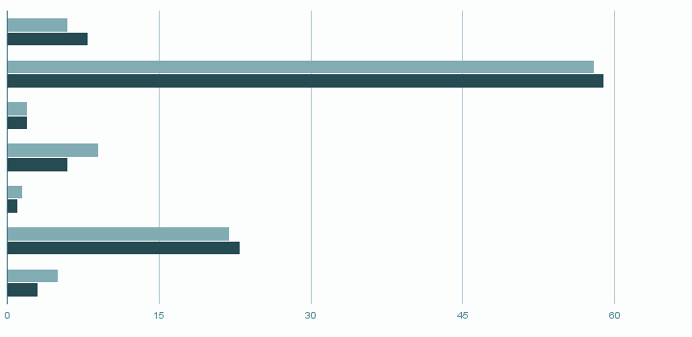
Analyzing Results
Fall 2015
Authority is constructed and contextual
Spring 2016
Information creation as process
Information has value
Research as inquiry
Scholarship as conversation
Searching as strategic exploration
Other
Notes:
This graph compares the percentage of responses from fall to spring 2016. You can see the trends are consistent.

Slide 25
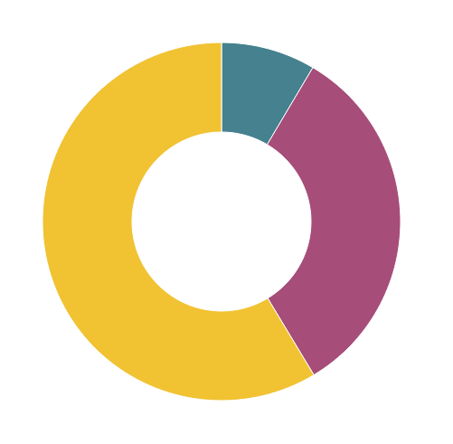
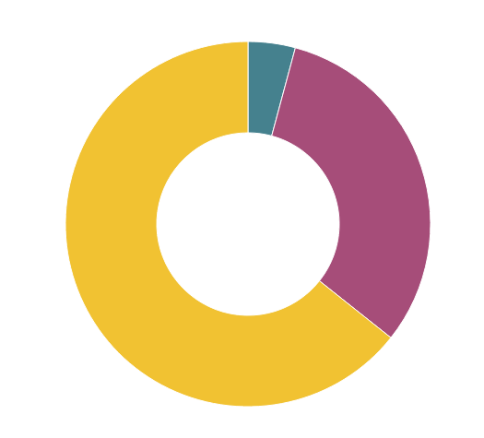
Analyzing Results
Advanced
8%
Advanced
4%
Proficient
31%
Proficient
30%
Fall 2015
Spring 2016
Beginning
56%
Beginning
62%
Notes:
Change in developmental levels from fall to spring 2016,

Slide 26
Challenges
norming
time
retention v. application
Notes:
Although we had made adjustments to the assessment, the transition from a pilot of 12 section to the nearly 115 sections we teach each semester unearthed some unexpected (and in some cases expected) challenges:
Norming. We are using this word loosely. To norm the rubric, we selected a sample of 50 responses from the 1300 submissions and sat together as a group until we came to a consensus about which criteria and which developmental level. Despite this, there continued to be discrepancies. Originally, we had assumed that everyone would agree a response was indicative of a certain category. What we found that was that sometimes, a library instructor had a very different idea about what a response meant, especially if they taught the session and brought the context of that exchange with the student to the table. So while we had planned to just average out the developmental levels, it ended up that there was no way to combine them, which is why we ended up with twice as many results as data collected. For spring 2016, we decided to just embrace the subjectivity of the assessment and let everyone evaluate their own responses.
Obviously, time was also a factor here, although it was not as cumbersome as we originally thought. Although the entire process was lengthy (developing the rubric, norming the rubric) the actual analysis is relatively straightforward. Each semester, one of the librarians pulls the responses by instructor and emails the instructor a spreadsheet with their responses. Because the responses are only 150 characters, it only takes a few seconds to review each one. Each instructor is responsible for analyzing their responses and submitting their results by a certain deadline (usually a week before the semester ends). We then compile and aggregate the data overall, which can take a few hours.
There is also the issue of retention vs application. Although this has given us great insight into our one-shot session, what is sticking with our students, and how deeply they are connecting with concepts, it still doesn’t help us see what our students are actually learning and what they will continue to build on during their course.

Slide 27
More Rubrics!
fall 2016
Notes:
…. With that in mind, we decided that what we really needed were more rubrics.
This fall, we have added to our assessment by also evaluating student artifacts. We piloted it the method this summer with a few sections and then scaled it up to a larger pilot this fall.

Slide 28
English 101: 6 Major Assignments
Academic Summary
Introduction to academic writing focused on clarity, concision, effective and ethical use of sources, and interconnection of reading + writing.
Annotated Bibliography
Five scholarly sources applicable to the topic. MLA style annotated bibliography.
Digital Forum
Website analyzing 3 different stakeholders. Expands research by adding 5 sources + annotations.
Inquiry Essay
Overview of a topic + personal connection to the issue, 4 to 5 p. Uses at least 5 sources.
Rhetorical Analysis
Analysis of a persuasive text related to the inquiry topic.
Position Paper
Final paper 8-10 p. 20 sources total.
Notes:
English 101 (Academic Writing Program) has 6 major assignments, which build on one another throughout the semester. The library session typically occurs as students are preparing for the annotated bibliography.
In fall 2015, AWP began a learning outcomes assessment using a rubric, which was applied to each of the position papers.

Slide 29
Excerpt: Academic Writing Program (AWP) Rubric, Fall 2015
 | Advanced (3) | Proficient (2) | Developing (1) | Unacceptable (0)
Source Quality | The writer consistently integrates a rich variety of high quality and scholarly research relevant to his/her argument. The writer exceeds the audience’s expectations for relevant sources | Writer employs research that is credible and relevant to his/her argument. The writer meets the audience’s expectations for appropriate sources. | Writer draws on sources that are not consistently relevant or credible. Few of these sources are scholarly. The writer may misunderstand the audience’s expectations for research, drawing on inappropriate sources or ignoring important sources. | Writer rarely integrates research into his/her essay, and/or when the writer does integrate sources, they are not relevant, credible, or scholarly. The writer fails to meet the audience’s expectations for relevant and appropriate sources.
Source Use | Writer effectively and expertly integrates research into the argument by means of attribution, summarizing, quoting, or paraphrasing. Writer thoroughly analyzes research and offers meaningful and persuasive explanations of how it relates to his/her argument. | The writer judiciously integrates research into the argument by means of attribution, summarizing, quoting, or paraphrasing. Writer analyzes research and explains how it relates to his/her argument. | The writer integrates research into his/her essay but attempts at attribution, summarizing, quoting, or paraphrasing are sometimes flawed. Writer may include quotations with no framing language when integrating source material. The connections between the research & argument may be missing or tenuous. | The writer’s attempts at summarizing, quoting, or paraphrasing are frequently flawed. Writer may not attribute sources or frame quotations. The writer may not make connections between the research and his/her argument.
Citation | The writer expertly cites sources, both citing them correctly within the text and using correct conventions throughout the works cited list. | The writer cites sources in text and throughout the works cited list. There may be minor errors in MLA citation. | The writer attempts to cite all sources in text and throughout the works cited list, but there may be major errors in MLA citation. | The writer makes no attempt to cite sources, or the writer may attempt to cite sources, but there is no evidence pattern or style for citations.
Notes:
Excerpt from the AWP Rubric. 3 of the criteria apply to information literacy.

Slide 30
Example from AWP Rubric
Advanced (3) | Proficient (2) | Developing (1) | Unacceptable (0)
Source Quality
The writer consistently integrates a rich variety of high quality and scholarly research relevant to his/her argument. The writer exceeds the audience’s expectations for relevant sources | Writer employs research that is credible and relevant to his/her argument. The writer meets the audience’s expectations for appropriate sources. | Writer draws on sources that are not consistently relevant or credible. Few of these sources are scholarly. The writer may misunderstand the audience’s expectations for research, drawing on inappropriate sources or ignoring important sources. | Writer rarely integrates research into his/her essay, and/or when the writer does integrate sources, they are not relevant, credible, or scholarly. The writer fails to meet the audience’s expectations for relevant and appropriate sources.
Notes:
Example of one of the criteria & responses for each of the levels pulled from spring 2016

Slide 31
AWP Results - Fall 2015
 |  | Advanced (3) |  | Proficient (2) |  | Developing (1) |  | Unacceptable (0)
Rubric Criterion | Mean | % | n | % | n | % | n | % | n
Source Quality | 2.05 | 37% | 1300 | 42% | 1468 | 12% | 430 | 2% | 60
Source Use | 2.00 | 30% | 988 | 47% | 1518 | 20% | 660 | 3% | 86
Citation | 2.04 | 33% | 1132 | 45% | 1520 | 15% | 514 | 7% | 230
Total |  | 35% | 3420 | 45% | 4506 | 16% | 1604 | 4% | 376
Notes:
The majority of students scored within the advanced (35%) and proficient levels (45%), with very few students scoring developing (16%) or proficient (4%). The highest number of unacceptable scores were in the citation category, which we do not teach in our library research sessions.

Slide 32
Applying AWP rubric to student artifacts
annotated bibliographies
  informed consent
  2 to 3 samples per section
comparing AWP instructors to librarians
comparing bibliographies before/after library instruction
Notes:
This semester, we have expanded our pilot program to collect student artifacts. Rather than collecting the position paper, which the AWP instructors use for their rubric, we are collecting annotated bibliography assignments, which will highlight the 3 categories related to information literacy (source use, source quality, and citation). To make this project manageable, we are only collecting 2 to 3 samples from each section.
Although the annotated bibliography will not provide a direct comparison to the position paper, the assignments build on one another and all the sources used in the bibliography will be used in the position paper.
In a small pilot this summer (1 section, 4 bibliographies) we found that the library instructors tended to give lower scores than the AWP instructors, which may mean that the numbers from the AWP assessment are inflated.
Because the annotated bibliography happens early in the semester, we will also be able to compare annotated bibliographies before and after library instruction to see if students who come to the library score higher than those that do not (and also those who attend 2 sessions v 1, etc.).

Slide 33
Lessons Learned

Slide 34
Challenges
causation v. correlation
academic partners
time
time
time

Slide 35
Benefits
community of practice
learning about our learners
building partners

Slide 36
Closing the loop
reflection
practice
assessment

Slide 37
Questions?

