Slide 1
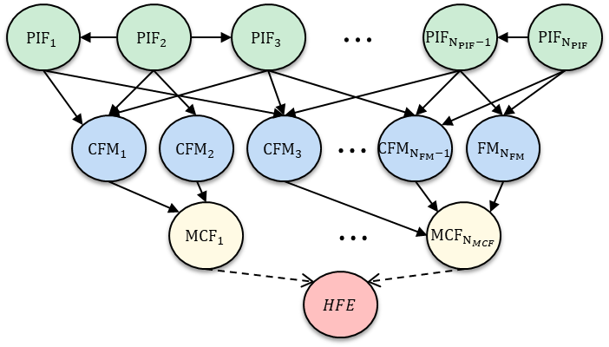
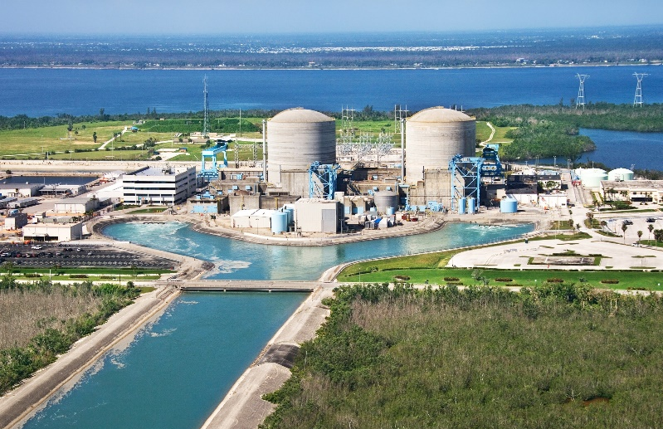
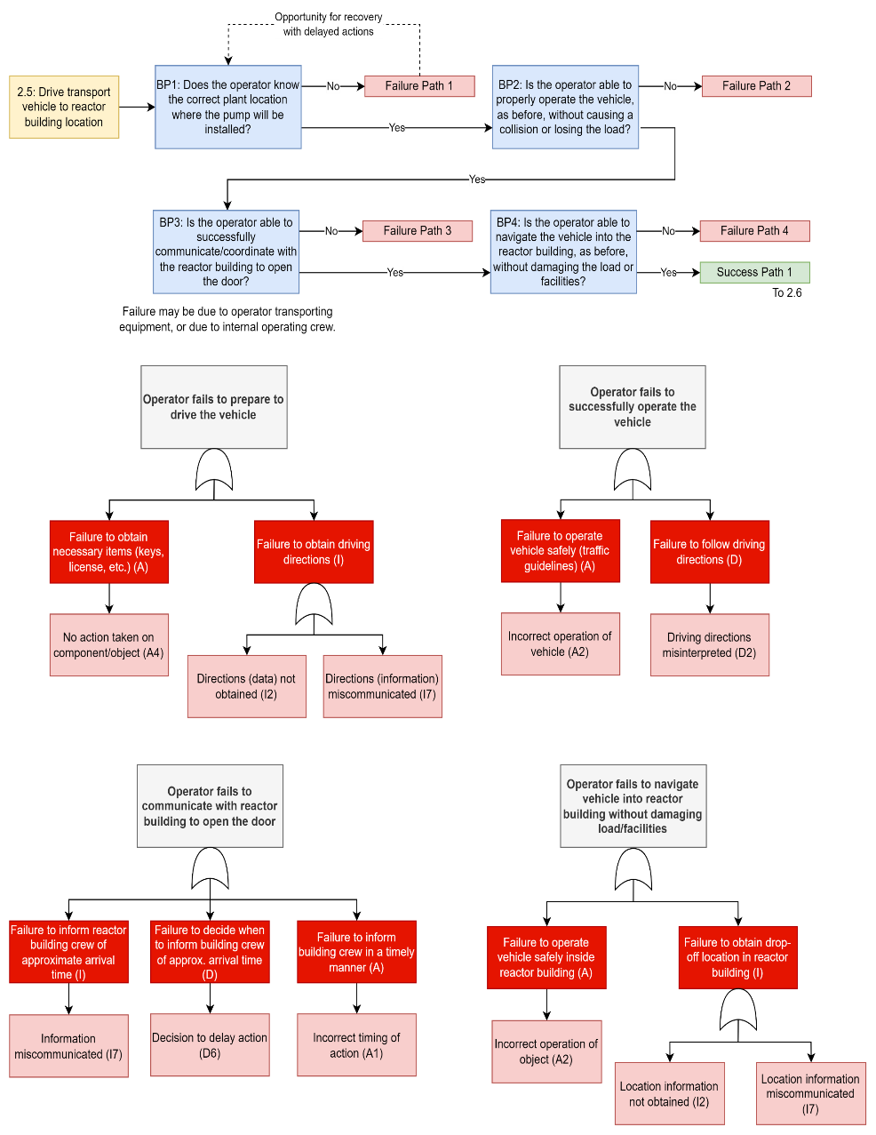
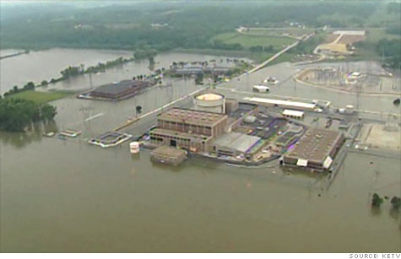
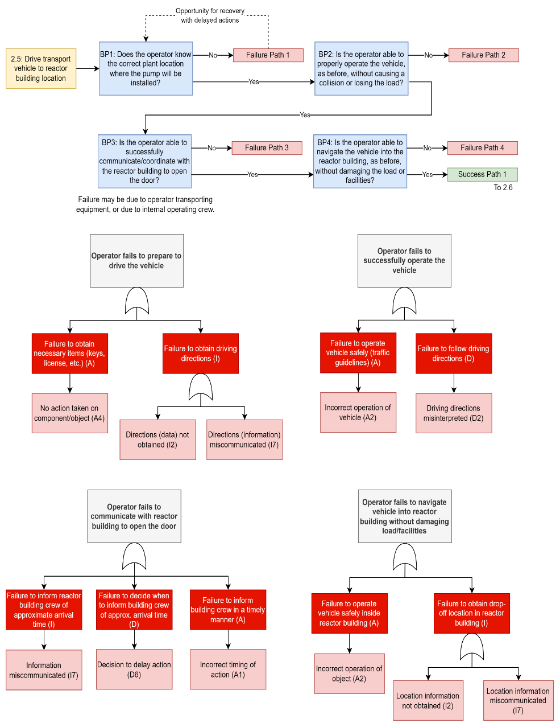
Causal Pathways Leading to Human Failure Events in
Information-Gathering System Response Activities
Camille S. Levine, Ahmad Al-Douri, and Katrina M. Groth
Systems Risk and Reliability Analysis (SyRRA) Lab
Center for Risk and Reliability
University of Maryland, College Park
NPIC&HMIT 2023, Knoxville TN, July 18, 2023
This material is based upon work supported in part by the Department of Energy Office of Nuclear Energy under Award Number DE-NE0008974. This report was prepared as an account of work sponsored by an agency of the United States Government. Neither the United States Government nor any agency thereof, nor any of their employees, makes any warranty, express or implied, or assumes any legal liability or responsibility for the accuracy, completeness, or usefulness of any information, apparatus, product, or process disclosed, or represents that its use would not infringe privately owned rights. Reference herein to any specific commercial product, process, or service by trade name, trademark, manufacturer, or otherwise does not necessarily constitute or imply its endorsement, recommendation, or favoring by the United States Government or any agency thereof. The views and opinions of authors expressed herein do not necessarily state or reflect those of the United States Government or any agency thereof.
Notes:
Thank you everyone- I will also be presenting this next paper which goes more in-depth on the models mentioned in the previous presentation, and describing those specific causal pathways leading to HFEs for information-gathering operator-system response activities.

Slide 2
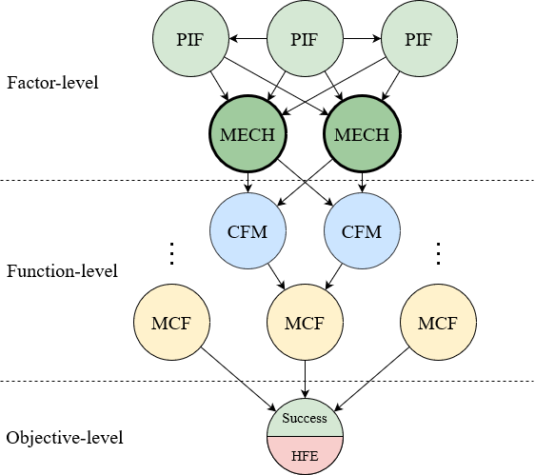
Motivation: causally robust HRA models
Human Failure Events (HFEs) represent the culmination of the failure process
There is more psychological depth to failure than most HRA methods are capable of representing
Performance Influencing Factors exert influence by various mechanisms
There is a wealth of cognitive/organizational psychological literature from which to draw these connections upon
We need to explicitly model these causal pathways to failure so that more targeted mitigation strategies can be developed.
Notes:
The overall motivation of this work is to improve the causal robustness of current HRA thinking. The HFE represents the culmination of the failure process- but how do you get there? It’s clear that there is more psychological depth to failure events than typically gets acknowledged.
There are multiple reasons why someone might fail due to a specific performance influencing factor, like task complexity which causes a high combined load on the operator. This could then lead to their failure to pay attention to all scenario aspects, or it could lead to a high perceived severity which then leads to internal biases towards or against particular information. There are even more ways that task complexity might affect operator performance for other failures outside of the information-gathering stage of operations- we called these human failure mechanisms.
Lastly, there is a largely untapped wealth of literature in cognitive and organizational psychology that these connections can be derived from. Precursor work to the development of the Nuclear Regulatory Commission’s IDHEAS method provided a great starting point for this.
What does this mean? We need to explicitly model these causal pathways to failure- it can be done- so that more targeted mitigation strategies can be developed in the pursuit of improving human reliability.

Slide 3
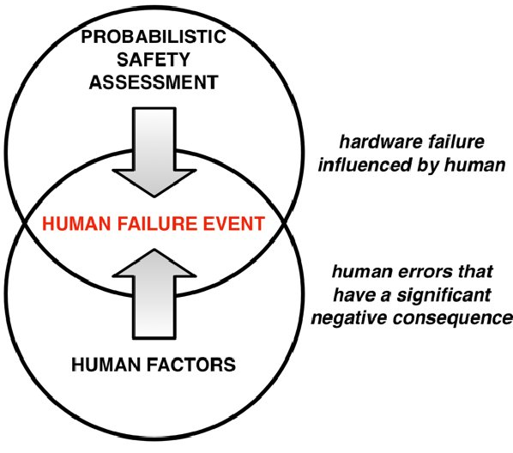
Motivation: External Hazards Probabilistic Risk Assessment (XHPRA)
Determine human and human-machine actions and decisions involved in plant response.
Select factors relevant to human-machine performance in flooding hazard response.
Encode causal relationships using Bayesian networks (BNs)
T4.1 Identification of human failure events (HFEs)
T4.2 Identification of performance influencing factors (PIFs)
T4.3 Development of framework for PIF-human failure mechanisms for XHPRA
Objective: Identify drivers of uncertainty in modeling human reliability for XH
Adapted from Al-Douri, Levine & Groth 2022; Boring 2014
Notes:
Again, this paper was motivated by a larger project on external hazards probabilistic risk assessment- this work represents advances that were made towards the last subtask on this project where we encoded causal relationships between HFE components using Bayesian networks. The objective of this research was to identify uncertainty drivers in modeling human reliability for external hazards.

Slide 4
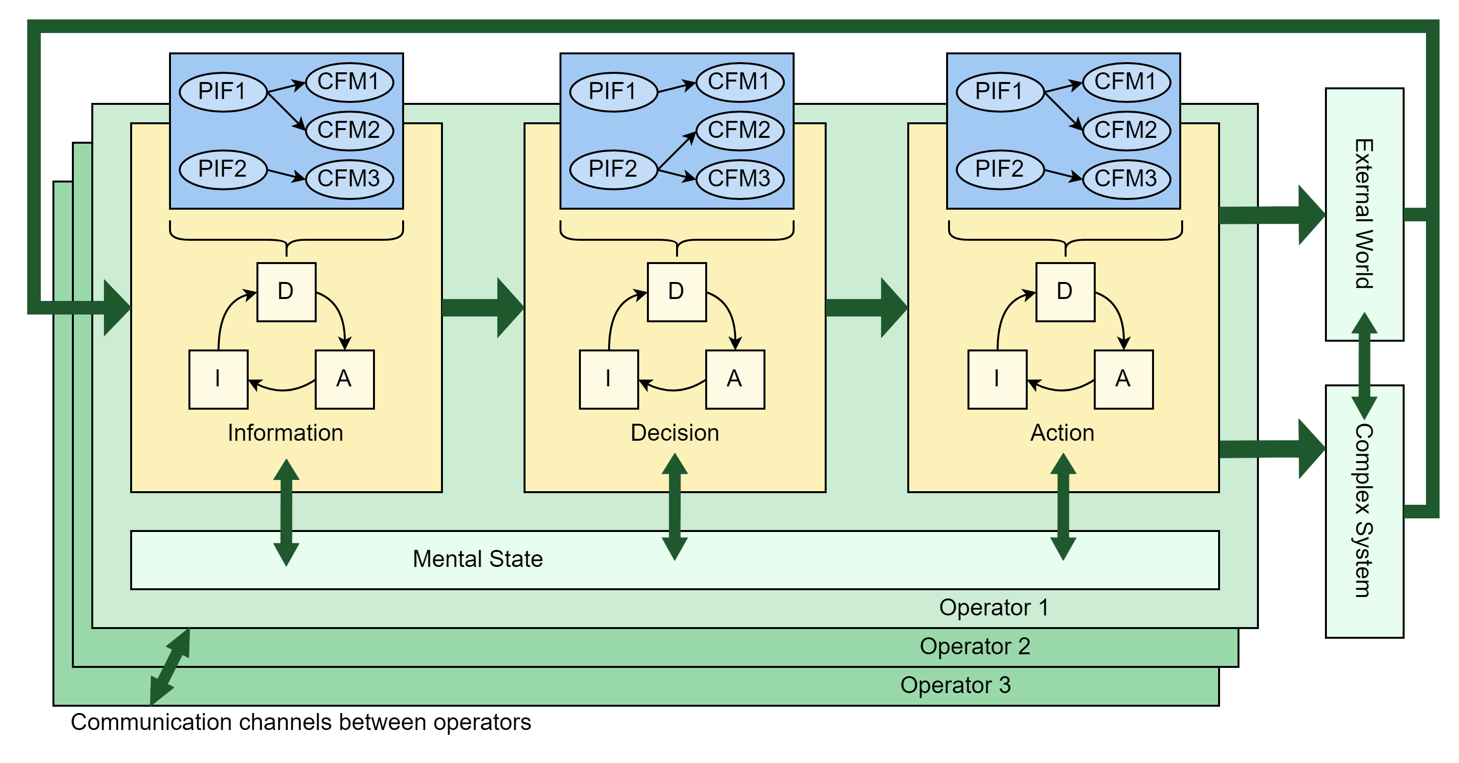
Context: Macrocognitive Framework
Chang & Mosleh’s Information-Decision-Action in Crew Context (IDAC) model:
  All human actions can be broadly categorized into information-gathering, decision-making, and action taking, within the broader context of crew collaboration
Adapted from Chang & Mosleh 2007
Notes:
The psychological basis of this work is Chang and Mosleh’s 2007 IDAC model, which stands for information-decision-action-in crew context. All human actions can be broadly categorized into one of the three functions. [Each function contains nested sub-functions, for example during an information-gathering task, you need to first detect the information, decide to pay attention to it, and decide to consider it in the subsequent decision. These sub-functions correspond to the I-D-A as well.] These actions, macrocognitive functions, are all affected by the operator’s mental state, and result in actions being performed in the external world and as part of the complex system (the human-machine team). The outputs of the system form a feedback loop that then feeds into the information that the operator is able to gather for the next step. Collaboration is modeled through communication channels between operators, each of whom has their own I-D-A functions and responsibilities.

Slide 5
Context: Phoenix Information-gathering Crew Failure Modes
19 Phoenix CFMs: Generic functional modes of failure
  Aggregated from a variety of sources: operating experience, relevant literature, expert discussion, and NRC-defined failure modes from SACADA
ID | Crew Failure Modes in “I” phase | ID | Crew Failure Modes in “D” phase | ID | Crew Failure Modes in “A” phase
I1 | Key alarm not responded to (intentional or unintentional) | D1 | Plant/system state misdiagnosed | A1 | Incorrect timing of action
I2 | Data not obtained | D2 | Procedure misinterpreted | A2 | Incorrect operation of component/object
I3 | Data discounted | D3 | Failure to adapt procedures to the situation | A3 | Action on wrong component/object
I4 | Decision to stop gathering data | D4 | Procedure step omitted (intentional)
I5 | Data incorrectly processed | D5 | Inappropriate transfer to a different procedure
I6 | Reading error | D6 | Decision to delay action
I7 | Information miscommunicated | D7 | Inappropriate strategy chosen
I8 | Wrong data source attended to
I9 | Data not checked with appropriate frequency
Ekanem, N. J., Mosleh, A., & Shen, S. H. (2016). Phoenix–a model-based human reliability analysis methodology: qualitative analysis procedure. Reliability Engineering & System Safety, 145, 301-315.
Notes:
Another basis for this work was the Phoenix HRA method, which identifies nineteen generic functional modes of failure, or crew failure modes. These were aggregated from a variety of sources, including operating experience, literature, expert discussion, and the NRC’s SACADA database. This research focuses on the information-gathering phase CFMs, shown here.

Slide 6
Approach: Bayesian network development for HRA
Bayesian networks (BNs) are ideal for capturing this causality between context (PIFs), observed failure modes (CFMs), and failure of larger functions (MCFs).
Scientific, substantiated BNs for Phoenix CFMs
CFM definitions documented in Phoenix method from Ekanem (2013)
Drafted BNs from Groth & Hendrickson (2012)
PIF hierarchy from Groth & Mosleh (2012)
NUREG-2114 cognitive literature from Whaley et al (2016)
HRA dependency idioms & definitions from Paglioni (2023)
Causal mapping methodology from Zwirglmaier & Groth (2017)
Additional scholarly psychological literature
Notes:
So our approach incorporates work from a lot of different sources. Our approach was centered around Bayesian networks, because they’re ideal for capturing these complex causal chains between contextual factors, PIFs, the observed failure modes, CFMs, and the larger tasks, or major crew functions. The four big components that we used were: the CFM definitions mentioned earlier from the Phoenix method, as well as drafted Bayesian Networks obtained internally from Groth and Hendrickson, the PIF hierarchy developed by Groth and Mosleh in 2012, and a cognitive literature organizer also from Groth and Hendrickson, with aggregated psychological literature and a structure for organizing it. These components work together to result in the development of literature-substantiated Bayesian Networks.

Slide 7
Data: Psychological literature review
Previous efforts that led to NUREG-2114 identified cognitive literature relevant to Information-gathering failures.
Underpins model structure, documenting the relationship between each causal factor
Ref # | Citation | Psychological mechanisms & PIF groups
a) | Broadbent, D. (1958). | Sensory limits
b) | Endsley, M. R. (1995). | Person-based PIFs, attention, bias, knowledge, training
c) | Eriksen, C.W., & St. James, J.D. (1986). | Sensory limits, attention
d) | Jones, D. G., & Endsley, M. R. (1996) | Loads
e) | Klein, G. A. (1993). | Person-based PIFs for misinterpretation
f) | Klein, G., & Moon, B. (2006). | Discounting of data
g) | Letsky, M. P., Warner, N. W., Fiore, S. M., & Smith, C. A. P. (2008). | Collaboration and organization based PIFs
h) | Lipshitz, R. (1993). | Training, perceived impact
i) | Orasanu, J., & Martin, L. (1998). | Bias, knowledge, training, goal prioritization
j) | Roth, E.M. (1997). | Safety culture, knowledge and training for misinterpretation
k) | Wickens, C. D., Lee, J. D., Liu, Y. & Becker, S. E. G. (2004). | Stress, fatigue, knowledge, training, perceived impact
Notes:
To expand on the psychological literature review from Groth and Hendrickson, it is closely tied to efforts from Hendrickson and others at the US NRC to develop the basis for the IDHEAS HRA method. Many of these citations ended up being used in IDHEAS. We used this literature to document the relationship between each causal factor, the mechanisms by which it acts, and the resulting crew failure modes. Each of these papers or books was relevant to a different area of the network- for example, Mica Endsley’s 1995 work was relevant to a lot of person-based PIFs, as well as the mechanisms of attention and bias. Letsky’s textbook was relevant to a lot of collaboration and team-based PIFs; and Wickens’ textbook was relevant to a lot of personal factors as well such as stress, fatigue, and situational knowledge. In the far left, I’ve also indicated a footnote for each citation that is applied to the Bayesian network.

Slide 8
Method: Substantiation example for CFM I5 (Data Misinterpreted)
Through this systematic process, we built Info-gathering BNs for all nine Phoenix I-phase CFMs.
“Operators also used their knowledge of the physical interconnections of plant systems, and… plant parameter behavior, to generate and narrow potential explanations of plant symptoms” (Roth 1997)
“…operator can attend only to a subset of information or may be actively working to achieve SA [situational awareness], yet has erroneous or incomplete perception and integration of information.” (Endsley 1995)
“Operators also needed knowledge of the procedures, which includes not only knowledge of how to follow the individual procedure steps, but also knowledge of assumptions and logic that underlie the procedures” (Roth 1997)
Notes:
Shown here is a truncated version of the previous Bayesian network for just the CFM I5, data misinterpreted. Here are some examples of quotes that were used to justify relationships between nodes. For example, Roth 1997 states that operators used their knowledge of the system to generate and narrow potential explanations- which could lead to internal biases towards more frequently observed situations. Roth also notes that operators need knowledge of the procedures as well as the underlying procedure assumptions and logic- in order to incorporate the data correctly into their mental schema of the situation. Lastly, Endsley 1995 states that an operator can only attend to a subset of information under high loads- even if they’re working hard to achieve situational awareness- and this may lead to incorrect perception and integration of information which sounds a lot like data being misinterpreted.
All of these arcs represent a real, psychological or physical relationship that has previously been explicitly documented in the literature.

Slide 9
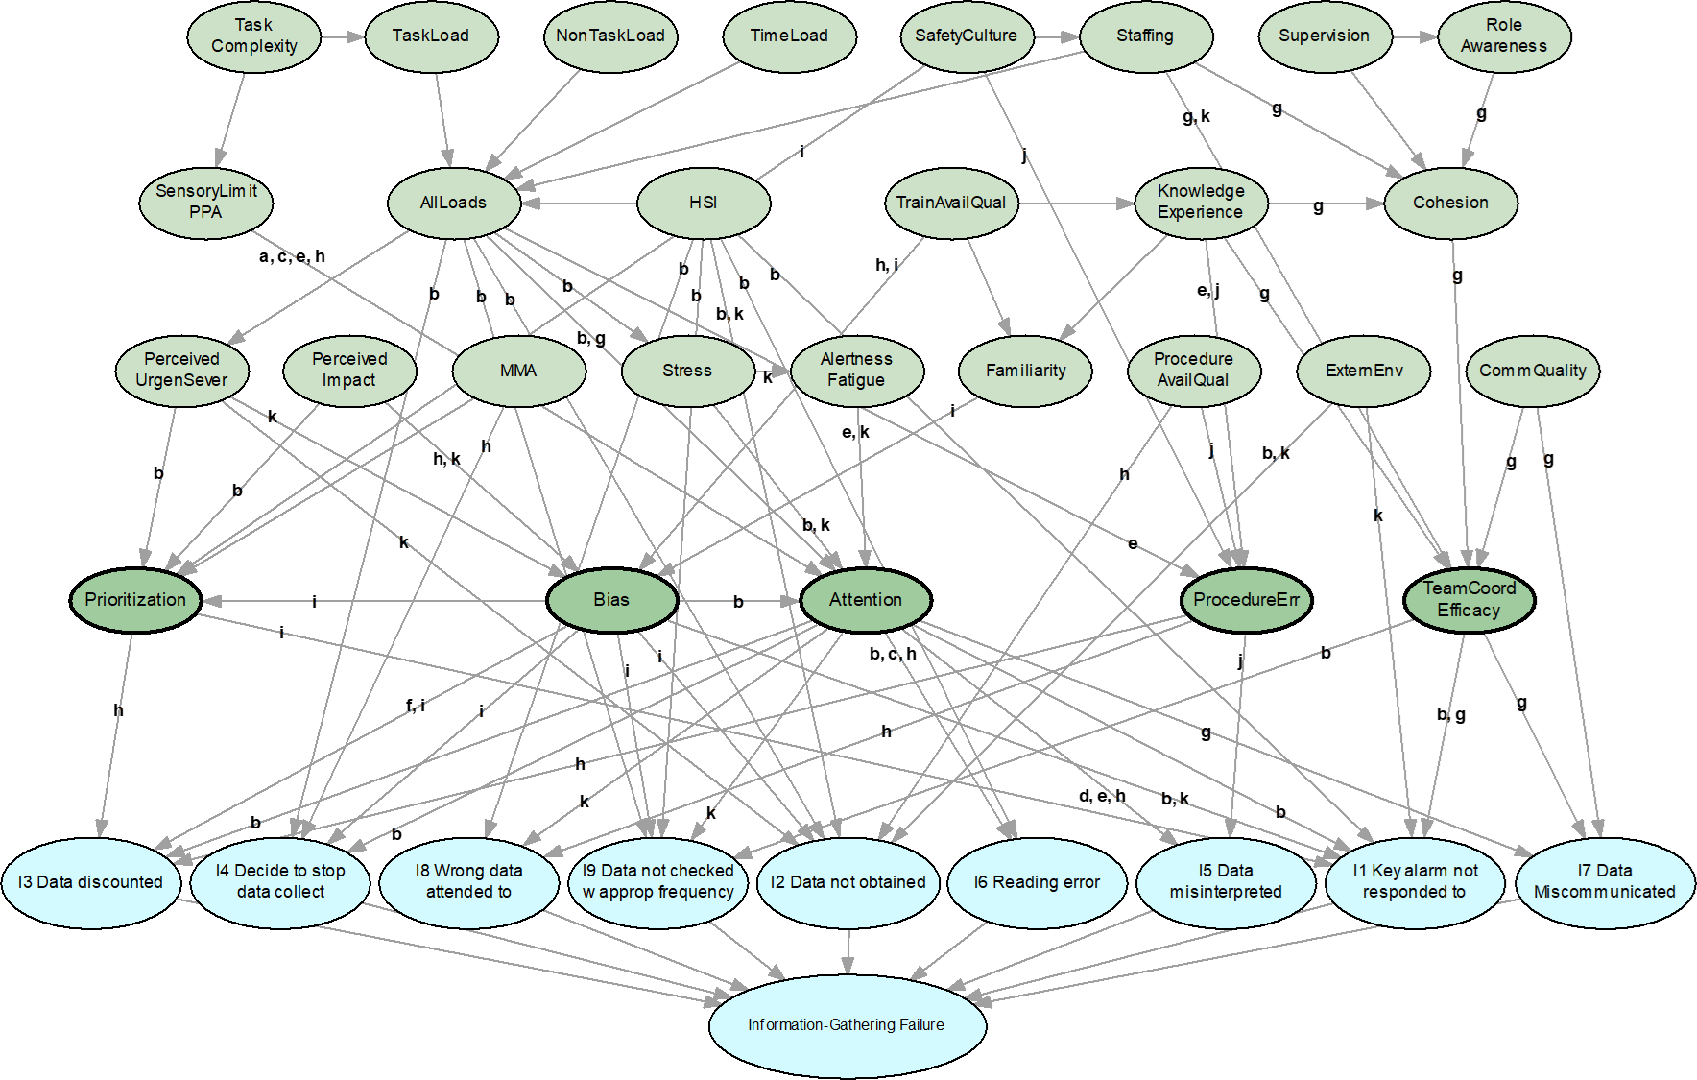
Result: Information-gathering BN structure
Causal chains of PIFs
Mechanistic PIFs
I-phase CFMs
Information-gathering failure (MCF)
Final structure developed from psych. literature, with each arc substantiated
Notes:
This BN documents the causal factors leading to 9 different target nodes: the CFMs of the Information-Gathering phase. There are 76 arcs connecting each of the nodes, and 37 nodes in the network. Each of those 76 arcs is substantiated in psychological literature, denoted by the letters which each correspond to a literature source in the table on the previous slide. Or it is part of a logical construction, for example All Loads being a logical construction of work load, non-work load, time load, and task complexity.
In this work, we identified five key causal clusters that are readily apparent in the structure. Each corresponds to a mechanistic PIF, and are shown through the darker green nodes and their connections in Figure 2. These clusters are prioritization, bias, attention, procedural, and team coordination/efficacy. These are not deterministic in their causation: they are probabilistic, increasing the probability of occurrence of a CFM. Thus, multiple clusters can contribute to a particular CFM, with differing degrees of influence on the causation of that CFM.
Bias errors are unique because although bias acts as a mechanism itself, it may also cause issues with attentional narrowing causing failures through that path.
However, all clusters are also affected by influences that propagate in from further-out PIFs. For example, staffing can be considered one of these higher-level influences because it affects the overall load to an individual (All Loads), which may induce stress on the operator. Supervision is another higher-level influence as it impacts an operator’s role awareness, which may affect the overall team cohesion. This inherently captures a wide range of additional indirect factors that meaningfully influence multiple CFMs resulting in structures with a strong, complete causal basis. This multi-layered result captures the dependencies between individual and mechanistic PIFs, whereas other existing models do not consider the interactions between the different HRA variables.

Slide 10
Contributions from development of Bayesian network
Harnessing psychological and organizational literature known to the Human Factors community to substantiate HRA models
  More valid, traceable qualitative models leads to a more valid HRA basis, HEP estimations, and causal understanding.
Existence of mechanistic PIFs (Paglioni, Levine, Al-Douri & Groth 2023).
  Identified five PIF clusters representing mechanisms by which contextual factors bring about observable human failures during the Information-gathering phase of operation.
Both of these results enable development of more targeted human reliability improvement strategies
Notes:
One main contribution as noted in my earlier presentation, the existence of mechanistic PIFs (or mechanisms), which were the five clusters described earlier. The PIF cluster and resulting mechanisms show how contextual factors bring about observable human failures, specifically during the information-gathering phase of human actions. This result will allow for better identification of root causes of human failure.
Another main contribution is the harnessing of psychological and organizational literature, which has been under-utilized in current HRA methods, but is known to the human factors community because it really gets into the specifics of how errors happen. This leads to a more valid qualitative model, since each modeling choice is based in peer-reviewed papers, then this leads to more valid quantitative Human Error Probability estimations once the quantification has been performed. This result also allows for deeper knowledge of root causes, which in turn allows for development of more targeted mitigation strategies to improve human reliability.
***
Previously thought that communication/collaboration errors didn’t fit with I-D-A so another phase would need to be developed, but this modeling showed that team-based factors are relevant to other macrocognitive functions
Team-based factors seem to have the most complicated causal origins
Stemming from organization’s practices and operator’s knowledge depth

Slide 11
Conclusions & Next Steps
This work is a novel synthesis of cognitive & psychological sciences with reliability engineering to develop traceable, causal BNs for HRA.
Information Gathering BNs fully developed & literature-substantiated.
  See paper for more details.
Decision-making and Action Bayesian networks have also been drafted, with each arc being substantiated in a similar method.
These networks will also be applied to modeling human reliability for external hazards PRA.
Next steps are quantification- likely with the NRC’s SACADA database, or other suitable sources if any are identified.
Notes:
In summary, this work represents a novel application of cognitive and psychological literature to the development of Bayesian networks for HRA. We have also developed similar Bayesian networks for the decision-making and action-taking phases of operation, and similarly substantiated each arc with literature. Some different sources beyond that from Groth & Hendrickson and the IDHEAS method had to be brought in particularly for the Action network.
The next steps after this will involve quantification of the networks using the US NRC’s SACADA database. Previous efforts from this group have involved developing methods for extracting these conditional probabilities from SACADA and using it to populate the conditional probability tables of Bayesian network nodes. If you’re aware of any other potential suitable sources, my contact information is on the second slide and I would greatly appreciate hearing from you.

Slide 12


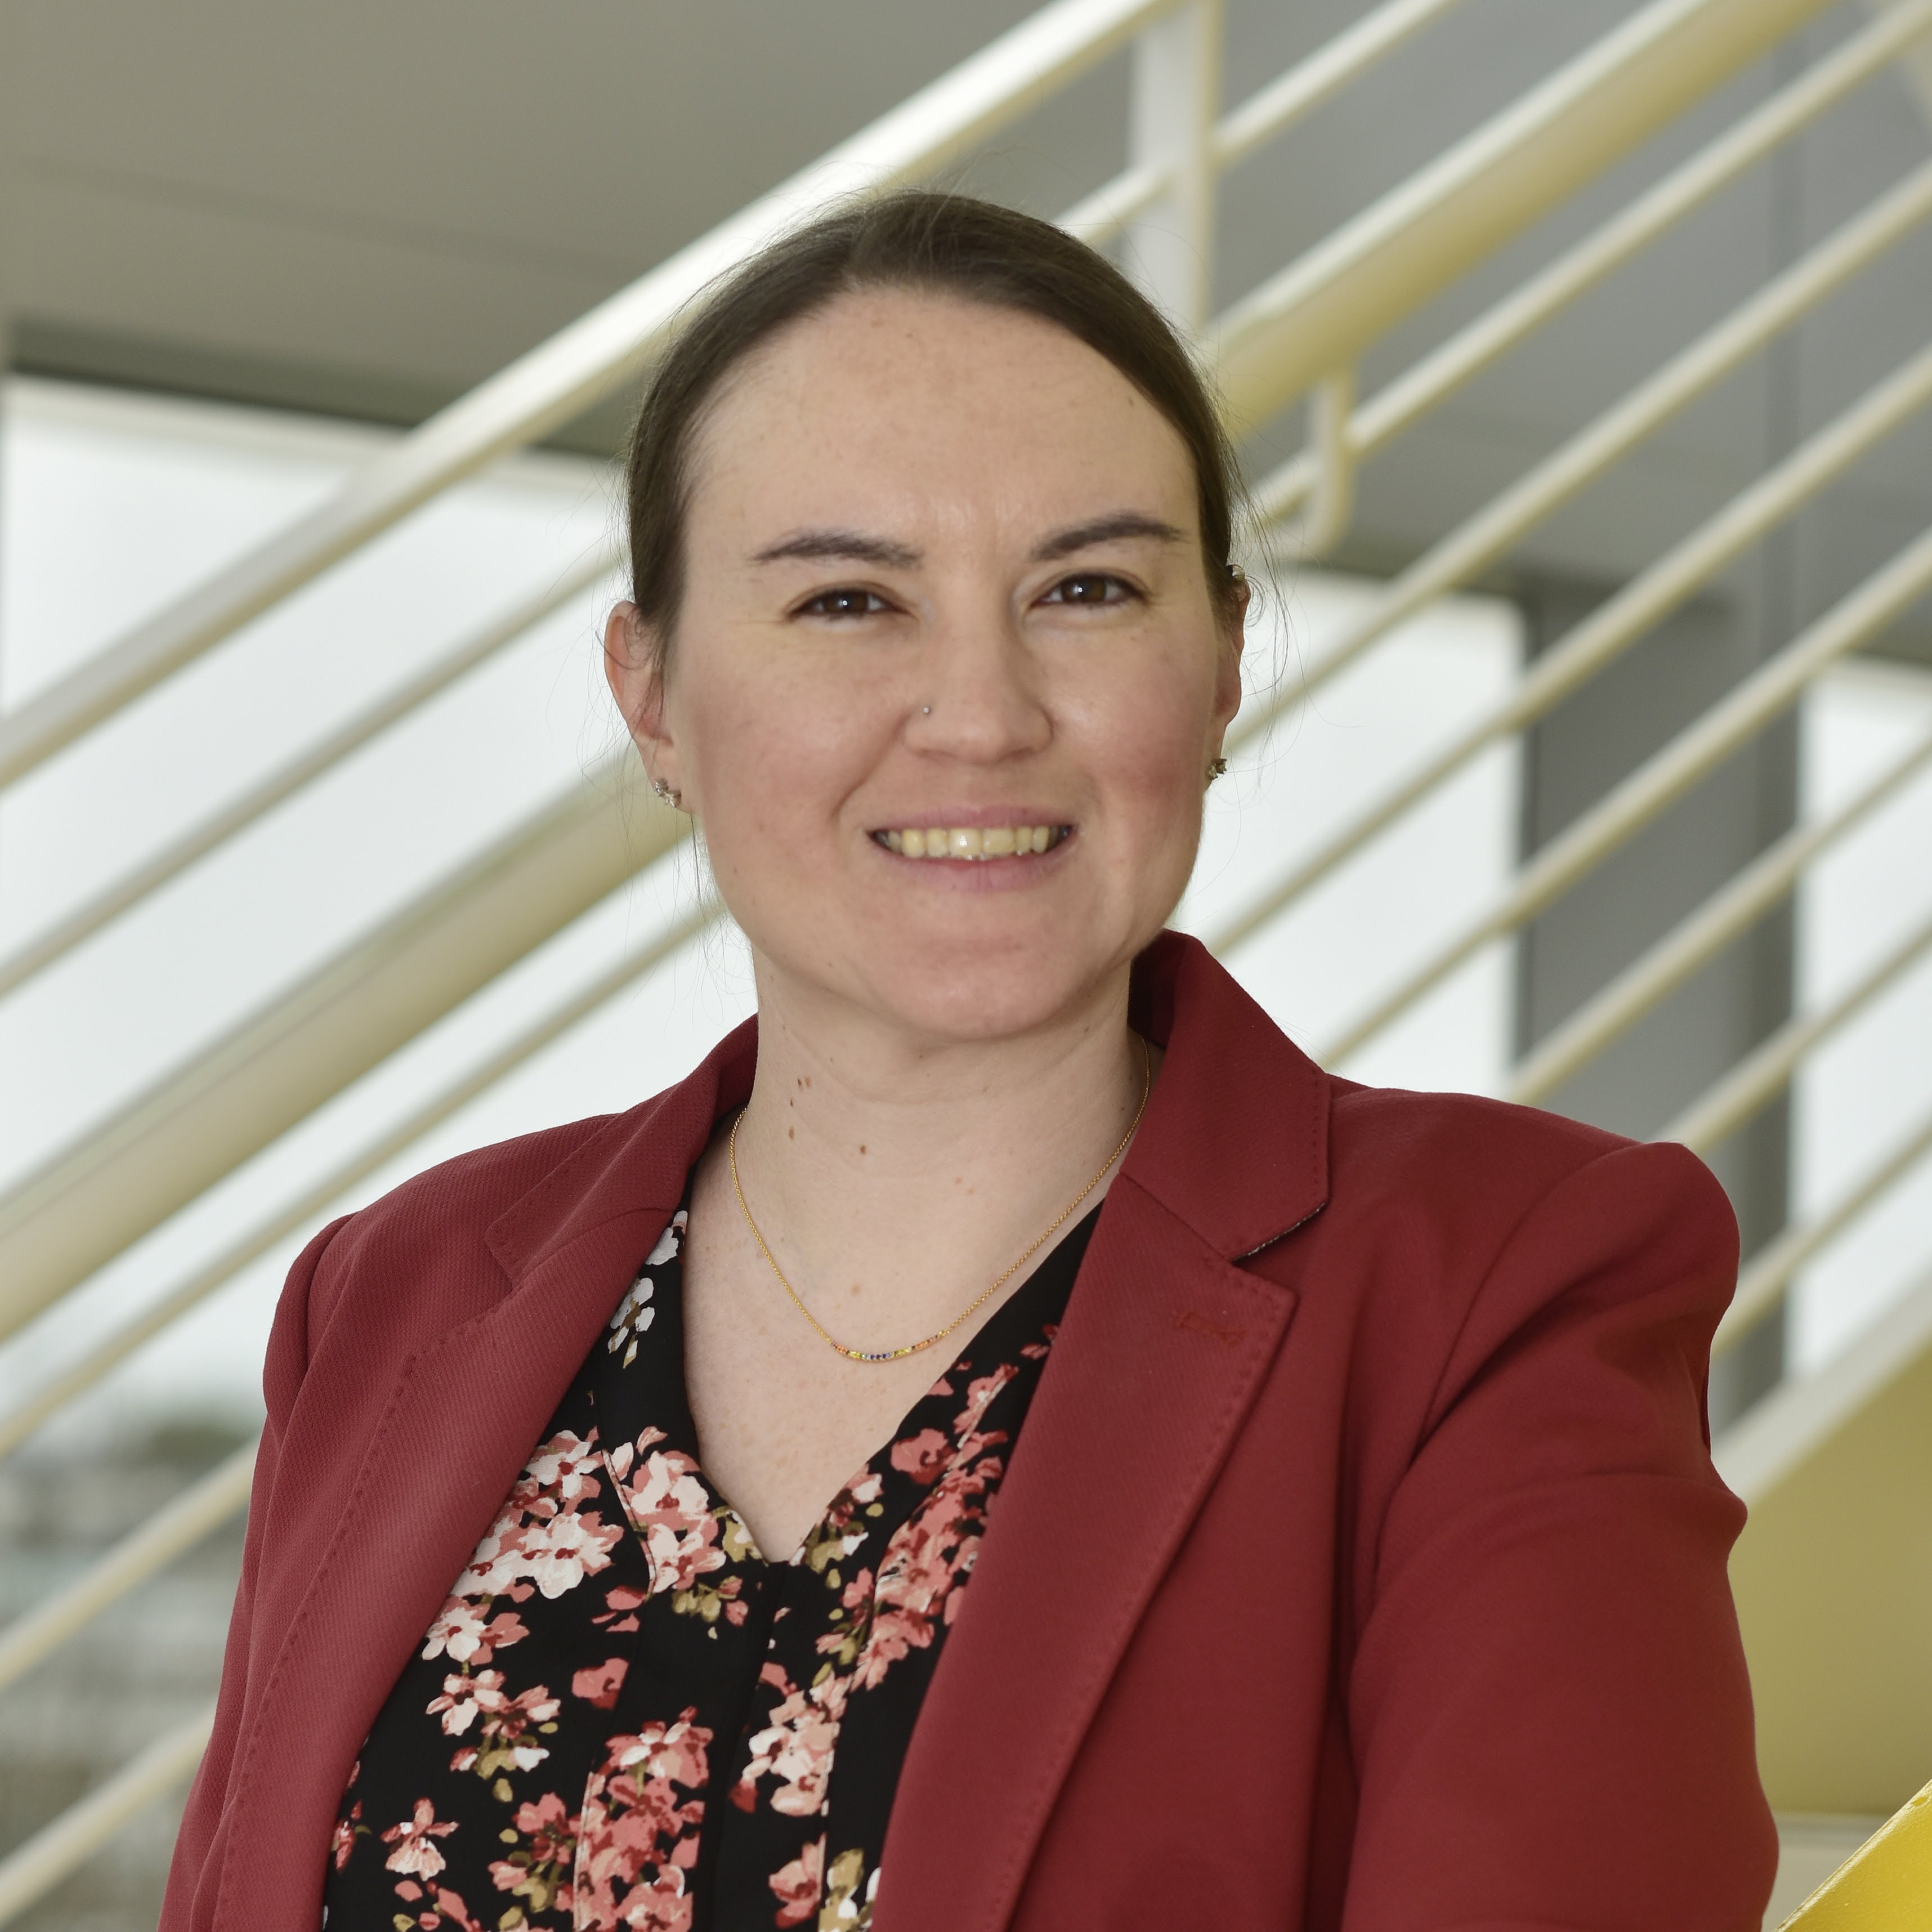
Thank you!
Camille S. Levine
Ahmad Al-Douri
Katrina M. Groth
clevine1@umd.edu
aaldouri@umd.edu
kgroth@umd.edu

Slide 13
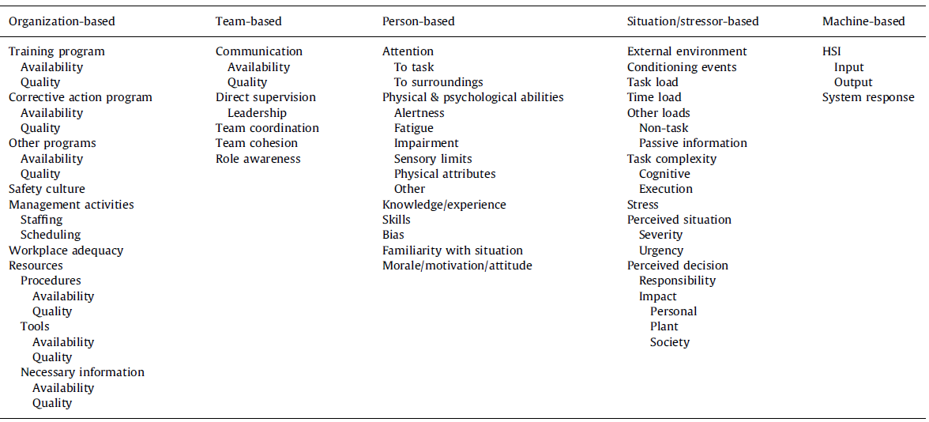
Methods: Performance Influencing Factors (PIFs) Hierarchy
Organized – The taxonomy delineates PIFs into five categories: organization, team, person, situation, and machine-based.
Versatile – The hierarchy of PIFs can be collapsed or expanded to meet a given objective.
Orthogonal – PIFs are clearly defined, with impact on individual/team as the main consideration.
Groth, Katrina M., and Ali Mosleh. "A data-informed PIF hierarchy for model-based human reliability analysis." Reliability Engineering & System Safety 108 (2012): 154-174.
Notes:
The performance influencing factors hierarchy used in this work is based off of 2012 work by Groth and Mosleh. We used this for three main benefits that it provides: it is organized, with five PIF categories each relating to a different aspect of operations (organization, team, person, situation, and machine); it is versatile, with multiple layers of PIFs so that you can use the more specific or less specific set depending on your objectives, and finally, it is orthogonal, with each PIF in the hierarchy clearly defined through a human-centric perspective, the impact on the individual or the team members is the main focus.

