Slide 1
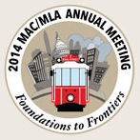

A Booster Shot for Health Science Librarianship Using Canvas and PechaKucha to Flip the Library Classroom
Alexander J. Carroll (ajcarrol@umd.edu)
Nedelina Tchangalova (nedelina@umd.edu)
Eileen G. Harrington (eharring@umd.edu)
University of Maryland, College Park, MD
Foundations to Frontiers
2014 MAC/MLA Annual Meeting
Alexandria, VA
October 21, 2014
Notes:
Alex
Alexander J. Carroll is an Agriculture and Natural Resources Librarian -- Engineering & Physical Sciences Library (EPSL), University of Maryland, College Park.
Professional Profile: alexanderjcarroll.wordpress.com
Nedelina Tchangalova is a Physical Sciences and Public Health Librarian -- Engineering & Physical Sciences Library (EPSL), University of Maryland, College Park.
Professional profile: http://www.lib.umd.edu/epsl/contact-epsl/profile_tchangalova
Eileen G. Harrington is a Health & Life Science Librarian, Priddy Library, The Universities at Shady Grove.
Professional profile: http://libguides.shadygrove.umd.edu/profile.php?uid=71206
Question to ask the audience: Have you experimented with a flipped information literacy program?

Slide 2
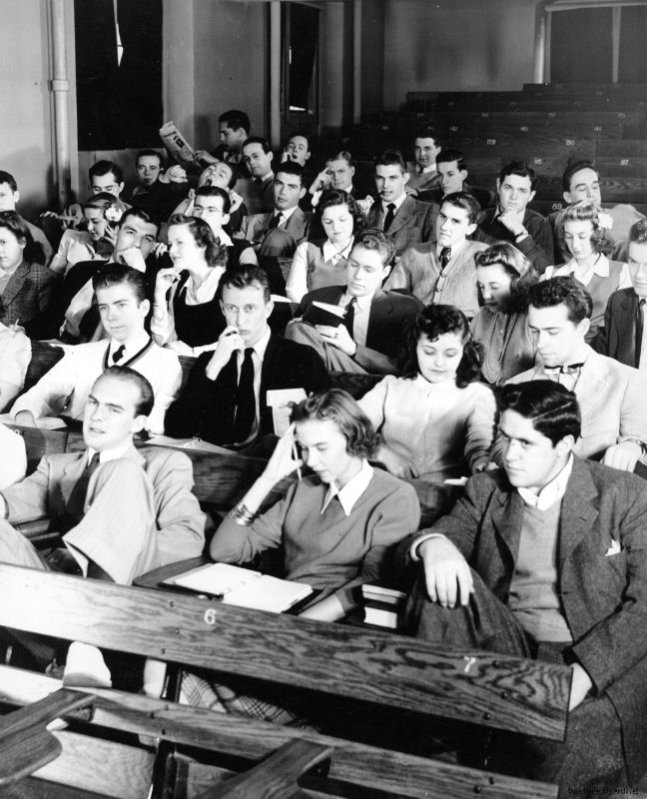
Background
Source: Duke University Archives
Boring Lecture, 1940s
Repository: Duke University Archives. Durham, North Carolina, USA. library.duke.edu/uarchives
Notes:
Nedelina
Information Literacy Instruction to the School of Public Health
The School of Public Health faculty are seeking alternatives to their teaching practices and offering more blended or online courses. Nedelina was approached with a request her information literacy sessions to be recorded, so distance students can have access to this information. Not willing to follow the old teaching practices because of students’ lack of engagement during class sessions, she designed a Canvas course to meet the needs of distance graduate students in the School of Public Health.

Slide 3

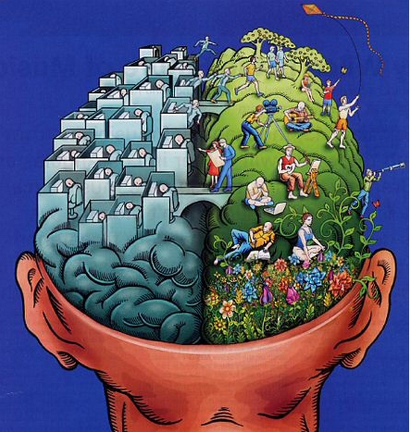
Changes in Our Instruction Practices
Source: https://www.flickr.com/photos/tza/3214197147
Notes:
Alex
At the same time, Changes to Information Literacy Instruction for the Professional Writing Program were under way – UMD Libraries moving away from one shot instruction, developing Canvas modules for our upper level writing course.
Before all these happenings, Alex was conducting research on best practice for improving the efficacy of EBM instruction for medical students, “Preparing Medical Students for Residency: Efficacy of Evidence Based Medicine Instruction” http://hdl.handle.net/1903/15077

Slide 4
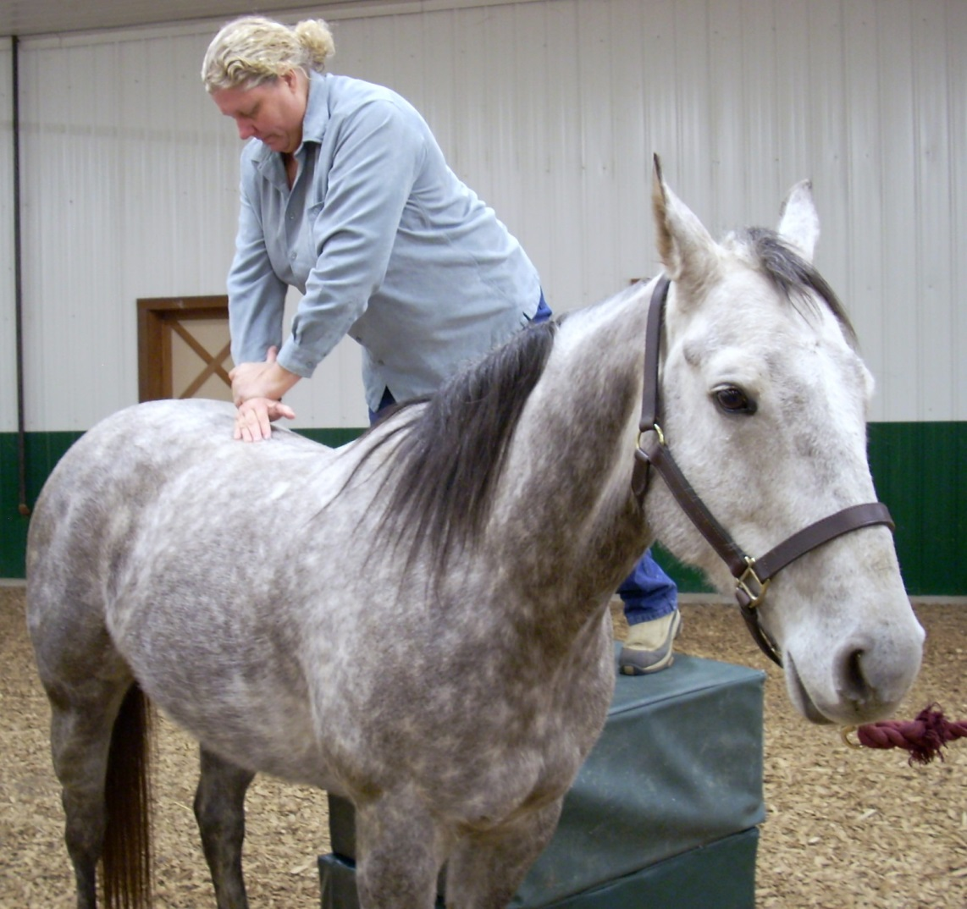
Best Practices in Evidence Based Medicine (EBM) Instruction
Source: A chiropractic adjustment of a horse. http://en.wikipedia.org/wiki/Chiropractic
Notes:
Alex
Increase the amount of time students practice information literacy concepts.
Willingham on the role of practice in the teaching and learning process:
“It is virtually impossible to become proficient at a mental task without extended practice”
Practice enables low level skills to become automatic, freeing up cognitive “space” for higher level tasks
“Memory is more enduring when practice is spaced out”
Source: Willingham, D. T. (2009). Why don’t students like school?: A cognitive scientist answers questions about how the mind works and what it means for the classroom. San Francisco, CA: Jossey-Bass.

Slide 5
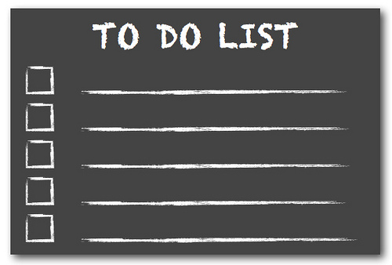
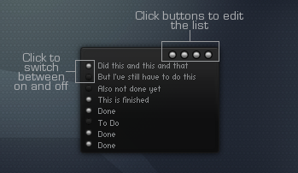
Best Practices in EBM Instruction continued
Source: http://acreelman.blogspot.com/2014/01/living-in-your-calendar.html
Source: http://sirence.deviantart.com/art/Eka-To-do-list-Updated-168082649
Notes:
Alex
Libraries should consider:
Creating online tools to supplement in-person instruction
Increasing the pervasiveness of instruction within the curriculum
Implementing active learning exercises that utilize team based learning and student peer assessment

Slide 6

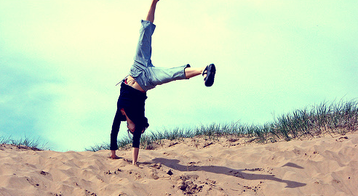
Our Goals
Source: http://www.thechangeblog.com/change-your-focus-and-be-happy/
Source: http://liberalarts.marygrove.edu/bid/142302/Flipped-Classroom-Ditches-Lecture-for-Hands-On-Curriculum
Notes:
Eileen
Our goals are to make students happy, effective and efficient researchers. We put our brains together to give them a better learning experience using some of the new methods for teaching such as the flipped classroom.

Slide 7
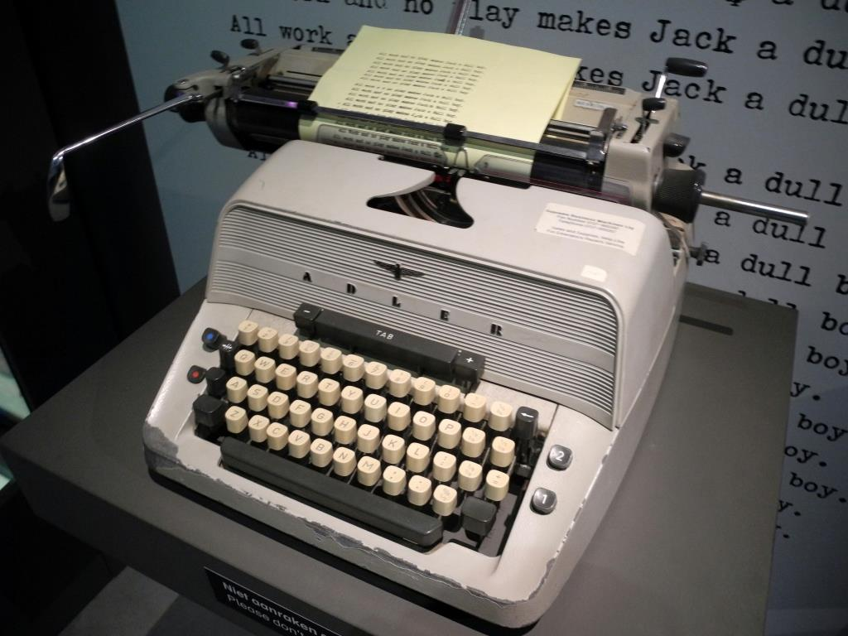

Our Proposal
Source: http://en.wikipedia.org/wiki/The_Shining_(film)
Source: http://pixabay.com/en/technology-informatics-computers-298256/
Notes:
Eileen
Apply best practices from evidence based medicine instruction for medical students to undergraduate students in health science disciplines.

Slide 8
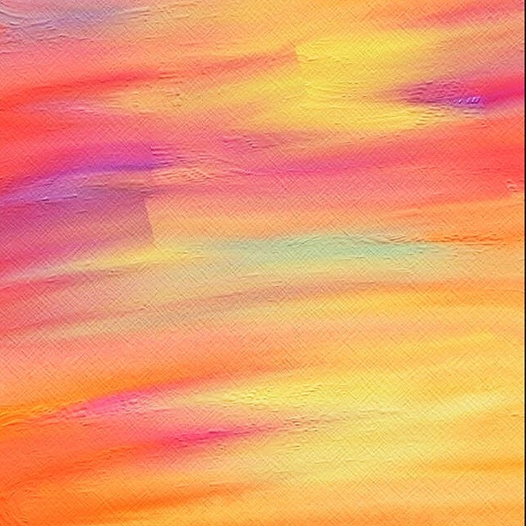
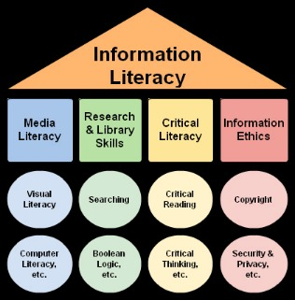
Our Proposal
Source: http://www.web2teachingtools.com/information-literacy.html
Source: https://www.flickr.com/photos/hersheydesai/14183923244/
Notes:
Eileen
Develop a Canvas online course that introduces students to information literacy concepts within the context of health sciences.
Use our Canvas course to “flip” the library classroom:
Assign the modules as homework prior to meeting with a class for an in-person library session.
After each module, students complete a post-module quiz.

Slide 9
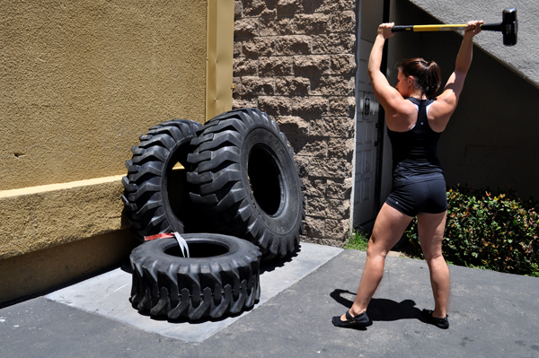
Why “flip” the classroom?
Source: http://commons.wikimedia.org/wiki/File:Pratiquante_de_CrossFit,_faisant_l'exercice_de_frappe_sur_pneu.jpg /
Notes:
Alex
The reason for flipping classroom isn’t to get on board with a trendy, technology driven fad. It’s a means to an end, not an end in itself.
A useful metaphor – the CrossFit craze
There’s nothing magical about CrossFit training (at least, there’s no data indicating that it’s magic)
The CrossFit environment causes individuals to spend 45+ minutes, 5+ times a week engaging in strenuous physical activity. They are encouraged by the peers to succeed in their goals, rather than by a fitness guru. Individuals track their results in real time to measure their achievement of personal records.
It’s not about hitting tires with a hammer – it’s about strenuous training, repeatedly and consistently, over an extended period of time, with the support of peers and the tracking of outcomes.
These are the same reasons you might flip a classroom.
Increasing the amount of time students spend practicing and grappling with complex and nuanced concepts, such as information literacy.
Creating a peer learning environment, which is learner centered instead of teacher centered.
Creating opportunities for us to meaningfully assess student learning in real time.

Slide 10
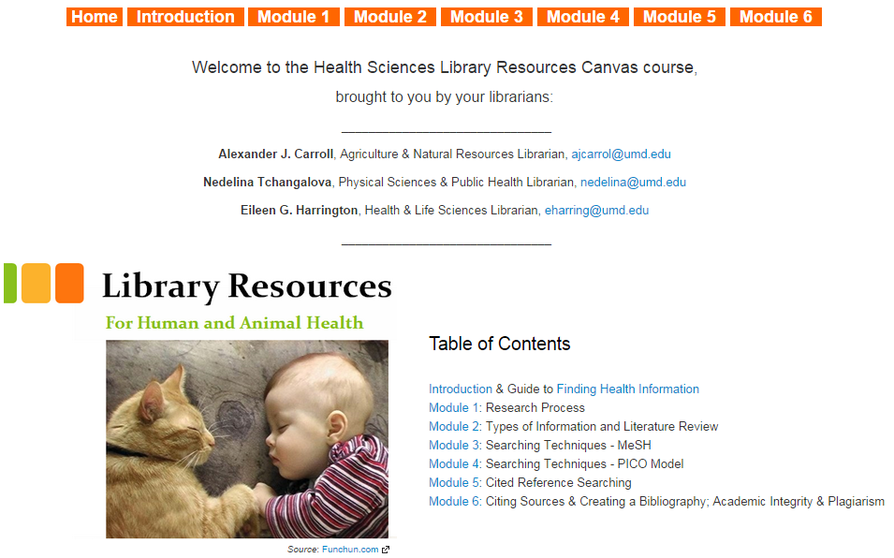
Our Canvas Course
Notes:
Nedelina
The Canvas course was designed with graphics and many selected YouTube videos describing each information literacy concept.

Slide 11
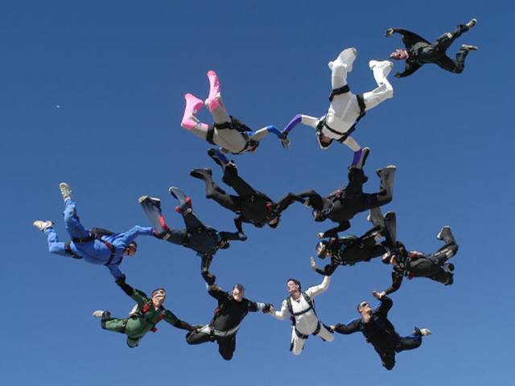
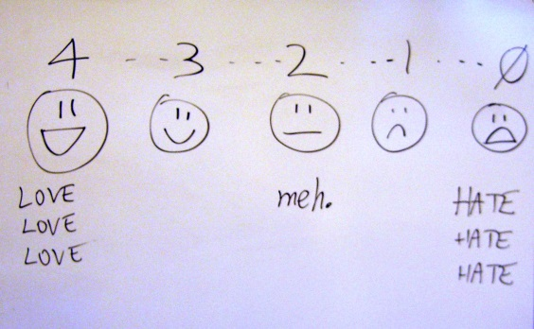

Experimental Group
PechaKucha
20 X 20
images seconds
Source: https://www.flickr.com/photos/billsophoto/4175299981/sizes/l
1st place
Source: http://upload.wikimedia.org/wikipedia/commons/b/b7/12way2.jpg
2nd place
Notes:
Alex
Worked with two Animal Science classes
During class, we empowered students to let their imaginations fly and work in groups to put together a 5 minute PechaKecha presentation on the modules.
While other groups present their assigned modules, students in the audience evaluate presentations using a rubric.
$30 Amazon gift card awarded to members of the highest scoring group.
$10 Amazon gift card awarded to members of the second highest scoring group.

Slide 12
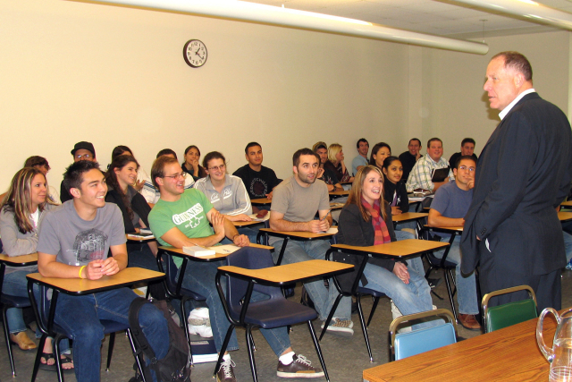


Comparison Group
The PICO Model
P = Patient
I = Intervention
C = Comparison
O = Outcome
Source: http://balachandark.wordpress.com/2012/06/21/school-teaching-vs-college-teaching/
Source: http://www.ncee.org/wp-content/uploads/2013/10/hand-raised.jpg
Notes:
Alex
Comparison group was with a Nutrition and Food Science class.
During class, librarian demonstrates advanced search strategies, such as PICO and MeSH, in a more traditional manner.
Students, working in groups, complete an exercise using these search strategies, and share their findings with the class.

Slide 13
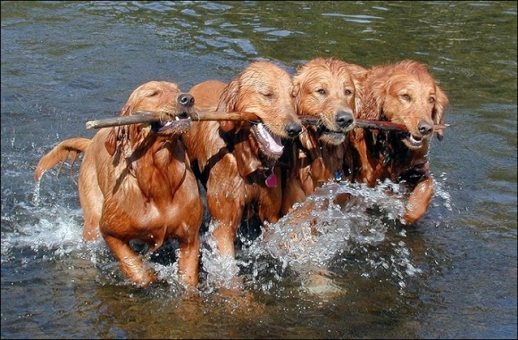
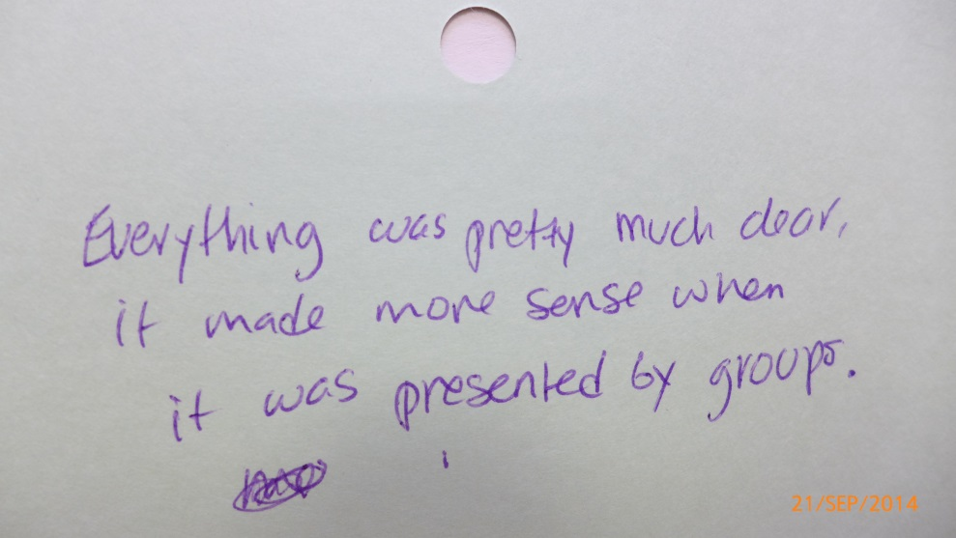
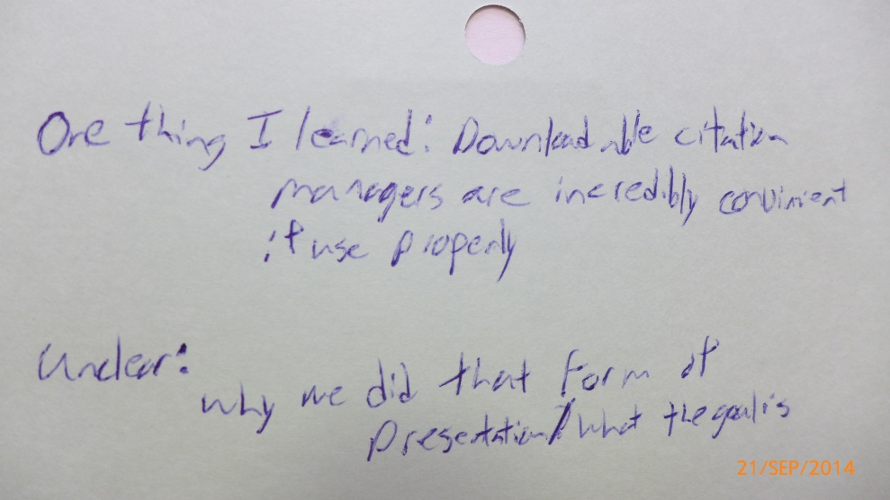
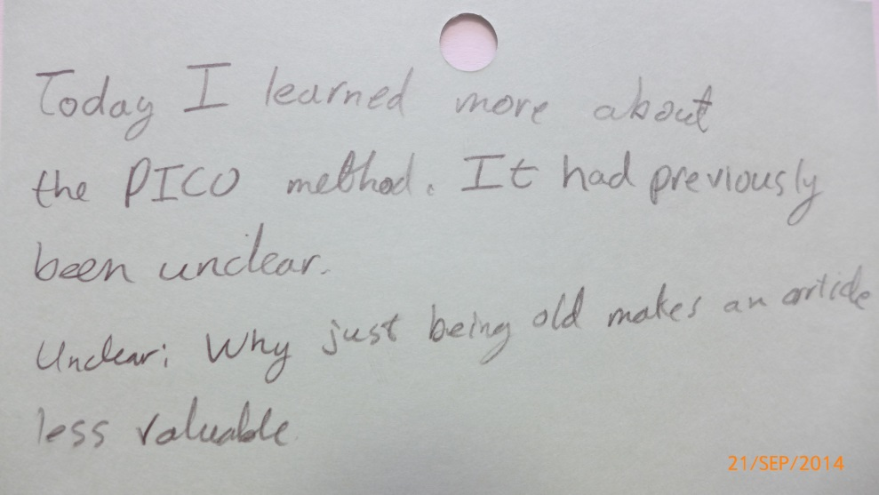
Lessons Learned (Thus Far)
Source: http://www.cutestpaw.com/images/team-work-2/
Notes:
Nedelina
We’re working on grading the online quizzes using a rubric and two graders, with a third as a tiebreaker.
We’re also analyzing feedback students provided on one thing they learned and one thing that still unclear after the session
Overall some lessons learned thus far include:
Group effort
Using preexisting relationships to identify willing faculty partners.
Money doesn’t necessarily talk!
Although no faculty from the Professional Writing Program and the School of Public Health was recruited for this project, Nedelina enrolled 20 faculty members and teaching assistants as designers. Three faculty requested direct assistance from Nedelina to import the Canvas course into their course space, while others are planning to include this information for their next courses—even if they don’t have full participation in our model, components of it can also be adapted to meet the different instructors needs.

Slide 14
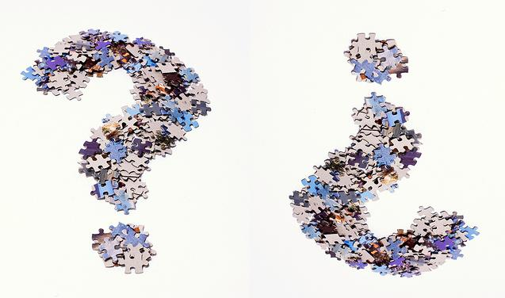
Next Steps – Part 1
Student Research Assignment Assessments
Using a rubric, evaluate:
Use of evidence to support claims
Use of appropriate evidentiary sources (high validity)
Consistent use of appropriate attribution mechanisms
Will we find differences between
the two groups when compared to similar studies in the literature?
Image by Roland O'Daniel:
https://www.flickr.com/photos/rlodan01/4555108439/sizes/o/
Notes:
Eileen

Slide 15
Next Steps – Part 2
Semi-structured interviews with faculty participants
Image by Roland O'Daniel:
https://www.flickr.com/photos/rlodan01/4555108439/sizes/o/
Notes:
Eileen

Slide 16
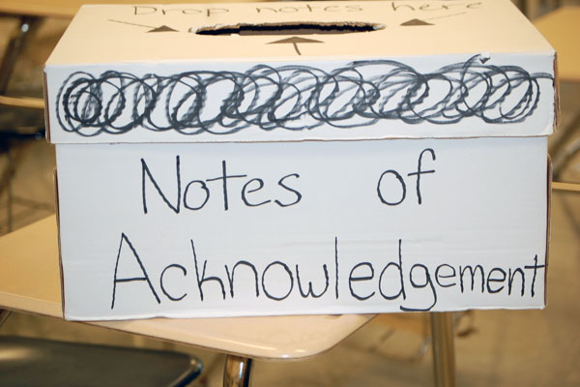
Acknowledgements
Source: http://rbclarion.com/top-stories/2012/10/16/thanking-teachers-one-note-at-a-time/
Our Faculty Partners
Our Funders
MAC-MLA Research & Assessment Grant ($1,000)
UMD Libraries Faculty Research Fund ($500)
Our Bosses
For the freedom to research this!
Notes:
Eileen
Our Faculty Partners
Our Funders
MAC-MLA Research & Assessment Grant
UMD Libraries Faculty Research Fund
Our Bosses
For the freedom to research this!

Slide 17

Any Questions?
Source: http://www.dougsblog.org/wp-content/uploads/2013/12/snow-covered-church-steps.jpg
Notes:
Eileen

