Slide 1
RDA and Linked Data: A New Way to Look at the Henson Collection
Kathy Glennan
Head, Monographs & Music Cataloging
University of Maryland
June 8, 2016

Slide 2
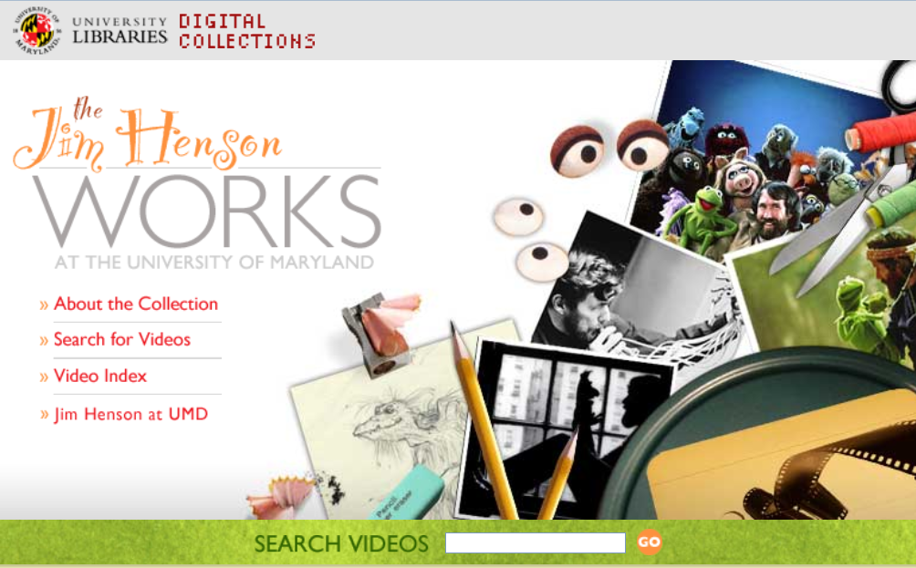
The Jim Henson Collection at UMD
Contains 75 digital videos spanning 35 years of Henson's innovative work in television and film
Discoverable through a finding aid (abstract only):
http://digital.lib.umd.edu/archivesum/actions.DisplayEADDoc.do?source=/MdU.ead.scpa.0009.xml&style=ead
The Jim Henson Works website has richer descriptions, links, etc.:
http://digital.lib.umd.edu/henson/
Videos also fully cataloged and appear in Aleph
But not in WorldCat

Slide 3
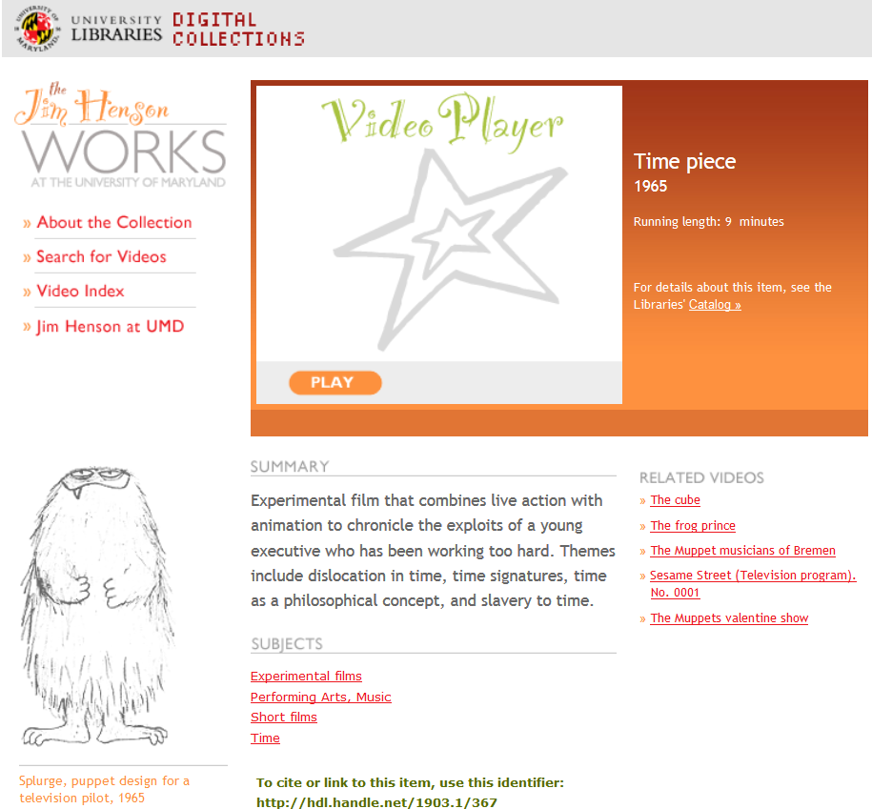
Notes:
The play button launches the video, as long as you’re at an authorized computer – it opens up full screen in a new window
The catalog link takes you to the corresponding MARC record in our OPAC
(Note: our records for this collection are not in OCLC, as part of the deed of gift)
I’m not sure how the related videos are determined
The summary is from the MARC record, as are most of the subject headings – but more on that in a minute

Slide 4
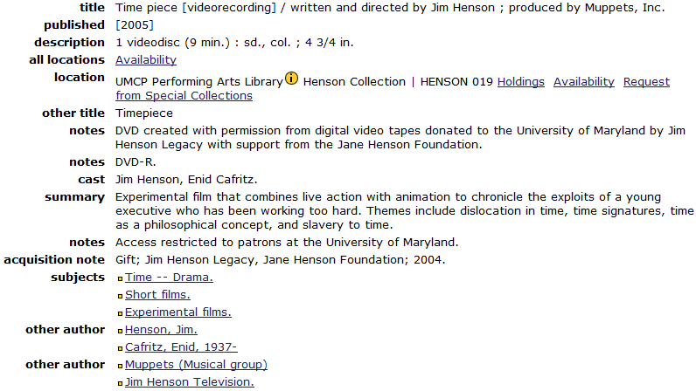
AACR2 / MARC21 Records
Notes:
Performing Arts, Music is not in this record, but is on the website.
With the subject heading Time – Drama: only “Time” is on the website.

Slide 5
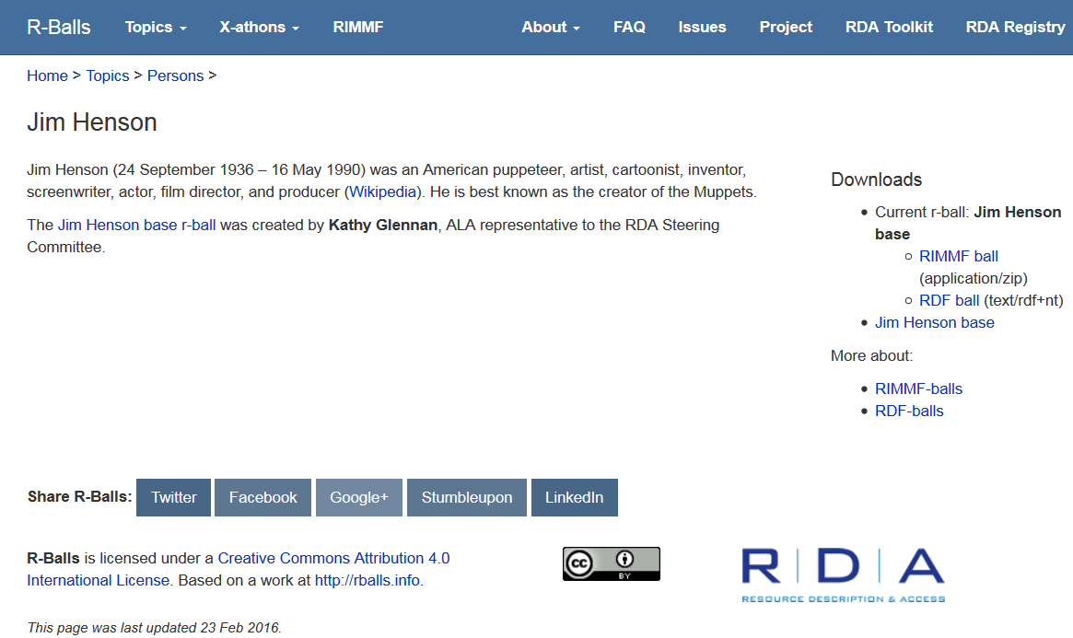
And now, an “r-ball” (http://rballs.info/topics/p/henson/)

Slide 6
So, what’s an “r-ball”?
A collection (or ball) of linked data
Usually related to a particular entity (such as person or work)
Described with RDA
Created using RIMMF (RDA in Many Metadata Formats)
The “r” stands for any/all of the following:
RIMMF
RDA: Resource Description and Access
RDF (Resource Description Framework)
Resource
Record

Slide 7
What’s in an r-ball?
R-balls may contain data for:
RDA elements describing the entity
one or more RDA Works that are related to the entity
one or more RDA Expressions that realize each Work
one or more RDA Manifestations that embody each Expression
one or more RDA Agents (RDA Persons, RDA Families, or RDA Corporate Bodies) that are related to the entity or related Works, Expressions, and Manifestations
You can explore the existing ones – see the guidelines under RIMMF-balls for newbies:
http://rballs.info/about/rimmfballsnewbies.html

Slide 8
What is RIMMF?
A program/tool for creating and editing data compliant with RDA, FRBR, and linked data
Not MARC based
Created & updated by Richard and Deborah Fritz
Freely available: http://www.marcofquality.com/wiki/rimmf
Can ingest MARC bibliographic and authority records, breaking them into entity records for: Manifestations, Works, Persons, Corporate Bodies, etc.
Links the resulting entity records; shows the relationships
Not widely used – at least not yet! But:
More than a dozen “Jane-athons” held
MARC output available
Notes:
You can ingest MARC records (and edit them as necessary), create the entity records in RIMMF itself, or some combination of both.

Slide 9
=LDR 01703nam a2200373 4500
=001 umdkpg00000366
=005 20160216101716.0
=008 160216\\\\\\\\\\\\\\\\\\\\\\\\\\\\\eng\d
=035 \\ $a http://hdl.handle.net/1903.1/367
=040 \\ $b eng $e rda
=100 1\ $a Henson, Jim, $d 1936-1990, $e screenwriter.
=245 10 $a Time piece /$c written and directed by Jim Henson ; produced by Muppets, Inc.
=246 3\ $a Timepiece
=264 \1 $a [2005].
=300 \\ $a 1 videodisc : $b color ; $c 4 3/4 in.
=336 \\ $a two-dimensional moving image $2 rdacontent
=337 \\ $a video $2 rdamedia
=338 \\ $a videodisc $2 rdacarrier
=344 \\ $a digital $b optical
=347 \\ $a video file $b DVD video
=500 \\ $a DVD created with permission from digital video tapes donated to the University of Maryland by Jim Henson Legacy with support from the Jane Henson Foundation.
=506 \\ $a Access restricted to patrons at the University of Maryland.
=520 \\ $a Experimental film that combines live action with animation to chronicle the exploits of a young executive who has been working too hard. Themes include dislocation in time, time signatures, time as a philosophical concept, and slavery to time.
=650 \0 $a Time--Drama.
=650 \4 $a Experimental films.
=650 \4 $a Short films.
=700 1\ $a Cafritz, Enid, 1937-,$e actor.
=700 1\ $a Henson, Jim, $d 1936-1990, $e animator.
=700 1\ $a Henson, Jim, $d 1936-1990, $e actor.
=700 1\ $a Henson, Jim, $d 1936-1990, $e director.
=700 1\ $a Nemeth, Ted, $d 1911-1986, $e director of photography.
=700 1\ $a Sahlin, Donald G., 1928-1978, $e special effects provider.
=700 1\ $a Sebesky, Don, 1937-, $e composer (expression).
=710 2\ $a Muppets, Inc., $e producer.
Notes:
MARC Output from RIMMF

Slide 10
Jane-athons?
Half- or full-day workshops using RIMMF to explore using RDA – beyond the limitations of MARC
The first few were focused on Jane Austen
Have held 3 in association with ALA conferences, and more outside the US as well
More planned, including one before ALA Annual in Orlando
Feedback has identified potential areas for improving RDA instructions and elements
Two r-balls focus on UMD’s collections:
Henson
George F. Root (songbook collection in SCPA)
Notes:
5 Mar 2016: Cincinnati, MLA: Lenny-athon (Leonard Bernstein)
14 April 2016, National Library of Spain, Madrid: Cervathon (topic: Miguel de Cervantes) 4 May 2016, BnF, Paris: French X-athon 9 May 2016, National Library of Sweden, Stockholm: Selma-thon 1 (topic: Selma Lagerlöf) 10 May 2016, National Library of Sweden, Stockholm: Selma-thon 2 24 May 2016, EURIG/National Library of Latvia, Riga: Riga-thon (topic: Vaira Vīķe-Freiberga) 23 June 2016, Orlando, USA: Lang-athon (multilingual aspects of RDA and RIMMF)
16 Jul 2016, Chicago, AALL: Hugo-a-thon (Hugo Grotius)
Fall 2016: Dutch X-athon

Slide 11
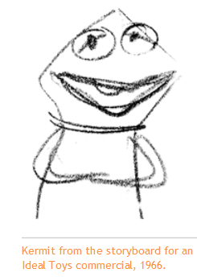
Jim Henson r-ball
A good way to compare the data from more traditional finding aids with a set of related linked data
Includes the 75 videos, along with related books, digital photographs, etc. – mostly imported from Aleph
Contains 798 entity records:
99 works
93 expressions
103 manifestations
437 persons
66 corporate bodies
Notes:
Some work records don’t have corresponding expression records because they are “related works” for a collection of clips from various talk shows: the Jack Paar program, Tonight! with Steve Allen, the Jimmy Dean show, the Ed Sullivan show, and the Dick Cavett show

Slide 12
A closer look at RIMMF

Slide 13
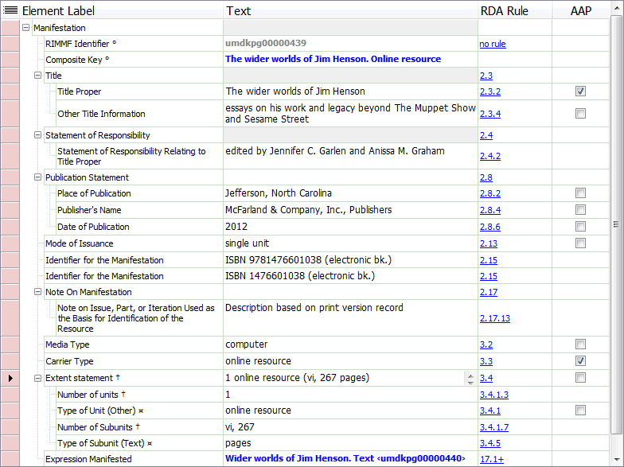
Manifestation record in RIMMF

Slide 14
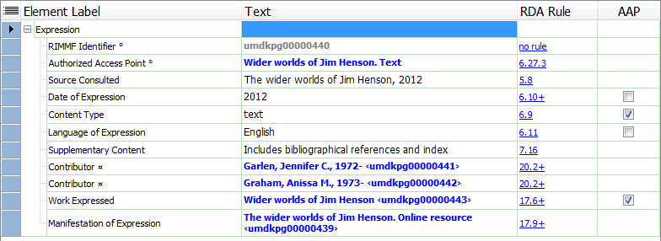
Expression Record in RIMMF

Slide 15
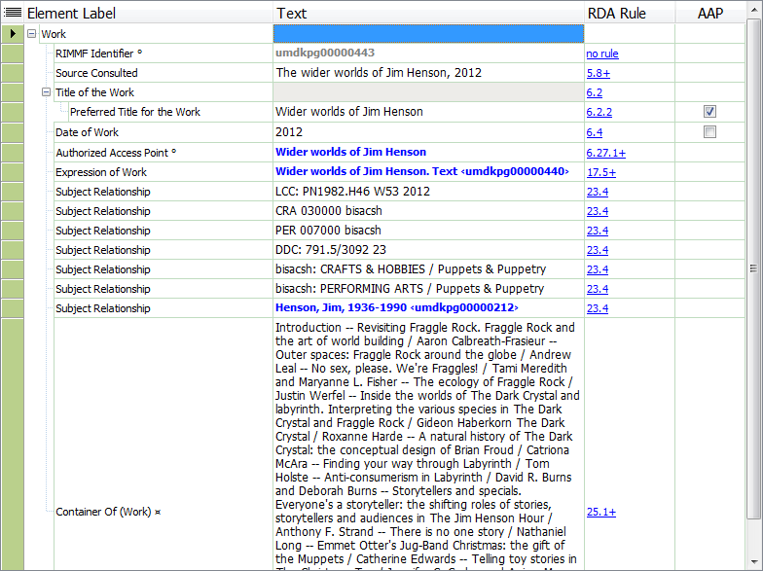
Work Record in RIMMF
Notes:
RIMMF built this work record based on information in the original bibliographic record.
The subject relationships were created based on the 050, 072 and 6XX fields, with labels for identification of the type of subject.

Slide 16
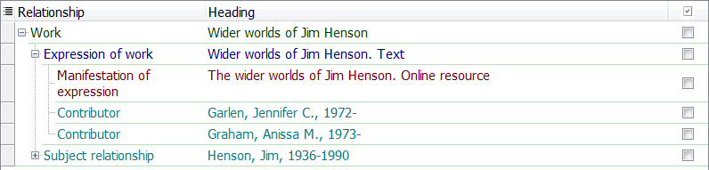
Work Tree Visualization in RIMMF

Slide 17
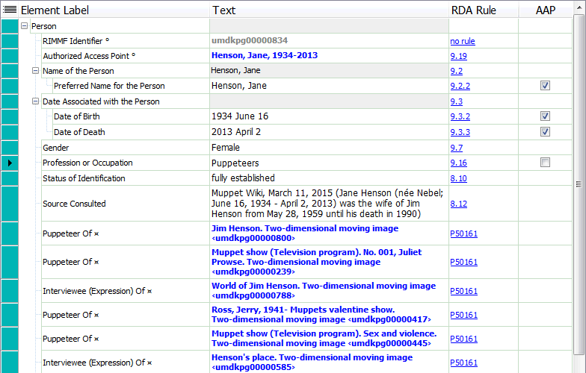
Person Record in RIMMF
Notes:
The non-RDA “RDA rule” references link to the RDA Registry. They represent relationship designators that have been defined only in one direction in the RDA Toolkit – but obviously the relationship goes both ways. (Work to person; person to work)

Slide 18
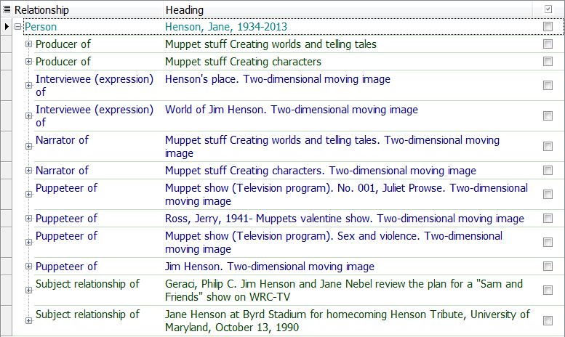
Person Tree Visualization in RIMMF
Notes:
Complete

Slide 19
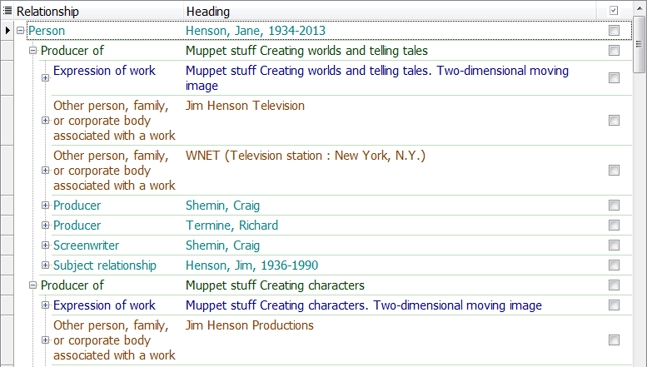
Person Expanded Tree Visualization
Notes:
Full for 1st work, partial for 2nd

Slide 20
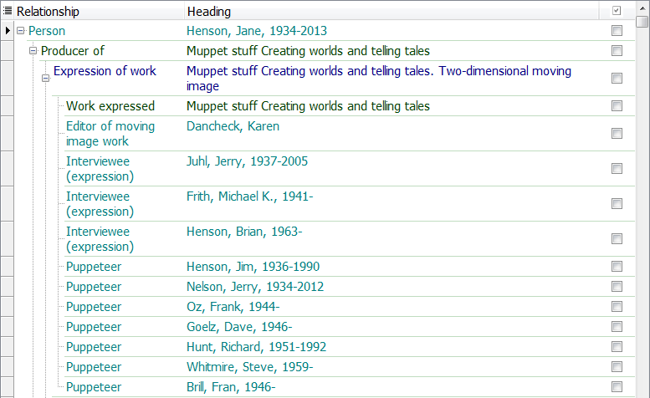
More Person Tree Expansion
Notes:
Partial entity relationships for 1st work

Slide 21
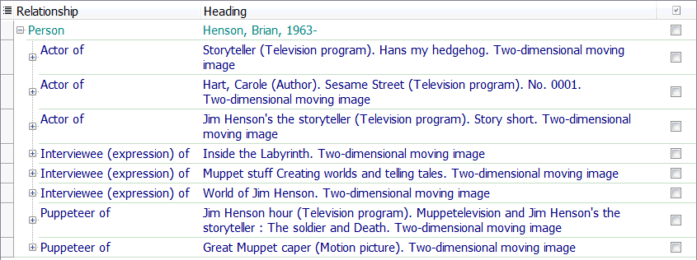
Related Person Tree

Slide 22
Data Challenges when using RIMMF
Identifying which element goes where
If ingesting MARC, sometimes data elements need to be moved from one entity record to another, and cataloger’s judgment comes in to play
Getting out of MARC thinking – and provider neutral guidelines, etc.
RIMMF allows for “pure” RDA implementation, without compromises made for MARC and local systems
Discovering that there aren’t relationship designators for everything – like puppet builders
Notes:
Where does "Entire original production directed and choreographed by Jerome Robbins“ belong in the WEMI stack anyway?
Is there a relationship here? More than one?

Slide 23
Data Opportunities
More granularity in records
Separate data elements display and function more clearly
Greater specificity of relationships and roles
Frank Oz as director, producer, screenwriter, actor, interviewee and puppeteer
Determining what to display as the AAP:
Henson, Jim [LC/NACO Authority File] or Henson, Jim, 1936-1990 [my r-ball]
Notes:
The RIMMF AAP functionality offers the same type of customization for works and expressions

Slide 24
Other visualizations of linked data?

Slide 25
Linked data graphs
Problems with bibliographic data visualizations
There aren’t many free visualization tools for bibliographic data
For meaningful displays, the data needs to be massaged
Bibliographic data can have very detailed relationships
From a RIMMF perspective, every entry in an entity record is a relationship to that entity
This makes graphs very big, very quickly
More programming work needed to improve visualizations of our complex data
Notes:
I hoped to give you a visualization of how RDF triples can be displayed to show relationships that a set of corresponding MARC records don’t make explicit, but…

Slide 26
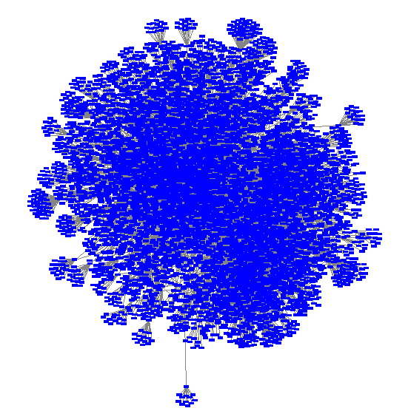
Henson r-ball: Very Busy!
Notes:
Not too surprising. There are 798 entity records, but over 14,000 relationships in this r-ball.

Slide 27
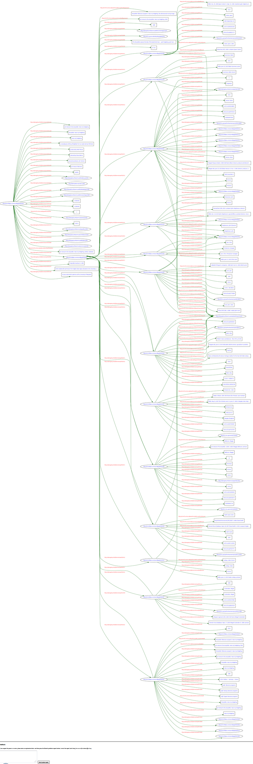
Graph of one Henson record: Hans My Hedgehog

Slide 28
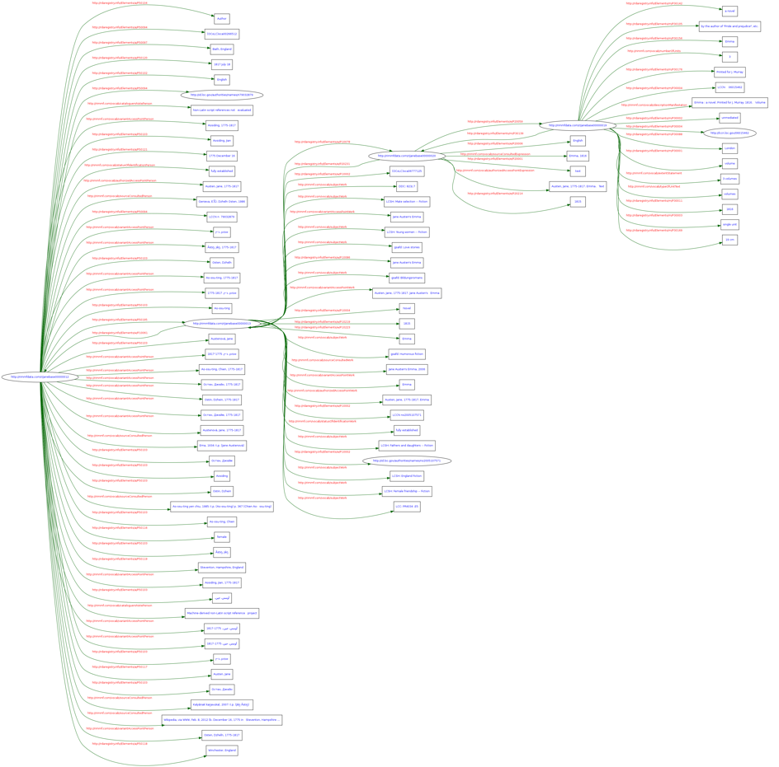
Graph of 4 entities: Austen’s Emma
http://rballs.info/images/janeemmaur.png

Slide 29
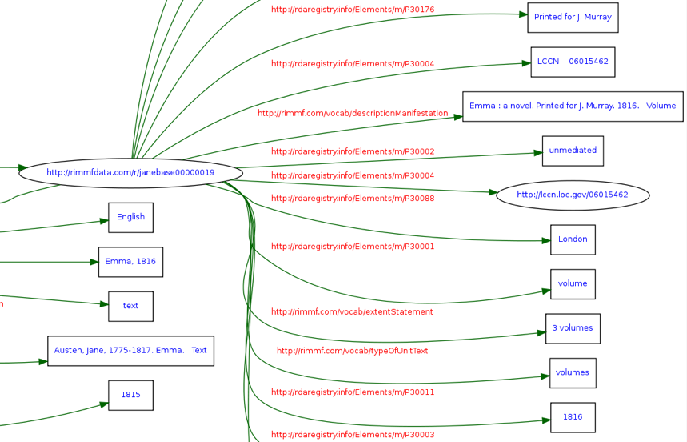
A closer look

Slide 30
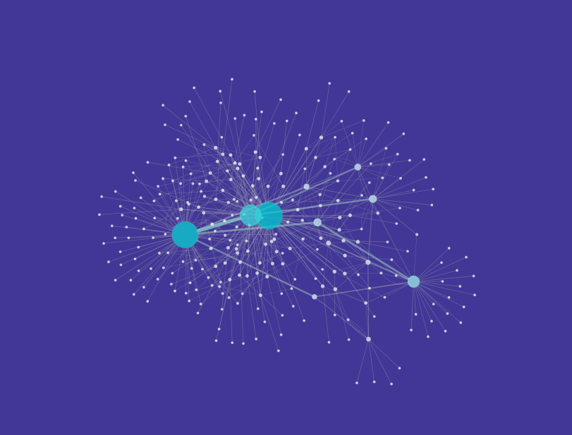
5 entity records from the Root r-ball

Slide 31
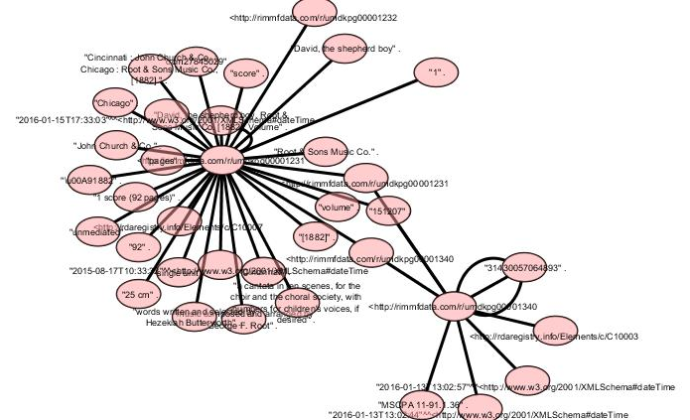
A subset of those (just 2)

Slide 32
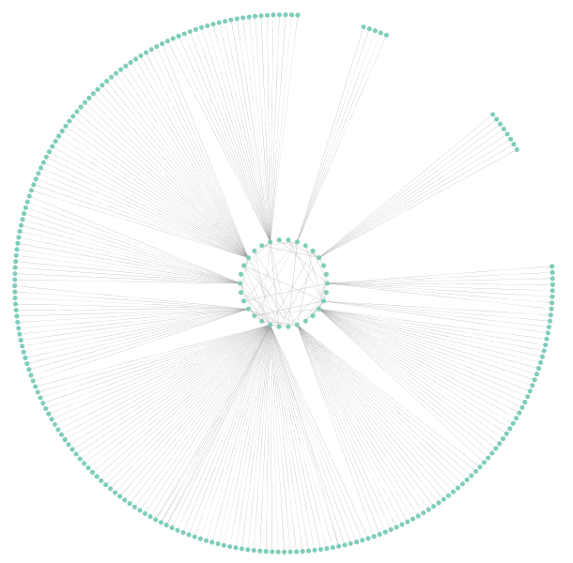
A graph of the complete Root r-ball
Notes:
232 entity records

Slide 33
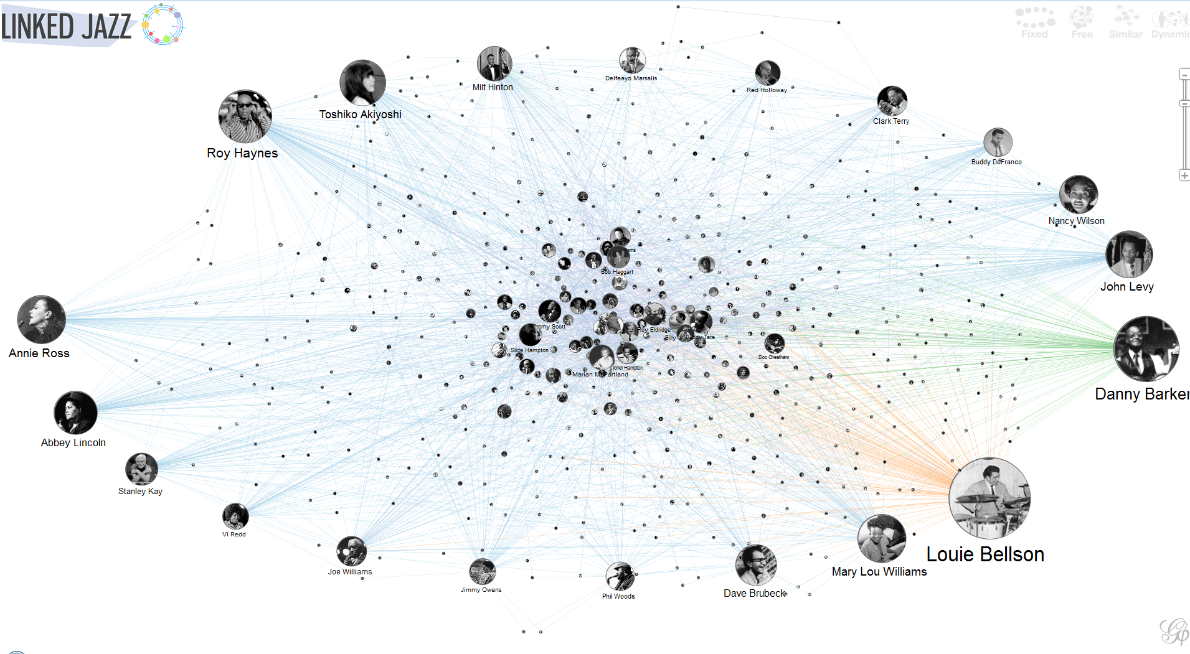
We still have a ways to go….
https://linkedjazz.org/network/

Slide 34
Questions?

