Slide 1

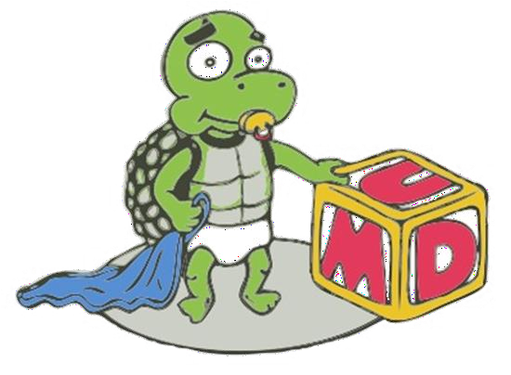
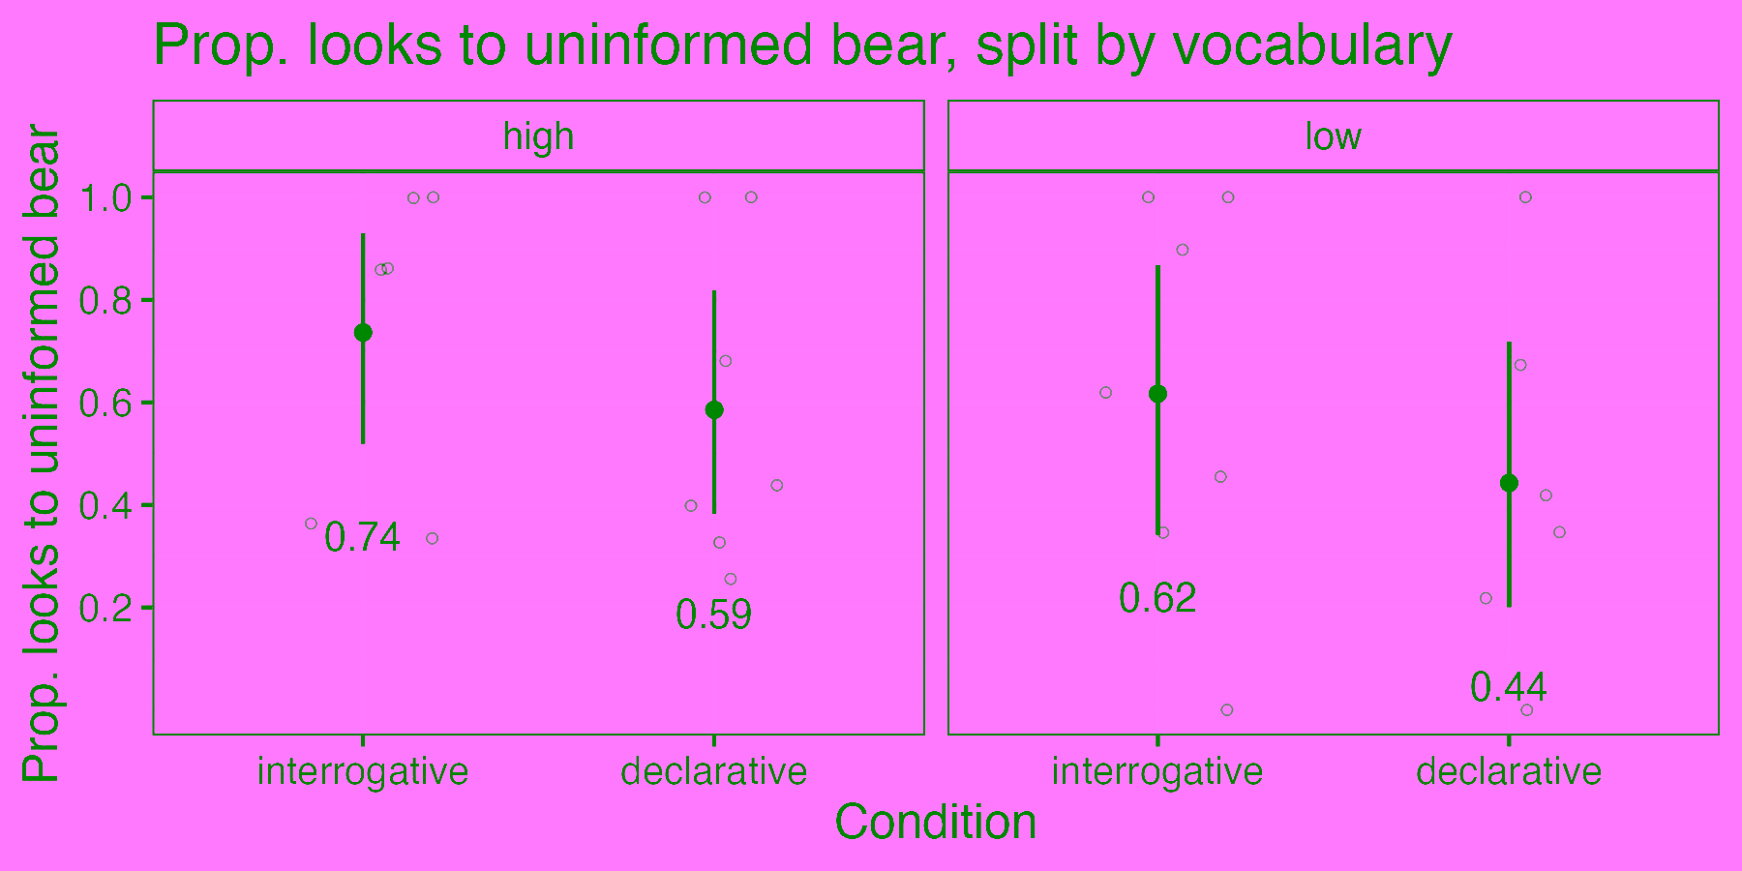
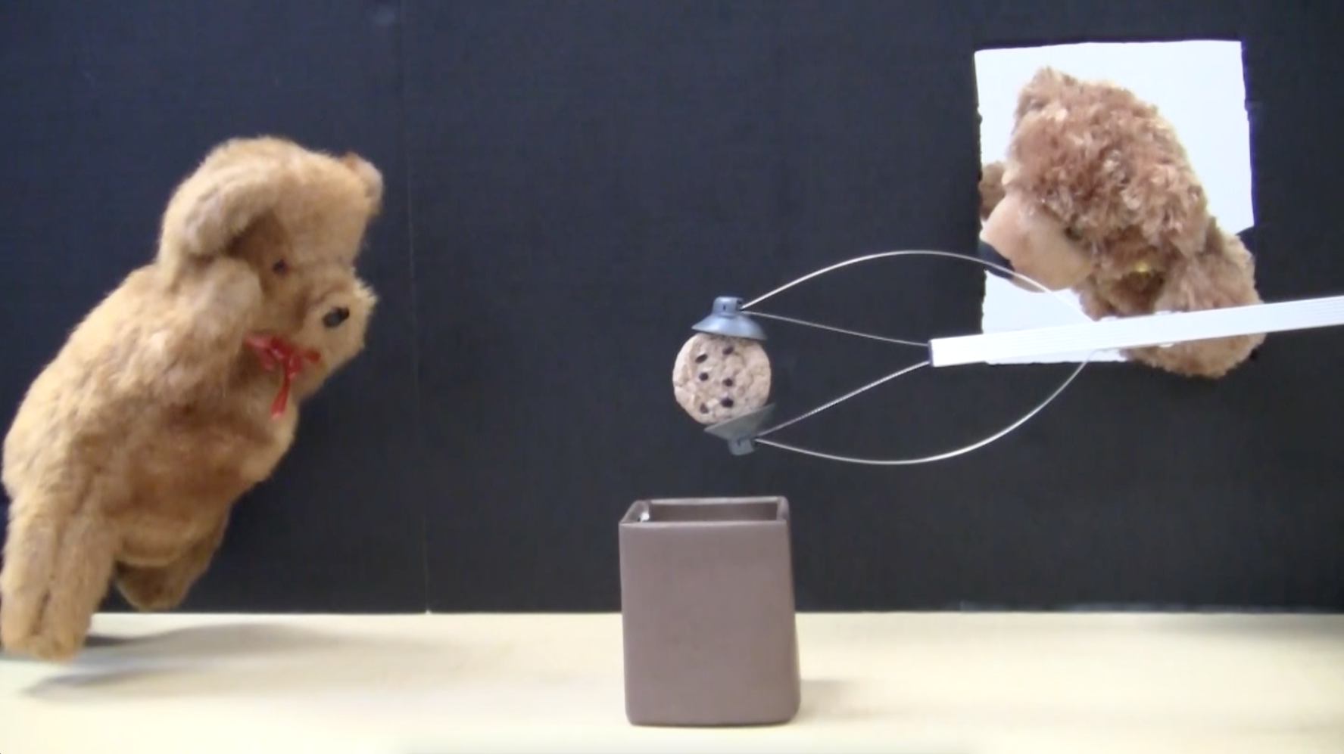


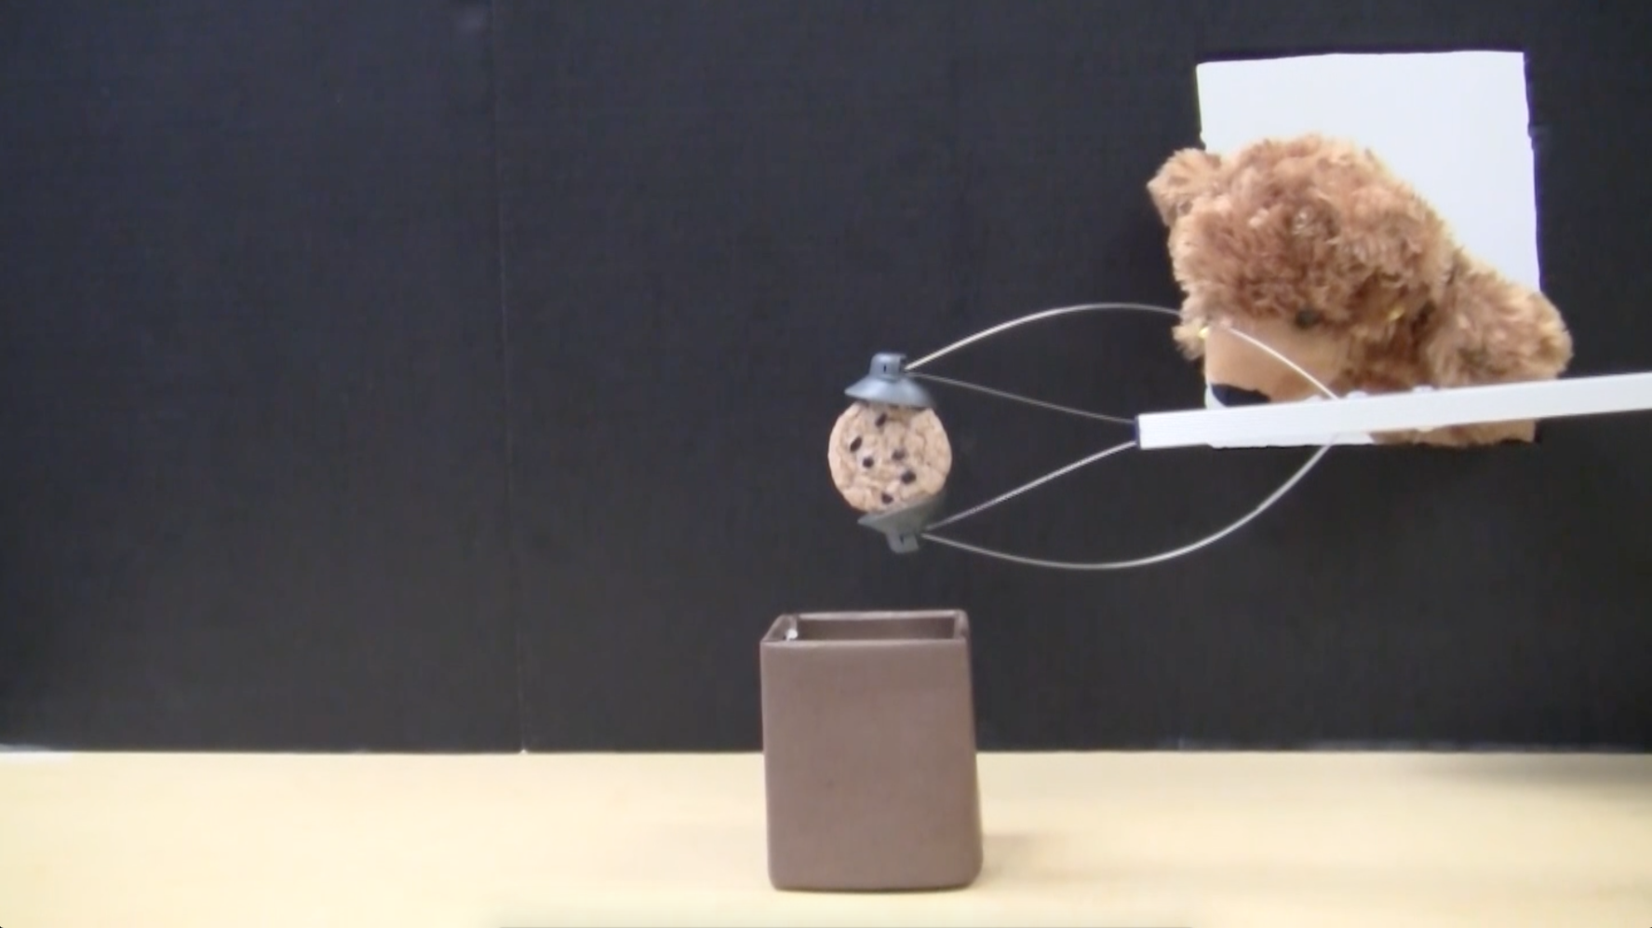
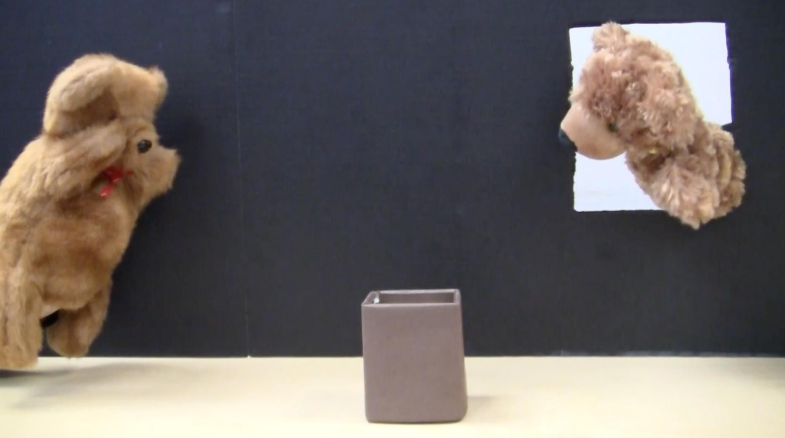
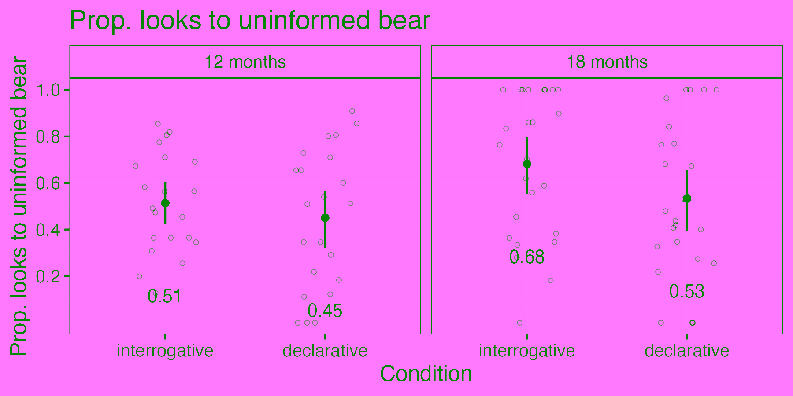
When do children map clause types to canonical speech acts?
Maia Swisdak, Amudha Krishnan, Elizabeth Swanson, Jeffrey Lidz, Valentine Hacquard
University of Maryland, Department of Linguistics
Background
Method
Results cont.
Clause types map to speech acts.
Declaratives and interrogative clause types are distinguished by syntax and prosody.
In polar questions…
Training trials
Declarative → Assertion
Children are shown that the box may or may not have a cookie deposited into it.
Interrogative → Question
There is a cookie in the box.
Test trials
Is there a
cookie in
the box?
There’s a
cookie in
the box.
🔊
Auxiliary
Productive vocabulary size showed no significant effect on looks to the target bear.
Is there ___ a cookie in the box?
Auxiliary
Subsequent Study
Research Question
See if 15 month olds can link polar interrogatives to an uninformed speaker, as well as whether 18 month olds can link wh-interrogatives to an uninformed speaker *
(Uninformed bear leaves)
(Uninformed bear returns)
When do children figure out the mapping between interrogative clauses with questions, and declarative clauses with assertions?
Results
By 18 months, children seem to associate interrogatives with the uninformed bear. This suggests that they understand that interrogatives are used for questions.
There is [a cookie/a shoe] in the box.
Study Setup
What is in the box?
Paradigm: Preferential looking
Task:
* See Amudha Krishnan’s poster
Distinguish the high and low voice
Identify the interrogative and declarative sentences
Correlate the sentences with the uninformed and informed bears based solely on the sentences’ forms
References and Acknowledgements
Bernard, C., Depierreux, A., Huet, V., C Mascaro, O. (2025). Infants Assume Questions Serve an Information-Seeking Function, Link Them to Interrogative Sentences and Differentiate Them From Assertions. Child Development. https://doi.org/10.1111/cdev.14267
Geffen, S., C Mintz, T. H. (2015). Can You Believe It? 12-Month-Olds Use Word Order to Distinguish Between Declaratives and Polar IInterrogatives. Language Learning and Development, 11(3), 270–284. https://doi.org/10.1080/15475441.2014.951595
Murray, S., C Starr, W. (2021). The structure of communicative acts. Linguistics and Philosophy, 44. https://doi.org/10.1007/s10988-019-09289- 0
Huge thanks to Tara Mease, the Project on Children’s Language Learning, and all of our participants!

