Slide 1
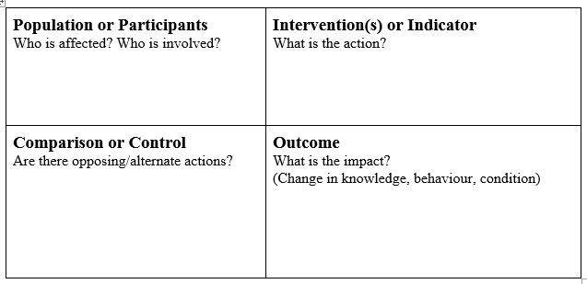
Using PICO in Library Instruction for STEM Disciplines
Stephanie Ritchie, Agriculture and Natural Resources Librarian, University Libraries
Abstract
PICO
Framework for Information Literacy for Higher Education
PICO is understood to support evidence based practice/medicine research, part of the medical and health sciences disciplines. However, very little use of the PICO methodology found outside of these disciplines. The idea to use PICO for research question and search strategy formulation in other disciplines has been explored in the recent past, but did not seem to generate wide use outside of traditional medical and health fields. However, the use of PICO to support research at the initial exploration phase for information literacy and basic science instruction may help students with the challenging step of formulating a research question.
P = Population
Population w/ (health) condition
of interest
Participants
Principal person or thing
Problem
Predicament
I = Intervention
Intervention, therapy, treatment, tests
OR
Issue of interest
C = Comparison
Another intervention
True control placebo
Standard operation
Standard of care
O = Outcome
Measurement of comparisons
Research as Inquiry
Learners who are developing their information literate abilities:
formulate questions for research based on information gaps or on reexamination of existing, possibly conflicting, information;
determine an appropriate scope of investigation;
deal with complex research by breaking complex questions into simple ones, limiting the scope of investigations;
use various research methods, based on need, circumstance, and type of inquiry;
monitor gathered information and assess for gaps or weaknesses;
organize information in meaningful ways;
synthesize ideas gathered from multiple sources;
draw reasonable conclusions based on the analysis and interpretation of information
Searching as Strategic Exploration
Learners who are developing their information literate abilities:
determine the initial scope of the task required to meet their information needs;
identify interested parties, such as scholars, organizations, governments, and industries, who might produce information about a topic and then determine how to access that information;
utilize divergent (e.g., brainstorming) and convergent (e.g., selecting the best source) thinking when searching;
match information needs and search strategies to appropriate search tools;
design and refine needs and search strategies as necessary, based on search results;
understand how information systems (i.e., collections of recorded information) are organized in order to access relevant information;
use different types of searching language (e.g., controlled vocabulary, keywords, natural language) appropriately;
manage searching processes and results effectively.
Why Use PICO?
PICO is a framework that can help students and practitioners identify the key elements or concepts of their information needs. It is a tool that can be used to break complex queries into simpler components. These simpler components can be combined to form a concise research question and act as a basis for a literature search strategy. Additionally, PICO supports information literacy learning objectives in higher education (see Framework excerpt in right sidebar)
Sample Worksheet for Students
Example Topics:
1) Breakfast consumption among college students
2) How are floodplains with levees impacted by deforestation?
References
PICO methodology and background information from:
Sackett, 1997, Evidence-based medicine; how to practice & Teach It, (p. 27.)
http://www.mclibrary.duke.edu/subject/ebm?
tab=questiontable
Straus, 2010, Evidence-based medicine; how to practice and teach it, ( p. 15 - 18)
Melnyk, 2011, Evidence-based practice in nursing & healthcare: A guide to best practice, (p. 31)
  College Students
  Floodplains with levees
Breakfast Consumption
Deforestation
Cohort 2
Cohort 2
No Breakfast
No Levees
Academics? Health?
Athletic Performance?
Increased/Decreased Floods?

