Slide 1
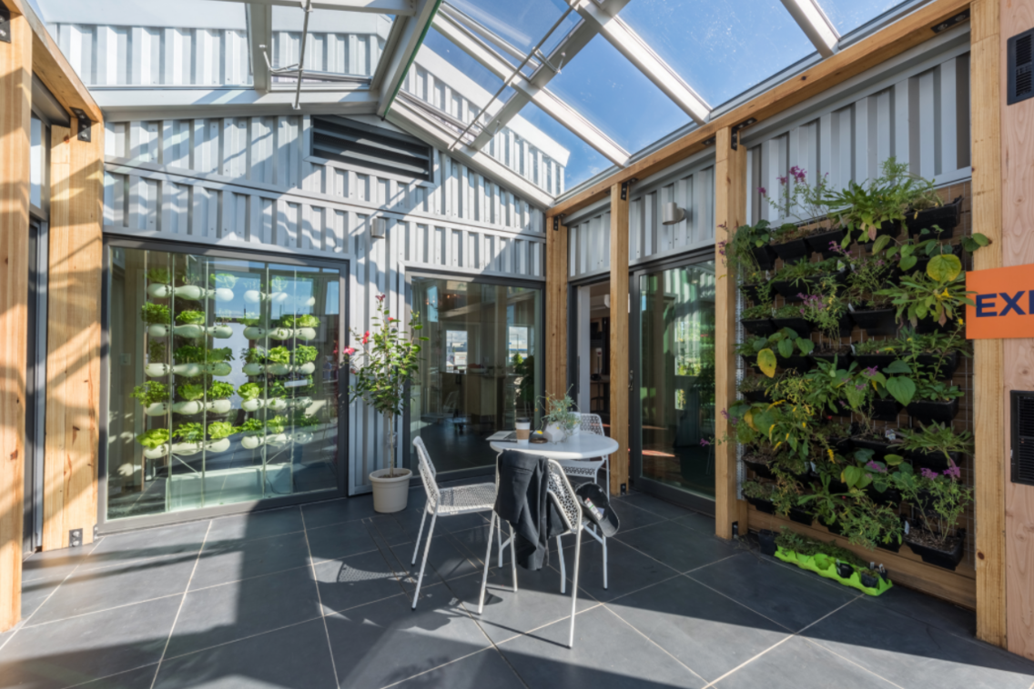



Developed by Zack Bishop and Matthew Lagomarsino
Narrated By Peter Brooks
Living Systems and Waste

Slide 2

Land Acknowledgement
We acknowledge that the University of Maryland is built upon the ancestral and unceded lands of the Piscataway. As students and scholars at the University of Maryland, we recognize that we have historically, personally and collectively benefited from the occupation of Piscataway lands. We recognize that it is our responsibility to acknowledge this occupation and the negative impacts that our occupation of Piscataway lands has had on the Piscataway people, their lands, and the ecosystems which are vital to their way of life.

Slide 3
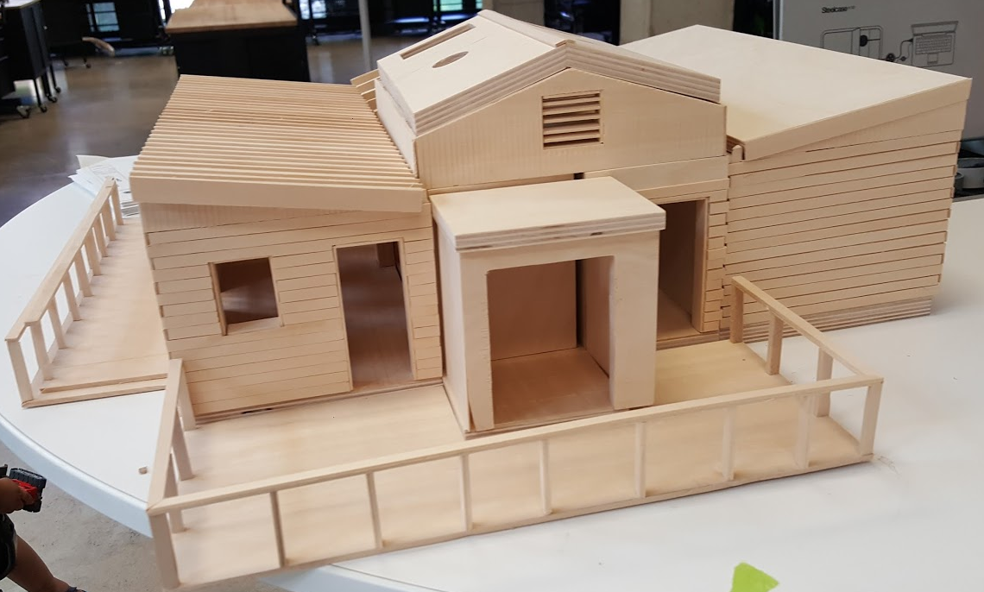
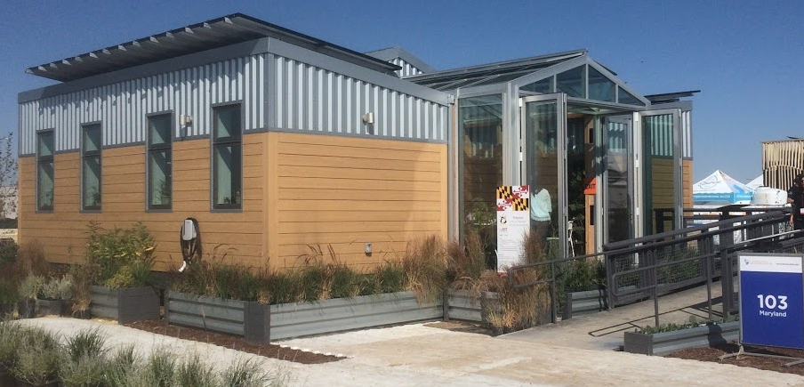
What is reACT?
reACT (resilient Adaptive Climate Technology) is the University of Maryland competition house for the 2017 Solar Decathlon.
Solar Decathlon - international competition to build a sustainable solar powered house.
reACT features many interdisciplinary sustainability innovations. The design was heavily informed by Native American knowledge systems.
This learning module focuses on living systems and waste within reACT.
Notes:
This slide should have kind of a curious or inquisitive tone. The aim is to invite people to learn more

Slide 4
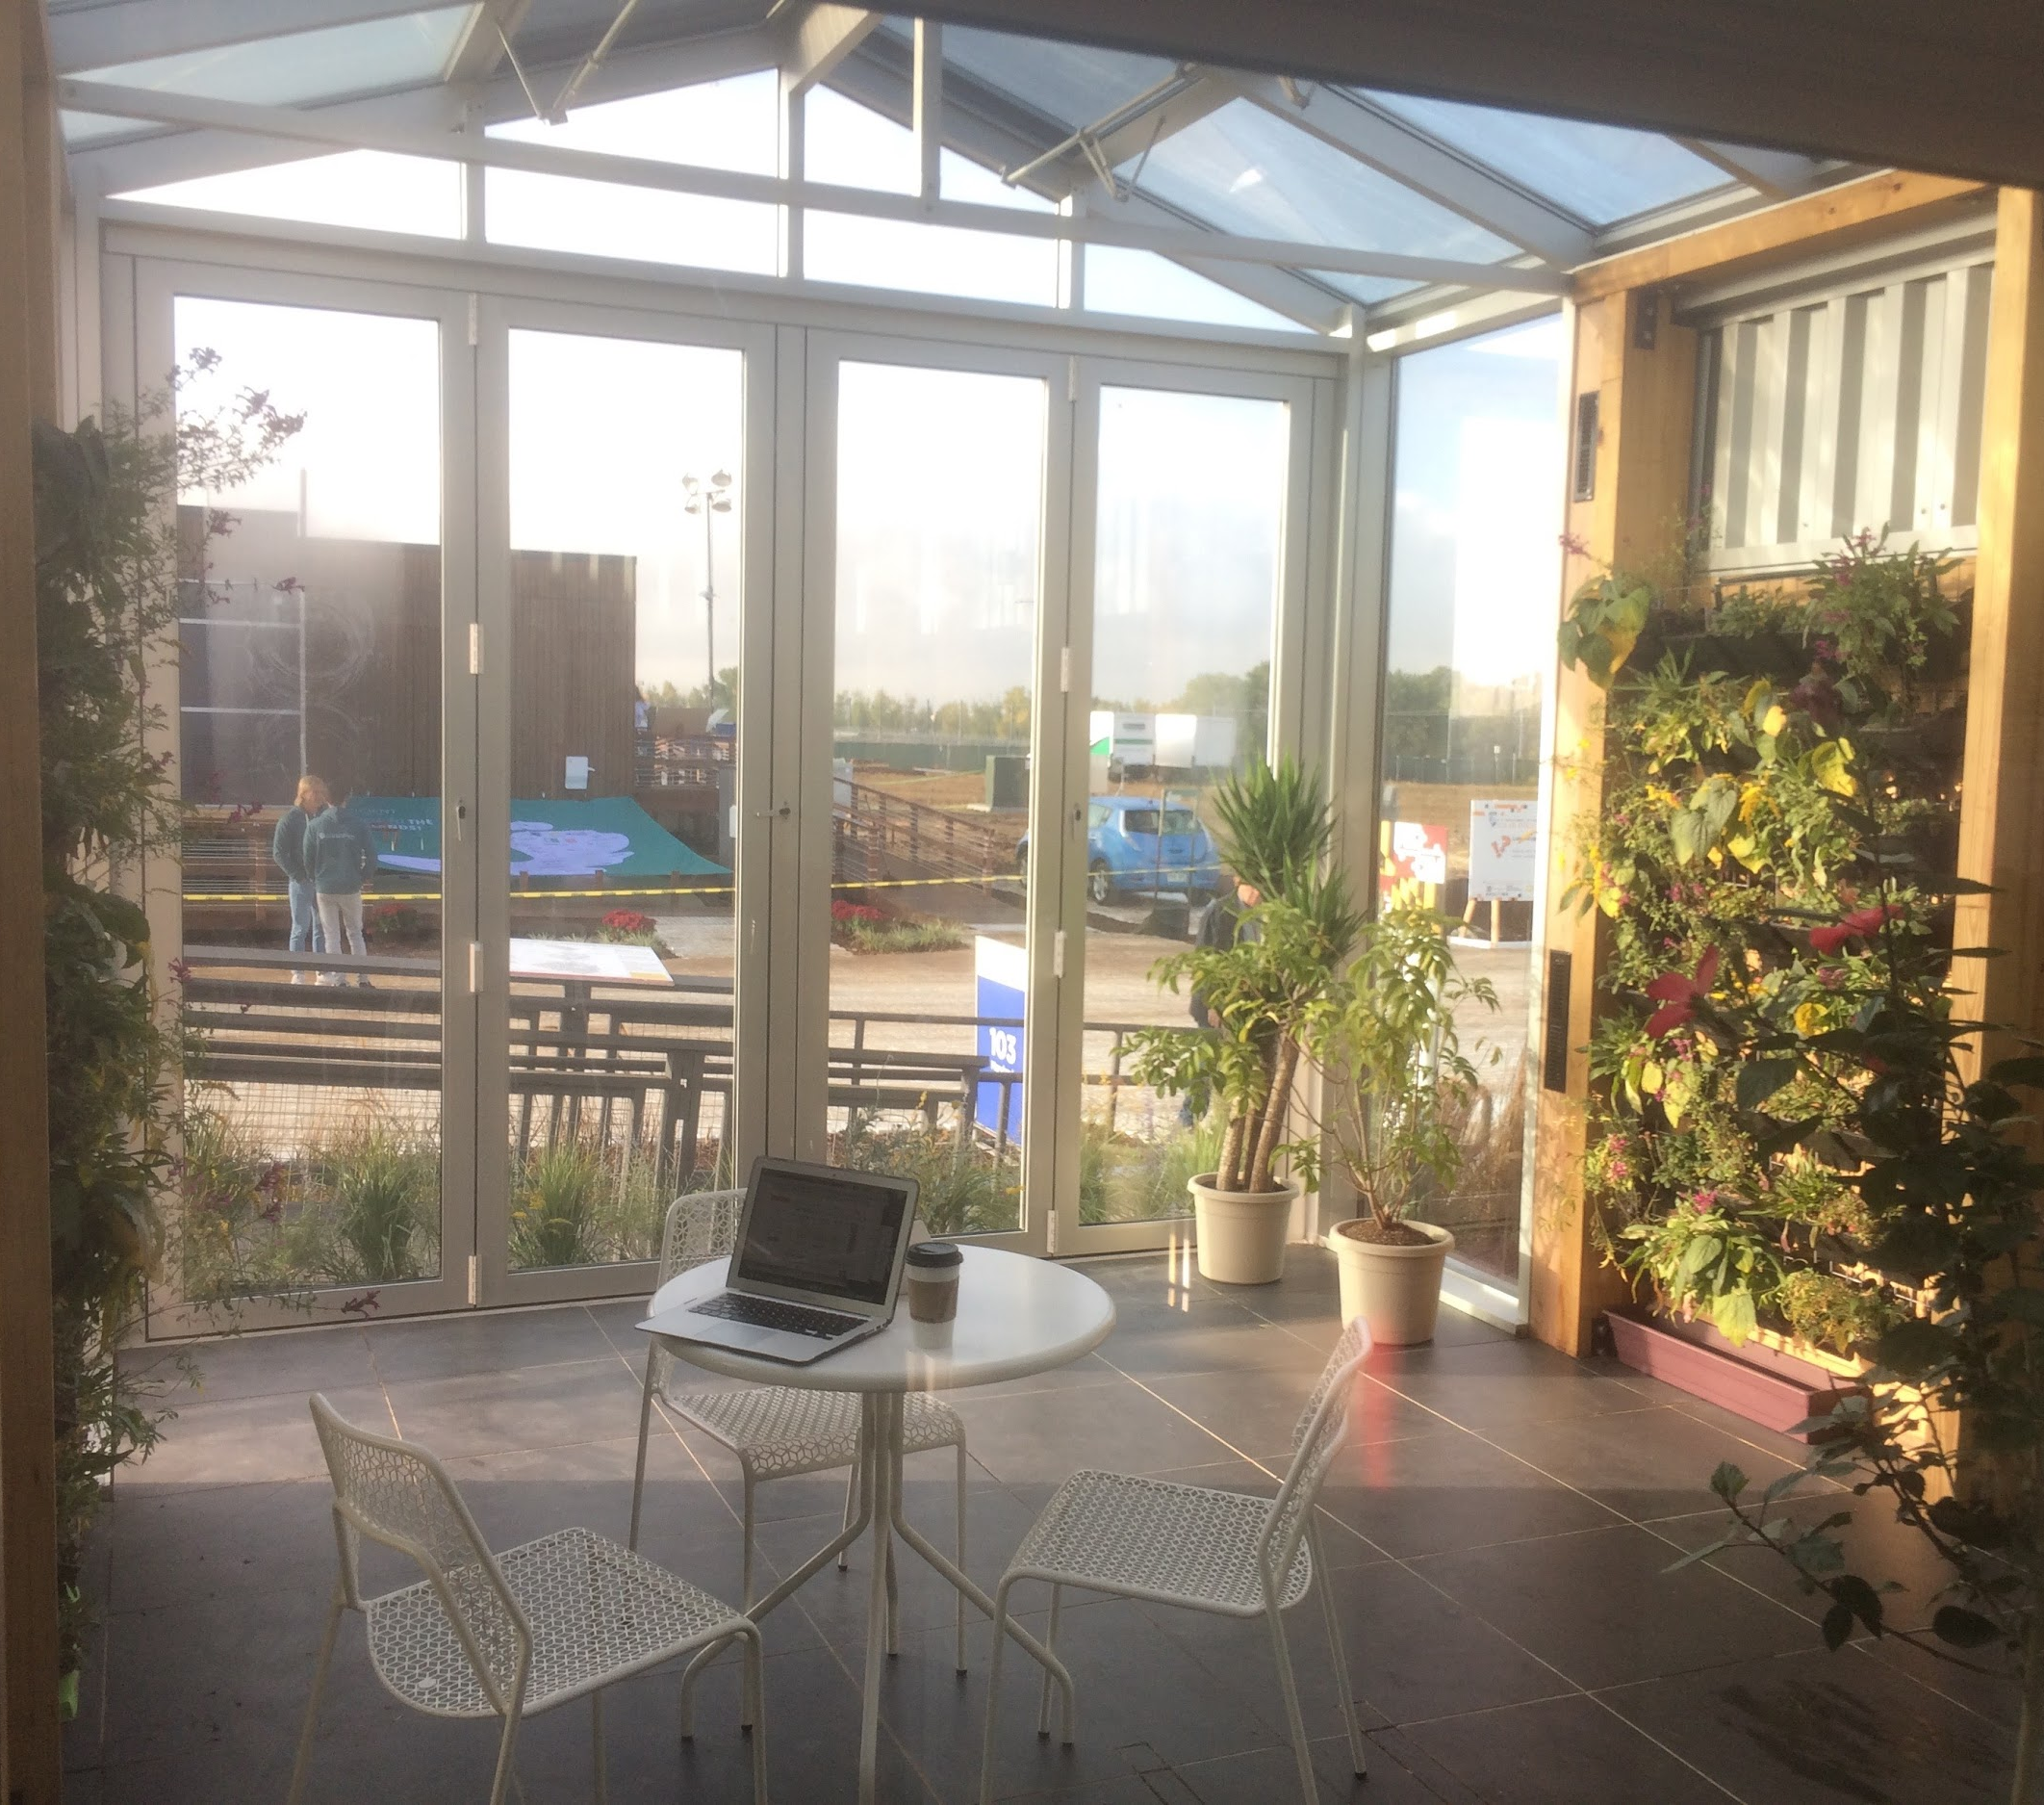
Learning Objectives
Understand the origins of reACT’s living systems
Understand core components of the living systems
Realize core themes within the living systems
Understand how the Piscataway use native plants
Be inspired to contribute to the sustainability field

Slide 5
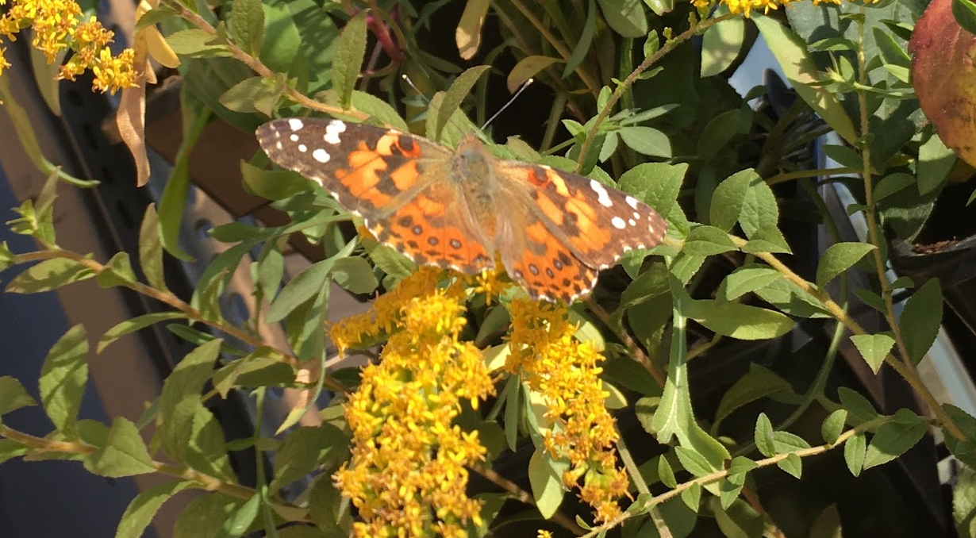

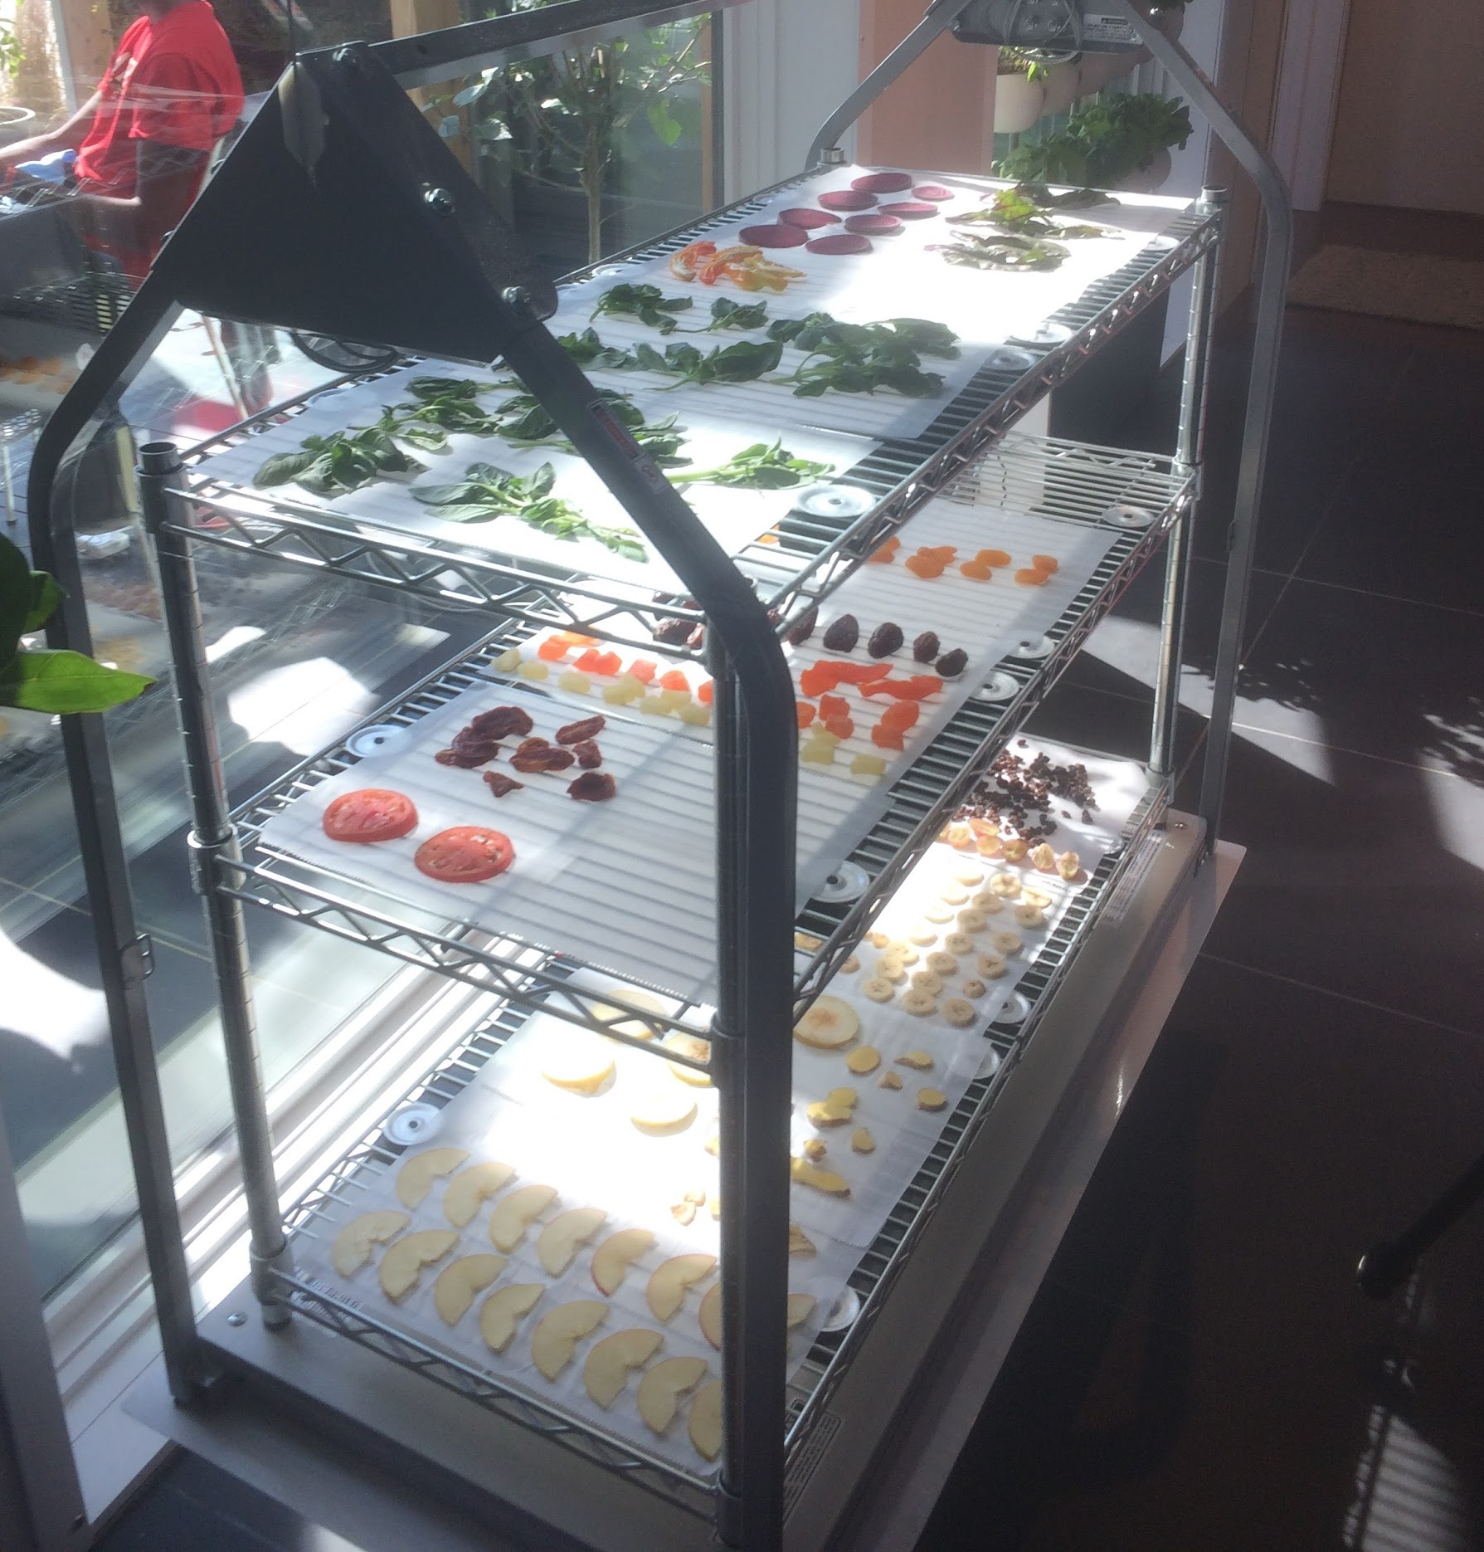

Core Themes of reACT
Protection of ecological integrity
Local food production
Modular systems
Conservation of resources
Interconnectedness of all systems
Collaboration of academic disciplines

Slide 6
Connection to Local Native Principles
Core Themes of reACT
Native American Cultural Principles
Protection of ecological integrity
Local food production
Modular systems
Conservation of resources
Interconnectedness of all systems
Collaboration of academic disciplines
Resilience through ecological diversity
Sacred use of sun, water & plants
Multi-use spaces and materials
Self sufficient living
7th generation principle
Interconnectedness of all things
Notes:
For this slide, consider going a little slower to allow the audience to fully take in the diagram.

Slide 7
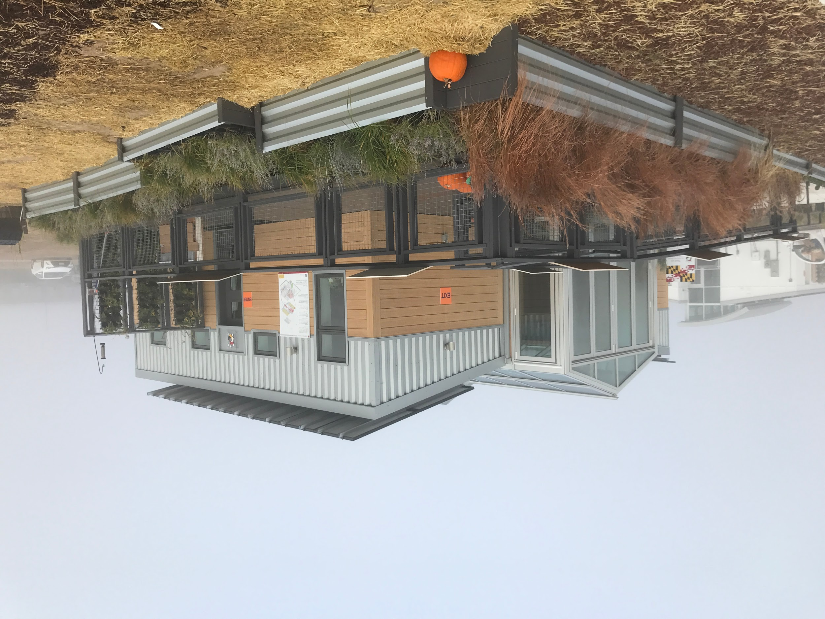
Why Living Systems?
Reduce your ecological footprint
  Ecological footprint - the amount of land needed to produce resources consumed by a population and absorb its waste.
Think in terms of systems ecology
  Systems ecology focuses on the energy and material flows within ecosystems.
  reACT’s human and nonhuman systems are interconnected.

Slide 8
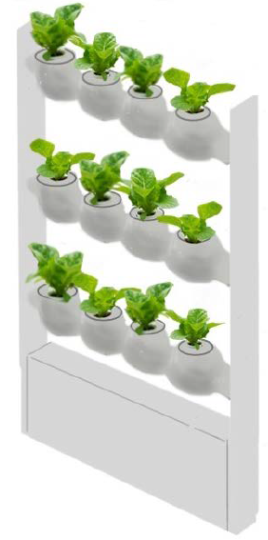
Hydroponics Garden - Design
Ceramic planters sit in rows on a steel frame.
Planters hold edible plants in 3” pots.
Plant roots dangle in liquid nutrient solution.
Submersible pump sends water from reservoir to top planter.
Water flows via gravity to each ceramic planter below.
Water flows back into 10 gal reservoir.
Liquid nutrients and water are added to 10-gal reservoir as needed.
10 gal reservoir
Notes:
For slides 8-17, I tried to speak slower when there is technical information that the reader needs to understand fully to grasp. You can use your own discretion, and/or use my audio clips as a placeholder for the spacing I would set it. A david attenborough style tone will be a model as it is educational and yet holds just enough cheerfulness and inquisitiveness to make it interesting.

Slide 9
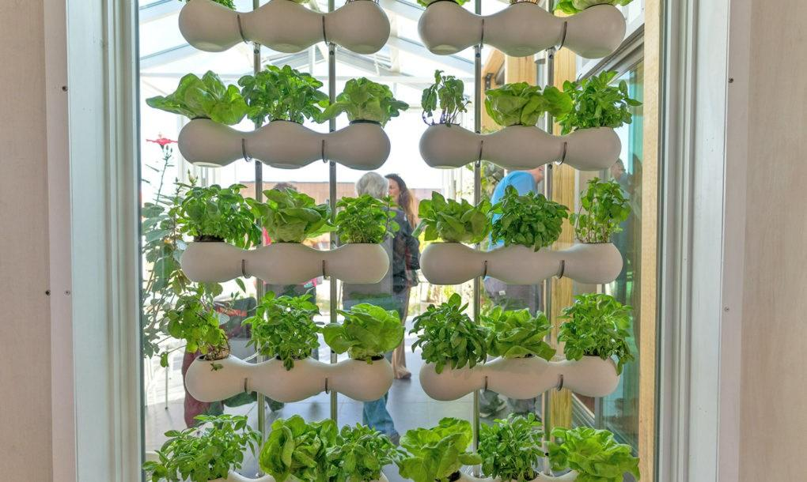
Hydroponics Garden - Benefits
Produces edible greens and herbs.
Uses water efficiently.
Requires minimal nutrients.
Uses no soil.
Free from pesticides and herbicides.
Makes use of previously unused vertical space.
Acts as a ‘green screen’ for indoor windows.
Theme: Conservation of Resources
Recirculating water flow minimizes water usage.
Indoor environment minimizes evaporation.
Can you think of creative ways water can be reused in your own home?
Notes:
For yellow theme boxes, a change in tone could be useful to differentiate it from the bullets. Not required but this can be at your own discretion! The same goes for the other 3 slides with theme boxes.

Slide 10
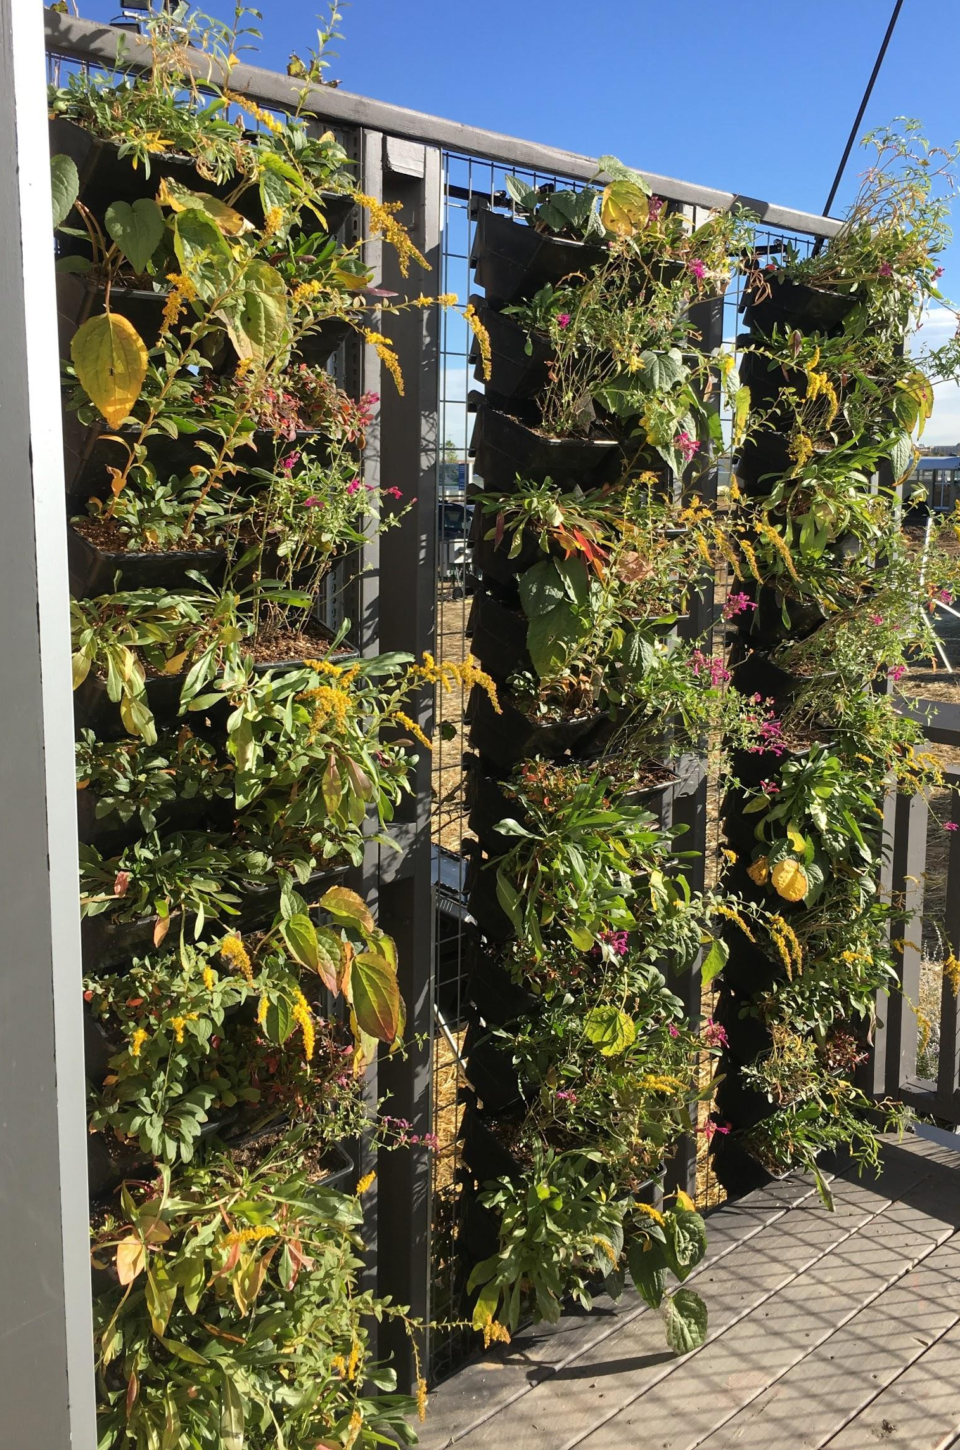
Green Walls - Design
One exterior green wall faces South on the deck.
Two interior green walls face each other in the Green Court.
Plantable trays fit on 3x2” wire mesh panels.
Trays can be arranged for varying aesthetics and functions.
Drip irrigation nozzles efficiently deliver reclaimed grey-water and rainwater.
Irrigation is automated based on data inputs from
soil moisture sensors and local weather data.
‘VGP Tray Living Wall System’ by Tournesol Siteworks, LLC

Slide 11
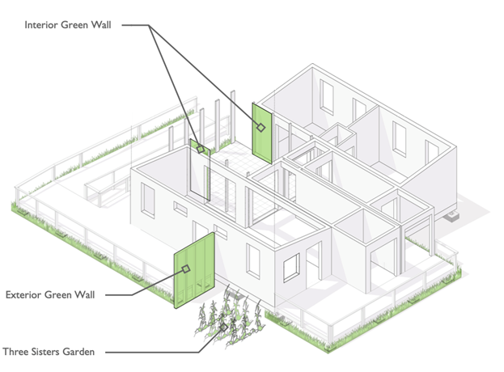
Green Walls - Benefits
Exterior walls:
Grows native flowering species.
Acts as habitat for beneficial pollinators.
Interior walls:
Grows medicinal/ceremonial herbs and botanicals.
Promotes psychological wellness for humans.
Improves indoor air quality in the Green Court.
Both walls:
Make use of previously unused vertical space.
Use water efficiently to grow plants.
Constructed of 100% recycled plastics.
Low maintenance systems.
Theme: Modular Systems
The 3 green walls are modular in their design to allow for a seasonal crop rotation.
During the winter months, exterior trays can be placed on interior green wall panels to keep plants alive.
What plants would you grow if you had a green wall inside your house? How about outside?

Slide 12
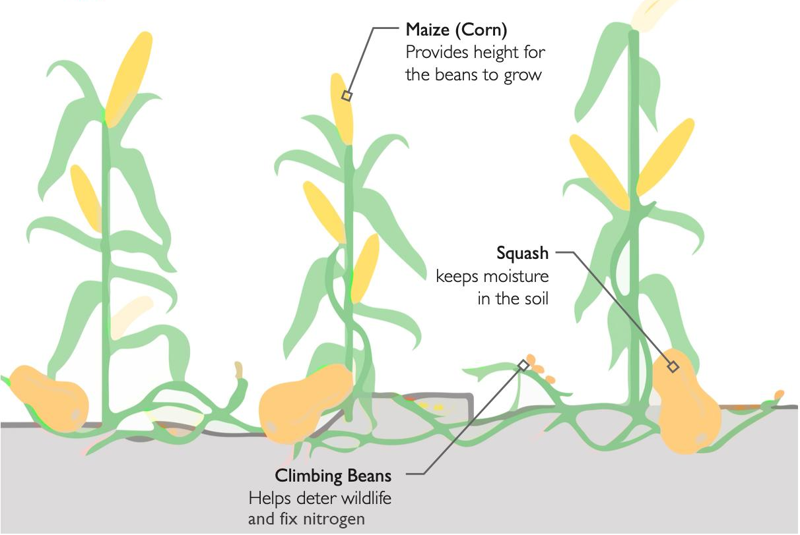
Exterior Raised Beds - Design
Two 12’ x 12’ above ground planter beds constructed of water-resistant lumber grow edible crops off the ground.
Drip irrigation efficiently delivers reclaimed grey water and/or rainwater on a fixed interval schedule.
Plant Palette:
Native edible crop species fit the climate wherever reACT is placed.
Three Sisters Garden, a Native American growing technique, is featured in reACT as a method of companion planting that predates colonization.
Three Sisters Garden consisting of corn, squash and beans.

Slide 13
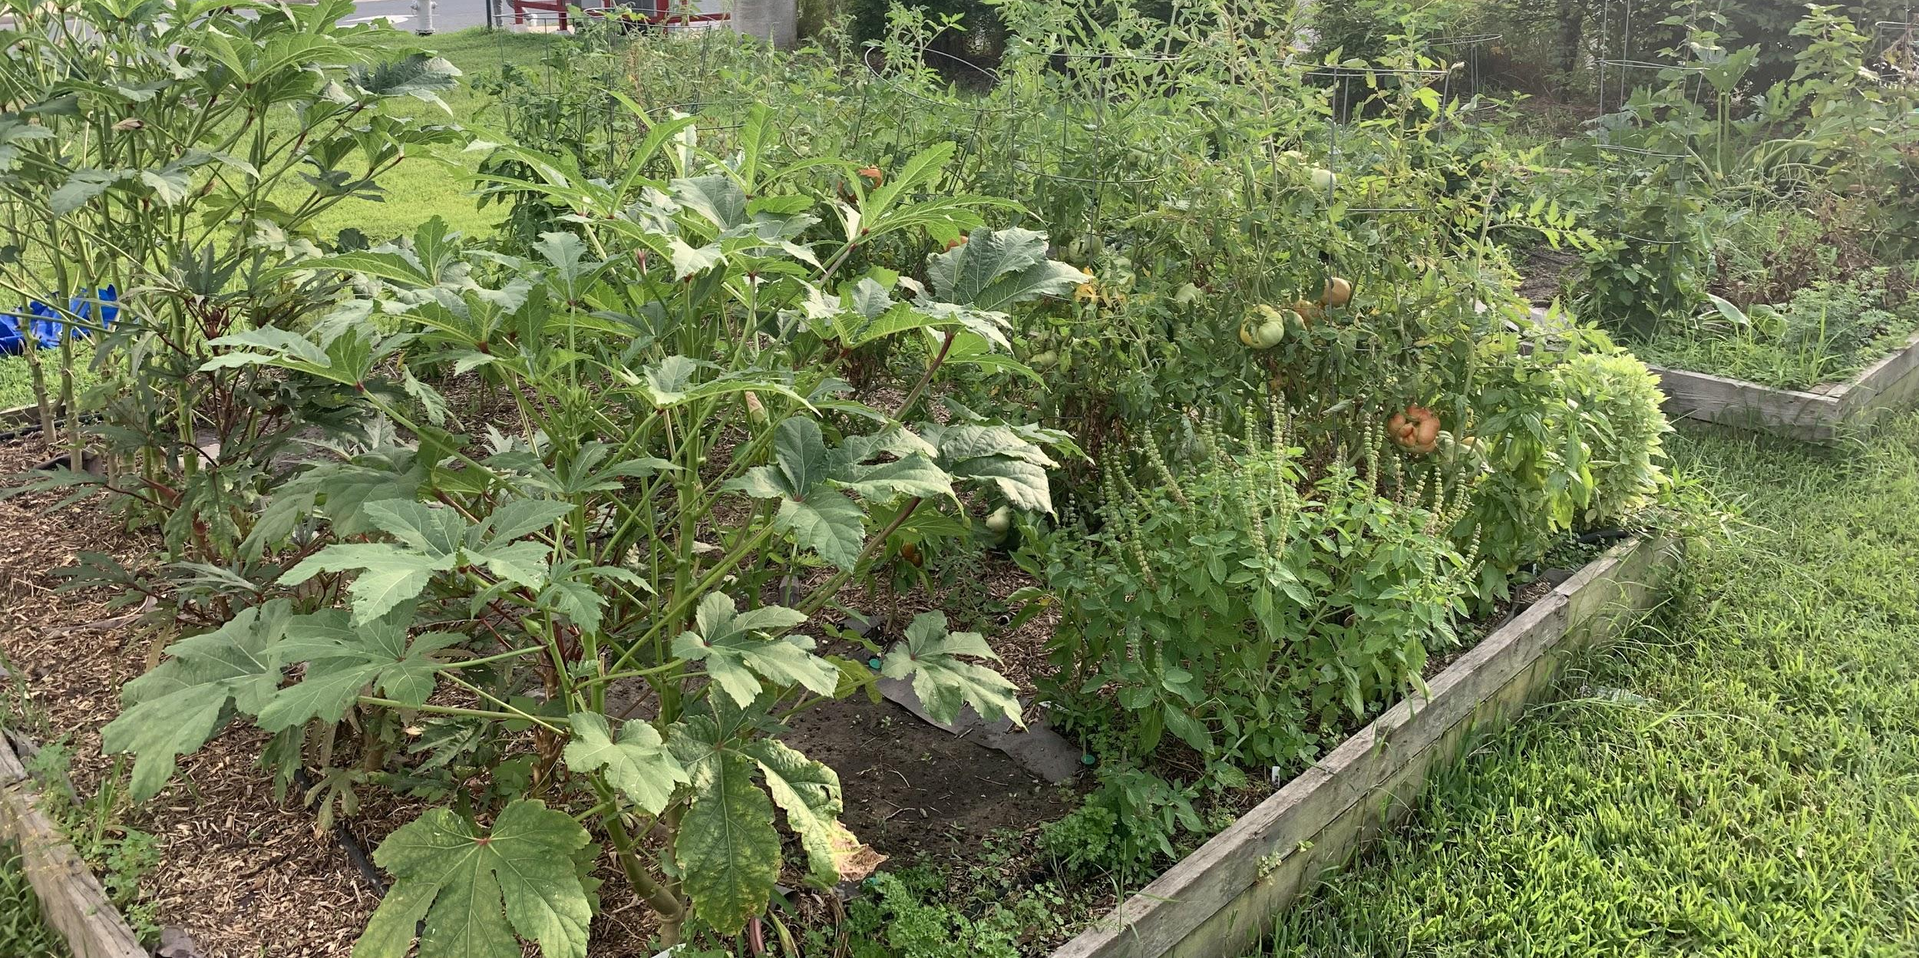
Exterior Raised Beds - Benefits
Production of healthy local foods, including vegetables, legumes, fruits, and herbs
Reduction in food miles
Physically and spiritually fulfilling activity for homeowners
Habitat and food for native pollinators
Protection from burrowing animals
Theme: Honoring the Sense of Place
For the 2017 Competition in Colorado, plants were used that can survive in Plant Hardiness Zone 5b and 6a.
Do a web search, and see what hardiness zone you live in. What kind of native plants could you grow?

Slide 14

Composting Toilet - How it Works
Solids and urine are separated into two different compartments of the toilet.
Solids are mixed with a carbon source such as peat moss and are aerated after each use via a hand-crank.
Bacteria begin to break down the solid waste.
A fan ventilates the toilet to the exterior of the house to prevent odors indoors.
When full, the solid waste compartment is emptied outside into a compost bin and covered with soil.
This compost is broken down by heat-loving bacteria called ‘Thermophiles’, after a minimum of 6 months.
The broken down compost is used as fertilizer for non-edible plants in the landscape.
Urine is diluted with water and applied directly on non-edible plants as a nitrogen fertilizer.

Slide 15
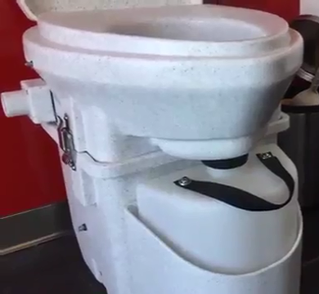
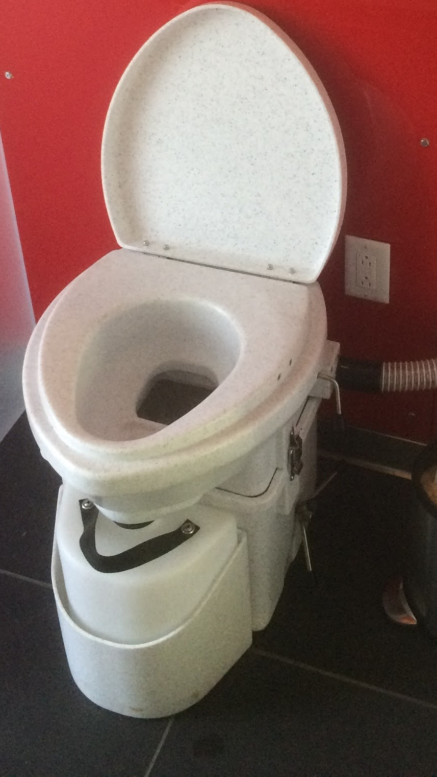
Composting Toilet - Benefits
Conserves water (waterless)
Produces no waste-water
Requires no plumbing
Odorless
Treats human waste as a valuable resource
Leads to the creation of fertile soil for non-edible plants in the landscaping
Educates humans in their role in greater systems of our planet
‘Natures Head Self Contained Toilet’ by Nature’s Head Inc.

Slide 16
Barrel Composter - Design
Basics:
Food scraps and grass clippings are termed “Green Compost”
Yard wastes are termed “Brown Compost”
Barrel composter is ideally placed in sun to heat up.
How to:
Green compost and Brown compost are inserted into the barrel composter at a ratio of 4:1.
The Barrel composter is ‘tumbled’ about every 3-5 days to mix the compost and aid in the breakdown of material.
When the bin is about 75% full, stop adding to it to allow the bacteria inside to have enough oxygen to thrive.
In 1-2 months, your compost will be ready to fertilize your garden!

Slide 17
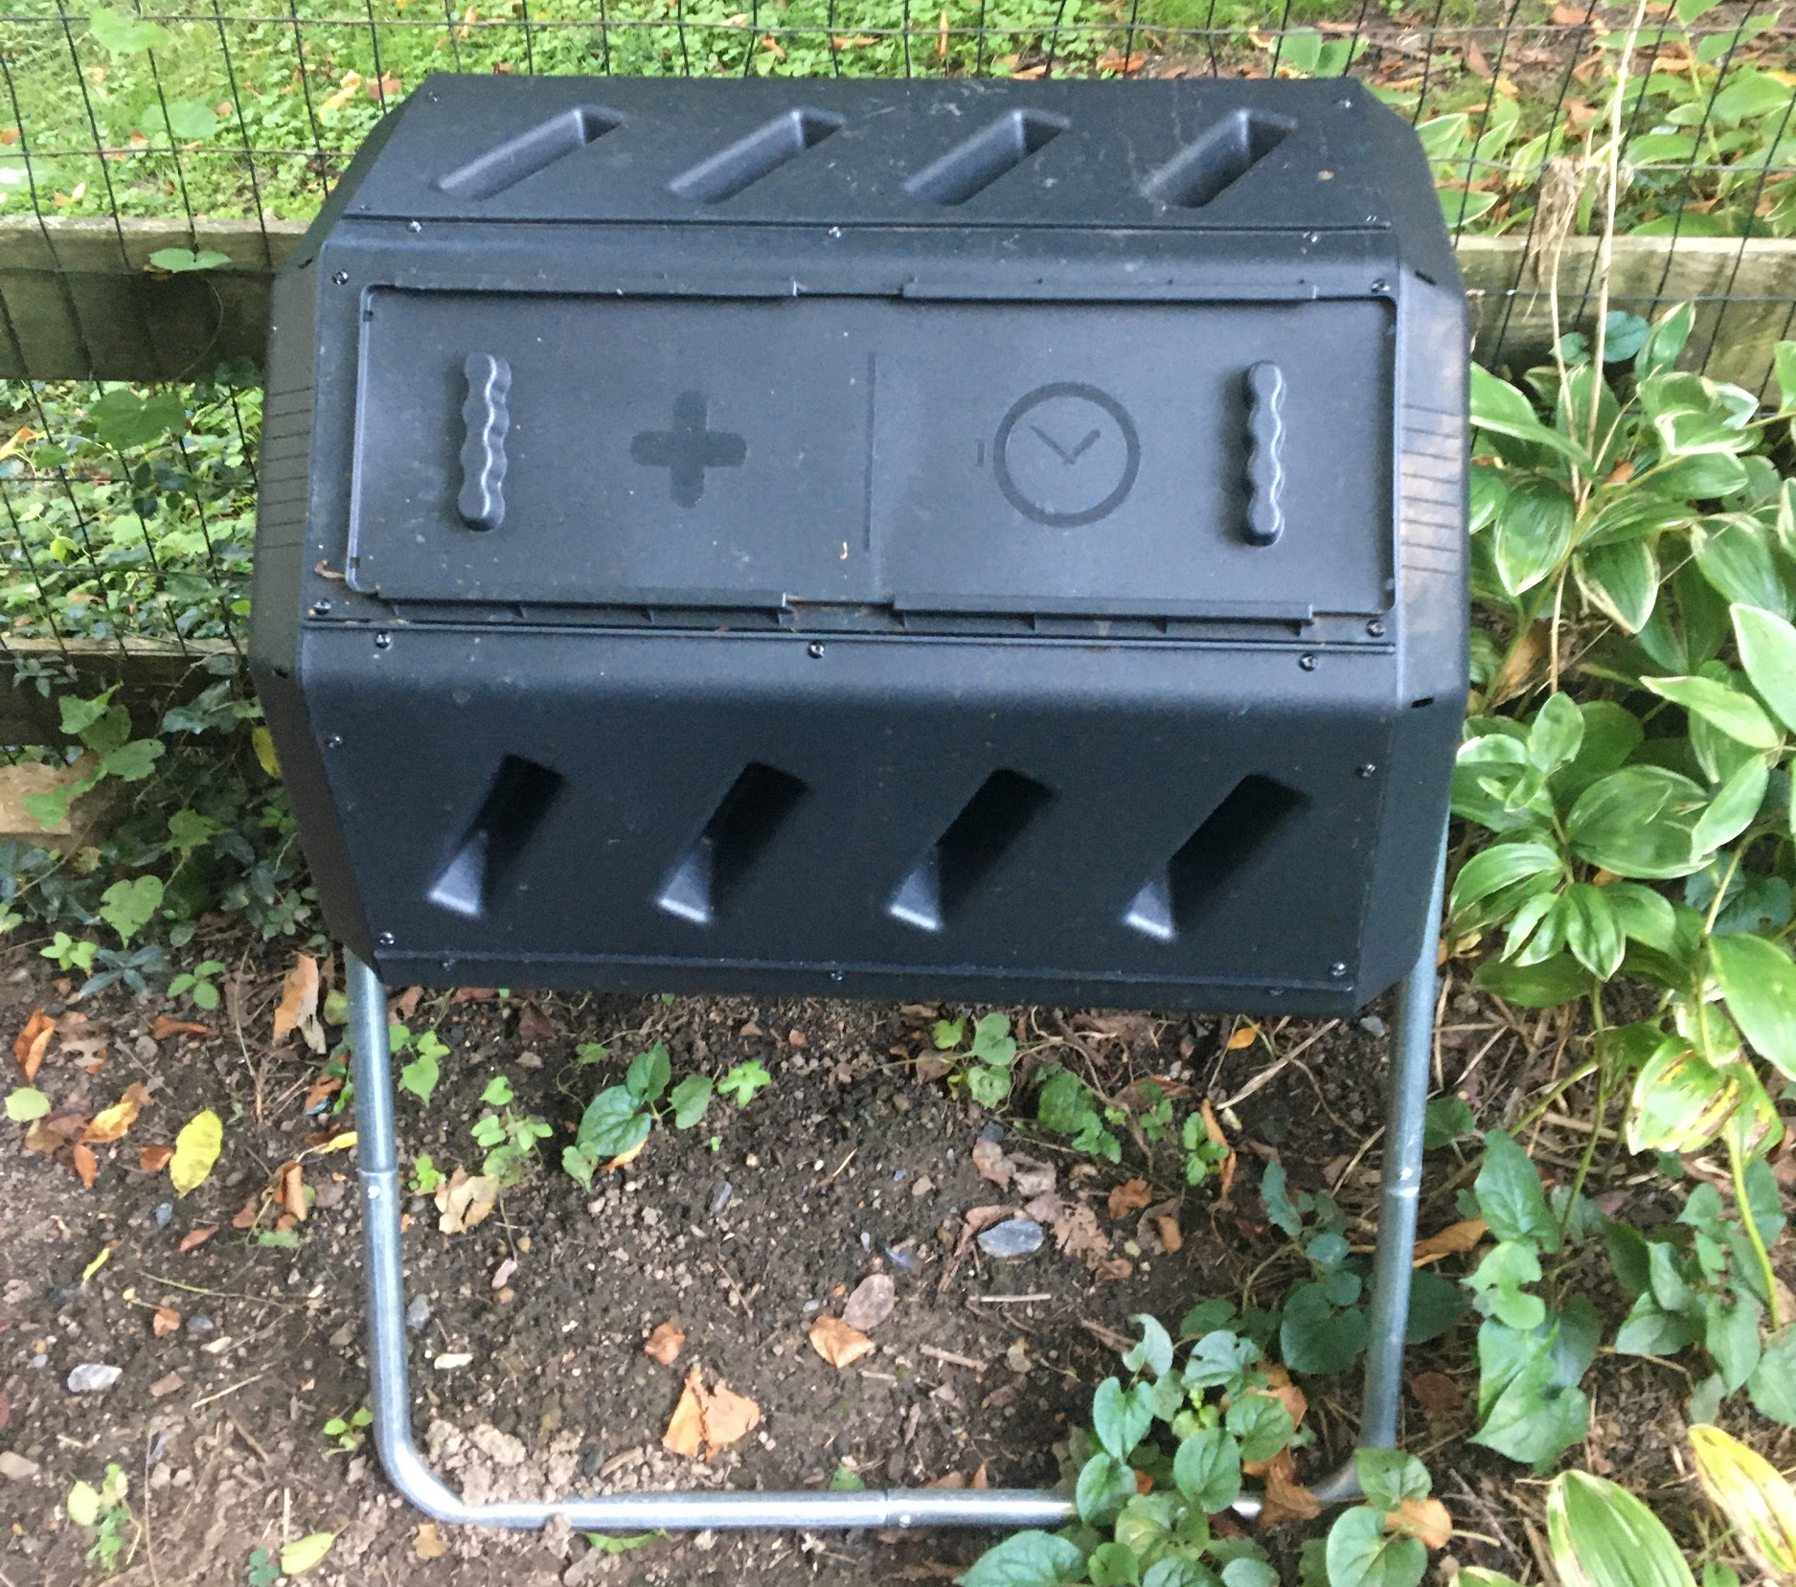
Barrel Composter - Benefits
Minimizes food waste from the kitchen, and yard waste.
  Less food going to landfills and septic tanks
  Less export of yard waste from property
Creates compost high in organic matter that can be used on edible crops.
Reduces the need for fertilizer, saving money and fossil fuels.
Raises humans’ awareness to soil fertility and nutrient cycling.
Dual Composter By YIMBY

Slide 18
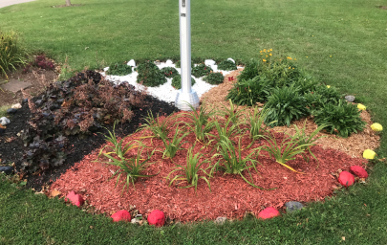
Example use of Living Systems: Native Herbs
A variety of edible and nonedible plants can be grown within reACT.
The Piscataway people use tobacco, cedar, sweetgrass, and sage for a variety of uses.
  Sweetgrass can be woven together.
  Tobacco commonly used as a gift for visitors.
Cedar - South
Sage - West
Cultural and Symbolic Uses:
  All 4 sacred plants can be used for ceremonies if grown organically.
  Represent cardinal directions.
  Replant tobacco when harvesting each herb to give back to the earth.
Tobacco - East
Sweetgrass - North

Slide 19
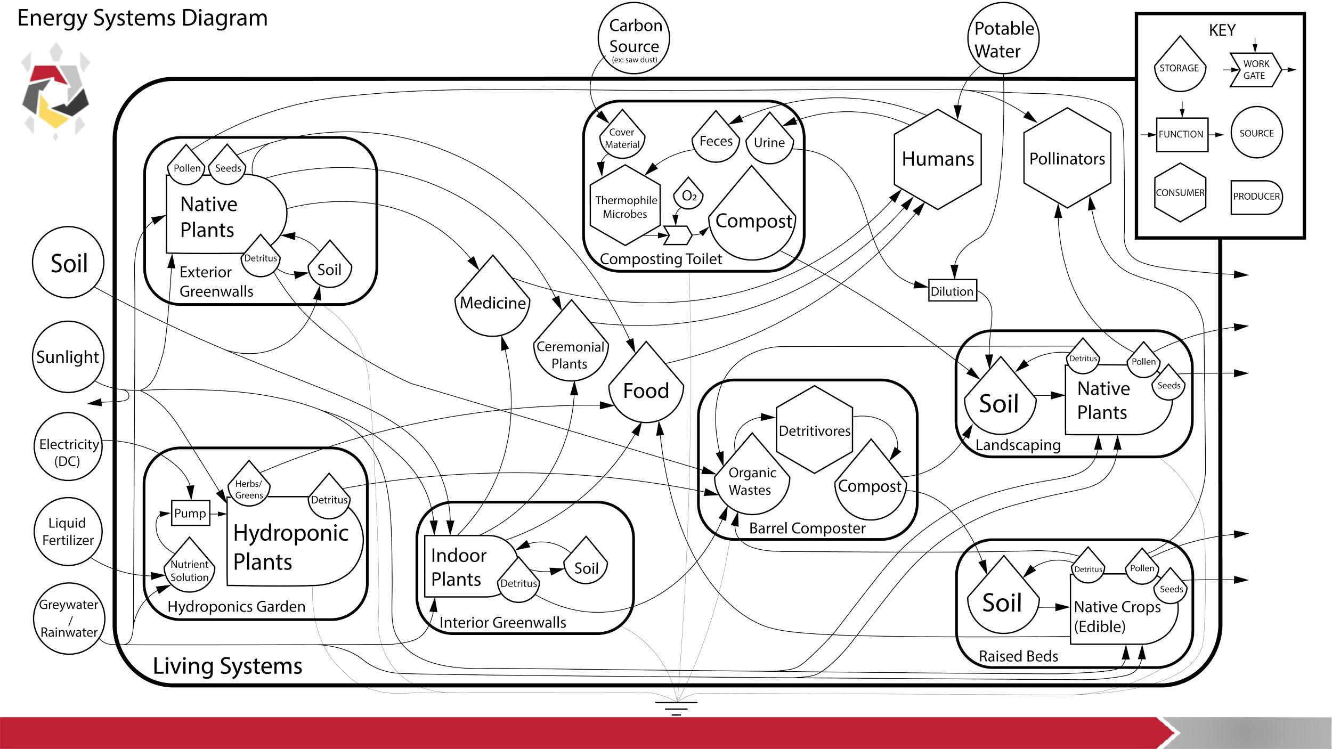
19
19
Notes:
There is a lot of info on this slide, so I tried to keep it moving along while speaking clearly at a somewhat slow pace. For the section with the arrows (Sunlight → Interior Greenwalls: Indoor Plants → Food) … I will automate the diagram to go along with the voice narration. So, leaving about 2 seconds between each spoken word will be necessary. The more evenly spaced they are the cleaner it will sound.

Slide 20
Interconnected to other systems of reACT
Interconnected Systems of reACT
Humans
Native Ecosystems
Living Systems
Water Systems
Architecture
Electrical
Engineering
Smart-House Automation

Slide 21
Get Inspired! This expanding field is evolving rapidly!
YOU can build these living systems for your home or community!
YOU can collect your own data and expand on the research!
YOU can help to foster harmony between humans and the environment!
… Be part of the movement!
How?
Get involved at UMD with the American Ecological Engineering Society, or join ENST!
Volunteer and participate in events hosted by local tribal organizations!
Notes:
The tone of this slide should be upbeat and inspirational

Slide 22
Local Tribal Resources
Piscataway Conoy Tribe - http://www.piscatawayconoytribe.com/index.html
Nanticoke Tribe - https://www.nanticokeindians.org/
Nanticoke Historic Preservation Alliance Chicone Village Project https://www.restorehandsell.org/?page_id=42
Baltimore Native Indian Center - http://baltimoreamericanindiancenter.org/
Maryland Commission of Indian Affairs https://goci.maryland.gov/maryland-commission-on-indian-affairs/
Native American Lifelines - http://www.nativeamericanlifelines.org/

Slide 23
reACT Readings & Resources
Videos and Tours
  Watch the competition tour
  Watch the Inhabitat video
  Watch the virtual tour
Solar Decathlon 2017 D-8: Market Potential Narrative
  https://drum.lib.umd.edu/handle/1903/24862
Solar Decathlon 2017 D-8: Innovations Narrative
  https://drum.lib.umd.edu/handle/1903/24866
Solar Decathlon 2017 competition page
  http://2017.solarteam.org/makingitreal/architecture/livingsystems

Slide 24
Acknowledgements
We would like to thank the following individuals for their contributions to this learning module.
Patricia Cossard and Angela Stoltz for providing project guidance and organization.
Peter I. May and Bill Hubbard for providing technical expertise.
Kyle Harmon, Keith Colston, and Rico Newman for providing insights into Nanticoke and Piscataway living principles and traditions.
Peter Brooks for for providing the uplifting narration.
The reACT think tank team, whose members provided feedback and review.
The 2017 University of Maryland Solar Decathletes who designed, documented, and built reACT.

Slide 25
Contact Information
Zack Bishop: Project Lead & Co-author
  zwbishop98@gmail.com
Matthew Lagomarsino: Technical Advisor & Co-author
  mattlagomarsino51@gmail.com
Peter I. May: Systems Ecology Advisor
  pimay@umd.edu
Patricia Cossard: reACT Program Director
  pcossard@umd.edu

Slide 26
Sources
Kangas, P. C. (2004). Ecological engineering: Principles and practice. Boca Raton, FL: Lewis.
Odum, Howard T. Environment, Power, and Society for the Twenty-First Century: The Hierarchy of Energy. Columbia University Press, 2007. JSTOR, www.jstor.org/stable/10.7312/odum12886. Accessed 3 Feb. 2021.
Richert, A., Gensch, R., Jönsson, H., & Stenström, T., Dagerskog L. (2010). Practical Guidance on the Use of Urine in Crop Production.
Team reACT, Cossard, P., Lagomarsino, M., Binder, M., Rockcastle, G., & Adomaitis, R. (2017, August 10). Solar Decathlon 2017 D-8: Innovations Narrative. Retrieved from https://drum.lib.umd.edu/handle/1903/24866
Team reACT, Cossard, P., Stoltz, A., Lagomarsino, M., Rockcastle, G., & Binder, M. (2017, August 10). Solar Decathlon 2017 D-8: Market Potential Narrative. Retrieved from https://drum.lib.umd.edu/handle/1903/24862
Team reACT. (2017, October 26). Living Systems. Retrieved from http://2017.solarteam.org/makingitreal/architecture/livingsystems
U.S. Environmental Protection Agency. (2020, September 25). Residential Toilets. Retrieved from https://www.epa.gov/watersense/residential-toilets

Slide 27
Image Credits by Order of Appearance
Green court of reACT during daytime by Josh Bauer
Wooden model of reACT by Paige Andros
reACT exterior by Paige Andros
Green court during evening by Paige Andros
Butterfly by Matthew Lagomarsino
Solar drier with fruit by Paige Andros
reACT exterior and deck by Zack Bishop
Diagram of hydroponics garden by Elizabeth O’Keefe
Hydroponics garden by Matthew Lagomarsino
Green wall by Matthew Lagomarsino
Diagram of green walls by Emma Schrantz, Greg Goldstein, Wadiah Akhbar, and Ryan Banger
Diagram of three sisters garden by Emma Schrantz, Greg Goldstein, Wadiah Akhbar, and Ryan Banger
Raised beds by Matthew Lagomarsino
Composting toilet by Paige Andros
Barrel composter by Zack Bishop
Herb garden by Rico Newman
Energy Systems Diagram by Matthew Lagomarsino

Slide 28
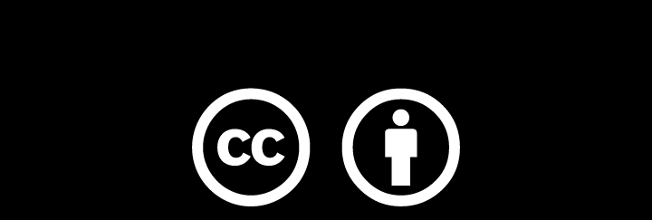
Except where otherwise noted, this work is licensed under
https://creativecommons.org/licenses/by/4.0/

