Slide 1
THE ONLY CONSTANT IS CHANGE: Adapting for the E-resources Environment
Leigh Ann DePope, Maggie Saponaro and Kelley O’Neal
MLA/DLA Conference
May 3, 2018
Notes:
Maggie Good morning, we are here to talk about the on-going e-resource review process implemented at UMCP, with each of us discussing their respective roles in the process and the communication that developed across departments to facilitate the review process.
Our Session Focus: All continuing resources and the process for how we reviewed all resources:
Databases (eg, datasets, e-book collections)
Serials (journals, journal packages, standing orders)

Slide 2

Session Outline
Background
Data Supplied
Process
Lessons Learned/Next Steps
Notes:
Maggie will provide some background on the UM Libraries, our budget situation and how we are organized.
Leigh Ann will discuss the data supplied in the review processes
Kelley will talk about the process from the point of view of the subject specialists involved
We will then review what we learned from these processes and how they impact future review projects.
There will be plenty of time at the end of the program for your questions, so we ask that you hold your questions to the end

Slide 3

Background
UMD Libraries budget
Unit organization
Role of the Collection Development Council (CDC)
Communication efforts
Notes:
The University of Maryland Libraries serves over 37,000 students and faculty.
In order to understand the process we began, we feel it would be helpful to understand a little about the budget, how we are organized, and how efforts were communicated within the libraries and to campus

Slide 4
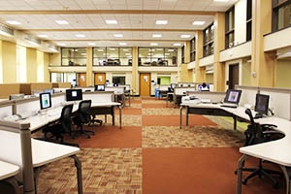
Overview: UMD Libraries Budget
Collections budget
86.9% - electronic resources
91.7% - continuations
Serials inflation
Resulting actions:
FY 2016 Database Review
FY 2016 Serials Review
FY 2018 Journal package review/adjustment
Notes:
The Libraries has experienced a static collection budget for over 16 years.
Currently, 86.9% of the collections budget devoted to electronic resources and 91.7% of the collections budget is spent on continuing costs.
Average 8% serials inflation combined with a flat budget eventually took a toll.
Despite the best efforts of the Collection Development and Acquisitions units to mitigate the continuing effect of serials inflation, in summer 2015 was determined that budgetary expenses would have to be curtailed in order to meet increasing serials costs.
Changes to the approval plan were made and a portion of discretionary funds were withheld from disciplines, but these actions were not enough to meet the anticipated shortfall. A more immediate solution was required, with databases being the only remaining option.
In the fall of 2015, the Libraries initiated the first-ever comprehensive database review across all subject areas. This was followed by a serials review in spring 2016, a second database review in fall 2017 and the review and cancellation of a journal “big deal” last fall.

Slide 5
Overview: UMD Libraries Organization
Public Services
Subject Specialists/Subject Groups
InterLibrary Loan
Collection Strategies and Services
Acquisitions and Data Services
Continuing Resources and Database Management
Collection Development
Collection Development Council (CDC)
Notes:
In order to understand how the reviews worked, you need to know who was involved
Public Services
Subject Specialists – approximately 40,
provided the expertise in the subject areas;
made the decisions,
communicated with their faculty,
In the DB Reviews in particular, they were also responsible for creating entries in our system linked from the library webpage describing why the particular database was canceled and alternatives (LibAnswers entries)
3 subject groups – STEM, Social Sciences, Arts and Humanities
group input and decision making in such areas as big ticket purchases
InterLibrary Loan – provided ILL data, particularly for package reviews
Worked collaboratively with ILL and selectors
Collection Strategies and Services
Acquisitions and Data Services – generated the workbooks with data from the acquisitions system (Aleph) and contacted vendors
Continuing Resources and Database Management – responsible for notifying vendors of cancellations, updating holdings records in Aleph and (what else?)
Collection Development - responsible for identifying budget targets; communicating with CDC/individual subject specialists and campus and follow-up with vendors
Collection Development Council – consists of representatives from each of the subject groups, as well as Acquisitions, Continuing Resources and CD - membership responsible for communicating with subject groups and reviewing/making decisions for interdisciplinary resources in both the database and journal reviews

Slide 6

Overview: Communication
File availability
“Databases to be Canceled” spreadsheet
LibAnswers Entries
Serials Review LibGuide
Subject specialist communication to faculty
Other communication efforts
Notes:
One key goal of all our review projects is transparency.
This is realized in several ways.
all files associated with the review were made available to all subject specialists and Acquisitions and Collection Development personnel via an online file sharing service (box.umd.edu). Additionally,
In database reviews, Acquisitions creates and shares a “Databases to Be Canceled” spreadsheet which was made available via on the same online file sharing service. This spreadsheet contained information including the date when the database subscription ended (Subscription Period), and the date the vendor was notified of the database cancellation. It also included fields indicating which subject specialist would be responsible for creating a LibAnswers entry announcing the database cancellation, and a link to the LibAnswers entry once it was created. This spreadsheet was regularly updated as vendors were contacted and LibAnswers entries posted.
A further effort at transparency was in the methods used to notify the campus community of the cancellations.
Subject Specialists were responsible for sending direct notifications to their constituent faculty and students. Beyond this, LibAnswers was used as a broader means of explaining cancellations and point to equivalent products.
In the database review, CDC reviewed the list of cancelled databases and assigned a LibAnswers contact (subject specialist) to each database canceled. This contact was responsible for creating an entry in LibAnswers indicating when the database would be canceled, alternative resources available (if any), and including a name and e-mail of an individual who could be contacted for more information.
A template and guidelines for LibAnswers was created and provided to subject specialists to assist them in this process.
As a means of informing patrons of the upcoming cancellation, LibAnswers entries were linked to the canceled database in the Database A-to-Z list one month prior to the cancellation date. Access to the database itself remained active in this one-month lead up period. Once the cancellation date had passed, access to the database itself ceased and all Database A-Z links pointed to the LibAnswers entry.
Serials review (2016 and 2017) – communication letter drafted by myself and Associate Dean for Collection Strategies and Services for Subject Specialists to send out
Also included on a special LibGuide created for that purpose – which contained the list of titles under review and comment and later the final list.
For the fall 2017 package realignment – the final list of continuing titles was posted along with the memo
Additional communication efforts included library website announcements and individual LibGuide updates.

Slide 7
THe Process
Gather Data
Organize it by Subject Groups
Create and populate a shared storage location
Launch review
Provide support to subject librarians
Compile and follow through on decisions
Notes:
Our first review using this process was a database review in 2016.
Folks in Acquisitions, Continuing Resources and Collection Development decided what data was needed and the most effective way to deliver it.
We settle on using Excel – most of our data is already in this form and it was the most versatile.
Our subject librarians are grouped into subject collaboratives. We prepare the spreadsheets for these four groups. We always have a master that contains all the content.
We chose Box (a file sharing service) because there was it was web-based and had no limit to the number of people who could access. Used Box because allows for multiple users, version control, real time updates.
CD manages the review process and is responsible for the instructions and deadlines.
Acq/CR provided training on using Ebsonet (subscription management platform) , answered any questions about the data or resources, and provided additional information as requested.
Subject libs have several weeks (4-8) to review and make decisions.
Once deadline reached. CD and Acq compile the decisions, discuss and finalize with CDC.
Acq/CR notifty vendors of cancellations and update info ILS.

Slide 8
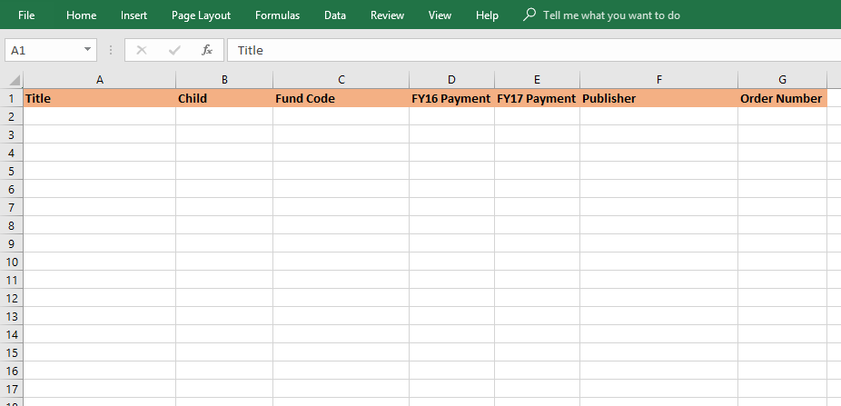
Foundation Data
Basic Data
Title
Come with or related titles
Publisher/Vendor
Fund Code
Order Number
Cost information
Notes:
Comes from ILS (Aleph). We have a weekly report that pulls the order history for our continuing resources.
Additional data depends on the type of review database or serials

Slide 9
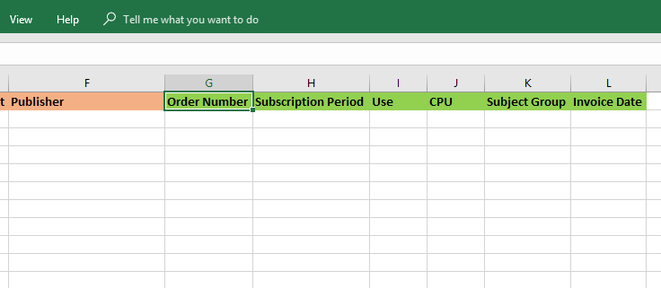
Data for Databases
Basic Data
Subscription Period
Invoice Date
Subject Group
Usage Statistics*
Rank
Notes
Notes:
For databases we add (see slide)
Statistics - For database we started off using the "total searches" or "regular searches" since most COUNTER and non-COUNTER reports provide those. For Databases - DB1, PR1, and NCC. sometimes JR1 and BR1.
And calculate CPU on that.
For latest review, after request from sub libs, included result clicks and records views.

Slide 10
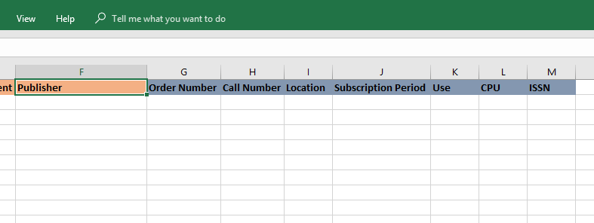
Data for Journals
Basic Data
ISSN
Subscription Period
Format
Collection/Location
Call Number
Usage Statistics*
Notes
Notes:
For journals we add (see slide)
Use JR1 and JR 5COUNTER for Journals
For broad journal reviews, use Ebsconet for statistics and comparisons. For single publisher journal review, provided stats in spreadsheet. Training videos (By GA), in person sessions with Subject groups and one-on-one to show how to use Ebsconet. Brief overview of what Ebsconet.
ILL data for serials - work with ILL folks to get the data. use by publication year to compare possible ILL costs to yearly subscription costs.

Slide 11
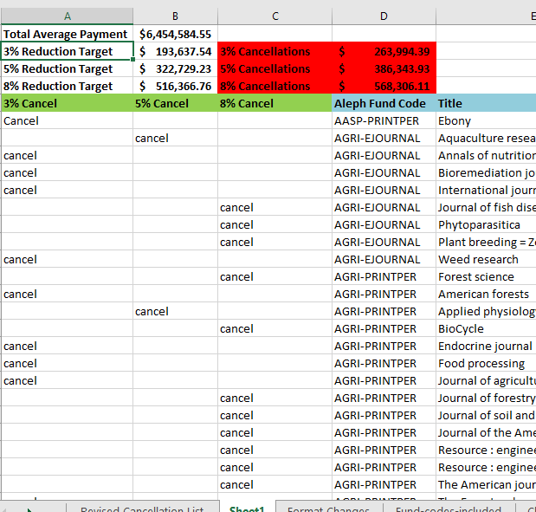
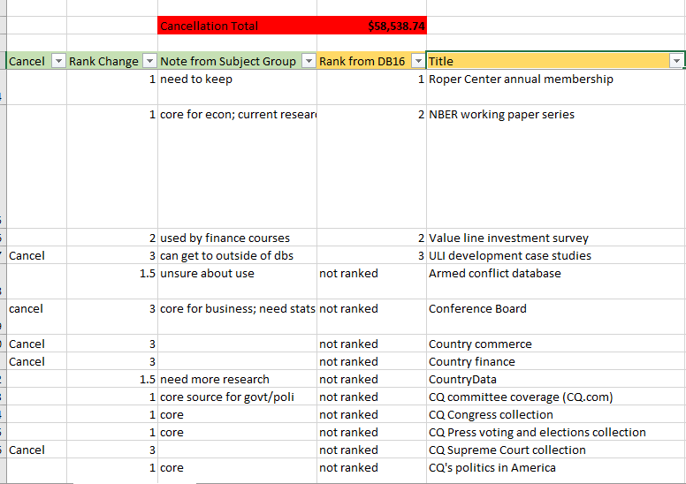
Decisions
To the order data, we added other data such as usage statistics and columns to collect feedback and decisions.
Notes:
Finally, we added columns to collect feedback and decisions.
Used formula to tally cost in real time.
Decisions were extracted from the working spreadsheets and compiled. This new document used to publicize decisions to campus and by acquisitions/e-resource management staff to execute the decisions.
With each review, we've taken the feedback we've received and adjusted the process.

Slide 12


Roles
Selector
Social Sciences and STEM Groups
Collection Development Council
Notes:
I have several roles in this work:
Geographical Sciences Subject Specialist and Selector
Member of the Social Sciences Group
Informal member of the STEM Group since my subject is interdisciplinary with significant overlap
Member of Collection Development Council as the Social Sciences Group Liaison
My role in CDC is to relay information between the council and social sciences and to organize efforts such as our database and serials reviews

Slide 13

Overview of the Selector Review Process
Reduction target assigned
Supporting data provided
Decisions made individually
Group discussion for final decisions
Report back to Collection Development Council
Final decisions
* Communication is key
Notes:
We’re given our target reduction amount.
We are provided with an organized and easy to use spreadsheet with information about the databases or serials.
- This is the work Leigh Ann just discussed.
Once we have all of the information, we review the materials individually then move on to group discussion. Group discussion and agreement, even if it is agree to disagree, is critical in this process. This is a democratic process and selectors are given the ultimate decision power for their subject areas, but we all understand that if we do not reach our target amount then the decision power is passed to the collection development council.
So there is incentive to negotiate and compromise.
As the Social Sciences Group representative I report back our decisions to Collection Development Council where there is a final discussion and decision made.
Finally, communication is key. We often have questions back and forth between the subject group, sometimes also with other subject groups, and with Leigh Ann and Maggie to seek clarification or request additional data.

Slide 14


Serials Vs Databases
Process is mostly the same
Additional serials considerations
ILL
Package deals
Impact, citations, UMD publications
EBSCOnet
Reduction amount
Databases have a dollar amount
Serials have percentage reduction tiers
Notes:
The process is mostly the same for serials and databases but serials have a few additional considerations –
ILL availability and costs
Package deal groupings and limitations
Impact, number of citations, and number of UMD publications
And we can also review EBSCONet data
In general, serials are harder to balance cuts across subject area groups, especially with package deal limitations
The approach to reduction amounts is also different with percentage tiers vs dollar amounts

Slide 15
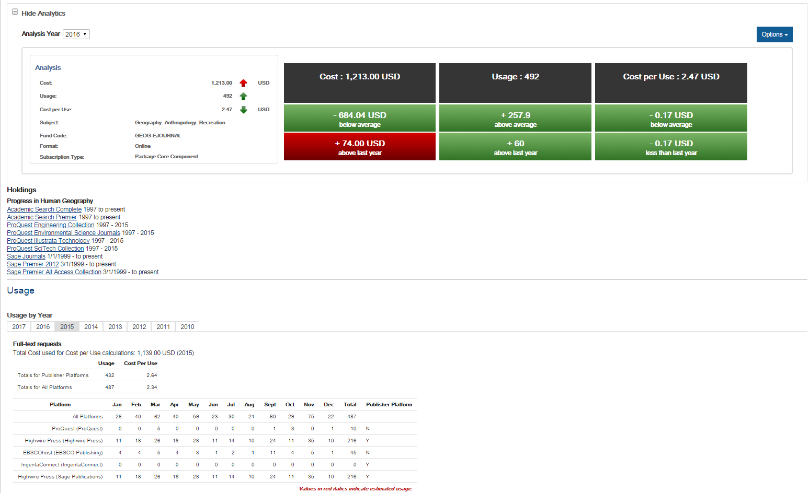
EBSCOnet
Notes:
This is a screen capture from Ebsconet showing some of the information provided. I can see
In what databases the journal is found
Number of searches per database
Number of full text downloads
I also have this great decision box up here that compares cost, usage, and cost per use from last year for this journal and also to an average of all journals. The results are color coded for an easy at a glance assessment with red indication and increase in cost or cost per use or a decrease in usage and green indicating more favorable results.

Slide 16
Strategies and Considerations
Total usage
Cost per use
Related titles/children
Full text vs only abstracts
Availability of information elsewhere
Protecting materials for smaller departments and niche subjects
Items on the Collection Development Council list
Materials used in courses
Previous rankings or cancellation levels
Swapping resources
Preserving purchases made by moving money from other funds, such as mono
Reprieves for groups with larger than normal reductions in a previous year - serials

Slide 17

Final Steps
Notify departments
Create LibAnswers entries
Update LibGuides and other web resources
Notes:
After final decisions are accepted in Collection Development Council, we:

Slide 18

Reflection
Selectors are passionate about their collections
Budget cuts are difficult for all involved
Data enables a logical approach and is critical to informed and defendable decisions
It is necessary to balance different personalities and maintain a goal-oriented approach
This is the first time selectors had to work collaboratively in these decisions
Everything about this is evolving - data, approach, and strategy - as we learn from past experience and seek to improve future experiences
Notes:
Some reflection on the process
Passion:
Contention grows as the fluff is eliminated and we reach the point of making decisions on core collections.
Subsequent iterations increase in difficulty
Cuts:
We all struggle through this process

Slide 19
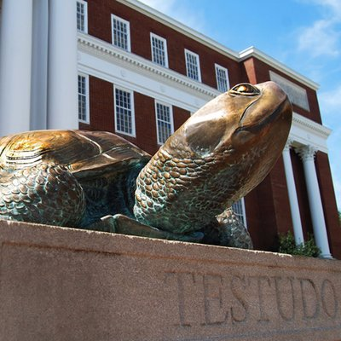
Lessons Learned/NexT steps
Continuing Budget Status
Collaboration
Moving Forward
Notes:
Until a permanent solution to the collection budget is realized either through additional campus funding or via other means, it is likely the database and serials review processes will become the ‘new normal’ for the UMD Libraries.
However, having a path to follow already established makes it that much easier to undergo any additional review activities.
Even though not everyone was happy - decisions were still made in process
Future- we are exploring an allocation model with pot of money and how divide out by disciplines
We found that numbers can be used as objective measures but also identifying that is not the only measure (eg. African American studies, keep materials to support special cases).
In the end, we evolved,
This takes work - whole process is not out of the box, we had to develop it ourselves, yes it was difficult for subject librarians - we took the data we had and gave to them and they experienced it, how learned to make it better - each time try to improve it to make process less onerous next time around, an iterative process - this helps us to do better next time.

Slide 20
THE ONLY CONSTANT IS CHANGE: Adapting for the E-resources Environment
Leigh Ann DePope, ldepope@umd.edu,
Maggie Saponaro, msaponar@umd.edu
Kelley O’Neal, KelleyO@umd.edu
MLA/DLA Conference - May 3, 2018
Notes:
Thank you for your time…
Questions?

