Slide 1

Collaborating for Access: Implementing Aeon’s OpenURL in our Discovery System
Ben Bradley
Discovery Librarian
University of Maryland University Libraries
Across Metadata and Special Collections Forum
May 7, 2018
Notes:
Hello everyone. My name is Ben Bradley and I’m the Discovery Librarian at the University of Maryland University Libraries. I started in this position in August of last year, and while I was starting, one problem I heard from several people in the libraries, both in and outside of special collections, is that there wasn’t a way for users to request items in special collections. There was a real need to enable users to request materials from special collections using our Discovery system. This presentation will cover how I worked with the special collection libraries at UMD to implement a solution, and give you an introduction to the tools and technologies we used to enable users to make requests, but also to share metadata between systems.

Slide 2
Outline
Background
Why?
How?
What?
Implementing the project
Notes:
This is a general outline for my presentation. I’ll first begin by providing some background to help explain the context of the situation. I’ll explain why we needed to pursue this project; the tools involved in the project or the how; and then explain what the solution is. Then I’ll discuss how we went about tackling the project. And then I’ll talk about how we went about tackling the project.

Slide 3
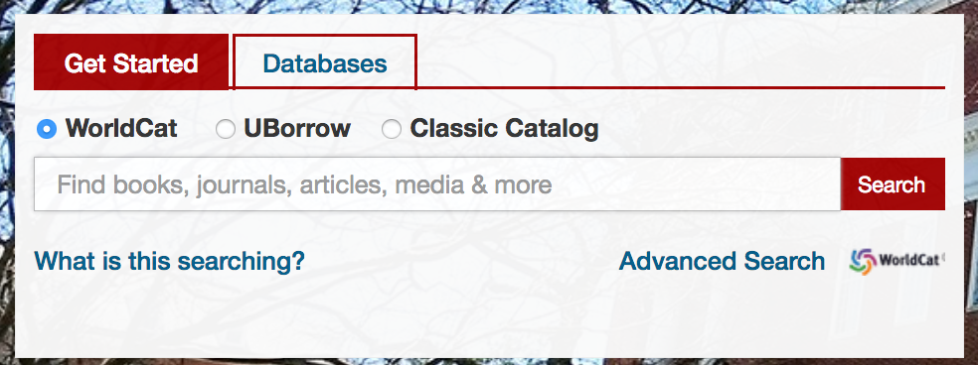
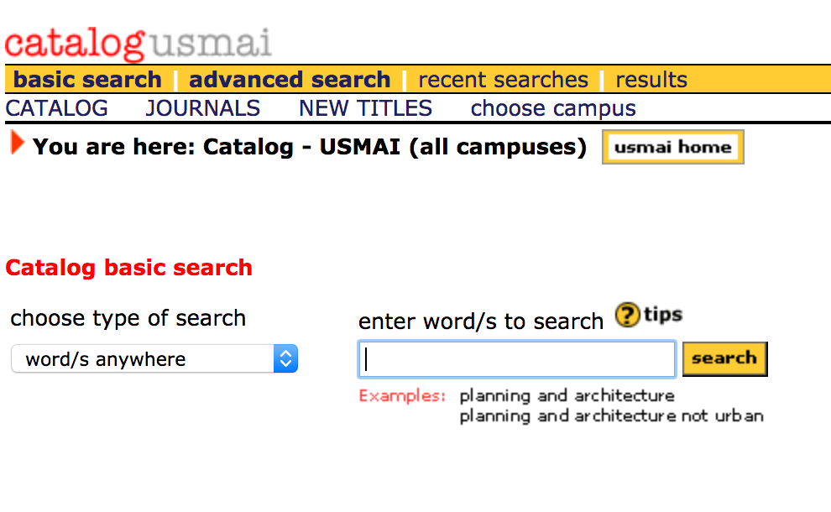
Background--Why?
UMD Libraries implemented new discovery tool
Classic Catalog only way to request materials
Confusing experience for users
Notes:
So, why did we undertake this project? In 2015, the University of Maryland University libraries implemented a new primary discovery tool, WorldCat Discovery replacing WorldCat local. WorldCat does provide some fulfillment options, such as a way to request materials and place holds on materials at the libraries and at other USMAI institutions. It also provides a fulfillment option for ILL. These options are individually configurable which allows us to create our own settings but we are also limited by the configuration options. In short there simply wasn’t another option feature to connect with Aeon to facilitate special collections requests.

Slide 4
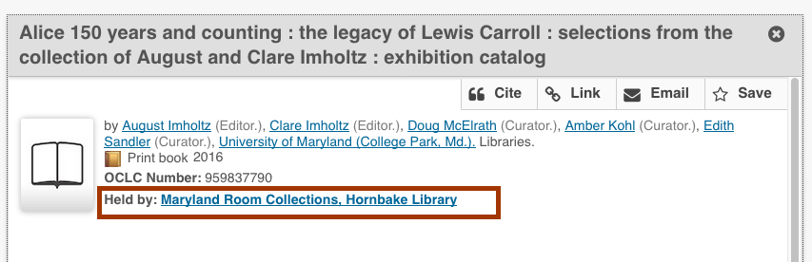
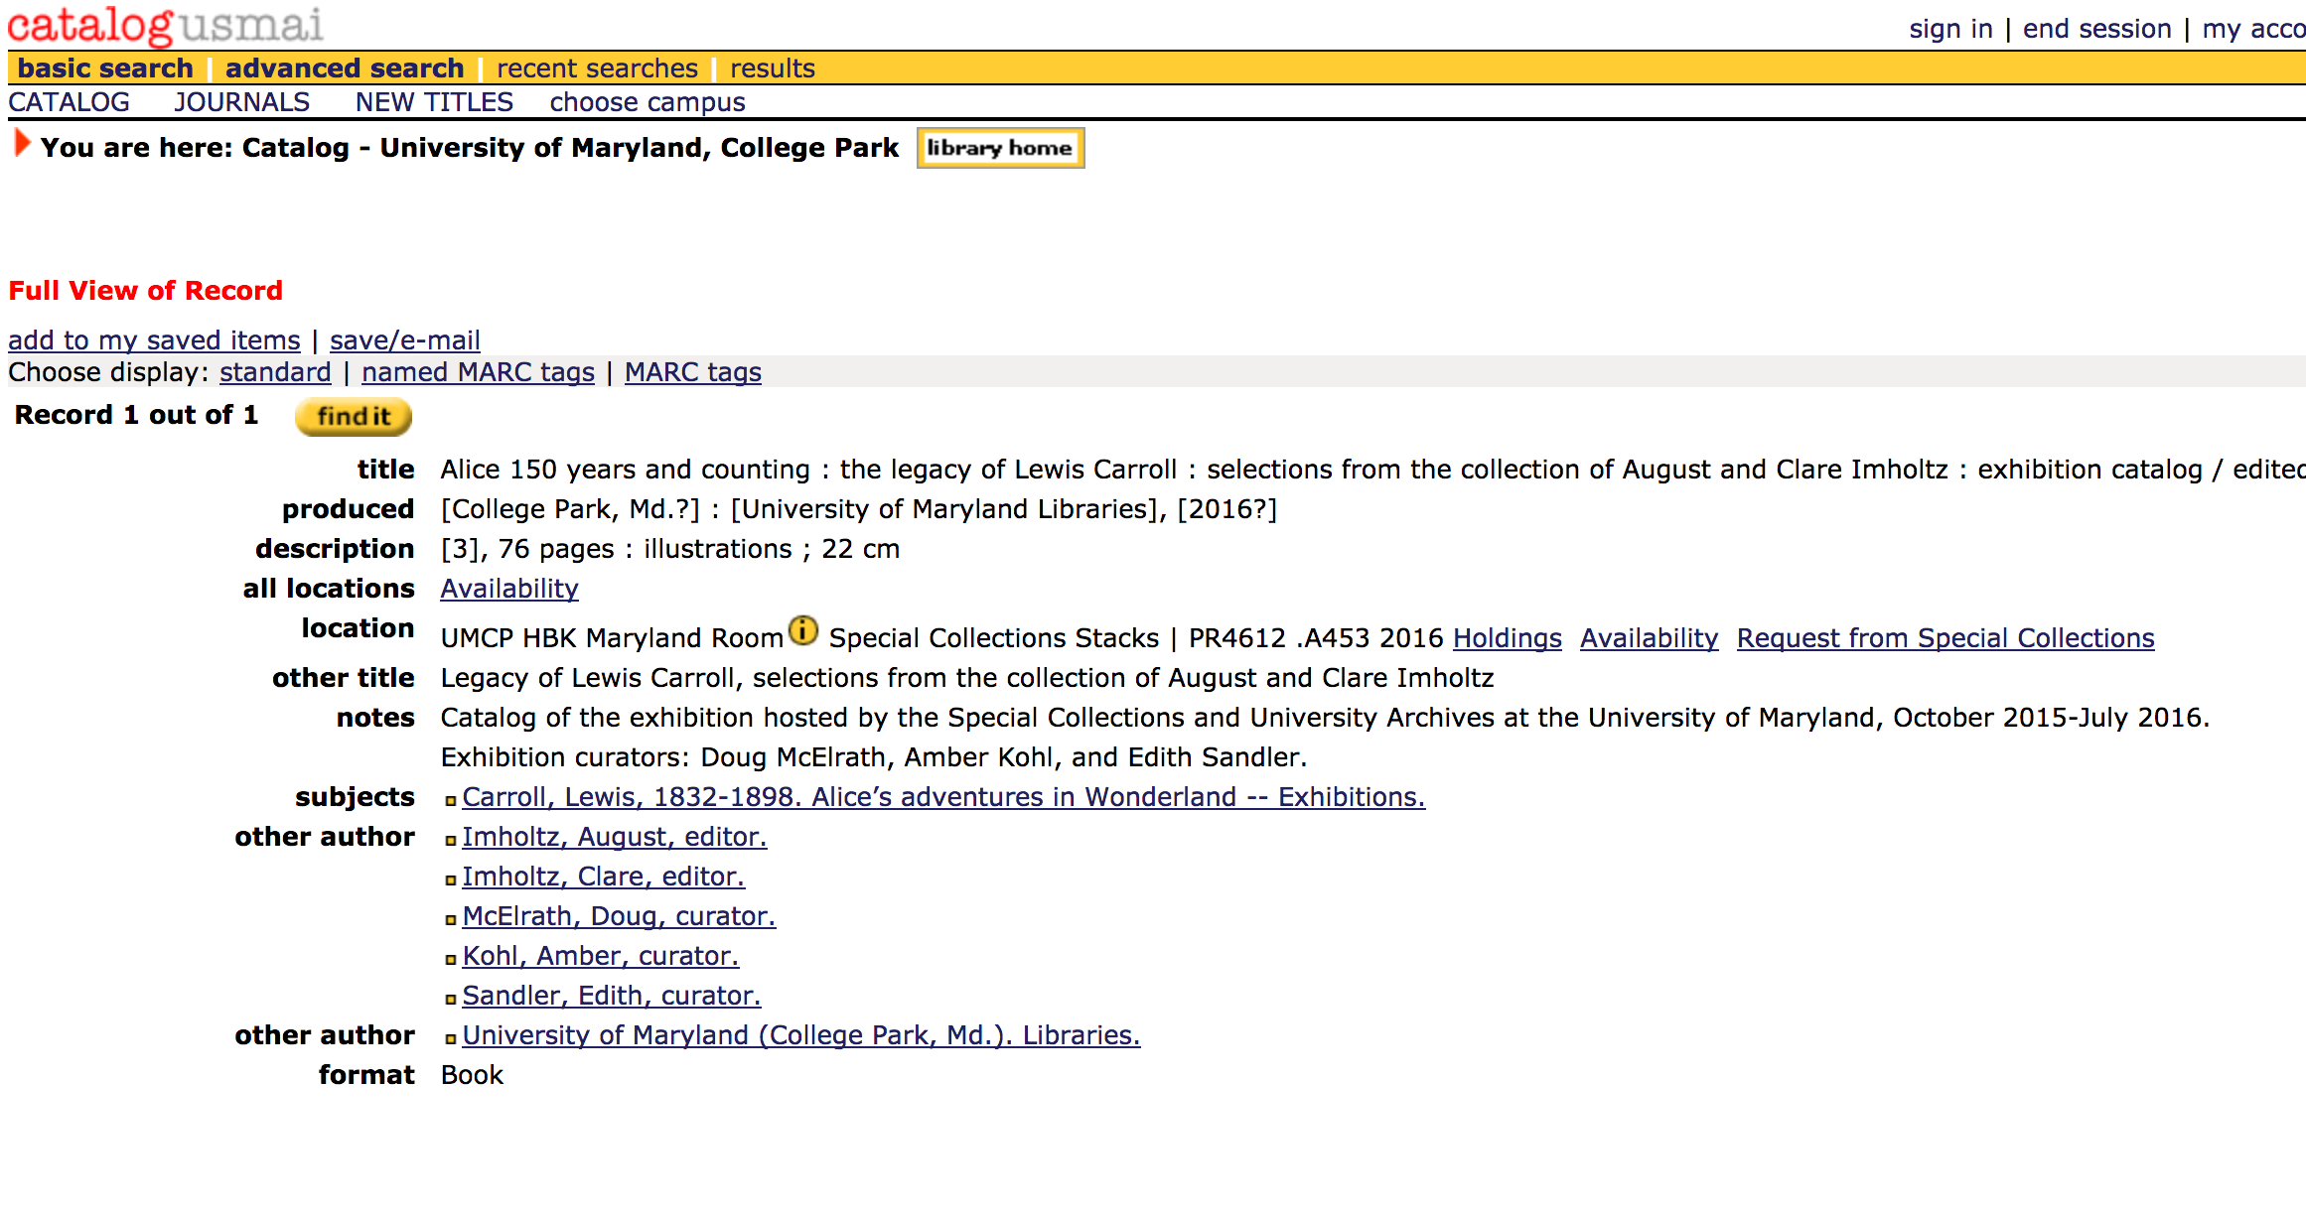
The Original Request Workflow
User performs search in WorldCat UMD
User is directed to CatalogUSMAI by link or searches in CatalogUSMAI
User clicks on request button, metadata pulled into the Aeon request form and the user submits the request.
Staff receive request and item is pulled
Notes:
The original workflow for users began usually in our WorldCat UMD search which is presented as our primary search tool. After performing a search and finding an item held by special collections, the user had to navigate to our classic catalog, CatalogUSMAI, in order to request the item. The user could normally do this simply through a link available on the item record, but it was not an intuitive process and some patrons made be unfamiliar with CatalogUSMAI; the library patron would either have been consulting instructions or received library instruction to know about the feature. Once in CatalogUSMAI, they could place the request for the item. While this process is not overly complex, it is discouragingly unintuitive. A user simply performing a search and trying to get access to an item usually requires help which discourages use.

Slide 5
Background--The Tools?
Products
WorldCat Discovery and OCLC Service Configuration
Aeon
Tools
OpenURL
Z39.50
Notes:
I’m next going to cover these different tools and technologies. So the first two items are vendor products. WorldCat Discovery, as I previously mentioned is our primary discovery tool. What is important to keep in mind is that the interface for this tool is managed via OCLC Service Configuration, a tool used to manage a variety of OCLC products. This means that customization in Discovery is limited to what is available to us in Service Configuration, if we want to do something in Discovery, it has to be available in Service Configuration. The next tool, Aeon, is a workflow management tool for archive and special collections libraries. It manages processes from requesting and pulling items all the way through digitization and circulation functions. Essentially, if someone wants to use an item in one of our special collections libraries, it is mediated by Aeon.
The last two are the technologies we used to connect these systems. OpenURL is a system that sends bibliographic metadata between systems. It is perhaps most commonly associated with link resolvers--it sends article metadata to a system that is then able to use the data to call up the article. But OpenURL is used in other contexts like ILLiad for ILL and in this case, Aeon can use OpenURL to receive metadata for a request.

Slide 6
OpenURL Example
https://aeon.lib.umd.edu/logon?Action=10&
Form=30&url_ver=Z39.88-2004&
rfr_id=info:sid/umaryland.worldcat.org:worldcat&
rft_val_fmt=info:ofi/fmt:kev:mtx:book&
rft.genre=book&
rft.genre=book&
rft_id=info:oclcnum/5393399&
rft_id=urn:ISBN:9780841435452&
rft.aulast=Cary&
rft.aufirst=Elisabeth&
rft.auinitm=Luther&
rft.btitle=William+Morris+:+poet,+craftsman,+socialist&
rft.date=1902&
rft.isbn=9780841435452&
rft.identifier=PR5083+.C3&
rft_dat={"stdrt1":"Book","stdrt2":"PrintBook"}&
req_id=info:rfa/oclc/institutions/1284&
req_dat=&
rfe_dat=5393399
Notes:
This is an example of an OpenURL request. I just wanted to give an illustration of what it actually looks like. Normally the url would just be a long string, but I tried to seperate each metadata element by line so you could get a better idea of what is going on in an OpenURL request. I’ve tried to highlight some of the more recognizable elements, for example you can see the OCLC number, ISBN, author information and title information.

Slide 7
Z39.50
Parts of Z39.50 Query
NISO Standard
Enables library systems to share bibliographic data (especially ILS)
See: https://www.loc.gov/z3950/agency/defns/bib1.html
1 -- Use Attribute (defines the kind of search or search access point: title, author, etc)
2 -- Relation Attribute (equal, unequal, less than, etc)
3 -- Position Attribute (ex. first in field, anywhere in field)
4 -- Structure Attribute (what is the data? a phrase, url, year)
5 -- Truncation Attribute (ex. do not truncate, right truncate)
6 -- Completeness Attribute (ex. complete field, incomplete subfield)
ex: @and @attr 1=4 @attr 4=1 @attr 5=1 “Harry Potter” @attr 1=1 “Rowling”
Notes:
z39.50 is the other technology we used to connect systems. I just want to briefly introduce Z39.50 and what it is and what it looks like. I feel like Z39.50 is something I’ve heard people talk about, but you rarely actually see a z39.50 query. And as a recent library school graduate, it isn’t something you really learn about there. So: z39.50 is a NISO standard for a protocol that enables systems to share data: largely it enables library systems to share bibliographic data. A z39.50 query can contain up to six different attribute types (numbered 1-6). Only the first attribute is required, it tells the system what kind of search is being performed. The other attributes add additional information or enable certain functions, like truncation. At the bottom of the slide is a quick example of a more complex z39.50 so you can get an idea of how it would look. This query is searching for the words in a title “Harry Potter” which has a right truncation and then for a personal name “rowling”.

Slide 8
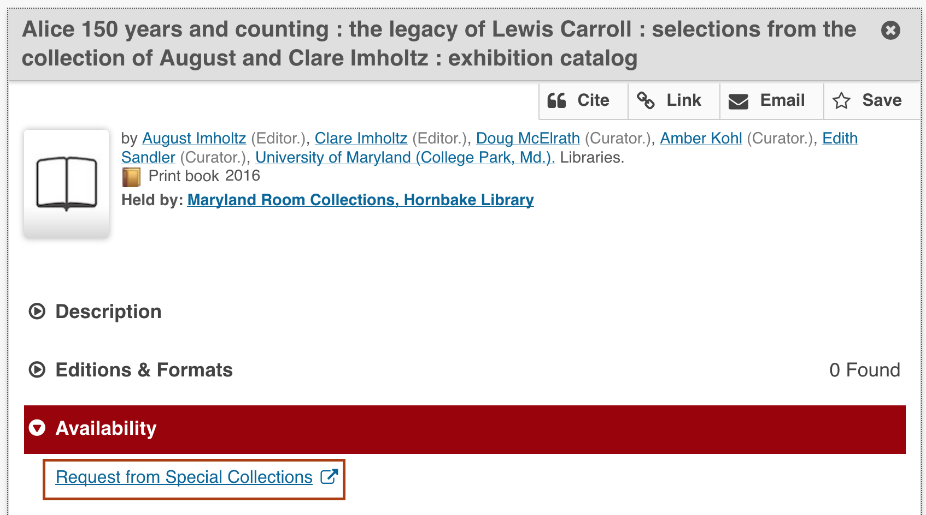
Solution: the Aeon OpenURL
User finds item in WorldCat UMD.
Clicks on request and metadata is sent to Aeon request form.
User adds pick-up location and call-number (if not pulled into the form) and submit request.
Staff open request and run Z39.50 search in Aleph using OCLC number. Metadata is copied over.
Staff print request and item is pulled for user.
Notes:
The solution to the problem, which appears rather plain, is the image on the top of my this slide. While OCLC Service Configuration does not have a fulfillment option we could use to facilitate special collections requests, I did find a way to sort of hack the configuration system to facilitate requesting. I found that Service Configuration does provide an option to configure an outgoing OpenURL. Normally this feature would be used for a link resolver. For example, if we were not using OCLC’s link resolving product and used another link resolver like SFX, we would use the feature to enable users to access articles online, but we didn’t need to use this feature. So while the feature wasn’t intended to facilitate special collections request, it could be leveraged to do so using Aeon’s OpenURL feature. This solution meant that when a user finds an item in Discovery, they can simple click on the link to request it, and a request would open to with many of the fields already pre-populated. The only problem this solution posed, is that this way of submitting a request sent the library less metadata for retrieving an item. In particular, this way of submitting requests does not include shelving location information. When paged items in special collections are pulled, locations such as Special collections folio, special collections oversized, or Katherine Anne Porter Stacks are required to find the item, but this information could not be passed into the Aeon system. We needed to introduce a new step in the workflow for staff to use a feature in Aeon that searched the catalog and pulled in the necessary metadata from the Classic Catalog to enable staff to find and pull the item.

Slide 9

Background--Who?
Discovery and Metadata Services (DMS)
Special Collections and University Archives (SCUA)
Prange Collection
Special Collections in the Performing Arts (SCPA)
Notes:
This project required collaboration between several units. As a member of the Discovery and Metadata Services Department (known as DMS) I worked with stakeholders across the campus to implement this solution, particularly our major special collections units: Special Collections and University Archives including Joanne Archer, head of Access & Outreach Servcies for Special Collection; Amber Kohl, the acting Head of Literature and Rare Books, and Liz Caringola, Archival Metadata Librarian who is with us today; Kana Jenkins, a Coordinator with the Prange collection; and Vin Novara, Curator for Special Collections in Performing Arts.

Slide 10
Implementing the Solution
Notes:
After discovering that I could add the Aeon OpenURL in Discovery, I contacted librarians at Special Collections and University Archives about if they were interested in exploring this option as a solution. After demonstrating its functionality, they decided to move forward with implementation and we began to develop a plan for implementing the feature. Our first step was the schedule a meeting with personnel in SCUA to further discuss implementation.

Slide 11
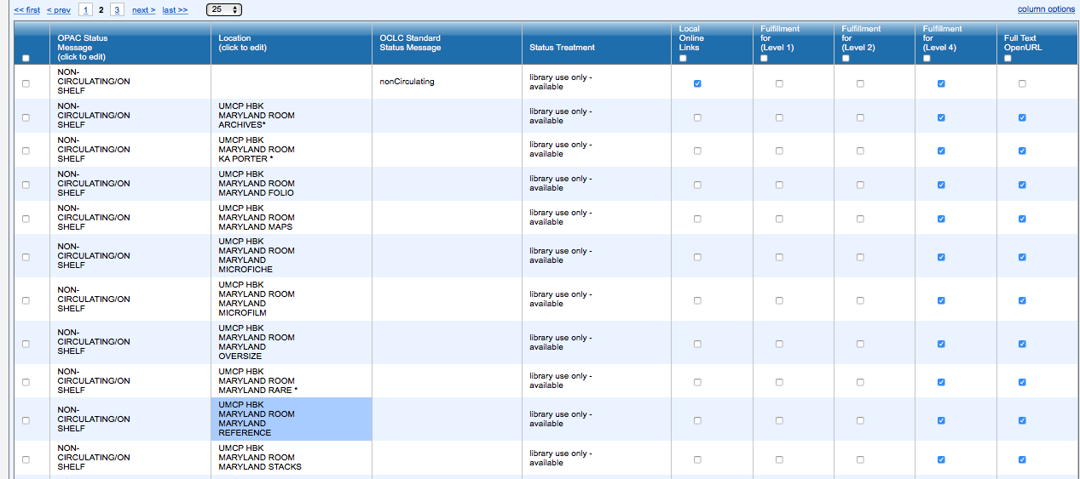
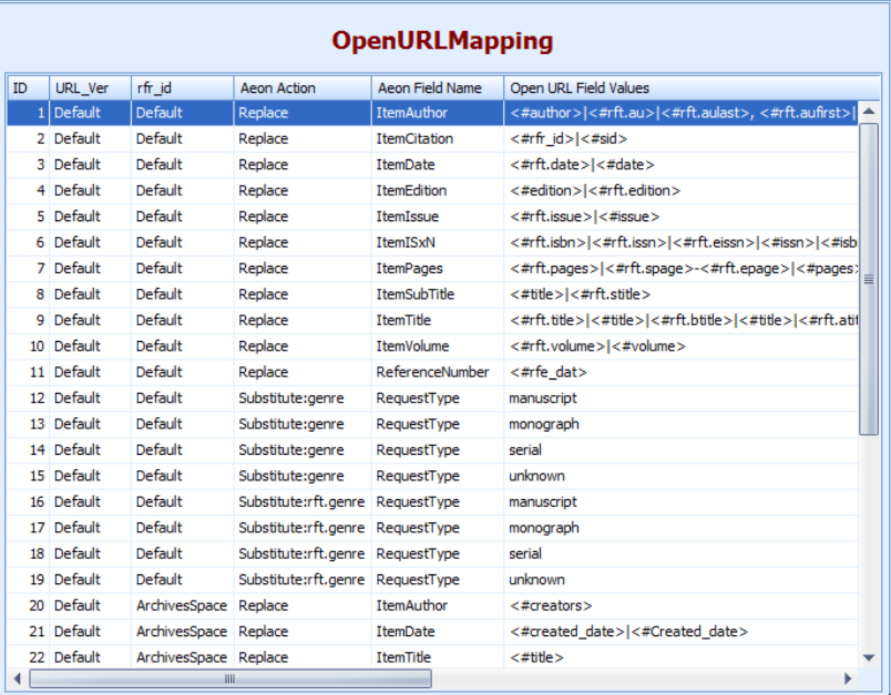
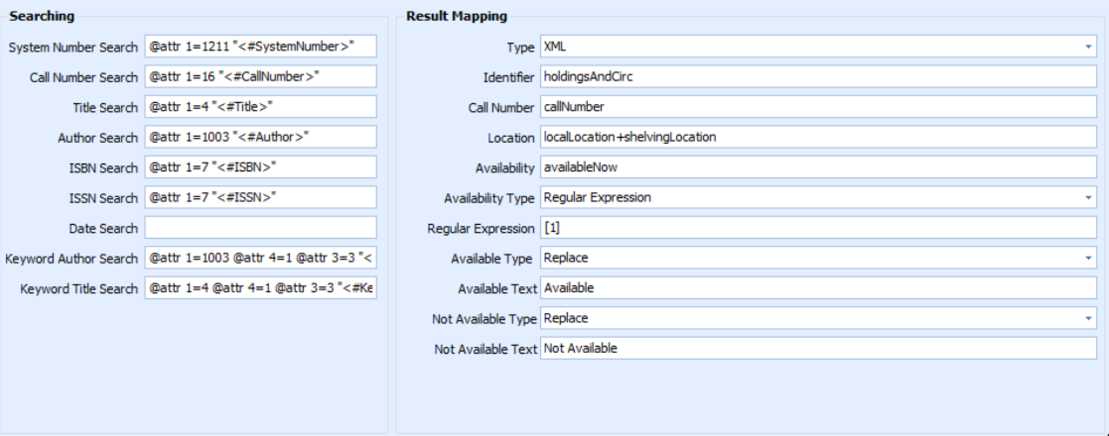
Configuration
Service Configuration
Aeon
OpenURL Mapping Table
Z39.50 Configuration
Service Configuration
OpenURL Mapping Table
z39.50 Configuration Table
Notes:
Configuring Discovery and Aeon was one of the major tasks for implementing the request feature. Using Service Configuration, I needed to list out the sub-library and other location information where the request button should appear. This is how we could control where the request link would appear. Additionally, there were two different tools that needed to be configured in Aeon. The first, the OpenURL Mapping Table, is essentially a crosswalk table allowing you to map OpenURL fields to Aeon request form fields. Some of the fields may be pre-populated by Atlas and they are able to help if you have any questions. The remaining tool to be configured is the Z39.50 tool in Aeon. This enables you to customize what z39.50 attributes are searched using data passed from OpenURL. Again, this will likely have some default values provided, but we needed to make some changes. For example, the system number we use is the OCLC Number, so configured the 1=1211 OCLC number search for the system number. Additional in the result mapping I added the localLocation+shelvingLocation information to add the necessary location information that would be needed to find an pull the material.

Slide 12

Testing the Requests
Check requests worked for different types of materials
Ensure request links appeared on correct materials
Resolve any problems that surface
Notes:
After the systems were configured in our sandbox test environment and I performed some preliminary tests to make sure the systems was working, I notified the group that the system was ready for testing. On the one hand we needed to make sure that the request systems properly work, but we also needed to make sure that the request button was appearing on records for materials it should appear on and not appearing on materials that it should--like student theses and dissertations that are currently embargoed. After the testing was completed, and I resolved the issues that cropped up, I could add the settings in Service Configuration to the production interface, making the request functionality officially live.

Slide 13
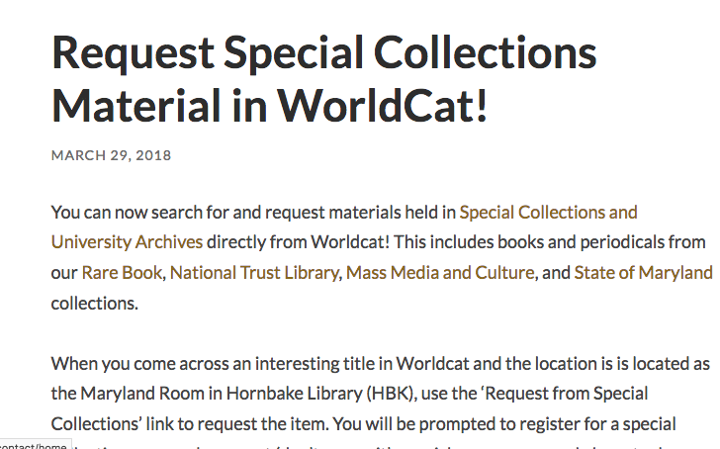
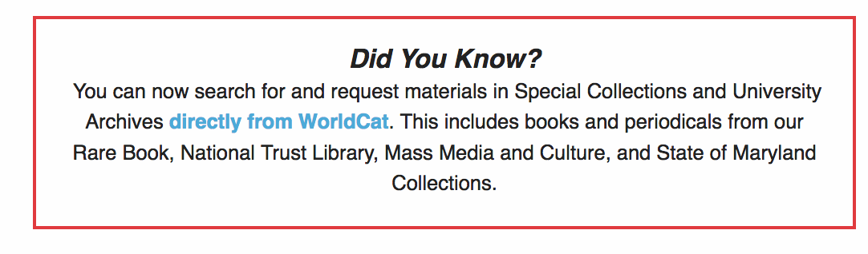
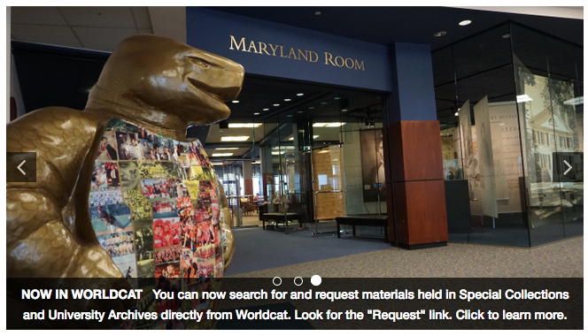
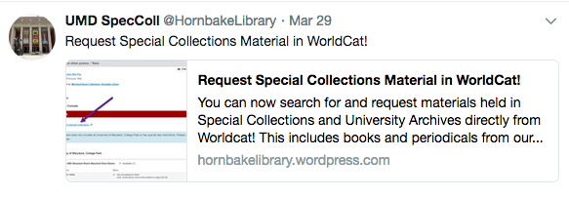
Communication
Special Collections Blog
Library Newsletter
Library Webpage
Social Media
Notes:
We felt that making the university community aware of this new feature and provide instructions for using the feature was important, but we also felt that this was an opportunity to help increase the visibility of special collections for our users. Amber created a blog post on the special collections blog that included instructions and screenshots to help guide readers. This post then also acted as a central place we could direct people to find instructions or more information. The blog post could be pushed out on social media, and we could e-mail it to library staff to inform them. I reached out to the libraries’ communication office and we got links to the blog post in the library’s newsletter, Library Link, and an image in the carousel on the front page of the website. And that is all I wanted to share. I hope you all gained a better idea of the technologies that share metadata between library systems and how critical they are for libraries. I hope you also gained an appreciated for thinking outside the box and how, librarians, working together can find a way to make things work for our user communities… even when it looks like a vendor product won’t let you do something.

