Slide 1
A Collection Created from Community, Crisis, and Trauma: _____________________________
processing the “University of Virginia Library Collection oN the Events in Charlottesville, VA, August 11-13, 2017”
By:
Joseph Azizi
University of Virginia Library

Slide 2
In this Presentation
“University of Virginia Library Collection of the Events in Charlottesville, VA, August 11-13, 2017”
Modern web-based technologies
Participatory archival practices
Mediated participatory collection
Democratization of archival power
Notes:
In this presentation I will feature the “University of Virginia Library Collection of the Events in Charlottesville, VA, August 11-13, 2017” as one that adopts participatory archival practices, and archival practices that employ newer and more far reaching technologies to give voice to individuals and groups whose stories and documenting efforts would otherwise not have been recorded in an archival setting and thus made accessible to a larger public.
I will present this collection as an example of a mediated collection centered around a traumatic event whereby the University of Virginia Library mediated most archival work when there was community participation. The term community, however, is used more liberally here than in some other cases.
The collection will also be shown to exhibit democratization of appraisal and archival power, which occurs through active engagement with communities, and through more conscientious archival efforts that draw together expressions of solidarity from various sources around a singular event.

Slide 3
Collection Contents
Notes:
A brief overview of the collection contents

Slide 4
Collection Contents
Physical/Analog (series 1)
Chronological arrangement, first
Then by type/format: correspondence, printed ephemera, artifacts, posters, etc.
Community gatherings
Viewpoints (political, social, or otherwise)
Educational purposes
Condolence and solidarity with victims and their community
Sympathy with ralliers, white supremacist ideals
Notes:
The physical materials, either donated, or collected by UVA librarians (staff), are first arranged chronologically, then further by type. They include printed ephemera created in anticipation of the “Unite the Right” Rally like announcements and pamphlets for community gatherings in Charlottesville, and flyers and zines for educational purposes or expressing either anti-fascist views, or racist/white supremacist views, or something else to these effects. There are anti-fascist/anti-white supremacist posters from the counter protest, as well, correspondence and artifacts that express condolences to, and solidarity with Charlottesville citizens, as well as correspondence sympathetic with the ralliers and white supremacist ideals. A large portion of the physical materials were donated by Charlottesville City Hall.

Slide 5
Collection Contents
Born-Digital (series 2)
Arranged by format, then further by type where appropriate:
Stories (typed narratives) and audio-visual materials (photos and videos) submitted via online collection site
Archived webpages:
Archive-It crawled webpages
ReplayWeb/Conifer/Webrecorder crawled webpages
Audio files (“Together”)
Archived Tweets/Twitter datasets: access TBD
Notes:
Born-digital materials are arranged by type, or more specifically type of archiving activity. First there are digital materials donated via an online digital collection site based on the OMEKA public user interface, an interactive platform technology, that includes a portal for public submissions of documentation and metadata. The materials donated here include digital photos, videos, audio files, text documents, and links to larger collections of materials, like personal Flickr webpages.
The archived web pages exist on two platforms. Web pages on the Archive-It site were crawled using the Archive-It tool, and the pages accessible through ReplayWeb were crawled using Webrecorder (now Conifer). The content found in these collections include, but are not limited to, YouTube videos, blog posts, news articles, listserves, tweets, community sites, and reddit and 4Chan posts.
There are digital audio files from a compilation album accessible via the Avalon platform, the university’s online database of audio and moving image collections. The songs were created by various artists in response to the events that took place on August 11 and 12, 2017.
Finally, the collection archived Tweets and Tweet IDs, while not yet open for research, includes content based on searches for a wide range of hashtags, and timelines and accounts from the university, the city, and individuals associated with them. Tweets and Tweet IDs were captured using the Twitter search-command and user-timeline-command REST APIs, the Twitter Stream API, and TWARC, an open-source, Python-based command line tool developed by Documenting the Now.
An important note I want to make is that the final products for this collection that we see on the web, and that are also not visible but being preserved until access issues can be resolved are entirely reliant on the meticulous work of UVA Library staff. Staff had a very small window of time to include in the website contribution terms of service for the online submission form, general, anonymous contact information for donations that could not be uploaded, metadata fields that were easy for people to read and use, and a nomination form for suggesting someone else’s work for capture. Staff also wanted to be sure they were creating a site that may be used as a template for future collecting events.
A great deal of precise vetting was conducted, as well, during a necessary selection and appraisal process for submissions that did not meet the terms and conditions, materials not directly related to the events, or that had lesser research value. Increased vetting was of great importance also because of the possibilities of targeted vandalism of shared resources. This process was applied to materials submitted or nominated by donors, and to websites and webpages nominated by curators and other staff which would later be published in Archive-It and ReplayWeb, or not.
With the vast amounts of born-digital materials being donated and nominated, the processing stage is very lengthy and complex. Each link submitted to be crawled resulted in hours of work on the back end. Virus scans detect malware viruses in the file uploads. After the quarantine stage, the files become visible in an admin interface, where checksums are conducted, and where submissions and user metadata are vetted for inappropriate content then prioritized. Similarly, hours of work were needed to archive the millions of tweets based on just several hashtags.

Slide 6
Community Identities:
Expressed and Inferred
Ralliers July 8 KKK rally Aug 11 torch rally Aug 12 “Unite the Right”: pamphlets and flyers | Counter protesters Aug 11 UVA campus Aug 12 v. “Unite the Right”: posters, flyers, and zines | Charlottesville residents . Community events Responses on social media Memorials (installations) Digital submissions to Archive
Solidarity w/Cville Condolence letters & artifacts Responses on social media Captured websites | Solidarity w/Ralliers Letters written to City Hall Responses on social media Captured websites
Notes:
I was able to identify shared characteristics between various voices in the collection after some time. I believe that the distinct patterns of traits could easily be separated into groups or communities. Charlottesville residents, including UVA students and faculty, who were either creators of documentation donated to the archive, or represented in the collection records clearly stands out as a distinct community. Other community identities can also be inferred from the contents, and the intended functions of some of the materials: there are photos and videos of ralliers from the July 8 KKK rally and the “Unite the Right” rally in August; photos and videos of counter protesters as well as posters, signs and printed materials created by them; condolence materials sent to city hall, which include letters and official announcements of solidarity as well as handmade artifacts; and also letters from people who expressly state their support of the ralliers, or communicate perspectives that align with the ralliers.

Slide 7
Mediated Participatory Collection
Notes:
Several definitions and criteria for community and participatory archives and projects emerged in my research. However, I felt that these helped me the most in choosing the description of a “mediated participatory” collection.

Slide 8
Participatory Archiving Practices
Caswell & Mallick: 3 functions
Generate new records that represent perspectives not commonly found in archives
Convey a sense of emotion and effect
Solicit community participation in the archival endeavor
Notes:
Caswell and Mallick identified 3 functions of their community-based South Asian American Digital Archives First Days Project as generating new records that represent perspectives not commonly found in archives, conveying a sense of emotion, and soliciting community participation in the archival endeavor

Slide 9
Participatory Archiving Definitions
Caswell & Mallick definition (South Asian American Digital Archive):
Use internet-based & interactive digital technologies
Facilitate creation of new records directly by users themselves
Records must document past or ongoing event(s)
Records must be included in archives where they are subject to archival interventions
Thomson Definition:
History about a particular community, however defined, created in partnership with members of that community, and for the benefit of that community.
Notes:
Expanding on the third objective, they emphasize the use of internet-based technologies to create interactive projects that are facilitated by users themselves, that document past and ongoing events, and that are included in an archives where they can be preserved, described, and made publicly accessible.
One argument for participatory and community archiving is that allowing, enabling, and empowering community members to “take an active and primary role in their creation, curation, and use” so that archival endeavors are conducted on the communities’ own terms and would allow community members some level of control.

Slide 10
Participatory Archiving Categories
Benoit and Roeschley – participatory archives in the context of “demarcated boundaries”:
Mediated projects:
institutional body mediates some or most archival work with community participation
Less- and non- mediated spaces:
the role of the archivist is diminished
projects may begin and exist completely outside the influence of archives
often transition into, and engage in a symbiotic relationship with a mediated space
Notes:
Benoit and Roeschley discuss participatory archives in the context of the demarcated boundaries that have emerged in the field. They classify participatory archives into mediated projects, and less- and non- mediated spaces. In these mediated projects, or mediated participatory archives, an institutional body mediates some or most archival work with community participation. Some of these projects have centered around traumatic events that have affected a number of communities, and some efforts have focused on the histories and cultures of particular communities. Archivists and representatives of institutions, the authors explain, can acquire appropriate funding and supply spaces while working together with community members to host events that would promote collection building and education among communities
In many cases, when a project aims to document specific events or movements, it can “provide platforms for people to share their experiences”, an important activity that helps define the purpose of community and participatory archives. These projects are able to either fill in many existing gaps in archives, or document histories and cultures in ways that archives are not able to.

Slide 11
Democratization of Archival Power

Slide 12
Appraisal Power
Primary goals:
Allow archival endeavors to be conducted on the communities’ and activists’ own terms
Offer a multiplicity of voices and formats
Make archival heritage more inclusive, and “more representative of the diversity of our whole society
Transparency through participation
Notes:
Some of the primary goals of participatory and community archiving is to allow archival endeavors to be conducted on the communities’ and activists’ own terms, and to offer a multiplicity of voices and formats, the effects of which would make archival heritage more inclusive, and “more representative of the diversity of our whole society.
In either mediated and less or non-mediated participatory/community archives, community members are meant to have appraisal power based on what they choose to archive, donate, and how they choose to describe the materials.
Inclusion and participation, are meant to reveal the diversity of motivations, viewpoints, arguments, and counterarguments that can surround an event or subject, and exist in society

Slide 13
Appraisal Power
Platforms for previously marginalized voices to engage in a form of political protest motivated by political activism, community empowerment, and social change (Caswell)
Constructed spaces in a digital environment
proven to help empower community members, and to create channels of interactivity that may not have been conceivable otherwise.
Aug 11-13 collection features voices (marginalized and dominant) via:
OMEKA platform web archives, Twitter datasets, digital audio archive
Notes:
The constructed digital spaces are meant to serve as platforms, ideally for previously marginalized voices, to engage in political protest, and express viewpoints motivated by political activism, community empowerment, and social change.
Some of the digital spaces created for this collection do not achieve every one of the aforementioned goals, and likely feature more dominant than marginalized voices. The OMEKA digital collecting site, however, would be the closets to meeting these criteria.

Slide 14
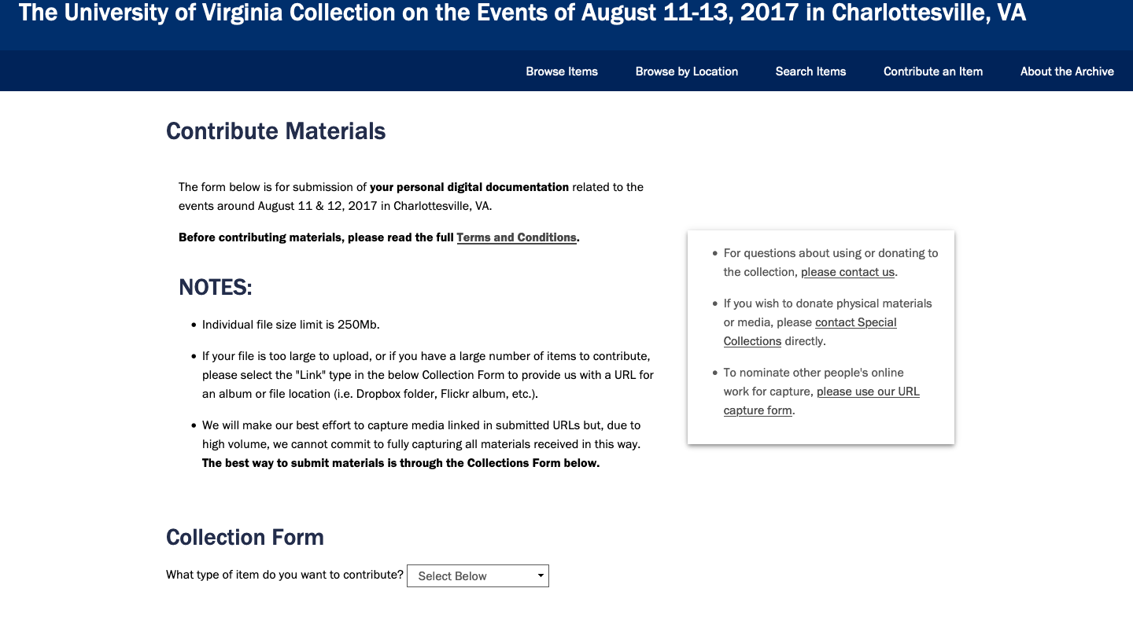
OMEKA
Notes:
This website was used by library staff during a community collecting event that was hosted by the downtown branch of the Jefferson-Madison Regional Library. This allowed members of the Charlottesville community who were affected by the events to submit and describe materials on their own terms. The effort was led by a team of UVA library staff including, the manuscripts archivists, the head of preservation, the digital preservation librarian, curators, the director of information policy, and head of research of development. The content would fall under the curatorial control of the Special Collections library.
The library’s manuscripts archivist coordinated staff and equipment, contacted the head of the Jefferson-Madison Regional Library downtown branch to schedule the event, and worked with library public relations to publicize the event throughout the university, the local Charlottesville community, and across social media. At least some of the staff present at the collecting event needed to be able to advise on donations via, data transfers from flash drives, cell phones, and online storage platforms.
Dublin Core Metadata fields were chosen for use on the submission form to best accommodate smooth uploads.

Slide 15
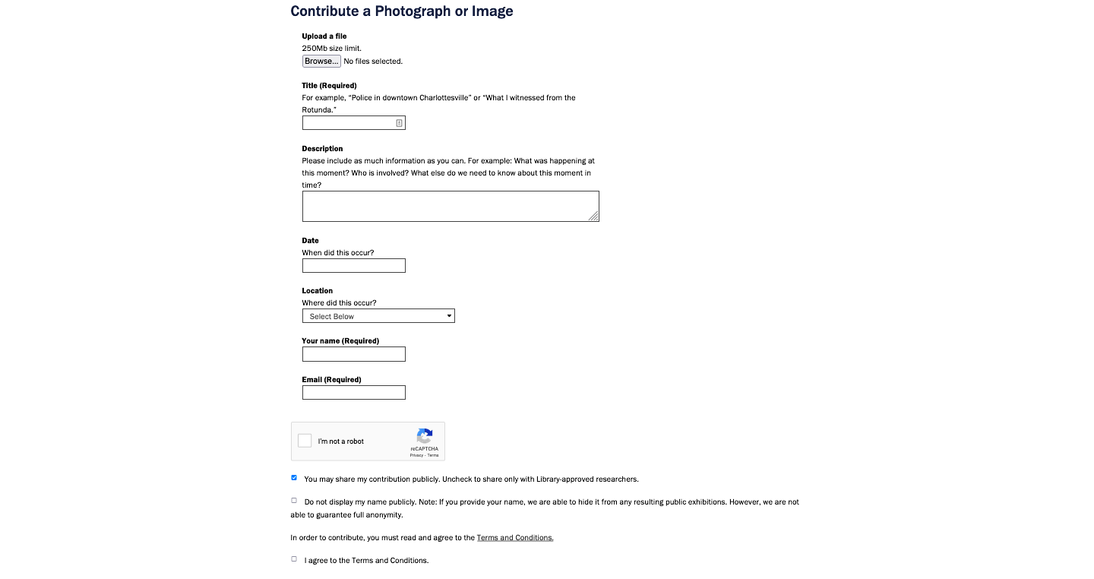
OMEKA

Slide 16
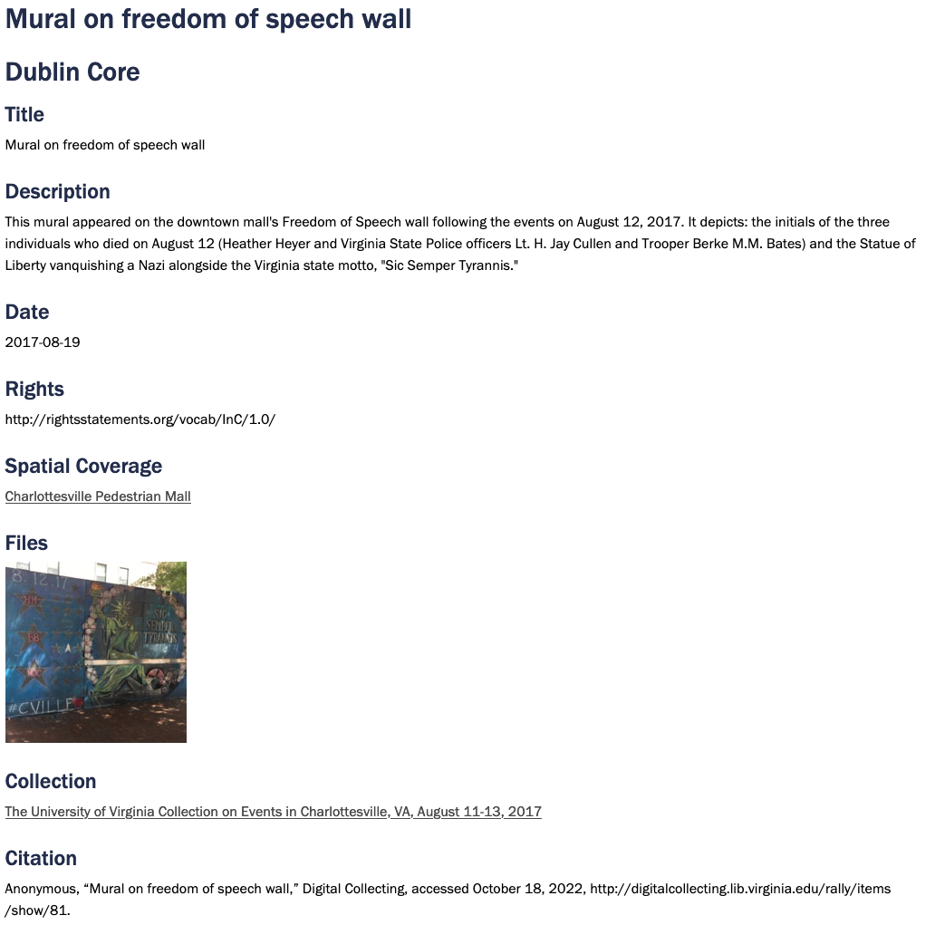
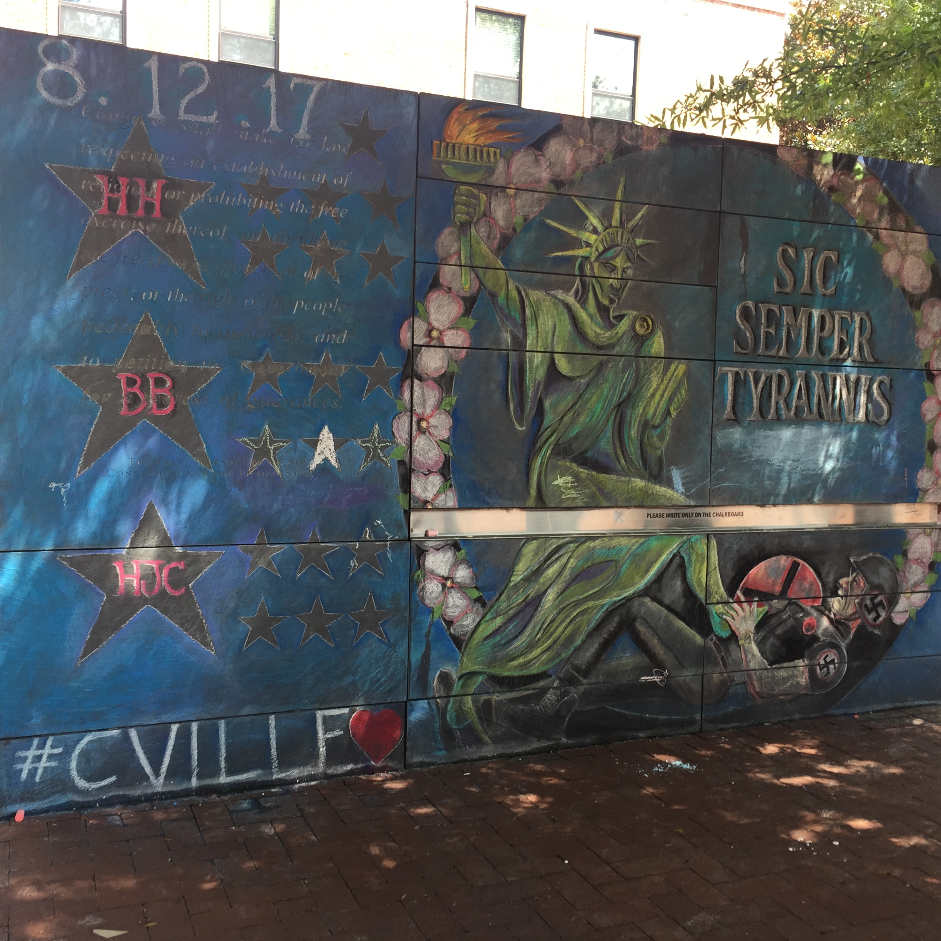
OMEKA

Slide 17
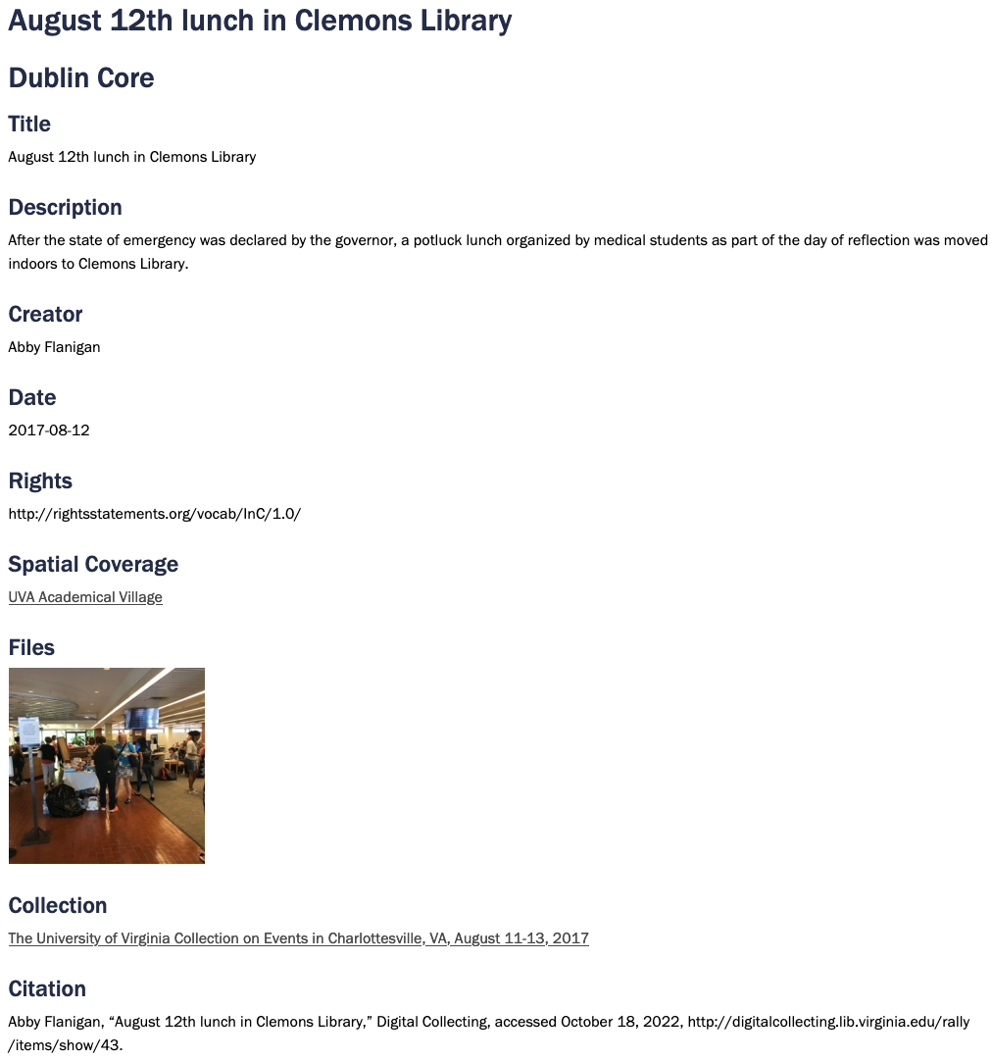
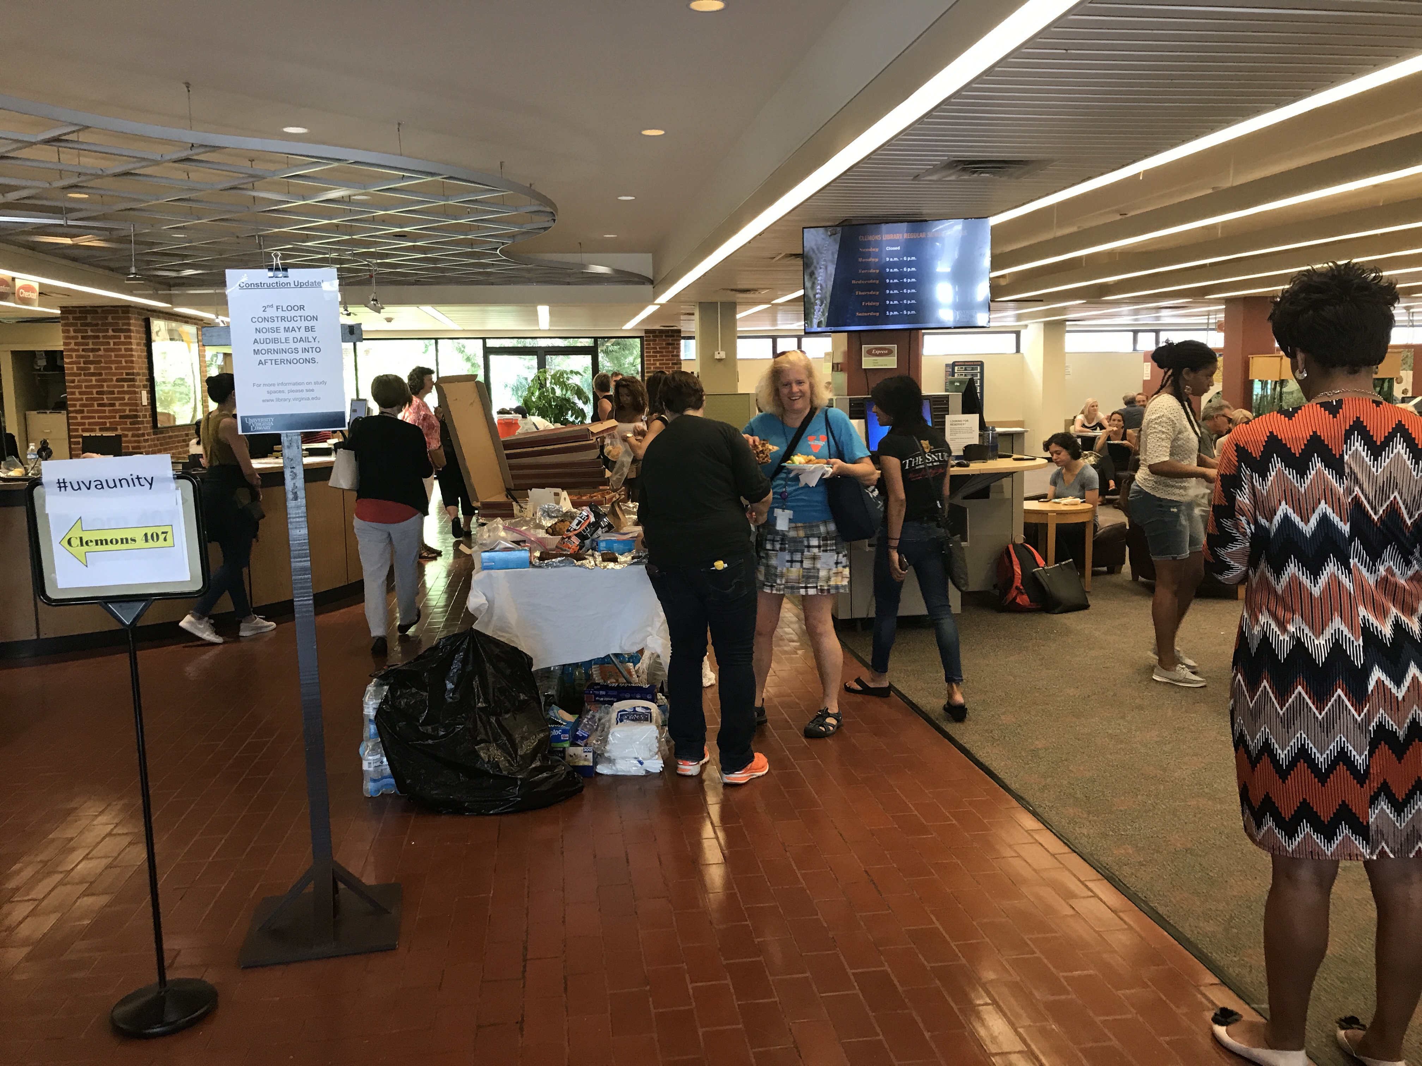
OMEKA

Slide 18
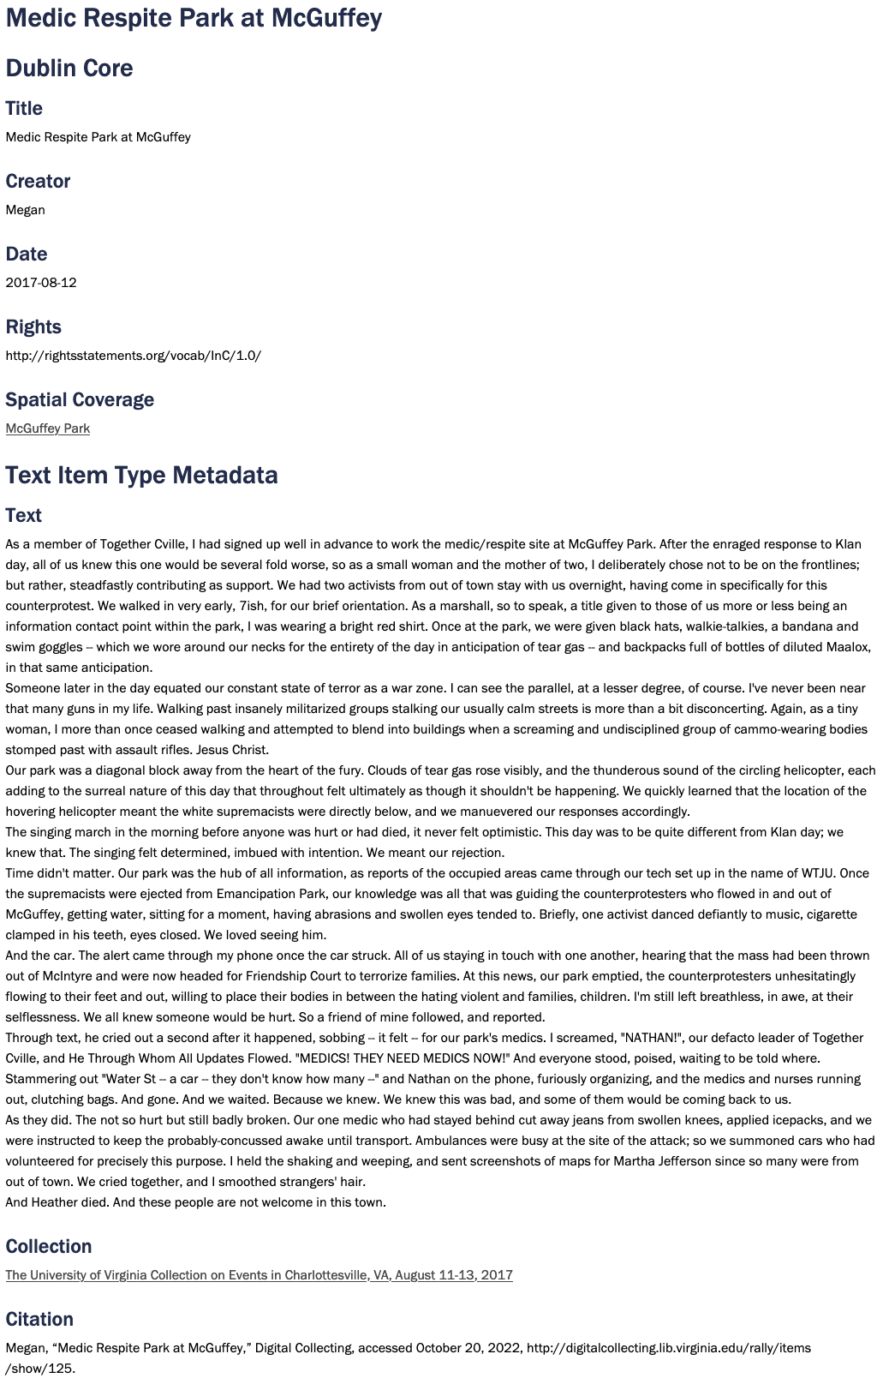
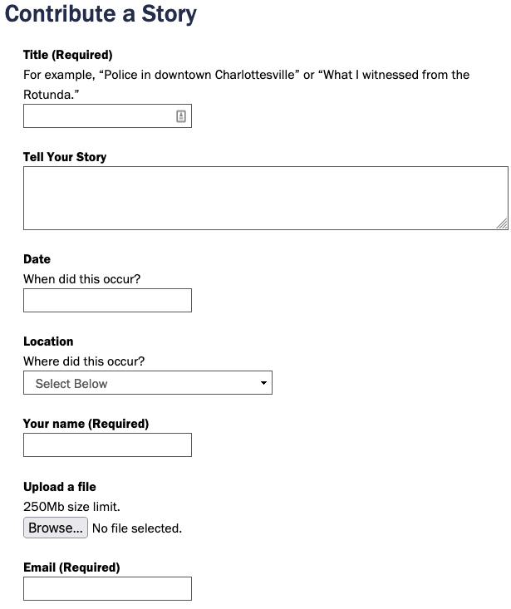
OMEKA

Slide 19
Appraisal Power
Creating histories and heritage that speak to all people
Evolving as society evolves
Redefining records
Unconventional formats & unconventional methods of documentation
Digital records in August 11-13 collection
Web pages – blogs, YouTube videos, social forums, memes, etc.; Tweets; Audio files
Interactive digital technologies allow users to facilitate new records themselves, to define their communities, fill gaps, change the definitions of historical events, and capture emotions.
Notes:
A significant impact of participatory archiving is the creation of histories and heritage that talk of and speak to all the people, an ongoing process that is constantly evolving and continuing as society itself evolves. Archivists must focus on redefining records, and updating definitions for the digital age. Our understanding of records must evolve alongside society’s ability to document, define their communities, fill gaps, change the definitions of historical events, and capture emotions. For these reason it is beneficial to use the broadest and most inclusive definitions possible.

Slide 20
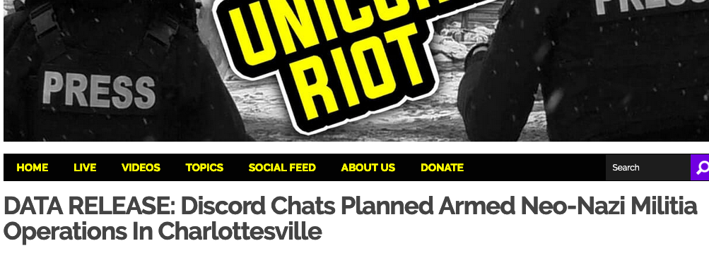
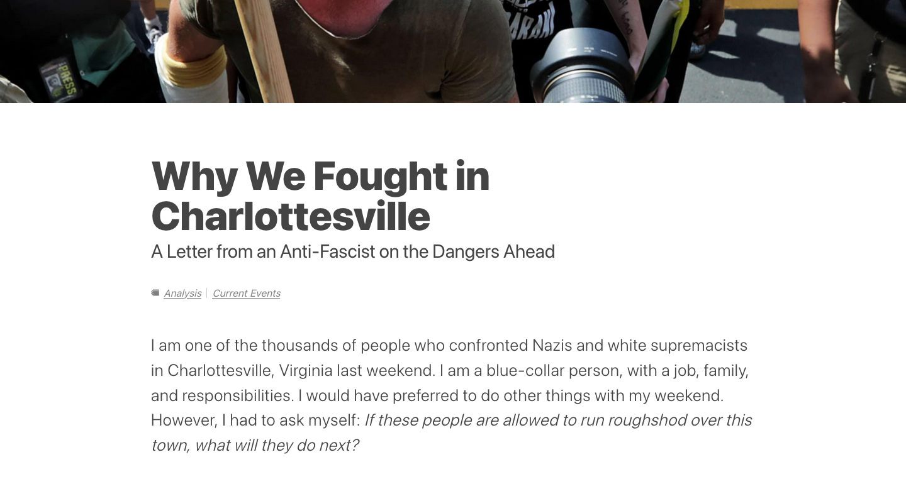
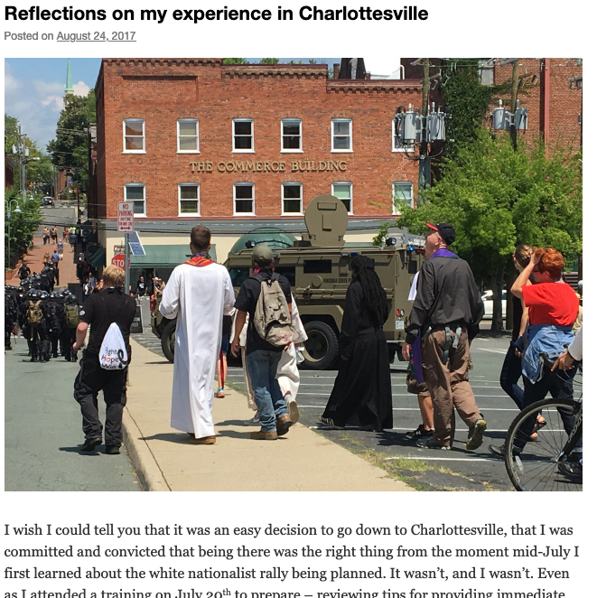
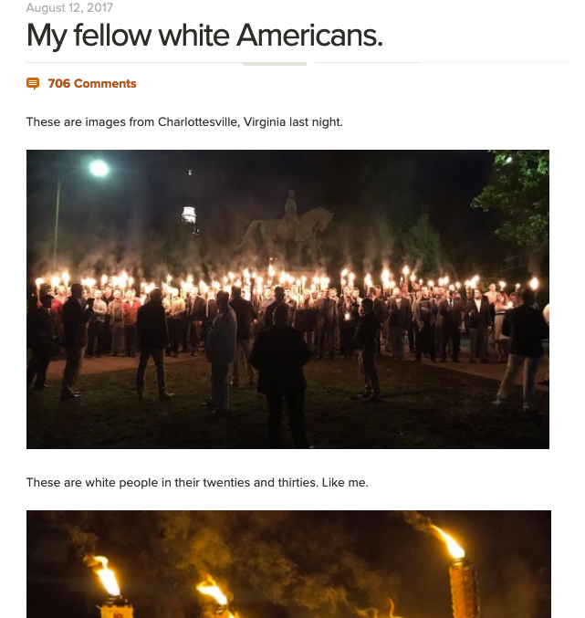
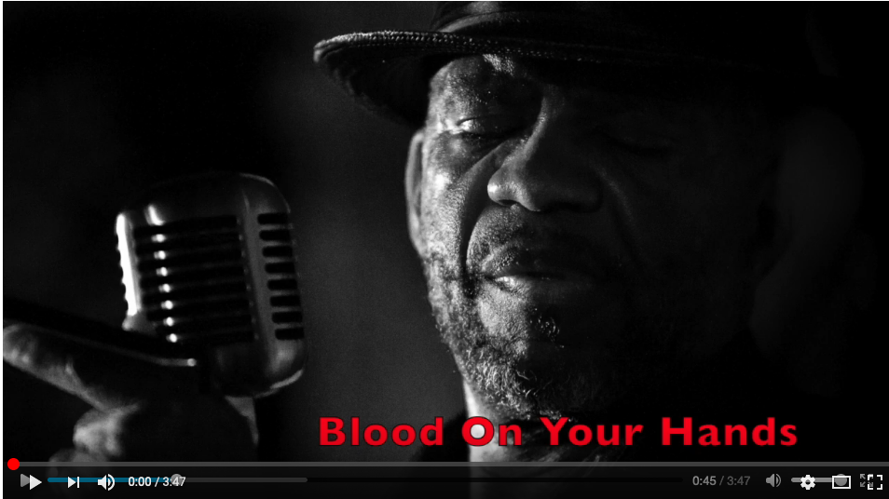
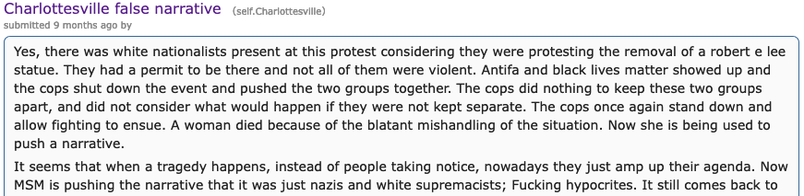
Web Crawls

Slide 21
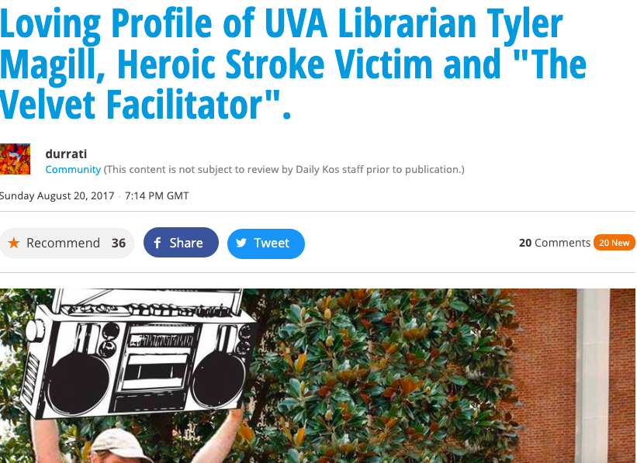
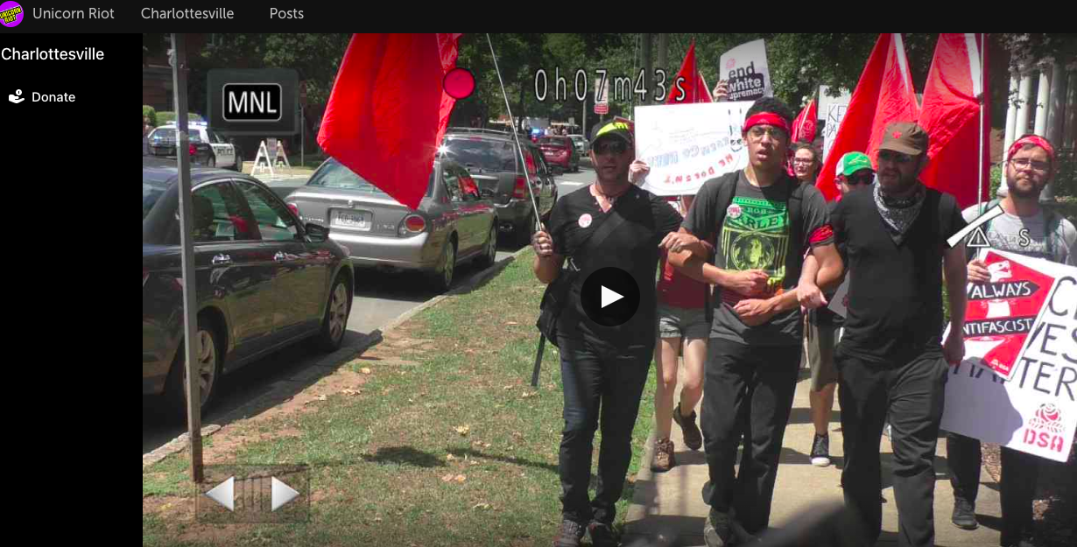
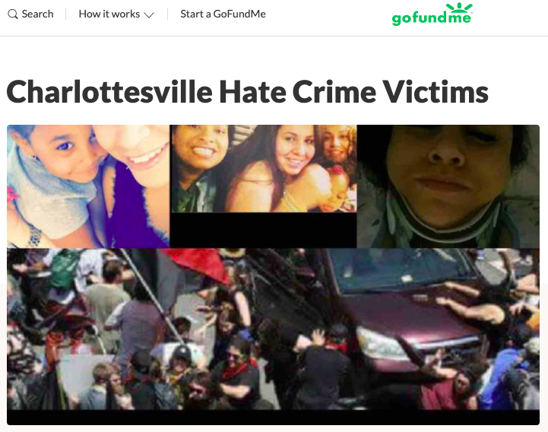
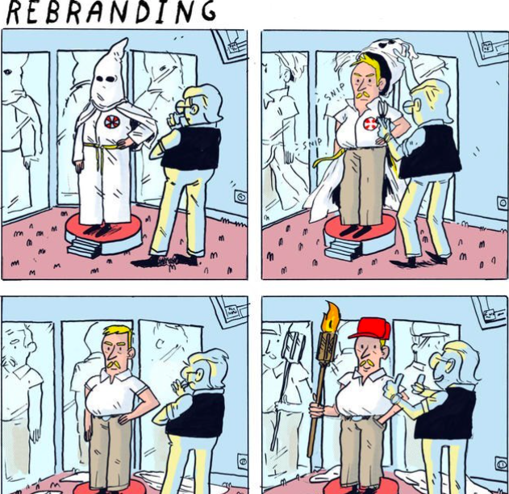
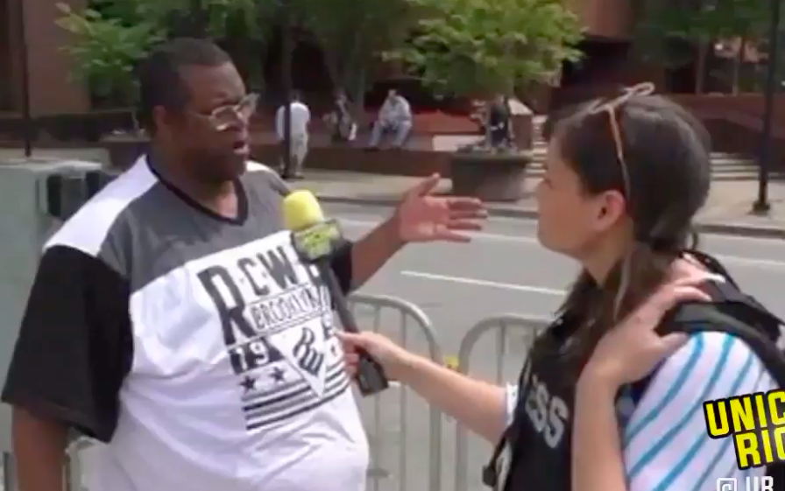
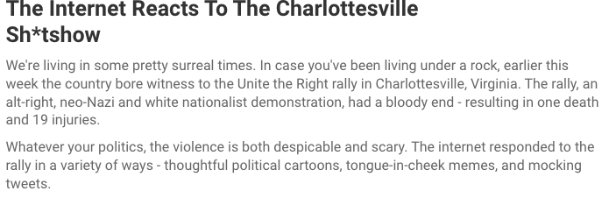
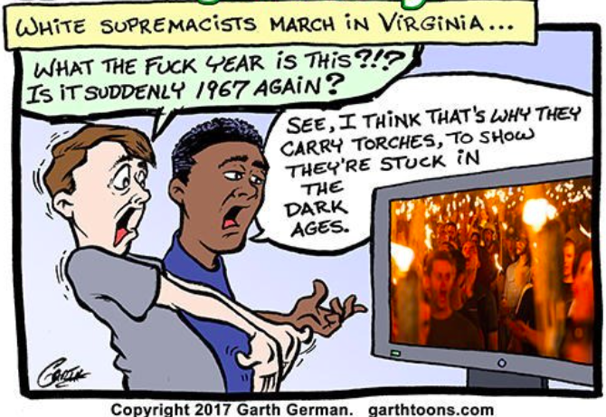
Web crawls

Slide 22
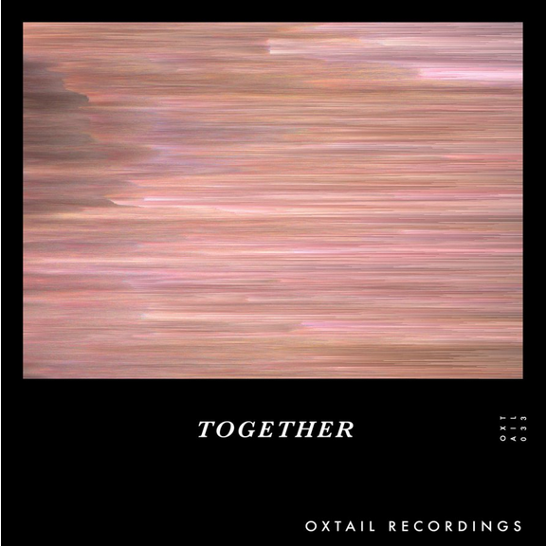
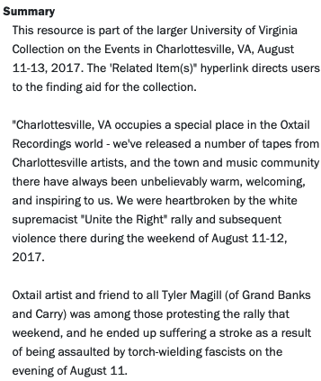
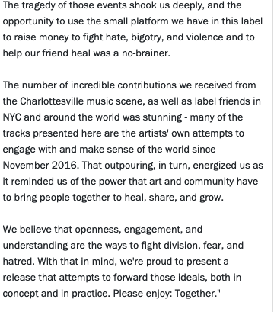
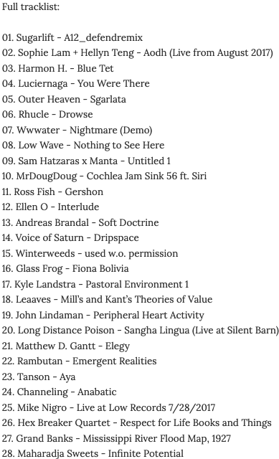
Audio recordings

Slide 23
Concluding Remarks
August 11-13 collection
Mediated community participation in creating archival records: whole community of Charlottesville called upon (no guarantee they will participate)
No focus on a specific underrepresented group
More like a mediated participatory project within a collection that exhibits many different communities (explicitly stated or inferred later)
Also a collection that captured voices otherwise not likely to have been represented in archives
Nevertheless, it can be defined and categorized as participatory archiving
Notes:
The attempt at mediated participatory archiving by the University of Virginia Library shows a very controlled instance. The OMEKA submission portal certainly gave contributors some appraisal power in deciding what to contribute, and how to describe it on their own terms. As long as the content and format met the minimum guidelines according to the University’s contribution terms of service, donors were empowered to shape the collection and the representation of their community within the collection as they saw fit.
While the community of Charlottesville was called upon to participate, there was no guarantee that people would. An invaluable element of the relationship is trust, and unfortunately, the University of Virginia’s relationship with its surrounding communities, mainly the underrepresented and historically oppressed, lacks that trust. Conducting these efforts within the boundaries of the institutional power (the university) does not ensure transparency through participation.
Only one segment of this collection involved active participation from a community, and despite having provided diverse voices that create a more comprehensive representation, the collection did not focus on any underrepresented group. In fact, the majority of voices are likely to be more dominant in society. It may even be more accurate to describe this as a participatory archiving project within a larger collection. Nevertheless, elements of this collection fall within the definitions and criteria of participatory archiving.

Slide 24
Looking Ahead
Transparency through participation is an achievable goal only if
Disrupt existing power structures, traditional archival theory and practice, and governmental/bureaucratic approaches
Break down traditional power dynamics that disproportionately privilege the ‘great white western men’ who have the power that gives them the ability, literacy level, time, and means to create records.
“Lens of public memory” (Smith)
Policy, Policy, Policy
Notes:
Achieving complete transparency through participation would only be realistic, though, when existing power structures are contested. It will be necessary to break down traditional power dynamics that enable situations in which women, the poor, and people of color are unable, unlikely or less likely than dominant groups to create written records, or when such records exist, have been undervalued and ignored by archivists. Participatory and community archiving enables a “lens of public memory”, in which users are empowered as ordinary people to see themselves and each other as creative authors and interpreters of public memory with a legitimate claim to space in the cultural public sphere. But in order for greater community engagement to occur, even not in the context of tragedy, institutional policies that address the use of web-based, interactive technologies for this purpose are imperative.

Slide 25
Some Links
Virgo resource record
ArchivesSpace resource record
Digital Collecting site on OMEKA
Archive-It web archive collection
ReplayWeb web archive collection (Google Chrome browser only)
Digital audio recordings record on Avalon
Related material:
https://doi.org/10.18130/V3/MSCNLT
https://doi.org/10.7910/DVN/DVLJTO

Slide 26
Bibliography
Allard, Danielle and Shawna Ferris. “Antiviolence and Marginalized Communities: Knowledge, Creation, Community Mobilization, and Social Justice through a Participatory Approach.” Library Trends 64, no. 2 (Fall 2015): 360-383.
Benoit III, Edward and Ana Roeschley. “Degrees of Mediation: A Review of the Intersectionality between Community and Participatory Archives.” In Participatory Archives: Theory and Practice, edited by Edward Benoit III and Alexandra Evaleigh, Facet Publishing, 2020, 139-149.
Caswell, Michelle. “Seeing Yourself in History: Community Archives and the Fight Against Symbolic Annihilation.” The Public Historian 36, no. 4 (November 2014): 26-37.
Caswell, Michelle and Samip Mallick. “Collecting the easy missed stories: digital participatory microhistory and the South Asian American Digital Archive.” Archives and Manuscripts (March 2014): 1-14.
Douglas, Jessica. “Documenting a Social Movement in Real Time: The Preserve the Baltimore Uprising Archive Project.” In Participatory Archives: Theory and Practice, edited by Edward Benoit III and Alexandra Evaleigh, Facet Publishing, 2020, 169-177.
Flinn, Andrew. “Community Histories, Community Archives: Some Opportunities and Challenges.” Journal of the Society of Archivists, 28, no. 2 (October 2007): 151-176.
Flinn, Andrew and Anna Sexton. “Activist Participatory Communities in Archival Contexts: Theoretical Perspectives.” In Participatory Archives: Theory and Practice, edited by Edward Benoit III and Alexandra Evaleigh, Facet Publishing, 2020, 150-168.
Huvila, Isto. “Participatory archive: towards decentralised curation, radical user orientation, and broader contextualisation of records management.” Archival Science 8 (September 2008): 15-36.
Niblett, Hannah and Jennifer Vickers. “Community Partnerships and Collection Development in the Legacy of Ahmed Projet.” In Participatory Archives: Theory and Practice, edited by Edward Benoit III and Alexandra Evaleigh, Facet Publishing, 2020, 178-182.

Slide 27
Bibliography
Rolan, Gregory. “Agency in the archive: a model for participatory recordkeeping.” Archival Science 17 (July 2017): 195-225.
Smith, Kevin G. “Negotiating Community Literacy Practice: Public Memory Work and the Boston Marathon Bombing Digital Archive.” Computers and Composition 40 (April 2016): 115-130.
“Unite the Right” Rally and Community Response finding aid, Albert and Shirley Small Special Collections Library, University of Virginia Library, https://archives.lib.virginia.edu/repositories/3/resources/754.
“Unite the Right” Rally and Community Response digital collecting website, University of Virginia Library, http://digitalcollecting.lib.virginia.edu/rally/contribution.
University of Virginia Library. “Digital Collecting Emergency Response Team” (institutional documents). University of Virginia Library Confluence Website. University of Virginia, Last modified November 26, 2018.

Slide 28
Questions
Contact:
Joseph Azizi
Albert and Shirley Small
Special Collections Library
ja3nu@virginia.edu

