Slide 1

small bites and
A Big GULP
MARAC Fall 2023
S1: Small Staff, Big Impact: The Work of Lone Arrangers
Deborah Smith, Jones Memorial Library

Slide 2
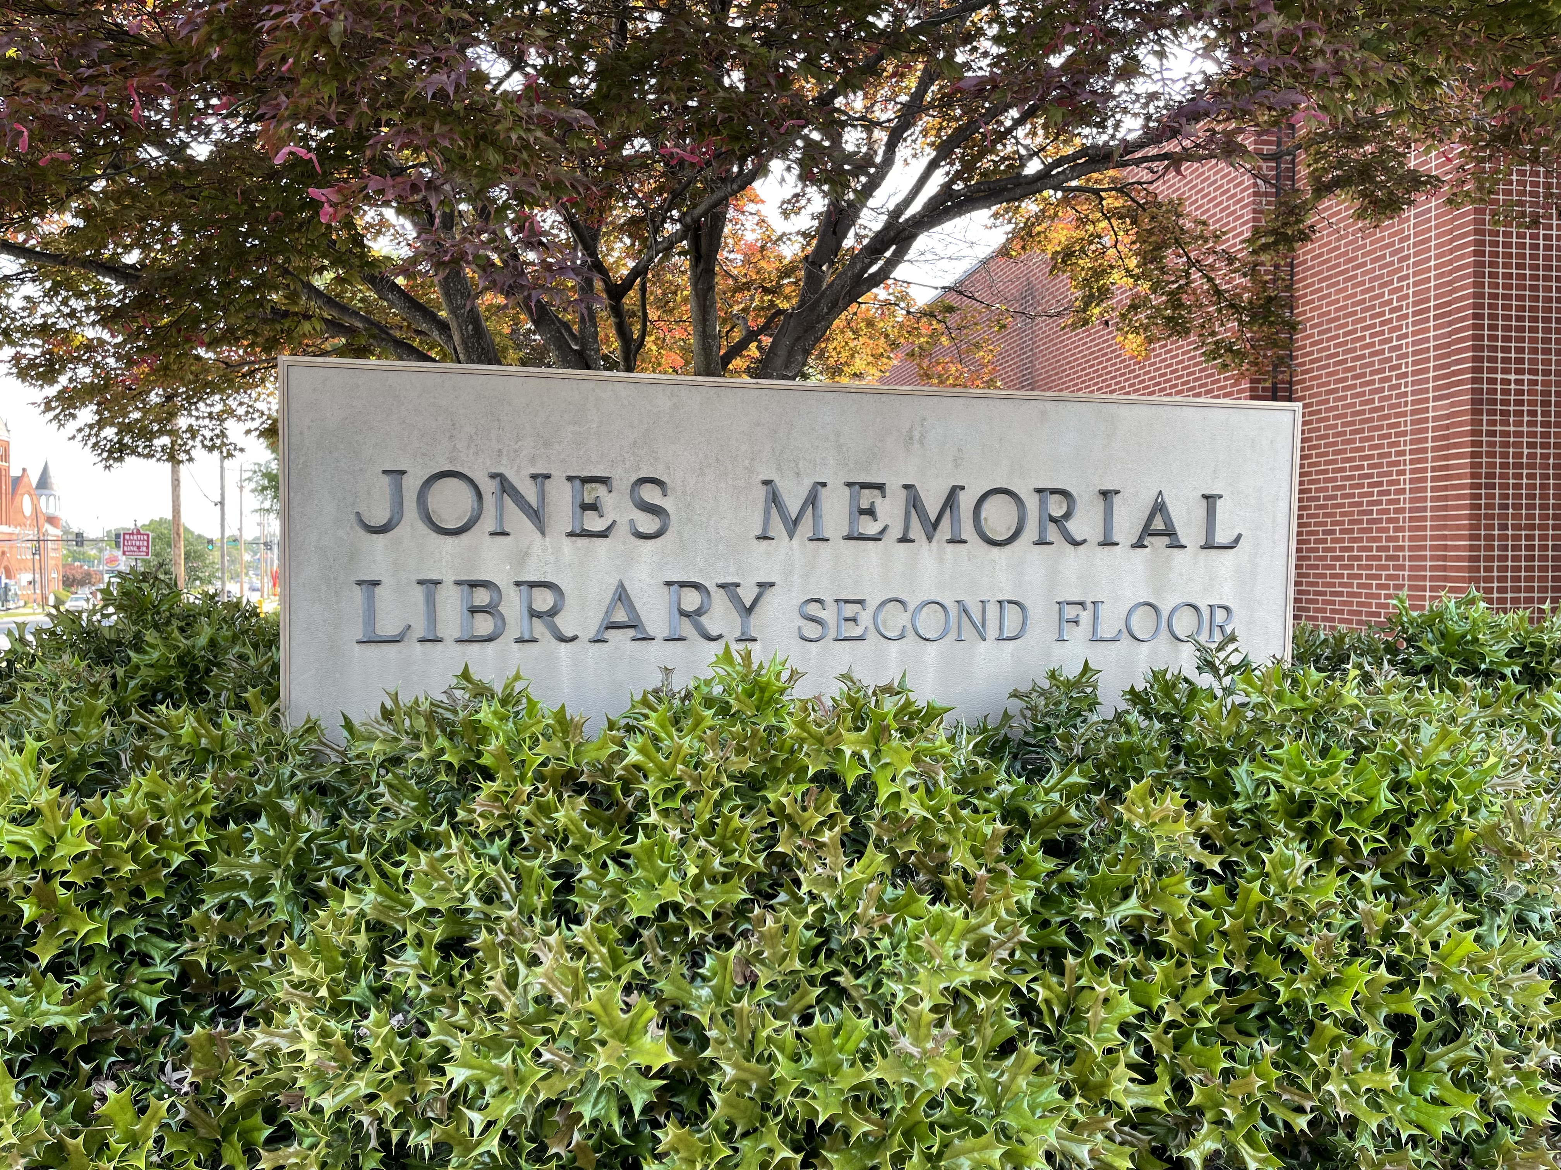

Jones
Memorial Library
Genealogy and history library in Lynchburg, Virginia.
Opened in 1908 as Virginia’s second public library. Refocused on special collections in 1969.
At current location since 1987.

Slide 3
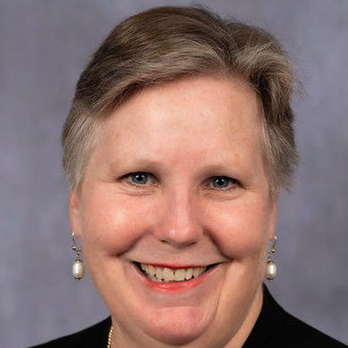
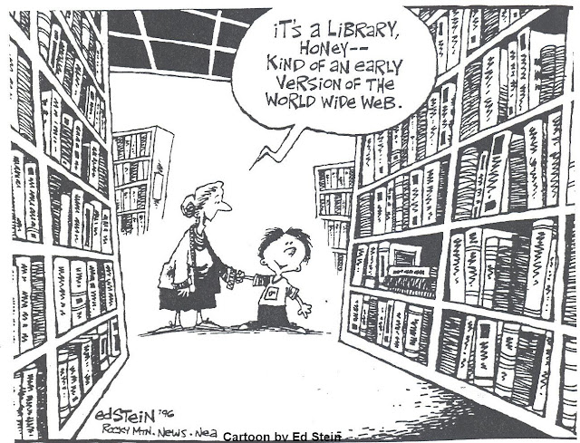
ABOUT ME
Deborah Smith, M.L.I.S.
Executive Director - Jones Memorial Library
director@jmlibrary.org
Notes:
Hi. I’m Deb Smith from the Jones Memorial Library in Lynchburg, Virginia. We are a special library with collections in genealogy and Virginia history.
I joined the Jones as Executive Director in 2022.

Slide 4
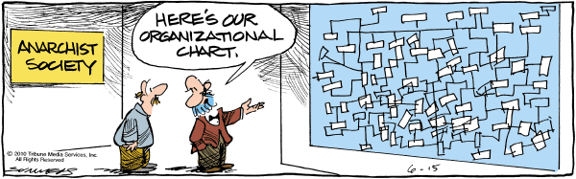
STAFFING STRUCTURE
One full-time librarian/director
Three part-time research assistants
Volunteers

Slide 5
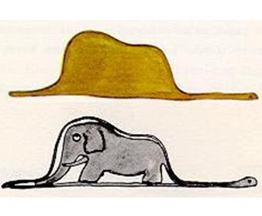
HOW DO YOU EAT AN ELEPHANT?
Image credit:
Antoine de Saint Exupery
Le Petit Prince

Slide 6
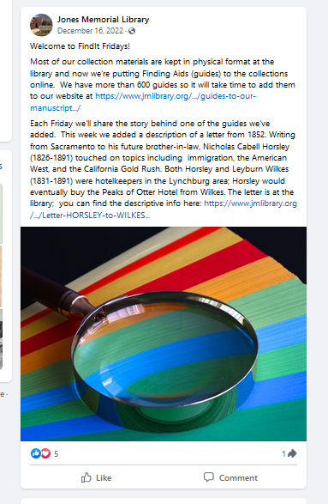
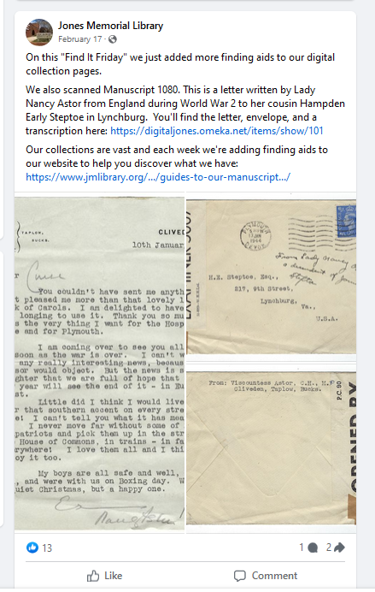
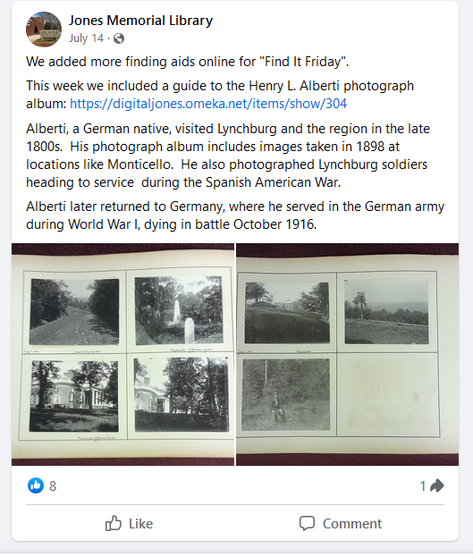
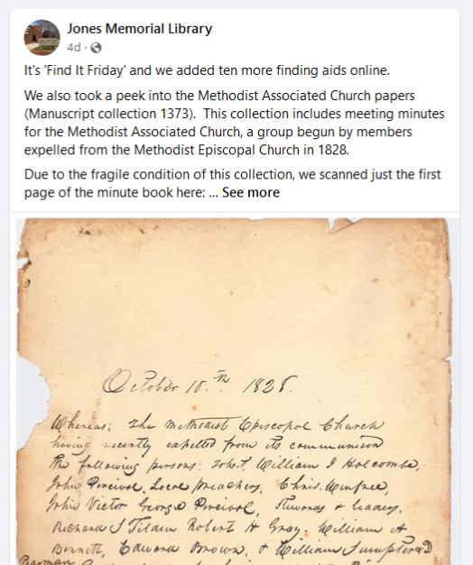
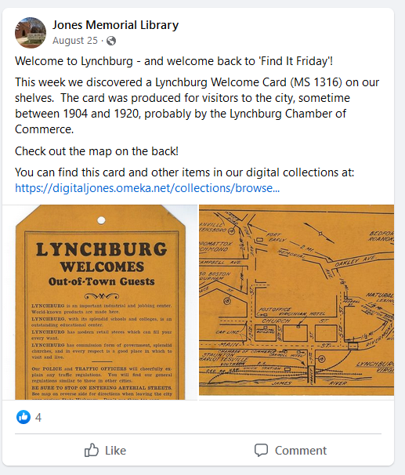
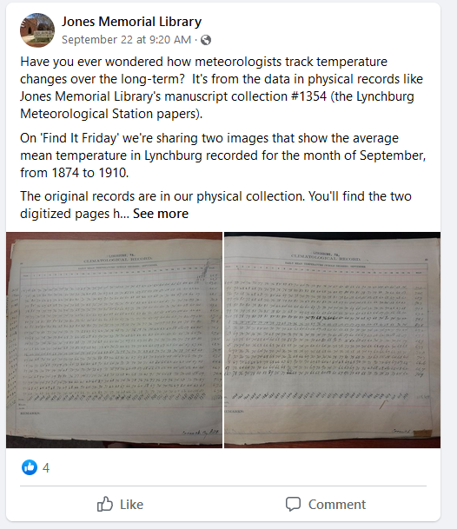
MANY SMALL BITES - “FIND IT FRIDAYS”
Weekly Facebook posts launched in January 2023
10 Finding Aids added weekly to digiJones on Omeka
Time commitment of 2 hours/week
Reading the finding aids + digging through the boxes

Slide 7
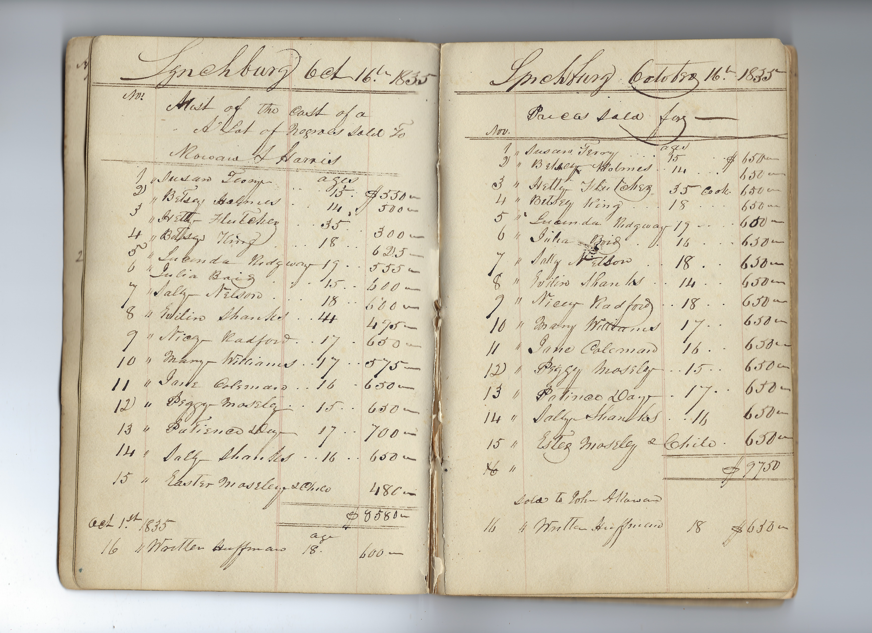
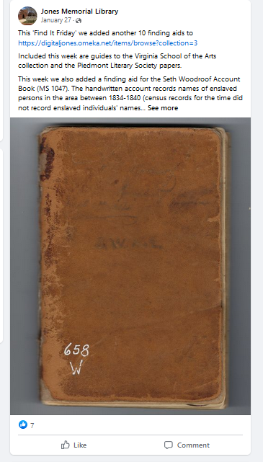
ONE Big GULP -
MANUSCRIPT 1047

Slide 8
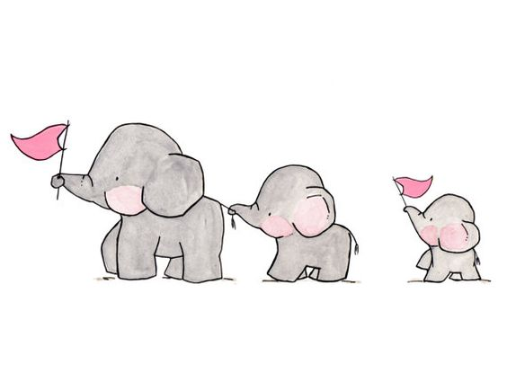
SOLO NO MORE
Shift focus to managing volunteers
Chunk projects into smaller bites
Project buy-in = more $$$
MAY 2023 – ONGOING Student Interns & Volunteers
OCTOBER 2023
Part-time Saturday Assistant
NOVEMBER 2023
Part-time Archivist

