Slide 1
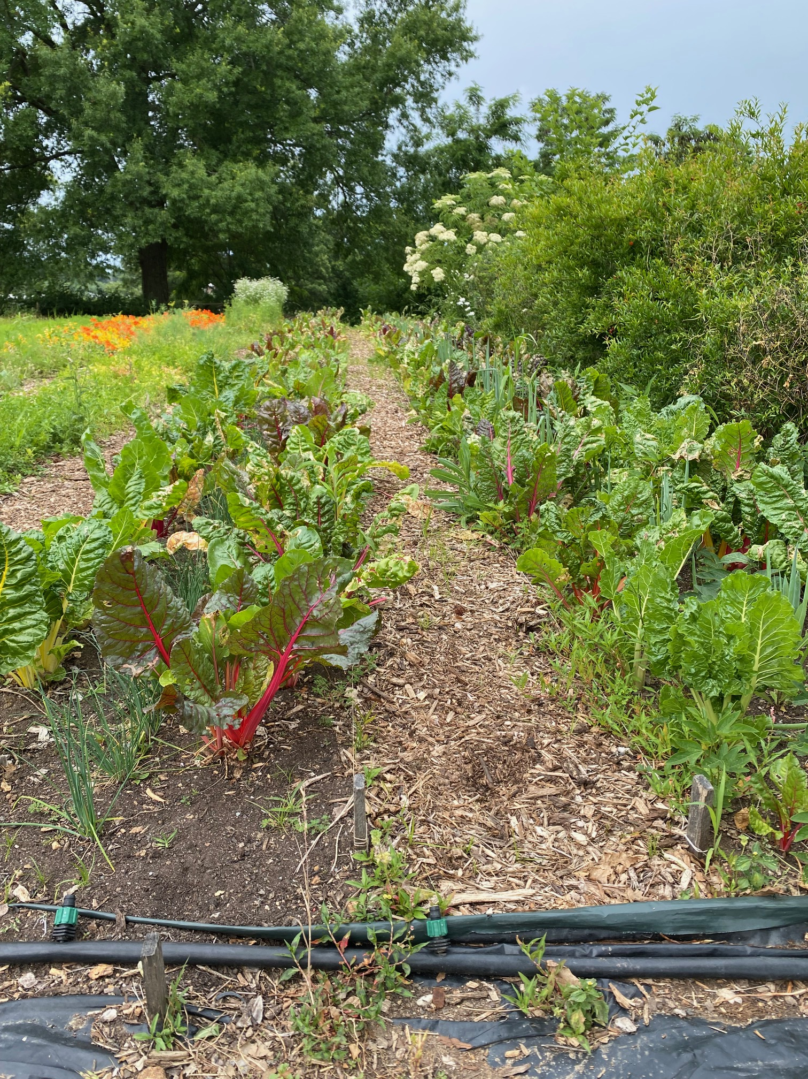
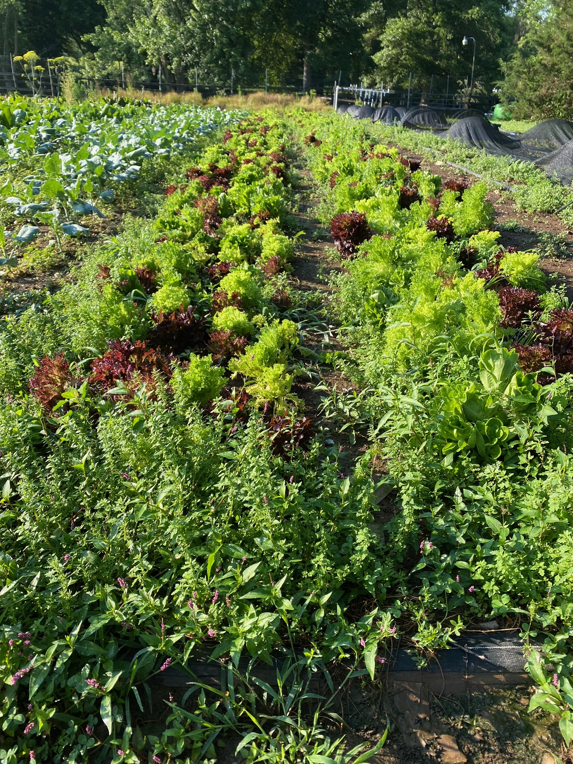
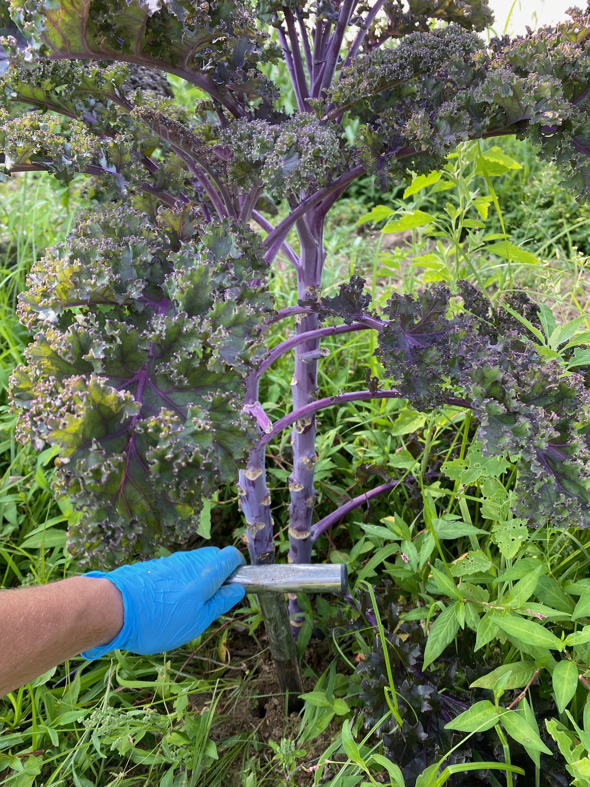
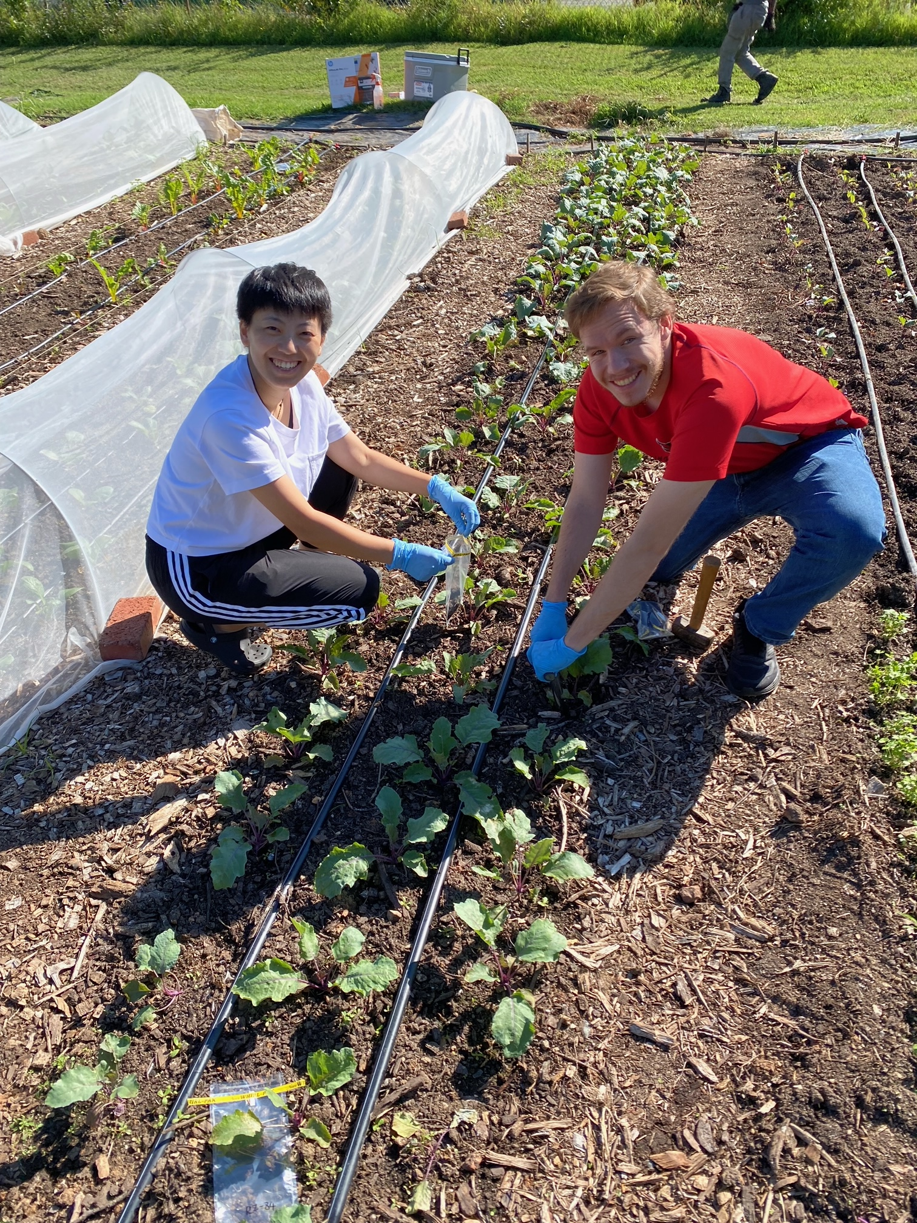
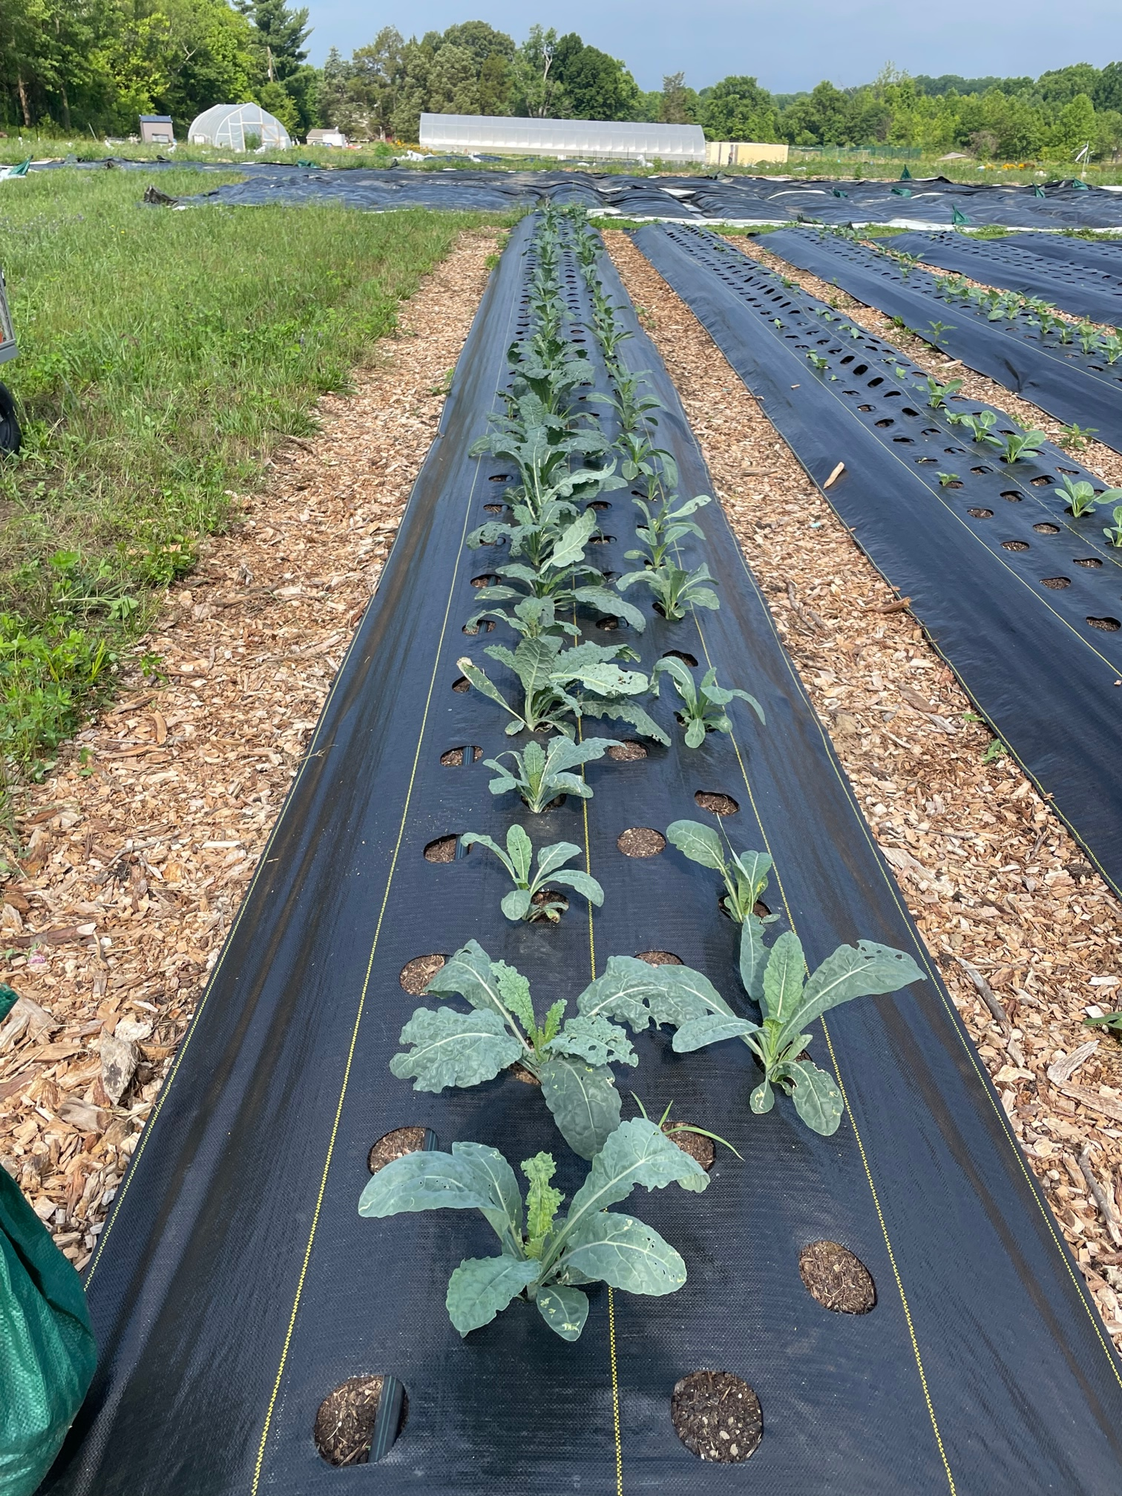
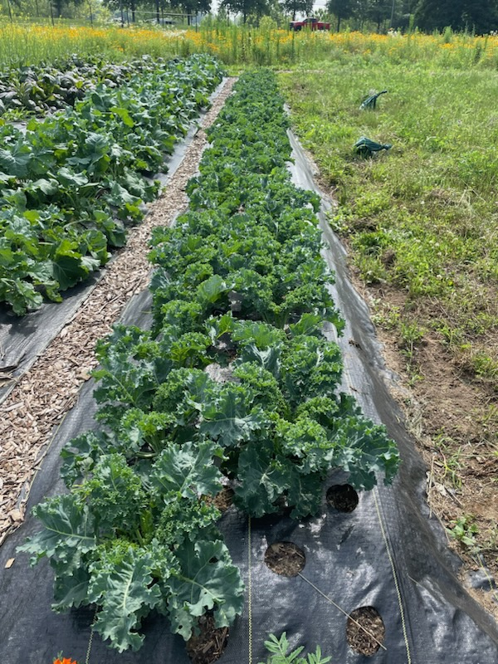
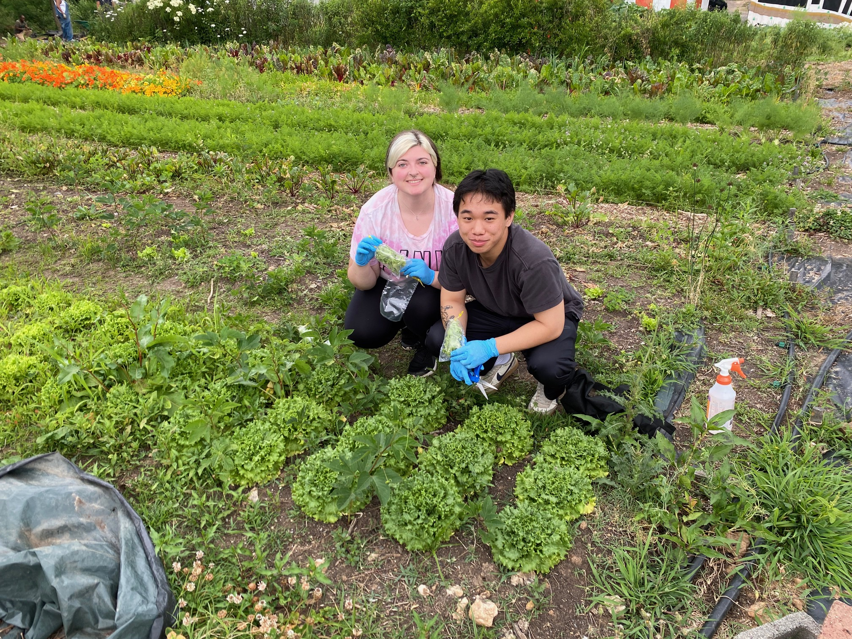
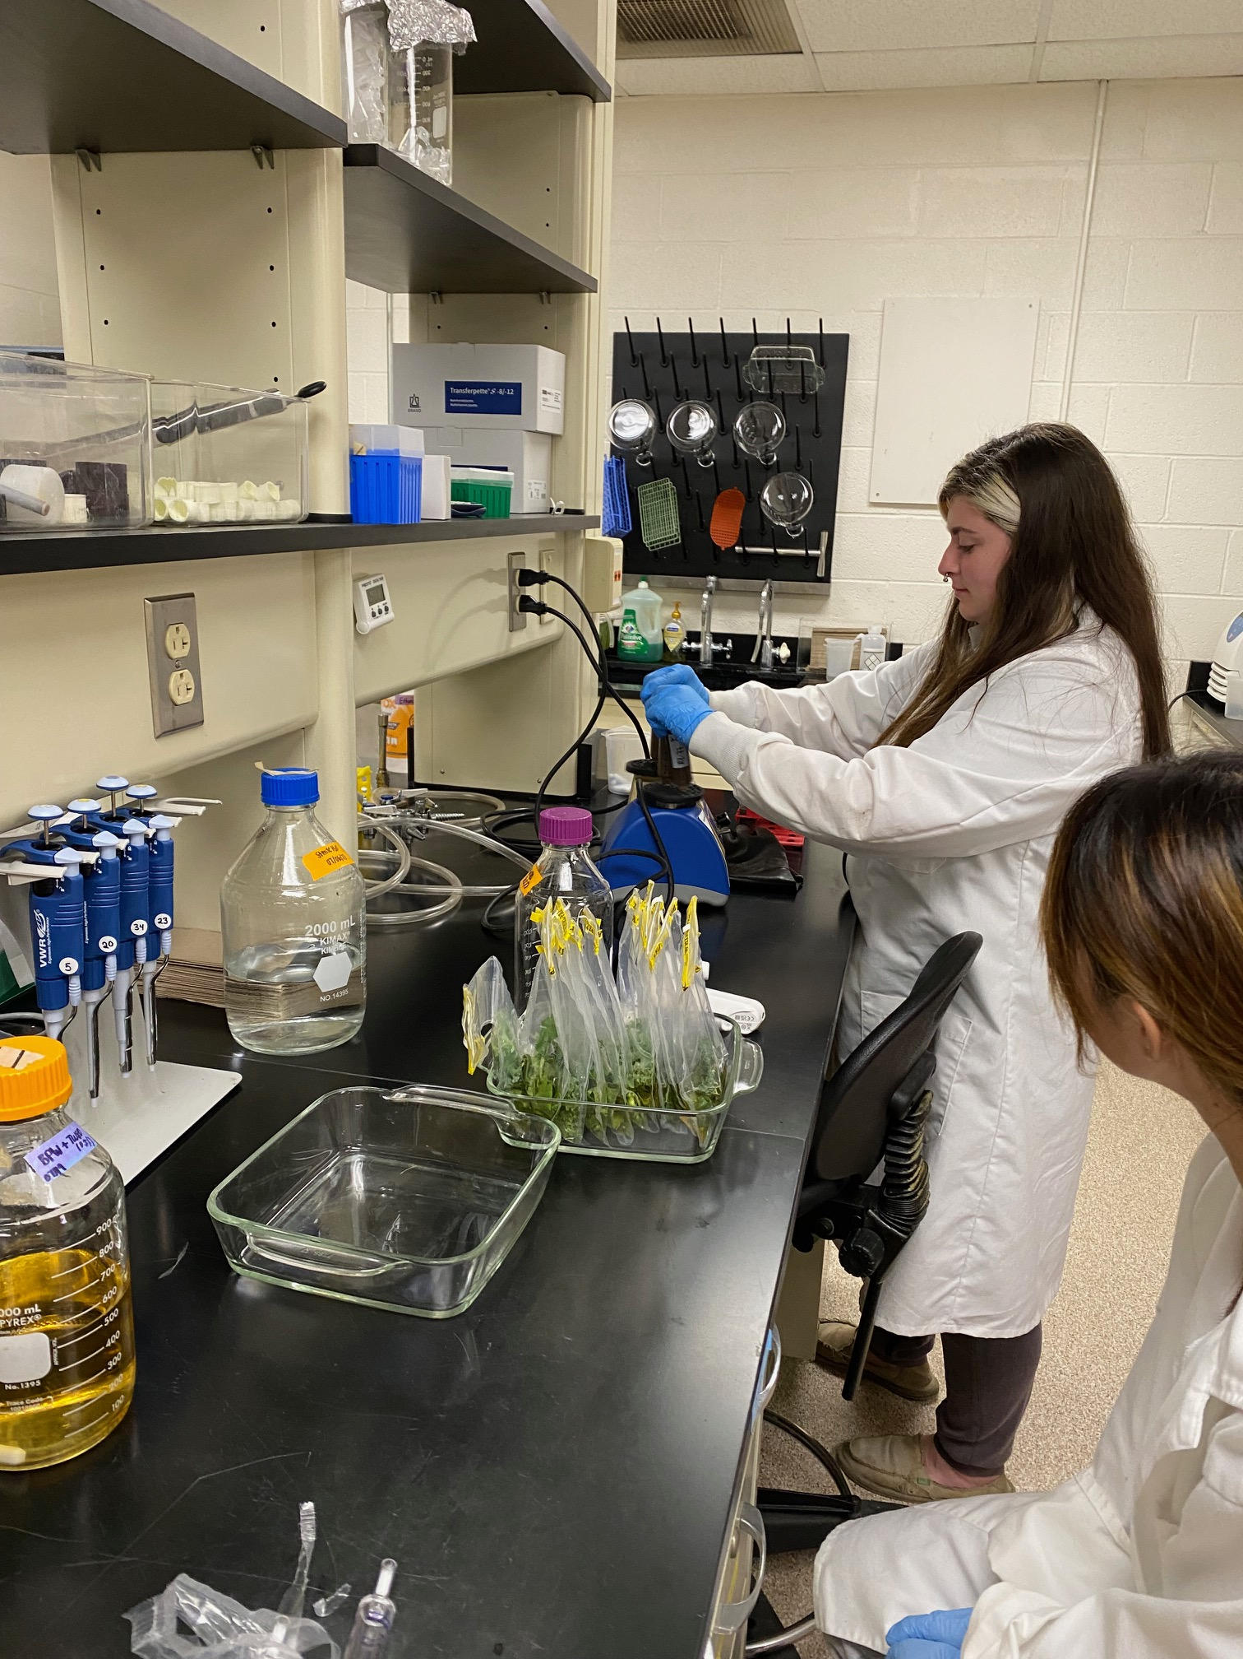
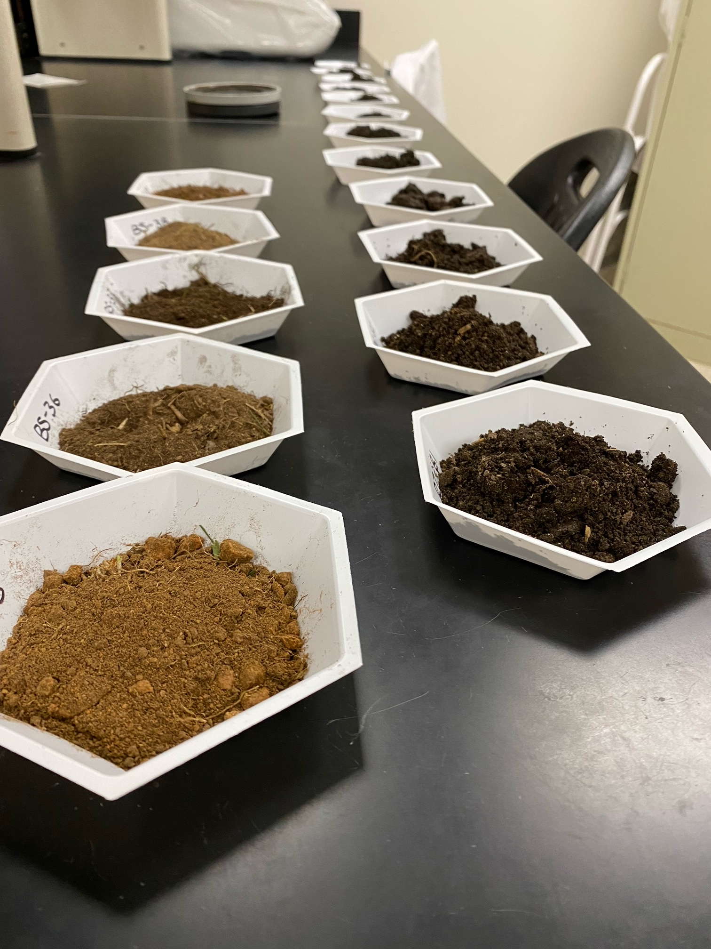
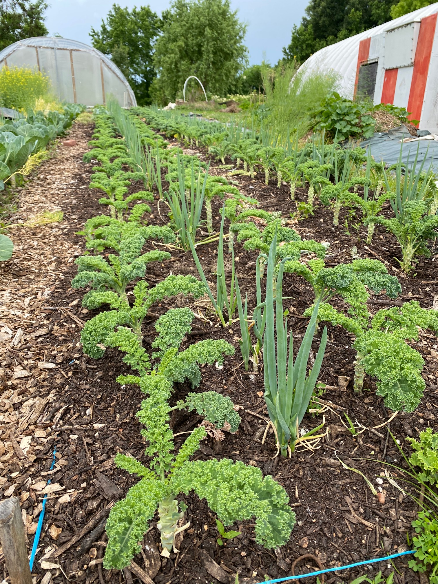





Antimicrobial Resistance in Urban Agriculture Environments
Qingyue Zeng, Kevin Lam, Autumn Salcedo, Derek Konsen, Ryan Blaustein; Dept. Nutrition & Food Science, UMD
Background
Results
5. Within-site variation on produce based on vegetable type
Urban farming offers many benefits from engaging communities to expanding local food production
Contaminants reflective of unique land history and local conditions (e.g., heavy metals from industrial emissions) can create challenges for growers
Organic soil amendments are often used to boost biological activity and manage depleted soil health
Antimicrobial resistance (AMR) dissemination, a factor of microbe-chemical interactions and broader ecological dynamics, has implications for ’one-health’
Hypothesis: Organic amendments have added-value to control naturally occurring antibiotic-resistant bacteria and, in turn, hold potential for tailored management to establish healthier food systems
1. Beneficial impacts of soil amendments across urban farms is universal
(A) Prime soil bacteria activity
(B) Reduce burdens of AMR
(C) Mitigate food safety risk
F-1 (06/16/23)
F-4 (07/06/23)
F-5 (06/12/23)
**
**
*
**
*
**
**
**
*
**
*
**
**
**
*
**
**
**
Tetracycline Resistance (%)
**P<0.05
*P<0.1
Methods
Seasonality **
(A) Field survey at urban farms (n=5) and community gardens (n=2) to evaluate microbiological variation as factor of site-specific conditions:
  Land history and soil properties (e.g., pH)
  Farm management (e.g., amendments, raised beds)
  Plant-host traits (veggie type, variety, age)
  Seasonality
2. Multidrug resistance patterns in isolates suggest that native soil bacteria, not necessarily transient bacteria, may be responding to chemical stressors
6. Within-site variation on produce based on growth stage
**
**
**
Antibiotics Screened
Ampicillin
Azithromycin
Cefoxitin
Chloramphenicol
Ciprofloxacin
Gentamicin
Tetracycline
F-2 (06/26/23)
**
(B) Samples of leafy vegetables, soil in the root zone, and bulk soil (site controls) were collected and analyzed for total bacteria, food safety indicators, and AMR bacteria (ampicillin, tetracycline)
3. Managing soil properties has applications for controlling AMR
4. Leafy vegetables harbor site-specific ranges of bacteria
Summary
Restoring soil health is crucial for enhancing production of urban farms
Relatively high incidence of multidrug resistance among drug-resistant bacteria in these food systems
Organic amendments boost bacterial activity and have applications to control AMR and promote food safety
Future research on soil and plant microbiomes aims to understand specific bacterial taxa and genes involved in establishing healthy food systems
(C) Representative bacterial isolates were screened for multidrug resistance to antibiotics
q<0.1
AB
A
BC
C
AB
A
A
AB
Spearman rho = 0.530
P < 0.001
Acknowledgement
(D) Bacterial contents and resistance phenotypes across sites and soil types, among other factors, were compared
We thank the participating farms and gardens. This project is supported by MAES award MD-NFSC-232657

