Slide 1
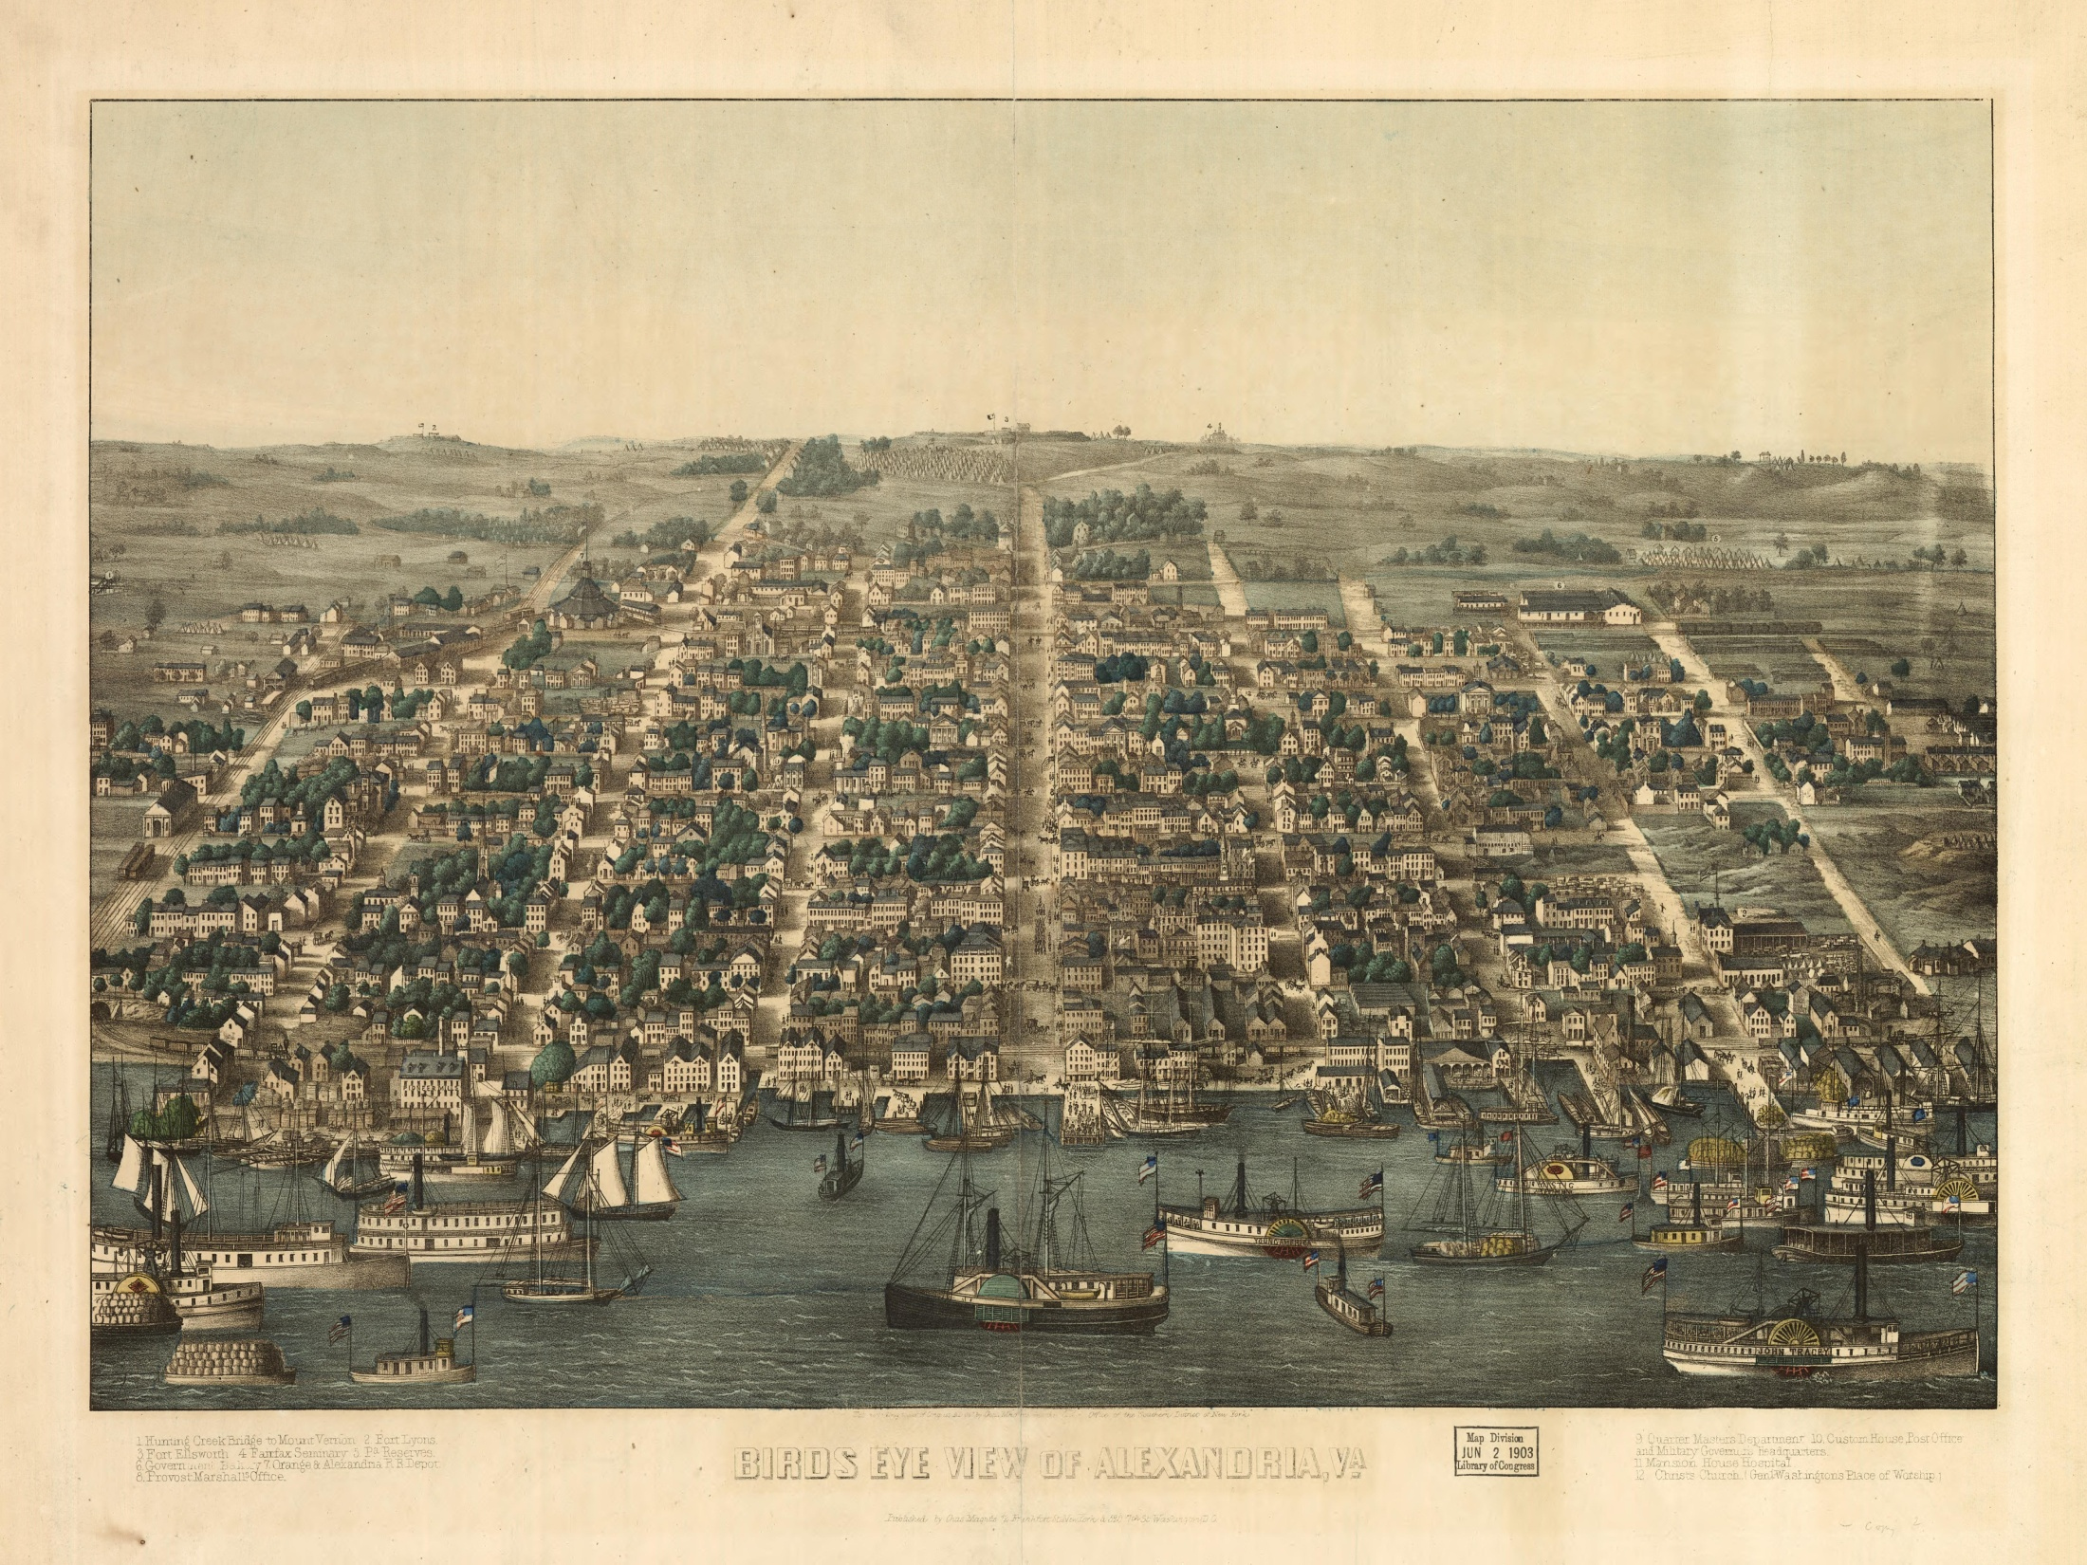
Valuing “Others”: African American Neighborhoods in Antebellum Alexandria
Kate Gastner HISP 711 Fall 2011
Reviewers: Donald Linebaugh, Paul Shackel

Slide 2
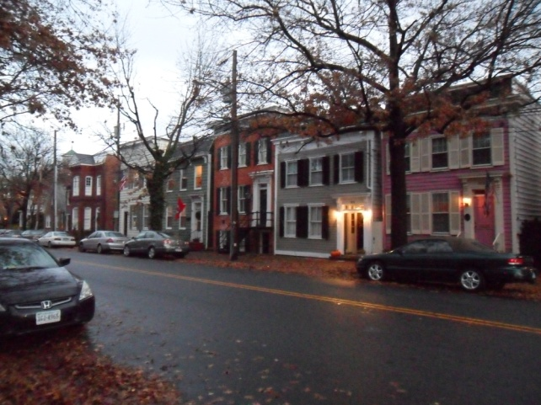
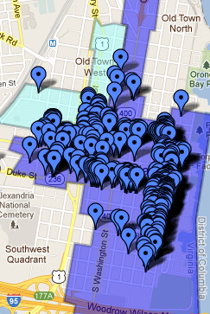
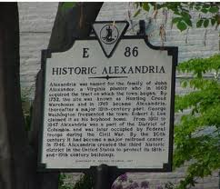
Introduction
Scope/Research Questions
Methodology
  Town Establishment
  African American Neighborhoods
  Legal Situation
Preservation Efforts
Reassessing Values

Slide 3
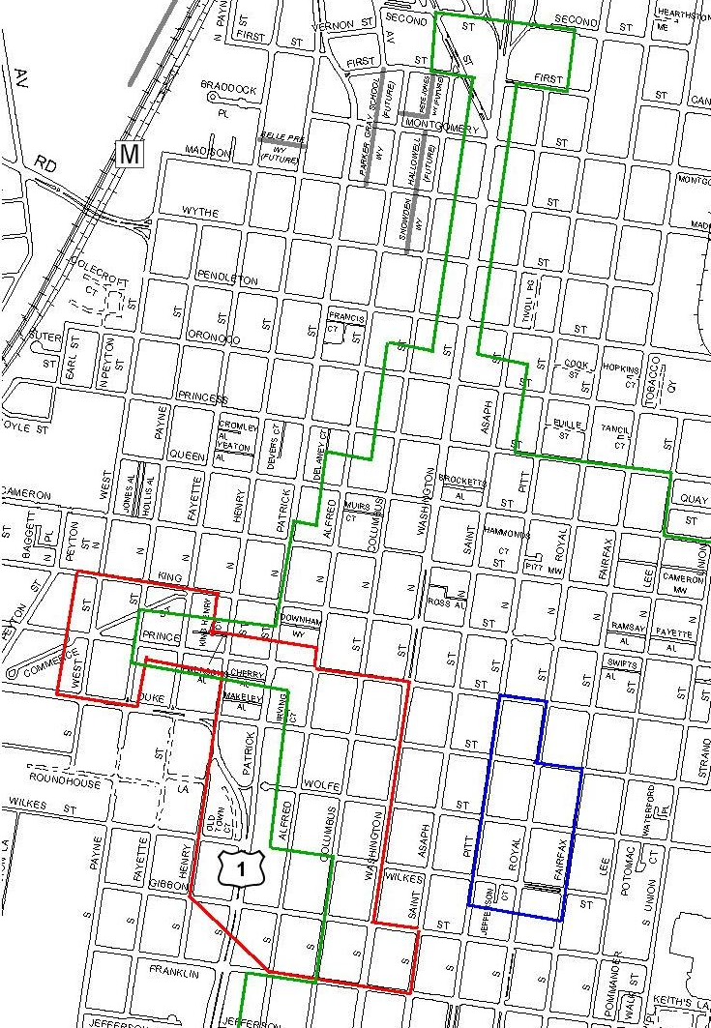
Scope/Research Questions
Scope- 1749-1847
African American
Neighborhoods
Contributing Structures
Legal Situation
Evidence
Official Narrative/Values
Engaging in Preservation

Slide 4
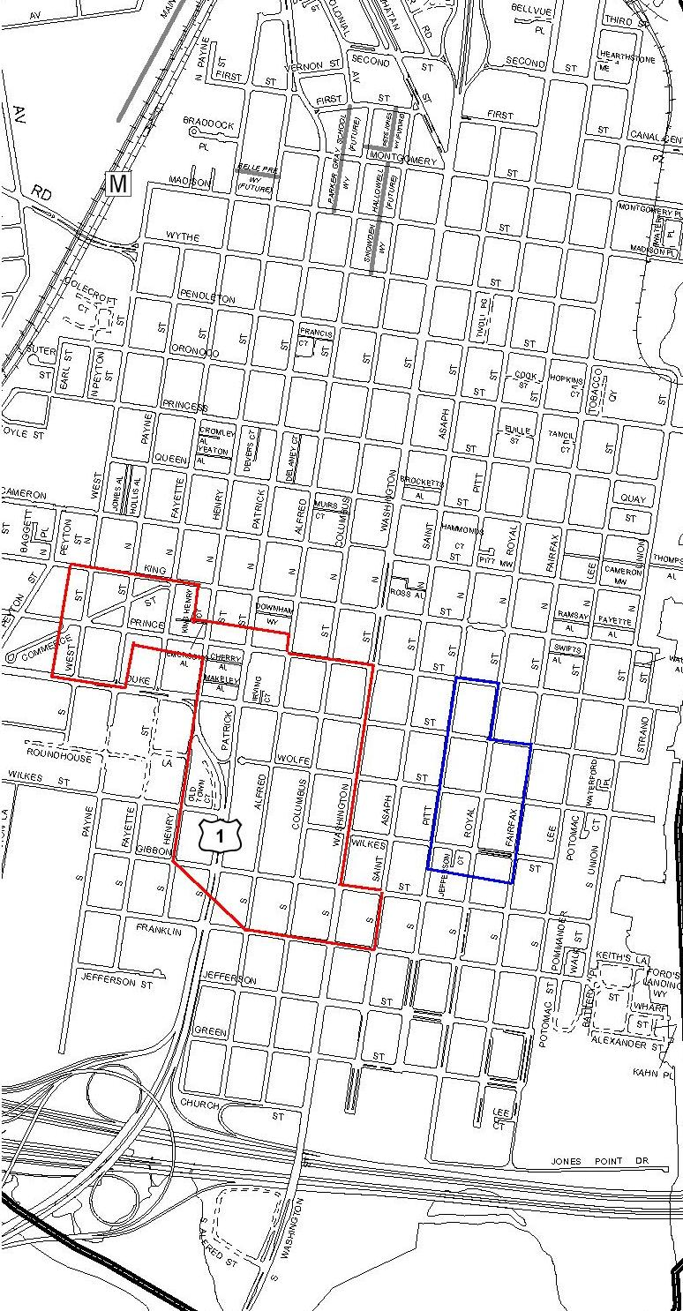
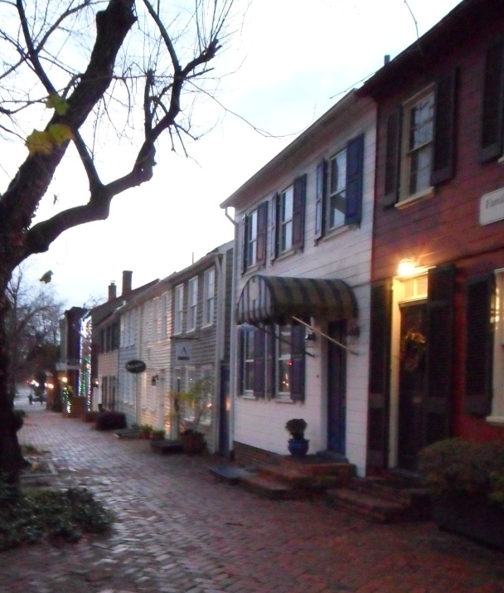
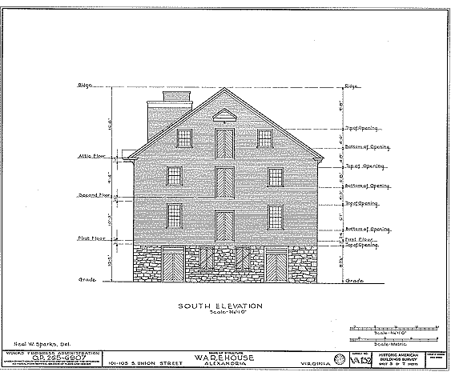
Methodology
Neighborhood Research
Building on Landscape
Preservation Efforts

Slide 5
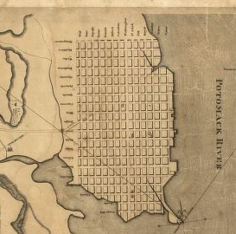
Town Establishment
“Alexandria is built precisely on the plan of Philadelphia and is indeed frequently called Philadelphia in miniature. The houses have a mean appearance. There is ... scarcely one handsome mansion in place. A great many of the habitations are of wood and are called frame houses from their being built in a frame on moveable foundation.”
- English Traveler 1824

Slide 6
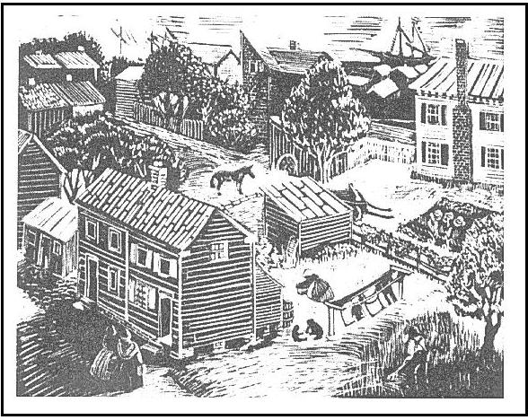
Free African American Neighborhoods: Establishment
Bottoms (1798)
Hayti (1800)

Slide 7
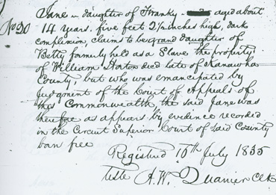
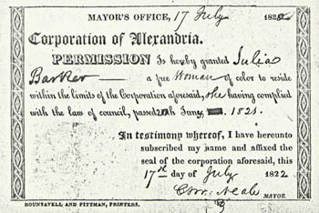
Legal Situation
1800-1847 Subject to DC Laws
Annual Registration
Certificates of Freedom

Slide 8
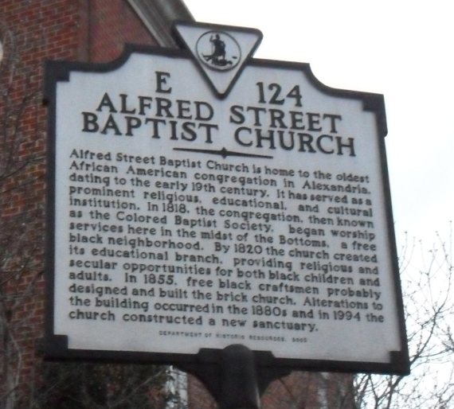
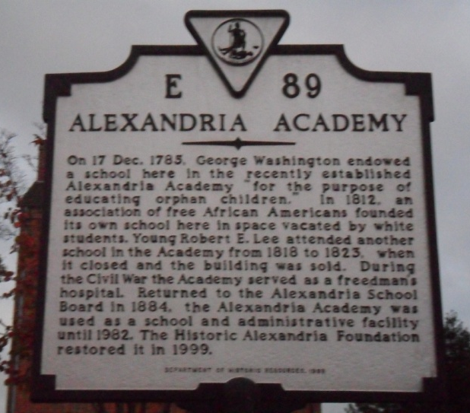
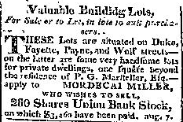
Free African American Neighborhoods: Development
Why Successful?
  Religious Groups
  “Living Out”/ Apprenticeships
  Educational Opportunities

Slide 9
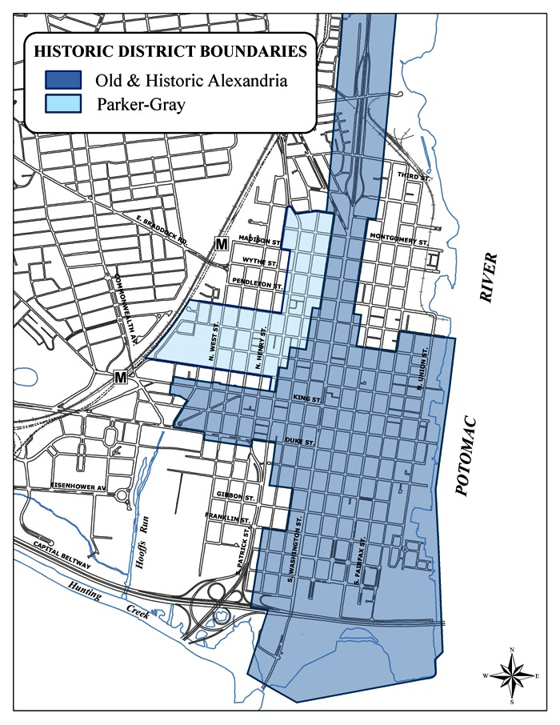
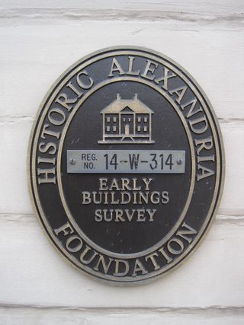
Preservation Efforts
Early Preservation Values
  Significant Architecture
  Military/Political

Slide 10
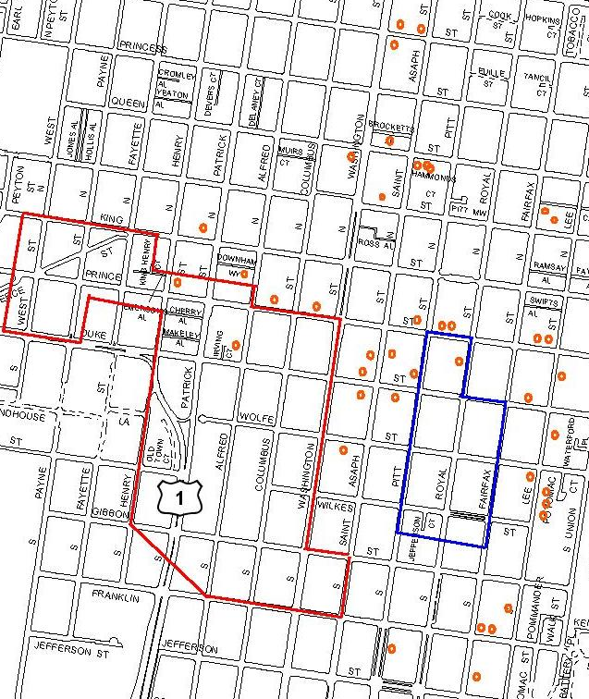
Preservation Efforts
Resources
Two Historic Districts
42 National Register sites
14 Save America's Treasures
Grant Recipients
47 Easements

Slide 11
Preservation Challenges
Gentrification
Interpretation
Local Politics
Public Interest
Importance
Values

Slide 12
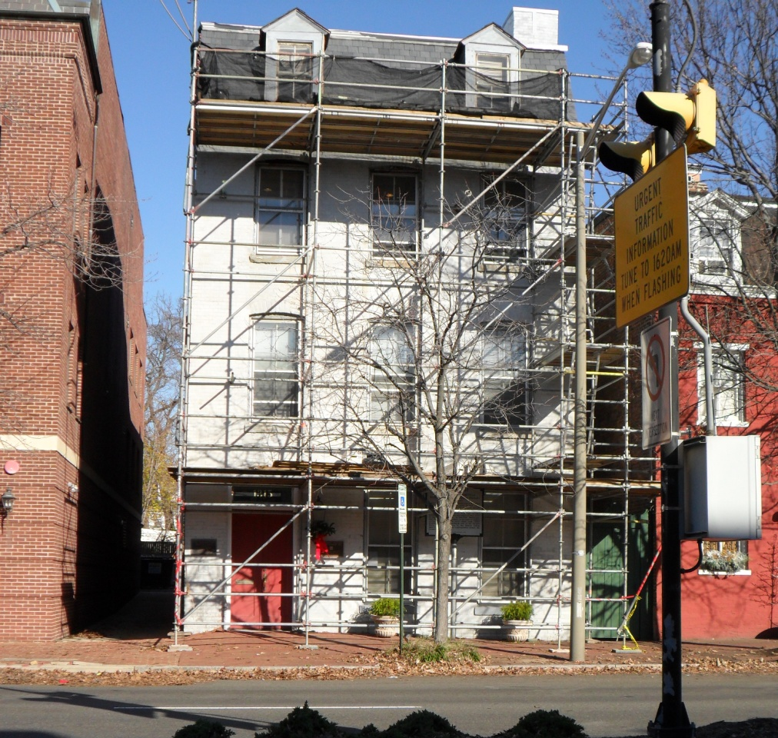
Preservation provides,
"context in which differing points
of view can be explored, diversity
acknowledged, empathy inculcated,
dialogue facilitated, and common
ground defined."

Slide 13
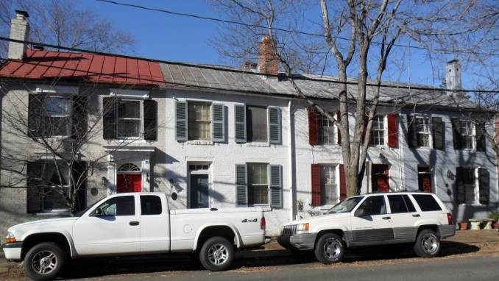

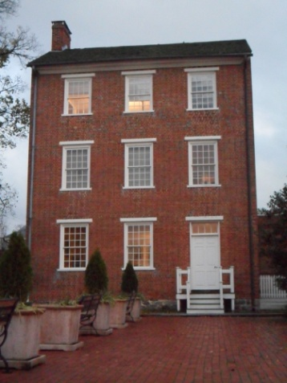
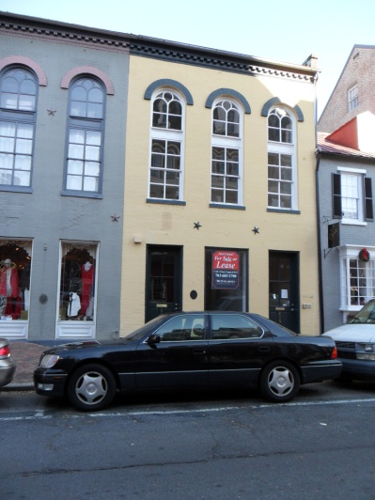
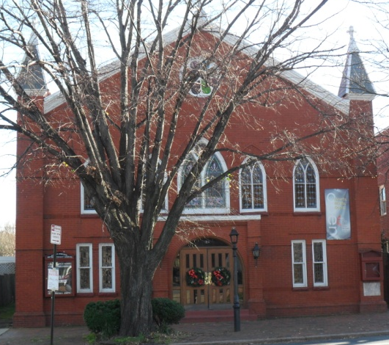
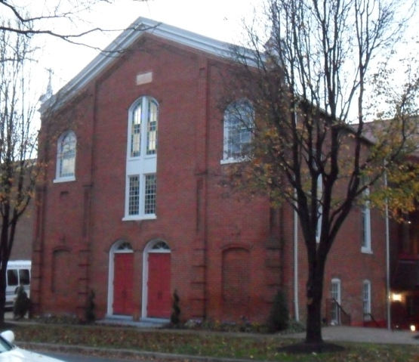
Preservation Efforts
1990-2000
  Master Plan
  Multiple Property Nominations
  Changing Values

Slide 14
Preservation Efforts
Wealth of Resources
Development of Tours/Trails
Future of Preservation?

Slide 15
Conclusion

