Slide 1
Teaching Critical Citation
Empowering Students and Researchers Through Citation Practice
Jodi Coalter, Life Sciences and Outreach Librarian
Suzy Wilson, Teaching and Learning Librarian

Slide 2
Table of contents
The Theory
01
Issues & Solutions
02
What we taught
03
Exercise
04
What is critical citation? Why is it important?
Introduction to some issues in critical citation.
Teaching younger students (freshman and sophomores)
Why is citing important?

Slide 3
01
The Theory
What is Critical Citation?
Why is practicing it important?

Slide 4
What is it?
It’s regular citation, but...
Notes:
Citing based not just on content, but also on identity (race, gender, sexual orientation, ethnicity, etc)
So, for example, choosing to cite Black researchers in your field more often.

Slide 5
What Is It? Continued
Race
Power
Citation
Notes:
Based on critical race theory - which was originally developed to look at the intersection of race, power, and law
Obviously, we’ve incorporated the intersection of race, power, and citation
We also expanded it to encompass not just race but other issues that are tied in as well, including gender, immigration status, etc.

Slide 6
Why is it important?
Notes:
Many (all?) academic institutions, from citation practice to tenure, are designed within the system of white, male, cis-heteronormative supremacy.
This has made it incredibly difficult for women, People of Color, and LGBTQ+ academics to make and keep a career in education.
In several fields, white males are cited more frequently than literally anyone else, even by people who don’t identify as white male.
So, for example, Black women researchers still cite white men more than they cite others.
This has long term implications for academia - if these people aren’t being cited, then they are less likely to be promoted/achieve tenure, they are less likely to be represented in their profession, they are less likely to stay in academia, and, therefore, are less likely to be in the classroom - this has huge implications!
Choosing to cite these people, therefore, is an attempt at equality.

Slide 7
Issues
In depth
Notes:
In order to cite these people, you have to identify them. There are a whole slew of issues that come with this.

Slide 8
In depth
Race
Gender & LGBTQ+
The “Classics”
Sight based
Binary
Identification
Deadnaming
“You have to cite them! They’re an essential classic!”
Notes:
Race
If a researcher doesn’t come out and tell you, “I’m x” then you are making a judgement call based entirely on sight.
This is generally ok - since race is a social construct that makes all judgements based on sight, you are literally following the definition of race.
However, this can be tricky in the absence of photos or if someone identifies as Black but has light skin, etc.
The more troubling aspect is that it does reduce race to a binary - Black and white
There are people who are racially profiled who don’t fit this binary, such as Hispanic, Latino, Middle Eastern, Indian, Asian (these ethnicities may be impacted by race stereotypes, even though they are not Black).
Gender and LGBTQ+
Like race, one problem is identifying someone
Also, is it important that they be identified? Why are you choosing this topic? Does your field have a problem with LGBTQ+ representation in academia?
Deadnaming is probably the biggest problem
The Classics
Data Feminism, they attempted to cite more people from marginalized communities
Set goals and regularly audited themselves
Open peer review
At each step of the review, they were asked “why didn’t you cite important researcher x?”
Over the course of the editing process, due to this feedback, the percentage of authors from these communities decreased in favor of white men, despite their efforts.
Misc.
Mixing up race and ethnicity, pushback

Slide 9
Finding Solutions
Research Databases
Social Media
Networking
Auditing
Cite Black Authors
Follow your favorite researchers
Keep tabs on people you meet. What are they publishing?
Set Goals!
Keep Track!
Notes:
Solutions
Folks are putting together lists of self identified researchers in their field.
For example: Cite Black Authors
Researchers often identify themselves on social media
A little stalkerish, but it’s actually becoming an accepted practice, especially on Twitter & Instagram
Networking, networking, networking
White men set up “citation pacts”
I will cite you if you cite me.
Obviously we discourage this, but networking is important in research/academia.
Find someone you really respect and who does great work in your field.
Follow them on ResearchGate
When they publish something, center their paper before you read a white man’s
Cite that paper.
Auditing - even despite the trouble, it still keeps you on track and you still end up citing more often
Publishing - make the process known!

Slide 10
03
What we taught
Putting the theory into practice
Notes:
We wanted students to invest in citation and feel how powerful it can be.
Giving credit where credit is due can be an incredibly powerful experience.

Slide 11
Lesson plan
Introduction to Citation
Ac
3rd event
4th event
Citation Activity
Critical Citation
Tools for Critical Citation
What is citation and why is citation important?
Students create their own citation style
Resources for auditing
How can citation challenge power?

Slide 12
Citation power exercise
Visit muralsdcproject.com
Visit menti.com, enter code “9290 5165”
Notes:
Do the exercise!

Slide 13
Framing the Activity
Learning Goal: Students will create a mock citation style, based on MuralsDC, in order to model the creation and revision of standard citation styles.
Audience: Undergraduate students (OMSE UPP Workshop & GEMS 103)
Learning Tools Used:
  Mentimeter (gathering citation criteria and polling)
  Zoom (breakout rooms for discussion)
  MuralsDC (basis for citation style)

Slide 14
Citation Activity Flow
Prior to class, set up 2 slides in Mentimeter or polling software of your choice.
  Slide 1: Open ended response, asking “Talk in your small groups - which elements would you like included in our citation style”
  Slide 2: Ranking slide, leave blank. (Facilitator will enter the elements that the students supply on slide 1 in real time)
Ask students to open MuralsDC and menti.com with appropriate access code
Display first Mentimeter slide. Split into breakout rooms and ask student to submit three elements they would like to see in a citation style for the murals to the Mentimeter poll.
While students are working in small groups, facilitator enters citation elements into Mentimeter ranking slide in real time
Close breakout rooms. Open the ranking slide. Ask students to rank citation elements in the order meaningful to them.

Slide 15
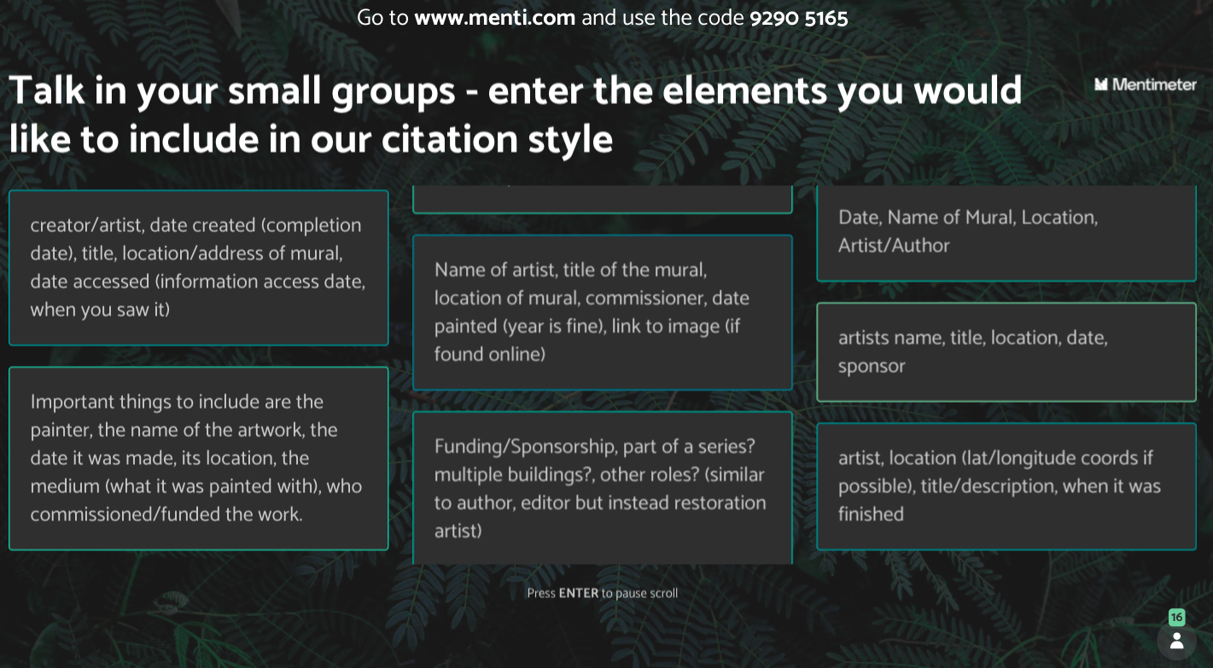

Slide 16
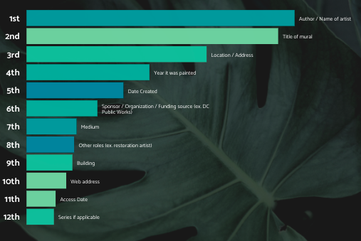

Slide 17
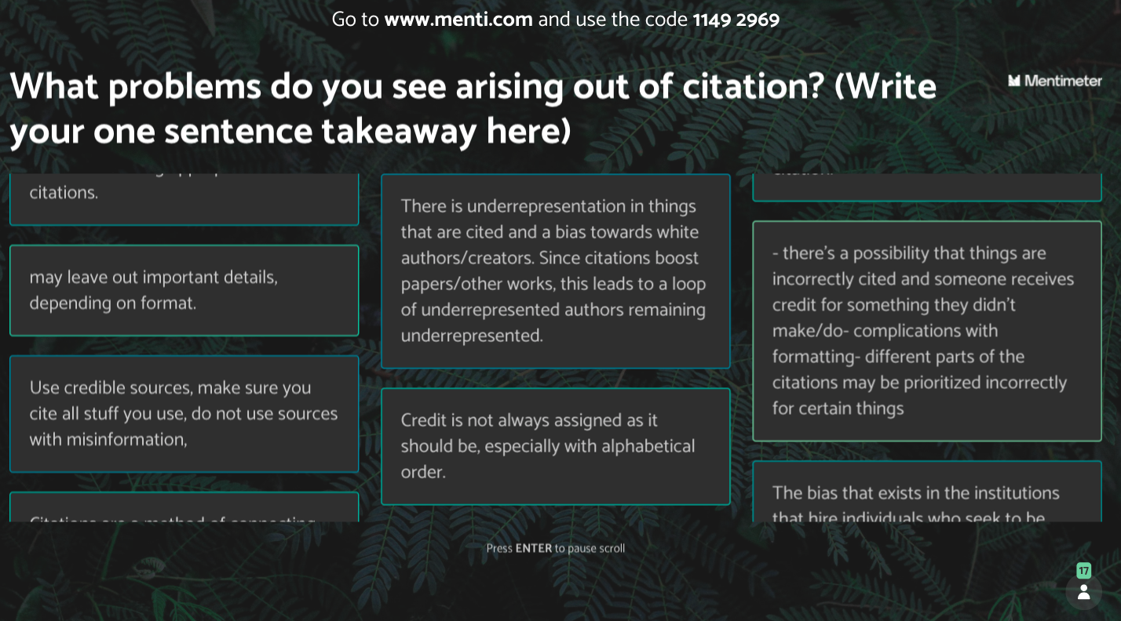

Slide 18
Critical Citation Resources
Cite Black Authors – A database for academic research by Black authors. (n.d.). Retrieved June 1, 2021, from https://citeblackauthors.com/
Delgado, R., & Stefancic, J. (2017). Critical Race Theory: An Introduction (Third). NYU Press.
D’Ignazio, C., & Klein, L. F. (2020). Data Feminism. MIT Press.
Guzmán, R. L. (2020, June 10). How to Cite Like a Badass Tech Feminist Scholar of Color. Medium. https://points.datasociety.net/how-to-cite-like-a-badass-tech-feminist-scholar-of-color-ebc839a3619c
Mott, C., & Cockayne, D. (2017). Citation matters: Mobilizing the politics of citation toward a practice of ‘conscientious engagement.’ Gender, Place & Culture, 24(7), 954–973. https://doi.org/10.1080/0966369X.2017.1339022

Slide 19
Thank you!
Questions?

