Slide 1
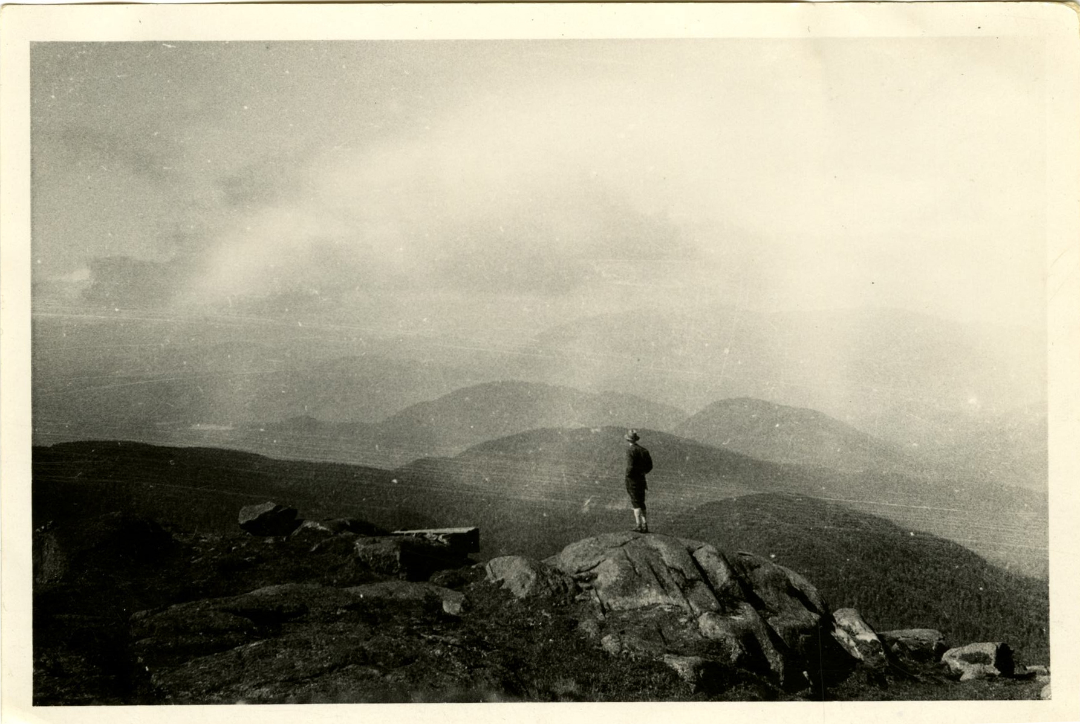

Seven minutes to Digitize and Describe
An approachable, hands-on metadata workshop
India Spartz, Head of Special Collections and Archives, Union College
Abi Simkovic, Project Archivist/ Project Manager, Union College
Notes:
Intro slide

Slide 2
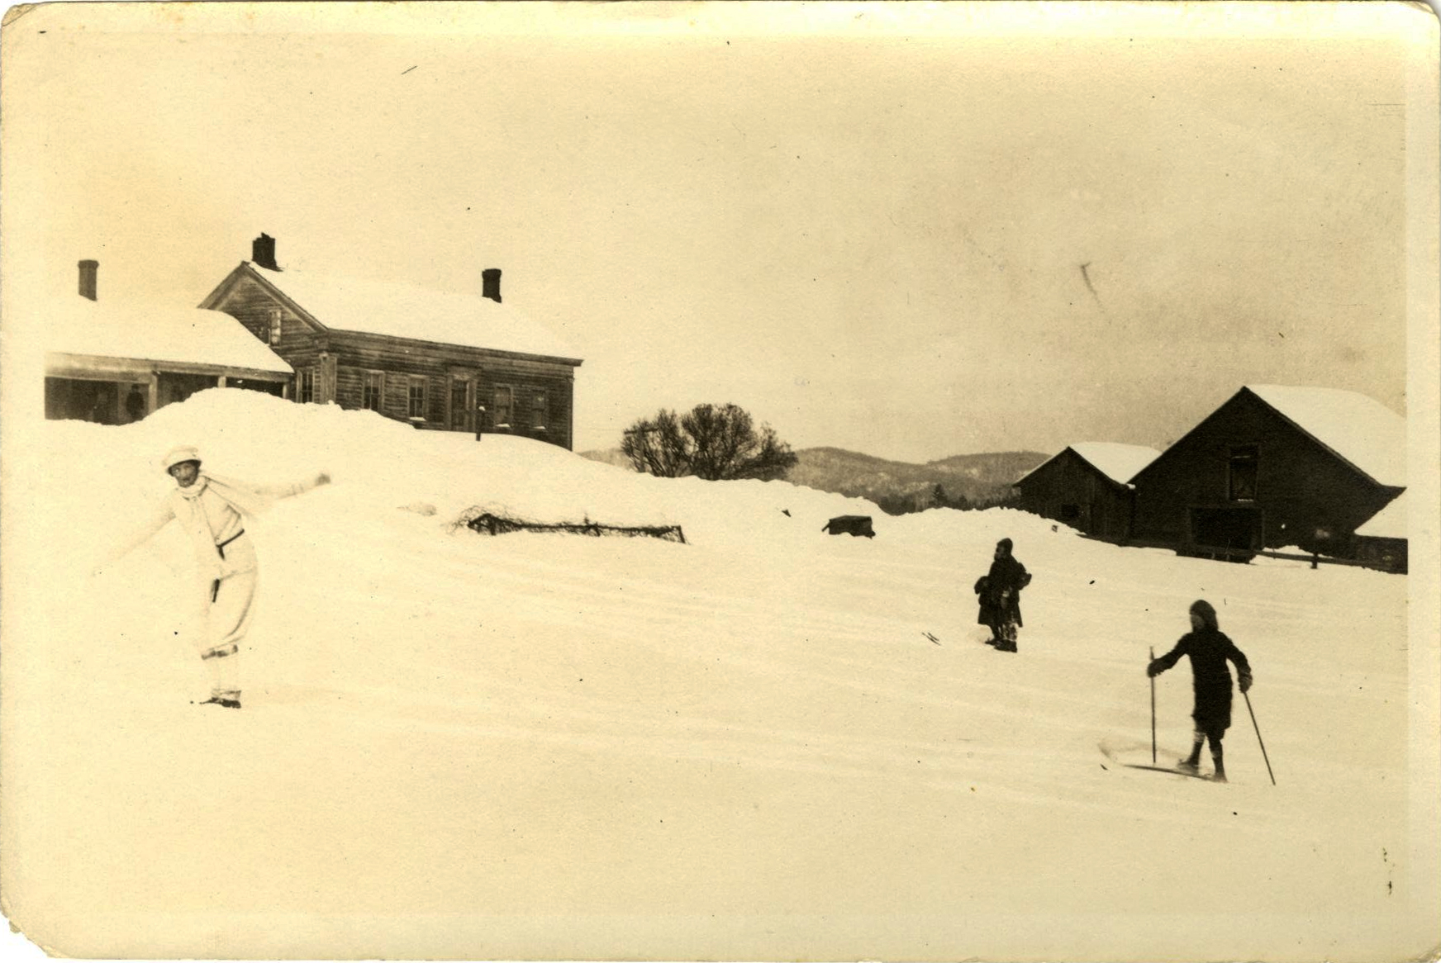
Our Project
Project Title: Grass Roots Activism and the American Wilderness: Pioneers in the Twentieth Century Adirondack Park Conservation Movement.
  CLIR Hidden Collections Cataloging grant awarded in 2013.
Project Scope:
  The John S. Apperson Jr. papers (1878-1963) and the Paul Schaefer Collection (1908-1997), totaling 210 cubic feet.
Digitization Within the Project:
  Selective with a minimum of 500 objects.
  Showcased via scholarly website featuring undergraduate research.
  Disseminated via outside digital catalogs New York Heritage and DPLA.

Slide 3
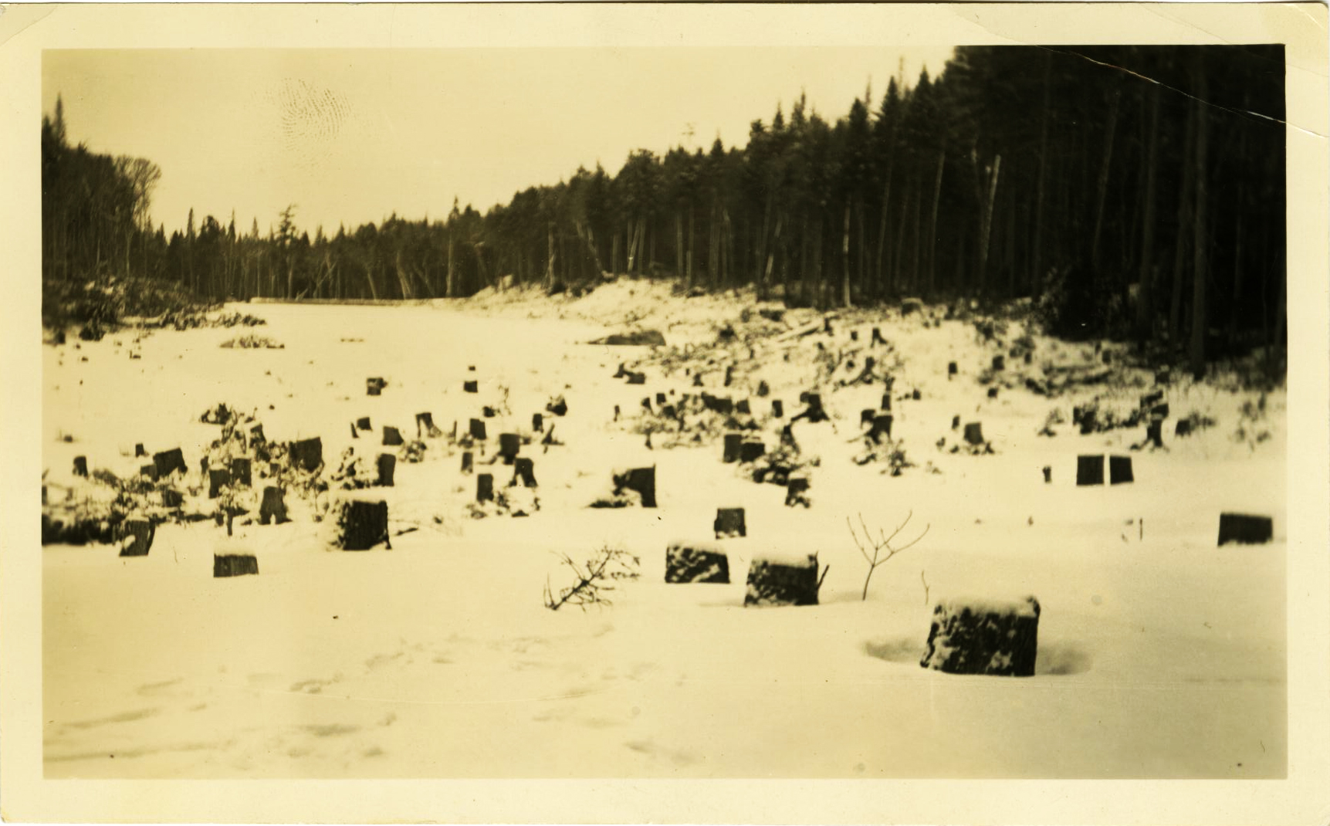
Metadata Development
Surveyed practices of successful, established institutions.
New York Heritage Metadata Dictionary and Best Practice.
Studied search capabilities of chosen digital catalogs.
  DPLA: Controlled vocabulary terms become disarticulated, only Title and Description fields are full-text searchable.

Slide 4
Our Final Metadata Fields
Collection ID
Contact Information
Creator
Date
Date of Digital
Description
Digital Collection
Filename
Format of Digital
Holding Institution
LCSH Subjects
Library Council
Local Location
Location
New York Heritage Topics
Physical Description
Physical Format
Publisher of Digital
Rights
Technical Data
Title
Type

Slide 5
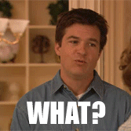

Slide 6


Slide 7
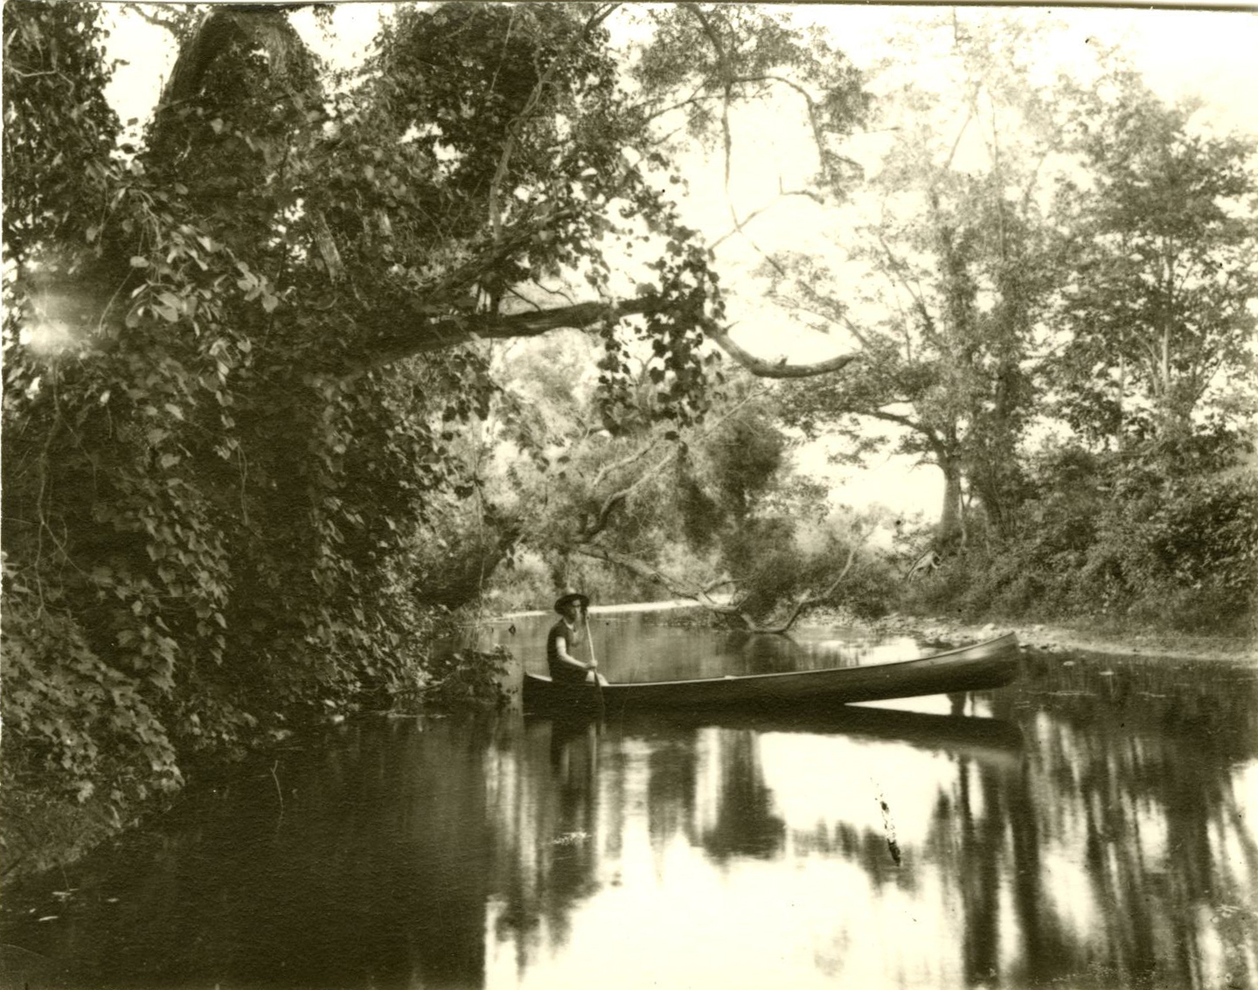
Divide and Conquer: Step 1
Default:
  Collection ID
  Contact Information
  Digital Collection
  Format of Digital
  Holding Institution
  Library Council
  Publisher of Digital
  Rights
  Technical Data
Discrete:
  Date
  Date of Digital
  Description
  Filename
  LCSH Subjects
  Local Location
  Location
  New York Heritage Topics
  Physical Description
  Physical Format
  Creator
  Title
  Type

Slide 8
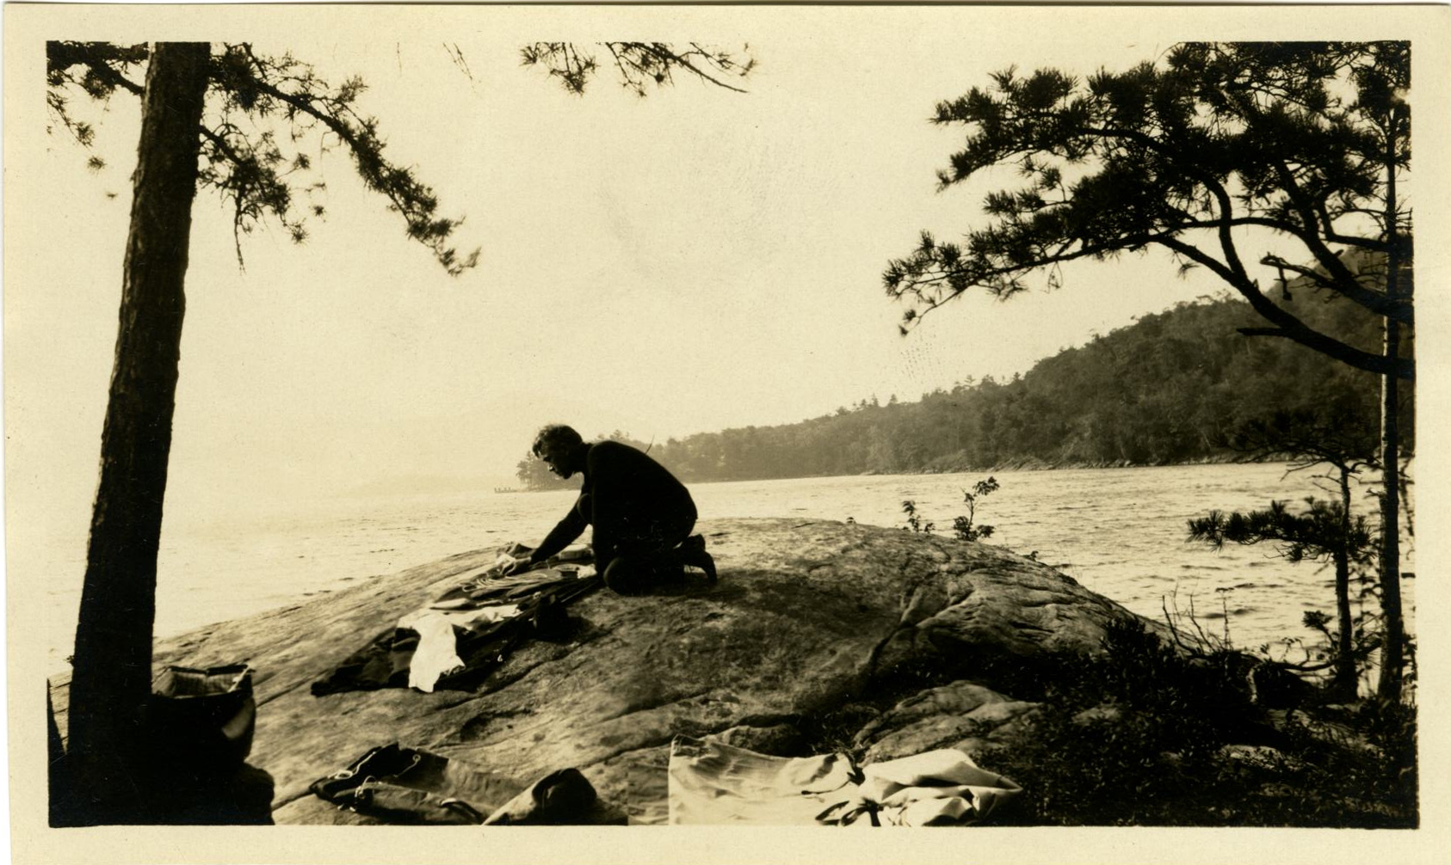
Divide and Conquer: Step 2
Low:
  Date of Digital
  Filename
  Local Location
  Physical Format
  Type
High:
  Creator
  Date
  Description
  LCSH Subjects
  Location
  New York Heritage Topics
  Physical Description
  Title

Slide 9
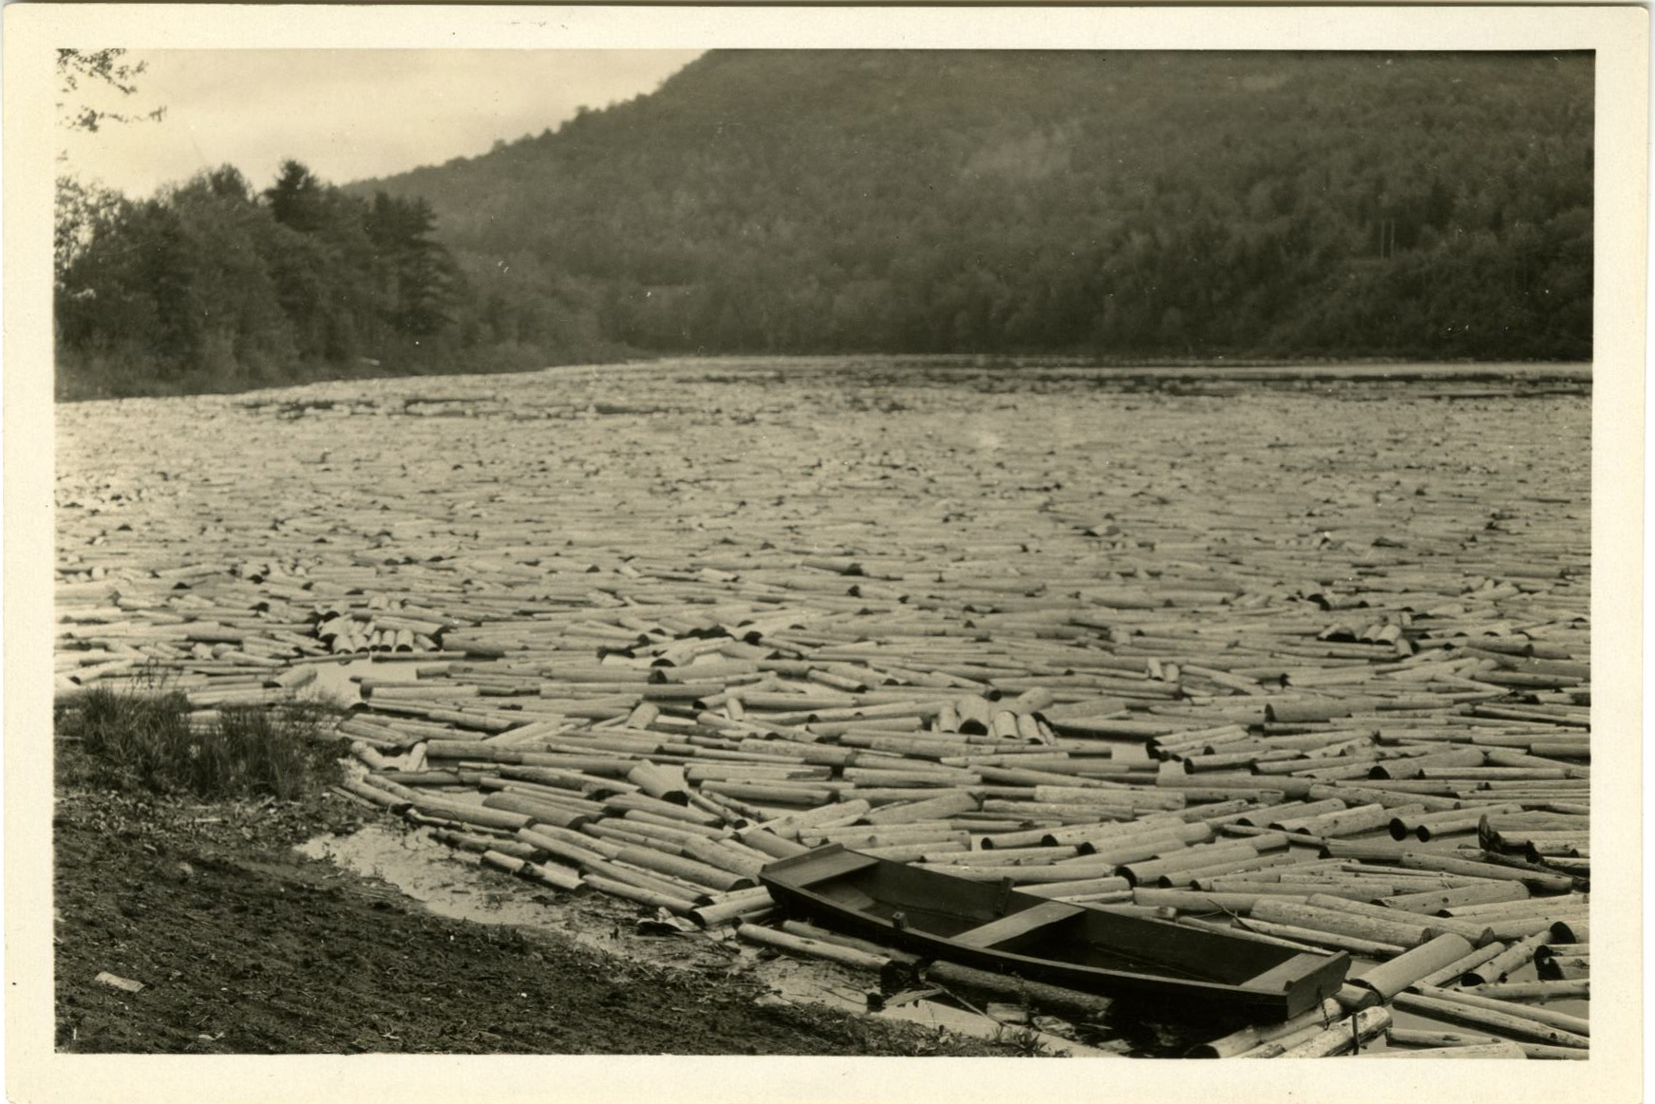
Divide and Conquer: Step 3
Create three spreadsheets, each the width of a computer screen.
1) Graduate Assistant A
• Removes item from folder.
  • Creator
  • Physical Description
  • New York Heritage Topics
  • Description
2) Undergraduate Assistant
• Scans item.
  • Type
  • Physical Format
  • Local Location
  • Filename
  • Date of Digital
3) Graduate Assistant B
• Returns items to folder.
  • Title
  • LCSH Subjects
  • Location
  • Date

Slide 10
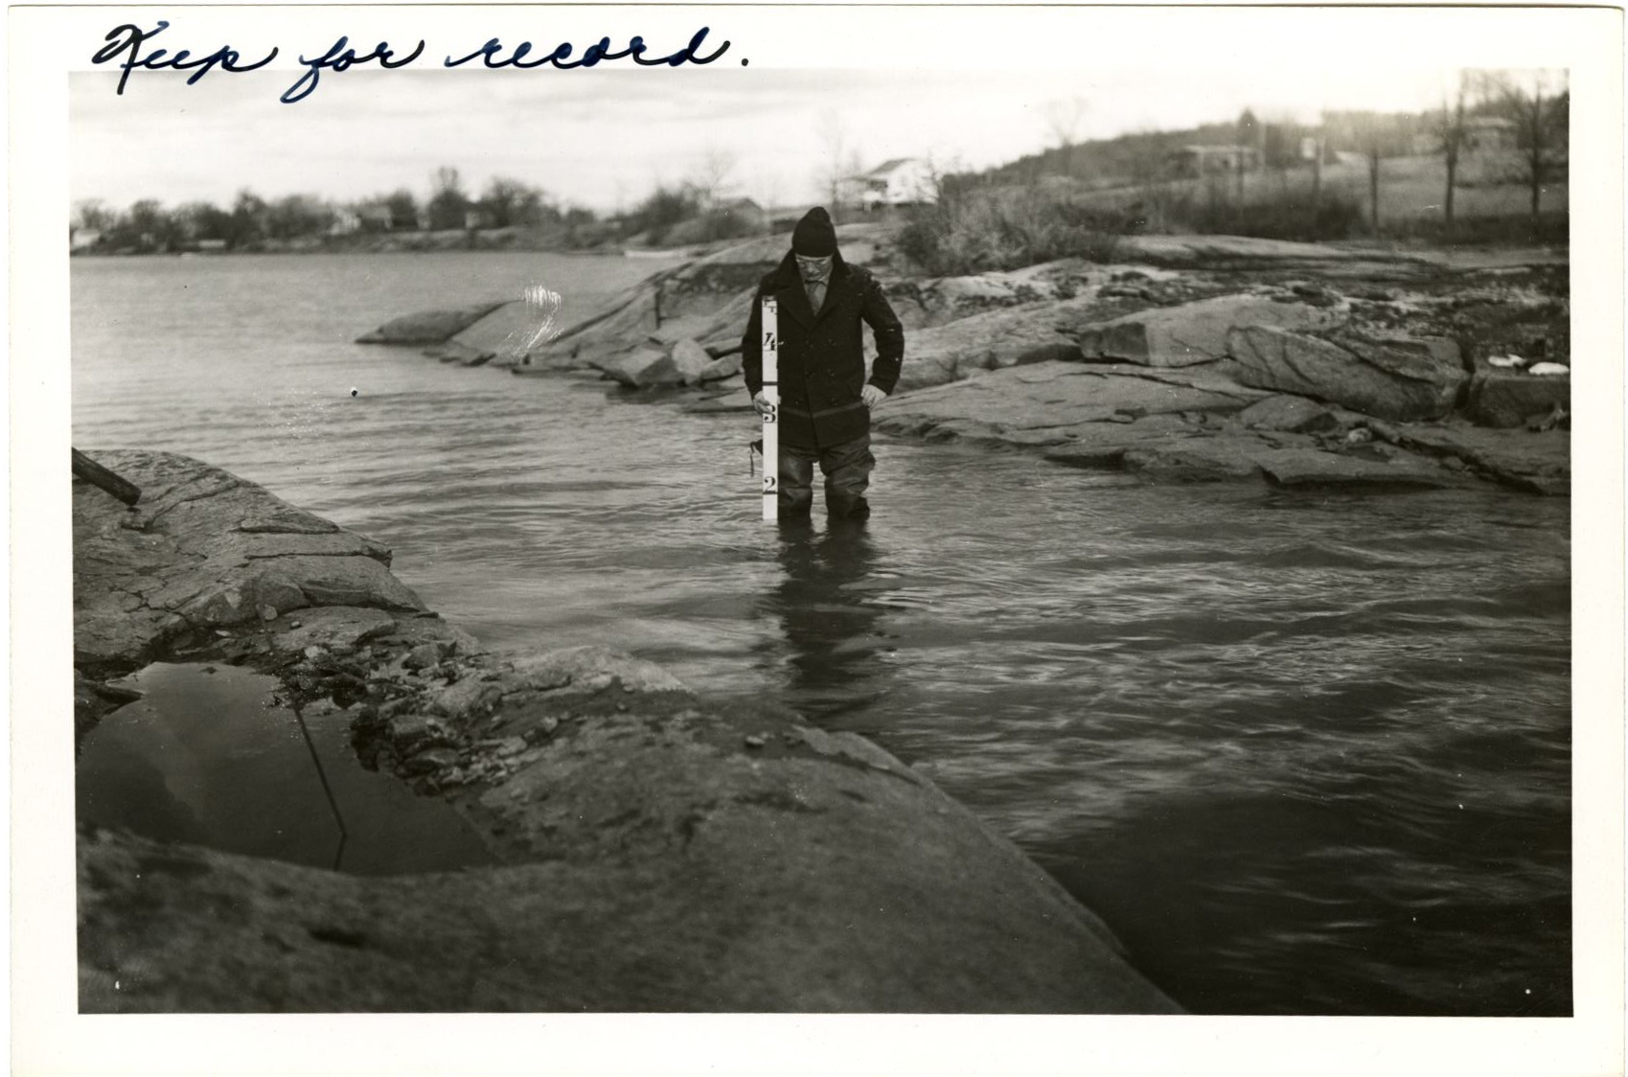
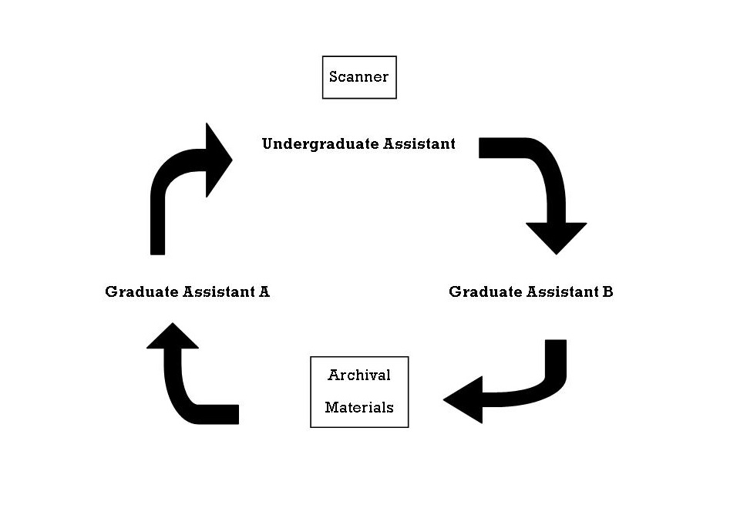

Slide 11
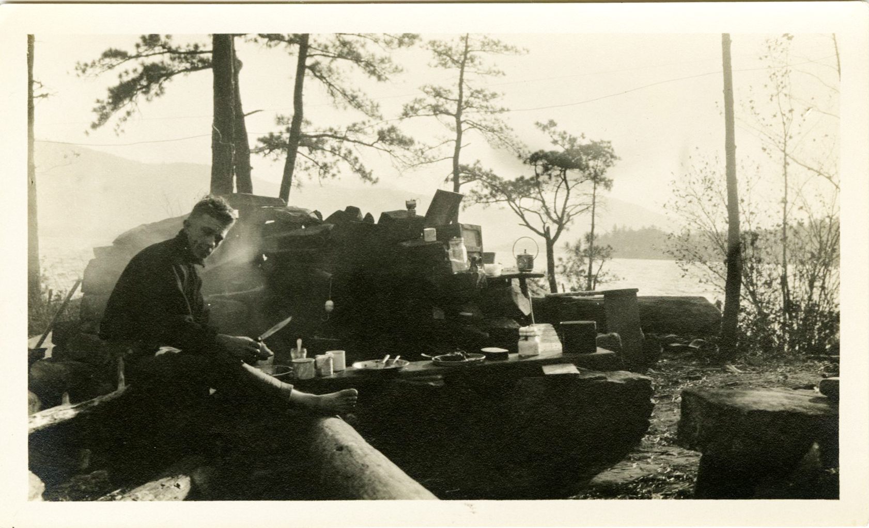
Divide and Conquer: Step 4
4) Project Archivist
Reviews metadata for quality control.
Combines spreadsheets.
Inserts 9 Default Fields
  Collection ID
  Contact Information
  Digital Collection
  Format of Digital
  Holding Institution
  Library Council
  Publisher of Digital
  Rights
  Technical Data

Slide 12
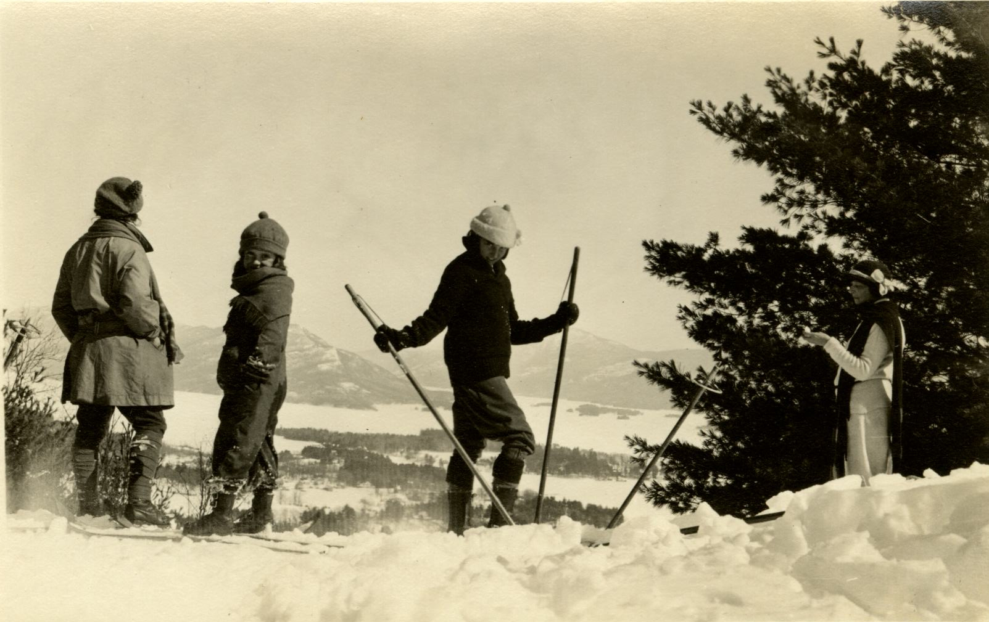
Metadata Reference Guide
Written with language for professionals, para-professionals, students, and volunteers.
Contains definitions, examples, and explanations for each field.
Links to resources.
https://goo.gl/yzVZys

Slide 13
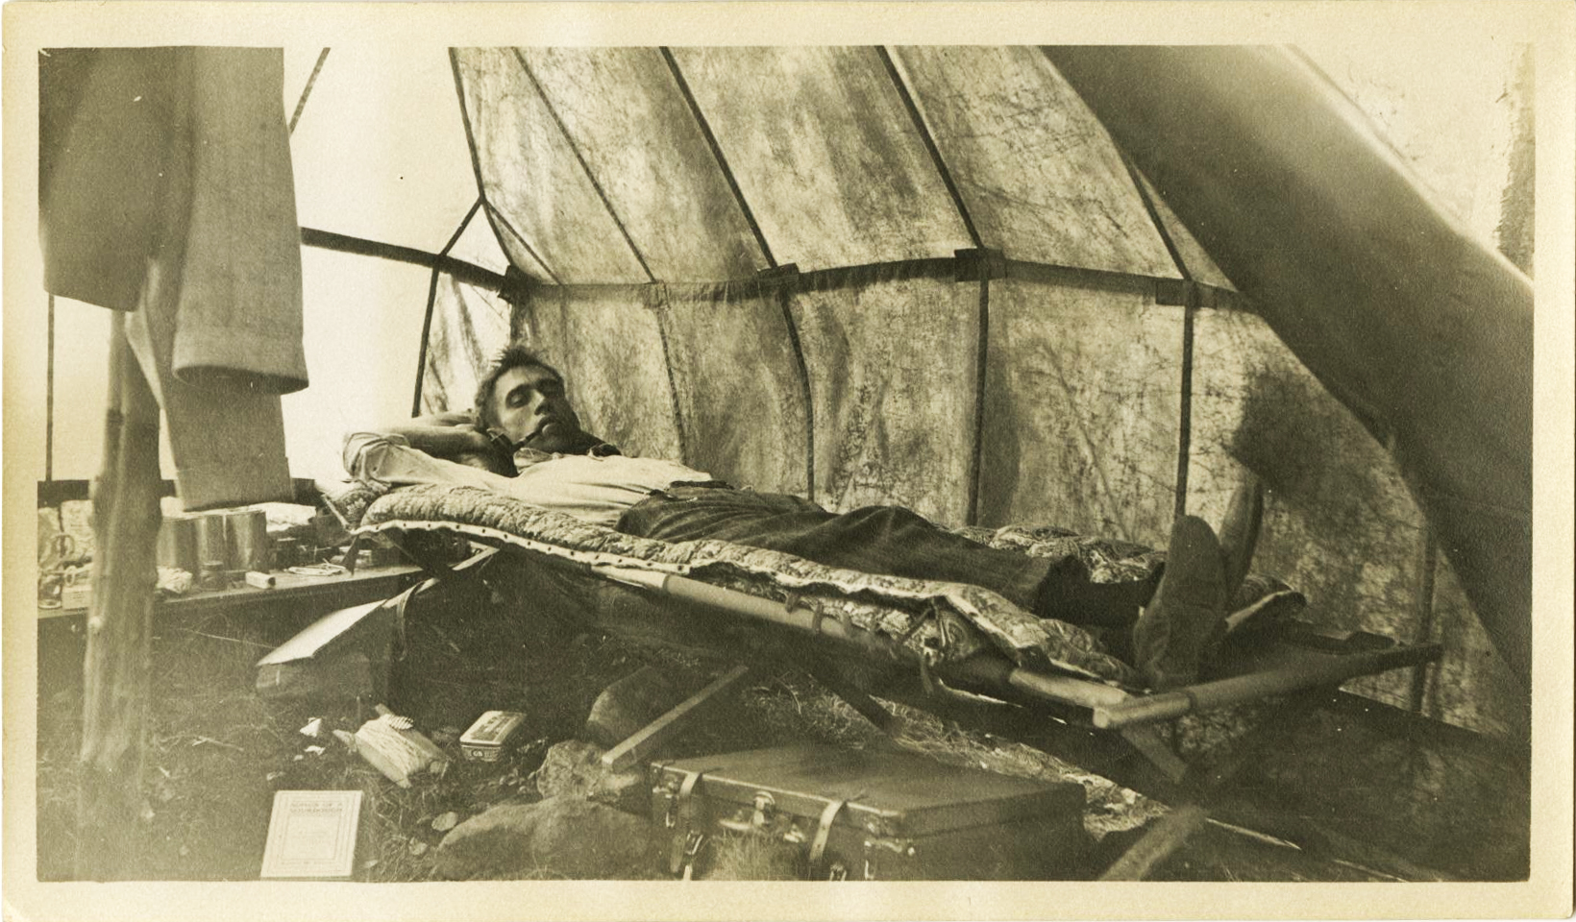
“Metadata Monday” Workshops
Practiced the workflow in analog format.
Created further documentation to support and expedite the workflow:
  Big sign with filename standards.
  Collection specific LCSH vocabulary list.
  Print copy of NYH Topics.

Slide 14
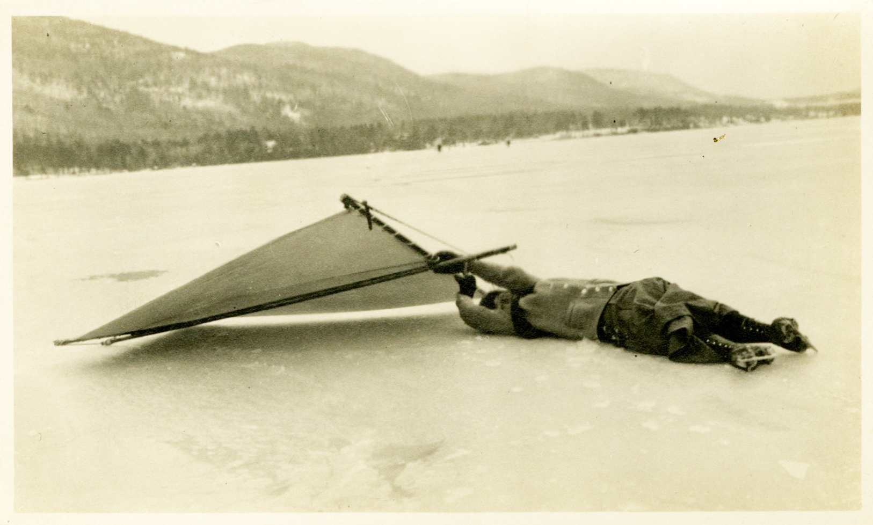
Time to Practice!

Slide 15
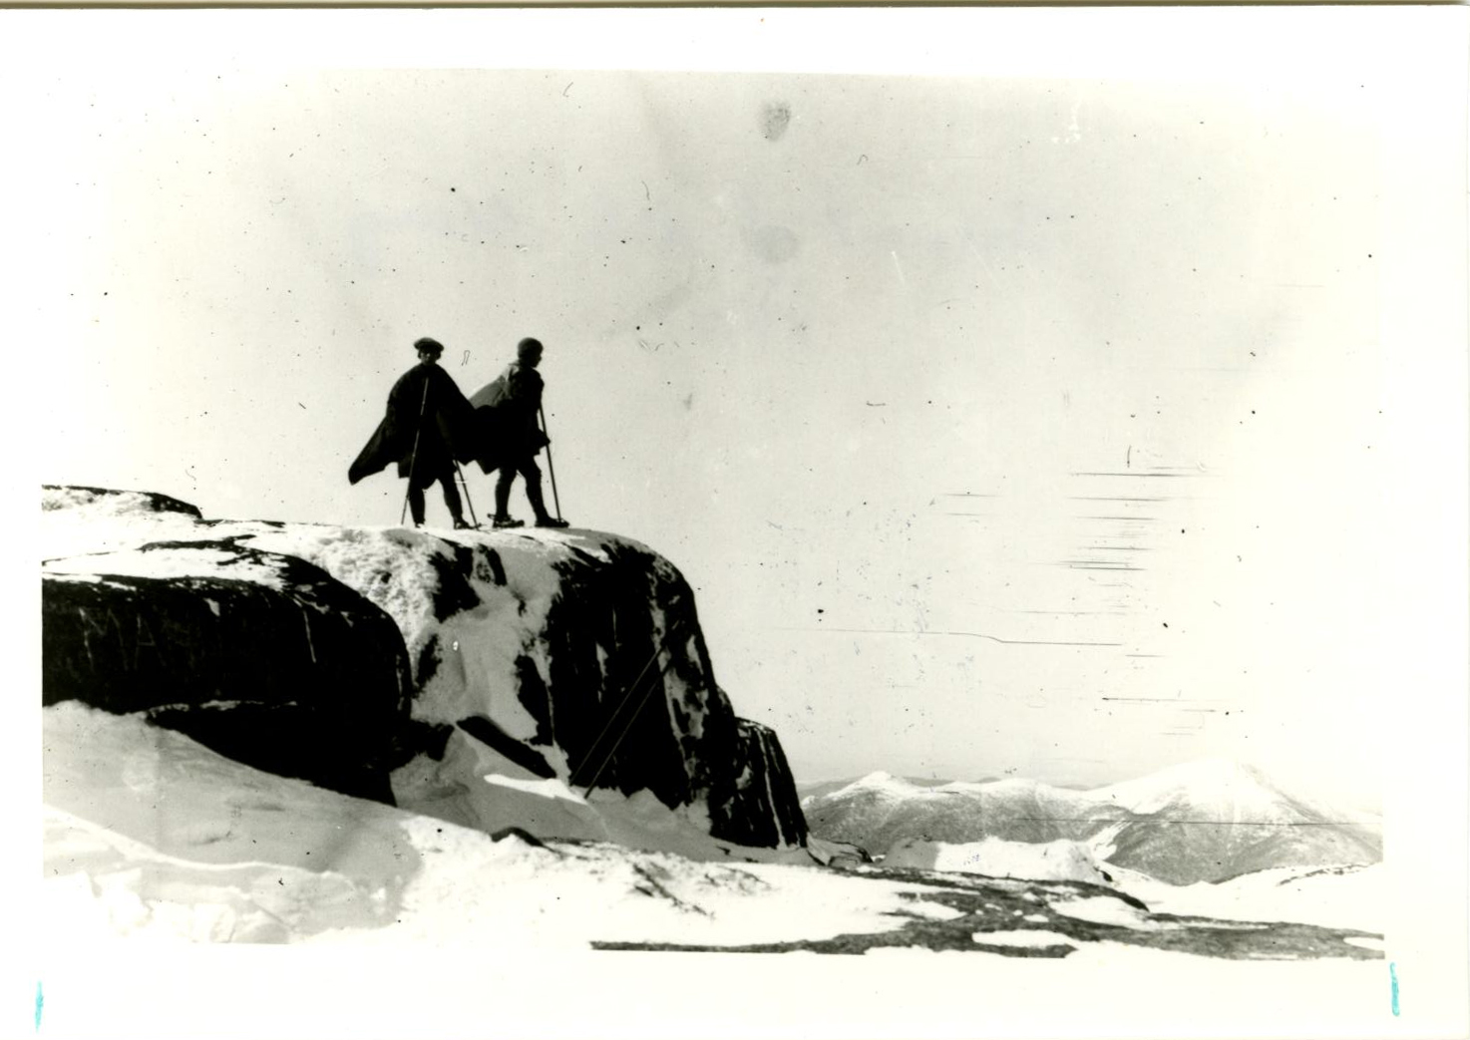
Questions/ Comments

