Slide 1
art, archives and accessions
…accessioning records information about origins, creator, contents, format and extent in such a way that documents cannot become intermingled with other materials held by the archives
Pearce-Moses, Richard. 2005. A glossary of archival and records terminology. Chicago: Society of American Archivists.
Meghan Petersen - Librarian and Archivist
mpetersen@currier.org
Notes:
My remarks are specific to the acquisition and accessioning of material into the archives and specifically the issues around donations which might logically find a home in either the archive or the museum collection. I will share two examples which highlight some of the issues we’ve been grappling with as an institution in light of the formalization of our archives program.
Background:
archivist hired in 2011 (me).
Museum had no formal archives program (no records management polices or procedures).
2012 established basic records management manual no schedules for individual departments. For the special collections No collection management manual and our collection development plan is in process which means we still have no policies formalized which govern the acquisition and accession procedures.
We have lots of intermingling! Our intermingling extends beyond even the reaches of the archive and crosses into the museum collection.
Archives has become a depository for non art object or non display quality. visual material specifically. Basically material that is not of exhibition quality. It has not been regarded as a collection with distinct goals.
The challenge in this is twofold. There is material in the collection which is out of scope and material which might be more appropriate for the archives than the museum collecton lands in the latter because we lack an intention around our collection. We ae not consistent with our selelction critera.

Slide 2
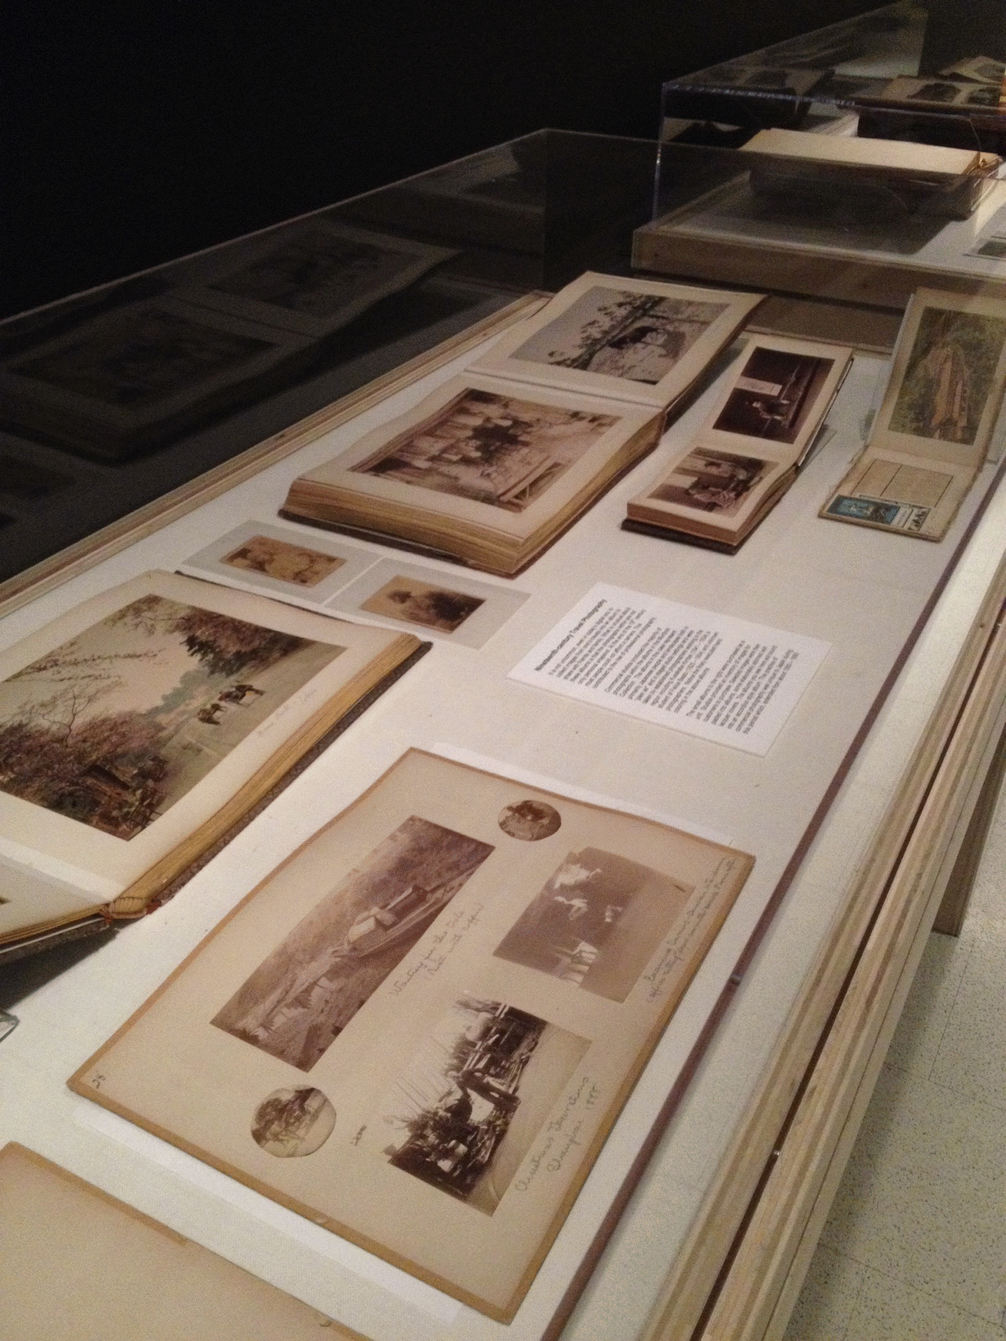
Notes:
As we’ve been working through the inventory and processing of the archives and special collections we’ve made some discoveries that have highlighted the need for thorough accession records. We’ve realized the challenges that result from the lack of documentation around these objects. .
The albums illustrated here are 19th century travel photography albums which were accepted into the museum collection in the 1950’s and at some point we think around 1970 were moved to physically live with the archives and rare book collection. There is very little documentation around this. No accession files on the archives side from the museum accession files we found accession numbers but very little in the way of object history reason behind collecting these materials.
The albums were assembled by a navy admiral during his active service. He also donated several objects to the museum. These albums include snapshots, annotations and ephemera tucked between the pages but are dominated by professional photography. In researching the albums for a library and archives exhibit we discovered that many early pioneers including Beato, Frith and kimbei are represented in the albums. Some of these artists are now represented in the museum collection.
Seems clear that our recordkeeping has failed us here as we’ve gone about to acquire duplicate content for the museum collection.

Slide 3
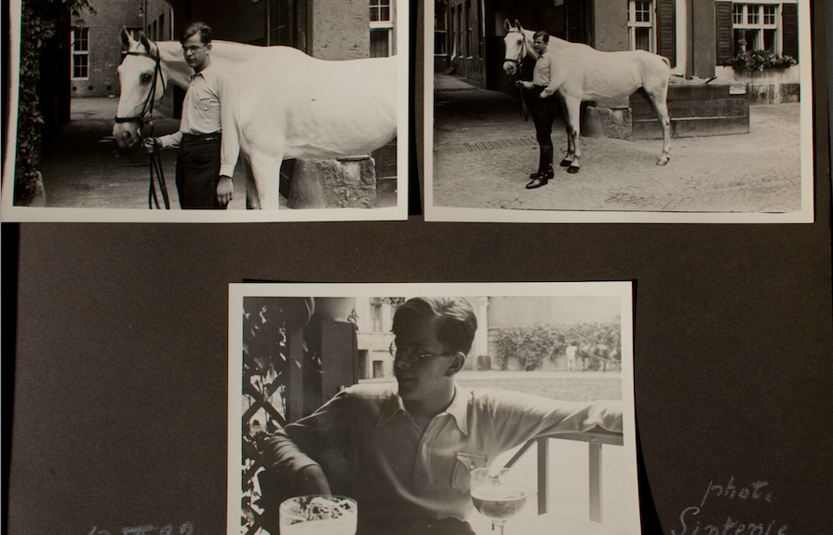
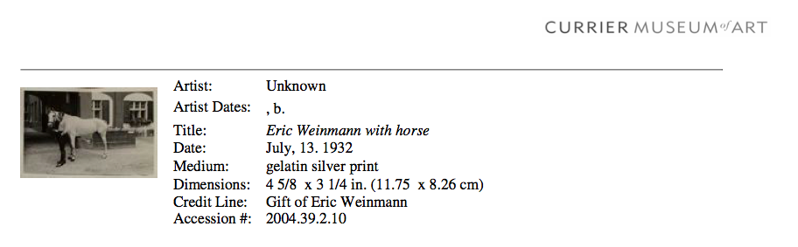
Notes:
The albums are family albums from Eric Weinmann a friend and student of phtogorapher Lotte Jacobi who emigrated from Germany in 1938. They include family snapshots by weinmann and other unknown phtogorpahers and dozens of prints by Lotte Jacobi.
During the appraisal and acquisition process the albums were determined to be destined for the museum collection. This suggests that the primary value of these albums was determined to be the Jacobi prints. The creator of the albums, Weinmann, became of secondary interest. I think another factor was lack of a strong collection development plan for the archives and an inconsistent accessioning procedure. Curatorial staff could not trust the the archives as a repository and we weren’t able to demonstate the value in acquiring these albums as a research object. Which privileges the narrative of the object and the information it conveys about its owner and his family’s experience in Nazi germany in the 1930’s. I believe a stronger set of policies and clearer collection development plan would have positioned the archives as a repository for this donation.
Other situations have come up with similar challenges and I have been working with the registrars and curators to think through how these donations should be handled moving forward.
I’ll share some of the governing questions we’ve been thinking about:
Does the collection or object serve primarily a display or a research function?
Should we “cherry-pick” individual objects to be accessioned into the museum collection from manuscript collections?
My hope is that engaging across departments in these conversations around our acquisition and accessioning models will improve our service to the public and the researcher and will ultimately strengthen the archives program.
This all hinges on a strong acquistion and accession process. If we can’t demonstrate through clear accession records the basics about these objects and their relationship to the collection including the motivation for collecting them, then they become potential wanderers and our intermingling issues persist.

