Slide 1
Crowdsourcing as a Means of Authority Assessment and Enhancement for Cultural Heritage Description
Joseph Koivisto, MSLIS
University of Maryland

Slide 2
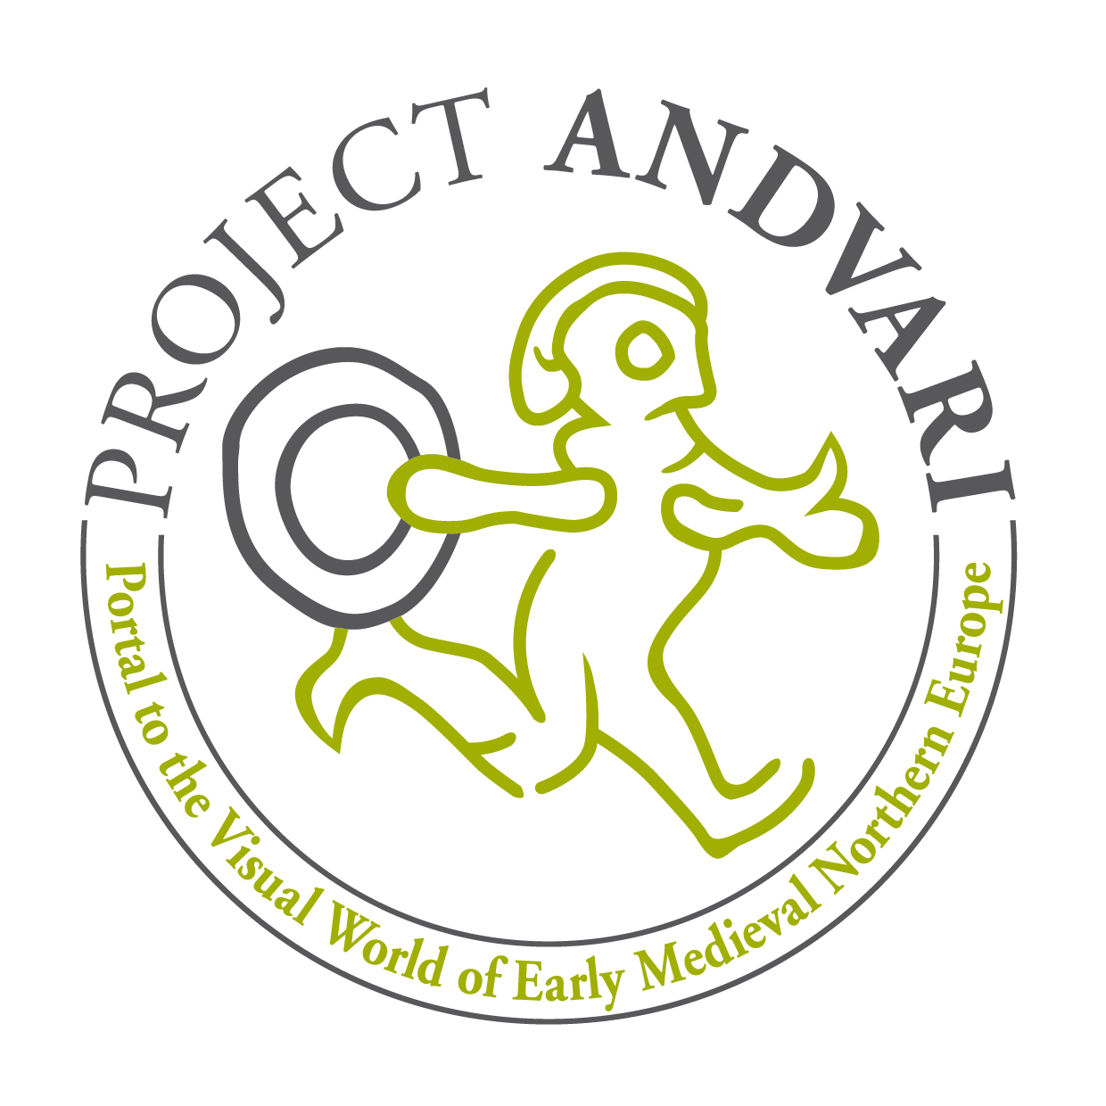

Slide 3



Slide 4
Aggregation portal of pre-Christian Art & Artifacts from the Northern Periphery of Early Medieval Europe

Slide 5
Thesaurus of pre-Christian Iconographic Art from the Northern Periphery of Early Medieval Europe

Slide 6
An Introduction to Iconography
Roelof van Straten
Pre-iconographic
Iconographic
Iconographical

Slide 7
An Introduction to Iconography
Roelof van Straten
Pre-iconographic
Iconographic
Iconographical

Slide 8
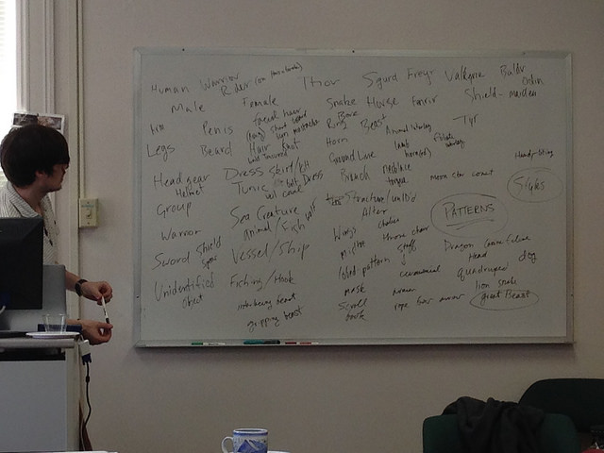

Slide 9
Rationale?
Graduate student review of existing authorities
Domain-specific authority promotes discoverability of cultural heritage resources (Patra)
User-generated subject terms can offer descriptive terms not otherwise found in extant authorities (Strader, Trant)
Crowd tags provide conceptual access at both higher and lower levels of specificity (Rolla)
Notes:
Graduate student volunteer group authority review

Slide 10
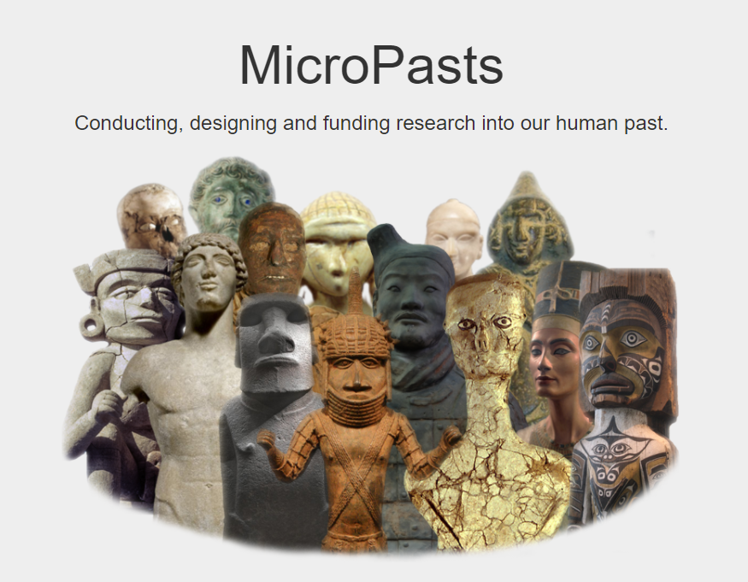
http://micropasts.org/

Slide 11




Slide 12
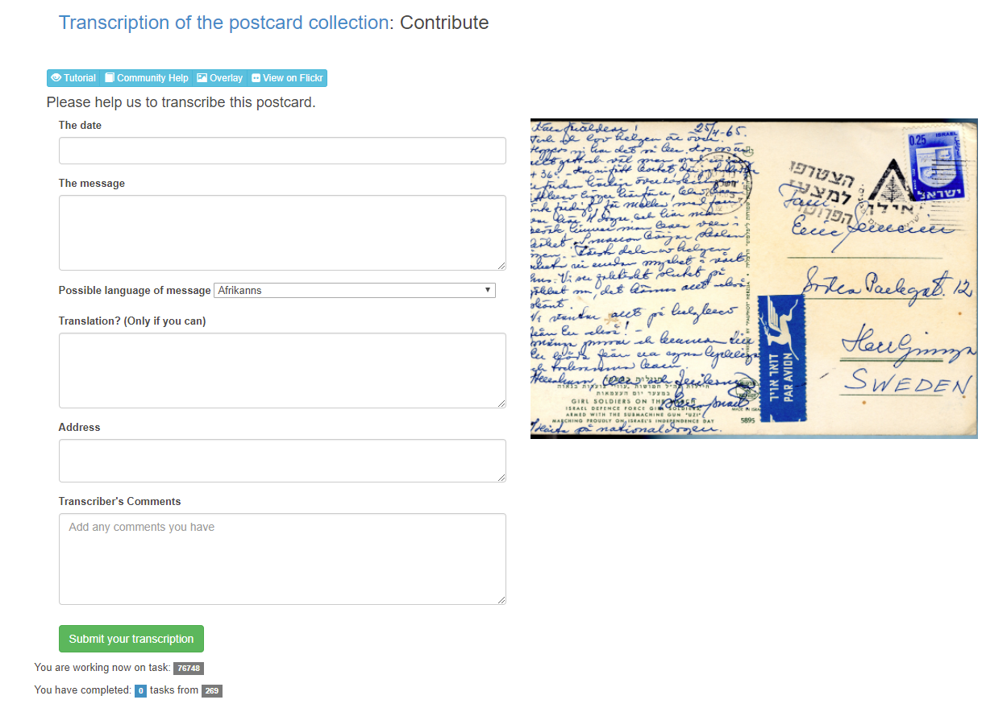
pybossa

Slide 13
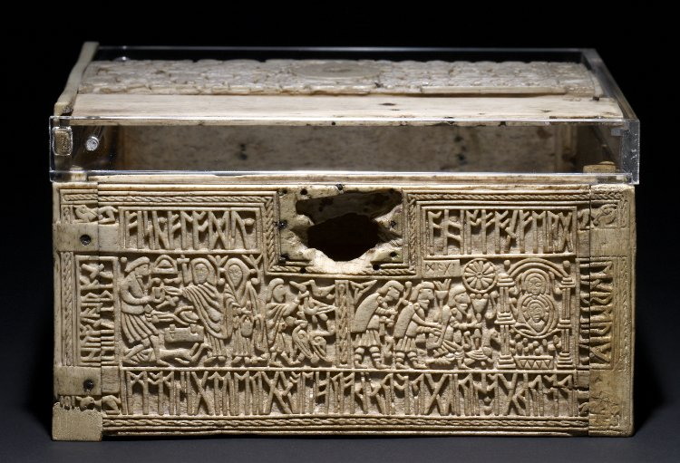
http://britishmuseum.org/collectionimages/AN00469/AN00469344_001_l.jpg

Slide 14
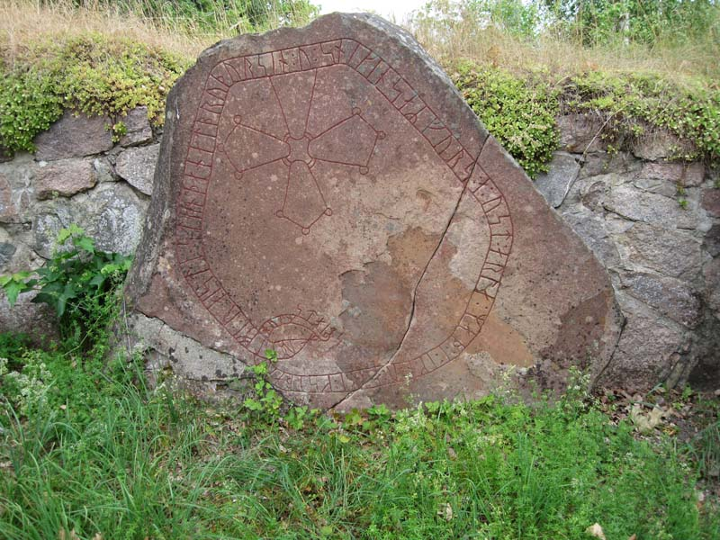
http://www.fmis.raa.se/fmis/bilder/04/0486/391/foto/12000000579040_F.jpg

Slide 15
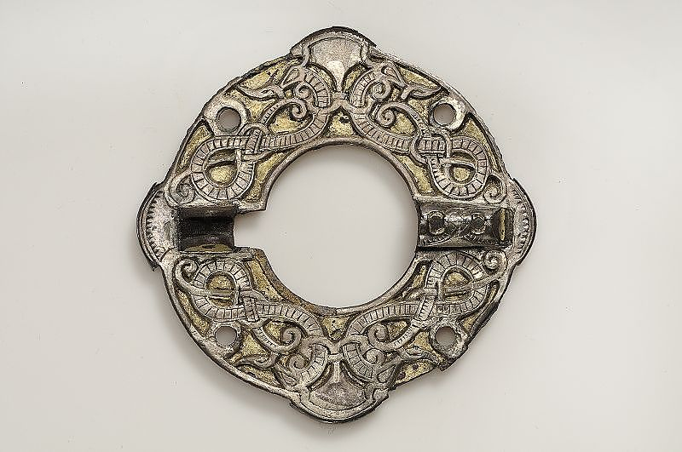
http://catview.historiska.se/catview/media/lowres/350556

Slide 16
Findings
250 tasks
426 responses
Asked to select terms from existing word list & suggest new terms
Conceptual areas
Abstract
Figure
Natural world
Object
Subject Matter

Slide 17
http://crowdsourced.micropasts.org/project/andvari/tasks/export

Slide 18
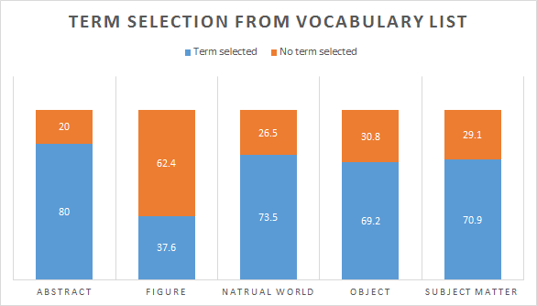
Responses

Slide 19
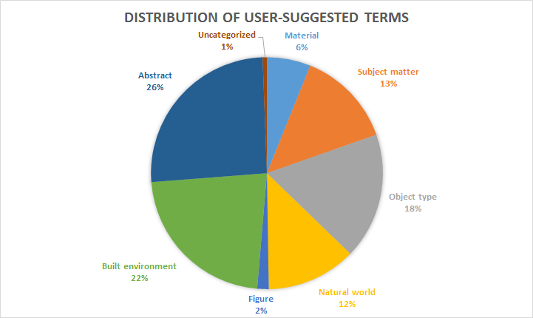
Notes:
312 suggested terms

Slide 20
Challenges -- Images

Slide 21
Challenges -- What am I describing?

Slide 22
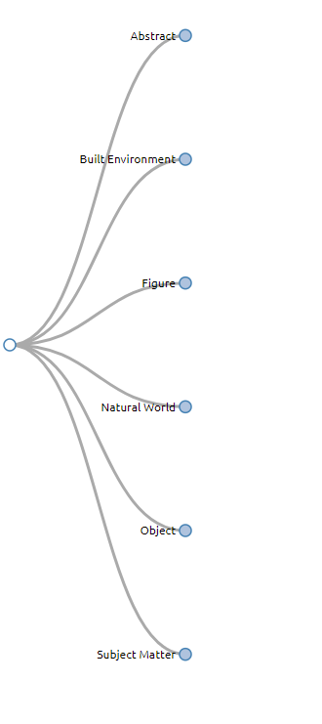

Slide 23
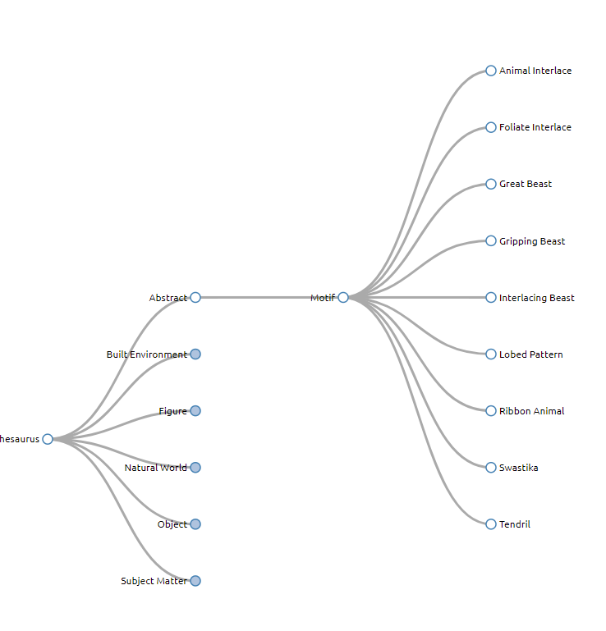

Slide 24
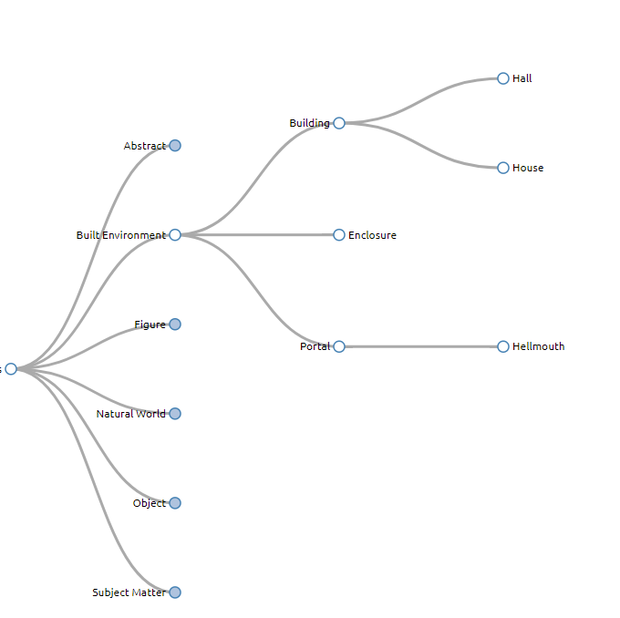

Slide 25
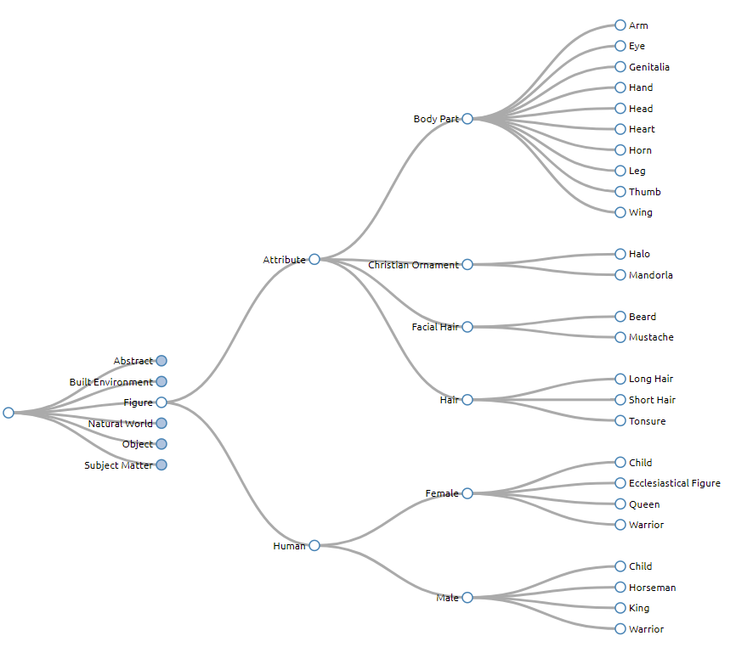

Slide 26
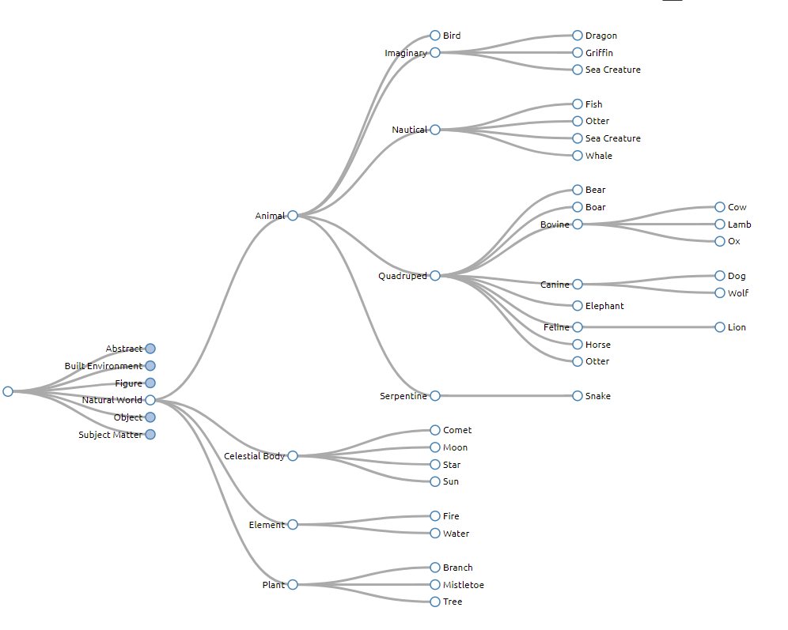

Slide 27
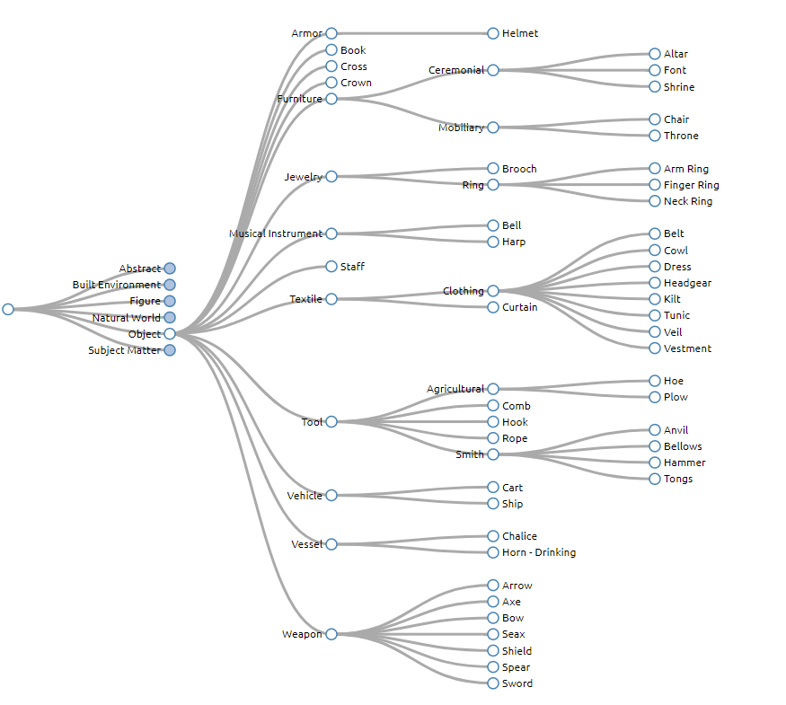

Slide 28
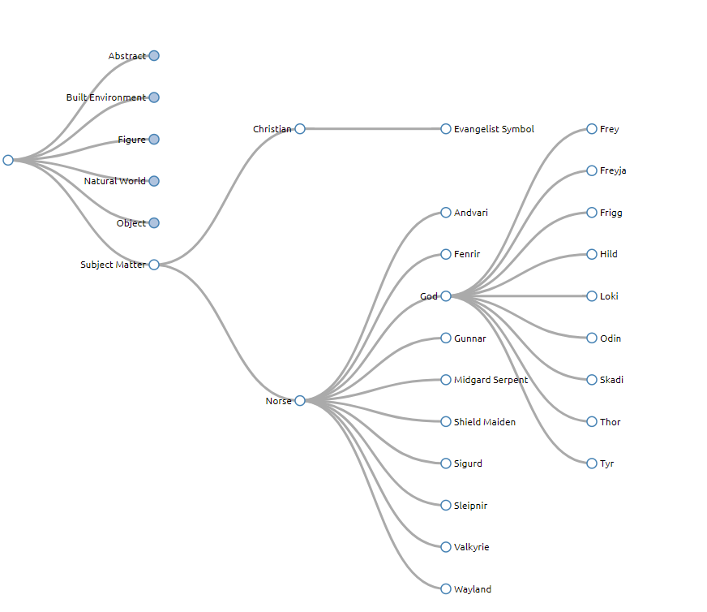

Slide 29
Discussion
Term selection indicates usefulness of provided terminologies
Suggested terms align with categories of icongraphic description established for project
Users maintain focus on object classification, not interpretive classification
Focus on abstract iconographic elements -- patterns, motifs, ornamentation

Slide 30
Conclusions
Crowdsourcing can be an effective approach towards authority creation and refinement
Clear instruction necessary
Expert review necessary
Identifying effective workflows to integrate crowdsourcing

Slide 31
Next Steps
Adding additional concepts
Identifying equivalences between existing authorities
Enhancing Andvari records
Publishing concepts for public reuse

Slide 32
Works referenced
Patra, C. (2008). “Digital repository in ceramics: a metadata study.” The electronic library, 26(4), 561-581.
Rolla, P. J. (2009). User tags versus subject headings: Can user-supplied data improve subject access to library collections? Library resources & technical services, 53(3), 174-184.
Strader, C. R. (2009). Author-assigned keywords versus library of congress subject headings: Implications for the cataloging of electronic theses and dissertations. Library Resources & Technical Services, 53(4), 243-250.
Trant, J. (2006). “Exploring the potential for social tagging and folksonomy in art museums: Proof of concept.” New review of hypermedia and multimedia, 12(1), 83-105.
Van Straten, R. (1994). An introduction to iconography (P. de Man, trans). Amsterdam: OPA.

Slide 33
Contact
jkoivist@umd.edu
@Joseph_Koivistoc
http://www.andvari.org/

