Slide 1

Interfiling 16mm Polyester Film with Acetate film: A Study
Mark Coulbourne
Head of Preservation

Slide 2

In 2024 the Preservation Department began testing all the films in 4th floor film room of Hornbake with the purpose of moving them to Severn library. The reason for this move is two-fold:
1st the environmental conditions in the room are less than ideal for motion picture film.
2nd this room would become the new home for the Hornbake Digitization Center.
The films in this area are a mix of polyester and acetate films, and they are interfiled with each other.
Acetate film can develop something called vinegar syndrome where the film begins to degrade and gives off acetic acid. This acid can spread and damage other acetate films that are nearby almost like a virus.

Slide 3
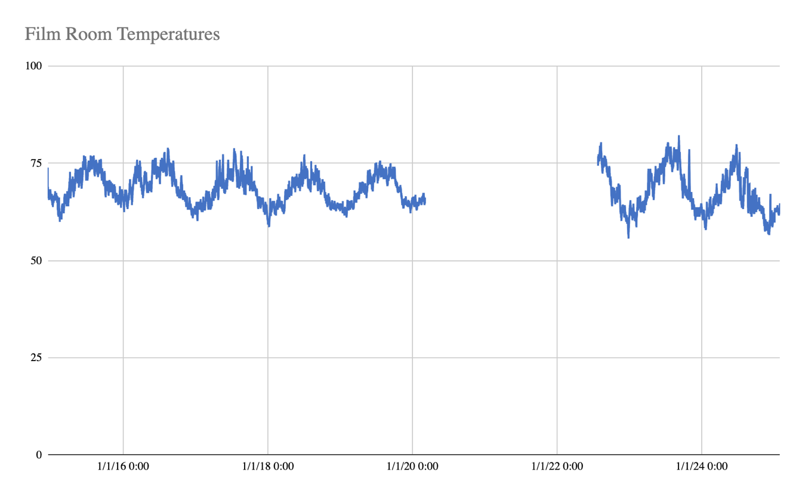
Storage Conditions - Temperature
The 4th floor film room has not been an ideal location to store motion picture film over a long period of time.
Ideally, motion picture film should be stored at 35℉ with 35% +/- 5% humidity¹
Black and white polyester film that is stored under these conditions should last for 500 years. Color film in the same conditions should last for 100 years.
The gap is because of the monitoring device being calibrated just before closing for Covid
1 - “Motion Picture Film Guidance: Storing Motion Picture Film.” National Archives and Records Administration. Accessed June 6, 2025. https://www.archives.gov/preservation/formats/motion-picture-film-storage.html.

Slide 4
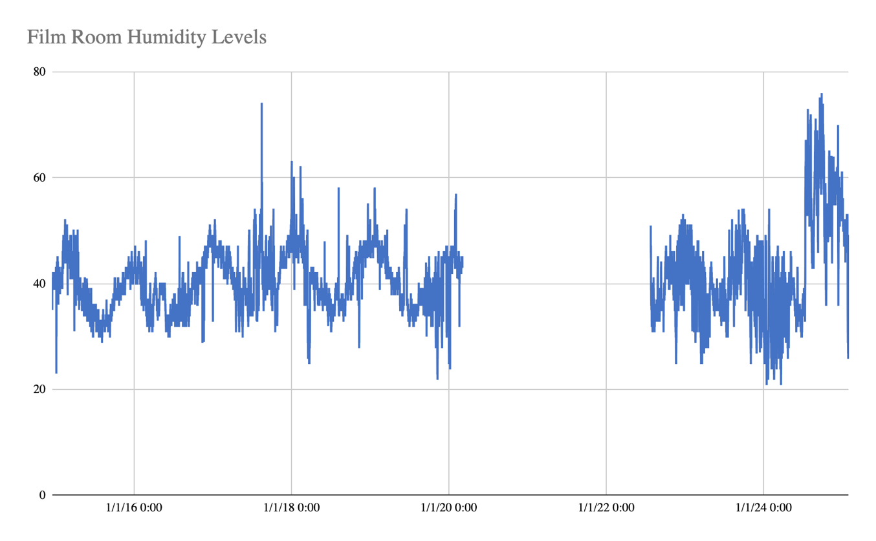
Storage Conditions: Humidity
Polyester motion picture film that is stored in humid conditions can hydrolyze and begin to produce their own acids.²
​2 - Edge, M., M. Mohammadian, M. Hayes, and N. S. Allen. 1992. "Aspects of Polyester Degradation: Motion Picture Film and Videotape Materials." Journal of Imaging Science and Technology 36 (1): 13-20. Accessed June 25, 2024.

Slide 5
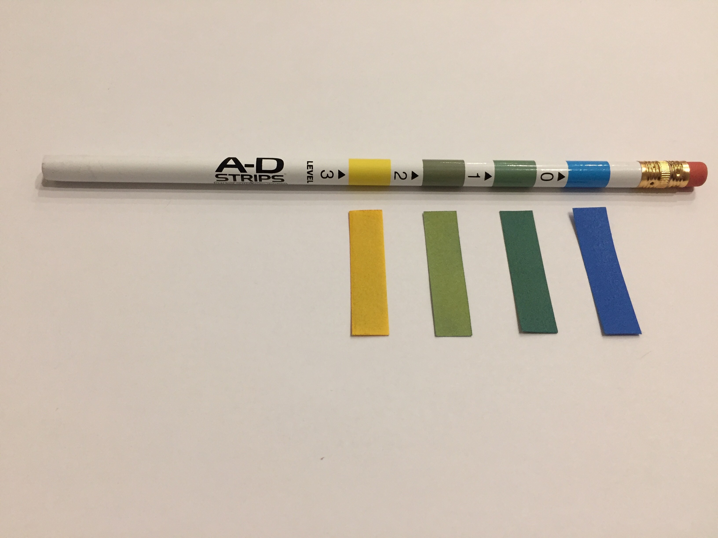
Testing Acetate Films
We test acetate films for vinegar syndrome by using small little strips of paper that are sensitive to the presence of acetic acid.
When acetic acid is present the paper changes color.
From a dark blue, to light blue, to green, and finally to yellow in extreme cases.
Image courtesy of The National Archives

Slide 6

Our Discovery
However, in testing all the films we quickly discovered that polyester films were testing positive for vinegar syndrome. Which in theory should be impossible. So, we sought to determine why that was happening.
We began by locating as many polyester films as we could and remove them from the film room environment for at least 30 days.
By isolating the polyester films, this should have removed any false positives we might have gotten from nearby acetate films that have vinegar syndrome.

Slide 7

The Research Plan
Also, the film canisters, film leader, and tape were tested to rule out acidity from any of these sources.
In addition to isolating the films for 30 days we decided to use a Cine-Scan (self contained movie viewer) to watch 10% of the films we were testing.
In watching the films we would look for three different forms of degradation in the film:
  Audio
  Visual
  Physical

Slide 8

Results
We tested 787 films
  596 of those films demonstrated some form of acid present
We viewed 122 films
  94 of those films demonstrated some form of degradation

Slide 9
Conclusions
Because 76% of the films tested had some form of acetic acid present indicates a form of inundation from the interfiled acetate films.
However, there are no records available to indicate the state of the polyester films prior to viewing so it is difficult to draw a conclusion from the degradation that was demonstrated.
There is the possibility that the polyester did begin to hydrolyze under the poor storage conditions. However, it is our conclusion that this did not play enough of a role to affect so many films.

Slide 10
Acknowledgements
A very special thanks to:
  Kirsten Elliott
  Bryan Draper
  Carla Montori
  Alex Trim
  Ethan Lewis
  Gabriela Rossello
  David Plumer

Slide 11


